Slide 1
Earthquake Engineering Introduction
Revision F
By Tom Irvine

Slide 2

Poseidon
Ancient Greeks believed that Poseidon triggered earthquakes by striking the ground or the seabed with his trident
https://paleothea.com/gods-and-goddesses/greek-myths-on-natural-disasters/

Slide 3

Thunderbird & Whale, Pacific Northwest Indigenous Legend
The Struggle: Thunderbird would grab the Whale with its talons, trying to carry it to the mountains to eat for itself and its offspring
The Earthquake: The impact of the Whale being dropped on the land, combined with the power of the fight, created intense shaking
The Tsunami: The Whale's escape back to the ocean, or its defensive thrashing, caused the ocean to rise, triggering massive flooding
Historical Event: Researchers believe this myth describes the massive 1700 Cascadia subduction zone earthquake (approx. magnitude 9.0)
https://www.washington.edu/news/2005/07/21/tall-tales-may-be-true-seismically-speaking/

Slide 4
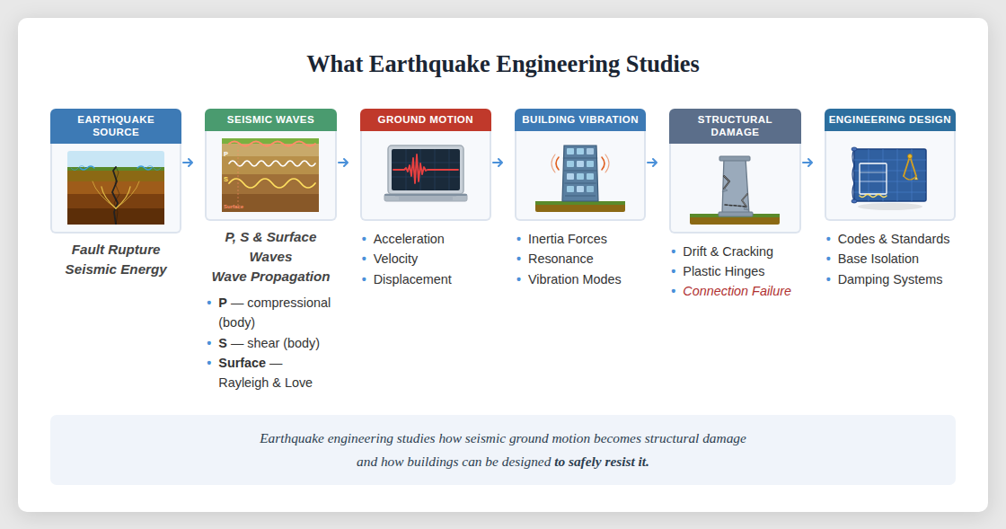

Slide 5

Earth’s Natural Frequency
The Earth experiences seismic vibration
The fundamental natural frequency of the Earth is 309.286 micro Hertz
This is equivalent to a period of 3233.25 seconds, or approximately 54 minutes
This is a “football mode” as shown in the next slide
Reference: T. Lay and T. Wallace, Modern Global Seismology, Academic Press, New York, 1995

Slide 6
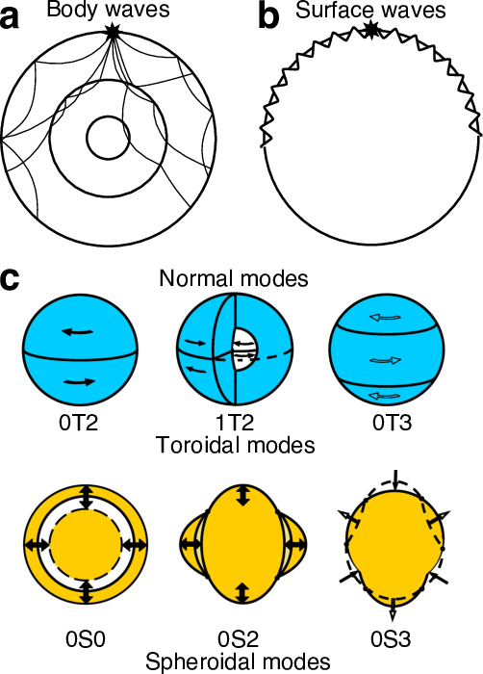
Earth’s Natural Frequencies
Mode | Name | Frequency (mHz) | Period (min)
₀S₂ | Football mode | 0.309 | 54
₀T₂ | - | 0.371 | 44.9
₀S₃ | - | 0.469 | 35.5
₀T₃ | - | 0.588 | 28.4
₀S₀ | Breathing / Radial mode | 0.8147 | 20.5
These modes are only excited to detectable amplitudes by the very largest earthquakes
Mw ≥ ~8.5, such as the 1960 Chile, 2004 Sumatra, and 2011 Tōhoku events
https://seismo.berkeley.edu/wiki_cider/REFERENCE_MODELS

Slide 7
Major Earthquakes (6.0+ M_{w}) between 1900 and 2017
Wikipedia

Slide 9
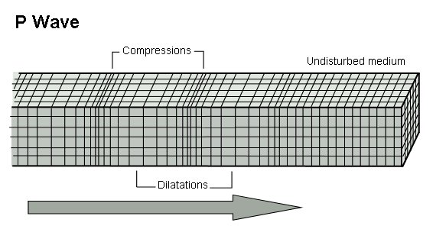
Seismic P-Wave
The primary wave, or P-wave, is a body wave that can propagate through the Earth’s core
This wave can also travel through water
The P-wave is also a sound wave
It thus has longitudinal motion
Note that the P-wave is the fastest of the four waveforms
Typical P-wave velocity 5 to 8 km/s
Airborne sound speed is 0.34 km/s

Slide 10
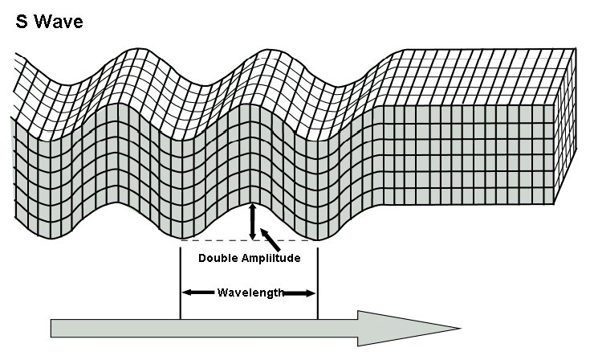
Seismic S-Wave
The secondary wave, or S-wave, is a shear wave
It is a type of body wave
The S-wave produces an amplitude disturbance that is at right angles to the direction of propagation
Note that water cannot withstand a shear force
S-waves thus do not propagate in water
S waves travel about 60% the speed of P waves

Slide 11
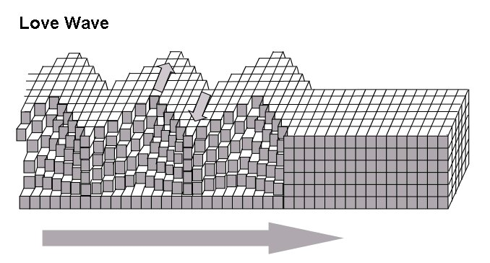
Seismic Love Wave
Love waves are shearing horizontal waves
The motion of a Love wave is similar to the motion of a secondary wave except that Love wave only travel along the surface of the Earth
Love waves do not propagate in water
Typical Love wave velocity 2 to 6 km/s

Slide 12
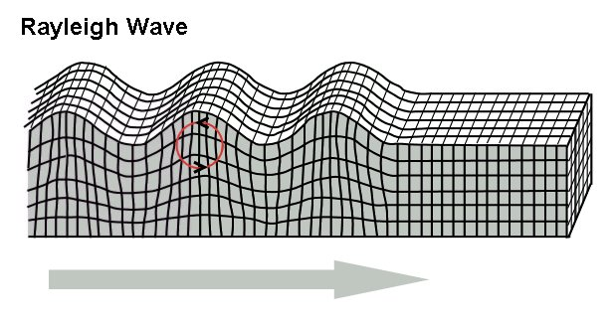
Seismic Rayleigh Wave
Rayleigh waves travel along the surface of the Earth
Rayleigh waves produce retrograde elliptical motion
The ground motion is thus both horizontal and vertical
The motion of Rayleigh waves is similar to the motion of ocean waves except that ocean waves are prograde
Typical Rayleigh wave velocity ~3 km/s

Slide 13
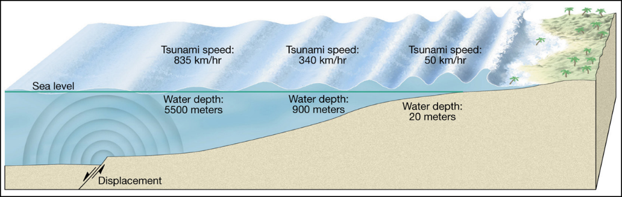
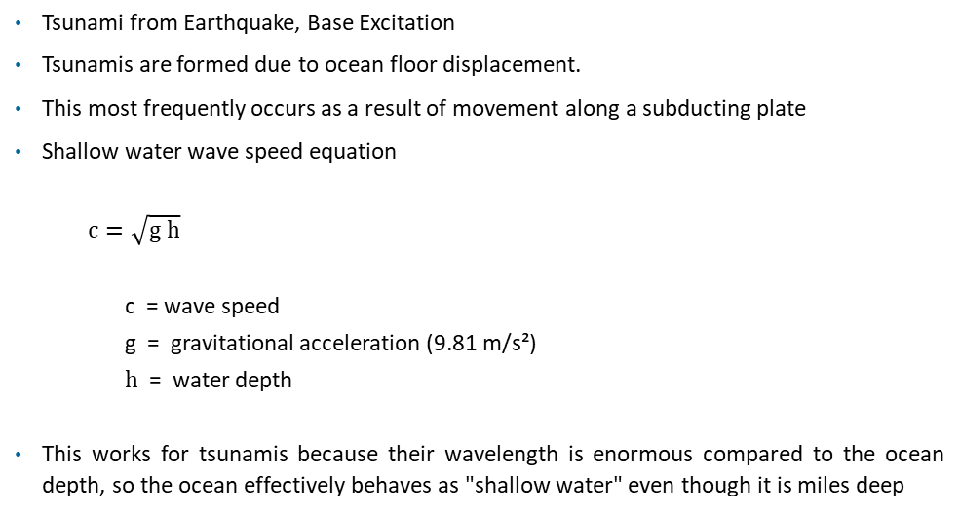
Base or Seismic Excitation
Vibrationdata
Tsunami from Earthquake, Base Excitation
Tsunamis are formed due to ocean floor displacement.
This most frequently occurs as a result of movement along a subducting plate
Shallow water wave speed equation
  $$c=\sqrt{g h}$$
c = wave speed
g = gravitational acceleration (9.81 m/s²)
h = water depth
This works for tsunamis because their wavelength is enormous compared to the ocean depth, so the ocean effectively behaves as "shallow water" even though it is miles deep
13
Notes:
13

Slide 14
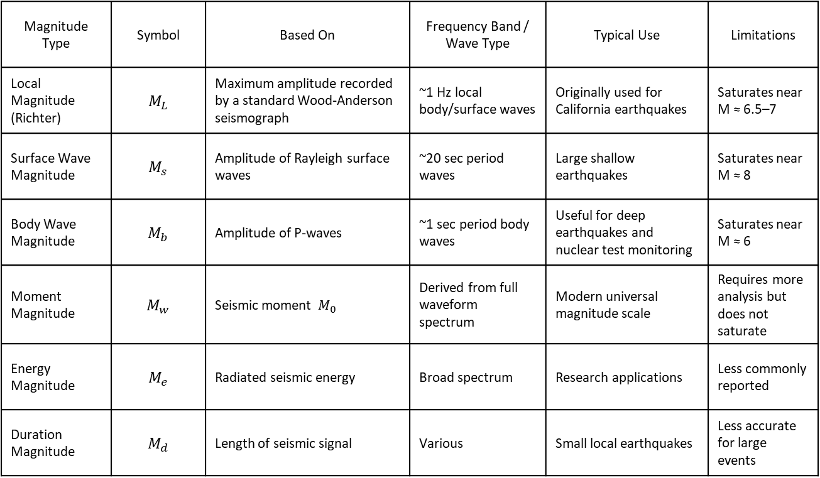
Magnitude Scales
Magnitude Type | Symbol | Based On | Frequency Band / Wave Type | Typical Use | Limitations
Local Magnitude (Richter) | $$M_{L}$$ | Maximum amplitude recorded by a standard Wood-Anderson seismograph | ~1 Hz local body/surface waves | Originally used for California earthquakes | Saturates near M ≈ 6.5–7
Surface Wave Magnitude | $$M_{s}$$ | Amplitude of Rayleigh surface waves | ~20 sec period waves | Large shallow earthquakes | Saturates near M ≈ 8
Body Wave Magnitude | $$M_{b}$$ | Amplitude of P-waves | ~1 sec period body waves | Useful for deep earthquakes and nuclear test monitoring | Saturates near M ≈ 6
Moment Magnitude | $$M_{w}$$ | Seismic moment $M_{0}$ | Derived from full waveform spectrum | Modern universal magnitude scale | Requires more analysis but does not saturate
Energy Magnitude | $$M_{e}$$ | Radiated seismic energy | Broad spectrum | Research applications | Less commonly reported
Duration Magnitude | $$M_{d}$$ | Length of seismic signal | Various | Small local earthquakes | Less accurate for large events

Slide 15
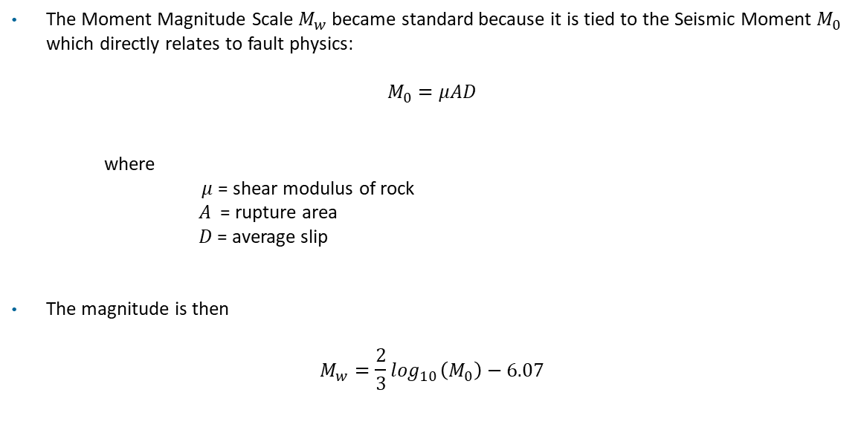
Moment Magnitude
The Moment Magnitude Scale $M_{w}$became standard because it is tied to the Seismic Moment $M_{0}$ which directly relates to fault physics:
$$M_{0}=μAD$$
where
$μ$ = shear modulus of rock
$A$ = rupture area
$D$ = average slip
The magnitude is then
$$M_{w}={\frac{2}{3}{log}}_{10}\left(M_{0}\right)−6.07$$

Slide 16
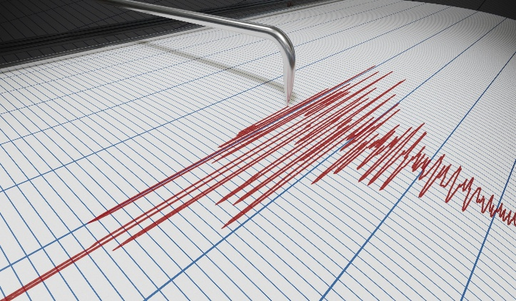
Magnitude Scales
Magnitude Mw | Engineering significance
4 | Noticeable shaking of windows and dishes. Small objects may move. Minor damage very rare.
5 | Threshold where structural damage begins to appear in vulnerable buildings. Cracks in plaster.
6 | Significant urban damage possible
7 | Regional structural failures likely
8+ | Large-scale infrastructure disruption
https://akpreparedness.com/understanding-the-earthquake-magnitude-scale/

Slide 17
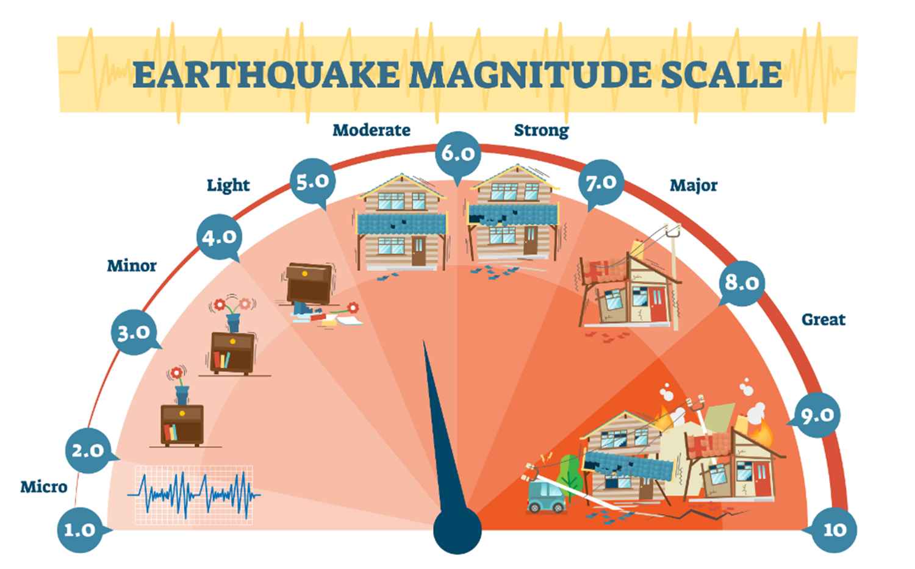
Magnitude Scales
Ground motion amplitude: a one-unit increase in magnitude corresponds to about a 10× increase in recorded seismic wave amplitude on a seismograph
Energy release: a one-unit increase in magnitude corresponds to about 32× more seismic energy released at the source
https://geovera.com/2023/04/27/history-richter-scale/

Slide 18
Modified Mercalli Intensity – Human Reports
CIIM Intensity | People's Reaction | Furnishings | Built Environment | Natural Environment
I | Not felt |  |  | Changes in level and clarity of well water are occasionally associated with great earthquakes at distances beyond which the earthquakes felt by people.
II | Felt by a few. | Delicately suspended objects may swing.
III | Felt by several; vibration like passing of truck. | Hanging objects may swing appreciably.
IV | Felt by many; sensation like heavy body striking building. | Dishes rattle. | Walls creak; window rattle.
V | Felt by nearly all; frightens a few. | Pictures swing out of place; small objects move; a few objects fall from shelves within the community. | A few instances of cracked plaster and cracked windows with the community. | Trees and bushes shaken noticeably.
VI | Frightens many; people move unsteadily. | Many objects fall from shelves. | A few instances of fallen plaster, broken windows, and damaged chimneys within the community. | Some fall of tree limbs and tops, isolated rockfalls and landslides, and isolated liquefaction.

Slide 19
Modified Mercalli Intensity – Human Reports
CIIM Intensity | People's Reaction | Furnishings | Built Environment | Natural Environment
VII | Frightens most; some lose balance. | Heavy furniture overturned. | Damage negligible in buildings of good design and construction, but considerable in some poorly built or badly designed structures; weak chimneys broken at roof line, fall of unbraced parapets. | Tree damage, rockfalls, landslides, and liquefaction are more severe and widespread with increasing intensity.
VIII | Many find it difficult to stand. | Very heavy furniture moves conspicuously. | Damage slight in buildings designed to be earthquake resistant, but severe in some poorly built structures. Widespread fall of chimneys and monuments.
IX | Some forcibly thrown to the ground. |  | Damage considerable in some buildings designed to be earthquake resistant; buildings shift off foundations if not bolted to them.
X |  |  | Most ordinary masonry structures collapse; damage moderate to severe in many buildings designed to be earthquake resistant.

Slide 20
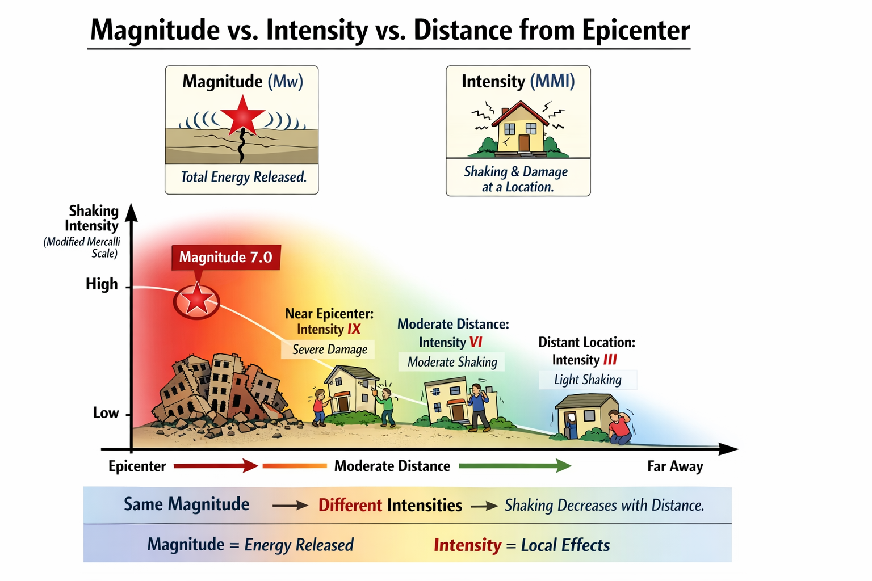

Slide 21

Children’s Song Lyrics
Vibrationdata
Bedrock is generally one of the best foundation conditions for earthquake resistance because it minimizes seismic wave amplification
It has high shear wave velocity & stiffness which results in low strain amplification
https://www.gigwise.com/childrens-song-the-wise-man-and-the-foolish-man-lyrics/
Notes:
21

Slide 22
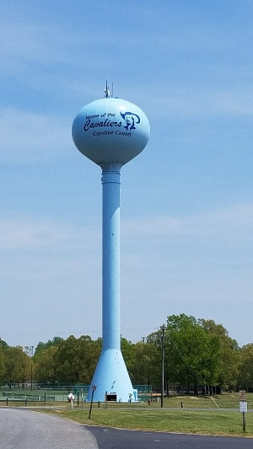

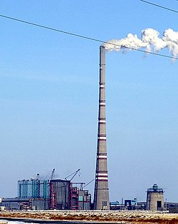
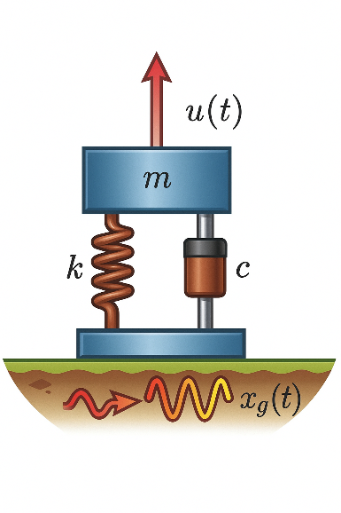
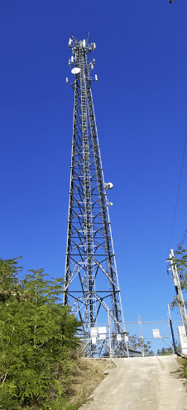
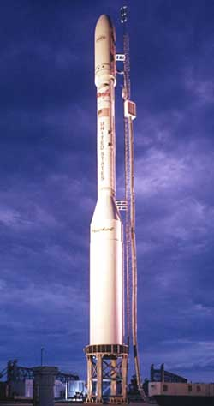
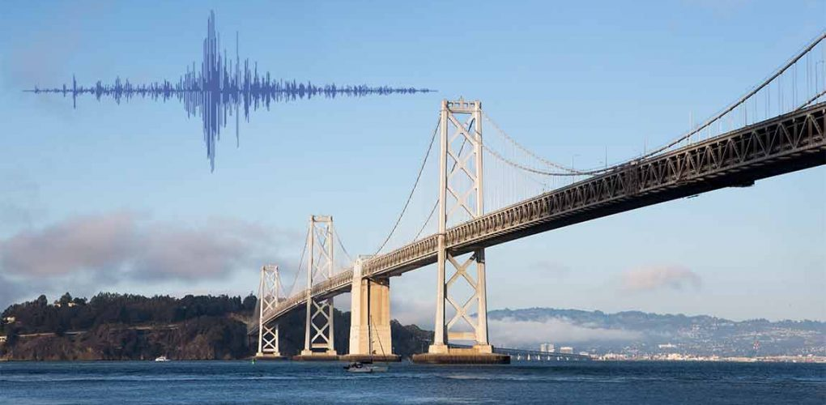

Slide 23
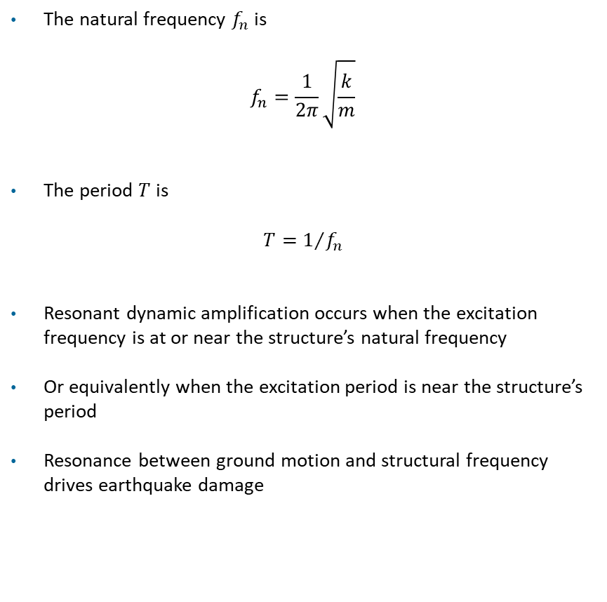
Resonance
The natural frequency $f_{n}$is
$$f_{n}=\frac{1}{2π}\sqrt{\frac{k}{m}}$$
The period $T$is
$$T=1/{f_{n}}$$
Resonant dynamic amplification occurs when the excitation frequency is at or near the structure’s natural frequency
Or equivalently when the excitation period is near the structure’s period
Resonance between ground motion and structural frequency drives earthquake damage
m | = mass
c | = damping coefficient
k | = stiffness

Slide 24
Soil
Buildings
Soil Condition | Typical Amplified Frequency
Soft soil basins | 1–2 Hz
Medium soil deposits | 2–4 Hz
Stiff soil | 4–8 Hz
Hard rock | little amplification
Building Type | Natural Frequency (Hz)
1–2 Story Wood Frame | 3.3 – 10
Low-Rise Masonry (2–3 story) | 2 – 5
3–5 Story Steel Moment Frame | 1.1 - 2.5
5–10 Story RC Moment Frame | 0.67 – 1.7
10–20 Story Steel Moment Frame | 0.33 – 0.83
20–40 Story RC Shear Wall Building | 0.18 – 0.40
Tall Flexible Steel Frame (40+ stories) | 0.125 – 0.25
Industrial Steel Braced Frame (1–3 story) | 1.7 - 5

Slide 25
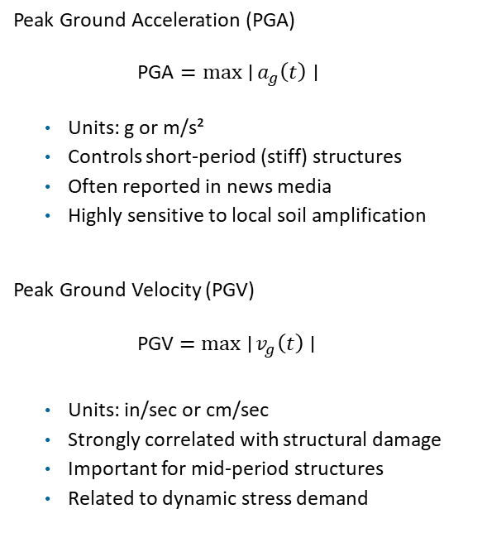
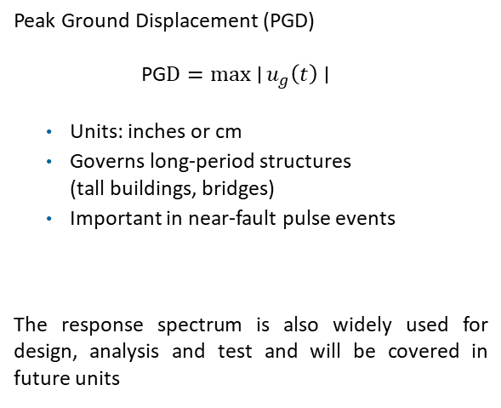
Earthquake Engineering Metrics
Vibrationdata
Peak Ground Acceleration (PGA)
$\text{PGA}=\max{∣}a_{g}\left(t\right)∣$
Units: g or m/s²
Controls short-period (stiff) structures
Often reported in news media
Highly sensitive to local soil amplification
Peak Ground Velocity (PGV)
PGV $=\max{∣}v_{g}\left(t\right)∣$
Units: in/sec or cm/sec
Strongly correlated with structural damage
Important for mid-period structures
Related to dynamic stress demand
Peak Ground Displacement (PGD)
$\text{PG}D=\max{∣}u_{g}\left(t\right)∣$
Units: inches or cm
Governs long-period structures
(tall buildings, bridges)
Important in near-fault pulse events
The response spectrum is also widely used for design, analysis and test and will be covered in future units
25
Notes:
25

Slide 26
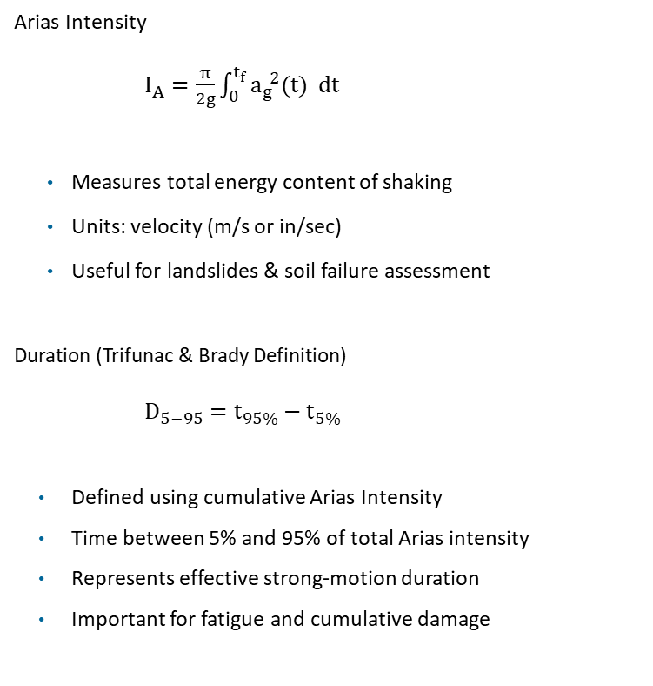
Earthquake Engineering Metrics (cont)
Vibrationdata
Arias Intensity
$I_{A}=\frac{π}{2g}\int_{0}^{t_{f}}{a_{g}^{ 2}(t) dt}$
Measures total energy content of shaking
Units: velocity (m/s or in/sec)
Useful for landslides & soil failure assessment
Duration (Trifunac & Brady Definition)
$D_{5−95}=t_{95\%}−t_{5\%}$
Defined using cumulative Arias Intensity
Time between 5% and 95% of total Arias intensity
Represents effective strong-motion duration
Important for fatigue and cumulative damage
26
Notes:
26

Slide 27
Arias Intensity
Vibrationdata
Arias Intensity (m/s) | Arias Intensity (cm/s) | Typical Ground Motion Severity | Expected Structural / Geotechnical Effects
< 0.01 | < 1 | Very weak | No structural damage; motion felt only by sensitive instruments
0.01 – 0.05 | 1 – 5 | Weak shaking | Felt by people; no structural damage
0.05 – 0.2 | 5 – 20 | Moderate shaking | Minor non-structural damage (plaster cracks, objects fall)
0.2 – 0.5 | 20 – 50 | Strong shaking | Damage to poorly built structures; chimneys and masonry cracking
0.5 – 1.0 | 50 – 100 | Very strong shaking | Significant structural damage in vulnerable buildings
1 – 2 | 100 – 200 | Severe shaking | Collapse of weak masonry structures; major structural damage
> 2 | > 200 | Extreme ground motion | Widespread structural collapse; landslides and liquefaction likely
27
Notes:
27

Slide 28
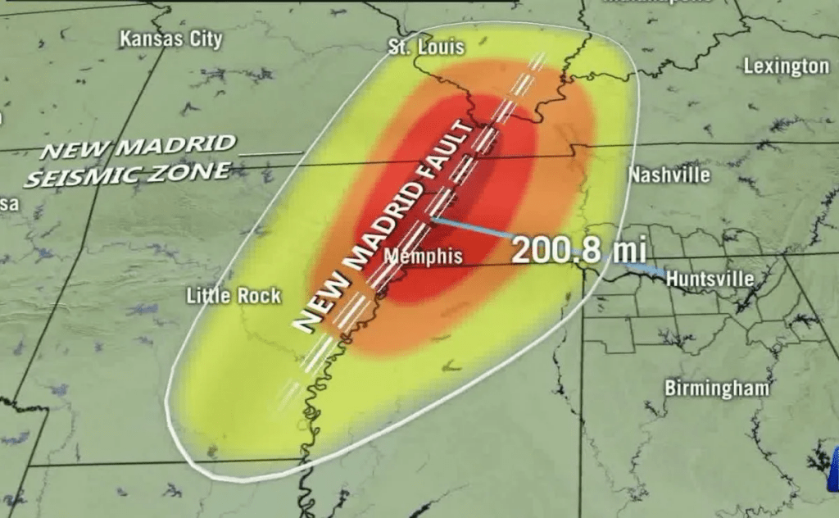
New Madrid Earthquakes 1811-12
A series of very large earthquakes occurred between December 1811 and February 1812 in the central United States near New Madrid, Missouri
Estimated magnitudes were about Mw 7.0–7.5, making them among the largest earthquakes in U.S. history
The earthquakes occurred within the New Madrid Seismic Zone, a region of ancient buried faults in the Mississippi Valley
Shaking was felt across most of eastern North America, reportedly ringing church bells in cities as far away as Boston
The earthquakes caused extensive ground deformation, including:
  Surface faulting
  Large sand blows and soil liquefaction
  Landslides along riverbanks
  Parts of the Mississippi River reportedly flowed backward temporarily due to strong ground uplift and seismic waves

Slide 29
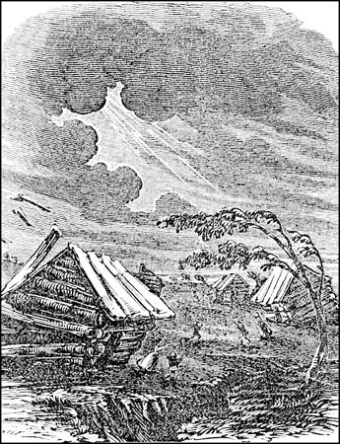
New Madrid Lesson Learned
Intraplate earthquakes can be very large
Major earthquakes are not limited to plate boundaries
The New Madrid Seismic Zone shows that ancient faults within continental interiors can still be active
Seismic waves travel very efficiently in eastern North America
The older, colder crust of eastern North America transmits seismic waves with less attenuation than the western U.S.
As a result, shaking from the New Madrid earthquakes was felt over extremely large distances
Severe soil liquefaction can occur in river valleys
Widespread sand blows, lateral spreading, and ground settlement occurred in the Mississippi River floodplain
Saturated alluvial soils were particularly susceptible
https://sharonahill.com/spooky-events-from-the-historic-new-madrid-earthquakes/

Slide 30
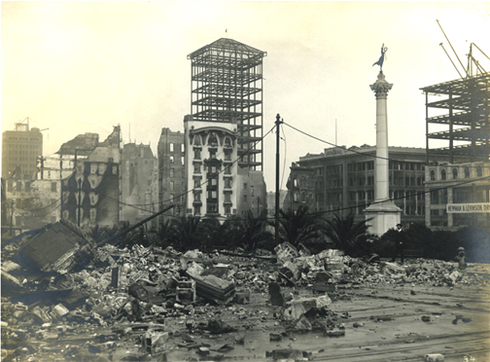
1906 San Francisco Quake
The San Francisco earthquake occurred at 5:12 A.M. on April 18, 1906
The source was a rupture of the San Andreas Fault
The duration of severe shaking was about 40 seconds
Reference sources give magnitude estimates ranging from 7.7 to 8.25
Many people died in the quake and in the fires which followed
The fires resulted from ruptured gas lines
Death toll estimates range from 700 to 3000

Slide 31
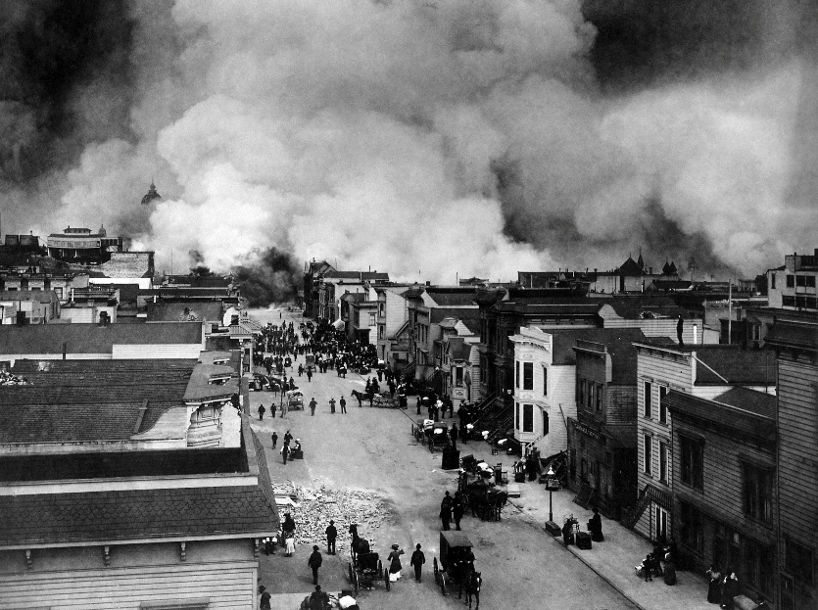
1906 San Francisco Quake Lessons Learned
Confirmed elastic rebound theory of earthquakes
The Elastic Rebound Theory explains how earthquakes occur due to the sudden release of stored elastic strain energy in the Earth's crust
Demonstrated surface fault rupture hazards
Revealed soil amplification effects
Showed weakness of unreinforced masonry buildings
Highlighted risk of post-earthquake fires
Demonstrated vulnerability of lifeline infrastructure
Led to development of modern seismic engineering and building codes
https://peoplesworld.org/article/today-in-eco-history-1906-san-francisco-earthquake/

Slide 32
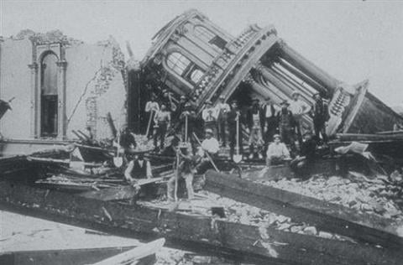
1906 San Francisco Quake Lessons Learned (cont)
Long Structures Experienced Large Displacements
Engineers observed that long, flexible structures suffered significant damage or distortion.
Examples included:
  Long bridges
  Water pipelines
  Tall or flexible steel-frame structures
Lesson: displacement demands even if accelerations are moderate
This concept later became central in response spectrum design
Structures with long natural periods can undergo large displacement demands even if accelerations are moderate
Santa Rosa City Hall
https://www.awesomestories.com/asset/view/126124

Slide 33
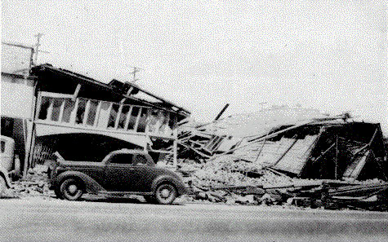
El Centro, Imperial Valley, Earthquake
Nine people were killed by the May 1940 Imperial Valley earthquake, magnitude 7.1
At Imperial, 80 percent of the buildings were damaged to some degree
In the business district of Brawley, all structures were damaged, and about 50 percent had to be condemned
The shock caused 40 miles of surface faulting on the Imperial Fault, part of the San Andreas system in southern California
Total damage has been estimated at about $6 million

Slide 34
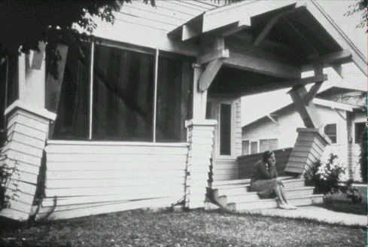
El Centro Lessons Learned
Importance of Dynamic Structural Behavior
Before 1940, structures were often analyzed using static lateral forces
The El Centro record showed that:
  Earthquake forces are dynamic and time-dependent
  Structural response depends on natural frequency and damping
  Resonance can greatly amplify motion
Resulting the development of:
  response spectrum analysis
  modal analysis
  time-history analysis
Many brittle structural elements failed
Later research showed that structures with ductile behavior survive earthquakes better
This insight contributed to modern seismic design principles:
  energy dissipation
  ductile detailing
  capacity design

Slide 35
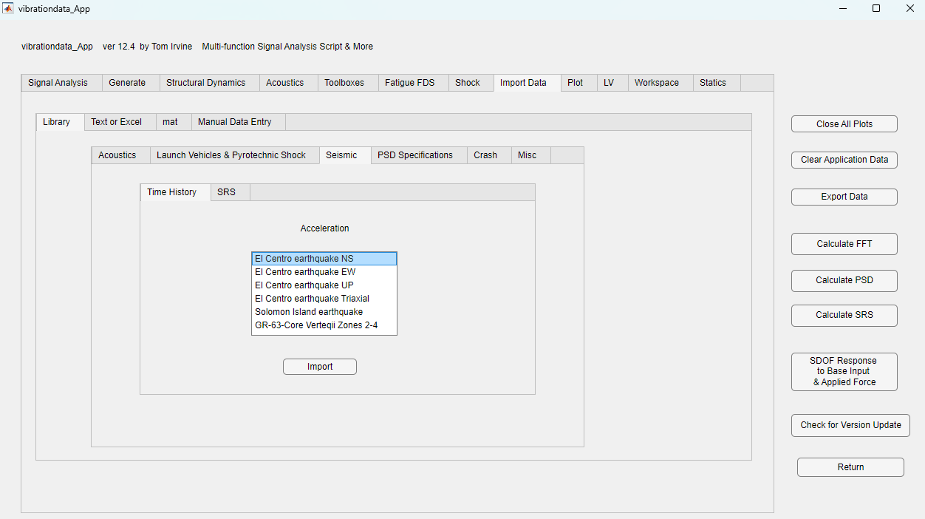
El Centro, Imperial Valley, Earthquake

Slide 36
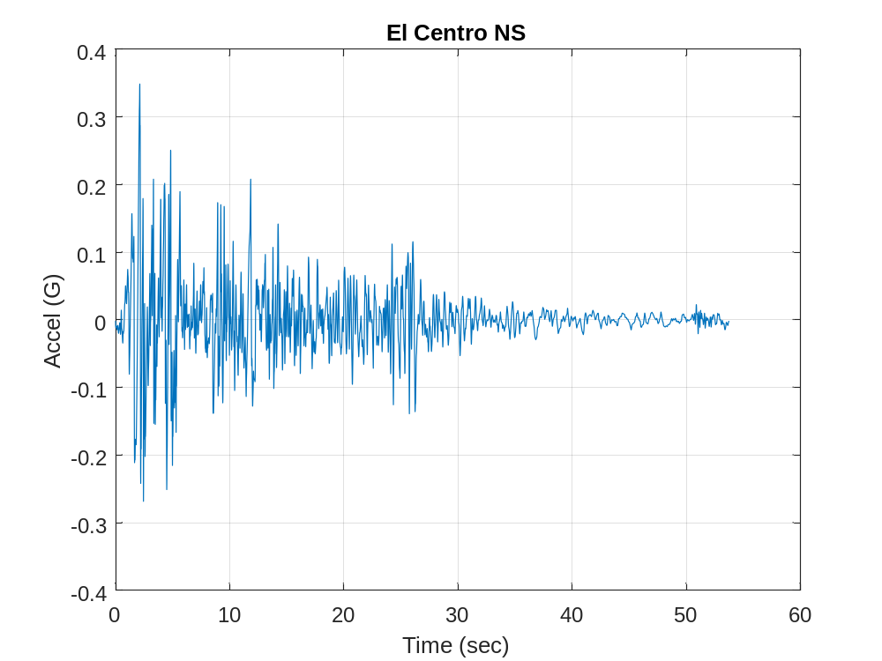

Slide 37
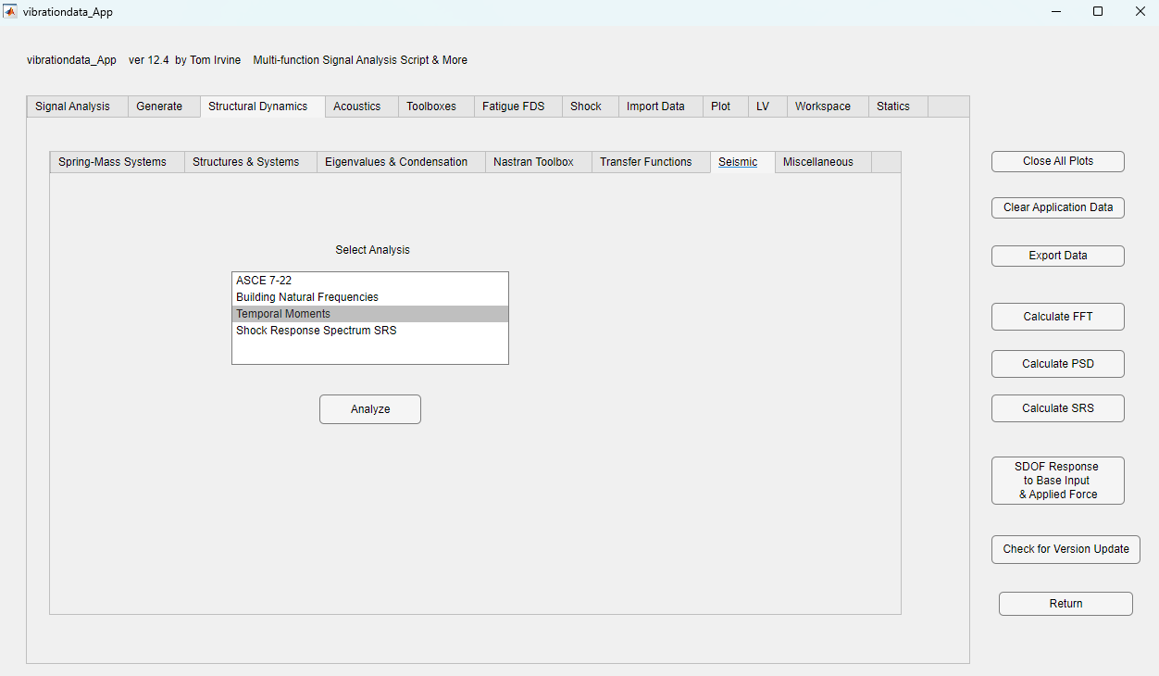

Slide 38
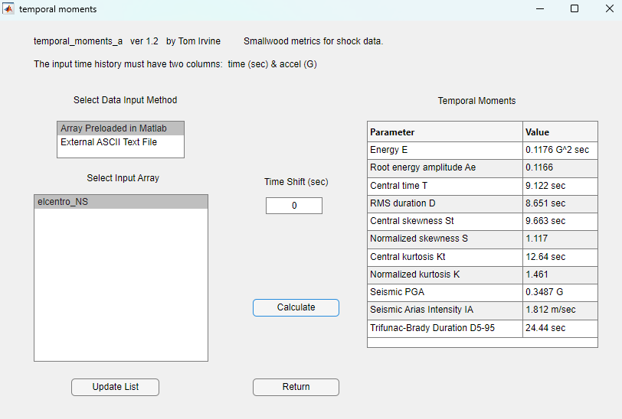

Slide 39
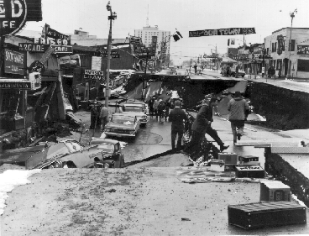
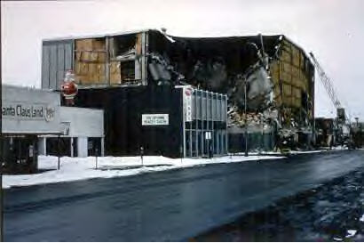
1964 Prince William Sound, Alaskan Quake
The Alaskan earthquake occurred on Good Friday, March 27, 1964, at 5:36 PM
It was the largest earthquake ever recorded in North America
Duration estimates range from 3 to 5 minutes
Bruce Bolt lists it as 8.6 Ms, where Ms is the surface-wave magnitude
The USGS gives it a 9.2 Mw, where Mw is the moment magnitude
The death toll was 131, mostly due to tsunami

Slide 40
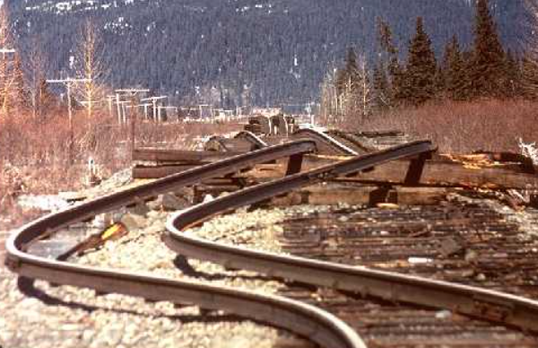
Rail Buckling
Alaskan Earthquake, 1964
Rails torn from their ties south of Portage, Alaska

Slide 41
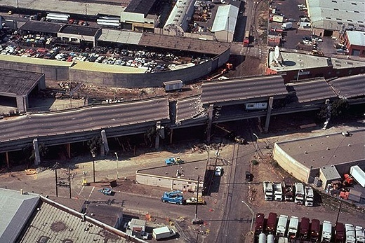
Loma Prieta Earthquake 1989
Vibrationdata
Magnitude: Mw 6.9
63 fatalities
Epicenter: Santa Cruz Mountains, near Loma Prieta Peak
Pancake Collapse of the Cypress Street Viaduct (I-880) in Oakland
Two traffic decks supported by reinforced concrete frames
Upper deck collapsed onto lower deck
Structure founded on soft Bay mud, which amplified shaking
Long-period components of motion increased displacement demand
Many columns failed in brittle shear, not ductile flexure
Notes:
41

Slide 42
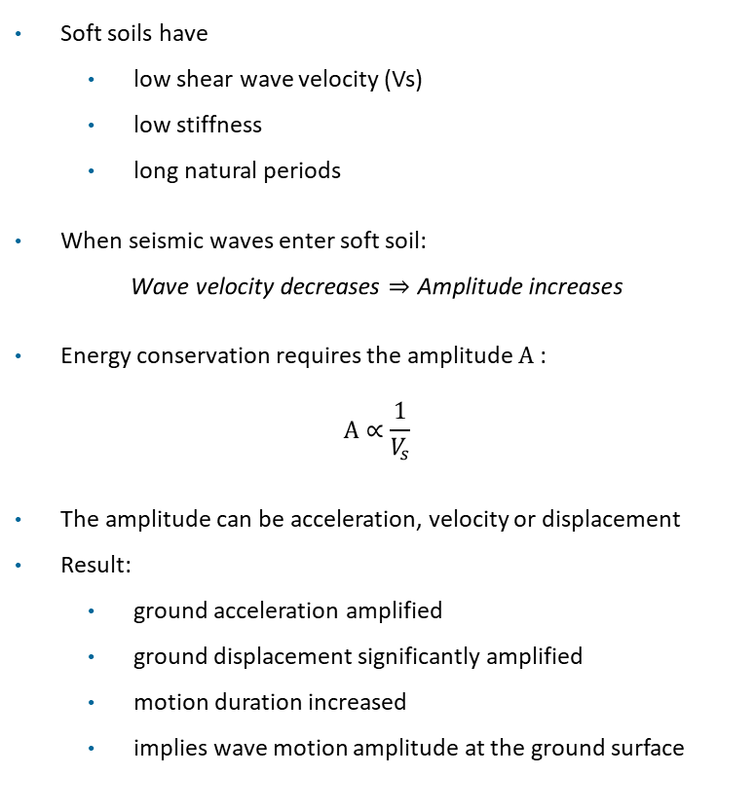
Loma Prieta Earthquake, Site Amplification
Vibrationdata
Soft soils have
  low shear wave velocity (Vs)
  low stiffness
  long natural periods
When seismic waves enter soft soil:
$$\text{Wave velocity decreases}⇒\text{Amplitude increases}$$
Energy conservation requires the amplitude A :
$$A∝\frac{1}{V_{s}}$$
The amplitude can be acceleration, velocity or displacement
Result:
  ground acceleration amplified
  ground displacement significantly amplified
  motion duration increased
  implies wave motion amplitude at the ground surface
Soft Bay mud:
Low shear wave velocity (~100–200 m/s)
Much lower than rock (~800–1500 m/s)
Notes:
42

Slide 43
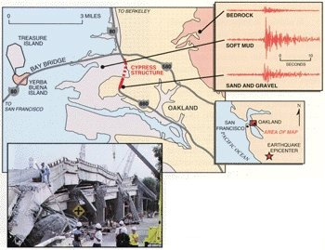
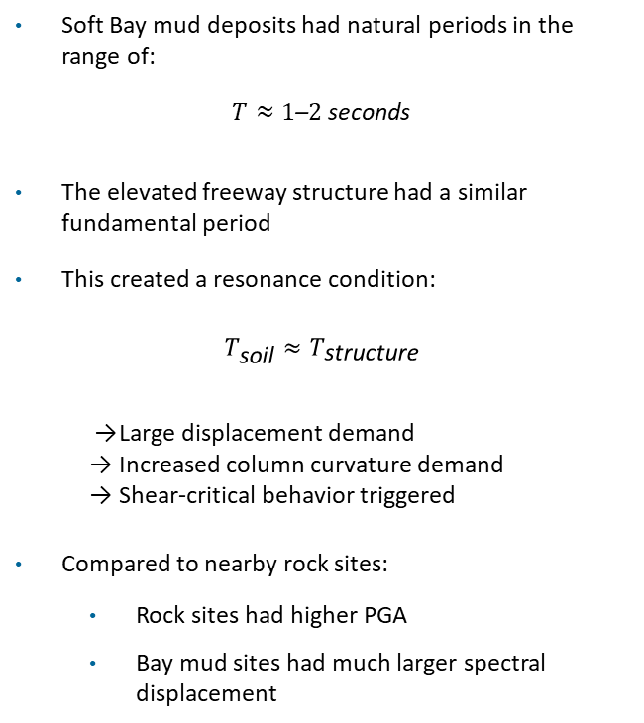
Loma Prieta Earthquake, Period Shift & Resonance
Vibrationdata
Soft Bay mud deposits had natural periods in the range of:
$$T≈1\text{–}2\text{ seconds}$$
The elevated freeway structure had a similar fundamental period
This created a resonance condition:
$$T_{\text{soil}}≈T_{\text{structure}}$$
  → Large displacement demand
  → Increased column curvature demand
  → Shear-critical behavior triggered
Compared to nearby rock sites:
  Rock sites had higher PGA
  Bay mud sites had much larger spectral displacement
Time histories are independently scaled for visual comparison of frequency content and duration
Relative peak amplitudes do not represent actual PGA values
https://www.engineering.com/cypress-street-viaducts/
Notes:
43

Slide 44
Loma Prieta Earthquake, Viaduct Column Failures
Vibrationdata
The columns were built prior to modern ductile seismic detailing requirements
The columns had Limited shear capacity and limited plastic rotation capacity
Failure Sequence (Simplified)
  Amplified ground motion → high lateral shear demand
  Diagonal shear cracking forms in columns
  Shear reinforcement yields or fractures
  Axial load cannot be maintained
  Upper deck drops onto lower deck
Need for capacity design (strong-column / weak-beam philosophy)
Strong-column / weak-beam (SCWB) is a seismic design principle used in moment-resisting frames to control where inelastic behavior occurs during an earthquake
Goals:
  Make beams yield first (ductile flexural hinging)
  Prevent columns from failing (especially in brittle modes)
Notes:
44

Slide 45
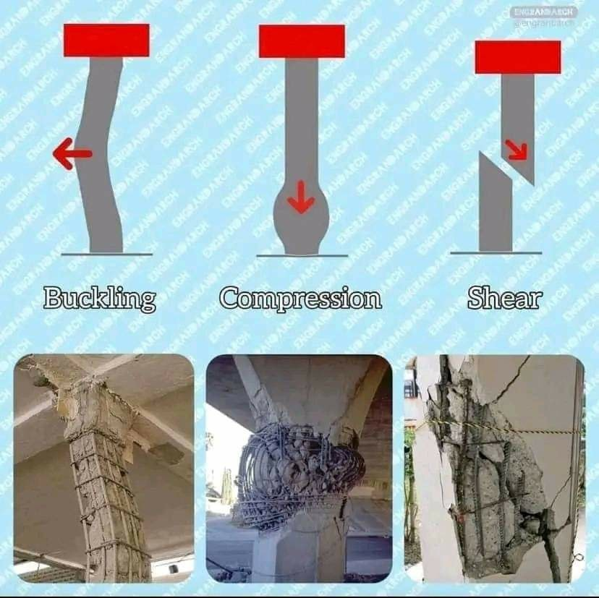
Reinforced Column
Failure Modes
All three failure modes are possible during an earthquake
Columns failed in brittle shear at the Cypress Viaduct

Slide 46
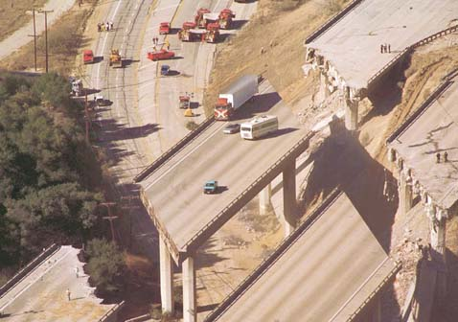
1994 Northridge Quake
Occurred at 4:30 a.m. local time on January 17, 1994
Had a 6.9 moment magnitude
Duration was about 20 second
Had the highest measured Peak Ground Acceleration (PGA) for USA at 1.7 G
Death toll was 57
The earthquake occurred along a previously unknown "blind" thrust fault, close to the San Andreas fault
Blind fault does not break Earth’s surface and is thus not visible
Los Angeles basin was once one of the most prolific oil fields in the world
Oil companies had known about this blind fault but had not publically disclosed information

Slide 47
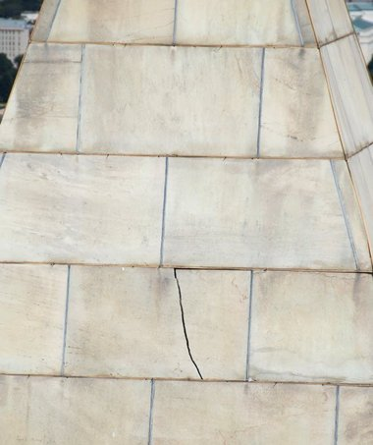
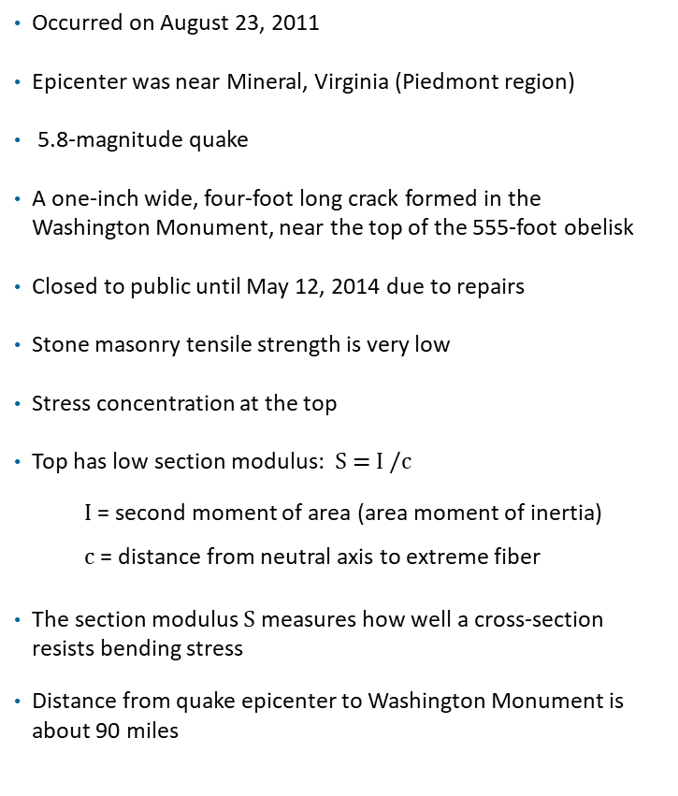
2011 Virginia Earthquake
Occurred on August 23, 2011
Epicenter was near Mineral, Virginia (Piedmont region)
5.8-magnitude quake
A one-inch wide, four-foot long crack formed in the Washington Monument, near the top of the 555-foot obelisk
Closed to public until May 12, 2014 due to repairs
Stone masonry tensile strength is very low
Stress concentration at the top
Top has low section modulus: S = I /c
  I = second moment of area (area moment of inertia)
  c = distance from neutral axis to extreme fiber
The section modulus $S$measures how well a cross-section resists bending stress
Distance from quake epicenter to Washington Monument is about 90 miles

Slide 48
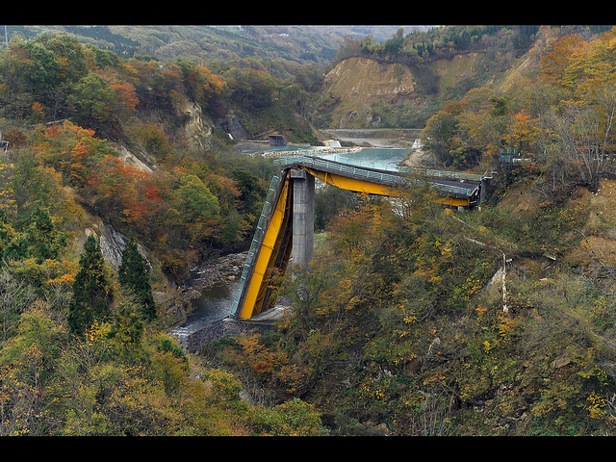
Highest Peak Ground Acceleration
The Iwate-Miyagi Nairiku earthquake struck northeast Honshu, Japan, on 14 June 2008
This earthquake had a moment magnitude Mw 6.9 according to the USGS
The peak ground acceleration (PGA) had a maximum vector sum (3 component) value of 4278 cm/sec^2 (4.36 G)
This is the highest ever recorded PGA, although other quakes have had higher moment magnitudes
The Richter and moment magnitudes are a measure of the total energy released by a quake over widespread area
The PGA is measured at a point
PGA depends on soil conditions, distance from the hypocenter, and other factors

Slide 49
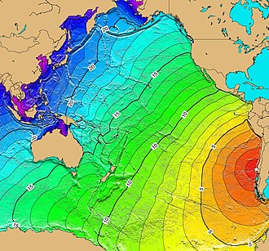
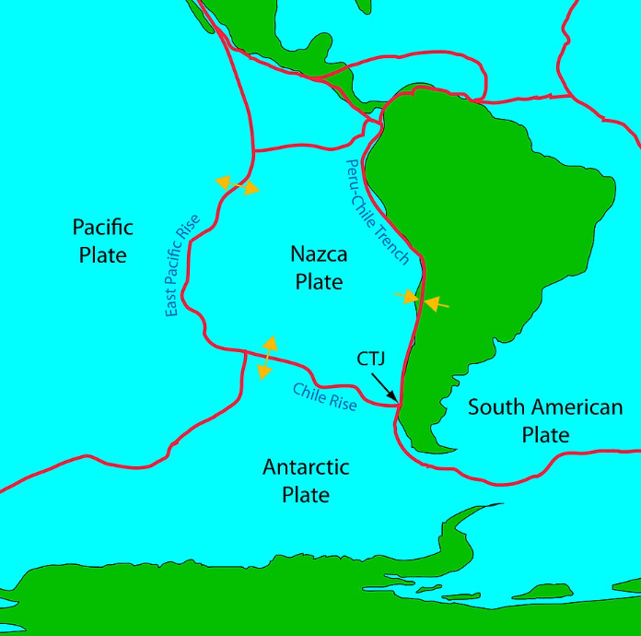
1960 Valdivia, Chile Earthquake & Tsunami
Most studies have placed it at 9.4–9.6 on the moment magnitude scale, making it the strongest earthquake ever recorded
The rupture lasted roughly 10 minutes in some areas
Tsunami: Hilo, Hawaii destroyed waterfront areas.
Waves reached Japan and the Philippines
Wikipedia images

Slide 50
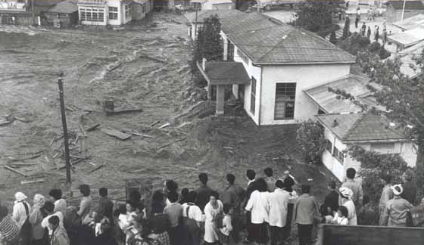
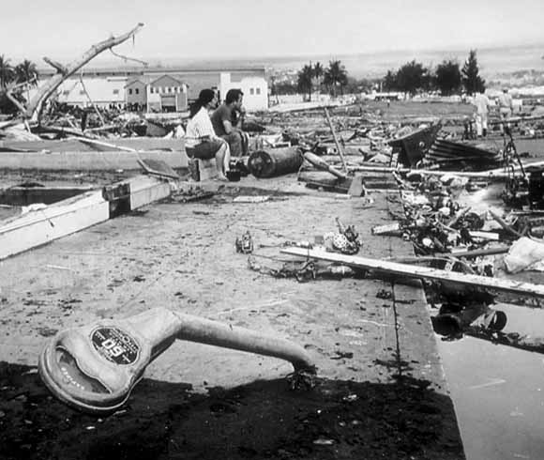
1960 Valdivia, Chile Earthquake & Tsunami
Top: Onagawa, Japan
Bottom: Hilo, Hawaii
The disaster highlighted the need for basin-wide tsunami detection and warning
The Pacific Tsunami Warning System (PTWS) was strengthened and expanded shortly afterward

Slide 51


1960 Valdivia, Chile Earthquake & Tsunami
Key lesson: Damage accumulates during long-duration shaking even if peak acceleration is moderate
Engineering implications:
  Structures must withstand many load cycles, not just peak force
  Modern design spectra include duration considerations
  This influenced research on cumulative damage and hysteretic energy dissipation
  This concept later became important in ductile seismic design

Slide 52

Liquefaction & Sand Boils
Widespread soil liquefaction occurred in the 1960 Chile earthquake
Liquefaction Mechanism:
  Occurs in loose, saturated sands or silts during cyclic earthquake loading
  Shaking raises pore water pressure, reducing effective stress
  Soil temporarily loses shear strength and behaves like a fluid
Observed Ground Effects:
  Sand boils / sand vents (water–sand eruption through cracks)
  Lateral spreading along riverbanks and coastal plains
  Ground settlement causing building tilt and infrastructure damage
  Ground fissures and sand-filled cracks
Why Liquefaction Was Extensive:
  Young alluvial and coastal sediments in the Valdivia region
  High groundwater levels due to rainfall and coastal environment
  Long-duration megathrust shaking

Slide 53

Liquefaction in 1964 Niigata, Japan Earthquake
The 1964 Niigata earthquake is one of the most famous real-world demonstrations of soil liquefaction and is widely used in geotechnical engineering education
Magnitude: Mw ≈ 7.5
Location: offshore near Niigata, a coastal city built on young river-delta sediments
Cyclic shear stresses from the earthquake caused sand grains to rearrange
Pore water pressure increased because water could not drain quickly
Effective stress dropped toward zero
The soil lost shear strength and behaved like a fluid

Slide 54

Earthquake Engineering Fatigue
LCF - low cycle fatigue
ULCF - ultra low cycle fatigue
Structure subjected to a major earthquake
Or multiple earthquakes including aftershocks
1994 Northridge Earthquake

Slide 55

Reinforced Concrete
Fatigue fractures of the steel reinforcement bars in the area of ​​a frame corner
The picture was made by Patrick Fehlmann as part of his dissertation on the fatigue of reinforced concrete bridges

Slide 56

Plastic Hinges in Beam Structures
Cracks form in the beam plastic hinge zones
Image courtesy of Canterbury Earthquake Royal Commission

Slide 57

Plastic Hinge with Reduced Beam Section (RBS)
Weaker section forms plastic hinge before the brittle failure of the beam-column connection
  Purpose: To prevent brittle fracture of beam-to-column welding by forcing yielding to occur within the beam itself
  Mechanism: Flanges are reduced (often with a radius cut) in a specific area near the column, lowering the local bending strength, which causes the plastic hinge to form at that location
  Design Benefits: Creates a "strong column-weak beam" scenario
  The beam develops large rotational capacity and ductility, absorbing significant energy during seismic events
  Performance: Proper design allows the connection to withstand significant story drifts (e.g., >8%) without severe strength loss
  Image: https://www.facebook.com/groups/1646963768885734/posts/1965751330340308/

Slide 58

Transamerica Pyramid Building
Vibrationdata
The Transamerica Pyramid is built from a steel frame, with a truss system at the base
The height is 850 ft (260 m)
Amplitude-dependent stiffness degradation and increased damping due to joint friction, connection slip, and soil–structure interaction
Direction | Loma Prieta Earthquake |  | Ambient Vibration
 | fn (Hz) | Damping | fn (Hz) | Damping
North-South | 0.28 | 4.9% | 0.34 | 0.8%
East-West | 0.28 | 2.2% | 0.32 | 1.4%
Çelebi, M., “Dynamic Characteristics of the Transamerica Pyramid Building”
Earthquake Spectra, Vol. 7, No. 4, 1991
58
Notes:
58

Slide 59

Steel Moment Frame Connection, Pre-Northridge Earthquake 1994
Continuous, joint penetration weld (CJP)
The connections were designed to yield under strong shaking and to behave as plastic hinges to dissipate earthquake energy without loss of strength
This yielding without fracturing is intended to achieve the ductility requirement so building occupants may exit safely
High stress concentration at welded joints
Flawed welding was unable to achieve the intended design strength
Poorly designed and under-sized bolts that were unable to withstand the forces after the failure of the welded section
These defects resulted in the unexpectedly early yielding and brittle fractures of these connections

Slide 60

Kobe Japan Earthquake, 1995
Failure of steel structure at welded connection due to poor design
Steel is strong in tension and ductile after reaching its yield stress
The material can dissipate large hysteretic energy under cyclic loading
But the welded connection may not be as ductile as the steel

Slide 61
Corrective Actions Based on Northridge & Kobe Earthquakes
Increased inspection, repair and retrofit of buildings in active earthquake zones
Building codes & inspection practices changed to require
  Stronger materials
  Higher quality welds to increase metal-weld toughness
  More rigorous testing for new designs
  Codes also moved away from using a prescriptive detail and moved toward performance-based criteria

Slide 62
Category | Prescriptive Design | Performance-Based Design
Philosophy | Follow rules | Predict behavior
Design Driver | Detailing-driven | Response-driven
Safety Concept | Implicit safety | Explicit performance targets
Analysis Method | Linear static (ELF), basic response spectrum | Nonlinear static (pushover), nonlinear time history
Model Fidelity | Simplified (lumped, elastic) | Detailed (material nonlinearity, hinge models, SSI possible)
Acceptance Criteria | Member stresses, code checks | Drift limits, hinge rotations, damage states (IO, LS, CP)
Uncertainty Treatment | Hidden in safety factors (R, Ω₀) | Explicit (multiple ground motions, probabilistic checks)
Testing / Validation | Code provisions based on past tests (indirect) | Direct validation via experiments & simulation correlation
Experimental Basis | Historical empirical rules | Cyclic tests, shake table tests tied to performance limits
Ground Motion Use | Equivalent forces or spectrum | Suites of real/scaled time histories
Damage Philosophy | Try to avoid damage | Allow controlled, predictable damage
Typical Tools | ETABS (linear modes) | OpenSees, nonlinear ETABS

Slide 63
U.S. Nuclear Regulatory Commission Damping
Some interfacial friction damping effects also occur in welded joints, but welded joints are much stiffer than the bolted joints
The U.S. Nuclear Regulatory Commission gives the damping ratios for nuclear plant structures
The values are intended for analysis purposes when measured damping values are unavailable.
Damping Values for Steel Buildings, Operating-Basis Earthquake
Joint Type | Damping Ratio
Welded Joints | 2%
Bolted Joints | 5%

Slide 64

Building Isolation
Vibrationdata
A soft support is placed between the building and the ground
Softening the anchorage to the ground makes the natural shaking period of the building longer and reduces the seismic force input to the building
https://www.toda.co.jp/

Slide 65


Bhuj Hospital, Gujarat Province, India
The isolators are Lead Rubber Bearings (LRB) which are stiff and strong in the vertical direction but flexible in the horizontal direction
Isolation frequency is typically 0.4 to 1.0 Hz with a period T ≈ 1–2.5 seconds
Provide energy dissipation through yielding of the lead core
Recrystallization of the lead core prevents strain hardening and maintains stable hysteretic energy dissipation over repeated seismic cycles
New strain-free grains nucleate and grow, replacing the distorted grains since the recrystallization temperature is close to room temperature

Slide 66

Seismic Isolation Bearing
https://www.youtube.com/shorts/05UK-Ljd02E

Slide 67

Building Dampers, RC Columns
Vibrationdata
Hysteretic steel dampers, often called U-shaped steel dampers or steel yielding dampers, used for seismic energy dissipation
The red elements are ductile steel bars formed into large loops
During an earthquake they deform plastically (yield) and absorb energy, reducing the forces transmitted into the concrete frame
During seismic motion:
The structure moves laterally
The red steel loops bend cyclically
The bending causes plastic deformation in the steel
That deformation dissipates energy as hysteretic damping
Instead of the concrete column or beam cracking, the damper absorbs the damage
Widely used in Japan
https://www.ijfmr.com/papers/2025/6/64282.pdf

Slide 68

Beam & Frame Hysteresis
  Hysteresis describes the path-dependent, non-linear relationship between force (moment) and deformation (rotation) in a structural element under cyclic loading
  During earthquakes, beams experience repeated load reversals that cause yielding at plastic hinge regions
  The structural response depends on loading history, not just peak demand
  Stable hysteretic behavior allows controlled inelastic deformation without brittle failure
  The area enclosed by the hysteresis loop represents the energy dissipated through inelastic deformation (plastic hinging)
Internal friction and heat generation cause a deviation from perfect elasticity, resulting in the hysteresis loop in the stress-strain curve

Slide 69

Beam & Frame Hysteresis
Hysteresis in seismic moment frames, this energy is dissipated primarily through reinforcement yielding, concrete cracking, and microstructural friction
This mechanism reduces seismic force demands transmitted to the rest of the structure and is the fundamental reason ductile systems are assigned larger response modification factors (R) in ASCE 7
This “internal friction” is the primary mechanism that prevents buildings from collapsing during major seismic events
Hysteretic energy dissipation acts as an equivalent viscous damping mechanism (often increasing effective damping from ~5% in elastic systems to 10–20%+ in yielding systems)
Proper detailing ensures stable, full hysteresis loops rather than degrading or pinched behavior, which can lead to strength loss and potential collapse
Nonlinear yielding behavior: The response transitions from an initial elastic slope to a reduced post-yield stiffness, representing inelastic deformation after the yield rotation is exceeded
Path-dependent response: The loading and unloading branches differ, demonstrating memory effects and realistic cyclic behavior typical of structural elements under earthquake excitation

Slide 70



Taipei City Hospital
Vibrationdata
The shock absorbers are viscous dampers, designed to limit the building’s lateral seismic response
The absorbers and diagonal bracing frames were installed as a seismic retrofit
Should be modeled as dashpots with force $F$
$F=Cv^{α}$
where $C$ is the viscous damping coefficient, $v$ is velocity, and the exponent α=1 is for linear damping

Slide 71

Earthquake Simulation Shaker
Vibrationdata
“E-Defense,” Miki City, Hyogo Prefecture, Japan
Hydraulic actuators
Designed for full-sized models
Horizontal (X and Y): ±100 cm & Vertical (Z): ±50 cm
71
Notes:
71

Slide 72

Generator Test Video
Click to play

