Slide 1
Vibrationdata
EARTHQUAKE ENGINEERING · NONSTRUCTURAL COMPONENTS
Earthquake Floor Response Spectra
What the equipment actually feels: generation, interpretation, damping, peak broadening, equipment coupling, and code practice
Revision B
Tom Irvine
Notes:
This unit covers floor response spectra, also called in-structure response spectra. The ground response spectrum describes the earthquake. The floor response spectrum describes what a component mounted on a floor, roof, or wall actually experiences after the building has filtered the ground motion. We will work through a generic five-story example from ground motion to floor spectra, then look at damping, peak broadening, equipment-structure coupling, code practice under ASCE 7-22 Chapter 13, and qualification by analysis and test.

Slide 2
MOTIVATION
Vibrationdata
The ground spectrum is not the equipment’s input
What the building does
Who uses floor spectra
WORKED EXAMPLE, THIS DECK
Filters broadband ground shaking into narrowband floor motion near its own modes
Amplifies peak acceleration with height
Adds vertical, torsional and relative-displacement demands
Nuclear: ASCE 4-16, USNRC RG 1.122 and SRP 3.7.2
Buildings: ASCE 7-22 Chapter 13 (simplified or from analysis)
Qualification test: required response spectra for IEEE 344 and ICC-ES AC156 shake-table testing
Launch, defense and industrial facilities with critical equipment
3.4× Peak Time History
Roof peak acceleration over Peak Ground Acceleration PGA (Roof 1.39 g vs Ground 0.41 g)
5.7× SRS
Roof 5% spectral peak over ground at 2 Hz (5.9 g vs 1.0 g)
Why it matters
Equipment tuned to a building mode can see several times the ground spectral value
Rooftop units, piping, batteries, switchgear, and racks fail by anchorage, sliding and toppling
9.9 g
Roof peak for 2%-damped equipment tuned to the building
Takeaway Qualify components to the spectrum at their mounting point, not to the site ground spectrum.
2 / 41
Notes:
The central point: a component does not see the ground motion. It sees the motion of the floor it is attached to. In the example we build later, the peak floor acceleration at the roof is 3.4 times the peak ground acceleration, and a 5 percent damped component tuned to the fundamental building frequency sees 5.7 times what the ground spectrum predicts at that frequency. At 2 percent damping, which is realistic for welded or bolted steel equipment, the roof peak is almost 10 g. Floor spectra are standard practice in nuclear work and are increasingly used for buildings through the analysis options in ASCE 7-22 Chapter 13.

Slide 3
CONCEPT
Vibrationdata
Two filters in series
Ground motion
Building
Floor motion
Equipment SDOF
Broadband, random, 0.2–25 Hz
Filter #1: modes at f₁, f₂, … with damping ζₕ
Narrowband, near-harmonic at f₁
Filter #2: fₑ, ζₑ → floor spectrum ordinate
THE CALCULATION
Why the tuned peak is so large
Absolute floor acceleration at floor level k:
üₖ(t) = Σⱼ φₖⱼ Γⱼ ÿⱼ(t)
where ÿⱼ is the absolute response of a mode-j SDOF to the ground input and
Σⱼ φₖⱼΓⱼ = 1.
Floor response spectrum:
FRSₖ(fₑ, ζₑ) = max |response of an (fₑ, ζₑ) SDOF to üₖ(t)|
Same shock response spectrum algorithm as for the ground, applied to each floor record.
Ground motion is broadband, so a 5% oscillator amplifies it only about 2 to 2.5 times
Floor motion near f₁ is almost a sinusoid, so a tuned oscillator approaches its full Q = 1/(2ζ)
Q = 10 at 5% and 25 at 2%, limited in practice by the strong-motion duration and the floor’s own bandwidth
Takeaway The floor spectrum is the SRS of the floor motion; the building is the first filter, the equipment the second.
3 / 41
Notes:
Think of two filters in series. The building is the first filter. It takes broadband ground motion and passes mainly the energy near its own natural frequencies, so the floor motion at upper levels looks close to a sinusoid at the fundamental frequency. The equipment is the second filter. The floor response spectrum is simply the shock response spectrum of the floor acceleration record. The absolute floor acceleration is a sum of modal absolute accelerations weighted by mode shape times participation factor, and those weights sum to one at every floor. When the equipment frequency matches a building frequency, a lightly damped oscillator driven by a near-sinusoid builds up toward its Q, which is why tuned floor spectrum peaks are far larger than ground spectrum amplifications.

Slide 4

WORKED EXAMPLE
Vibrationdata
A generic five-story shear building
Roof
Property | Value
Stories / story height | 5 stories at 3.6 m (h = 18 m)
Floor mass | 400 t each, 2,000 t total
Story stiffness | 780 MN/m, uniform
Building damping | 5% modal
Behavior | Linear elastic, fixed base
Mode | f (Hz) | Eff. mass
1 | 2.00 | 88.0%
2 | 5.84 | 8.7%
3 | 9.20 | 2.4%
4 | 11.82 | 0.8%
5 | 13.48 | 0.2%
Level 4
Level 3
Level 2
Why this model
Level 1
Stiffness set so f₁ = 2.0 Hz (T₁ = 0.50 s), inside the plateau-to-descending region of the design spectrum
Mode 1 carries 88% of the mass; mode 2 at 5.84 Hz still matters for the lower floors
Generic teaching model, not a real building; every number in this deck is computed from it
$${\ddot{u}}_{g}(t)$$
Takeaway Keep enough modes to reach the rigid range of the equipment — here all five, up to 13.5 Hz
4 / 41
Notes:
The worked example is a generic five-story shear building with 400 tonnes per floor and uniform story stiffness of 780 meganewtons per meter, chosen so the fundamental frequency is exactly 2 hertz, a period of half a second. Modal damping is 5 percent and the building stays elastic. The first mode has 88 percent effective mass, the second 8.7 percent. For base shear you would stop after two modes, but for floor spectra higher modes matter more, especially at the lower levels, as we will see. This is a teaching model, not a real building.

Slide 5
WORKED EXAMPLE
Vibrationdata
Input: a spectrum-compatible ground motion
SDS = 1.0 g, SD1 = 0.6 g design shape; 25 sec, 500 samples/sec; PGA 0.41 g
Frequency-domain spectral matching, 20 passes: 5% SRS within 0.88–1.12 of target from 0.25 to 50 Hz
Takeaway One matched record is fine for teaching; design practice uses several and averages or envelopes.
5 / 41
Notes:
The input is a synthesized ground acceleration matched to an ASCE 7 style design spectrum with SDS of 1.0 g and SD1 of 0.6 g. I started with enveloped random noise and adjusted its Fourier amplitudes over 20 passes until its 5 percent response spectrum was within about 12 percent of the target from a quarter hertz to 50 hertz. The peak ground acceleration is 0.41 g. For design, ASCE 4 and the NRC guidance require either multiple records or a single record meeting enveloping and power spectral density criteria, because one record can leave notches that happen to fall at a building frequency. The response spectra here are computed with the Smallwood ramp-invariant digital recursive filter, the same algorithm used in the Vibrationdata SRS tools.

Slide 6
WORKED EXAMPLE
Vibrationdata
Synthesized Random ground shaking tends to become a near-sinusoid
What to notice
Roof record is dominated by a 0.5 sec cycle: the first mode (2 Hz)
Peak roof acceleration 1.39 g, 3.4 times the 0.41 g PGA
Energy away from 2 Hz is largely filtered out
A 2 Hz component on the roof is being driven at resonance by an almost harmonic input
Takeaway Floor motion is tending toward narrowband; that single fact explains most of what follows.
6 / 41
Notes:
Here is an eight second window of the ground and roof absolute acceleration. The ground record is broadband and irregular. The roof record is dominated by a regular half-second cycle, the fundamental mode, with some higher-mode ripple. Peak roof acceleration is 1.39 g against a peak ground acceleration of 0.41 g. Anything on the roof with a natural frequency near 2 hertz is being driven by what is essentially a sine dwell lasting several seconds.

Slide 7
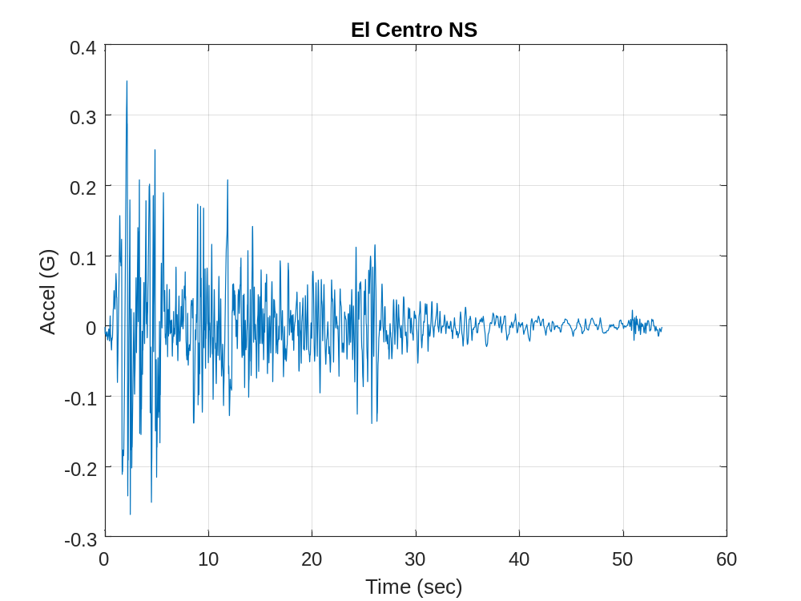

Slide 8
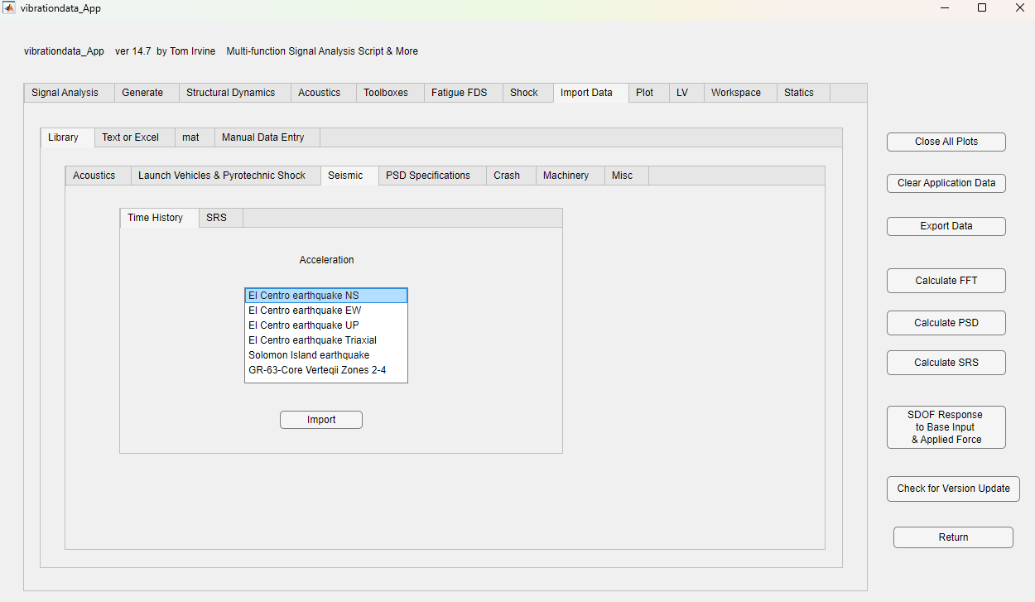

Slide 9
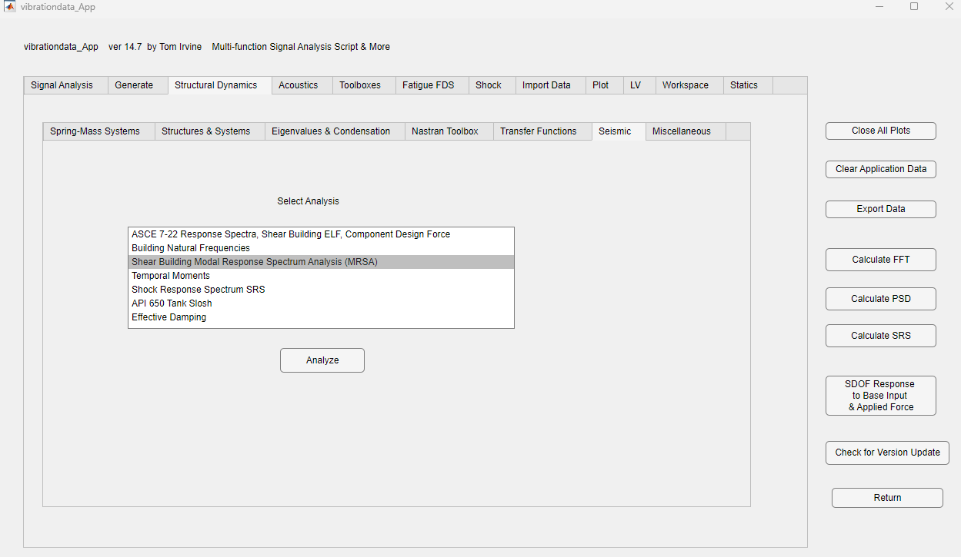

Slide 10
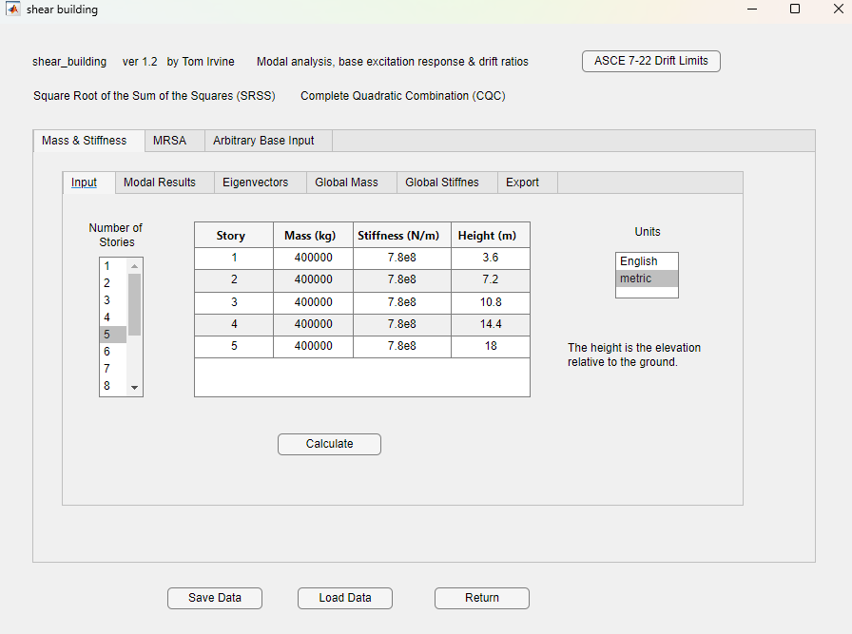

Slide 11
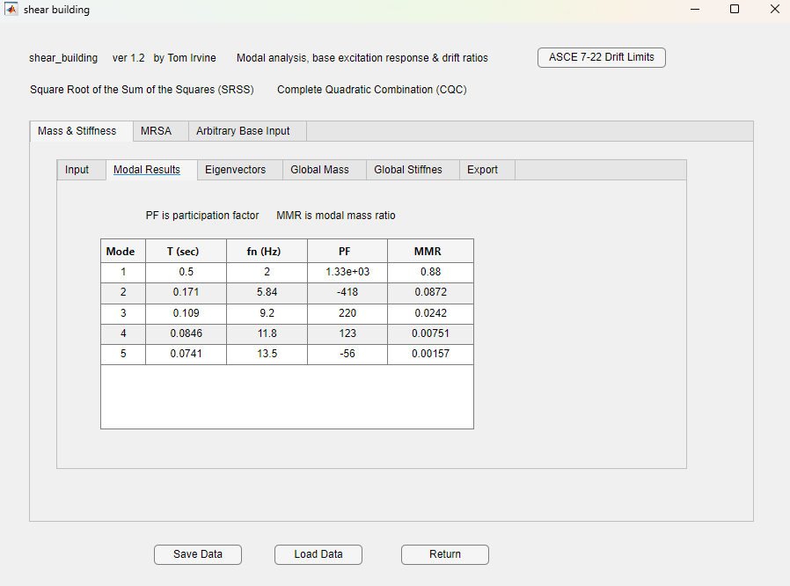

Slide 12
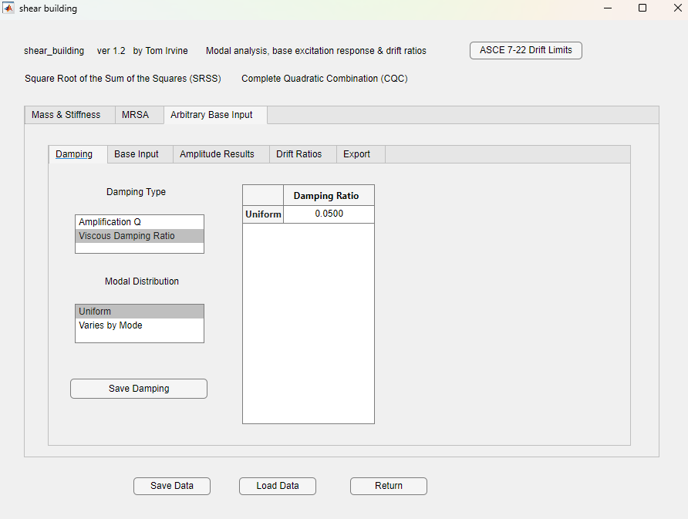

Slide 13
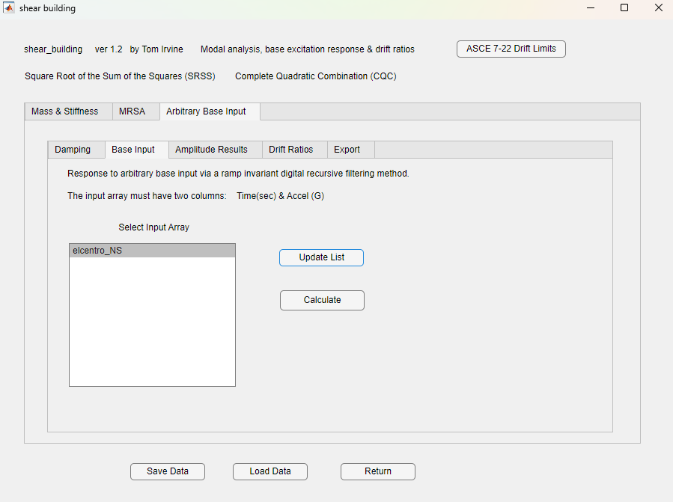

Slide 14
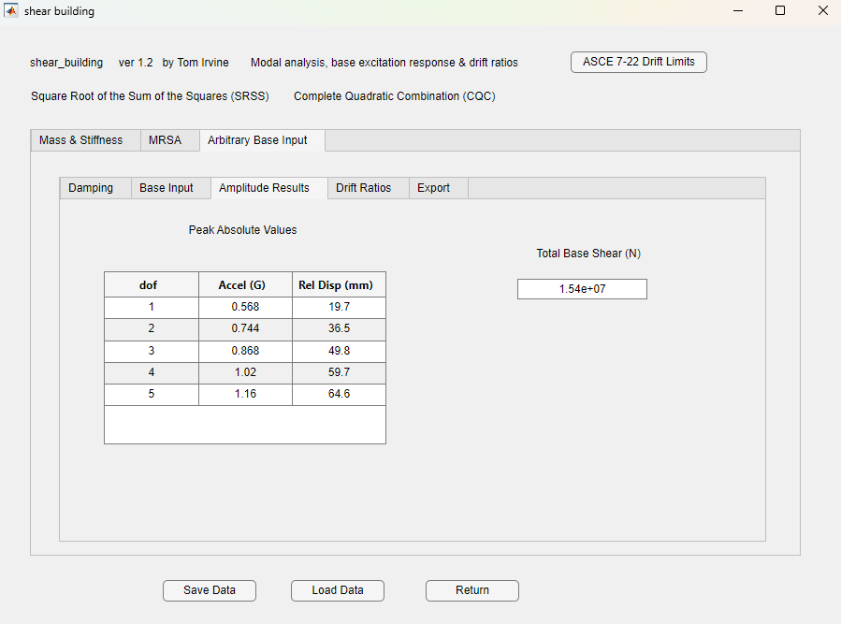

Slide 15
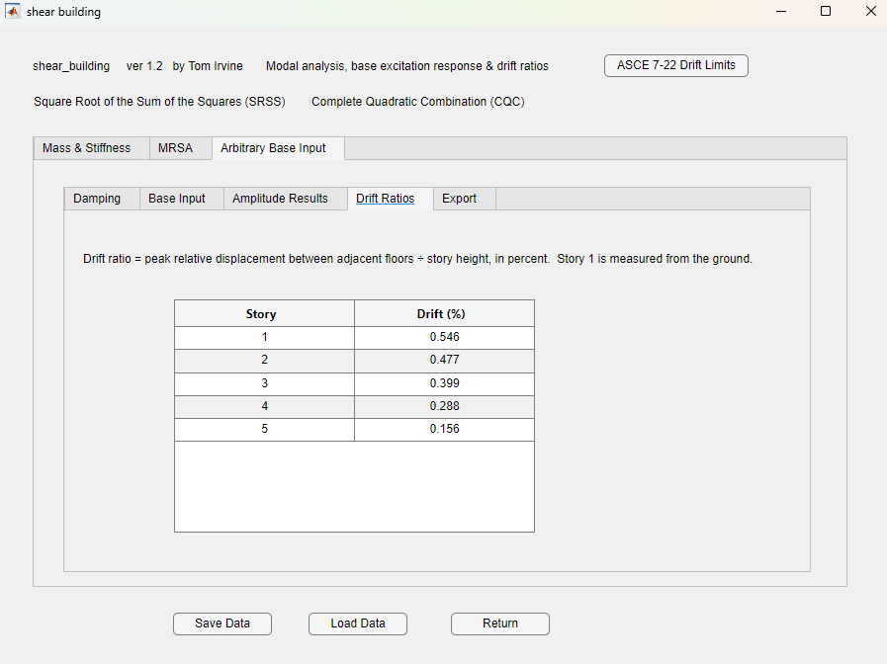

Slide 16
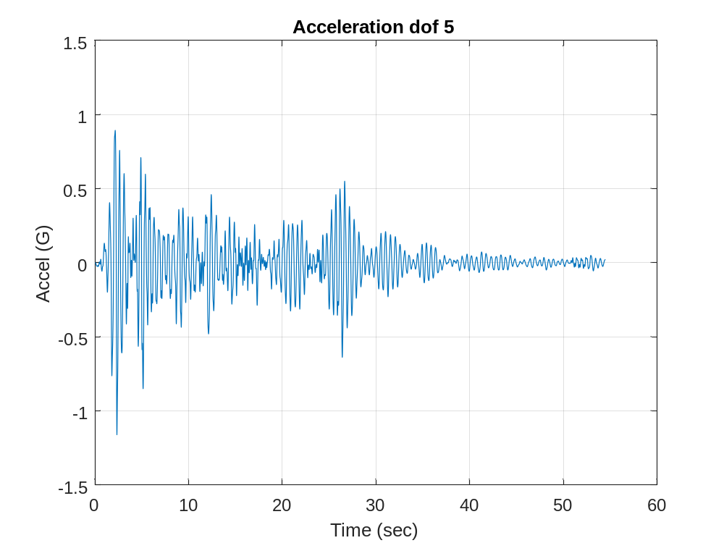
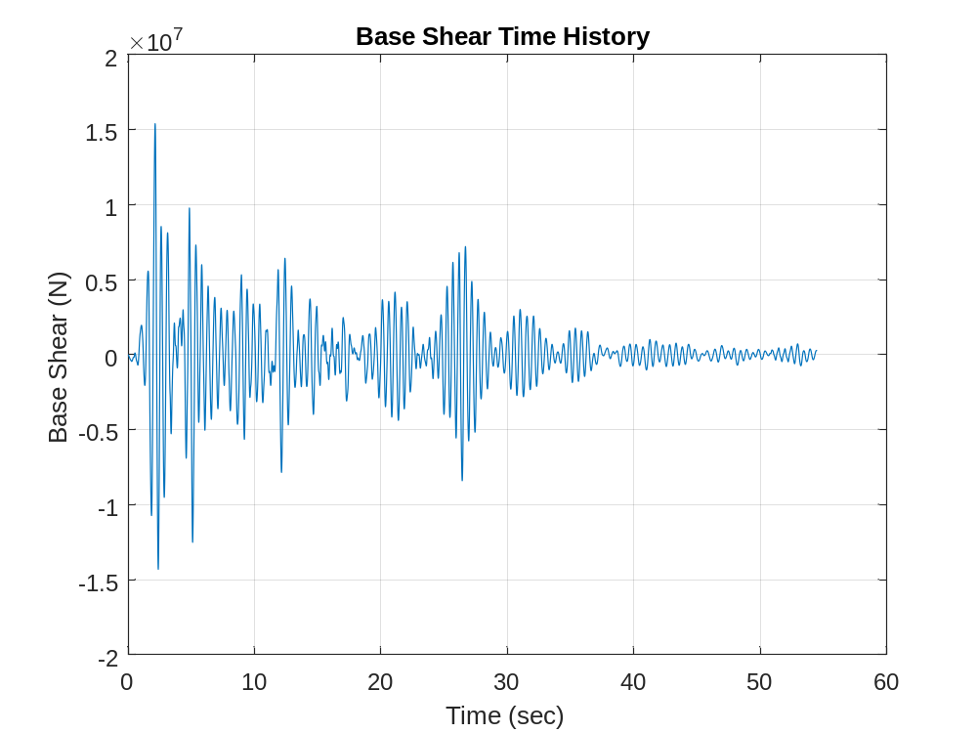

Slide 17
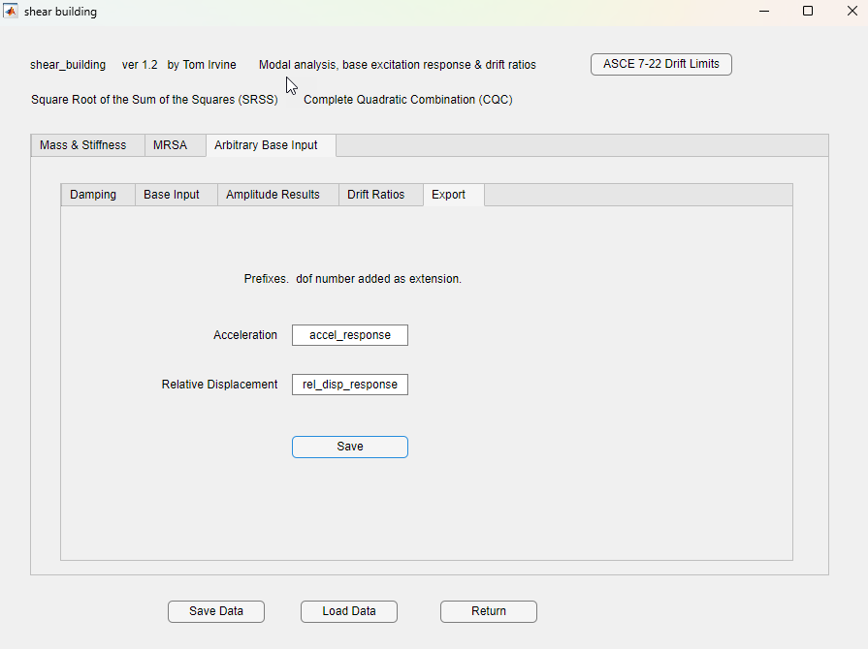

Slide 18
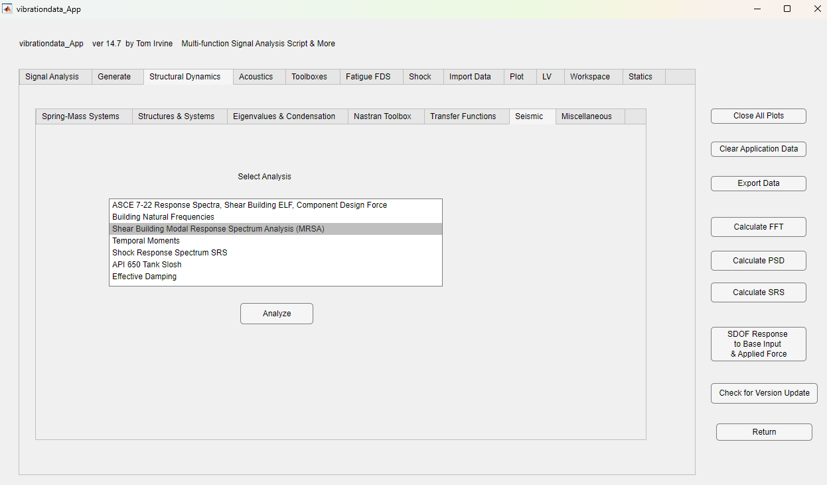

Slide 19
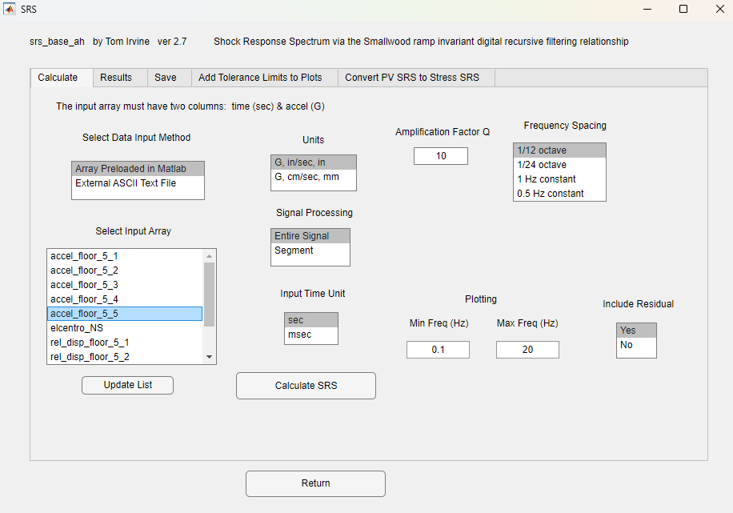

Slide 20
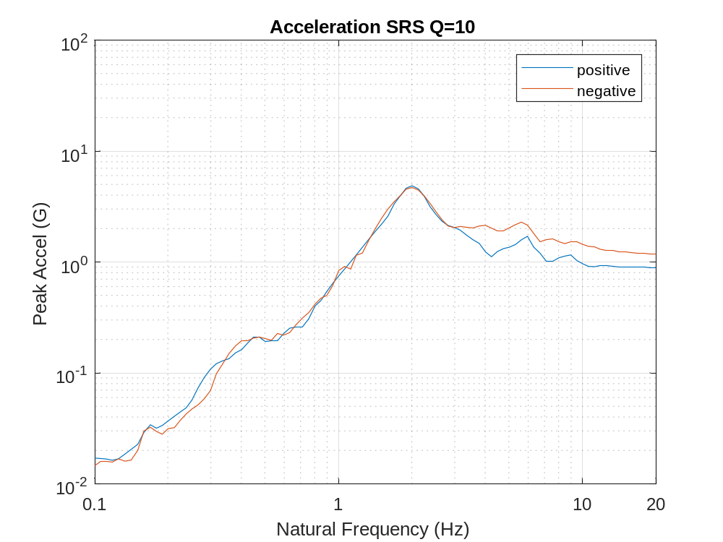
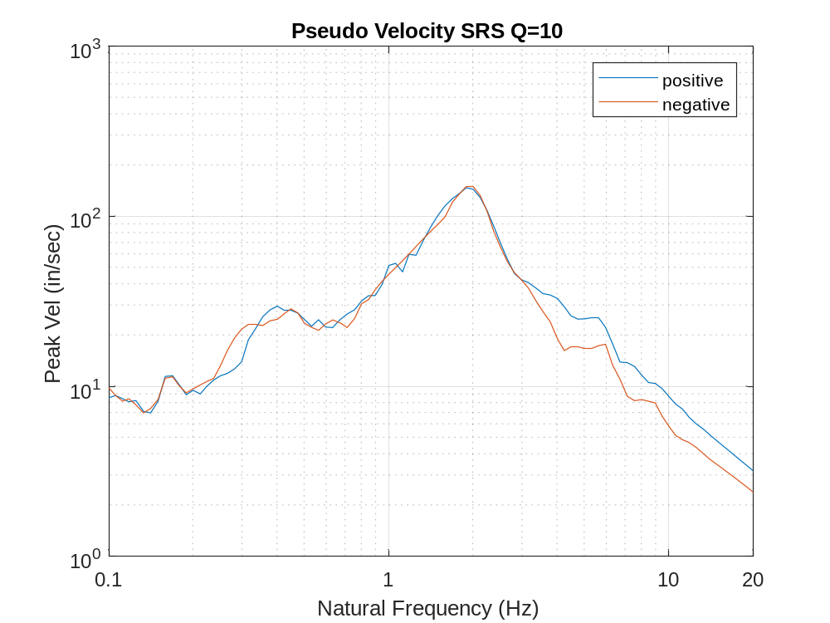
SRS for Equipment Mounted on 5th Floor, Q=10
Peak SRS Values
Acceleration: 2 Hz 4.9 G
Pseudo velocity: 1.89 Hz 150.9 in/sec
Next, repeat analysis with Q=25 or 2% damping

Slide 21
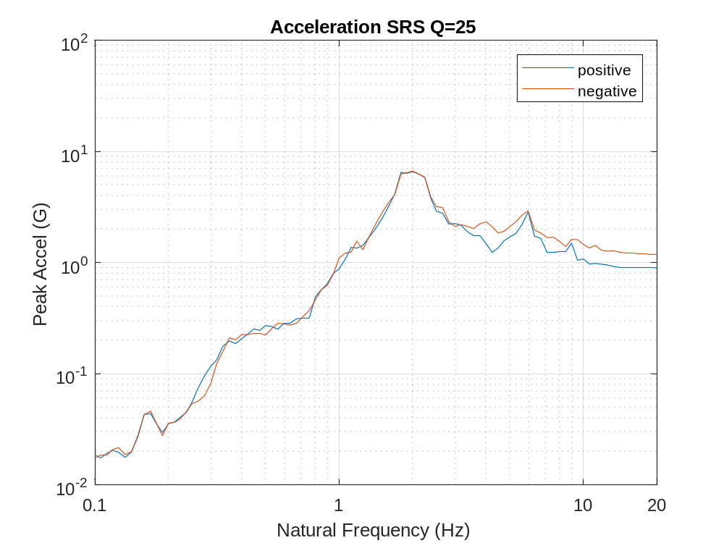
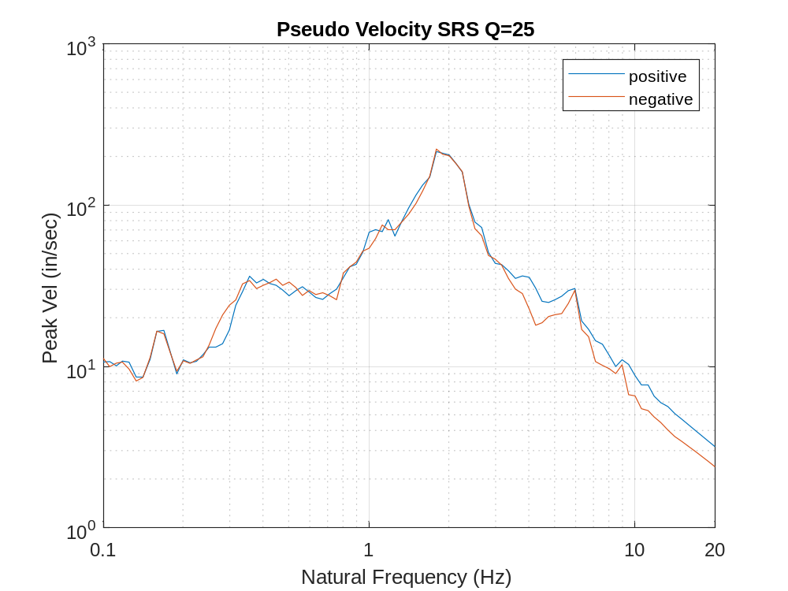
SRS for Equipment Mounted on 5th Floor, Q=25
Peak SRS Values
Acceleration: 2 Hz 6.69 G
Pseudo velocity: 1.79 Hz 223.5 in/sec

Slide 22
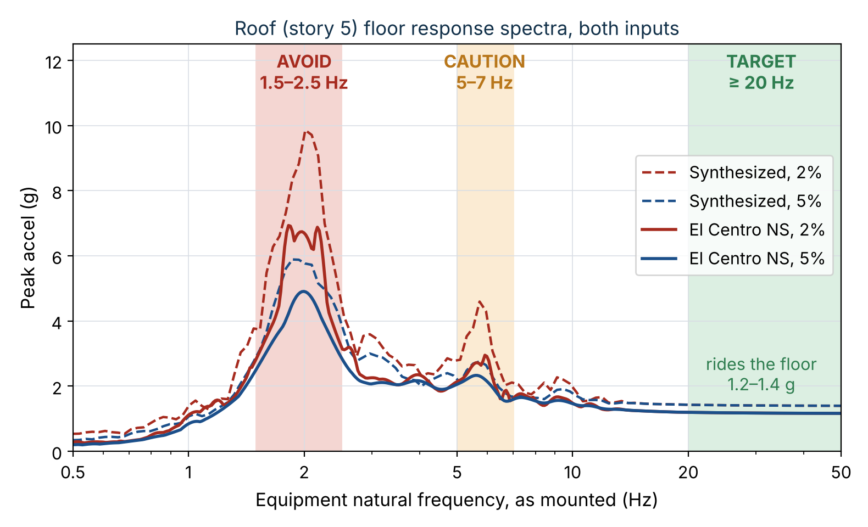
SECOND EXAMPLE · DESIGN RECOMMENDATION
Vibrationdata
Equipment on the roof (story 5): mount it stiff
Recommendations
Hard-mount rather than isolate
Rigid: f ≥ 20 Hz as mounted. The item rides the floor at 1.2–1.4 g
Avoid 1.5–2.5 Hz: 7–10 g at 2% damping on the broadened plateau
Caution 5–7 Hz: second-mode peak, 2.3–4.5 g
Qualify to the ±15% broadened envelope of several records
Across floors: 65–80 mm roof motion, 6–7 mm story 5 drift
Over ~20 t (1% of building mass): include it in the model
Building
Mode 1
Building
Mode 2
Takeaway On the roof, stiffness is the cheapest protection: a rigid mount sees 1.2–1.4 g; one tuned to the building sees 7–10 g.
22 / 41
Notes:
What does this mean for equipment on the roof, story 5? The plot overlays the roof spectra from both inputs at 2 and 5 percent damping, shaded by equipment frequency. Above about 20 hertz, beyond the highest building mode at 13.5 hertz, the spectra settle to the peak floor acceleration, so a rigid item simply rides the floor at about 1.2 to 1.4 g. Near the building fundamental, 1.5 to 2.5 hertz after broadening, a lightly damped item sees 7 to 10 g, which is not practical to qualify. The second mode near 5.7 hertz adds a smaller peak of 2.3 to 4.5 g. So the first recommendation is to mount the equipment stiffly and check its frequency on its actual mounts. Rooftop units on spring isolators are the classic trap, because isolators are often 2 to 5 hertz; they need seismic restraints and snubbers. Qualify to the broadened envelope of several records, not one. Piping and conduit that cross floors must take the relative motion, 65 to 80 millimeters at the roof. And anything heavier than about one percent of the building mass, about 20 tonnes here, belongs in the building model.

Slide 23



PEAK FLOOR ACCELERATION
Vibrationdata
Nomenclature for the height amplification factor H_{f}
WHERE THEY APPEAR
Symbol
Definition
In this example
H_{f} = 1 + a₁(z/h) + a₂(z/h)¹⁰
PGA
Peak ground acceleration at the base of the structure
Normalizing value, z/h = 0
ASCE 7-22, Section 13.3.1.1
Horizontal component force
PFA
Peak floor acceleration at the level considered
3.39 × PGA at the roof
z
Height of the level above the base
0 at grade
$$F_{p}=0.4 S_{DS} I_{p} W_{p} \left(H_{f}/R_{μ}\right)\left(C_{AR}/R_{po}\right)$$
h
Average roof height above the base
Five levels, equal story heights
Ductility factor C_{AR} and $stength factor R_{po}$ describe the component, not the building.
z/h
Relative height: 0 at the base, 1.0 at the roof
Plotted in 0.2 increments
H_{f}
Structure height amplification factor, i.e. code PFA/PGA
3.36 at the roof
Cap and floor
a₁ is capped at 2.5 and a₂ floored at 0, so H_{f} never exceeds 4.5 at the roof.
a₁
Coefficient on the linear term, a₁ = 1/T_{a} ≤ 2.5
2.00
a₂
Coefficient on the whip term, a₂ = 1 − (0.4/T_{a})² ≥ 0
0.36
Legacy form
ASCE 7-16 used 1 + 2z/h — linear, with no whip term.
T_{a}
Approximate fundamental period of the building
0.5 sec
$$R_{μ}$$
Structure ductility reduction factor; divides H_{f} for yielding
≥ 1.3 by definition
No-period option
H_{f} = 1 + 2.5(z/h) is permitted when T_{a} is not computed; roof value 3.5.
Takeaway H_{f} is a curve fit to instrumented-building records, not a modal result — the (z/h)¹⁰ exponent is empirical.
23 / 41

Slide 24
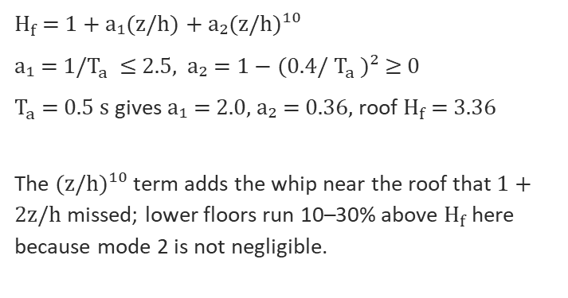
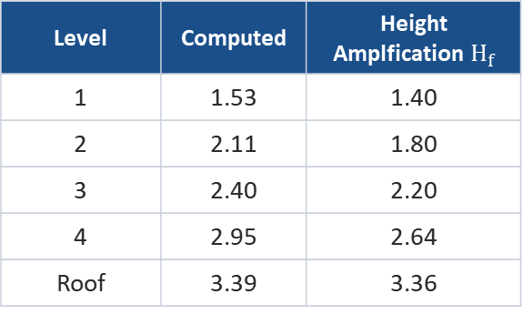
PEAK FLOOR ACCELERATION PFA
Vibrationdata
Amplification with height: analysis vs ASCE 7
Level | Computed | Height Amplfication $H_{f}$
1 | 1.53 | 1.40
2 | 2.11 | 1.80
3 | 2.40 | 2.20
4 | 2.95 | 2.64
Roof | 3.39 | 3.36
$H_{f}$= 1 + a₁(z/h) + a₂(z/h)¹⁰
a₁ = 1/$T_{a}$ ≤ 2.5, a₂ = 1 − (0.4/ $T_{a}$ )² ≥ 0
$T_{a}$ = 0.5 s gives a₁ = 2.0, a₂ = 0.36, roof $H_{f}$= 3.36
The (z/h)¹⁰ term adds the whip near the roof that 1 + 2z/h missed; lower floors run 10–30% above $H_{f}$ here because mode 2 is not negligible.
Takeaway For this elastic building the ASCE 7-22 roof value is almost exact (3.36 vs 3.39); Rμ then reduces it for yielding structures.
24 / 41
Notes:
This compares the computed ratio of peak floor acceleration to peak ground acceleration against the ASCE 7-22 height factor Hf, and the older ASCE 7-16 factor of one plus two z over h. With an approximate period of half a second, a1 is 2.0, a2 is 0.36, and Hf at the roof is 3.36. The computed elastic roof ratio is 3.39, remarkably close. The old linear factor gave 3.0. At the lower floors the computed values run 10 to 30 percent above Hf because the second mode contributes more there. Remember that ASCE 7-22 divides Hf by R mu, which accounts for building yielding. Our building is elastic, so the comparison is with R mu of one.

Slide 25
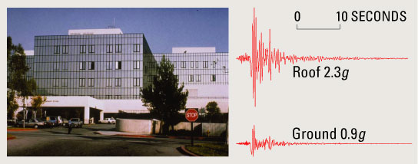
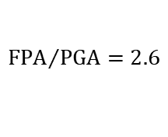
Northridge Earthquake 1994, Olive View Hospital
$${FPA}/{PGA}=2.6$$
Accelerometers were mounted in the new Olive View Hospital and on the adjacent ground
The peak ground level was 0.91 G, and the amplified peak roof level was 2.31 G
The building structure’s fundamental frequency is estimated at 2.5 Hz in the north-south axis, rocking mode
The dominant earthquake excitation at the hospital’s foundation was in the 2 to 3 Hz domain and is largely a result of the local soil conditions
Thus, the building natural frequency and the site excitation frequency were nearly the same, causing the building to undergo a resonant response
https://pubs.usgs.gov/fs/2003/fs068-03/

Slide 26
PEAK FLOOR ACCELERATION
Vibrationdata
Measured case histories: roof acceleration vs. ground
Building | Stories | Earthquake | PGA (g) | Peak PFA (g) | PFA/PGA
UCSB office, Santa Barbara | 3 | 1978 Santa Barbara | 0.40 | 1.00 | 2.5
LA commercial (dept. store) | 3 | 1994 Northridge | 0.33 | 0.97 | 2.9
Watsonville commercial | 4 | 1989 Loma Prieta | 0.66 | 1.24 | 1.9
LA warehouse | 5 | 1994 Northridge | 0.25 | 0.28 | 1.1
Imperial County Services Bldg ᴰ | 6 | 1979 Imperial Valley | 0.34 | 0.58 | 1.7
Olive View Hospital, Sylmar † | 6 | 1994 Northridge | 0.91 | 2.31 | 2.5
Burbank commercial | 6 | 1994 Northridge | 0.36 | 0.47 | 1.3
Van Nuys hotel ᴰ | 7 | 1994 Northridge | 0.45 | 0.58 | 1.3
UCLA Math-Science | 7 | 1994 Northridge | 0.29 | 0.76 | 2.6
Burbank residential | 10 | 1994 Northridge | 0.34 | 0.77 | 2.3
Sherman Oaks commercial ᴰ | 13 | 1994 Northridge | 0.46 | 0.65 | 1.4
Woodland Hills office ᴰ ‡ | 13 | 1994 Northridge | 0.44 | 0.33 | 0.75
Los Angeles office | 19 | 1994 Northridge | 0.32 | 0.65 | 2.0
North Hollywood hotel | 20 | 1994 Northridge | 0.33 | 0.66 | 2.0
Pacific Park Plaza, Emeryville | 30 | 1989 Loma Prieta | 0.26 | 0.39 | 1.5
Los Angeles office | 52 | 1994 Northridge | 0.15 | 0.41 | 2.7
Los Angeles office | 54 | 1994 Northridge | 0.14 | 0.19 | 1.4
Transamerica Pyramid, SF ‡ | 60 | 1989 Loma Prieta | 0.10 | 0.31 | 3.1
WHAT THE RECORDS SHOW
1.9 median
18 fixed-base records; range 0.75 to 3.1
No height trend
A 3-story store reached 2.9; a 54-story tower reached 1.4.
Yielding lowers it
The four damaged buildings all fall between 0.75 and 1.7, which is the effect Rμ represents.
Isolation reverses it
USC University Hospital, 7-story base isolated: 0.37 g foundation, 0.21 g roof, ratio 0.57.
Against the code
Legacy 1 + 2z/h gives 3.0 at the roof and ASCE 7‑22 caps the roof factor at 3.5. Only Transamerica tops 3.0.
ᴰ Structurally damaged in the event. † Free-field PGA; the ground-floor sensor read 0.80–0.82 g, giving 2.1–2.8.
‡ Highest sensor below the roof: 12th floor (Woodland Hills), 49th floor (Transamerica). All other PFA values are at the roof.
Takeaway Roof amplification scatters from below 1 to about 3 with no trend in story count; rather period, site frequency and yielding govern it.
Notes:
Measured PFA/PGA from instrumented buildings. PGA is the base or basement record unless noted; PFA is the largest horizontal peak at the roof unless noted.
Olive View (Sylmar County Hospital): USGS reports 0.91 g free field and 2.31 g roof (ratio 2.5). Celebi (1997) gives 0.82 g at the ground floor with 2.31 g roof (2.8). Naeim's processed CSMIP data give 0.80 g ground floor and 1.71 g roof (2.1). The ratio depends on which base record and which processing level is used.
Transamerica Pyramid: 48 occupied floors; Celebi and Safak describe it as 60 levels including the spire. Sensor at level 49; foundation 0.10 g.
Damaged buildings (Van Nuys hotel, Sherman Oaks, Imperial County Services Building, Woodland Hills) cluster at 0.75 to 1.7. Yielding caps floor acceleration, which is what R-mu represents in ASCE 7-22.
USC University Hospital (base isolated, 7 stories above the isolation plane): free field 0.49 g, foundation 0.37 g, roof 0.21 g. Not included in the median.
Sources:
Naeim, F. (2000). Learning from structural and nonstructural seismic performance of 20 extensively instrumented buildings. 12WCEE, Paper 0217.
Goel, R. K. (2003). Evaluation of nonlinear static procedures using strong-motion records of buildings. CSMIP data utilization report (Woodland Hills 13-story).
Goel, R. K. and Chadwell, C. (2007). SMIP07 Seminar Proceedings (Imperial County Services Building, Watsonville, UCSB).
USGS Open-File Report 89-568, Loma Prieta strong-motion records (Transamerica, Pacific Park Plaza).
USGS Open-File Report 96-263 and Celebi (1997), J. Struct. Eng. 123(4) (Olive View).
Nagarajaiah, S. and Sun, X. (2000). J. Struct. Eng. 126(10) (USC University Hospital).

Slide 27
FLOOR RESPONSE SPECTRA
Vibrationdata
Spectra at every level, 5% equipment damping
Anatomy of a floor spectrum
Tuned peak at f₁ (plotted near 1.9 Hz): roof 5.9 g vs ground 1.0 g
Second peak at f₂ ≈ 5.7 Hz: roof 2.8 g, and the largest peak at Level 1 (2.3 g)
Below f₁: little amplification; roof 1.06 g vs ground 0.62 g at 1 Hz
Rigid range: spectrum settles to the peak floor acceleration, 1.40 g at the roof
Takeaway Floor spectra are peaked, not smooth plateaus — the frequency of the equipment matters far more than on the ground.
27 / 41
Notes:
These are the 5 percent floor response spectra at every level along with the ground spectrum. Four features to read. First, the tuned peak near the fundamental building frequency. At the roof it is 5.9 g against 1.0 g on the ground spectrum at 2 hertz. The peak plots slightly below 2.00 hertz because of the frequency content of this particular record near the mode. Second, a peak at the second mode near 5.7 hertz. At Level 1 this second-mode peak is actually the largest ordinate on the curve, which is why truncating to one mode is unconservative for low-level equipment. Third, below the fundamental frequency the floors add little. Fourth, the rigid range, where the spectrum settles to the peak floor acceleration, 1.40 g at the roof. A rigid component simply rides the floor.

Slide 28
EQUIPMENT DAMPING
Vibrationdata
Floors are far more damping-sensitive than the ground
2% / 5% RATIO AT THE PEAK
1.67
1.23
Synthesize Time History Example
Roof (9.9 g / 5.9 g)
Ground at 2 Hz
Choosing ζₑ
Use the damping of the component, not the building
Welded steel and bolted cabinets: often 2–3%; nuclear practice specifies values by component type
Harmonic input would give the full Q ratio, 2.5; broadband gives about √2.5 ≈ 1.6 at most
Takeaway An error in equipment damping costs much more on a floor than it does on the ground.
28 / 41
Notes:
Now vary the equipment damping at the roof. Going from 5 percent to 2 percent raises the roof peak from 5.9 g to 9.9 g, a factor of 1.67. The same change on the ground spectrum at 2 hertz is only 1.23. The reason is the narrowband floor input. For a pure harmonic input the ratio would be the ratio of the Qs, 25 over 10, or 2.5. For a long broadband input the RMS response scales roughly with the square root of Q, which is about 1.6. Short strong-motion duration pulls both down. Our floor result sits between the two, closer to harmonic behavior. The practical point: use the damping of the component, and be careful, because on a floor spectrum that choice moves the answer a lot.

Slide 29
UNCERTAINTY
Vibrationdata
Peak broadening for frequency uncertainty
Sources of nonlinearity & frequency error
Concrete cracking, stiffness and mass estimates
Soil-structure interaction
Nonstructural stiffness, modeling idealization
Amplitude-dependent stiffness in strong shaking
Practice
ASCE 4-16: broaden peaks ±15%
USNRC RG 1.122: minimum ±10%, larger if variation warrants
Alternative: peak shifting, rerunning at shifted frequencies
Takeaway Broadening turns a sharp 9.9 g spike into a 9.9 g plateau from 1.7 to 2.35 Hz; equipment in that band must take the peak.
29 / 41
Notes:
A computed floor spectrum has sharp peaks at frequencies that depend on the building model. Those frequencies are uncertain because of concrete cracking, mass and stiffness estimates, soil-structure interaction, and nonstructural stiffness. The standard remedy is peak broadening. ASCE 4-16 widens each peak by plus or minus 15 percent in frequency. Regulatory Guide 1.122 calls for a minimum of plus or minus 10 percent, more if the computed variation justifies it. Here I formed the broadened curve as the envelope of the spectrum shifted over plus or minus 15 percent. The 9.9 g spike becomes a plateau from about 1.7 to 2.35 hertz. The alternative, peak shifting, evaluates the equipment at several shifted peak locations and takes the worst; it can be less conservative for multi-mode equipment.

Slide 30
SECOND EXAMPLE · RECORDED MOTION
Vibrationdata
Input: El Centro 1940, north-south component
Target is generic level for California
Imperial Valley earthquake, 18 May 1940. 53.7 sec at 100 samples/sec, PGA 0.35 g, used unscaled. Upsampled to 1000 samples/sec for the building and SRS.
Not spectrum-matched: 0.84 g at f₁ = 2 Hz, a 0.94 g peak at 3.9 Hz. SA(f₁)/PGA = 2.4, the same as the synthesized record.
Takeaway A real record has its own peaks and valleys; where they fall against the building modes sets the floor spectra.
30 / 41
Notes:
Now the same five-story building with a recorded ground motion: the north-south component of the 1940 Imperial Valley earthquake recorded at El Centro. It is 53.7 seconds long at 100 samples per second with a peak ground acceleration of 0.35 g, and I used it unscaled. The record was upsampled to 1000 samples per second by linear interpolation before running the building and the response spectra, because 100 samples per second is only two samples per cycle at 50 hertz. Unlike the synthesized input, El Centro is not matched to a design spectrum. Its 5 percent spectrum is 0.84 g at the 2 hertz building frequency and peaks at 0.94 g near 3.9 hertz. Normalized by peak ground acceleration, the ordinate at the building frequency is 2.4, the same as the synthesized record, which makes the comparison that follows a fair one.

Slide 31
SECOND EXAMPLE · RECORDED MOTION
Vibrationdata
Roof response to El Centro
What to notice
The same 0.5 sec roof cycle as the synthesized case: the building, not the record, sets the period
Roof PFA 1.16 g, 3.33 × PGA, against 3.39 for the synthesized record and 3.36 from ASCE 7-22 Hf
Roof displacement relative to the ground 65 mm, against 80 mm
First story drift 20 mm, against 22 mm
Takeaway PFA/PGA is a property of the building: two very different inputs give 3.33 and 3.39.
31 / 41
Notes:
Here is the first twelve seconds of the ground and roof absolute acceleration with El Centro as the input. The roof again settles into the half-second cycle of the fundamental mode. The building sets that period, not the record. The peak roof acceleration is 1.16 g, which is 3.33 times the peak ground acceleration. The synthesized record gave 3.39, and the ASCE 7-22 height factor at the roof is 3.36. The roof moves 65 millimeters relative to the ground, against 80 for the synthesized record, mostly because El Centro is a smaller record in absolute terms.

Slide 32
SECOND EXAMPLE · RECORDED MOTION
Vibrationdata
Floor spectra from El Centro, 5% damping
Against the synthesized record
Roof tuned peak 4.9 g at 2.0 Hz, 5.8 × the ground spectrum there. Synthesized: 5.9 ×
Level 1: mode 1 governs, 1.63 g against 1.48 g at mode 2. With the synthesized record mode 2 governed
Rigid range: 1.17 g at the roof, equal to the PFA
Below f₁ the floors add little: 0.84 g at the roof against 0.52 g on the ground at 1 Hz
Takeaway The tuned-to-ground ratio carried over between records; which mode governs a low floor did not.
32 / 41
Notes:
These are the 5 percent floor spectra from El Centro at every level. The tuned roof peak is 4.9 g at 2 hertz, 5.8 times the ground spectrum at that frequency. The synthesized record gave 5.9 times, so the building amplification carries over almost exactly. What does not carry over is the second mode. With the synthesized record, the second-mode peak was the largest ordinate at Level 1. With El Centro the first mode governs at Level 1, 1.63 g against 1.48 g at the second mode, because El Centro has relatively less energy near 5.8 hertz. The rigid range again settles to the peak floor acceleration.

Slide 33
SECOND EXAMPLE · COMPARISON
Vibrationdata
Same building, two inputs
Quantity | Synthesized | El Centro NS
PGA | 0.41 g | 0.35 g
Ground 5% SA at f₁ | 1.0 g | 0.84 g
Roof PFA / PGA | 3.39 | 3.33
Roof 5% peak | 5.9 g | 4.9 g
Roof 5% peak / ground SA at f₁ | 5.9 | 5.8
Roof 2% peak | 9.9 g | 6.9 g
Roof 2% / 5% ratio | 1.67 | 1.41
Level 1 governing peak | mode 2, 2.3 g | mode 1, 1.6 g
Roof displacement | 80 mm | 65 mm
Shaded rows: ratios set by the building. They carry over between the two inputs; the others move with the record.
Takeaway Ratios set by the building carry over; ratios set by the record do not. Use several records and average or envelope.
33 / 41
Notes:
Side by side. The ratios that the building sets carry over almost exactly between the two inputs: peak floor acceleration over peak ground acceleration, 3.39 against 3.33, and the tuned roof peak over the ground spectrum at the building frequency, 5.9 against 5.8. The ratios that depend on the details of the record do not. The 2 percent to 5 percent ratio at the roof is 1.67 for the synthesized record and 1.41 for El Centro. A lightly damped oscillator needs many cycles of steady input near its frequency to build up, and the spectrum-matched synthetic, with a 25 second envelope, likely supplies that more steadily than El Centro does near 2 hertz. Which mode governs Level 1 also changes. The chart shows the roof spectra divided by peak ground acceleration. At 5 percent the two records nearly overlay at the tuned peak; at 2 percent they separate. That is the practical argument for using several records and averaging or enveloping them, rather than trusting one.

Slide 34
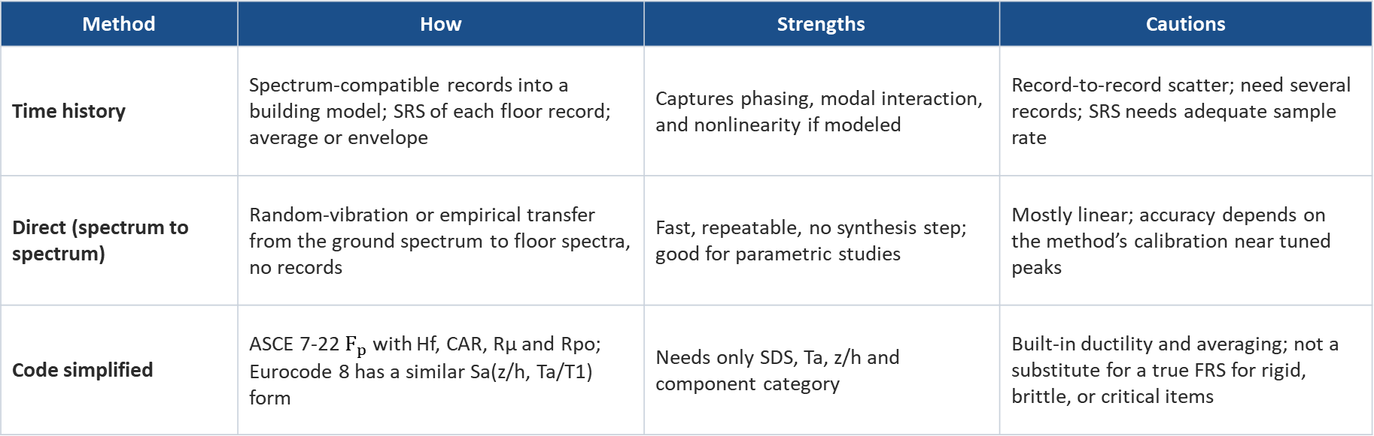
GENERATION METHODS
Vibrationdata
Three ways to get a floor spectrum
Method | How | Strengths | Cautions
Time history | Spectrum-compatible records into a building model; SRS of each floor record; average or envelope | Captures phasing, modal interaction, and nonlinearity if modeled | Record-to-record scatter; need several records; SRS needs adequate sample rate
Direct (spectrum to spectrum) | Random-vibration or empirical transfer from the ground spectrum to floor spectra, no records | Fast, repeatable, no synthesis step; good for parametric studies | Mostly linear; accuracy depends on the method’s calibration near tuned peaks
Code simplified | ASCE 7-22 $F_{p}$ with Hf, CAR, Rμ and Rpo; Eurocode 8 has a similar Sa(z/h, Ta/T1) form | Needs only SDS, Ta, z/h and component category | Built-in ductility and averaging; not a substitute for a true FRS for rigid, brittle, or critical items
Sample-rate rule for the time-history route: at least 10 samples per cycle at the highest spectrum frequency, or an SRS algorithm that handles it (ramp-invariant filter).
Takeaway Use the code form for ordinary components; generate true floor spectra when the component is critical, rigid, brittle, or near a building mode.
34 / 41
Notes:
There are three routes. The time-history route is what we just did: run spectrum-compatible records through a building model and compute the SRS of each floor record. It is the most general and can include nonlinearity, but it has record-to-record scatter, so practice uses several records. The direct methods, going back to Singh in the 1970s and developed by many researchers since, map the ground spectrum to floor spectra through random vibration theory or calibrated transfer functions, with no records. They are fast and repeatable but mostly linear. The code route is ASCE 7-22 Chapter 13, or the similar Eurocode 8 expression. It is appropriate for ordinary components, but it contains ductility and averaging assumptions, so for rigid, brittle, or functionally critical equipment a real floor spectrum is the better basis. One numerical point: for the SRS itself use at least ten samples per cycle at the highest frequency.

Slide 35
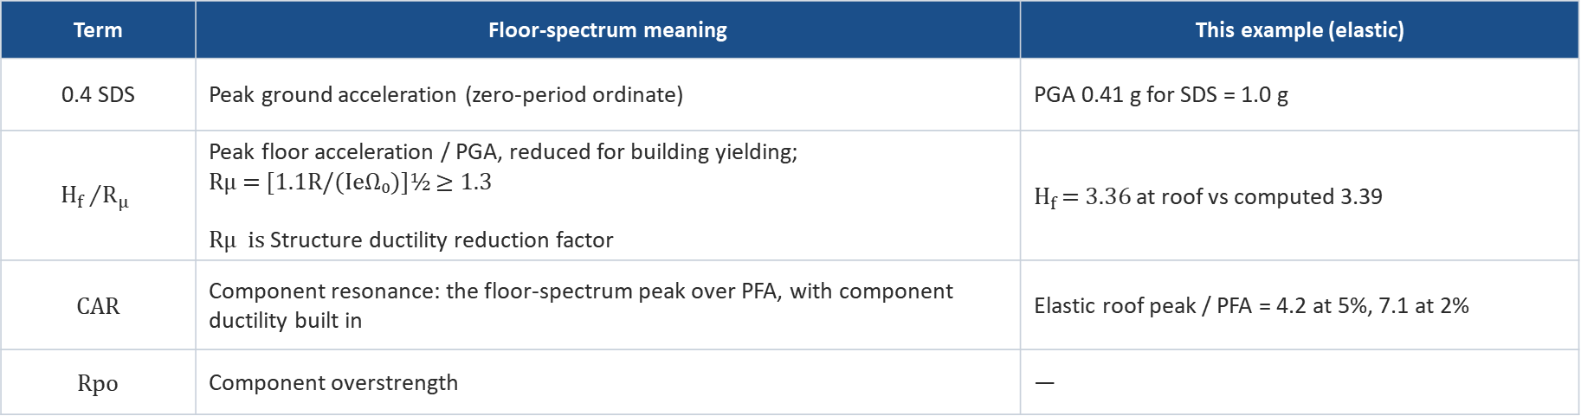
CODE PRACTICE
Vibrationdata
ASCE 7-22 Chapter 13 in floor-spectrum terms
Fp = 0.4 SDS Ip Wp · (Hf / Rμ) · (CAR / Rpo), 0.3 SDS Ip Wp ≤ Fp ≤ 1.6 SDS Ip Wp
Term | Floor-spectrum meaning | This example (elastic)
0.4 SDS | Peak ground acceleration (zero-period ordinate) | PGA 0.41 g for SDS = 1.0 g
$${H_{f }}/{R_{μ}}$$ | Peak floor acceleration / PGA, reduced for building yielding; Rμ = [1.1R/(IeΩ₀)]½ ≥ 1.3 Rμ is Structure ductility reduction factor | $H_{f }$= 3.36 at roof vs computed 3.39
CAR | Component resonance: the floor-spectrum peak over PFA, with component ductility built in | Elastic roof peak / PFA = 4.2 at 5%, 7.1 at 2%
Rpo | Component overstrength | —
Chapter 13 also permits peak floor accelerations and floor spectra from modal or response history analysis of the building; tabulated CAR values sit well below the elastic tuned ratios above.
Takeaway Read the ASCE 7-22 equation as a simplified floor spectrum: PGA × height amplification × resonance amplification.
35 / 41
Notes:
The ASCE 7-22 component force equation maps directly onto floor spectrum concepts. 0.4 SDS is the peak ground acceleration. Hf over R mu is the peak floor acceleration ratio, reduced when the building yields. CAR, the component resonance ductility factor, plays the role of the floor spectrum peak divided by the peak floor acceleration, with component ductility and non-exact tuning built in. In our elastic example that ratio is 4.2 at 5 percent damping and 7.1 at 2 percent, well above the tabulated CAR values. That is not a code error. It reflects the ductility and statistical assumptions behind the table. But it tells you where the simplified method is least appropriate: rigid or brittle anchorage, or functionally critical equipment tuned to a building mode. Chapter 13 allows floor accelerations and spectra from building analysis for those cases. Check the edition in force for the exact CAR table values and limits.

Slide 36
EQUIPMENT–STRUCTURE INTERACTION
Vibrationdata
Heavy tuned equipment talks back to the floor
What the 2-DOF result shows
Decoupled FRS peak at f₁: 10.4 g
Mass ratio 0.1%: coupled 9.2 g (−12%)
1%: 6.4 g (−38%); the pair splits to 1.87 and 2.14 Hz
10%: 3.1 g (−70%)
Decoupling criteria (ASCE 4, SRP 3.7.2)
Rm < 0.01: decouple at any frequency
0.01 to 0.1: decouple if Rf < 0.8 or > 1.25
Rm > 0.1: include the component in the model
Takeaway Decoupled floor spectra are conservative for tuned equipment but can mislead for the slab and nearby items once Rm exceeds ~1%.
36 / 41
Notes:
The floor spectrum assumes the equipment does not affect the floor, which is true only for light equipment. Here I attached a 2 percent damped oscillator to the roof, tuned exactly to the 2 hertz building mode, and solved the coupled system. With a mass ratio of 0.1 percent of the building mass, the coupled peak is 12 percent below the decoupled floor spectrum value of 10.4 g. At 1 percent it is 38 percent lower, and the tuned pair splits into modes at 1.87 and 2.14 hertz; this is the tuned mass damper effect. At 10 percent the reduction is 70 percent. The ASCE 4 and SRP 3.7.2 criteria use the mass ratio Rm and the frequency ratio Rf. Decoupling is conservative for the tuned item itself. But the split modes move the floor spectrum peaks for other items on the same floor, and heavy equipment changes slab demands, so above about 1 percent include the equipment in the model.

Slide 37
BEYOND ONE HORIZONTAL SPECTRUM
Vibrationdata
Directions, location in plan, and relative motion
Three components
Vertical
Plan location
Generate FRS for each direction at each location
Combine responses by SRSS or
100-40-40 (next slide)
Keep the component’s own axes in mind
Rigid-column assumption gives vertical FRS near the ground spectrum
Slab vertical modes (often 8–25 Hz) amplify strongly at midspan
Use FRS at the actual mounting point
Torsion raises edge and corner demands
Flexible diaphragms add their own peak
One spectrum per floor is a simplification
Level | Peak displacement relative to ground (mm) | Peak story drift (mm)
1 | 22 | 22
2 | 43 | 21
3 | 60 | 17
4 | 73 | 13
Roof | 80 | 7
Seismic anchor motion
A riser anchored at grade and roof sees 80 mm of differential motion
An FRS says nothing about this; it is a separate displacement load case
Combine inertial (FRS) and anchor-motion stresses by absolute sum or SRSS
Takeaway Floor spectra cover inertia only; piping, ducts and cable trays that span floors also need the relative displacements.
37 / 41
Notes:
A single horizontal floor spectrum is only part of the demand. You need all three directions at each mounting location, combined by SRSS or the 100-40-40 rule. The vertical direction deserves special care: with rigid columns the vertical floor spectrum is close to the ground spectrum, but slab vertical modes, often 8 to 25 hertz, amplify strongly at midspan, so equipment on a slab bay needs a spectrum at that point. In plan, torsion raises demands at edges and corners. Finally, relative displacement. In our example the roof moves 80 millimeters relative to the ground and the first story drift is 22 millimeters. A riser anchored at grade and roof must accommodate that differential motion. The floor spectrum does not capture it, so seismic anchor motion is a separate load case.

Slide 38
LOAD COMBINATION
Vibrationdata
The 100-40-40 rule for three earthquake directions
The rule
Worked example: anchor bolt tension
R = 1.0 |R_{x}| + 0.4 |R_{y}| + 0.4 |R_{z}|
R = 0.4 |R_{x}| + 1.0 |R_{y}| + 0.4 |R_{z}|
R = 0.4 |R_{x}| + 0.4 |R_{y}| + 1.0 |R_{z}|
R_{x} = 10 kN, R_{y} = 6 kN, R_{z} = 4 kN
Each response (force, stress, displacement) is computed separately for X, Y and Z shaking
Each direction takes the 100 % share in turn; design to the largest of the three
The 40 % reflects that the three components do not peak at the same instant
Accepted alternative to SRSS in ASCE 4 and NRC RG 1.92; ASCE 7 uses the similar 100-30 rule
Design value 14.0 kN, 14 % above SRSS (12.3 kN)
Takeaway Check all three permutations with absolute values; 100-40-40 usually lands a little above SRSS, so it is a slightly conservative choice.
Notes:
The 100-40-40 rule combines the responses to the three orthogonal components of earthquake motion. Compute each response quantity for X, Y and Z excitation separately. Then form three combinations, each giving one direction 100 percent and the other two 40 percent, using absolute values, and design to the largest. The 40 percent reflects that the components are statistically independent and do not peak simultaneously. It traces to Newmark and is accepted in ASCE 4 and NRC Regulatory Guide 1.92 as an alternative to SRSS. Building codes such as ASCE 7 use the similar 100-30 rule for orthogonal horizontal effects. Worked example: anchor tension of 10, 6 and 4 kN from X, Y and Z. The three permutations give 14.0, 11.6 and 10.4 kN, so the design value is 14.0 kN. SRSS gives the square root of 152, or 12.3 kN, so 100-40-40 is about 14 percent higher here. The rule is usually slightly conservative relative to SRSS, but it can be about 1 percent below SRSS when two components are equal and the third is zero.

Slide 39
QUALIFICATION
Vibrationdata
From floor spectrum to qualified component
By analysis
By test
Modal analysis of the component on its actual mounting stiffness
Read the broadened FRS at each component frequency, at component damping
Combine modes (SRSS or CQC) and directions; add the rigid-range ZPA term for missing mass
Add seismic anchor motion; check anchors, welds, and function
Watch frequency error: a component near the broadened plateau gets the peak
Required response spectrum (RRS) = broadened FRS, often with margin
Shake-table test response spectrum (TRS), at the same damping, must envelope the RRS
Multi-frequency random input with adequate strong-motion duration
IEEE 344 for nuclear safety-related equipment; ICC-ES AC156 for ASCE 7 building components
Resonance search before and after; functional checks during and after
Takeaway The floor spectrum is the handoff document between the structural analyst and the equipment qualifier.
39 / 41
Notes:
Once you have a broadened floor spectrum, qualification goes one of two ways. By analysis: model the component on its real mounting stiffness, read spectral accelerations at its frequencies and damping, combine modes and directions, include the rigid-range term for the missing mass, and add seismic anchor motion. By test: the broadened floor spectrum, usually with a margin, becomes the required response spectrum. The shake-table test response spectrum, computed at the same damping, must envelope it, with adequate strong-motion duration. IEEE 344 governs nuclear safety-related equipment, and ICC-ES AC156 is the common acceptance criterion for building components under ASCE 7. Either way, the floor spectrum is the handoff document between the building analyst and the equipment qualifier.

Slide 40
CHECKLIST
Vibrationdata
Common floor-spectrum mistakes
Input and building model
Spectrum and component
Qualifying rooftop or upper-floor equipment to the site ground spectrum
Using building damping instead of component damping
Skipping peak broadening, or broadening only the first peak
Truncating to mode 1; mode 2 governs the lower floors here
Relying on a single ground motion with a notch near a building frequency
Ending the spectrum before the rigid range (ZPA)
ZPA (zero period acceleration) is the value a response spectrum flattens out to at high frequency. It is the spectral acceleration of a very stiff oscillator, with period approaching zero, which simply rides along with its base.
Too few samples per cycle in the SRS calculation
Ignoring vertical slab flexibility at the mounting point
Decoupling equipment above about 1% of the supporting mass
Forgetting relative displacements between supports
Takeaway Most errors come from treating a floor like the ground: the floor is narrowband, peaked, and damping-sensitive.
40 / 41
Notes:
Here is a checklist of the common mistakes. On the input and building side: using the ground spectrum for upper-floor equipment, using building damping instead of component damping, skipping or only partially applying peak broadening, truncating to one mode, and relying on one ground motion that may have a notch near a building frequency. On the spectrum and component side: stopping the spectrum before the rigid range, poor sample rate in the SRS calculation, ignoring slab vertical flexibility, decoupling heavy equipment, and forgetting relative support displacements. Nearly all of these come from treating the floor as if it were the ground.

Slide 41
Vibrationdata
SUMMARY AND REFERENCES
The building is the first filter
Roof PFA 3.4× PGA
ASCE 7-22 Hf matched it at the roof (3.36 vs 3.39)
Tuned roof peak 5.9 g at 5% and 9.9 g at 2%, vs 1.0 g on the ground spectrum
2%/5% ratio 1.67 on the roof vs 1.23 on the ground
±15% broadening turns the spike into a 1.7–2.35 Hz plateau
A tuned item at 1% of building mass sees 38% less than the decoupled FRS
ASCE/SEI 7-22, Chapter 13: Seismic Design Requirements for Nonstructural Components
ASCE/SEI 4-16, Seismic Analysis of Safety-Related Nuclear Structures
USNRC Regulatory Guide 1.122, Development of Floor Design Response Spectra
USNRC SRP 3.7.2, Seismic System Analysis
IEEE 344, Seismic Qualification of Equipment for Nuclear Power Generating Stations
ICC-ES AC156, Seismic Certification by Shake-Table Testing of Nonstructural Components
Smallwood, D.O., An Improved Recursive Formula for Calculating Shock Response Spectra, 1981
Singh, M.P., Generation of Seismic Floor Spectra, J. Eng. Mech. Div., ASCE, 1975
Generic five-story teaching model; not a real building. Spectra computed with the ramp-invariant recursive filter used in the Vibrationdata SRS tools.
Notes:
To summarize with the numbers from the worked example. The roof peak floor acceleration was 3.4 times the peak ground acceleration, and the ASCE 7-22 height factor matched it at the roof. A tuned roof component saw 5.9 g at 5 percent damping and 9.9 g at 2 percent, against 1.0 g on the ground spectrum. Damping sensitivity is much larger on the floor. Broadening plus or minus 15 percent turns the spike into a plateau. And heavy tuned equipment reduces its own response through interaction. The references listed are the main standards and two classic papers: Smallwood for the SRS algorithm and Singh for direct floor spectrum generation.

