Slide 1
Vibrationdata
ASCE 7-22, Ch 13, Requirements for Nonstructural Components
Revision C
By Tom Irvine

Slide 2
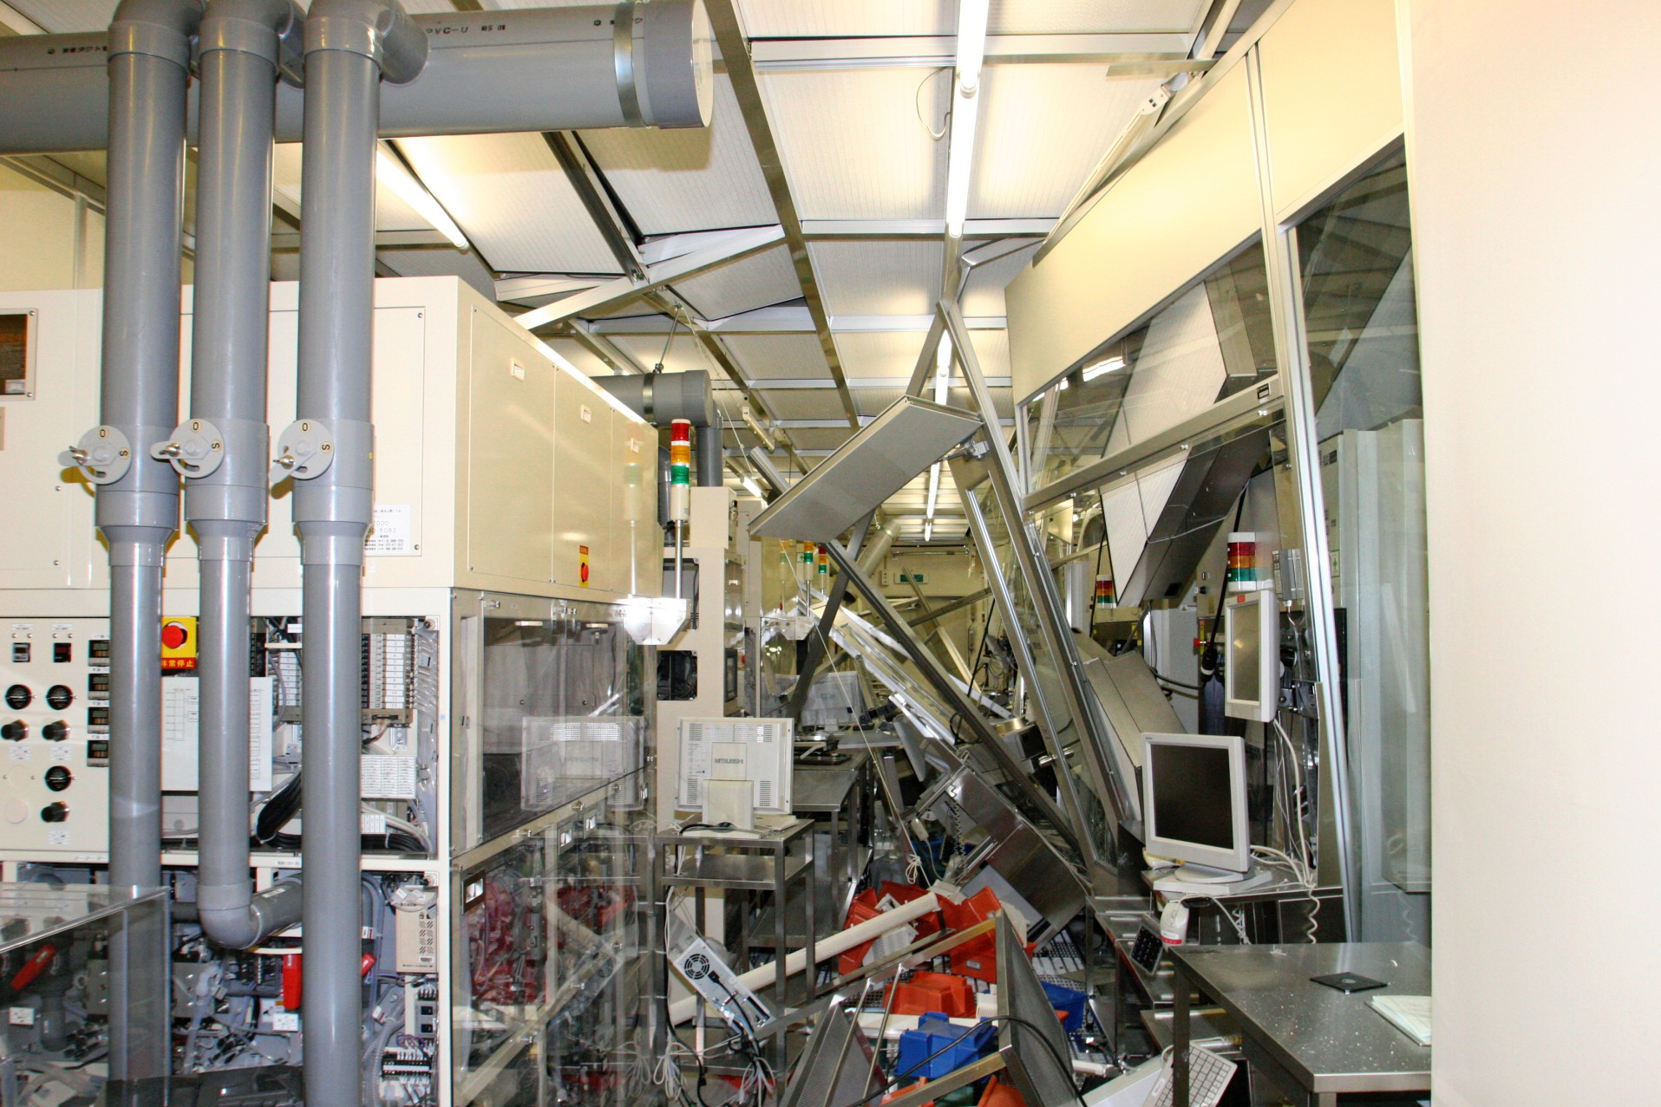
Vibrationdata
Introduction
Structural collapse is rare in modern codes
Most earthquake losses come from nonstructural damage
Damage causes:
  injuries
  building shutdowns
  fire protection failure
  economic loss
2011 Tōhoku Japan Earthquake
Semiconductor plant
https://asia.nikkei.com/business/business-trends/japanese-manufacturers-capitalize-on-the-lessons-from-3-112

Slide 3
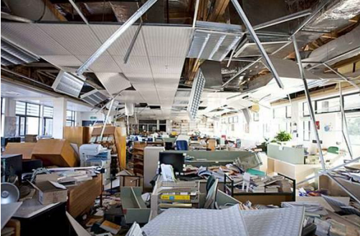
Vibrationdata
Nonstructural Component Types
Nonstructural components include:
  Mechanical equipment
  Electrical equipment
  Light fixtures
  Architectural components
  Piping and ducts
  Ceilings and partitions
  Storage racks
  Heating, Ventilation & Air Conditioning (HVAC)
  Elevators & escalator
2011 Christchurch, New Zealand earthquake
https://www.bhbengineers.com/articles/seismic-bracing-of-non-structural-components

Slide 4
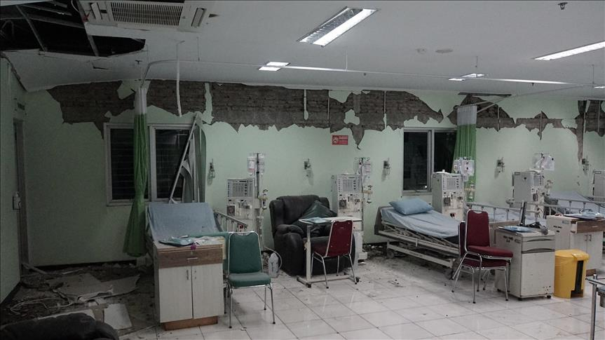
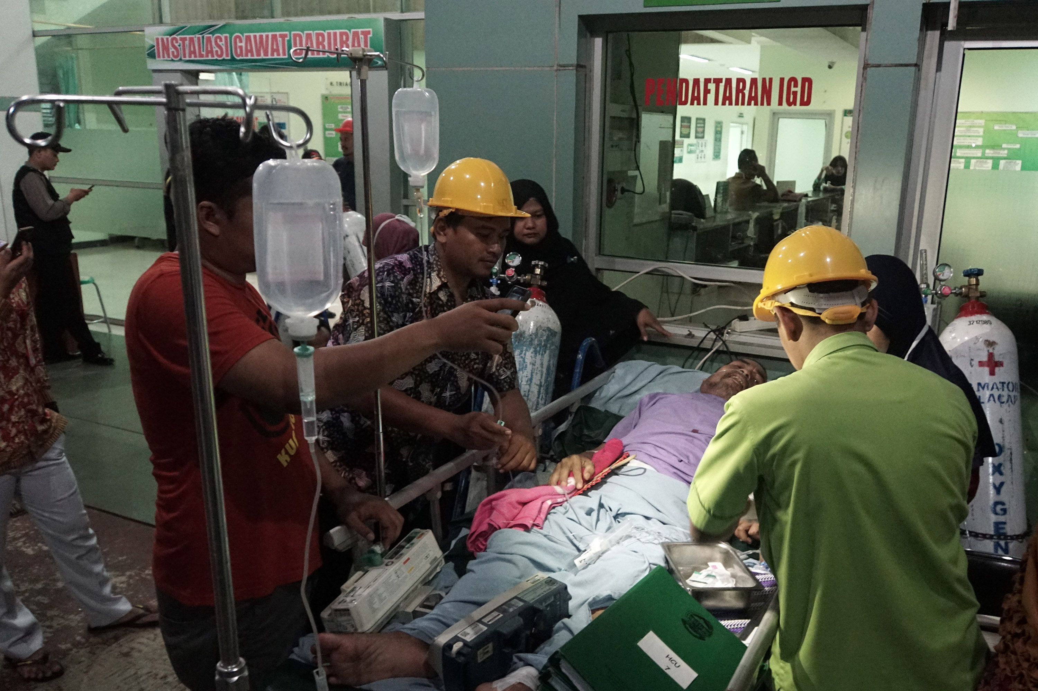
Vibrationdata
Nonstructural Damage
Earthquake performance is not only about preventing collapse
Nonstructural damage can cause:
  Hospital shutdowns
  Loss of emergency services
  Fire protection system failure
  Data center outages
  Economic losses
Central Java, Indonesia, December 16, 2017, Magnitude 6.9
https://www.aa.com.tr/en/asia-pacific/two-dead-buildings-damaged-by-indonesia-earthquake/1006495

Slide 5
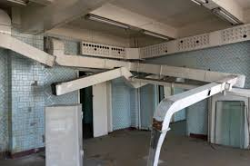
Nonstructural Components
Vibrationdata
Architectural Components
  Ceilings
  Partitions
  Facades
  Cladding
  Lighting
Mechanical Components
  HVAC equipment
  Pumps
  Boilers
  Chillers
Electrical Components
  Switchgear
  Transformers
  Control panels
Distribution Systems
  Piping
  Ductwork
  Cable trays
https://blog.qrfs.com/329-seismic-bracing-for-ductwork-hvac-electrical-systems/

Slide 6
Elevators as Nonstructural Components
Vibrationdata
machine
Elevators and escalators are nonstructural components under ASCE 7 Chapter 13
Designed to ASME A17.1, Safety Code for Elevators and Escalators, with ASCE 7 additions
Machinery, controllers, guide rails and brackets are designed for Fp from the elevator entry in Table 13.6-1
Seismic switch: when it trips, the car goes to a landing, opens its doors and shuts down until inspected
Retainer plates on the car and counterweight keep them on their guide rails
counter-
weight
retainer
plates
car
San Fernando, 1971
Awkward fit for Fp
guide
rails
Hundreds of counterweights came off their rails, and some struck cars. California then adopted elevator seismic rules, later carried into ASME A17.1. Seen again in Northridge 1994 and Chile 2010.
Spans the full height, so there is no single z. Rails are loaded by interstory drift as well as acceleration. The counterweight is a mass on a flexible rail: a resonance case for CAR.
hoistway
Schematic, not to scale

Slide 7
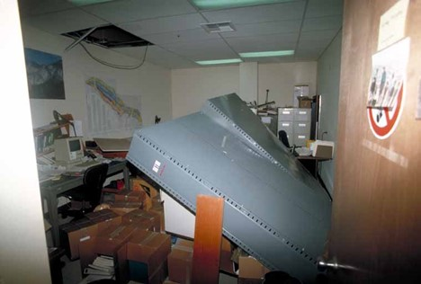
Nonstructural Components Failure Modes
Component | Typical Failure
Suspended ceilings | Grid collapse
HVAC units | Sliding or overturning
Piping | Joint rupture
Fire sprinklers | Pipe separation
Equipment racks | Toppling
https://www.jdsupra.com/legalnews/major-earthquakes-what-to-expect-during-8852622/

Slide 8
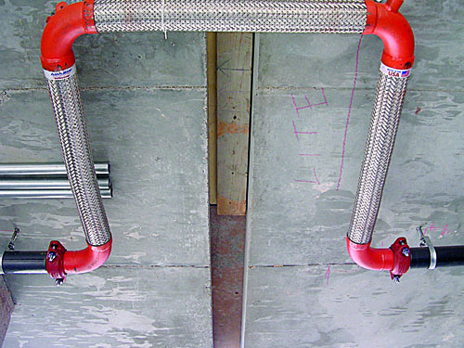
Seismic Joint for Fire Sprinkler Pipes
The expansion sections have a braided metal outer layer
The inner layer is typically corrugated stainless steel
National Fire Protection Association NFPA 13, Standard for the Installation of Sprinkler Systems
https://www.nfpa.org/news-blogs-and-articles/blogs/2021/03/19/introduction-to-seismic-protection-for-sprinkler-systems

Slide 9
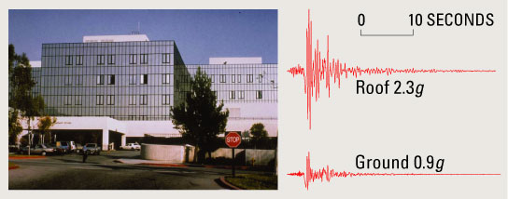
Vibrationdata
Floor Acceleration Amplification
Components see floor acceleration, not ground acceleration
Location | Approximate Acceleration
Base | 1.0 × ground
Mid height | 1.5 ×
Roof | 2–3 ×
Olive View Hospital, Northridge Earthquake 1994

Slide 10
Vibrationdata
Seismic Design Force for Components

Slide 11
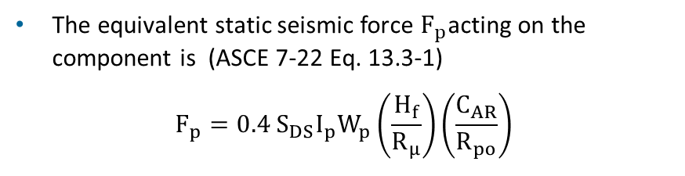
Vibrationdata
Seismic Design Force for Components
The equivalent static seismic force $F_{p}$acting on the component is (ASCE 7-22 Eq. 13.3-1)
$$F_{p}=0.4 S_{DS}I_{p}W_{p}\left(\frac{H_{f}}{R_{μ}}\right)\left(\frac{C_{AR}}{R_{po}}\right)$$
The equation is essentially Newton’s law F = ma
It is the core of Chapter 13
Peak ground acceleration PGA ≈ 0.4 S_{DS}
ASCE 7-22 replaces the 7-16 form
0.4 a_{p}S_{DS}W_{p}(1 + 2z/h)/(R_{p}/I_{p})
SDC A: Essentially no nonstructural seismic requirements
SDC B: Only critical components (I_{p} = 1.5)
SDC C: Critical components + some architectural items
SDC D–F: Almost everything must be designed for seismic
Symbol | Description
W_{p} | component operating weight
S_{DS} | design spectral acceleration, short period
I_{p} | component importance factor
H_{f} | height amplification factor (z, h, T_{a})
R_{μ} | structure ductility reduction factor
C_{AR} | component resonance ductility factor
R_{po} | component strength factor

Slide 12
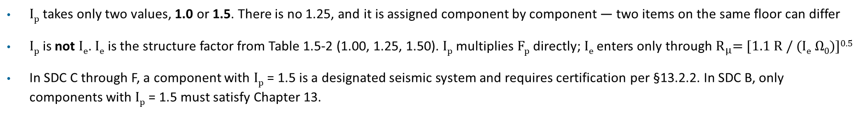
Component Importance Factor I_{p}
Vibrationdata
I_{p} | Condition (ASCE 7-22 §13.1.3) | Typical Examples
1.5 | Required to function for life-safety purposes after an earthquake | Fire protection sprinkler systems, egress stairways, emergency lighting
1.5 | Conveys, supports or contains toxic, highly toxic or explosive substances above the threshold quantity set by the authority having jurisdiction | Bulk chemical piping, compressed gas storage
1.5 | In or attached to a Risk Category IV structure and needed for continued operation, or whose failure could impair continued operation | Hospital standby generator, fire station communications, essential HVAC
1.5 | Contains hazardous substances and is attached to a structure classified by the authority having jurisdiction as a hazardous occupancy | Process equipment in a hazardous occupancy
1.0 | All other components | Ordinary HVAC, partitions, office and laboratory equipment, signage
I_{p} takes only two values, 1.0 or 1.5. There is no 1.25, and it is assigned component by component — two items on the same floor can differ
I_{p} is not I_{e}. I_{e} is the structure factor from Table 1.5-2 (1.00, 1.25, 1.50). I_{p} multiplies F_{p} directly; I_{e} enters only through $R_{μ}$= [1.1 R / (I_{e} Ω₀)]^{0.5}
In SDC C through F, a component with I_{p} = 1.5 is a designated seismic system and requires certification per §13.2.2. In SDC B, only components with I_{p} = 1.5 must satisfy Chapter 13.

Slide 13
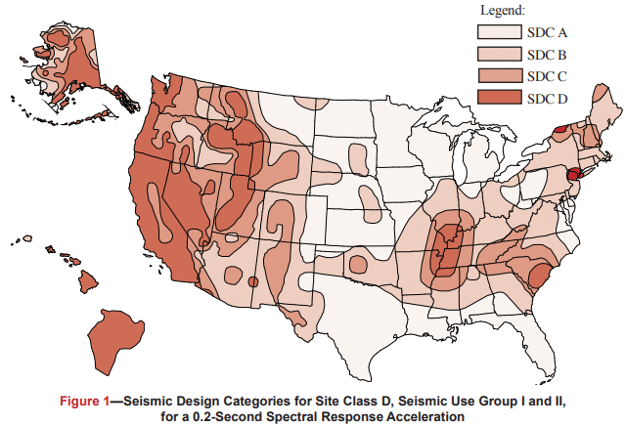
Vibrationdata
Seismic Hazard Map
Each figure is based on Site Class D (the default class when the soil profile is not known) and is applicable to structures assigned to Occupancy Categories I, II, and III (buildings other than high hazard exposure structures)
Note that if the soil profile is known and is lower than D, a correspondingly lower SDC may be realized
https://www.cmha.org/resource/tek-14-18b/

Slide 14
Vibrationdata
Seismic Design Categories (SDC)
Seismic Design Category (SDC) | Applicability of ASCE 7-22 Chapter 13 (Nonstructural Components) | Key Requirements / Exemptions
A | Chapter 13 does not apply | Essentially exempt. Only a simple lateral force requirement (§1.4) applies.
B | Limited applicability | Only components with Ip = 1.5 (life-safety or post-earthquake critical components) must be seismically designed. Ordinary components (Ip = 1.0) are exempt.
C | Moderate applicability | All mechanical and electrical components with Ip = 1.5 must comply. Certain architectural components (parapets, exterior wall elements, etc.) also apply. Most ordinary equipment (Ip = 1.0) still exempt.
D, E, F | Full applicability | Virtually all nonstructural components must meet Chapter 13 requirements. Exemptions limited to very small/light items (§13.1.4).

Slide 15
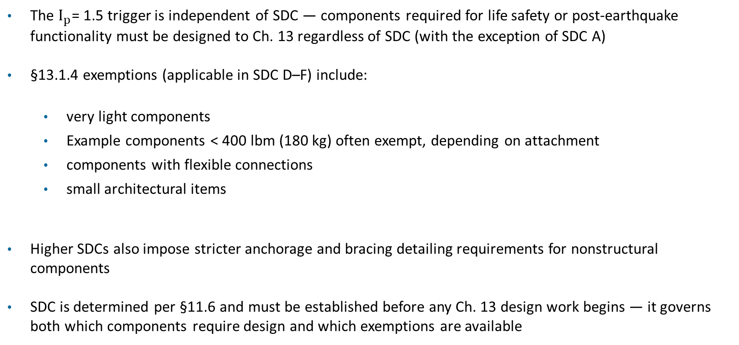
Vibrationdata
Factors
The $I_{p}$= 1.5 trigger is independent of SDC — components required for life safety or post-earthquake functionality must be designed to Ch. 13 regardless of SDC (with the exception of SDC A)
§13.1.4 exemptions (applicable in SDC D–F) include:
  very light components
  Example components < 400 lbm (180 kg) often exempt, depending on attachment
  components with flexible connections
  small architectural items
Higher SDCs also impose stricter anchorage and bracing detailing requirements for nonstructural components
SDC is determined per §11.6 and must be established before any Ch. 13 design work begins — it governs both which components require design and which exemptions are available

Slide 16

Vibrationdata
Component Strength Factor R_{po}
Effect | ASCE 7-16 | ASCE 7-22
Floor amplification with height | 1 + 2z/h | H_{f}
Component resonance | a_{p} | C_{AR}
Component ductility | R_{p} | C_{AR}
Component overstrength | R_{p} | R_{po}
Building ductility | none | R_{μ}
The equivalent static seismic force F_{p} acting on the component is (ASCE 7-22 Eq. 13.3-1)
$$F_{p}=0.4 S_{DS}I_{p}W_{p}\left(\frac{H_{f}}{R_{μ}}\right)\left(\frac{C_{AR}}{R_{po}}\right)$$
R_{po} is the component strength factor: the reserve strength of the component and its attachments above the design level
In ASCE 7-16, R_{p} combined ductility and overstrength
ASCE 7-22 splits them: ductility moves into C_{AR}, overstrength stays in R_{po}
R_{po} is in the denominator, so a higher R_{po} gives a lower design force
R_{po} values are much smaller than the old R_{p} values (up to 6)
Entering a 7-16 R_{p} as R_{po} can understate F_{p} by a factor of 3 or more
Take C_{AR} and R_{po} together from the same row of Table 13.5-1 (architectural) or Table 13.6-1 (mechanical and electrical)

Slide 17

Vibrationdata
Component Resonance Ductility Factor C_{AR}
The equivalent static seismic force $F_{p}$acting on the component is (ASCE 7-22 Eq. 13.3-1)
$$F_{p}=0.4 S_{DS}I_{p}W_{p}\left(\frac{H_{f}}{R_{μ}}\right)\left(\frac{C_{AR}}{R_{po}}\right)$$
C_{AR} accounts for amplification of the floor motion by the component’s own flexibility, reduced by its ability to deform inelastically
A component that moves in sync with the floor sees little amplification; one that resonates with the building sees much more
C_{AR} is in the numerator, so a higher C_{AR} gives a higher design force
Tables 13.5-1 and 13.6-1 list C_{AR} in two columns: components supported at or below grade, and components supported above grade
C_{AR} replaces a_{p} and takes over the ductility part of the old R_{p}
Component behavior | Effect on C_{AR}
Rigid, moves with the floor | lowest
Resonant, high ductility | reduced by ductility
Resonant, limited ductility | highest
Vibration isolated | high (resonant by design)
Supported at or below grade | separate, lower column

Slide 18
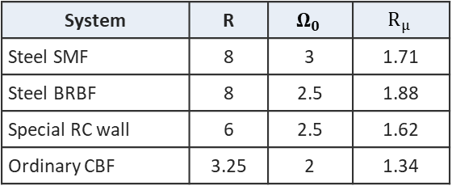
Typical Values for the F_{p} Terms
Vibrationdata
Term | Typical values | Source / note
W_{p} | Operating weight, including contents. Worked examples: 2,000 lb generator, 5,000 lb rooftop chiller | Use full operating weight
H_{f} | 1.0 at grade; about 1.3–2.3 at mid-height; about 2.5–3.5 at the roof | Eq. 13.3-4 uses building Ta; Eq. 13.3-5: 1 + 2.5 z/h if Ta unknown
R_{μ} | 1.0 at or below grade; 1.3 if SFRS unknown; about 1.3–1.9 above grade | Eq. 13.3-6: [1.1R / (IeΩ0)]^½ ≥ 1.3
C_{AR} | 1.0 rigid (e.g. generator); 1.8 / 2.2 vibration-isolated (at or below / above grade) | Table 13.6-1; higher for flexible, limited-ductility items
R_{po} | 1.5 most mechanical and electrical equipment; 1.3 vibration-isolated | Table 13.6-1; component overstrength
H_{f} from Eq. 13.3-4
R_{μ} by building system (Ie = 1)
Resulting F_{p} / (S_{DS}I_{p}W_{p})
Ta | z/h=0 | 0.5 | 1.0
0.2 s | 1.00 | 2.25 | 3.50
0.5 s | 1.00 | 2.00 | 3.36
1.0 s | 1.00 | 1.50 | 2.84
2.0 s | 1.00 | 1.25 | 2.46
System | R | $$Ω_{0}$$ | $$R_{μ}$$
Steel SMF | 8 | 3 | 1.71
Steel BRBF | 8 | 2.5 | 1.88
Special RC wall | 6 | 2.5 | 1.62
Ordinary CBF | 3.25 | 2 | 1.34
Case | Value
Rigid, at grade | 0.27 → 0.30 min
Roof chiller, SMF, Ta 0.6 s | 0.57
Vib-isolated, roof, SFRS unknown | 1.82 → 1.60 max
Bounds: 0.3 ≤ Fp/(SDS Ip Wp) ≤ 1.6. Rμ at Ie = 1.5 drops to about 1.3–1.5. Confirm CAR and Rpo for the specific component in Tables 13.5-1 and 13.6-1.

Slide 19
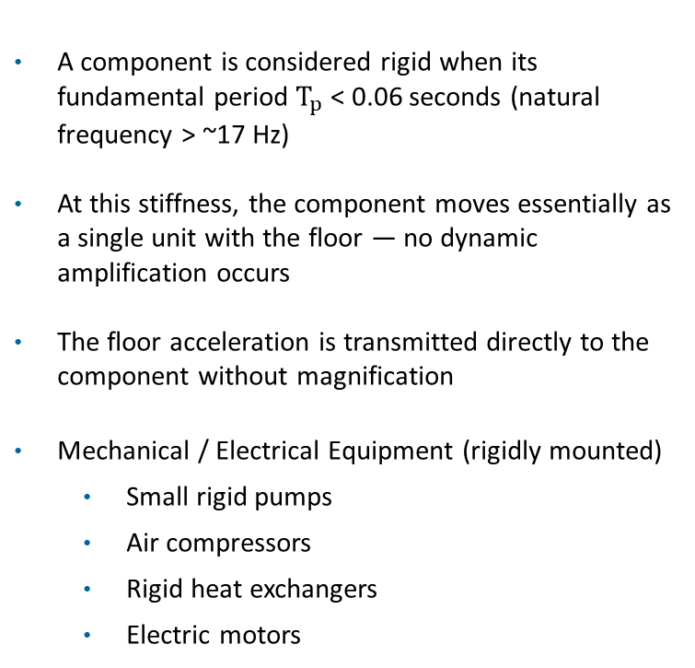
Vibrationdata
Rigid Components
A component is considered rigid when its fundamental period $T_{p}$ < 0.06 seconds (natural frequency > ~17 Hz)
At this stiffness, the component moves essentially as a single unit with the floor — no dynamic amplification occurs
The floor acceleration is transmitted directly to the component without magnification
Mechanical / Electrical Equipment (rigidly mounted)
  Small rigid pumps
  Air compressors
  Rigid heat exchangers
  Electric motors
  Diesel generators Plumbing Equipment
  Water heaters
  Pressure vessels
  Small storage tanks
  Boilers
Electrical Equipment (rigidly mounted)
  Rigid electrical cabinets
  Motor control centers
  Transformers (floor-mounted, rigid)
Architectural / Miscellaneous
  Rigid steel stairways
  Elevator machinery
  Rigidly mounted industrial machines

Slide 20
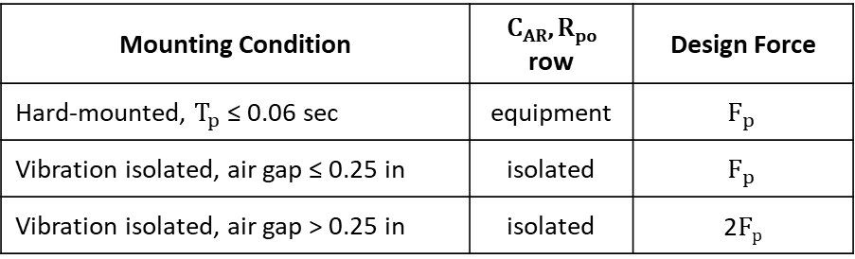
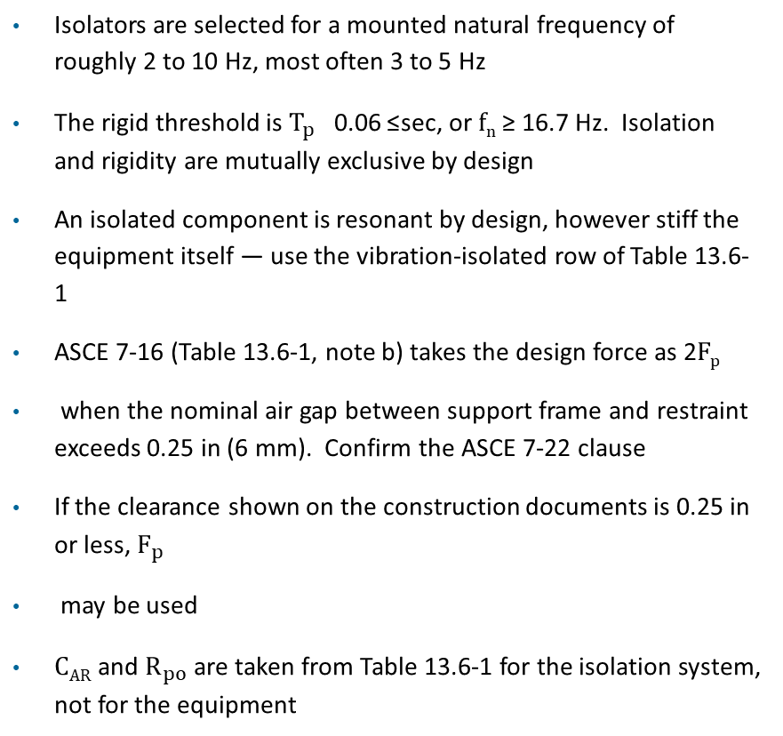
Vibration-Isolated Equipment
Vibrationdata
Isolators are selected for a mounted natural frequency of roughly 2 to 10 Hz, most often 3 to 5 Hz
The rigid threshold is $T_{p}$ ≤ 0.06 sec, or f_{n} ≥ 16.7 Hz. Isolation and rigidity are mutually exclusive by design
An isolated component is resonant by design, however stiff the equipment itself — use the vibration-isolated row of Table 13.6-1
ASCE 7-16 (Table 13.6-1, note b) takes the design force as 2F_{p}
when the nominal air gap between support frame and restraint exceeds 0.25 in (6 mm). Confirm the ASCE 7-22 clause
If the clearance shown on the construction documents is 0.25 in or less, $F_{p}$
may be used
C_{AR} and $R_{po}$ are taken from Table 13.6-1 for the isolation system, not for the equipment
Mounting Condition | C_{AR}, R_{po} row | Design Force
Hard-mounted, $T_{p}$ ≤ 0.06 sec | equipment | $$F_{p}$$
Vibration isolated, air gap ≤ 0.25 in | isolated | $$F_{p}$$
Vibration isolated, air gap > 0.25 in | isolated | 2F_{p}
TYPICALLY ISOLATED
Chillers, air handling units, large fans, pumps on inertia bases, engine-generator sets, cooling towers and rooftop units — any machine mounted on springs or elastomeric pads for noise control
A COMMON SLIDE ERROR
Air compressors, motors, pumps and boilers appear on rigid-component lists, but they are routinely spring-mounted. The list is valid only where the equipment is hard-mounted.

Slide 21
Isolated Equipment — Why the Force Is Doubled
Vibrationdata
THE 2F_{p} FACTOR IS AN IMPACT ALLOWANCE
ISOLATION DOES NOT HELP AGAINST EARTHQUAKE
Seismic displacement demand far exceeds the isolator stroke, so the equipment runs into the snubber
The restraint sees an impact, not a smooth resonant response — something an equivalent static F = ma cannot represent. The factor of 2 is a crude stand-in
The tighter the gap, the less velocity accumulates before contact. That is the reason for the relief at 0.25 in
Elastomeric snubbers and resilient perimeter mounts soften the contact and are preferred over hard steel stops
An isolator that works well against machine vibration at 30 to 60 Hz does almost nothing against an earthquake
Attenuation begins only above √2 f_{n}
For a 4 Hz mount that is about 5.7 Hz, which is above very little of the seismic energy
Seismic floor motion is broadband and concentrated below 10 Hz, so the mount sits in the middle of the input and amplifies rather than isolates
Isolator, snubber, restraint and anchorage must all be designed for the doubled force. Never rely on the isolator itself for seismic support

Slide 22
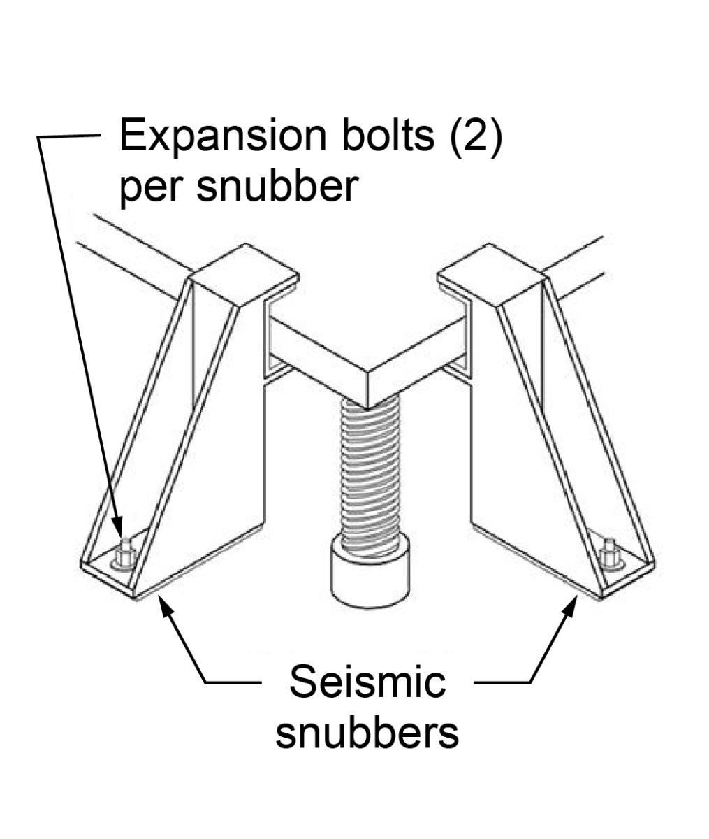
Hard Steel Stop
https://basc.pnnl.gov/images/seismic-snubber-type-bracket-specifically-designed-anchor-heavy-equipment-floor-restrain-it

Slide 23
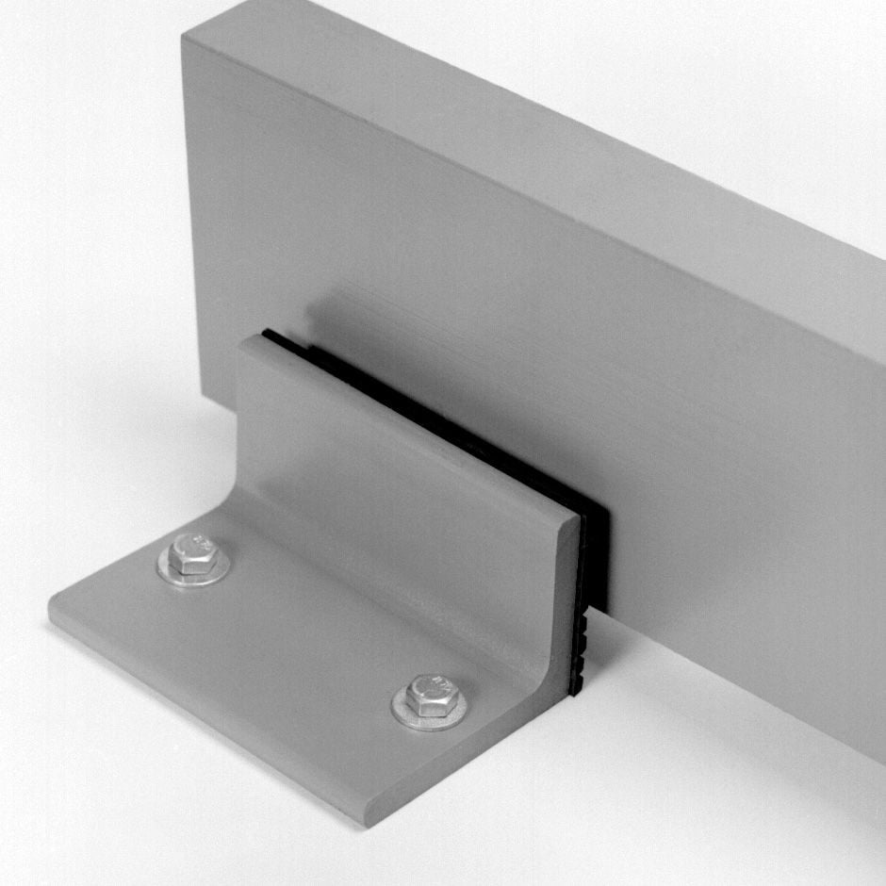
Seismic Snubber
Model HS-1 Seismic Snubbers are designed for use in locations subject to earthquakes and other external forces which could displace resiliently supported equipment.
Snubbers, when anchored to the building structure and placed around vibration-isolated equipment, are intended to limit motion by containing the supported equipment.
HS-1 Snubbers are designed to be used in a minimum quantity of four and will keep supported equipment contained when subjected to lateral forces from any direction.
HS-1 Snubbers are not designed for use with high center-of-gravity supported equipment or where vertical forces must be considered.
Kinetics Model HS-1 Snubbers are heavy structural steel weldments designed to minimize equipment motion.
A resilient neoprene pad on the contact surface reduces shock loads by cushioning the impacts.
Large diameter anchor bolt holes allow loads to be safely transferred to the building structure.
https://kineticsnoise.com/seismic/snubber-hs1

Slide 24
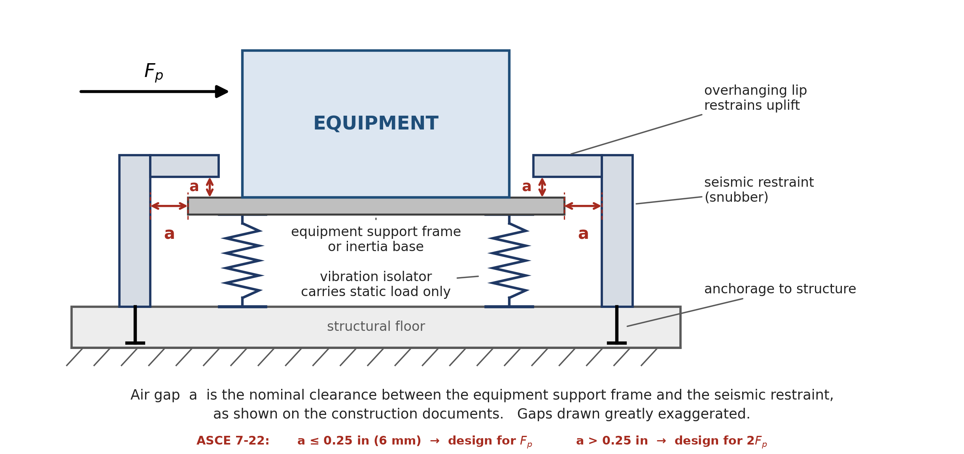
Separate Seismic Snubbers
Vibrationdata
The snubber is a separate bracket anchored to the floor beside the equipment, independent of the isolator
The gap is set in the field, so it can be measured and adjusted — and it can drift
One at each corner. The lip must overhang the base to restrain uplift
Usual choice for inertia bases and large floor-mounted equipment
Inspect after installation
A gap left above 0.25 in doubles the design force
F_{p} is from ASCE 7-22 Eq. 13.3-1, with C_{AR} and R_{po} for the vibration-isolated row of Table 13.6-1
The 2F_{p} air-gap rule carries over from ASCE 7-16 (Table 13.6-1, note b)
Confirm the governing ASCE 7-22 clause

Slide 25
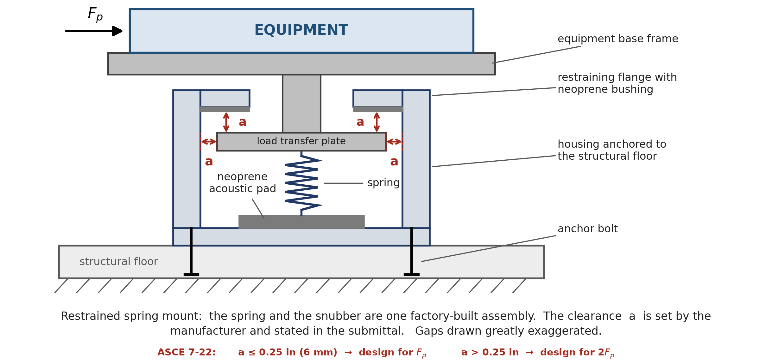
Restrained Spring Mounts
Vibrationdata
Spring and snubber are one factory-built assembly, so isolation and restraint share a single load path
The clearance is set by the manufacturer and stated in the submittal — cite that number rather than assuming it
Two clearances to check: lateral around the load transfer plate, and vertical under the restraining flange
Neoprene bushings soften the contact against the flange
Preferred where space is tight or field setting is unreliable. Common on packaged and curb-mounted equipment
F_{p} is from ASCE 7-22 Eq. 13.3-1, with C_{AR} and R_{po} for the vibration-isolated row of Table 13.6-1
The 2F_{p} air-gap rule carries over from ASCE 7-16 (Table 13.6-1, note b)
Confirm the governing ASCE 7-22 clause

Slide 26
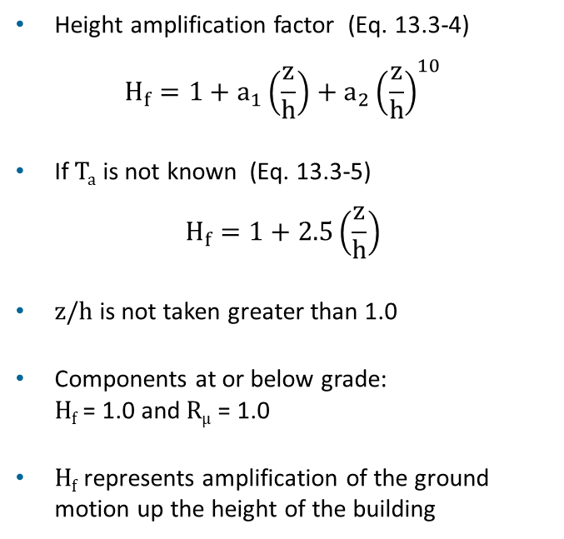
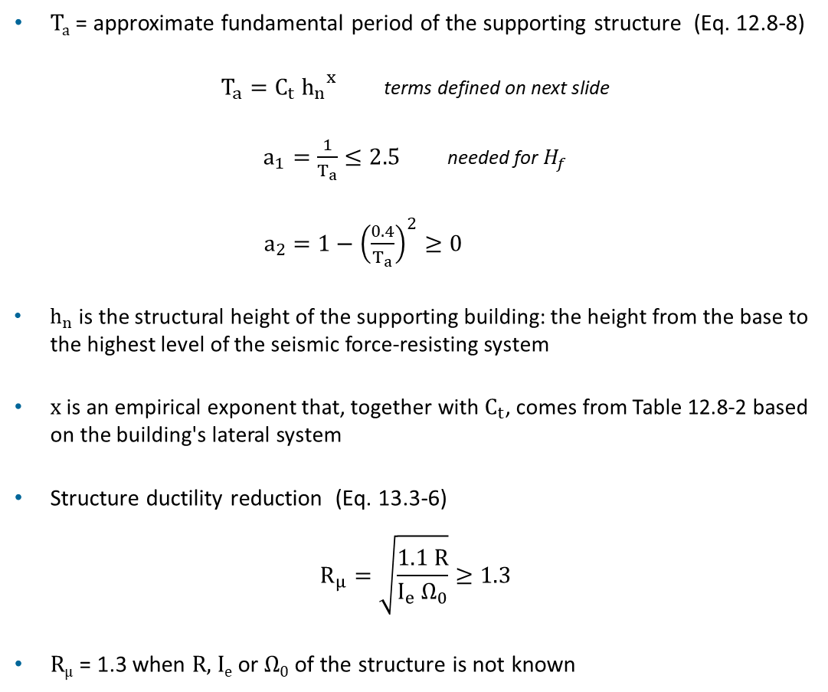
Height Factor H_{f} and Structure Ductility R_{μ}
Vibrationdata
T_{a} = approximate fundamental period of the supporting structure (Eq. 12.8-8)
$T_{a}=C_{t} {h_{n}}^{x}$ terms defined on next slide
$a_{1}=\frac{1}{T_{a}}≤2.5$ needed for $H_{f}$
$a_{2}=1−{\left(\frac{0.4}{T_{a}}\right)}^{2}≥0$
$h_{n}$is the structural height of the supporting building: the height from the base to the highest level of the seismic force-resisting system
x is an empirical exponent that, together with $C_{t}$, comes from Table 12.8-2 based on the building's lateral system
Structure ductility reduction (Eq. 13.3-6)
$$R_{μ}=\sqrt{\frac{1.1 R}{I_{e} Ω_{0}}}≥1.3$$
R_{μ} = 1.3 when R, I_{e} or Ω₀ of the structure is not known
Height amplification factor (Eq. 13.3-4)
$$H_{f}=1+a_{1}\left(\frac{z}{h}\right)+a_{2}{\left(\frac{z}{h}\right)}^{10}$$
If T_{a} is not known (Eq. 13.3-5)
$$H_{f}=1+2.5\left(\frac{z}{h}\right)$$
z/h is not taken greater than 1.0
Components at or below grade:
H_{f} = 1.0 and R_{μ} = 1.0
H_{f} represents amplification of the ground motion up the height of the building

Slide 27
Review: z, h, R, Ω₀ and I_{e}
Vibrationdata
Term | Definition | Typical values
z | Height of the component attachment point above the base. Take z = 0 at or below the base. | 0 to h
h | Average roof height of the structure above the base. z/h is not taken greater than 1.0. | Building dependent
R | Response modification coefficient of the building seismic force-resisting system (Table 12.2-1). Reflects ductility and energy dissipation. | 3 to 8 Steel SMF 8, special RC wall 6, ordinary CBF 3.25
Ω₀ | Overstrength factor (Table 12.2-1). Ratio of actual lateral strength to design strength. | 2 to 3 Typically, 2.5
I_{e} | Building importance factor, set by Risk Category (Table 1.5-2). | 1.0 (RC I, II) 1.25 (RC III) 1.5 (RC IV)
roof
component
h
z
Higher R lowers the floor accelerations because the building yields first, so R_{μ} rises. Higher I_{e} or Ω₀ keeps the building closer to elastic, so R_{μ} falls.
base (grade)

Slide 28
Vibrationdata
Approximate Period Coefficients C_{t} and x
Approximate fundamental period of the supporting structure (ASCE 7-22 Eq. 12.8-8)
$$T_{a}=C_{t} {h_{n}}^{x}$$
Structure type (Table 12.8-2) | C_{t} (h_{n} in ft) | C_{t} (h_{n} in m) | x
Steel moment-resisting frames | 0.028 | 0.0724 | 0.8
Concrete moment-resisting frames | 0.016 | 0.0466 | 0.9
Steel eccentrically braced and buckling-restrained braced frames | 0.03 | 0.0731 | 0.75
All other structural systems | 0.02 | 0.0488 | 0.75
h_{n} = structural height: base to the highest level of the seismic force-resisting system
Moment-frame rows apply when the frames resist 100% of the seismic force and are not enclosed or adjoined by stiffer components
Example: 60 ft steel moment frame, T_{a} = 0.028 (60)^{0.8} = 0.74 sec
T_{a} sets a₁ = 1/T_{a} and a₂ = 1 − (0.4/T_{a})² in the component height factor H_{f}

Slide 29
Energy Interpretation
Elastic system:
  Earthquake energy → stored as elastic strain → large forces
Ductile system:
  Earthquake energy → plastic deformation + friction → smaller forces
Seismic design codes intentionally allow controlled damage because ductility dissipates earthquake energy

Slide 30
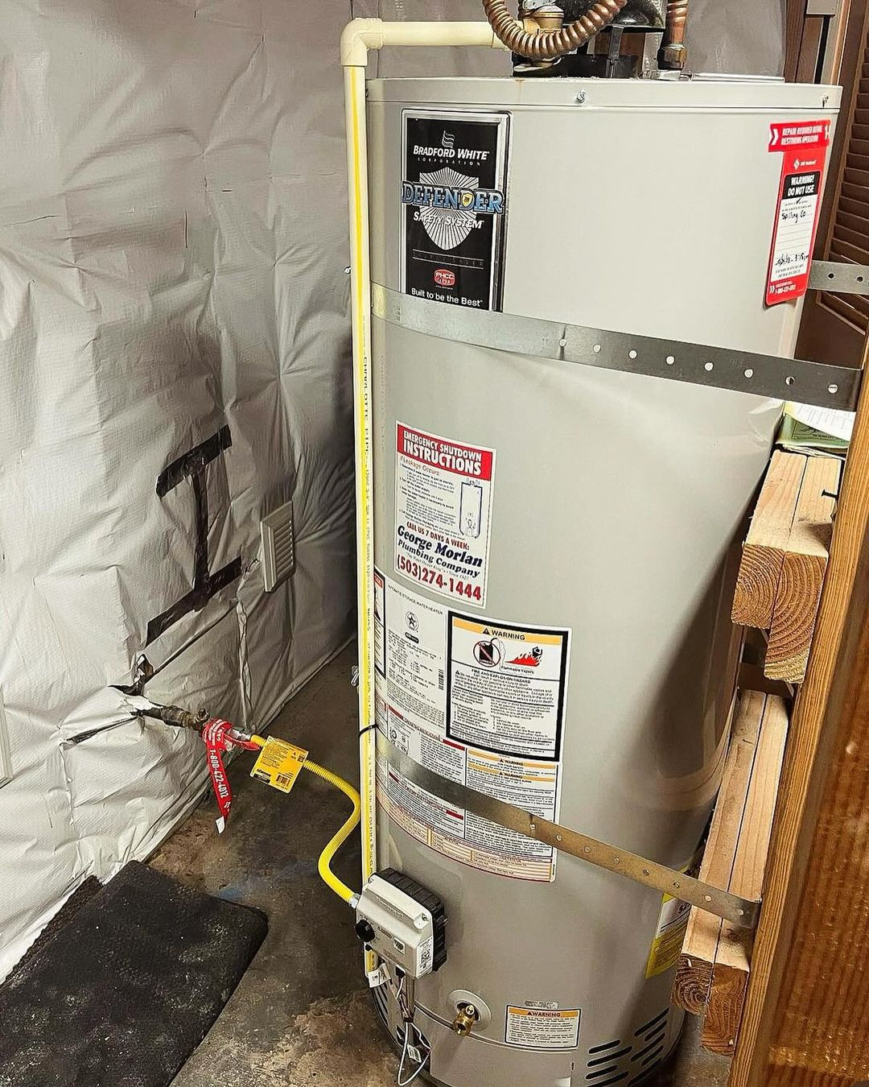
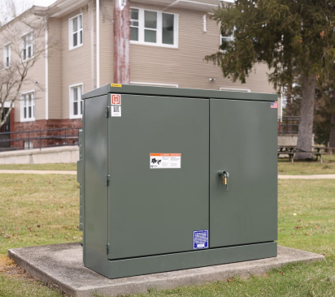
Rigid Examples
Water heater with seismic restraint straps
https://buyersask.com/strapping-of-water-heaters-for-earthquakes-3892
https://www.maddox.com/resources/articles/cast-resin

Slide 31
Vibrationdata
Flexible & Sensitive Components
Components that deform significantly under vibration
Components with low stiffness or long natural periods
Equipment whose function is affected by vibration
Systems that can amplify motion relative to the supporting structure
Mechanical Systems
  HVAC equipment mounted on spring isolators
  Air handling units (AHUs) with flexible supports
  Cooling towers on vibration isolators
  Large suspended ductwork
  Flexible piping systems with long unsupported spans
Electrical and Instrumentation Equipment
  Sensitive laboratory instruments
  Control panels with delicate electronics
  Computer servers or racks
  Medical imaging equipment (MRI, CT scanners)
Architectural Components
  Large suspended ceilings
  Pendant lighting systems
  Flexible partition walls
  Long-span cable-supported elements
Industrial Equipment
  Precision manufacturing machines
  Optical instruments
  Semiconductor fabrication tools
  Metrology equipment

Slide 32

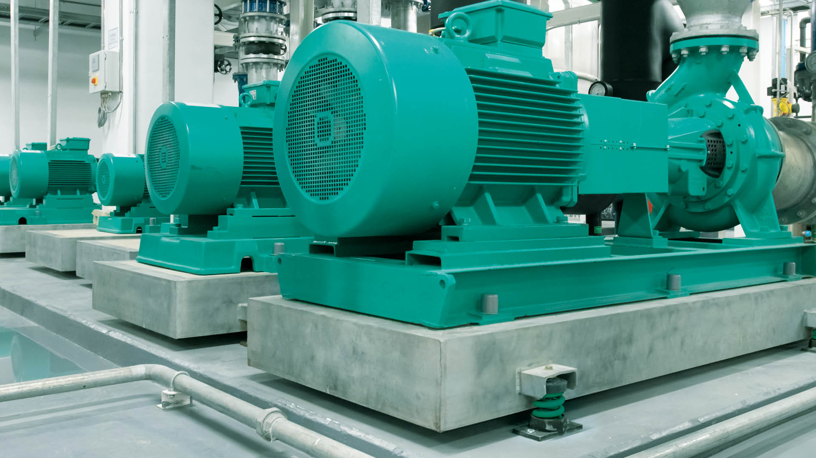
Flexible & Sensitive Examples
The equipment is mounted via isolators to reduce the dynamic forces transmitted to the floor
https://www.walraven.com/en/about-walraven/news/basics-of-vibration-isolation/
https://www.myssmi.com/blog/mri-101-preparing-for-your-first-scan-with-ease

Slide 33

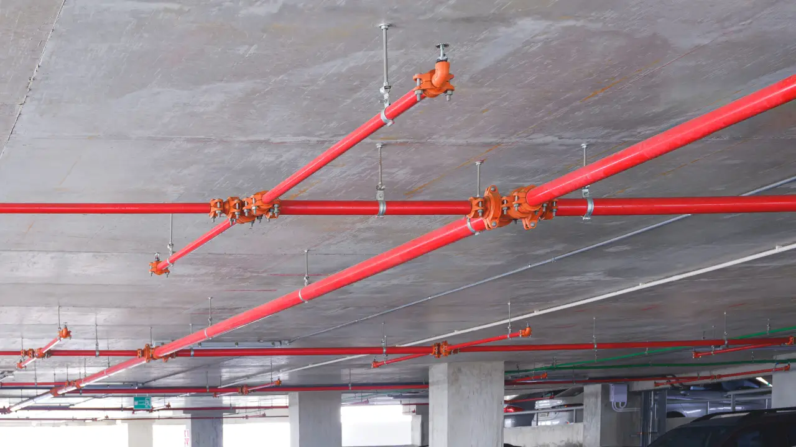
Vibrationdata
Resonance & Natural Frequency
Equipment Behavior | Typical Frequency | ASCE 7-22 treatment
Rigid equipment | > ~15–20 Hz | lower C_{AR}
Flexible equipment | < ~10 Hz | higher C_{AR}
Component | Equipment Behavior | Typical Frequency
Small rigid equipment | Rigid | 20–40 Hz
Suspended ceiling | Flexible | 1–5 Hz
Long piping | Flexible | 2–8 Hz

Slide 34
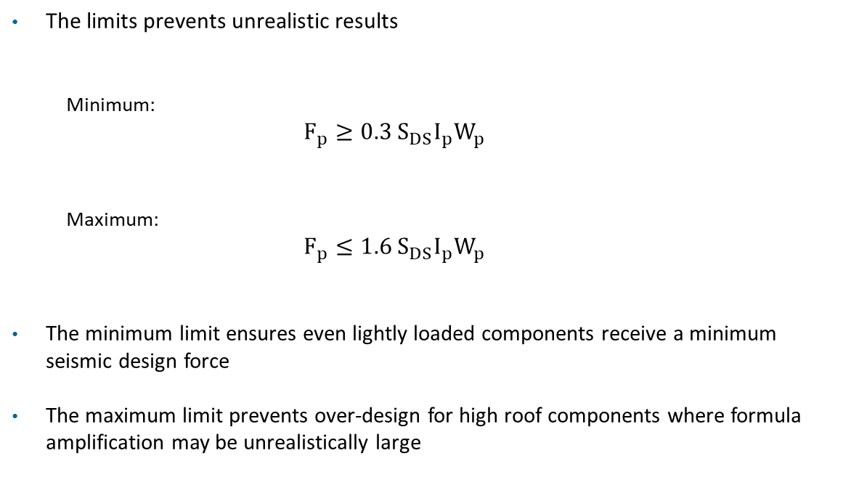
Vibrationdata
Force Limits
The limits prevents unrealistic results
  Minimum:
  $$F_{p}≥0.3 S_{DS}I_{p}W_{p}$$
  Maximum:
  $$F_{p}≤1.6{ S}_{DS}I_{p}W_{p}$$
The minimum limit ensures even lightly loaded components receive a minimum seismic design force
The maximum limit prevents over-design for high roof components where formula amplification may be unrealistically large

Slide 35
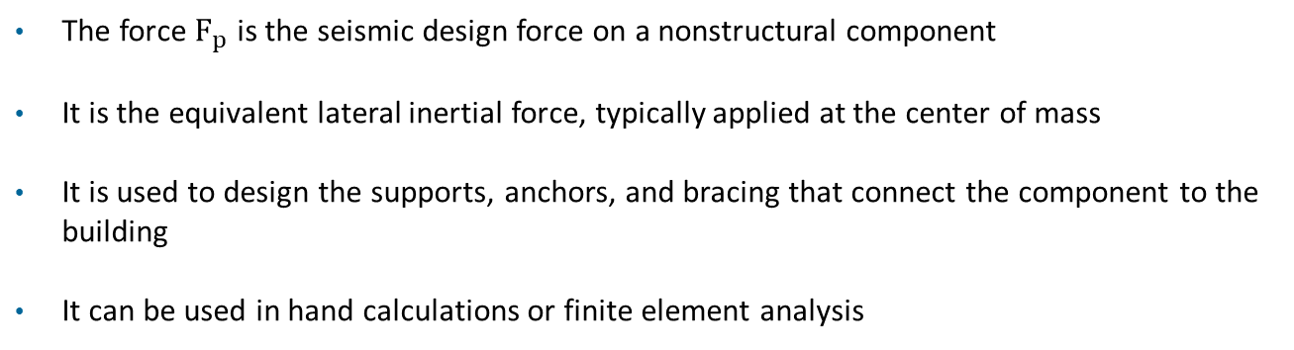

Why is the Design Force $F_{P}$Useful?
The force $F_{p}$ is the seismic design force on a nonstructural component
It is the equivalent lateral inertial force, typically applied at the center of mass
It is used to design the supports, anchors, and bracing that connect the component to the building
It can be used in hand calculations or finite element analysis

Slide 36
Design Force Limit Examples
Typical checks:
  bolt tension
  bolt shear
  brace axial force
  sliding
  overturning
Used for:
  equipment anchorage
  piping bracing
  ceiling systems
  support frames
  complex piping systems
  large mechanical units

Slide 37
Output Metrics & Design Checks
Metric | Used for
Bolt shear force | anchor bolt design
Bolt tension | uplift / overturning
Brace axial force | sway brace sizing
Frame stresses | support structure design
Displacement | clearance / impact checks
Anchorage checks
  anchor tension
  anchor shear
  combined tension + shear
Usually per:
  ACI 318 anchor design
  steel bolt design provisions

Slide 38
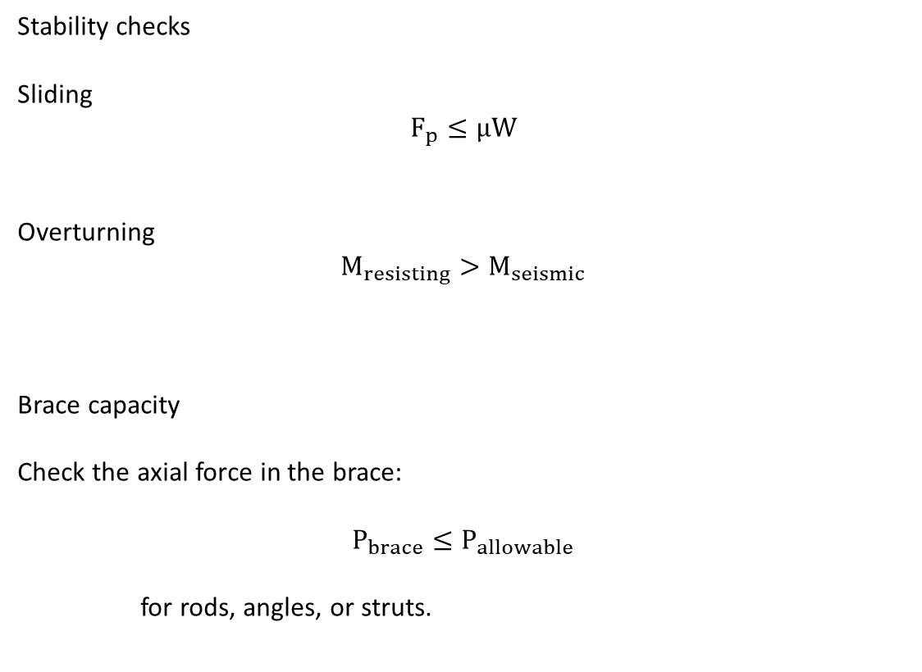
Stability Checks
Stability checks
Sliding
$$F_{p}≤μW$$
Overturning
$$M_{resisting}>M_{seismic}$$
Brace capacity
Check the axial force in the brace:
$$P_{brace}≤P_{allowable}$$
for rods, angles, or struts.

Slide 39
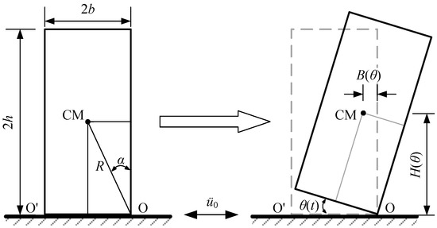
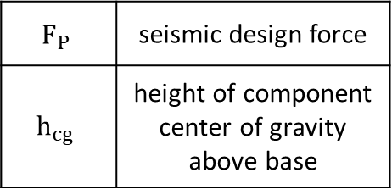
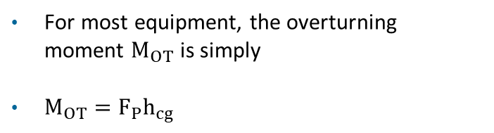
Overturning Moment
For most equipment, the overturning moment $M_{OT}$ is simply
$M_{OT}=F_{P}h_{cg}$
$$F_{P}$$ | seismic design force
$$h_{cg}$$ | height of component center of gravity above base
Freestanding (no anchor bolts) rigid block, rocking-overturning fragility
https://www.mdpi.com/2071-1050/15/6/4945

Slide 40
Rooftop AHU: F_{p} vs C_{AR}/R_{po} (ASCE 7-22)
Symbol | Description
W_{p} | component operating weight
S_{DS} | design spectral acceleration, short period
I_{p} | component importance factor
H_{f} | height amplification factor (z, h, T_{a})
R_{μ} | structure ductility reduction factor
C_{AR} | component resonance ductility factor
R_{po} | component strength factor
C_{AR}/R_{po} | F_{p} | F_{p}/W_{p} | Note
0.50 | 4,230 lb | 1.06
0.67 | 5,650 lb | 1.41 | e.g. 1.0/1.5, the hard-mounted example
1.00 | 8,470 lb | 2.12
1.50 | 12,700 lb | 3.18
1.69 | 14,330 lb | 3.58 | e.g. 2.2/1.3
2.00 | 14,400 lb | 3.60 | F_{p,max} governs
W_{p} = 4000 lb, S_{DS} = 1.5, I_{p} = 1.5, z = h = 60 ft (roof), steel moment frame: T_{a} = 0.74 s, H_{f} = 3.06, R_{μ} = 1.3
Code limits: 2,700 lbf ≤ F_{p} ≤ 14,400 lbf
Hard-mounted equipment sits at the low end of C_{AR}/R_{po}. Vibration-isolated equipment sits at the high end, and its snubbers take 2F_{p} when the air gap exceeds 0.25 in
Read C_{AR} and R_{po} for the actual mounting from ASCE 7-22 Table 13.6-1
The ratios above are illustrative

Slide 41
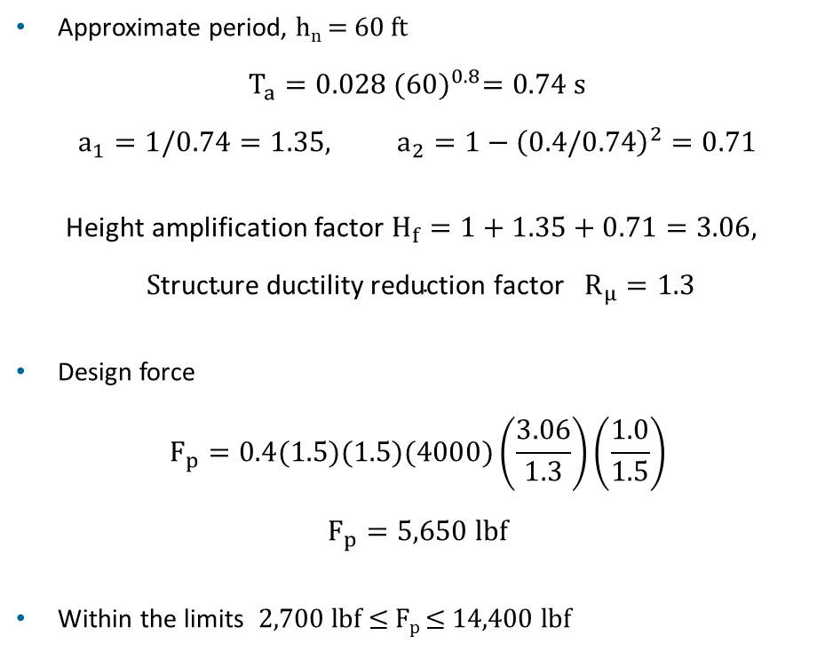
Example
Hard-mounted rooftop air-handling unit (AHU)
Component weight: W_{p} = 4000 lbf
Design spectral acceleration, Los Angeles: S_{DS} = 1.5
Importance factor: I_{p} = 1.5 (needed for continued function)
Component elevation: z = h = 60 ft (roof level)
Center of Mass above component base = 48 inch
Component factors: C_{AR} = 1.0, R_{po} = 1.5 (illustrative; confirm in Table 13.6-1)
Supporting structure: steel special moment frame,
R = 8, I_{e} = 1.5
Ω₀ not entered, so $R_{μ}=1.3$
Approximate period, h_{n} = 60 ft
$$T_{a}=0.028 {(60)}^{0.8}=0.74 s$$
$$a_{1}=1/0.74=1.35, a_{2}=1−{\left(0.4/0.74\right)}^{2}=0.71$$
Height amplification factor $H_{f}=1+1.35+0.71=3.06,$
$${\text{S}\text{tructure ductility reduction factor} R}_{μ}=1.3$$
Design force
$$F_{p}=0.4(1.5)(1.5)(4000)\left(\frac{3.06}{1.3}\right)\left(\frac{1.0}{1.5}\right)$$
$$F_{p}=5,650 lbf$$
Within the limits 2,700 lbf ≤ F_{p} ≤ 14,400 lbf

Slide 42
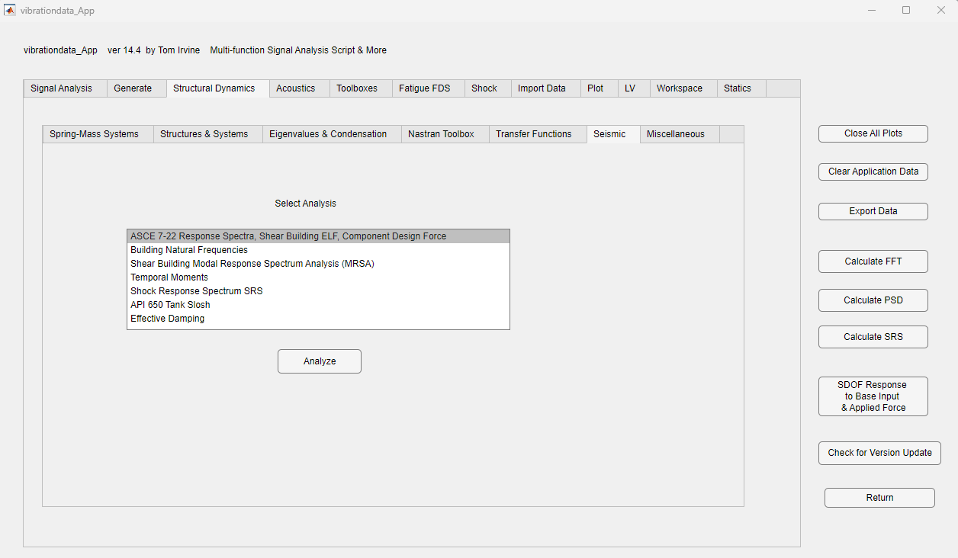
Example Vibrationdata

Slide 43
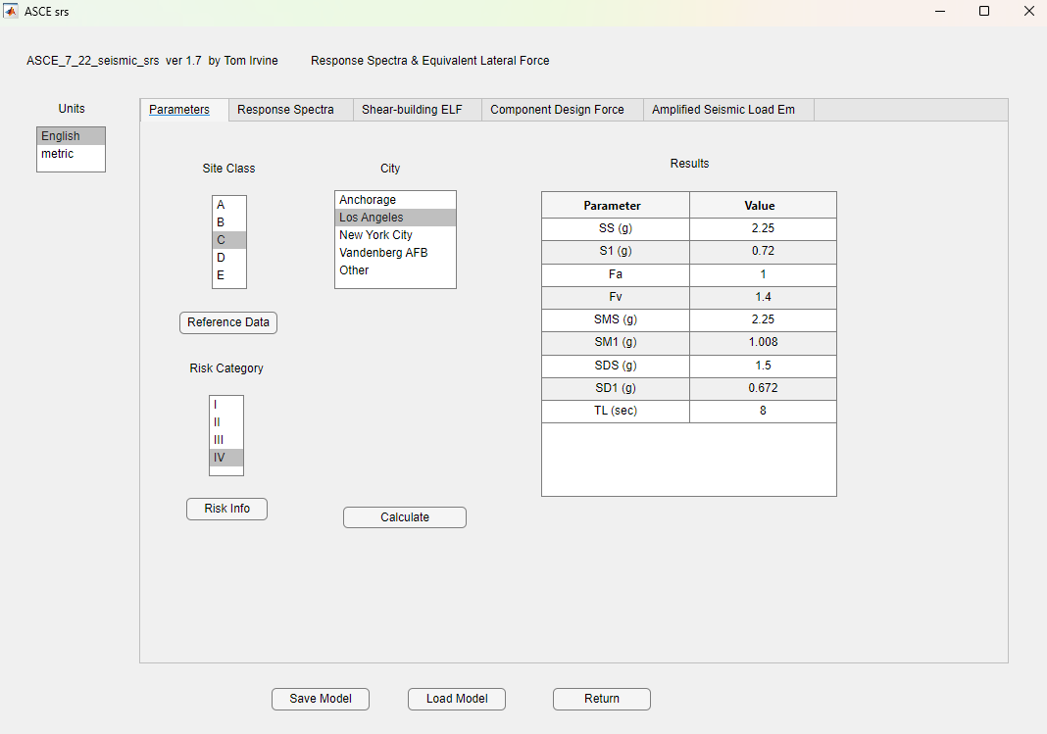

Slide 44
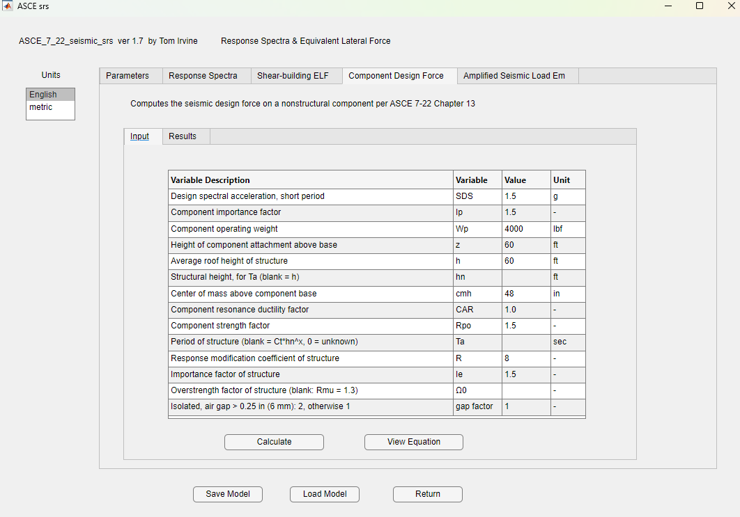

Slide 45
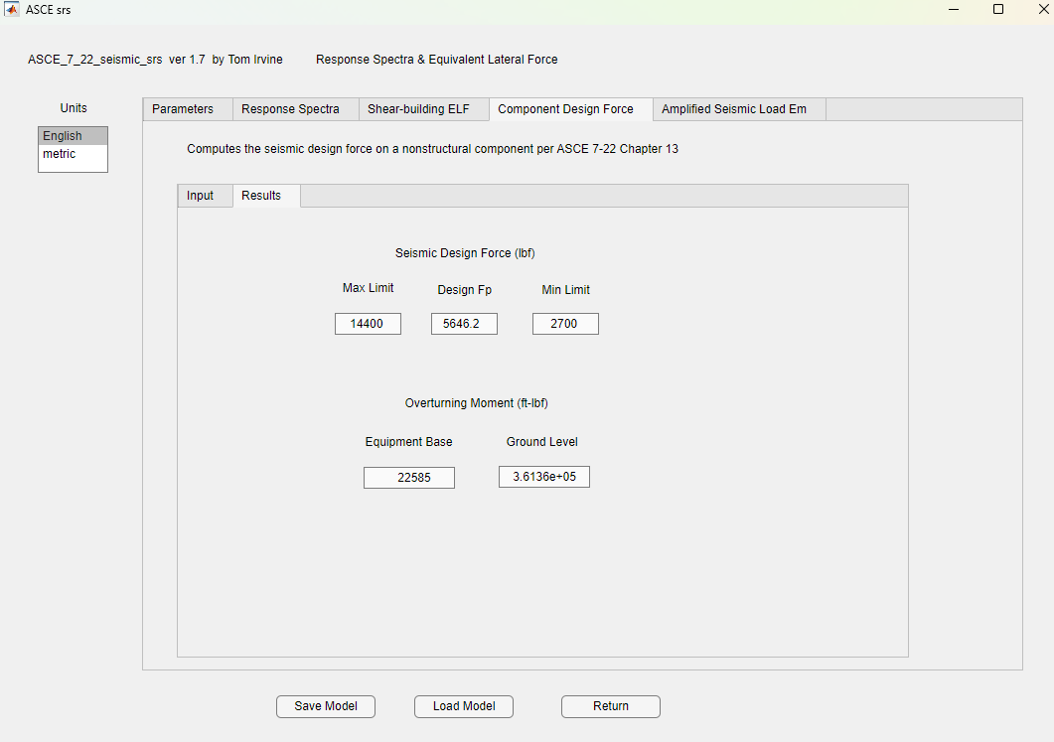

Slide 46
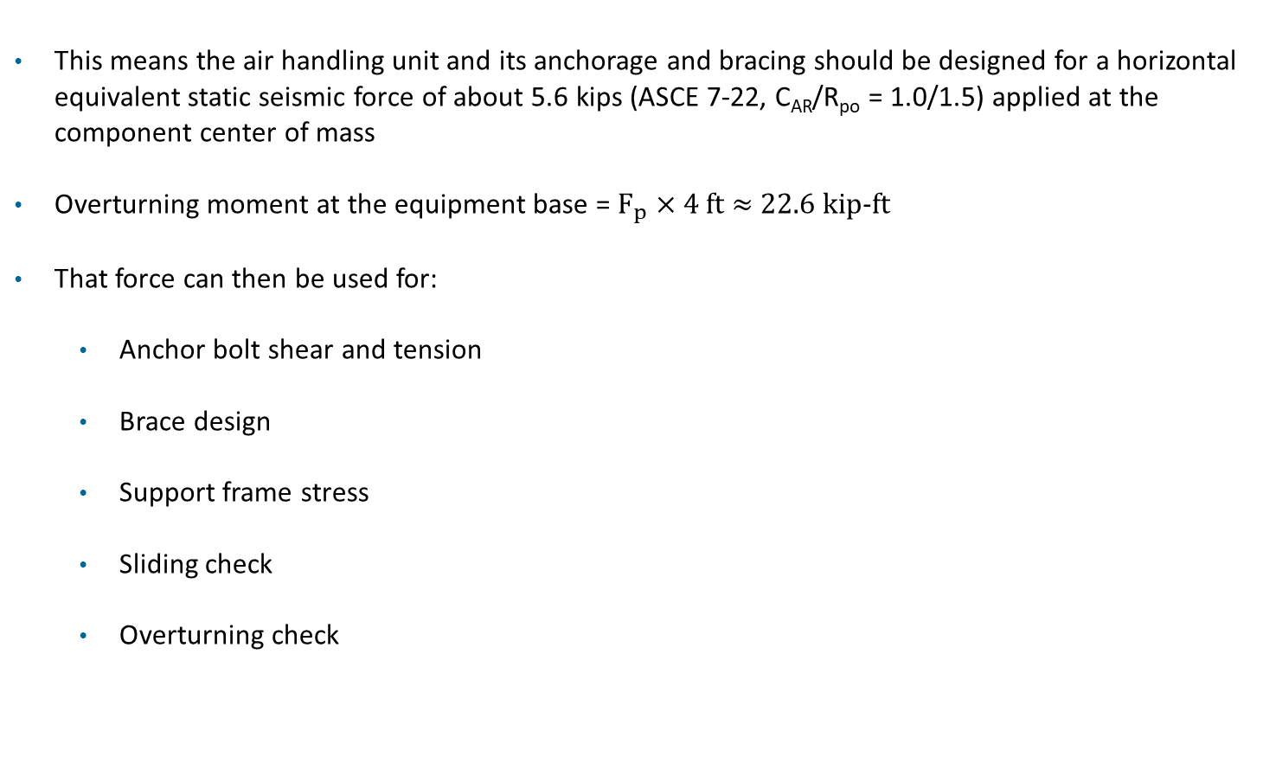
Results
This means the air handling unit and its anchorage and bracing should be designed for a horizontal equivalent static seismic force of about 5.6 kips (ASCE 7-22, C_{AR}/R_{po} = 1.0/1.5) applied at the component center of mass
Overturning moment at the equipment base = $F_{p}$ × 4 ft ≈ 22.6 kip-ft
That force can then be used for:
  Anchor bolt shear and tension
  Brace design
  Support frame stress
  Sliding check
  Overturning check

Slide 47
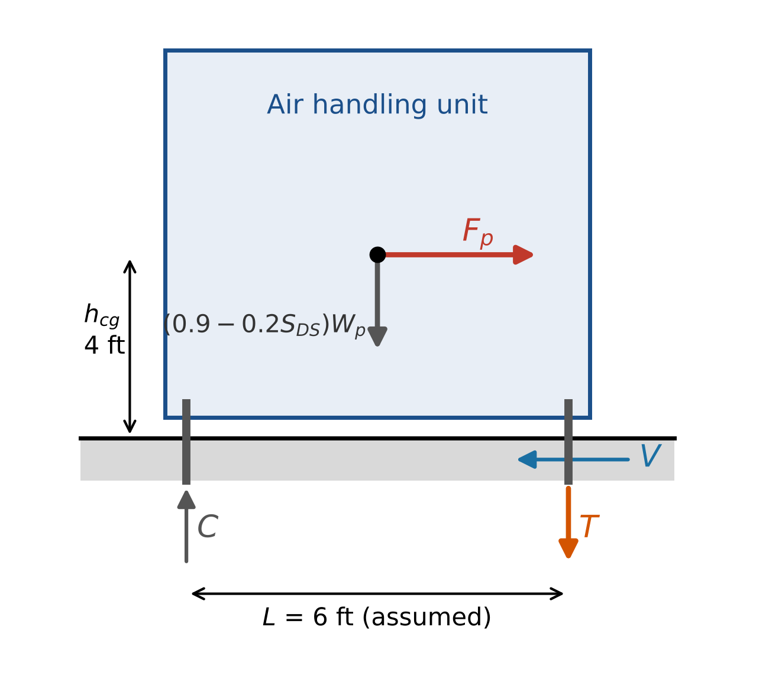
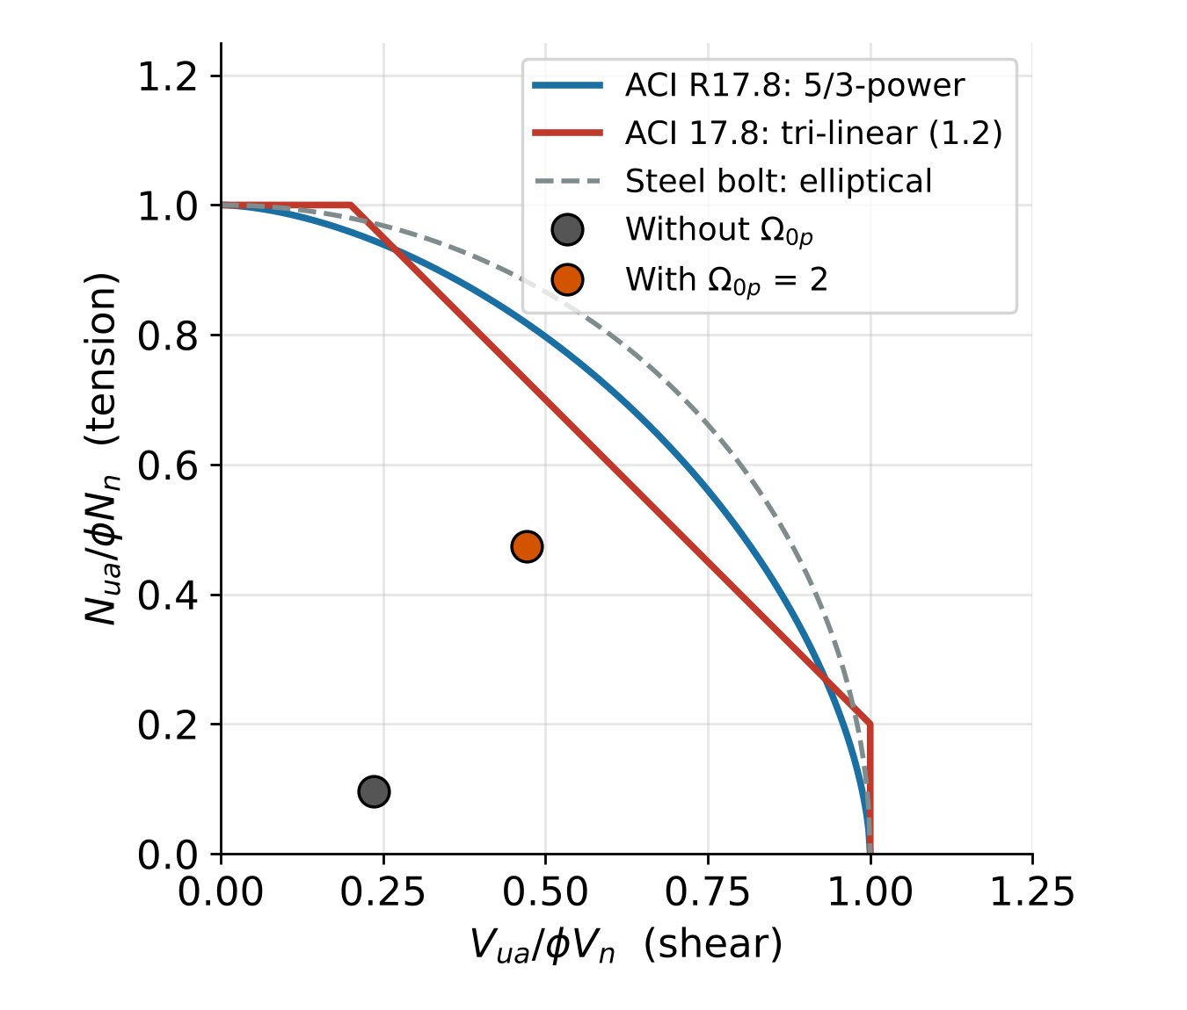
Anchor Bolts: Combined Shear and Tension
Vibrationdata
Tension per bolt, uplift side
T = [Ω_{0p} M / L − (0.9 − 0.2 S_{DS}) W_{p} / 2] / n_{t}
Shear per bolt
V = Ω_{0p} F_{p} / n
ACI 318-19 §17.8 interaction
N/φN_{n} + V/φV_{n} ≤ 1.2
(N/φN_{n})^{5/3} + (V/φV_{n})^{5/3} ≤ 1.0
Either ratio ≤ 0.2: check the other alone
Case | T / bolt | V / bolt | Linear sum (≤ 1.2) | 5/3 sum (≤ 1.0)
Without Ω0p | 0.48 kip | 1.41 kip | N ≤ 0.2: shear only, 0.24 | 0.11
With Ω0p = 2 | 2.37 kip | 2.83 kip | 0.47 + 0.47 = 0.95 OK | 0.57 OK
Overturning puts all uplift on one line of bolts, and those same bolts also carry shear
Vertical seismic, −0.2 SDS Wp, removes part of the weight that resists uplift
Ω0p doubles shear but raises tension about 5 times, because the restoring weight does not scale
Also check diagonal loading: a corner bolt sees both directions
Assumed for illustration: Fp = 5.65 kips, M = 22.6 kip-ft, Wp = 8 kips, SDS = 1.0, 4 anchors (2 per line, nt = 2, n = 4), L = 6 ft, φNn = 5.0 kips and φVn = 6.0 kips per anchor, Ω0p = 2 (ACI 318-19 17.10.5.3(d) and 17.10.6.3(c)). Replace with project values.

