Slide 1
SHOCK & VIBRATION SHORT COURSE
Vibrationdata
Pyrotechnic Shock
Source levels, distance attenuation and joint attenuation
Tom Irvine September 2026
Source
Distance
Joints
Published SRS for the device, measured 0.10–0.13 m from it. Charge weight spans two orders of magnitude.
A frequency-dependent low-pass filter along the shock path. The first 75 cm does most of the work.
30% to 40% percent per junction, three maximum, applied to the plateau branch only — the ramp passes through.
After NASA-HDBK-7005 §5.3, ECSS-E-HB-32-25A §8.3, MIL-STD-810F Method 517, and the Vibrationdata source shock library.
1 / 9

Slide 2
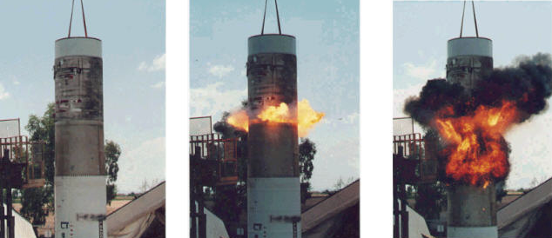
Stage Separation Ground Test
Linear Shaped Charge
But fire and smoke would not occur in near-vacuum of space
Plasma jet would occur instead

Slide 3
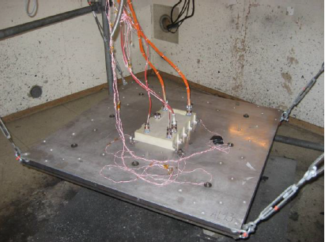
Component Qualification Testing, Pyrotechnic Excitation
Mild detonating cord is source shock
Resonant single or double plate
Plate made from steel or aluminium
Must over-test in out-of-plane axis in order to meet specification in lateral axis
Used for near-field shock specifications or far-field with very conservative margin

Slide 4
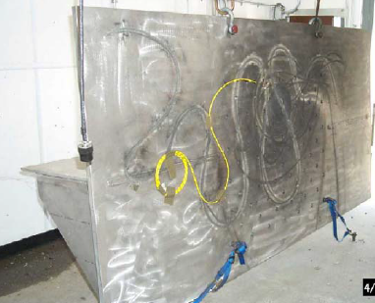
Shock Test Fixture, Back Side
Textile explosive cord with a core load of 50 grains/ft (PETN explosive)
Up to 50 ft of Detonating Cord has been used, that equals 0.36 pounds
Maximum frequency of shock energy is unknown
Test component is mounted on other side of plate
Near-field shock environment
In the U.S. customary system, a grain is a unit of mass equal to 1/7000 of a pound
“Grains per foot” describes how many grains of explosive mass are present in each foot of length of the detonating cord

Slide 5
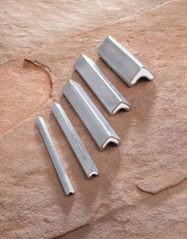
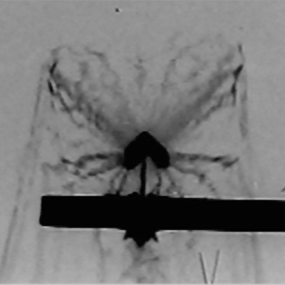
Linear Shaped Charge
Metal Clad Linear Shaped Charge & Flash X-ray (Ensign-Bickford Aerospace)

Slide 6
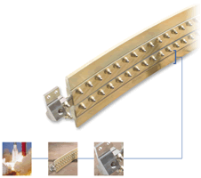
Frangible Joint
The key components of a Frangible Joint:
Mild Detonating Fuse (MDF)
Explosive confinement tube
Separable structural element
Initiation manifolds
Attachment hardware

Slide 7
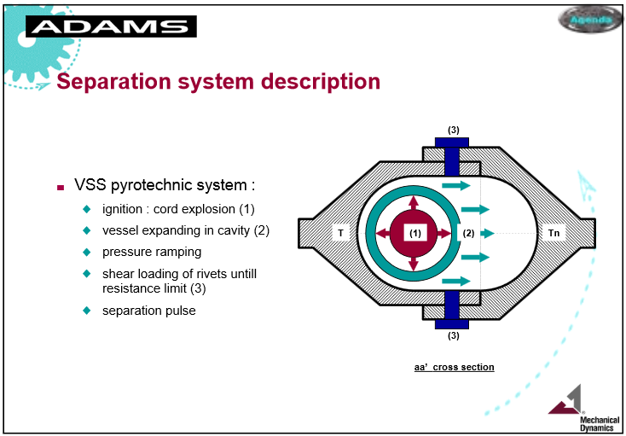
Ariane 4 Fairing Vertical Separation System
Fairing also has base circumference, horizontal shock system (HSS)
Need method to produce similar shock for system development testing in lab

Slide 8

PYROTECHNIC SHOCK
Vibrationdata
Payload fairing separation: three frangible joint cuts
WHAT THE PAYLOAD SEES
•
Three line sources, not one point source. The base cut is a ring. The two vertical cuts run the full length of the fairing, alongside the payload — so part of the source is never far away.
•
Point-source distance rules do not apply directly. NASA Eq. 5.78 and the ESTEC point-source curves were derived for discrete devices.
•
Source level, Q = 10 MPE: a 16,000 G plateau above 4200 Hz for a 26 grain/ft frangible joint. Paul reported 100–3000 g at 600–6000 Hz at equipment attach points.
•
All three cuts fire together, so the payload sees one combined event rather than three separable ones.
Ariane 5 and the James Webb Space Telescope. Frangible joints make the base cut and the two vertical cuts.
Takeaway The vertical cuts hold part of the source in the payload’s near field over its whole length — which is why fairing separation is so often a dimensioning shock.
Levels from the Vibrationdata source shock library, Rev G.

Slide 9
PYROTECHNIC SHOCK
Vibrationdata
How a frangible joint severs the shell
TWO JOINT TYPES IN SERVICE
CONSEQUENCES FOR TEST AND MEASUREMENT
V. R. Paul, "Mechanical Shock from Frangible Joints," Shock & Vibration Bulletin, Part 4, 1962 (Lockheed Missiles & Space Co.).
Type
Mechanism
MDF
Mild detonating fuse: an RDX or HMX core in a lead sheath. Explosive pressure bends the notched shell outward until it fractures at the centre notch.
•
Near-zero net velocity change. Most shock machines produce a pulse with a large velocity change, so a classical pulse is a poor substitute — it over-tests the low-frequency modes and under-tests the high.
FLSC
Flexible linear shaped charge, chevron cross-section. The lead casing collapses into a jet near 10,000 ft/s that cuts the shell; stagnation pressure of order 8×10⁶ psi.
•
Response varies sharply point to point. A rigid shock table forces the same motion at every attachment, which the real separation never does. Paul warned this can over-test "by some large, unknown factor."
•
Detonation propagates near 25,000 ft/s, so an entire cut is severed in far less than a millisecond.
•
Zero shift corrupts the record. A sudden offset in the baseline decaying over roughly 100 ms was a recurring cause of lost data; piezoelectric designs reduced it but did not eliminate it.
•
A single initiation point runs the whole joint. Redundant initiators add reliability without adding charge.
•
Failures are local. A relay a few inches from a separation joint tripped during ground test; a solid-state device fixed it. Proximity, not overall level, decided the outcome.
•
Preferred over explosive bolts and pin-pullers: continuous, lightweight and structurally efficient.
Takeaway High acceleration at high frequency with almost no velocity change — the signature that makes pyroshock hard to simulate and easy to mis-measure.

Slide 10
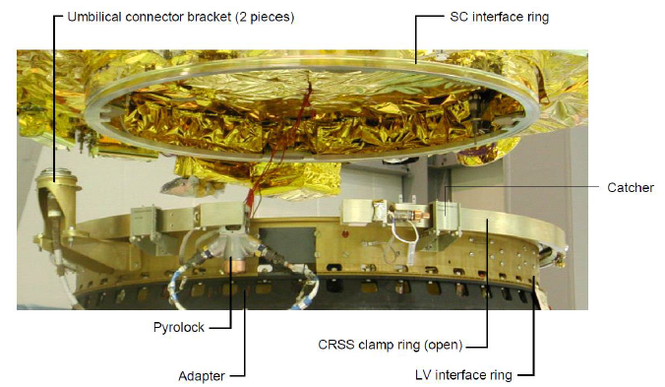
Clamp Band with Pyrotechnic-Bolt Cutters
A pyrotechnic bolt-cutter uses an explosive charge to drive a chisel blade to cut the band segments’ connecting bolt
The cutters produce some shock energy, but much of the shock is due to the sudden release of strain energy in the preloaded clamp band
This action can excite a ring mode in the radial axis

Slide 11
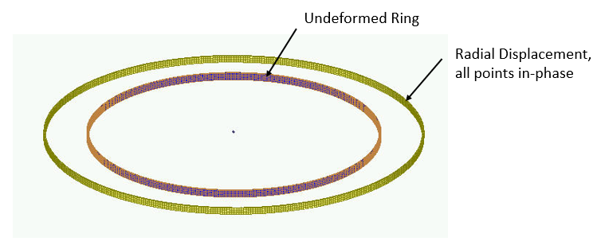
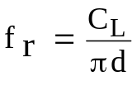
Ring Frequency
Vibrationdata
Consider a thin ring with a rectangular cross section and with completely free boundary conditions
The ring frequency corresponds to the mode in which all points move radially outward together and then radially inward together
This is the first extension mode, analogous to a longitudinal mode in a rod
The ring frequency is the frequency at which the longitudinal wavelength in the skin material is equal to the vehicle circumference
The ring frequency is an idealized concept for a cylindrical shell
In practice, cylindrical shells tend to have a high modal density near the ring frequency
The ring frequency f _{r} is
C_{L} is longitudinal wave speed
d is diameter

Slide 12
PYROTECHNIC SHOCK
Vibrationdata
Predicting pyroshock: the empirical model
THE FOUR-STEP CONSTRUCTION
PRIMARY REFERENCES
•
Start with the source SRS. Published source levels are measured 0.10–0.13 m (4–5 in.) from the device.
Document
Contribution
NASA-HDBK-7005
Eq. 5.78 distance rule; method
•
Attenuate for distance along the shock path — not straight-line distance. The whole spectrum comes down.
§5.3.2, 5.3.4
40% per joint, max 3 joints
ECSS-E-HB-32-25A
ESTEC point-source and
•
Attenuate for joints in the path. This reduces the plateau only, not the ramp.
§8.3.1, 8.3.2
clampband attenuation rules
MIL-STD-810F M517
Original distance curves
•
Apply isolator effects if present, then margin to reach the test level.
Martin Marietta
Source of the four-step
pyroshock guide
construction and curves
The distinction in step 3 is the one most often missed: a joint clips the high-frequency plateau and leaves the low-frequency ramp essentially untouched.
Vibrationdata
Source shock library, Rev G
Accuracy caveat from NASA-HDBK-7005: empirical predictions "may be in error by an order of magnitude at some frequencies." Update with measurement as soon as data exist.
Takeaway Source level, path distance and joint count — three numbers, applied in that order, give a first-cut component environment.
2 / 9

Slide 13
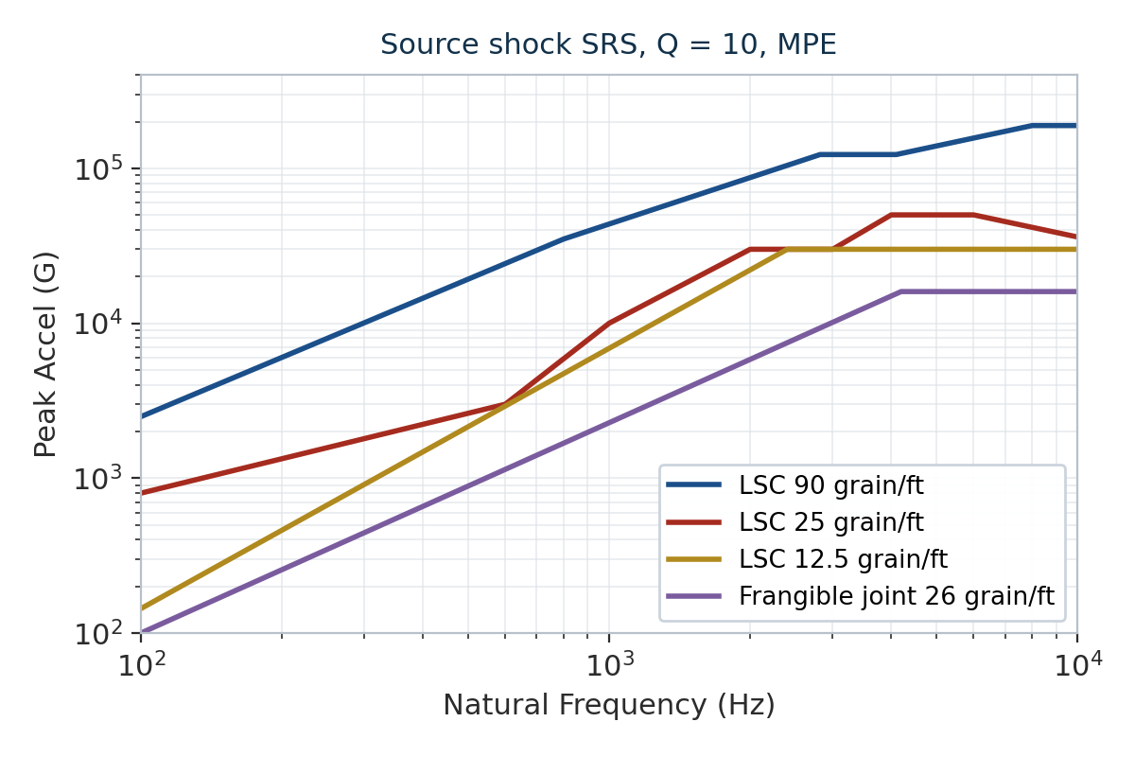
SOURCE SHOCK
Vibrationdata
Source levels depend on the device, not the vehicle
REPRESENTATIVE SOURCE LEVELS, Q = 10, MPE
Device
Plateau (G)
Knee (Hz)
LSC 90 grain/ft
188,600
8000
LSC 25 grain/ft
50,000
4000
LSC 12.5 grain/ft
30,000
2400
Frangible joint 26 gr/ft
16,000
4200
SRB frangible nut
15,000
4000
V-band, 72 in. dia.
4400
1700
V-band, ≤ 48 in. dia.
1950
3000
SAAB separation system
1950
1690
•
Linear shaped charge spans two orders of magnitude by charge weight alone — device selection dominates everything downstream.
•
Levels are MPE. Qualification is typically MPE + 6 dB.
Takeaway A 90 grain/ft LSC and a small V-band differ by a factor near 100 at the plateau — quote the device, never just "pyroshock."
3 / 9

Slide 14
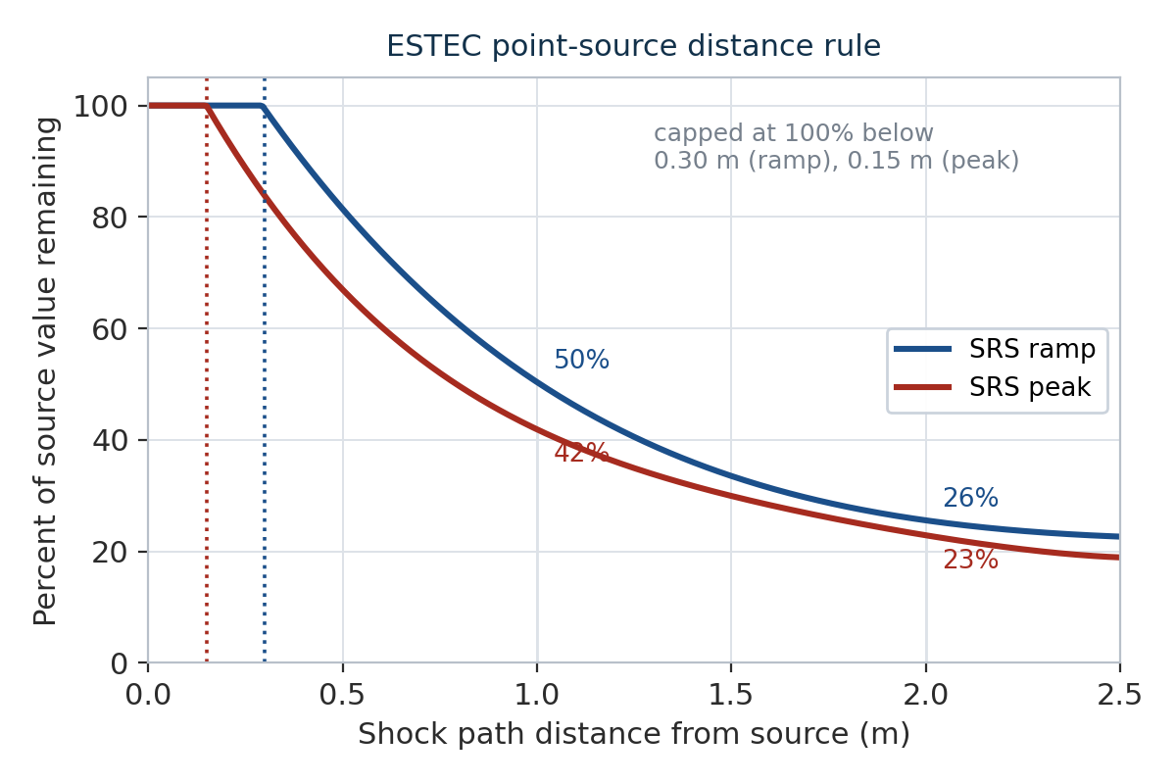
DISTANCE ATTENUATION
Vibrationdata
Distance: the plateau and the ramp decay differently
ESTEC POINT-SOURCE RULE (ECSS §8.3.1)
Percent of source value remaining, d in metres:
peak: 4.3d⁴ − 32.5d³ + 96.9d² − 146.7d + 119.9
ramp: 0.98d⁴ − 12d³ + 58.3d² − 130.4d + 133.5
•
Both are capped at 100%. The polynomials reach 100% at d = 0.15 m (peak) and d = 0.30 m (ramp) — the caps are not arbitrary.
•
Distance is measured along the load path, not point to point.
•
ECSS advises no shock-sensitive equipment within 20–30 cm of the source. Inside that radius the rule gives no relief at all.
•
MIL-STD-810F Method 517 gives the same shape but lower values; ESTEC is the more conservative of the two.
Takeaway Nearly 60% of the attenuation available over the first 2.5 m is won in the first 75 cm. Layout buys more than analysis does.
4 / 9

Slide 15
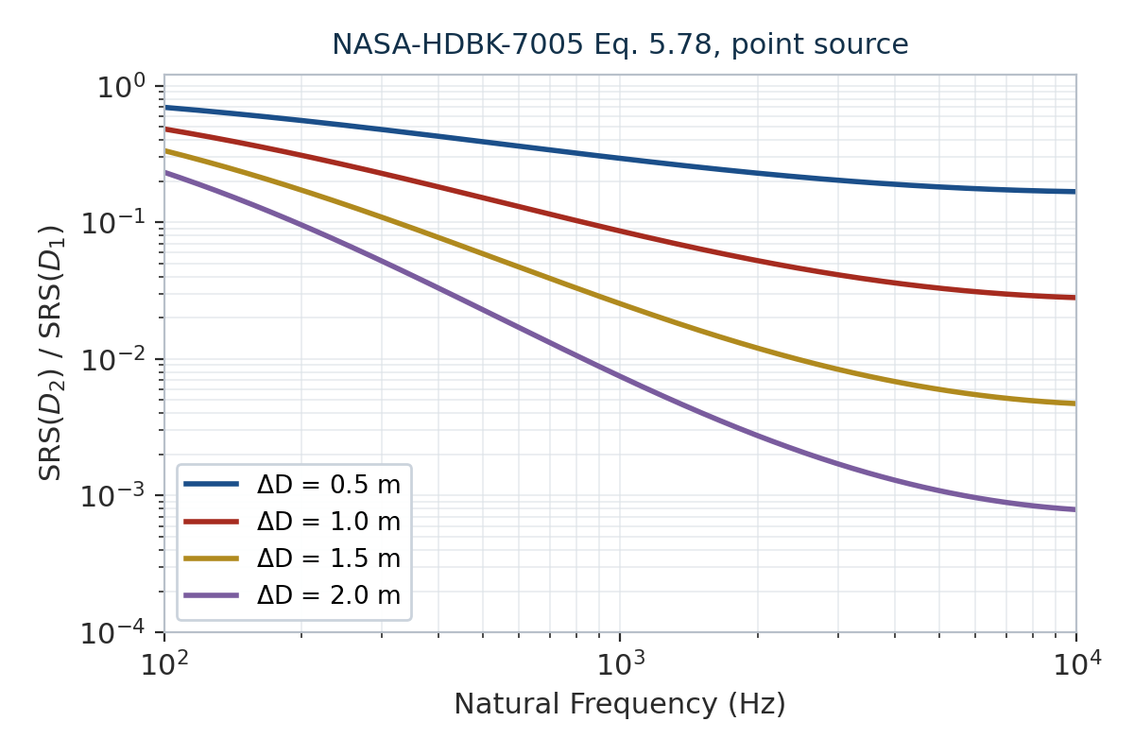
DISTANCE ATTENUATION
Vibrationdata
The closed-form distance rule
NASA-HDBK-7005, EQ. 5.78
SRS(D₂) = SRS(D₁) · exp[ − 8×10⁻⁴ · f_{n}^{m} · (D₂ − D₁) ]
where m = 2.4 f_{n}^{−0.105}
D in metres, f_{n} in Hz; point source on complex structure at sea level.
Freq (Hz)
0.5 m
1.0 m
1.5 m
2.0 m
100
0.69
0.48
0.34
0.23
300
0.48
0.23
0.11
0.05
1000
0.29
0.086
0.025
0.007
3000
0.20
0.041
0.008
0.002
10000
0.17
0.028
0.005
0.001
•
The frequency dependence is the whole point: at 2 m the 100 Hz content is down 13 dB while the 10 kHz content is down 62 dB.
•
Energy scaling is separate: SRS scales as the square root of the explosive energy ratio (Eq. 5.77).
Takeaway Distance is a low-pass filter. Far-field pyroshock is not a smaller near-field shock — it is a different spectrum shape.
5 / 9

Slide 16
JOINT ATTENUATION
Vibrationdata
Joints clip the plateau, not the ramp
THE RULE
WHAT COUNTS AS A JOINT
•
40% reduction per joint, applied to the SRS peak / plateau only.
ECSS-E-HB-32-25A: "a clear change along the load path: bifurcation, change of impedance, junction between panels."
•
No attenuation of the up-ramp portion of the SRS.
•
Maximum of three joints may be counted, however many exist in the path.
•
Two panels joined through screwed cleats is one junction — not three. Do not count each bolted interface separately.
•
NASA-HDBK-7005 notes the underlying data range from 20% to 75% per joint depending on joint type and how it redirects the path.
•
A bolt pattern within a continuous member is not a joint.
•
ECSS: never cumulate more than three junctions along the load path.
Joints
Factor
Remaining
Change
0
1.00
100%
0 dB
•
Shock levels rise just before a joint from wave reflection, and fall only moderately after it. Measuring across an interface without accounting for this overstates the attenuation.
1
0.60
60%
−4.4 dB
2
0.36
36%
−8.9 dB
3 (max)
0.216
21.6%
−13.3 dB
Three joints buy 13 dB. One metre of aluminium buys 21 dB at 1 kHz. Distance is the stronger lever in almost every layout.
Takeaway Count junctions along the load path, cap at three, and apply the reduction to the plateau only — the ramp passes through.
6 / 9

Slide 17
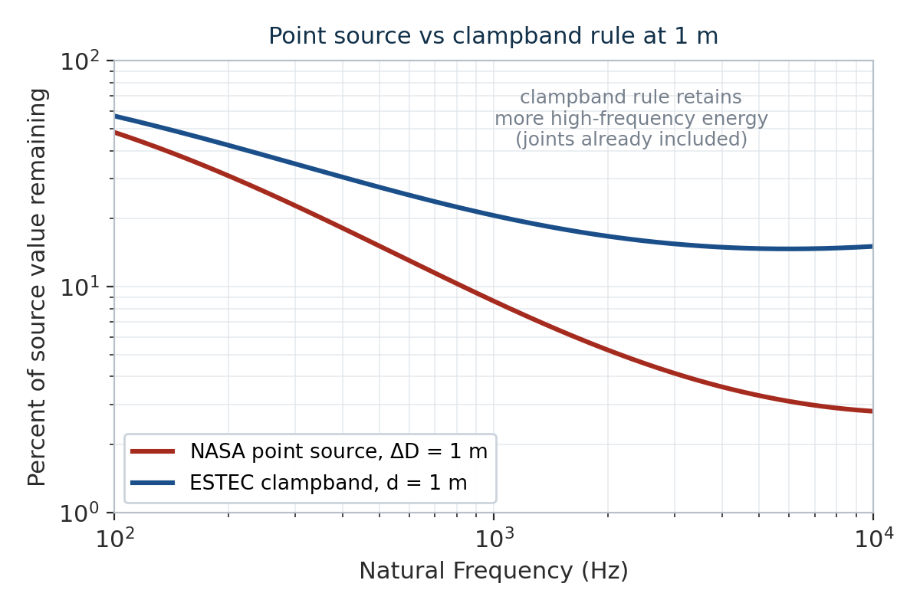
DISTRIBUTED SOURCES
Vibrationdata
Clampband release needs a different rule
ESTEC CLAMPBAND RULE (ECSS §8.3.2)
att = exp[ − 8×10⁻⁴ · f^{m} · g(d) ] with m = 2.515 f^{−0.115}
g(d) = 0.0144d³ − 0.2d² + 0.93d + 0.024
Derived from SMART-1, Cluster, ROSETTA, Spot5 and Eurostar 3000 heritage; d is the minimum distance along the load path.
•
Do not add joint attenuation to this rule. ECSS states the junction effect is already built in. Stacking the 40% factors on top double-counts and under-predicts.
•
Valid only for clampband separation, and only for the radial average at the spacecraft interface.
•
g(d) saturates near 1.47 beyond about 4 m, so the rule levels off in the far field where the point-source rule keeps decaying.
Takeaway At 1 m and 1 kHz the clampband rule leaves 21% against 9% for the point-source rule — applying the wrong one is a factor of two.
7 / 9

Slide 18
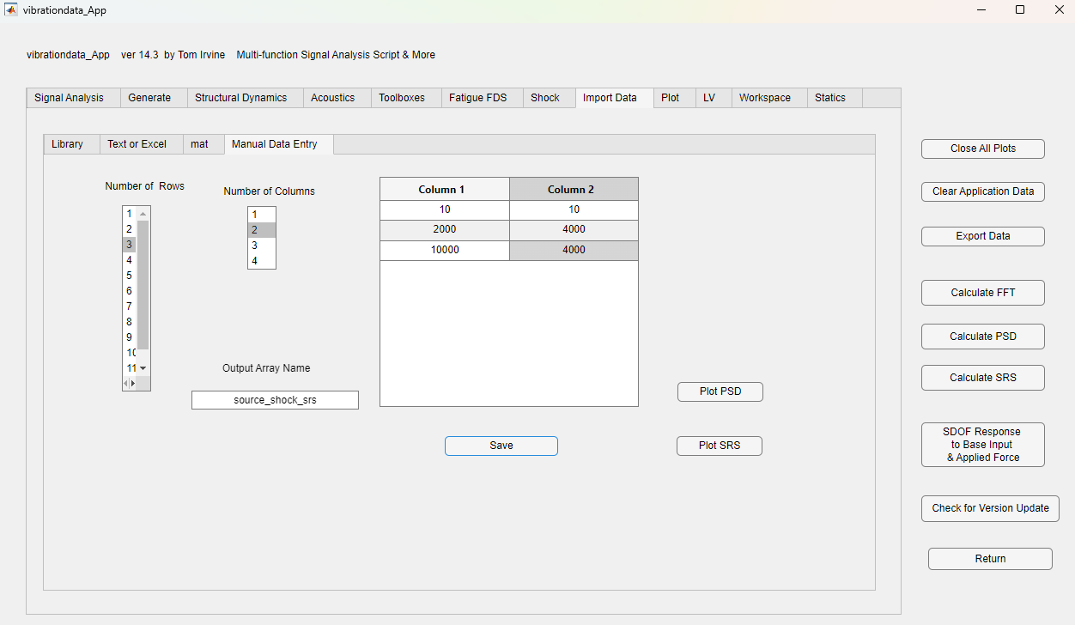
Example

Slide 19
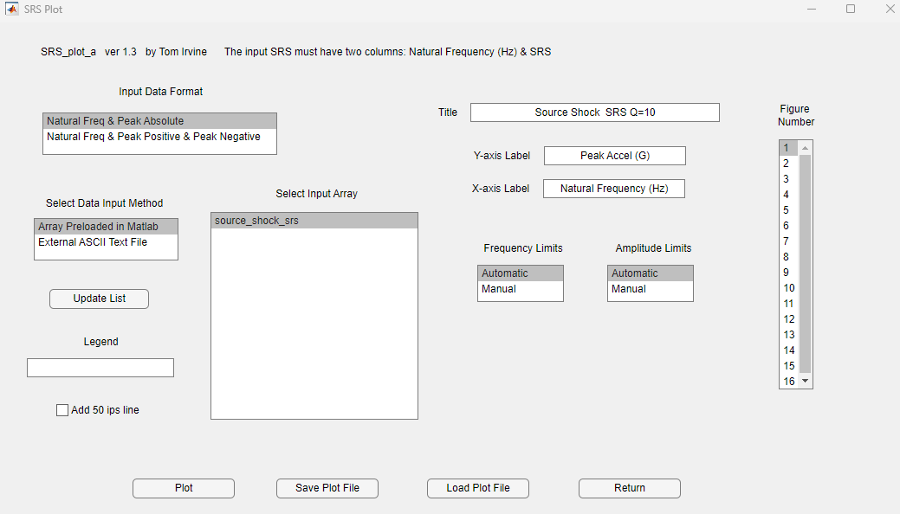

Slide 20
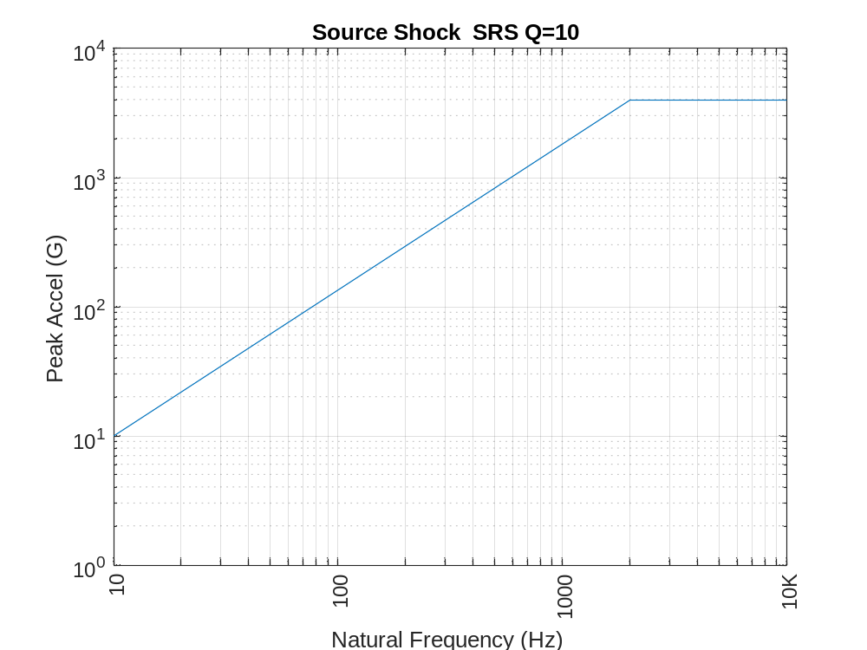
Example

Slide 21
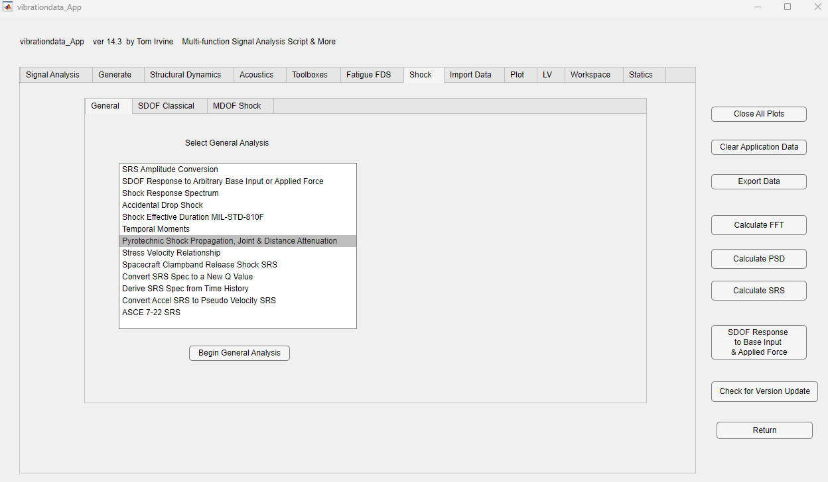

Slide 22
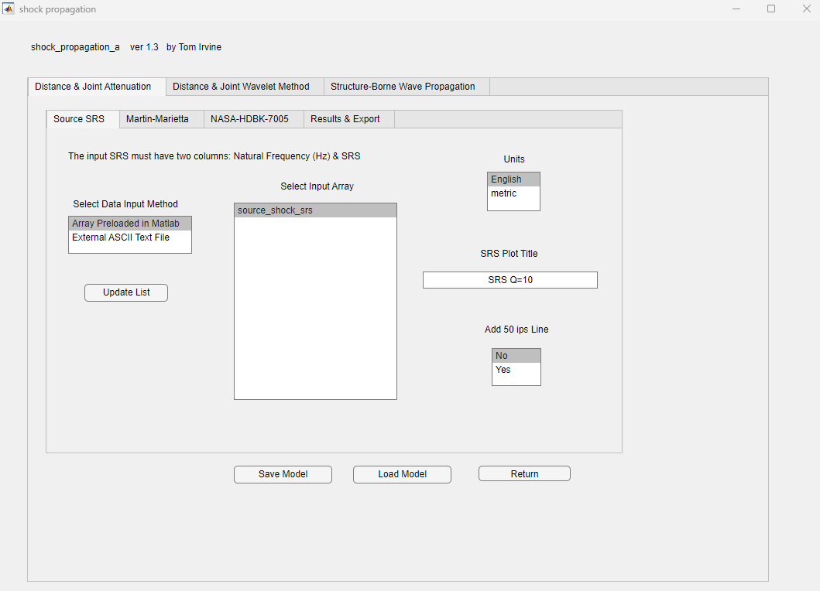

Slide 23
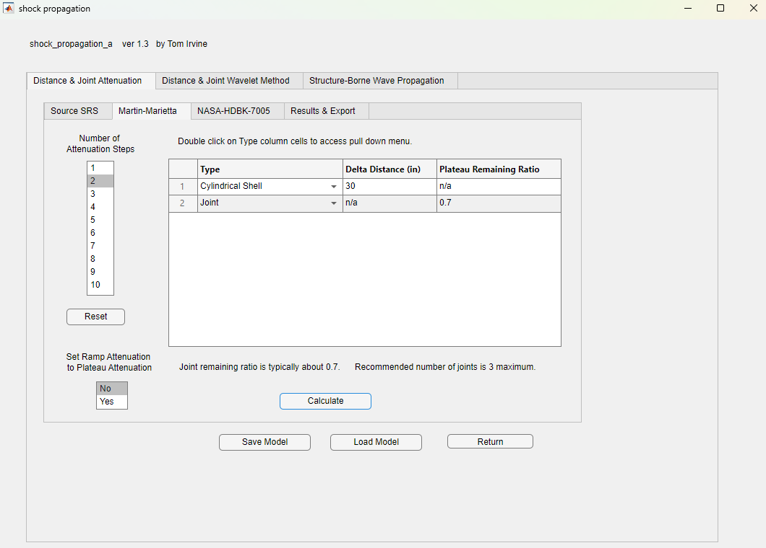

Slide 24
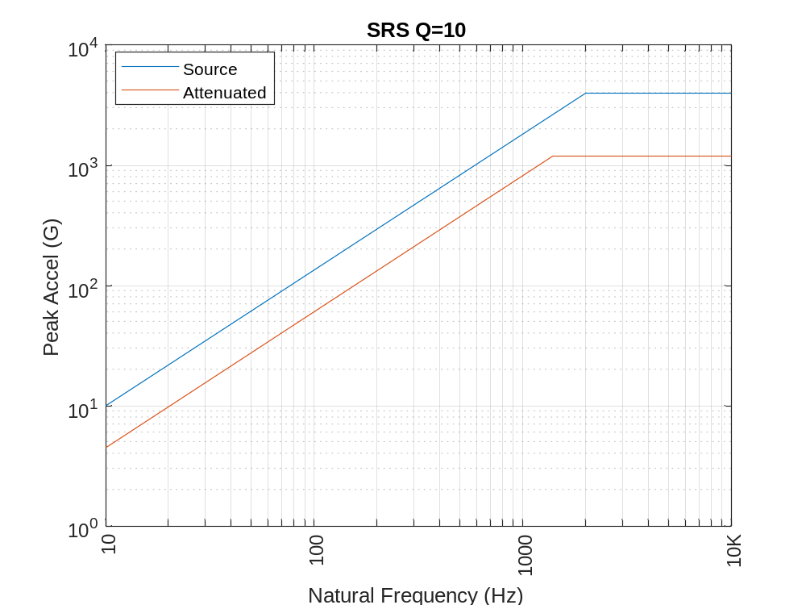
Source SRS
fn(Hz) Accel(G)
10 10
2000 4000
10000 4000
Step 1 Cylindrical Shell Delta Distance=30 in
Remaining: ramp= 0.448 plateau= 0.424
fn(Hz) Accel(G)
10 4.476
1907 1696
10000 1696
Step 2 Joint 0.7 plateau remaining
fn(Hz) Accel(G)
10 4.476
1391 1187
10000 1187

Slide 25
LIMITS
Vibrationdata
Where these rules stop working
KNOWN LIMITATIONS
PRACTICAL GUIDANCE
•
Order-of-magnitude accuracy. NASA-HDBK-7005 says predictions may be wrong by 10× at some frequencies. These are screening tools.
•
Keep sensitive units beyond 20–30 cm of any pyro device. This is worth more than any analysis refinement.
•
No modal content. The rules are smooth curves. Real substructures amplify near their own modes, especially below 1 kHz.
•
Prefer measured transfer functions on the actual or a similar structure over generic factors whenever data exist.
•
Primary load path only. ECSS explicitly excludes brackets and isostatically mounted equipment, whose response is modal.
•
Levels rise immediately upstream of a joint. Do not site a unit just before an interface and claim the downstream attenuation.
•
Do not stack factors. Distance, joints, and clamp band rules already overlap. Combining all of them compounds conservatism into nonsense.
•
Replace predictions with test data as soon as a development or separation test is run — every source recommends this.
•
Qualification margin is MPE + 6 dB in common US practice; ECSS applies 3 dB. These are alternative conventions — do not add them together.
Takeaway These rules size the problem and place the hardware. They do not qualify it — measurement does.
9 / 9

