Slide 1
Vibrationdata
Accidental Drop Shock
By Tom Irvine
1
Notes:
1

Slide 2

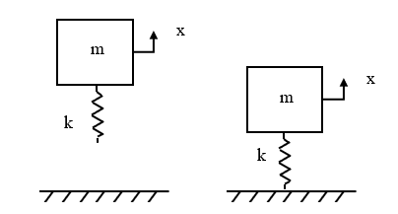
Initial Velocity
Vibrationdata
The first iPhone 6 was purchased in Perth, Australia on September 19, 2014
The event was covered by a live TV report
The buyer mishandled the phone as he unboxed it
The phone survived the drop onto the ground but may have had some fatigue or fracture damage
Portable electronic devices (PEDs) are expected to survive multiple drops
Most original equipment suppliers specify between 30 and 50 drops
Model as spring-mass system subjected to initial velocity
Oversimplification due to potential plastic deformation, nonlinearity, etc.
2
Notes:
2

Slide 3
Drop Shock Modeling
Vibrationdata
Drop shock is a very messy, nonlinear problem with potential plastic deformation, cracking, etc.
Making test measurements is probably more effective than analysis
The orientation of the item as it strikes the ground is one of several challenges for both measurement and analysis
But we can do some very simple modeling as a first approximation

Slide 4
Assumptions
Vibrationdata
Vast oversimplification
The object can be modeled as a single-degree-of-freedom system subjected to initial velocity
The object is dropped from rest
There is no energy dissipation
The collision is perfectly elastic
The object remains attached to the floor via the spring after initial contact
The object freely vibrates at its natural frequency after contact
The system has a linear response

Slide 5
SDOF Model
Vibrationdata
x
m
k
x
m
k
Dropped from rest at initial height
Attaches to ground upon initial contact
where m is mass, and k is stiffness

Slide 6


Some High School Physics
Vibrationdata
The initial velocity of the object as it strikes the ground can be found by equating the change in kinetic energy with the change in potential energy:
$$\frac{1}{2}m {\dot{x}}^{2}=mgΔh$$
$$\dot{x}\left(0\right)=\sqrt{2gΔh}$$
where Δh is the drop height above the ground, and g is gravity acceleration
Next, solve the undamped, free vibration problem with the initial velocity given above
Also, initial displacement is zero
$m\ddot{x}+kx=0$

Slide 7
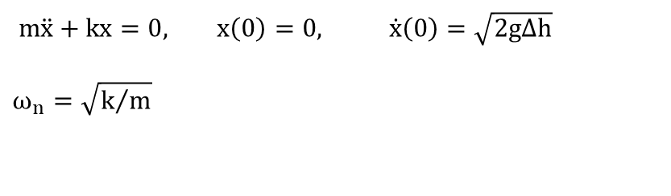
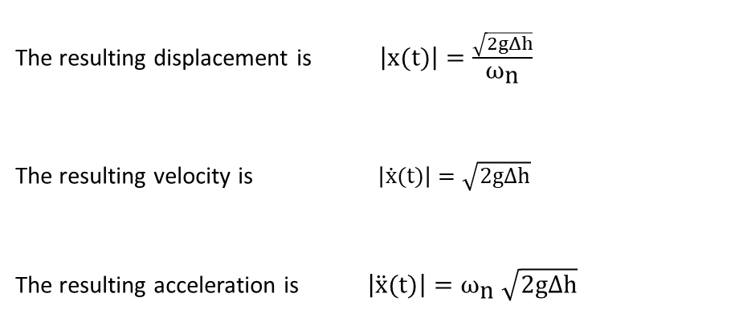
Solve Equation of Motion for Peak Responses
Vibrationdata
$m\ddot{x}+kx=0, x\left(0\right)=0, \dot{x}\left(0\right)=\sqrt{2gΔh}$
$$ω_{n}=\sqrt{k/m}$$
The resulting displacement is $\left|x(t)\right|=\frac{\sqrt{2gΔh}}{{\text{ω}}_{\text{n}}}$
The resulting velocity is $\left|\dot{x}(t)\right|=\sqrt{2gΔh}$
The resulting acceleration is $\left|\ddot{x}(t)\right|={\text{ω}}_{\text{n}} \sqrt{2gΔh}$

Slide 8
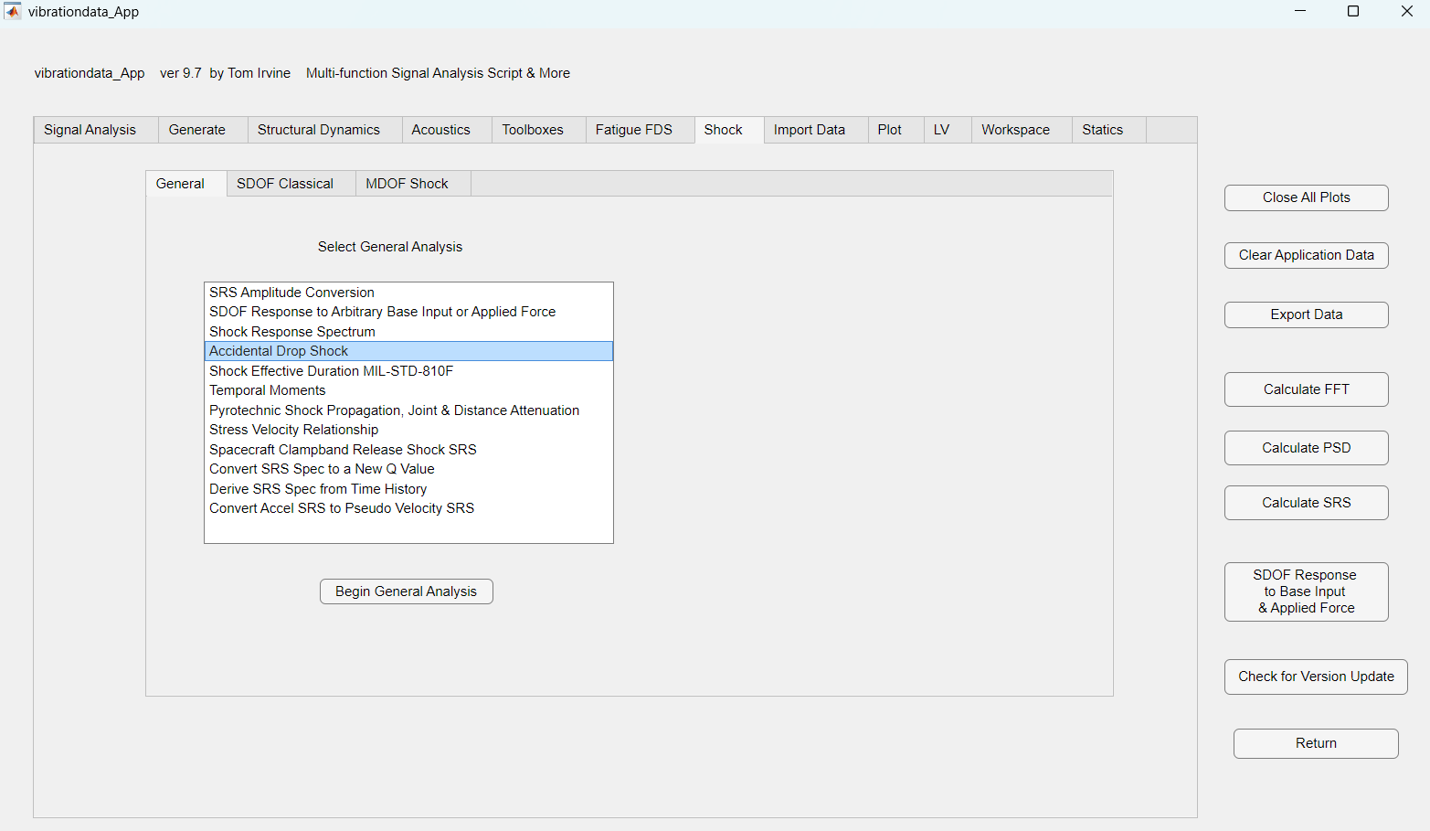
Vibrationdata GUI, Shock Toolbox

Slide 9
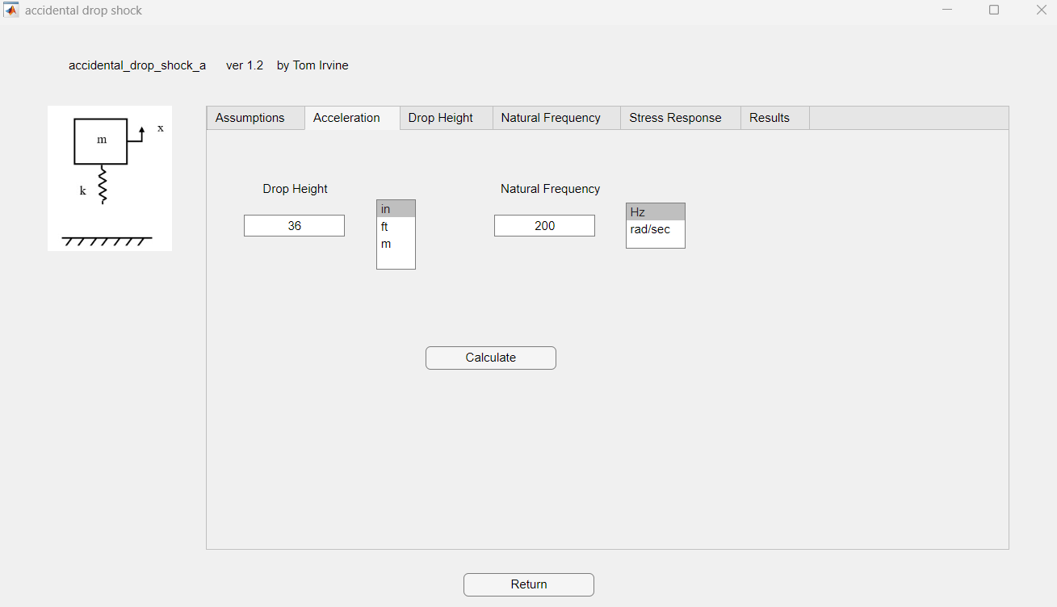

Slide 10
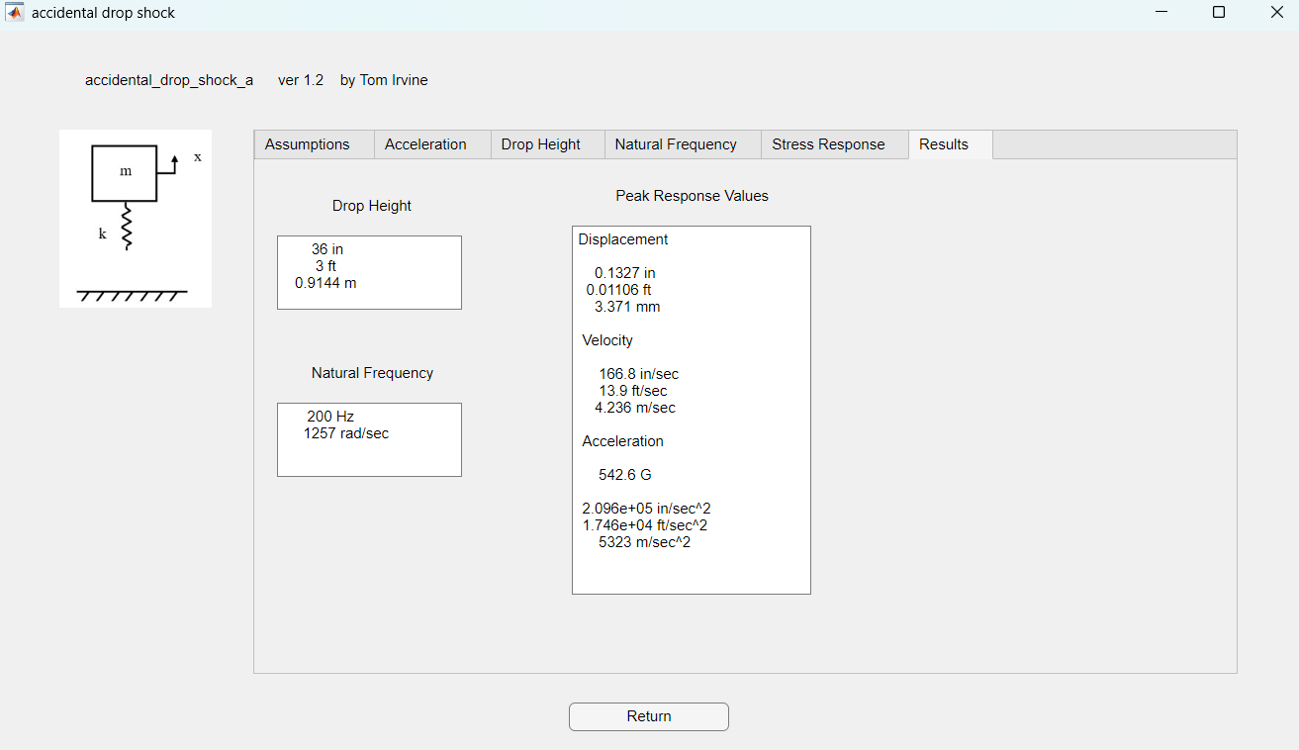

Slide 11
Peak Response Values
Vibrationdata
Drop height = 36 inches
Natural Freq (Hz) | Displacement (in) | Velocity (in/sec) | Acceleration (G)
200 | 0.133 | 167 | 543
600 | 0.044 | 167 | 1630
1000 | 0.027 | 167 | 2710
100 in/sec is “severity threshold” per some references
Drop height of 13 inches yields 100 in/sec
See Gaberson’s papers, MIL-STD-810H, etc.

Slide 12
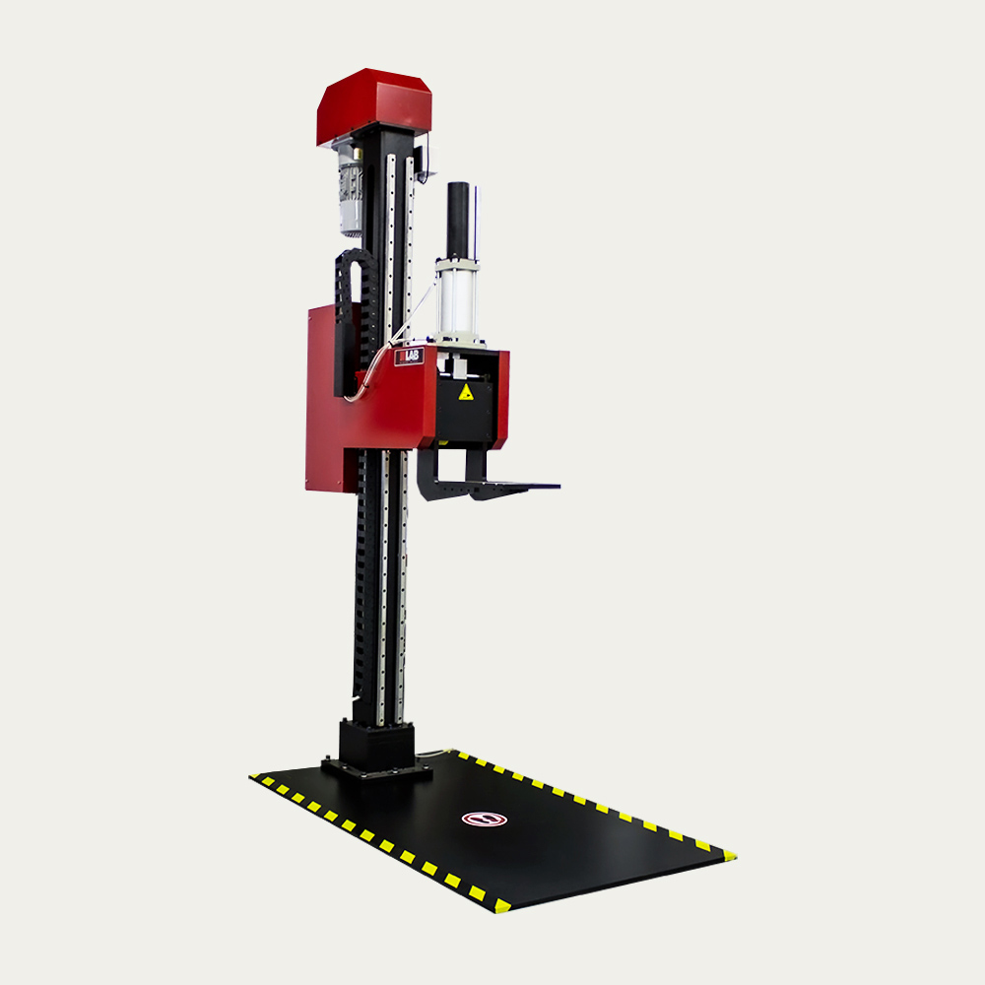
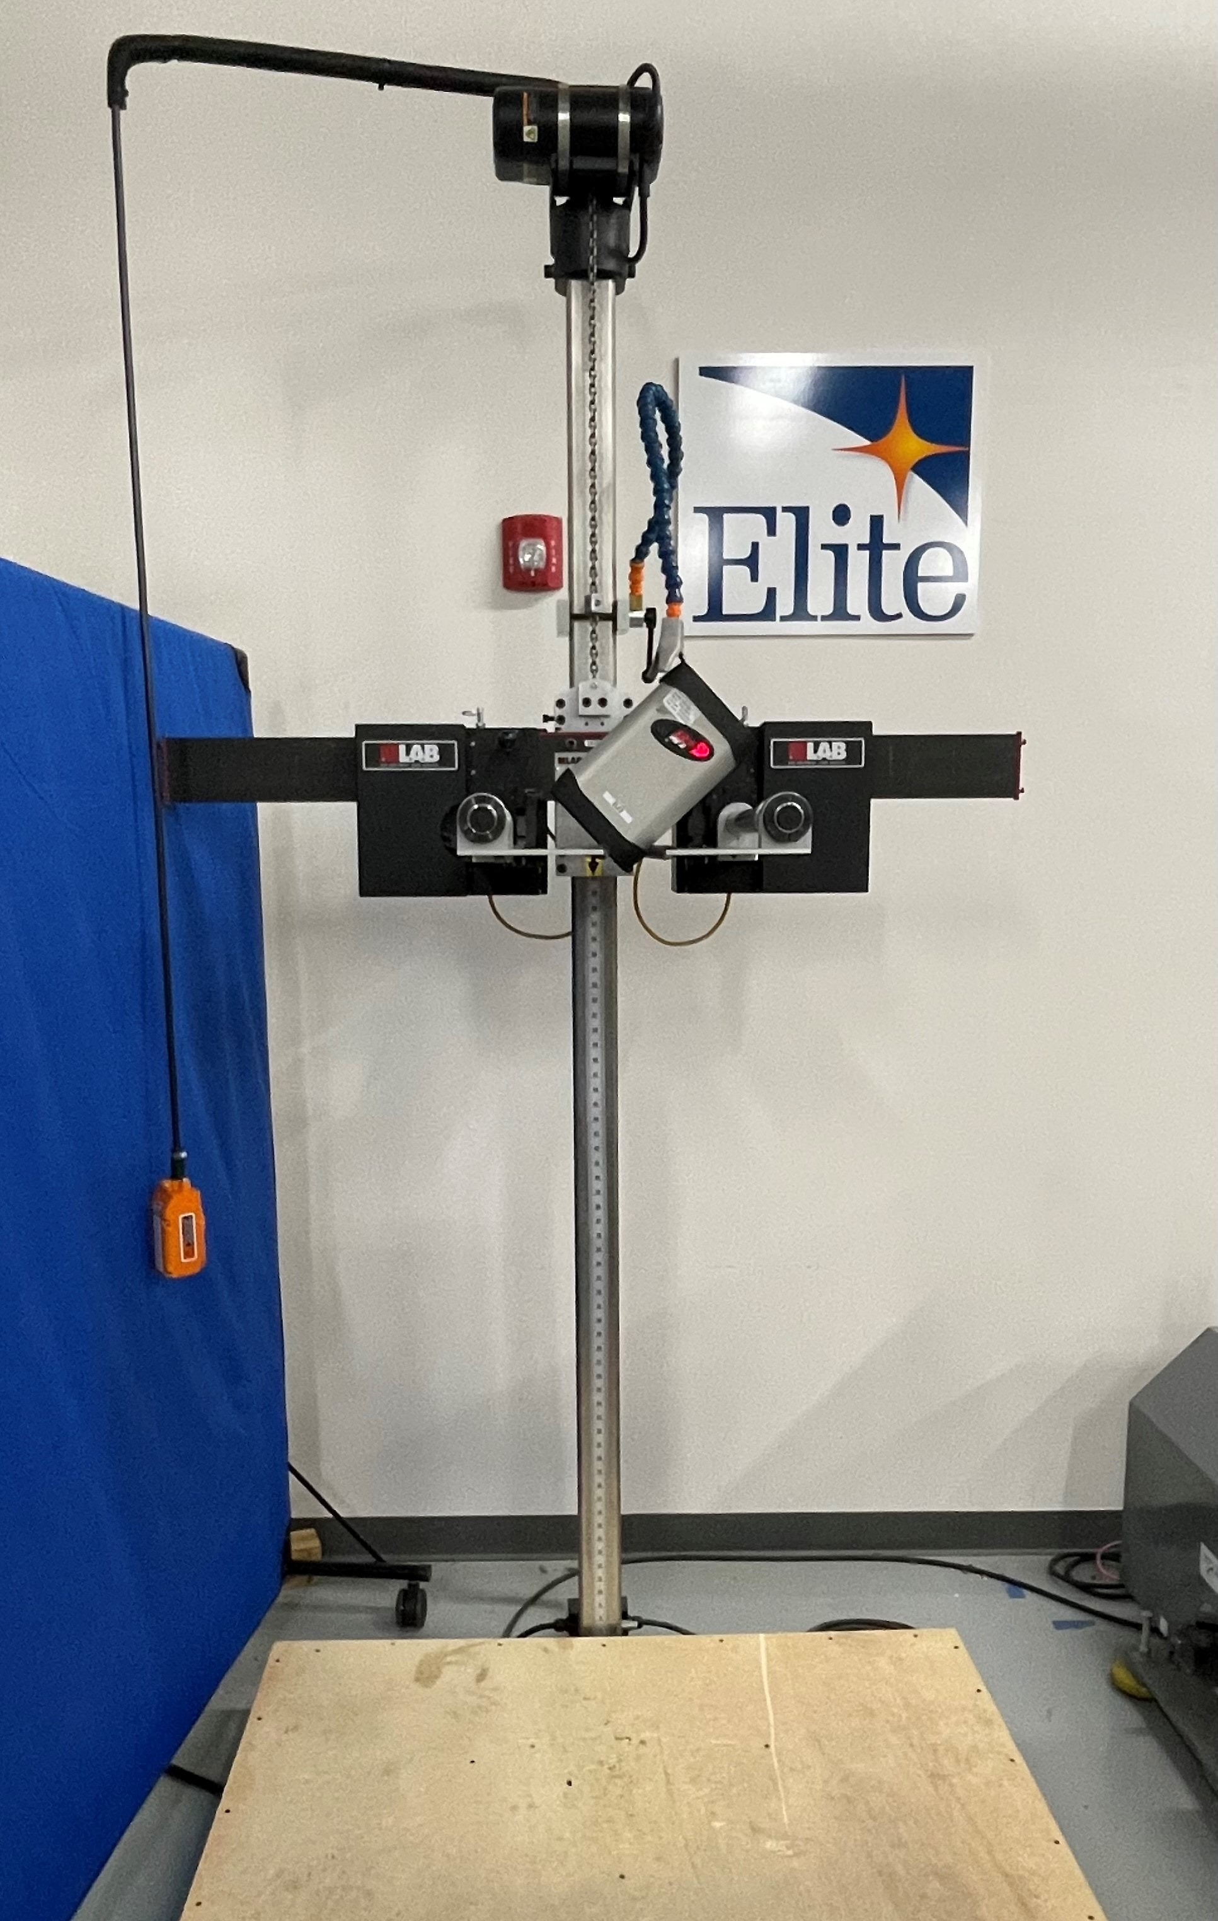
Drop Shock Test Machines
Vibrationdata
https://vibrationresearch.com/blog/drop-shock-testing-products-packaging/
https://techlabsystems.com/eng/product/truedrop-160-drop-tester/
Notes:
Design responses map directly onto the three orientation classes. Corners get bumpers, ductile frame material and glass insets. Edges get strengthened glass, polished chamfers and a lip above the glass. Faces get bonded glass, underfilled solder joints and mounting points that limit board bending.

Slide 13
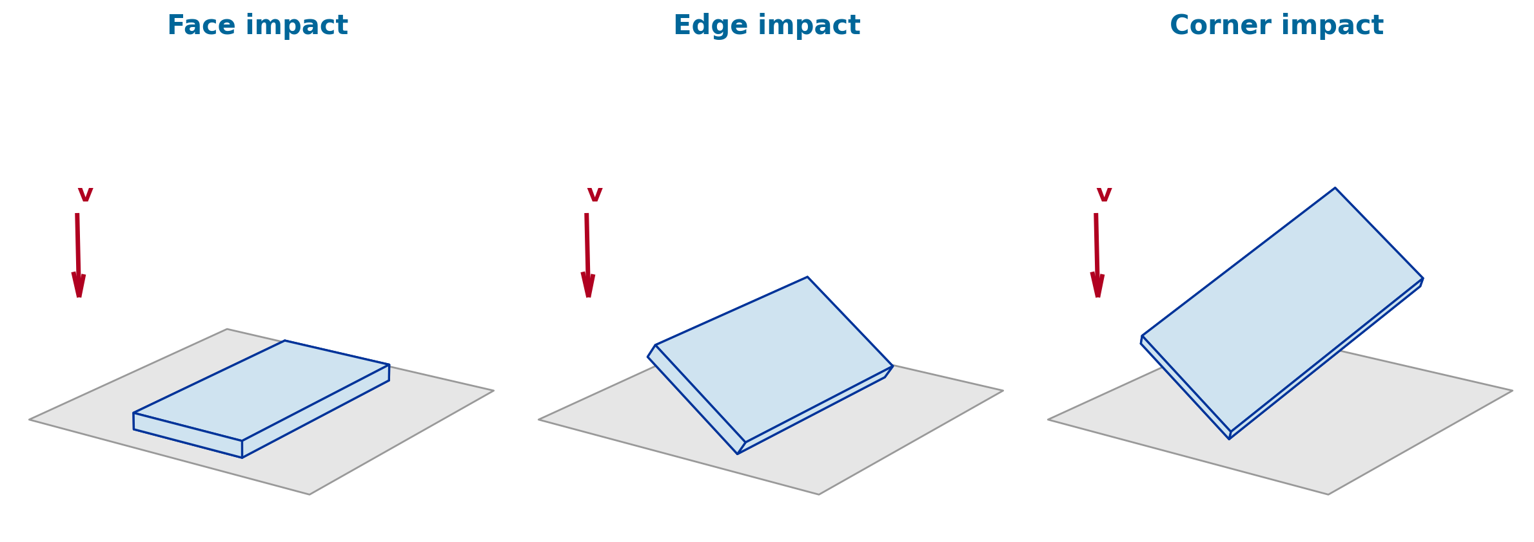
Drop Testing of Portable Electronic Devices
Vibrationdata
Face, Edge and Corner Impacts
Companion material to the Initial Velocity slide: an unboxed phone dropped on live TV survives, but which way it lands decides how it is loaded.
1
Notes:
This set follows the Initial Velocity slide. A drop is a velocity-driven shock, and the orientation at contact, face, edge or corner, controls the contact area, the pulse, and the failure mode. We cover the kinematics, the spring-mass idealization, the pulse and velocity change, the three orientation classes, the standards that call them out, the test hardware, and the design responses.

Slide 14
Why Drop Test?
Vibrationdata
Portable electronic devices (PEDs) are expected to survive multiple accidental drops during their service life
Most OEMs specify 30 to 50 drops per device, distributed across orientations, heights and surfaces
A drop is a velocity-driven shock: the impact velocity is fixed by the height, but the peak acceleration is set by the contact stiffness and orientation
Damage modes: cover glass fracture, display delamination, frame denting, solder joint cracking under the PCB, connector and battery displacement
The Perth iPhone 6 drop shown earlier was a single uncontrolled corner/edge fall onto pavers; a qualification test must cover every face, edge and corner
Two questions a drop test answers
1. Does the device still work after the drop sequence?
2. Is the cosmetic and structural damage acceptable, or does it seed later fatigue and fracture failures?
Orientation classes for a rectangular box
6 faces
12 edges
8 corners
26 orientations in total (MIL-STD-810 transit drop sequence)
2
Notes:
Drop testing is a qualification test with two outcomes: function after the sequence, and the damage state, which matters because cracked glass and cracked solder joints grow under later vibration and thermal cycling. A rectangular device has six faces, twelve edges and eight corners, twenty six orientations, and that is exactly the sequence MIL-STD-810 uses for the transit drop.

Slide 15
Free-Fall Kinematics
Vibrationdata
Impact velocity from drop height h, neglecting air drag: v = √(2 g h)
Kinetic energy per unit mass at impact: KE / m = g h
Velocity grows with the square root of height, so doubling the drop height raises impact velocity only 41 percent but doubles the energy
A hand-held drop from waist or ear height is 1.0 to 1.5 m; the MIL-STD-810 transit drop for man-portable items is 122 cm (48 in)
Drop height | h (in) | v (m/s) | v (ft/s) | KE / m (J/kg)
0.50 m | 19.7 | 3.13 | 10.3 | 4.9
0.75 m | 29.5 | 3.84 | 12.6 | 7.4
1.00 m | 39.4 | 4.43 | 14.5 | 9.8
1.22 m | 48.0 | 4.89 | 16.0 | 12.0
1.50 m | 59.1 | 5.42 | 17.8 | 14.7
1.80 m | 70.9 | 5.94 | 19.5 | 17.7
g = 9.81 m/s². Air drag is negligible for a phone over 1 to 2 m of fall (terminal velocity is tens of m/s).
3
Notes:
The only input the drop height controls is the impact velocity, and it goes as the square root of height. The table spans the heights that matter for hand-held devices. One metre gives 4.43 metres per second; the 48 inch MIL-STD-810 transit drop gives 4.89.

Slide 16
Spring-Mass Idealization with Initial Velocity
Vibrationdata
Model the device as mass m on a contact spring k, released with initial velocity v₀ and zero initial displacement
Response: x(t) = (v₀ / ωₙ) sin(ωₙ t), with ωₙ = √(k / m)
Peak displacement xₘₐₓ = v₀ / ωₙ
Peak acceleration aₘₐₓ = v₀ ωₙ
Peak contact force Fₘₐₓ = v₀ √(k m)
Time to peak = one quarter period = π / (2 ωₙ); contact ends at a half period if there is no energy loss
The spring k is the contact stiffness, which depends on orientation: face contact is much stiffer than a corner
Worked example: 1.0 m drop
v₀ = 4.43 m/s
Assume contact mode fₙ = 500 Hz, so ωₙ = 3142 rad/s
xₘₐₓ = 4.43 / 3142 = 1.41 mm
aₘₐₓ = 4.43 × 3142 = 13,900 m/s² ≈ 1420 G
Time to peak = 0.5 ms
Oversimplification
Plastic deformation, rate-dependent contact stiffness, rotation of the body, and multiple impacts are all outside this linear model. It gives scaling, not a design number.
4
Notes:
This is the model on the Initial Velocity slide. The device is a mass on a contact spring with an initial velocity. Peak displacement is v naught over omega n and peak acceleration is v naught times omega n, so a stiffer contact means a higher and shorter pulse. The example with a 500 hertz contact mode gives about fourteen hundred G with a half millisecond rise. The caveats on the right are the reasons this is a scaling tool rather than a design number.

Slide 17
Impact Pulse, Velocity Change and Restitution
Vibrationdata
The impact pulse is often approximated as a half-sine of peak acceleration A and duration τ
Velocity change through the pulse: Δv = 2 A τ / π
With coefficient of restitution e, the total velocity change is Δv = (1 + e) v₀
e ≈ 0 for a dead, plastic landing; e ≈ 0.5 is typical for a phone on concrete; e → 1 for an elastic bounce
For a fixed drop height, a shorter contact time must mean a higher peak G: the area under the pulse is set by Δv
Corner and edge landings usually have a lower e than face landings because local crushing absorbs energy
Duration τ | Peak A (G)
0.25 ms | 4,260
0.5 ms | 2,130
1.0 ms | 1,065
2.0 ms | 532
5.0 ms | 213
10 ms | 106
Half-sine peak for a 1.0 m drop, e = 0.5, Δv = 6.65 m/s
A = π Δv / (2 τ). Measured phone-on-concrete pulses are typically 0.3 to 2 ms, so peak accelerations of hundreds to several thousand G are normal.
5
Notes:
The half-sine relation ties the three numbers together: peak acceleration, duration, and velocity change. The velocity change is one plus the coefficient of restitution times the impact velocity. For a one metre drop with e of one half, delta v is 6.65 metres per second, and the table shows how sharply the peak G climbs as the contact time shortens. This is why a stiff face landing on steel reads thousands of G while a soft corner crush reads far less at the body centre.

Slide 18
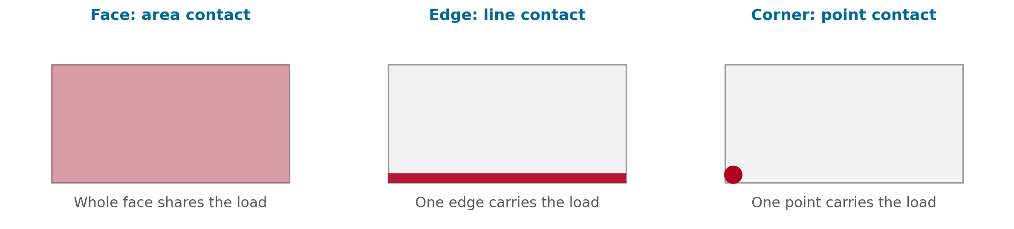
Drop Orientations: Face, Edge and Corner
Vibrationdata
Face: the largest contact area; load shared across the whole surface
Edge: a line contact; the frame and the glass rim carry the load
Corner: a point contact; the smallest area and the highest local stress
Same impact velocity in every case; what changes is the contact stiffness, the pulse shape, the energy absorbed locally, and how much of the energy goes into rotation
In practice the phone rarely lands square: a nominal face drop usually arrives a few degrees off and becomes an edge-then-face event
6
Notes:
Three orientation classes. Face drops share the load over an area, edge drops put it along a line, corner drops put it at a point. The impact velocity is identical; the difference is the contact stiffness and how the energy is absorbed. Most real drops are off-axis, which is why testing controls orientation deliberately.

Slide 19
Face Impact
Vibrationdata
Stiffest contact: large area on a hard surface gives the shortest pulse and the highest peak acceleration at the body center
Peak G on the PCB is therefore highest for face drops; this is the case that cracks BGA solder joints under the board
Display-down landings load the cover glass in bending as it spans the frame; tensile stress develops on the inner glass surface
A face drop onto a rough surface (gravel, a pebble, a paver edge) converts a face contact into a point contact on the glass, producing a Hertzian ring or cone crack
Back-face drops protect the display but drive the battery and camera modules against their mounts
Highest coefficient of restitution of the three classes: little local crushing, so the device bounces and can strike a second time
Governing quantity
Peak acceleration and PCB bending strain
Short pulse (0.3 to 1 ms), high G, whole-body response; board-level solder joint failure is the classic mode
Test note
The hardest orientation to achieve in free fall: any tilt becomes an edge-first landing. Guided drop towers or robotic release are used to hold it within a few degrees.
7
Notes:
The face drop is the stiffest contact, so it produces the highest whole-body acceleration and the largest board strains. That is why the JEDEC board-level drop test is a face-down event. On the glass side, a flat landing is survivable, but a pebble under the glass turns it into a point contact and cone cracking. Face landings are also the hardest to achieve in a free-fall test.

Slide 20
Edge Impact
Vibrationdata
Line contact along one edge of the frame; the most common orientation in real-world drops because the device tends to rotate as it leaves the hand
Long edges and short edges behave differently: a short-edge (top or bottom) landing loads the frame in its stiff direction; a long-edge landing bends the frame about its weak axis
Cover glass strength is set by edge flaws from cutting and finishing; an edge landing puts tension right where the flaw population is worst
The frame deflects inward, closing the gap to the glass; glass-to-frame contact at the rim is a frequent crack origin
Intermediate contact stiffness: longer pulse and lower body G than a face drop, but far higher local stress
The body then rotates about the contact edge and slaps down on a face, so an edge test is two impacts, not one
Governing quantity
Local stress along the contact edge and at the glass rim
Frame plastic deformation and glass edge cracking; body G is secondary
Test note
Twelve edges in the MIL-STD-810 sequence. Orientation is specified by the edge and by the tilt angle of the body about that edge (often 0, 15 or 45 degrees).
8
Notes:
Edge landings are the most common real-world drop because the phone rotates leaving the hand. The stress concentrates along the contact line and at the rim of the cover glass, where strength is governed by edge flaws from cutting. The body G is lower than a face drop, but the local stress is higher, and every edge landing is followed by a face slap.

Slide 21
Corner Impact
Vibrationdata
Point contact: the smallest area and the highest contact stress of the three classes
Local plastic deformation of the frame (a dented aluminum corner is the signature) absorbs a large share of the kinetic energy
Because the contact is soft and dissipative, the pulse is longer and the acceleration at the body center is the lowest of the three, and the coefficient of restitution is the lowest
Low body G does not mean benign: the corner of the cover glass sits at a stress concentration where two edges meet, and corner cracks radiate across the display
The off-center contact converts translational energy into rotation about the corner, followed by an edge or face secondary impact
Corner drops are the dominant field failure for glass-fronted devices and drive case and bumper design
Governing quantity
Contact stress and plastic strain at the corner; glass corner stress
Cosmetic dent, glass corner fracture, seal and gasket damage
Test note
Eight corners in the MIL-STD-810 sequence. The corner must strike first with the body diagonal near vertical; high-speed video is used to confirm the attitude at contact.
9
Notes:
The corner drop has the smallest contact area and the highest local stress, but the corner crushes and absorbs energy, so the body acceleration is actually the lowest of the three. Do not read a low accelerometer trace as a mild event. Corner cracks in the cover glass are the dominant field failure and the reason cases carry raised corner bumpers.

Slide 22
Face, Edge and Corner Compared
Vibrationdata
Attribute | Face | Edge | Corner
Contact geometry | Area | Line | Point
Contact stiffness | Highest | Intermediate | Lowest
Pulse duration | Shortest (≈ 0.3 to 1 ms) | Intermediate | Longest
Peak G at body center | Highest | Intermediate | Lowest
Local contact stress | Lowest | High along edge | Highest at a point
Energy absorbed locally | Little (elastic) | Moderate | Large (plastic dent)
Coefficient of restitution | High | Moderate | Low
Rotation after contact | Little | Rotates to a face | Rotates to an edge, then a face
Typical failure | PCB strain, solder joints, cone crack on glass | Glass edge crack, frame bending | Glass corner crack, frame dent, seal damage
Count in 26-drop sequence | 6 | 12 | 8
Trends assume a hard, flat landing surface. Rankings are qualitative; measured values depend on the device, the surface and the release method.
10
Notes:
This table summarizes the three classes side by side. The pattern worth remembering is the inversion: the orientation with the highest body G, the face, has the lowest local stress, and the orientation with the lowest body G, the corner, has the highest. An accelerometer at the centre of the device therefore ranks the three impacts in the opposite order from the damage they cause.

Slide 23
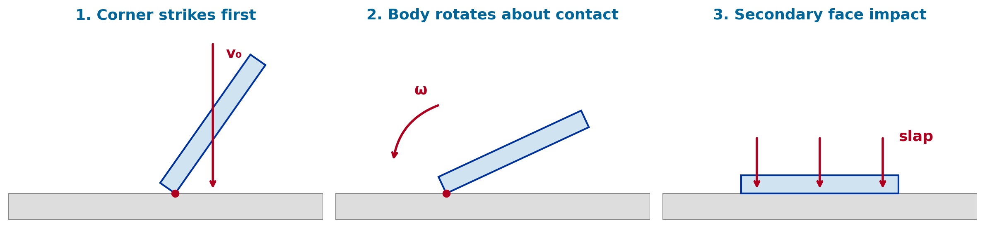
Rotation and Secondary Impacts
Vibrationdata
Any off-center contact applies an impulsive moment about the mass center, so part of the kinetic energy becomes rotational energy and the body pivots on the contact
The device then strikes a second time on an edge or face, often at a higher angular velocity than a straight fall would give that face
Instrumented drops routinely show two or three distinct pulses within 20 to 50 ms; the second pulse can exceed the first in peak G
Free-fall testers reproduce this behavior; guided drop towers suppress it, so the two methods do not give the same damage
Report the full sequence, not just the first pulse, and record a high-speed video of every drop
11
Notes:
Almost every real drop is a sequence. The corner strikes, the body rotates about that contact, and the face slaps down. The second pulse is often larger than the first at the accelerometer. Guided towers suppress rotation and free-fall testers reproduce it, which is one reason the two methods produce different damage.

Slide 24
Drop Test Standards
Vibrationdata
Standard | Scope | Orientations | Height and surface
MIL-STD-810H, Method 516.8, Procedure IV (Transit Drop) | Equipment in its transit configuration | 26 drops: 6 faces, 12 edges, 8 corners; may be split among up to 5 samples | 122 cm (48 in) for man-portable items under 45 kg; 5 cm plywood backed by concrete
IEC 60068-2-31 (Test Ec), rough handling shocks | Equipment-type specimens, hand-held devices | Free fall (Procedure 1), repeated free fall in a tumble drum (Procedure 2), topple, and drop-and-topple | 25 mm to 1000 mm; repeated falls typically 500 mm; hard rigid surface of concrete or steel
JEDEC JESD22-B111 | Board-level drop of handheld electronic products (solder joints) | PCB mounted face-down on a guided drop table; daisy-chain resistance monitored | 1500 G, 0.5 ms half-sine (Condition B); 30 drops typical
ASTM D5276 / ISTA procedures | Free-fall drop of loaded shipping containers | Flat, edge and corner drops on the package | Height set by package weight class; steel or concrete floor
OEM internal specifications | Finished consumer device | Rotating sequence over all faces, edges and corners | Commonly 30 to 50 drops from about 1 m onto concrete, steel, granite or plywood
Heights, counts and surfaces above are the commonly cited values; confirm against the edition of each document in force before writing a test plan.
12
Notes:
The standards differ in what they protect. MIL-STD-810 protects an item in transit with the twenty six orientation sequence. IEC 60068-2-31 covers free fall, repeated free fall in a tumbling drum, and topple. JEDEC B111 is a board-level test of the solder joints. ASTM and ISTA cover the packaged product. The consumer OEM specifications are internal but typically thirty to fifty drops from about a metre.

Slide 25
Test Equipment and Instrumentation
Vibrationdata
Release methods
Landing surfaces
Free-fall drop tester: pneumatic or vacuum release with the device held at the set attitude; reproduces rotation and secondary impacts
Guided drop tower: device on a carriage or fixture running on rails; repeatable attitude but no rotation
Tumble drum: rotating barrel gives repeated 0.5 m falls in random orientations (IEC 60068-2-31 Procedure 2)
Robotic arm: programmable attitude, height and spin; used for large orientation sweeps
Concrete, steel plate, granite, ceramic tile, plywood over concrete, asphalt
Surface hardness sets the contact stiffness and therefore the pulse; the same device gives very different peak G on steel and on plywood
Surface roughness (pebbles, grit) converts face contacts into point contacts on the glass
Measurement
Post-drop assessment
Piezoresistive accelerometers, ±20,000 G range, sampled at 100 kHz or faster, low-pass filtered to remove ringing
Strain gauges on the PCB near BGA sites for board bending
Daisy-chain continuity monitored in situ for solder joint opens
High-speed video at 5,000 to 20,000 frames per second to verify attitude at contact and capture the rotation
Functional test after every drop or every few drops
Cosmetic inspection: dents, scuffs, glass cracks, gap changes
Optical and X-ray inspection of solder joints; dye-and-pry on failed samples
SRS of each measured pulse to compare severities across orientations and surfaces
13
Notes:
Release method matters as much as height. Free-fall testers reproduce rotation and secondary impacts; guided towers give repeatable attitude but suppress rotation; tumble drums give many random-orientation falls; robotic arms allow programmed sweeps. The surface sets the contact stiffness. Instrumentation is high-range accelerometers sampled fast, PCB strain gauges, daisy-chain continuity, and high-speed video.

Slide 26
Analysis Methods
Vibrationdata
Energy balance: ½ m v₀² must be stored elastically, dissipated in local plastic work, or converted to rotation; this bounds the peak force for any assumed contact law
Hertz contact for a corner on a flat: F = (4/3) E* √R δ^(3/2), a hardening spring whose stiffness rises with penetration
Explicit finite element analysis (LS-DYNA, Abaqus/Explicit) with the device model dropped at a sweep of attitudes; the glass, frame, adhesive and PCB must all be present
Shock response spectrum of the measured pulse to compare orientations and surfaces on a common basis and to set a board-level test
Board-level: PCB bending strain rather than peak G is the solder joint damage metric; Steinberg-type fatigue on the strain amplitude
Stress-velocity perspective
For a bar striking a rigid surface end-on, the stress at the impact face is
σ = ρ c v₀
Aluminum (ρ = 2700 kg/m³, c = 5100 m/s), 1.0 m drop, v₀ = 4.43 m/s: σ ≈ 61 MPa
Glass (ρ = 2500 kg/m³, c ≈ 5400 m/s): σ ≈ 60 MPa
The edge strength of unstrengthened glass is of this order, which is why chemically strengthened cover glass with a deep compressive surface layer is essential. Real structures see σ = K ρ c v with K from 1 to about 8 (Hunt, Gaberson).
14
Notes:
Analysis ranges from an energy balance with an assumed contact law, through Hertz contact for the corner, to explicit finite element models dropped at a sweep of attitudes. For solder joints, board strain is the damage metric, not G. The stress-velocity relation is a useful sanity check: a one metre drop puts the bar-impact stress at about sixty megapascals in both aluminum and glass, which is the edge strength of unstrengthened glass, and real structures carry a K factor above that.

Slide 27
Design Responses to Face, Edge and Corner Drops
Vibrationdata
Corner
Edge
Face
Raised bumpers on the case so the corner never touches the ground
Ductile frame alloy that dents rather than cracks, absorbing energy before it reaches the glass
Glass corner radius and inset from the frame corner
Compliant corner gasket between glass and frame
Keep-out zone for components and solder joints at the PCB corners
Chemically strengthened glass with a deep compression layer covering the edge flaws
Polished, chamfered glass edges to reduce the flaw population
A raised lip on the frame or case above the glass surface
Controlled glass-to-frame gap with an elastomer buffer
Frame stiffness tuned so the edge does not close the gap onto the glass rim
Adhesive bonding of the glass to the frame to carry the bending as a composite
Underfill or corner staking for BGA components to survive board strain
PCB mounting points placed to reduce span and bending under face impact
Internal foam or gel pads between battery and housing
Slightly recessed display so a pebble contacts the lip, not the glass
15
Notes:
Design responses map directly onto the three orientation classes. Corners get bumpers, ductile frame material and glass insets. Edges get strengthened glass, polished chamfers and a lip above the glass. Faces get bonded glass, underfilled solder joints and mounting points that limit board bending.

Slide 28
Summary
Vibrationdata
A drop is a velocity-driven shock: v₀ = √(2 g h), 4.43 m/s from 1.0 m
The spring-mass model with initial velocity gives aₘₐₓ = v₀ ωₙ; the contact stiffness, not the height, sets the peak G
Half-sine relation Δv = 2 A τ / π with Δv = (1 + e) v₀ ties peak G, duration and restitution together
Face: stiffest contact, highest body G, PCB and solder joint damage
Edge: line contact, most common in service, glass rim and frame failures
Corner: point contact, lowest body G but the highest local stress, dented frames and corner-cracked glass
Rotation makes most drops a two- or three-impact sequence; free-fall and guided methods differ for this reason
MIL-STD-810 transit drop uses all 26 orientations; OEMs typically require 30 to 50 drops
Instrument with high-range accelerometers, PCB strain gauges and high-speed video; use the SRS and board strain, not peak G alone, to judge severity
16
Notes:
Summary. The height sets the velocity, the contact sets the pulse, the orientation sets where the stress goes. Face drops load the board, edge drops load the glass rim, corner drops dent the frame and crack the glass corner while reading the lowest G. Test all twenty six orientations and judge severity by strain and SRS, not the accelerometer peak alone.

Slide 29
References
Vibrationdata
MIL-STD-810H, Environmental Engineering Considerations and Laboratory Tests, Method 516.8 Shock, Procedure IV Transit Drop, 2019
IEC 60068-2-31, Environmental Testing, Part 2-31: Tests, Test Ec: Rough Handling Shocks, Primarily for Equipment-Type Specimens, 2008
JEDEC JESD22-B111A, Board Level Drop Test Method of Components for Handheld Electronic Products, 2016
ASTM D5276, Standard Test Method for Drop Test of Loaded Containers by Free Fall
F. V. Hunt, Stress and Strain Limits on the Attainable Velocity in Mechanical Vibration, Journal of the Acoustical Society of America, 32(9), 1960
H. Gaberson and R. Chalmers, Modal Velocity as a Criterion of Shock Severity, Shock and Vibration Bulletin 40, 1969
D. S. Steinberg, Vibration Analysis for Electronic Equipment, 3rd ed., Wiley, 2000
T. Irvine, Shock and Vibration Response Spectra, free ebook, blog.vibrationdata.com/2025/11/27/toms-ebooks/
17
Notes:
References for the standards, the stress-velocity work of Hunt and Gaberson, Steinberg for board-level electronics, and the Vibrationdata shock response spectra ebook.

