Slide 1
Vibrationdata
ASCE 7-22, Ch 12, Seismic Design Requirements for Buildings
Revision D
By Tom Irvine

Slide 2
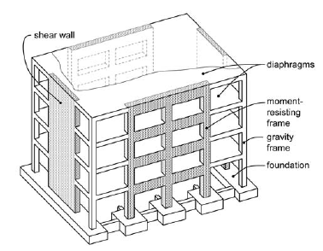
Vibrationdata
Introduction
Chapter 11 tells us how strong the earthquake is
Chapter 12 tells us what we’re allowed to build in response and controls which structural systems are legally permitted based on:
  Seismic Design Category (SDC)
  Building height
  Structural regularity
System selection is therefore a code-driven design decision, not purely an engineering preference
NEHRP Seismic Design Technical Brief No. 3, Seismic Design of Cast-in-Place Concrete Diaphragms, Chords, and Collectors

Slide 3
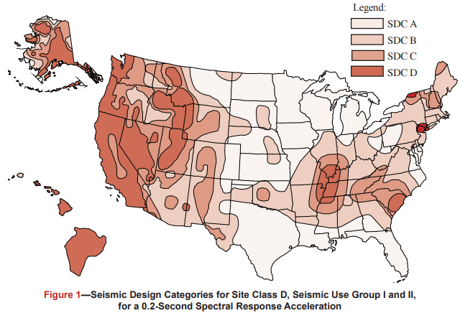
Vibrationdata
Seismic Hazard Map
Each figure is based on Site Class D (the default class when the soil profile is not known) and is applicable to structures assigned to Occupancy Categories I, II, and III (buildings other than high hazard exposure structures)
Note that if the soil profile is known and is lower than D, a correspondingly lower SDC may be realized
https://www.cmha.org/resource/tek-14-18b/

Slide 4
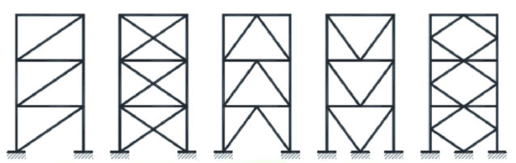
Vibrationdata
Scope
Of the five shown, X-bracing is the best performer — but the honest answer is that none of them are the most effective seismic system, because they're all concentric
Diagonal X-Bracing Inverted V-Bracing K-Bracing
Bracing V-Bracing
Chapter 12 = “How to design the building once hazard is known”
Applies to:
  Building Seismic Force-Resisting Systems (SFRS)
  Diaphragms
  Frames, shear walls, braced frames
  Building height & configuration limits
  Analysis procedures
  Drift and stability checks
https://www.linkedin.com/pulse/bracing-up-concentric-vs-eccentric-decoding-steel-skeleton-a-j-vkbfc/

Slide 5
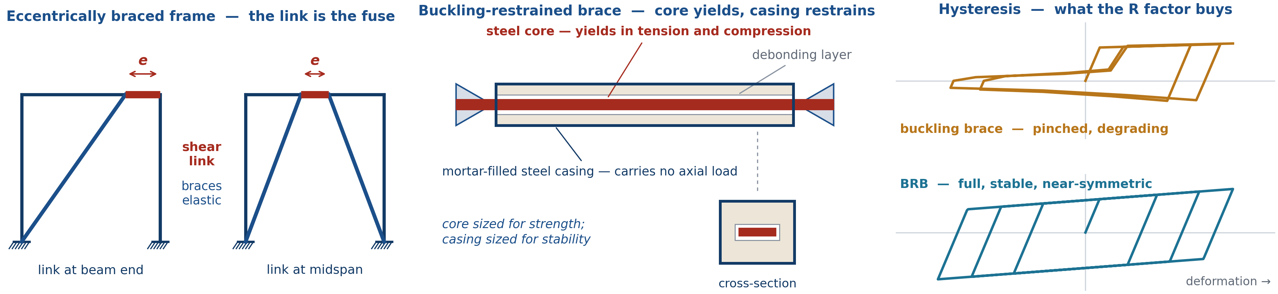
Better Bracing Designs
Vibrationdata
Concentric bracing dissipates energy by buckling the brace — pinched, degrading loops
EBF: a short link yields; the braces, columns and beam outside the link stay elastic
  Shear link when e ≤ 1.6 Mp/Vp; link rotation capacity to 0.08 rad
  Braced-frame stiffness with moment-frame ductility
BRBF: the casing restrains the core, so it yields in compression rather than buckling
  Near-symmetric capacity removes the chevron beam unbalanced force
  Core ductility 10–15, with no strength degradation
Both concentrate inelastic demand in a defined, inspectable, capacity-designed fuse
ASCE 7-22, Table 12.2-1
System | R | Ω₀ | Cd | Height limit SDC D & E
OCBF | 3¼ | 2 | 3¼ | 35 ft
SCBF | 6 | 2 | 5 | 160 ft
EBF | 8 | 2 | 4 | 160 ft
BRBF | 8 | 2½ | 5 | 160 ft
Not limited in SDC A–C; 100 ft in SDC F. OCBF is not permitted in SDC F.
The link and the core are engineered fuses — the inelastic action goes where the designer put it, not where the structure happens to be weakest.
ASCE 7-22 Table 12.2-1 | AISC 341-22 Sections F2 (SCBF), F3 (EBF), F4 (BRBF)
Notes:
This slide answers the question the previous scope slide raises: all five configurations shown there are concentric, and concentric bracing dissipates energy by buckling the brace. That mechanism gives a pinched, degrading hysteresis loop, which is why a special concentrically braced frame is held to R = 6.
The eccentrically braced frame moves the inelastic demand out of the brace and into a short link. If the link is short enough, e no greater than 1.6 Mp/Vp, it yields in shear rather than flexure, which is the most ductile and most stable of the available mechanisms; AISC 341 permits link rotations up to 0.08 rad. Everything else in the frame is capacity-designed to remain elastic against the link's expected strength, so the link is a defined and replaceable fuse. The result is braced-frame stiffness with moment-frame ductility, and R = 8.
The buckling-restrained brace attacks the problem differently. The steel core is decoupled from a mortar-filled steel casing by a thin debonding layer, so the casing provides lateral restraint without picking up axial load. The core then yields in compression at essentially the same load it yields in tension, giving full, stable, near-symmetric loops with core ductility on the order of 10 to 15. Because tension and compression capacities are nearly equal, the chevron unbalanced-force penalty that drives heavy beams in an SCBF largely disappears.
Both systems are held to the same 160 ft height limit in SDC D and E as an SCBF, and both carry R = 8 versus 6 for SCBF and 3-1/4 for OCBF. The trade is cost and connection complexity: EBF links require careful stiffener detailing and web doubler prohibitions, and BRBs are proprietary, qualification-tested assemblies.

Slide 6
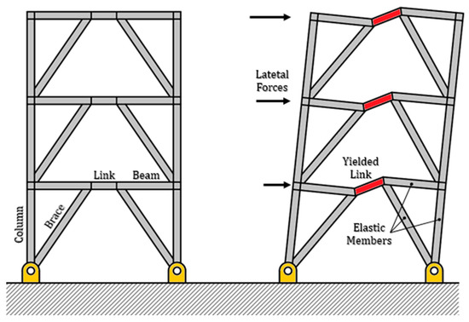
https://www.mdpi.com/2076-3417/14/21/9683

Slide 7

Vibrationdata
Workflow
Get SDS, SD1 (Ch 11)
Determine Seismic Design Criteria (SDC)
Select structural system
Apply Ch 12 analysis & detailing rules
Corrugated Steel Floor and Roof Diaphragms with Steel cross-bracing and diagonal members for lateral stability
https://www.constructionspecifier.com/smdi-and-aisc-partner-to-establish-sdii/

Slide 8
Vibrationdata
From Hazard to Structural System
Step | Meaning
Hazard | SS, S1, Site Class, Risk Category
Seismic Design Category (SDC) | A through F
System Selection | SMRF, SCBF, Shear Wall, Dual System
Analysis Method | ELF or MRSA
Drift Check | Δ ≤ Cd·Δe / Ie
Stability | P-Δ limits
Detailing | AISC 341 / ACI 318 seismic provisions
Special Moment Resisting Frame (SMRF)
Special Concentrically Braced Frame (SCBF)
Equivalent Lateral Force (ELF)
Modal Response Spectrum Analysis (MRSA)
Cd = Design Deflection Amplification Factor
Ie = Importance Factor
Δe = Story Elastic Displacement
P = vertical gravity load (axial load in columns)
Δ = lateral displacement

Slide 9
Decision Flowchart, Phase 1 – Seismic Hazard Determination
STEP 1 · Determine Risk Category (RC)
Classify by occupancy/function → RC I, II, III, or IV.
RC IV = Essential Facilities (hospitals, EOCs, fire stations)
§1.5 · Table 1.5-1
STEP 2 · Obtain Ground Motion Parameters
Use USGS/ASCE Hazard Tool: obtain SS & S1.
Apply site coefficients: Fa, Fv per Site Class A–F.
SDS = ⅔ · Fa · SS SD1 = ⅔ · Fv · S1
§11.4.1–11.4.5 · Table 11.4-1 & 11.4-2
STEP 3 · Assign Seismic Design Category (SDC)
Use Tables 11.6-1 & 11.6-2 with SDS, SD1 and Risk Category.
Categories: A (least) → B → C → D → E → F (most severe)
§11.6 · Tables 11.6-1 & 11.6-2
SDC = A only?
§11.6 · §11.7
Yes
No
Apply §11.7 Only
Min. lateral force = 1% W per floor. No further seismic analysis required.
§11.7.1–11.7.3
SDC B–F → Continue
Proceed to Step 4:
Select SFRS & analysis procedure
§12.2 et seq.

Slide 10
Phase 2 – SFRS Selection & Structural Irregularies
STEP 4 · Select Seismic Force-Resisting System (SFRS)
Choose system from Table 12.2-1. Obtain R, Ω₀, Cd.
Verify system is permitted for assigned SDC and height limit.
Systems: Bearing Wall, Building Frame, Moment Frame, Dual,
Cantilever Column, Shear Wall–Frame Interactive
§12.2.1 · Table 12.2-1
Yes
Irregularity Types (Tables 12.3-1 & 12.3-2) Horizontal & Vertical
Structural Irregularity present?
§12.3 · Tables 12.3-1 & 12.3-2
Regular Structure
No special irregularity requirements apply.
Proceed to analysis procedure selection.
§12.3.1 — Regular structures
→ Proceed to Phase 3
Analysis Procedure Selection (§12.6)
See next slide.

Slide 11
Phase 3 – Analysis Selection & Forces
Vibrationdata
STEP 5 · Select Analysis Procedure (Table 12.6-1)
Determine permitted method based on SDC, height h, period T, and irregularity type.
§12.6 · Table 12.6-1
LRHA
LRHA / NRHA
Linear or Nonlinear, Response History Analysis.
Permitted for all structures.
Required: isolated/damped.
Peer review required.
Base shear comes directly from the response history results, not from Cs·W
§12.9.2 · §16
Which Analysis Procedure?
§12.6 · Table 12.6-1
ELF
MRSA
ELF Procedure
Equivalent Lateral Force
V = Cs · W
Cs = SDS/(R/Ie)
Simplest method.
OK: SDC B–D, regular,
hn ≤ height limits
§12.8
Modal RSA (§12.9.1)
Multi-mode response spectrum.
Combine via SRSS or CQC.
Require ≥90% mass participation.
Required for irregular/tall.
Must scale if VMRSA < 0.85·VELF
Base shear is computed differently (summed modal forces via SRSS/CQC)
§12.9.1 · §12.9.1.4
LRHA — Reduced Roof Live Load, Horizontal Area-based
NRHA — Nominal (unreduced) Roof Live Load, Horizontal Area-based

Slide 12
Phase 3 – Analysis Selection & Forces (cont)
Vibrationdata
ELF
STEP 6 · Compute Seismic Base Shear ELF
Cs = SDS / (R/Ie) [§12.8.1.1]
Cs,max = SD1 / (T · R/Ie) or SD1 · TL / (T² · R/Ie)
Cs,min = max(0.044·SDS·Ie, 0.01) [or 0.5·S1/(R/Ie) if S1 ≥ 0.6g]
V = Cs · W
Scale MRSA result if Vmrsa < 0.85·VELF (§12.9.1.4)
STEP 7 · Distribute Forces Vertically & Apply Torsion
Fx = Cvx · V where Cvx = wxhxᵏ / Σwihiᵏ
k = 1 (T ≤ 0.5s) | k = 2 (T ≥ 2.5s) | interpolate between
Accidental torsion: Mta = Vx · 0.05 · B (§12.8.4.2)
Amplify torsion if Type 1a/1b horizontal irregularity (§12.8.4.3)

Slide 13
Phases 4-5, Drift, P-delta, Diaphragms & Foundations
Vibrationdata
ELF, MRSA, LRHA
STEP 8 · Compute Design Story Drift & Stability
δx = Cd · δxe / Ie (amplified elastic displacement)
Δ = δx − δx−1 (story drift)
P-Delta stability coefficient: θ = PxΔ / (Vx · hsx · Cd)
§12.8.6 · §12.8.7 · §12.12.1
Δ ≤ Δa and θ ≤ 0.10?
§12.12.1 · §12.8.7
No -> redesign
Yes
STEP 9 · Diaphragm Forces, Collectors & Connections
Fpx = (ΣFi / Σwi) · wpx ≥ 0.2·SDS·Ie·wpx
Collector (drag strut) elements: design for Ω₀ seismic forces.
Verify diaphragm shear transfer to vertical SFRS elements.
§12.10 · §12.10.2 Collector overstrength
STEP 10 · Foundation Design & Soil–Structure Interaction
Transfer amplified seismic demands to foundation per §12.13.
SSI reduction optional per §12.13.3 (can reduce base shear).
Pile/pier detailing varies by SDC per §12.13.5.
§12.13 · Foundation detailing by SDC
STEP 11 · Nonstructural Component Anchorage (§13)
Fp = 0.4·SDS·Ip·Wp · (1 + 2z/h) · (1 + 2/Rp)
Check mechanical, electrical, plumbing, cladding, equipment.
Triggered for SDC C–F. Use Tables 13.5-1 & 13.6-1.

Slide 14
Phases 4-5, Drift, P-delta, Diaphragms & Foundations (cont)
Vibrationdata
ELF, MRSA, LRHA
FINAL COMPLIANCE CHECKLIST (All Steps Complete?)
☑ RC & SDC assigned
☑ SFRS selected from Table 12.2-1
☑ Irregularities assessed
☑ Analysis procedure confirmed
☑ V & Fx computed
☑ Drift Δ ≤ Δa
☑ P-delta θ ≤ 0.10
☑ Diaphragm Fpx checked
☑ Collectors: Ω₀ forces
☑ Foundation demands transferred
☑ Nonstructural anchors (§13)
P-Delta Limits (§12.8.7):
θ ≤ 0.10: No P-delta amplification needed
0.10 < θ ≤ θmax: Amplify by 1/(1−θ)
θ > θmax: Redesign required
SEISMIC SEPARATION GAP (§12.12.3)
Adjacent dissimilar structures:
δMT = √(δM1² + δM2²)
Same structure with joint:
δMT = δM1 + δM2 (absolute sum)

Slide 15
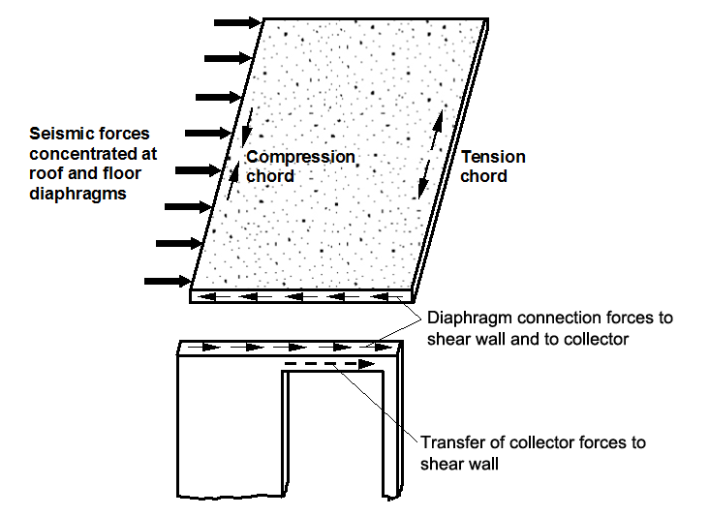
Vibrationdata
Structural System Selection
R (Response Modification Factor)
  Reduces design forces → assumes ductility and energy dissipation
Ω₀ (Overstrength Factor)
  Used for collectors, chords, connections, discontinuities
Cd (Deflection Amplification Factor)
  Used to compute amplified drift for code drift checks
Height Limits Increase with Ductility
Special systems (SMRF, SCBF, Special Shear Walls, Dual Systems) are permitted in higher SDC and greater heights
https://www.skghoshassociates.com/blog/about-that-25-increase-in-diaphragm-connection-forces/

Slide 16
Vibrationdata
Three Seismic Modification Coefficients
Factor | Used For | Physical Meaning
R | Reduces base shear | Expected ductility
Ω₀ | Amplifies forces locally | Hidden overstrength
Cd | Amplifies drift | Inelastic deformation

Slide 17
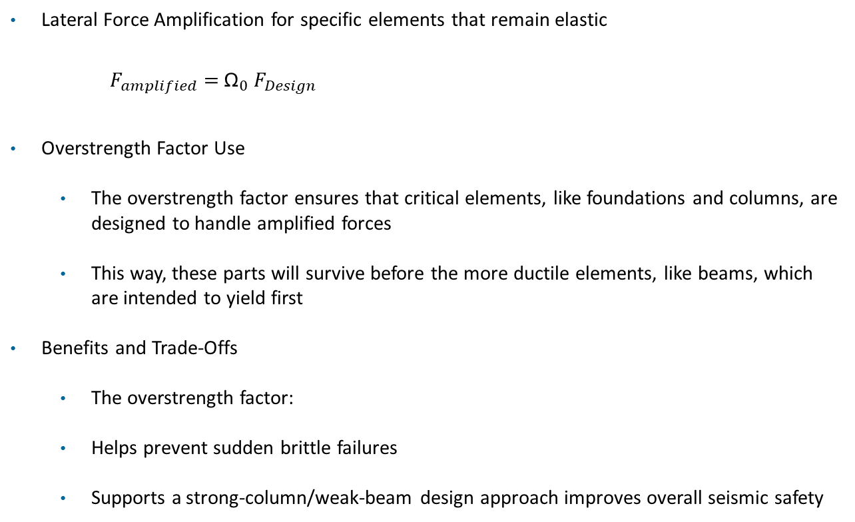
Vibrationdata
Overstrength Factor Ω₀
Lateral Force Amplification for specific elements that remain elastic
$F_{amplified}=$ ${\text{Ω}}_{0}{ F}_{Design}$
Overstrength Factor Use
  The overstrength factor ensures that critical elements, like foundations and columns, are designed to handle amplified forces
  This way, these parts will survive before the more ductile elements, like beams, which are intended to yield first
Benefits and Trade-Offs
  The overstrength factor:
  Helps prevent sudden brittle failures
  Supports a strong-column/weak-beam design approach improves overall seismic safety

Slide 18
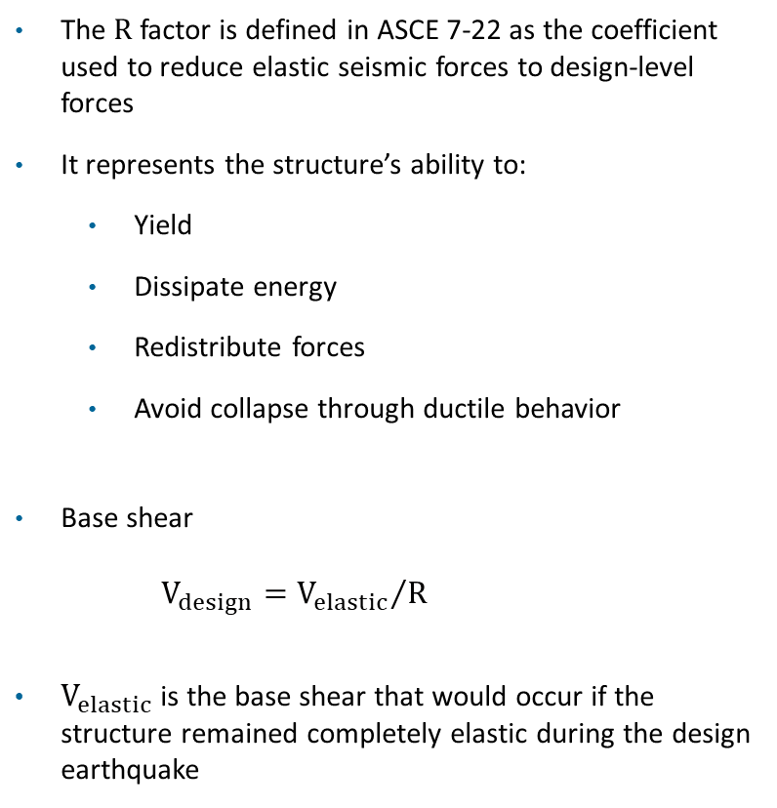
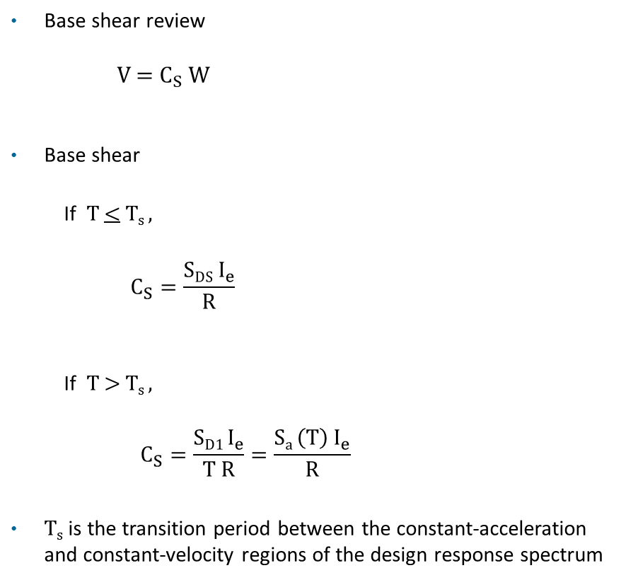
Response Modification Coefficient R “Credit for Ductility”
Vibrationdata
The R factor is defined in ASCE 7-22 as the coefficient used to reduce elastic seismic forces to design-level forces
It represents the structure’s ability to:
  Yield
  Dissipate energy
  Redistribute forces
  Avoid collapse through ductile behavior
Base shear
$V_{design}={V_{elastic}}/R$
$V_{elastic}$is the base shear that would occur if the structure remained completely elastic during the design earthquake
Base shear review
V = $C_{S}$ ​W
Base shear
  If T < T_{s} ,
$$C_{S}=\frac{\text{S}\text{DS} I_{e}}{\text{R}}$$
      If T > T_{s} ,
    $$C_{S}=\frac{\text{S}\text{D1 }I_{e}}{\text{T R}}=\frac{\text{S}\text{a }{\left(T\right) I}_{e}}{\text{R}}$$
    T_{s} is the transition period between the constant-acceleration and constant-velocity regions of the design response spectrum

Slide 19
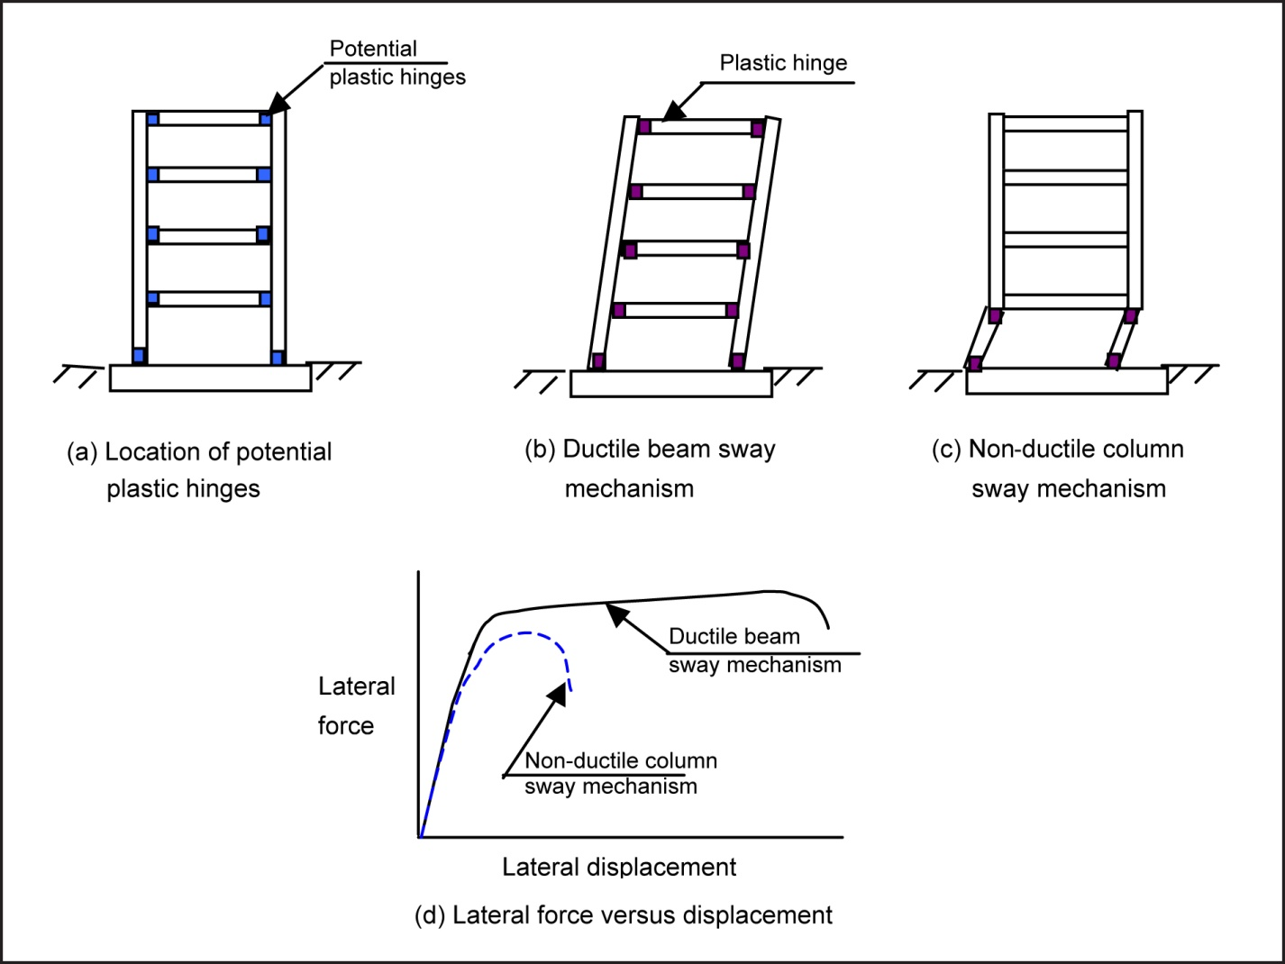
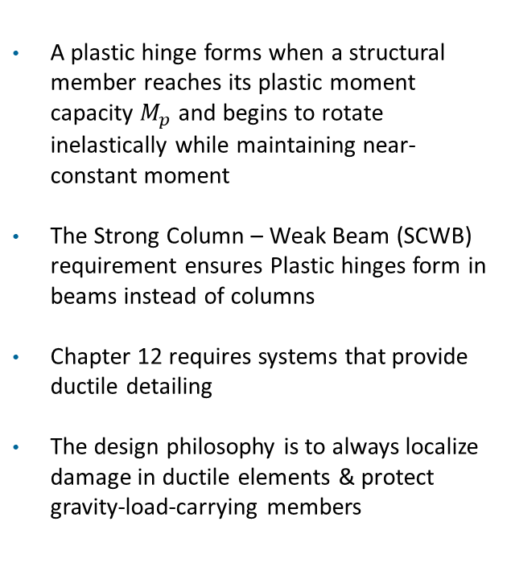
Plastic Hinges in Beam Structures
A plastic hinge forms when a structural member reaches its plastic moment capacity $M_{p}$ and begins to rotate inelastically while maintaining near-constant moment
The Strong Column – Weak Beam (SCWB) requirement ensures Plastic hinges form in beams instead of columns
Chapter 12 requires systems that provide ductile detailing
The design philosophy is to always localize damage in ductile elements & protect gravity-load-carrying members
Image courtesy of Canterbury Earthquake Royal Commission

Slide 20
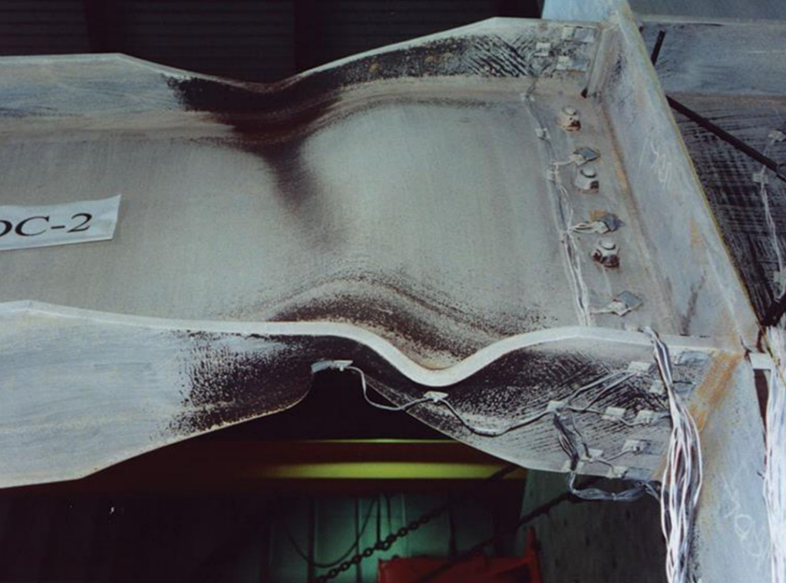
Vibrationdata
Formation of Plastic Hinge Zone
A wide-flange steel beam framing into a column with web yielding
A plastic hinge is not a literal hinge
It is a localized region where the section has yielded across most of its depth and rotates at approximately constant bending moment
The goal is controlled energy dissipation through stable beam plastic hinging
https://seblog.strongtie.com/2024/11/framing-the-future-the-evolution-of-moment-frames/formation-of-plastic-hinge-zone/

Slide 21
Vibrationdata
Structural Ductility
Ductility Level | Structural System | Primary Behavior | Typical R | Typical Ω₀ | Typical Cd | Design Philosophy
Low | Ordinary Shear Wall | Strength-controlled | 3 | 2.5–3 | 2.5 | Limited inelastic rotation
 | OCBF | Brace buckling governed | 3.25 | 2 | 3 | Limited ductility
 | OMF | Limited moment ductility | 3–3.5 | 3 | 3 | Basic detailing
Moderate | IMRF | Controlled yielding | 4–5 | 3 | 4 | Improved detailing
 | Special RC Shear Wall | Confined boundary yielding | 5–6 | 2.5–3 | 5 | Capacity design elements
OCBF = Ordinary Concentrically Braced Frame
OMF = Ordinary Moment Frame
IMRF = Intermediate Moment Resisting Frame
R (Response Modification Factor)
Ω₀ (Overstrength Factor)
Cd (Deflection Amplification Factor)

Slide 22
Vibrationdata
Structural Ductility
Ductility Level | Structural System | Primary Behavior | Typical R | Typical Ω₀ | Typical Cd | Design Philosophy
High | SCBF | Stable brace yielding | 6 | 2 | 5 | Designed ductile fuse
 | SMRF | Plastic hinge mechanism | 8 | 3 | 5.5 | Strong-column weak-beam
 | EBF | Link beam yielding | 8 | 2 | 5 | Replaceable ductile links
 | Dual Systems | Frame + wall interaction | 7–8 | 2.5–3 | 5–6 | Redundant energy dissipation
SCBF = Special Concentrically Braced Frame
SMRF = Special Moment Resisting Frame
EBF = Eccentrically Braced Frame

Slide 23
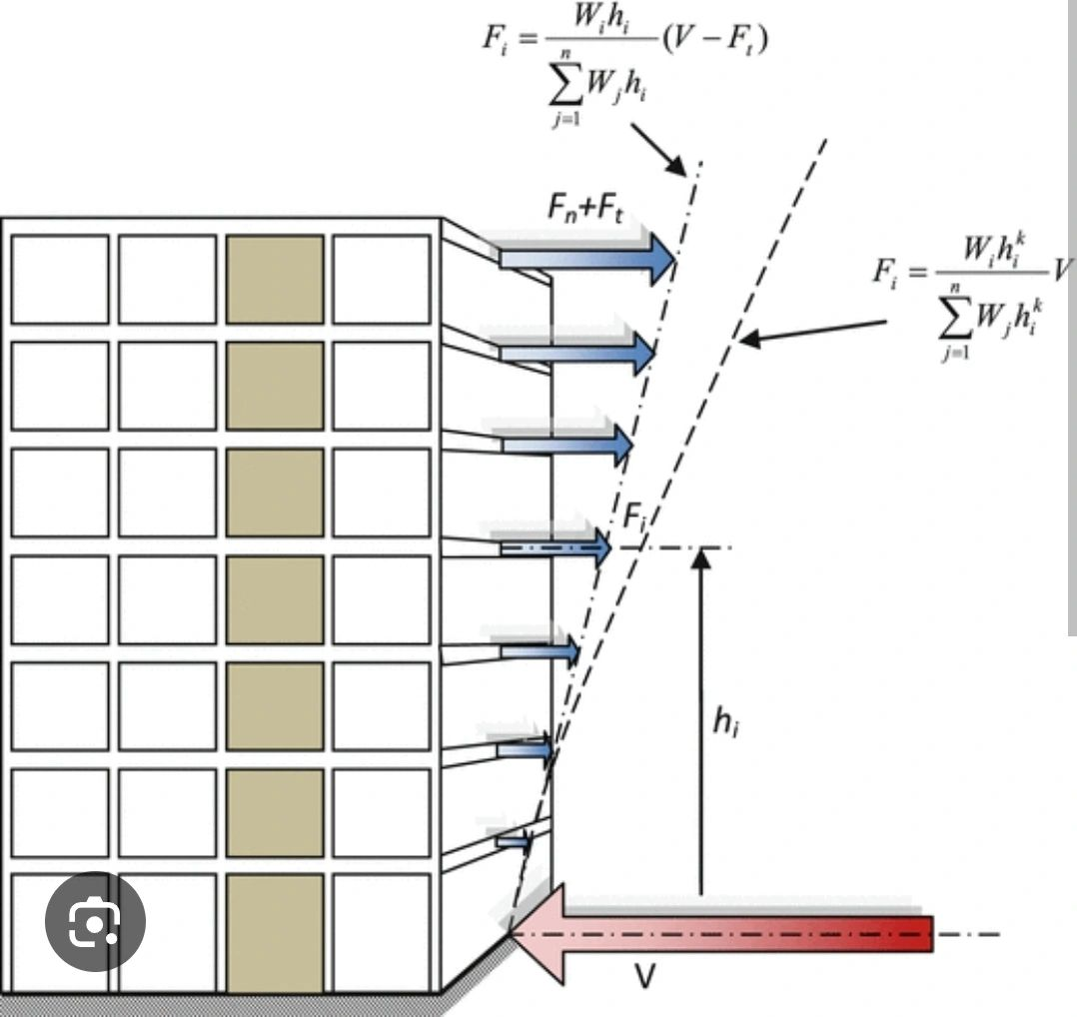
Vibrationdata
Permitted Analysis Procedures
Method | Use
Equivalent Lateral Force (ELF) | Most common
Modal Response Spectrum Analysis (MRSA) | Required for taller/irregular buildings
Nonlinear Response History | Chapter 16
Simplified Method | Limited low-rise
https://www.linkedin.com/posts/shawkatalikhan_the-equivalent-lateral-force-elf-procedure-activity-7363651518165663746-DMu-/

Slide 24
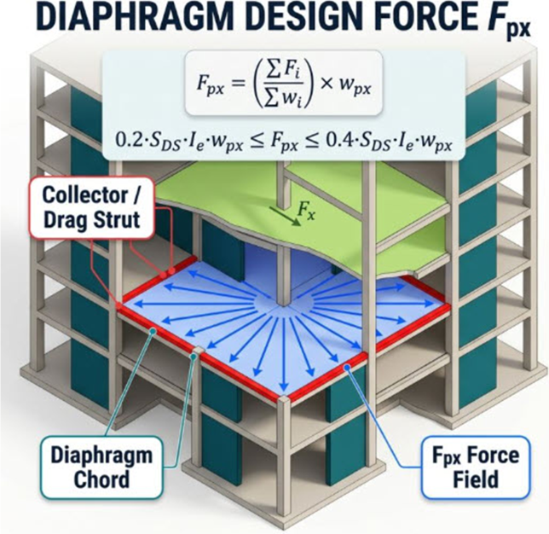
ASCE 7 §12.10 — KEY POINTS
What it is: the inertial force the floor or roof itself must carry into the walls and frames — a separate check from the story force F_{x} that sizes the vertical system.
Read the sums correctly: both run from level x up to the roof, not over the whole building. The ratio is an average acceleration coefficient for the levels at and above x.
w_{px} is the tributary weight of that level, including the walls tributary to it — half the story above and half below.
The bounds do the work: the 0.2 floor usually governs the lower levels; the ratio governs near the roof.
Chords are the flanges: in-plane bending is carried by a tension–compression couple, T = C = M / d, with M = wL² / 8 for a simple-span diaphragm.
Collectors drag shear into walls that stop short of the full diaphragm length — design them for the overstrength load, Ω_{o}, in SDC C through F.
Redundancy: ρ = 1.0 for the inertial force above; use the building ρ for transfer forces at discontinuities in SDC D–F.
ASCE 7-22 alternative (§12.10.3): an F_{px} that includes higher-mode amplification through R_{s} — required for precast concrete diaphragms.

Slide 25
Fpx is the diaphragm inertial design force of ASCE 7 Section 12.10.1.1. The summations run from the level under consideration, x, to the roof, n, so the ratio is a weighted-average acceleration for the levels at and above x, applied to the tributary weight of level x.
The 0.2*SDS*Ie*wpx floor usually governs the lower levels; the ratio governs near the roof.
Chords act as the flanges of the deep beam; collectors or drag struts carry shear into vertical elements that do not extend the full diaphragm length, and are designed with the overstrength factor in SDC C through F.
ASCE 7-22 Section 12.10.3 provides an alternative diaphragm design force that includes higher-mode amplification through Rs; it is mandatory for precast concrete diaphragms.

Slide 26
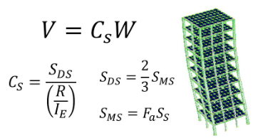
Vibrationdata
Equivalent Lateral Force
Steps:
  Compute period T
  Compute seismic response coefficient Cs
  Compute base shear V = Cs W
  Distribute vertically
  Check drift
Valid for:
  Regular structures
  Limited height
  Certain SDC limits
Covered in previous slide set
V is the seismic base shear: the total design lateral force applied at the base of the structure
Cs is the seismic response coefficient, the dimensionless fraction of weight taken as lateral force
https://www.youtube.com/watch?v=GjNI3VGmEfc

Slide 27
Response Modification & Height Limits by SDC
Vibrationdata
System | R | Ω₀ | Cd | Height Limits by SDC
Steel Special Moment Frame (SMRF) | 8 | 3 | 5.5 | No explicit limit in B/C; permitted to greater heights in D/E/F (commonly up to 160 ft+ depending on SDC & occupancy)
Steel Intermediate Moment Frame (IMRF) | 4.5 | 3 | 4 | Limited in SDC D; typically not permitted in E/F for tall buildings
Steel Ordinary Moment Frame (OMF) | 3.5 | 3 | 3 | Height limited in SDC C; prohibited in D/E/F
Steel Special Concentrically Braced Frame (SCBF) | 6 | 2 | 5 | Permitted in D/E/F; moderate height limits depending on occupancy
R (Response Modification Factor)
Ω₀ (Overstrength Factor)
Cd (Deflection Amplification Factor)

Slide 28
Response Modification & Height Limits by SDC
Vibrationdata
System | R | Ω₀ | Cd | Height Limits by SDC
Steel Ordinary Concentrically Braced Frame (OCBF) | 3.25 | 2 | 3.25 | Limited to low-rise in C; prohibited in D/E/F
Steel Eccentrically Braced Frame (EBF) | 8 | 2 | 4 | Permitted in D/E/F; good for mid- to high-rise
Special Reinforced Concrete Shear Wall | 6 | 2.5 | 5 | Permitted in D/E/F; height limits based on occupancy
Ordinary Reinforced Concrete Shear Wall | 5 | 2.5 | 4 | Limited in C; prohibited in D/E/F
Dual System (SMRF + Shear Wall or SCBF) | 8 | 2.5–3 | 5–5.5 | Often used for taller buildings in D/E/F

Slide 29
Vibrationdata
Building Height Limits by SDC
SDC B / C (Low–Moderate Seismic Risk)
  Ordinary systems generally permitted
  Height limits are moderate
  Dynamic analysis often not required
  Drift usually governs before system prohibition
SDC D (High Seismic Risk)
  Ordinary braced frames → height severely limited
  Ordinary moment frames → limited or prohibited
  Special systems required for taller buildings
    Special Moment Resisting Frame (SMRF)
    Special Concentrically Braced Frame (SCBF)
    Special shear walls
    Dual systems
  Increased detailing per AISC 341 / ACI 318

Slide 30
Vibrationdata
Permitted Analysis Procedures
SDC E / F (Very High / Near-Fault)
  Ordinary systems prohibited
    Ordinary Moment Frame (OMF)
    Ordinary Concentrically Braced Frame (OCBF)
    Ordinary shear walls
  Only Special or Dual systems permitted
  Stricter height caps apply
  Dynamic analysis commonly required
Design Decision Logic
  As SDC increases:
  Permitted ductility must increase
  Allowable height for low-ductility systems decreases
  Ordinary systems are eliminated
  Special detailing becomes mandatory

Slide 31
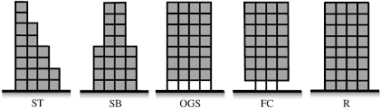
Vibrationdata
Structural Irregularities
ASCE 7-22 Tables 12.3-1 (Plan) & 12.3-2 (Vertical)
  Structural irregularities trigger:
    Mandatory dynamic analysis
    Torsional amplification
    Height restrictions
    Stricter detailing requirements
ST – Stepped / Setback Tower, vertically irregular
SB – Setback Building, vertically irregular
OGS – Open Ground Story, soft story / weak story irregularity
FC – Floating Column, vertical stiffness discontinuity, often with torsional issues
R – Regular

Slide 32
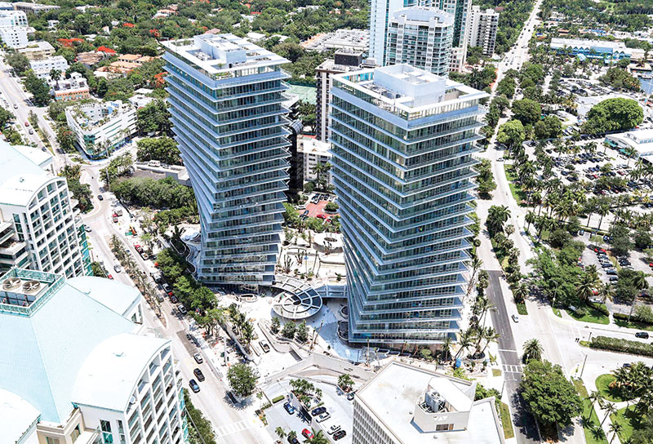
Twisted Towers
Grove at Grand Bay, Coconut Grove, Miami
Every frame line rotates with height
There are no consistent orthogonal axes anywhere in the tower
https://blog.vibrationdata.com/2026/08/23/two-towers-that-twist/

Slide 33
Is the torsional concern relative to a single axis or all three orthogonal axes?
Single axis
  In the ASCE 7 sense, torsional irregularity (Types 1a/1b, Table 12.3-1) means plan rotation of the diaphragm about the vertical axis, driven by the offset between the center of mass and center of rigidity at each story
  Rotation about the two horizontal axes is overturning/rocking, which the code treats separately as overturning moment, not torsion

Slide 34
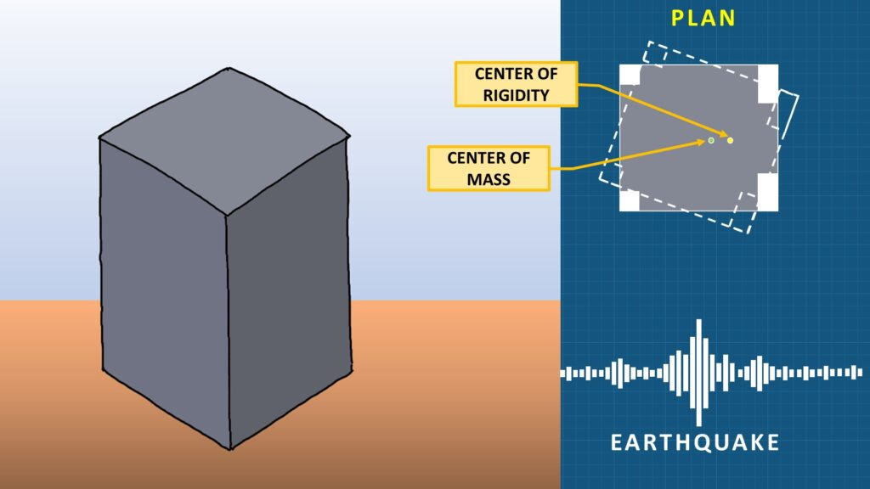
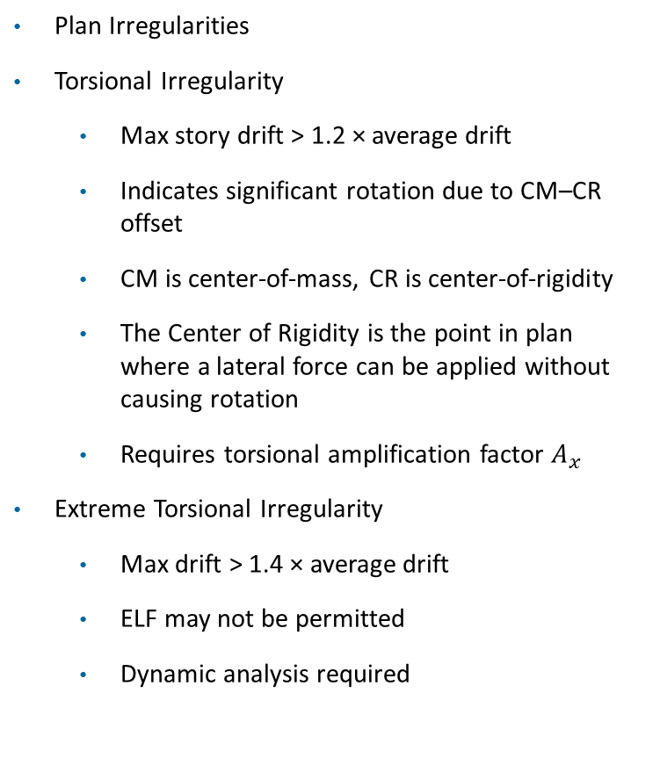
Vibrationdata
Structural Irregularities
Plan Irregularities
Torsional Irregularity
  Max story drift > 1.2 × average drift
  Indicates significant rotation due to CM–CR offset
  CM is center-of-mass, CR is center-of-rigidity
  The Center of Rigidity is the point in plan where a lateral force can be applied without causing rotation
  Requires torsional amplification factor $A_{x}$
Extreme Torsional Irregularity
  Max drift > 1.4 × average drift
  ELF may not be permitted
  Dynamic analysis required
https://structures-explained.com/torsion-in-structures/

Slide 35
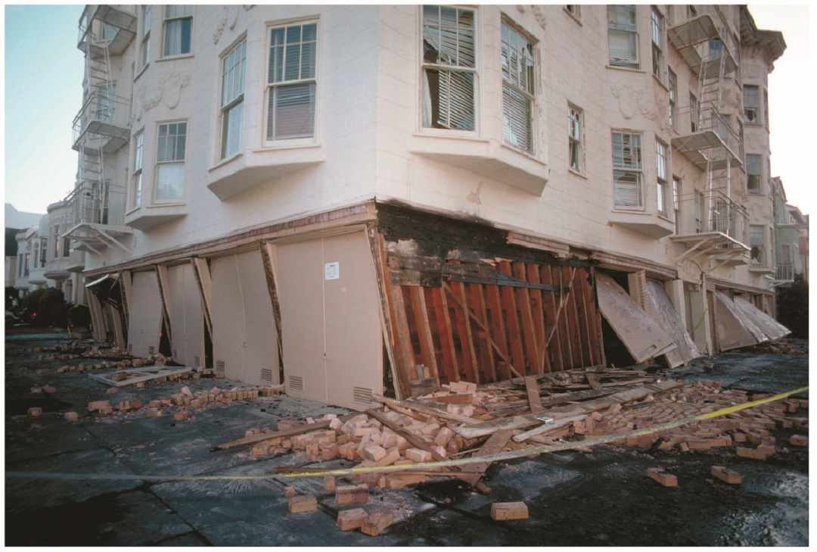
Vibrationdata
Structural Irregularities
Vertical Irregularities
Soft Story
  Story stiffness < 70% of story above
  OR < 80% of average of three above
  High drift concentration risk
  Common in podium / open first-floor buildings
Weak Story
  Story strength < 80% of story above
  Collapse mechanism risk
Soft-Story Building Failure, Loma Prieta Earthquake
https://seblog.strongtie.com/

Slide 36
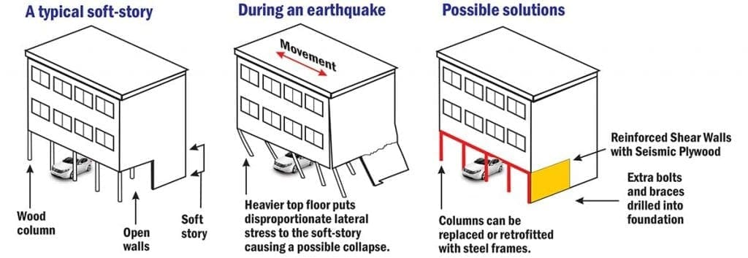
Soft Story & Retrofit
Vibrationdata
https://weinsteinconstruction.com/soft-story-retrofitting/

Slide 37
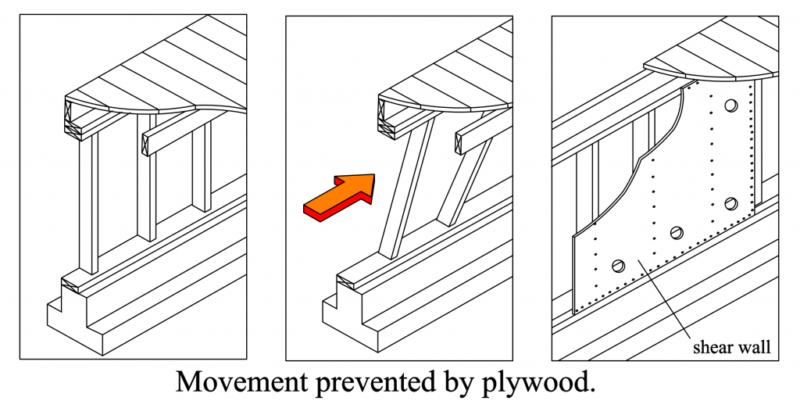
CRIPPLE WALL RACKING AND PLYWOOD SHEAR WALLS
Vibrationdata
An unbraced stud wall is a mechanism; sheathing turns it into a shear panel
WHY THE FRAME RACKS
Nailed stud-to-plate joints are effectively pins. Under lateral load the rectangle becomes a parallelogram with almost no resistance beyond the nails prying.
Cripple walls under raised-floor houses are the classic case: the crawl-space studs collapse and the house drops off its foundation.
WHAT THE PLYWOOD DOES
Racking now requires in-plane shear strain of the panel; the plywood is orders of magnitude stiffer than the bare frame.
Nails at the panel edges carry the shear into the framing. Capacity and stiffness are set by edge-nail spacing, not by the panel itself.
Nail yielding and slip supply the ductility and hysteretic damping; the panel stays elastic.
LATERAL LOAD PATH
DIAPHRAGM
›
TOP PLATE
›
EDGE NAILS
›
PLYWOOD
›
SILL PLATE
›
ANCHOR BOLTS
›
FOUNDATION
Takeaway: the panel is only as good as its boundary. Sheathing on an unbolted sill plate simply moves the failure to the sill, and a tall narrow panel without hold-downs at the ends rotates rather than shears. Check nails, bolts, and hold-downs before crediting the plywood.
Figure: https://bayarearetrofit.com/plywood-shear-walls/ . Retrofit references: FEMA P-1100 (cripple wall bracing), California Brace + Bolt program.

Slide 38
The three frames are a mechanism-to-structure story. Frame 1 is an unsheathed stud wall on a sill plate. Frame 2 shows what happens under a lateral load: the nailed stud-to-plate connections behave as pins, so the wall racks into a parallelogram with essentially no strength or stiffness beyond nail prying. This is the failure mode of cripple walls under older raised-floor wood houses, seen repeatedly in Loma Prieta 1989 and Northridge 1994 - the short crawl-space studs collapse and the house drops off its foundation, often intact above the floor line.
Frame 3 shows plywood nailed to the studs, top plate and sill. Racking now requires in-plane shear deformation of the panel. The panel is far stiffer than the frame, so the deformation and the energy dissipation move into the edge nails. Shear wall tables in the IBC and SDPWS are indexed by nail size and edge-nail spacing for exactly this reason; the plywood grade matters much less than the nailing.
Dynamics angle: bracing the cripple wall raises the lateral natural frequency of the house well out of the range where the flexible cripple wall would have been excited, and it restores a load path from the floor diaphragm through the sheathing and sill into the anchor bolts. The takeaway box is the field caution: sheathing an unbolted sill just moves the failure downward, and a narrow panel without hold-downs overturns instead of shearing.

Slide 39
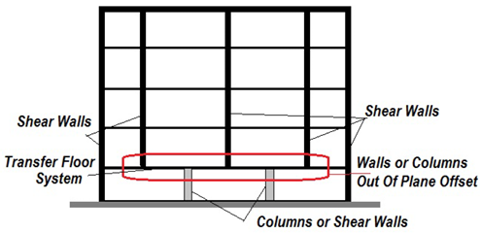
Vibrationdata
Structural Irregularities
In-Plane Discontinuity
  Sudden change in lateral-force-resisting elements
  Discontinuous shear walls / braced frames
Out-of-Plane Offset
  Vertical lateral elements not aligned between stories
  Load path interruption
Diaphragm Discontinuity
  Large openings
  Abrupt stiffness changes
  Split diaphragms
Vulnerability of Buildings With Irregularity Due to Out-of-Plane Offsets in Mexico, A. Gómez-Bernal, et al.

Slide 40
Irregularities
Irregularity →
  Higher torsion
  Concentrated drift
  Increased P–Δ
  Analysis restrictions
  Height limitations
  CM is center-of-mass
  Center of Rigidity (CR): The point on a floor diaphragm through which lateral forces produce pure translation without rotation

Slide 41
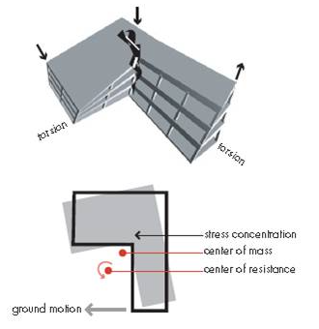
Re-entrant Corners: The L-Shaped Building Problem
Vibrationdata
Plan irregularity under earthquake ground motion
The two wings have different stiffnesses and periods, so they try to move differently during ground shaking
The re-entrant corner ties the wings together and must transfer the mismatch, producing high shear and a stress concentration
The center of mass and the center of rigidity cannot coincide in this plan shape, so lateral load also produces torsion
Center of rigidity, center of resistance, and center of stiffness are the same point: the point where a lateral load causes pure translation with no diaphragm rotation
Common fixes: a seismic separation joint at the corner, or added stiffness (shear walls, collectors, drag struts) at the re-entrant corner
https://taxonomy.openquake.org/terms/re-entrant-corner-rec
Figure and description adapted from FEMA 454, Designing for Earthquakes: A Manual for Architects (2006)
Notes:
L-shaped and other re-entrant-corner plans are a classic plan irregularity. The wings respond with different periods, and the corner has to transfer the incompatible motion. Because the center of mass and center of rigidity are offset, the diaphragm also twists. The FEMA figure labels the point 'center of resistance'; ASCE 7 calls it the center of rigidity. Same point. For multistory buildings there is no unique center of rigidity per floor, which is why codes now define torsional irregularity by diaphragm displacements rather than computed eccentricity.

Slide 42
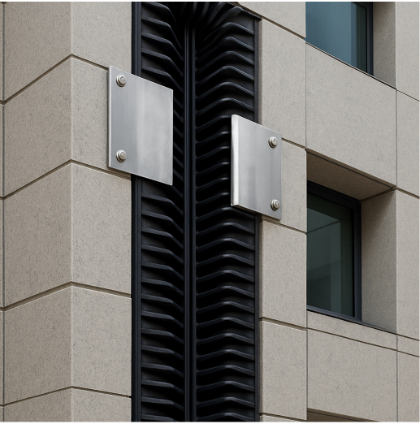
Seismic Expansion Joints
Vibrationdata
Separating the wings so they can move independently
A seismic joint splits an irregular building into simpler, regular blocks, each with its own lateral system and its own natural period
Unlike a thermal expansion joint, a seismic joint must accommodate motion in all three axes at once, including out-of-phase and rotational movement between the blocks
The gap must exceed the sum of the adjacent blocks' expected displacements (ASCE 7 uses the SRSS of the two design story drifts) to prevent pounding
Gaps range from a few inches for low-rise buildings to a foot or more at the top of tall or flexible ones, and are widest at the roof
Cover assemblies must bridge the gap in service, then compress, extend, and shear without falling or binding during the earthquake
The joint must pass through every element: floors, roof, facade, partitions, and the piping and ductwork that cross it
https://blog.nystrom.com/seismic-expansion-joints-and-multi-directional-movement
Photo: https://blog.nystrom.com/seismic-expansion-joints-and-multi-directional-movement

Slide 43
SEISMIC EXPANSION JOINTS
Vibrationdata
Is Fracture Toughness the Issue?
Mostly no. The joint is designed to move and be sacrificed; toughness matters at the hard points it loads into.
WHAT GOVERNS THE JOINT ITSELF
WHERE TOUGHNESS DOES ENTER
Displacement capacity in all six DOF: longitudinal, transverse, vertical, rotations
Pounding when the gap closes; header and blockout crushing
Unseating when the gap opens beyond the seat length
Traffic fatigue at centerbeam and support-bar welds (high cycle, service, not seismic)
The joint is the fuse: expected to be damaged and replaced after a design event
Cracked welded modular joints
Anchorages and restrainers
A traffic-fatigue crack in a centerbeam or support bar goes unstable under seismic overload. Worst in cold climates, where a winter quake can push a cracked member past K_IC.
Anchor bolts, restrainer cables, chain brackets and unseating devices see impact when the gap slams shut. Impact strain rates raise the ductile-brittle transition temperature.
Legacy castings and cast iron
Piping bellows (different animal)
Old sliding-plate assemblies and cast brackets carry low toughness by material. Fracture, not yield, is the failure mode.
Governed by low-cycle fatigue and squirm, but weld toughness at the bellows-to-flange attachment is a nuclear-industry concern.
Toughness concern rises along the load path from the moving elements to the hard points:
SEALS & SLIDING ELEMENTS
kinematic, sacrificial
›
CENTERBEAMS / SUPPORT BARS
fatigue, then fracture
›
ANCHOR BOLTS & RESTRAINERS
impact, cold
›
HEADERS / BLOCKOUTS / DECK
crushing, pounding
Takeaway. The Northridge lesson applies by analogy: the brittle failures were in welded connections, not in the elements designed to move. Specify Charpy toughness for the anchorage steel and welded support members, keep fatigue cracks out of them by inspection, and let the joint be the fuse.

Slide 44
SEISMIC IRREGULARITY: HOW IRREGULAR IS "IRREGULAR"?
Vibrationdata
Codes use threshold ratios with step penalties; research offers continuous indices measured against a regular reference
CODE RATIO METRICS (ASCE 7-22 Table 12.3-1 / 12.3-2)
Irregularity | Ratio | Threshold (extreme)
Torsional (plan) | Δmax / Δavg story drift | > 1.2 (> 1.4)
Soft story | kᵢ / kᵢ₊₁ or kᵢ / avg of 3 above | < 0.70 (0.60) / < 0.80 (0.70)
Weight (mass) | Wᵢ / W adjacent | > 1.5
Vertical geometric | Lᵢ / L adjacent (lateral system) | > 1.3
Reentrant corner | projection / plan dimension | > 0.15, both directions
Diaphragm | open area or stiffness change | > 50 %
Result is binary: cross the line → 25 % force increase, forced dynamic analysis, Ω₀ on discontinuous elements, or prohibition in SDC E/F.
EC8 similarly: e₀ ≤ 0.30 r, r ≥ lₛ; flat 20 % cut in q for vertical irregularity.
PRACTICAL SEVERITY SCALAR
Run the actual model and a regular reference; report three numbers rather than a yes/no:
first-mode effective mass fraction per direction (drops as torsion couples in)
Δmax / Δavg per story
peak drift ratio, irregular / regular.
Each maps onto a code category but carries magnitude.
Sources: ASCE 7-22 §12.3.2, Table 12.3-1/12.3-2, §12.8.4.3; EN 1998-1 §4.2.3; Sadashiva, MacRae & Deam, Earthquake Engng Struct. Dyn. (2009, 2012); Calvi & Pinto (1996); Isaković & Fischinger (2006)

Slide 45
SEISMIC IRREGULARITY (cont)
Vibrationdata
Codes use threshold ratios with step penalties; research offers continuous indices measured against a regular reference
THE ONE CODE METRIC THAT IS A SCALE
Ax​ is the torsional amplification factor applied at a given story level x
1.0
1.2
1.4
Regular
Type 1a
Type 1b extreme
Δmax / Δavg → amplification Ax = (δmax / 1.2 δavg)² ≤ 3.0 (continuous penalty)
CONTINUOUS INDICES (RESEARCH)
Drift ratio: peak interstory drift, irregular / equivalent regular (Sadashiva, MacRae & Deam)
Torsional coupling: Ω = ω(torsion) / ω(lateral) (worst near 1.0); eccentricity e / r
Modal regularity index: deformed-shape mismatch vs regular reference (Calvi–Pinto; Isaković–Fischinger, bridges)
Sources: ASCE 7-22 §12.3.2, Table 12.3-1/12.3-2, §12.8.4.3; EN 1998-1 §4.2.3; Sadashiva, MacRae & Deam, Earthquake Engng Struct. Dyn. (2009, 2012); Calvi & Pinto (1996); Isaković & Fischinger (2006)

Slide 46
WHERE DO TYPES 1, 1a, 1b COME FROM?
Vibrationdata
They are row labels in ASCE 7-22 Table 12.3-1, Horizontal Structural Irregularities; only Type 1 is graded into an a/b pair
ASCE 7-22 TABLE 12.3-1 — HORIZONTAL IRREGULARITIES
WHY TYPE 1 GETS TWO GRADES
Torsional
Δmax / Δavg > 1.2
Same ratio, two thresholds: 1.2 (1a) and 1.4 (1b); each grade unlocks a different consequence set
1a: torsional amplification Ax (§12.8.4.3), 25% force increase on diaphragm and collector connections, 3-D modeling, ELF restrictions
1b: all of the above, plus prohibited in SDC E and F (§12.3.3.1)
Ratio < 1.2 is simply “regular” — there is no lettered Type 1
1a
1b
Extreme torsional
Δmax / Δavg > 1.4
2
Reentrant corner
projection > 15% of plan dimension
3
Diaphragm discontinuity
opening > 50% of area, or stiffness change > 50%
SAME SCHEME IN TABLE 12.3-2 (VERTICAL)
4
Out-of-plane offset
vertical element offset between stories
1a soft story: stiffness < 70% of story above, or < 80% of the 3-story average
1b extreme soft story: < 60% / < 70%; these are stiffness ratios, not drift ratios
5
Nonparallel system
lateral elements not parallel to major axes
Sources: ASCE 7-22 §12.3.2.1, Table 12.3-1, Table 12.3-2, §12.3.3.1, §12.3.3.4, §12.8.4.3
Notes:
The 1, 1a, 1b labels are row numbers in ASCE 7-22 Table 12.3-1. Type 1 (torsional) is the only horizontal irregularity graded a/b, by the drift ratio thresholds 1.2 and 1.4. Table 12.3-2 uses the same a/b scheme for soft story, but on stiffness ratios.

Slide 47
Vibrationdata
Irregular Consequences
Irregularity | Effect | Code Consequence
Torsional | Edge drift amplification | Ax required
Soft Story | Drift concentration | Dynamic analysis
Weak Story | Collapse risk | Prohibited in high SDC
Diaphragm Discontinuity | Force redistribution | Collector design
Ax​ is the torsional amplification factor applied at a given story level x
It increases the design torsional moment when a building has torsional irregularity
Seismic Design Category (SDC)

Slide 48
Vibrationdata
Irregular Code Consequence Summary
Irregularity | Analysis | Height | Amplification
Torsional | MRSA required | Limited | Ax
Extreme Torsion | ELF prohibited | Severe | Ax > 1
Soft Story | Dynamic | Restricted | Drift amplified
Weak Story | Prohibited in D/E/F | N/A | Collapse risk
Diaphragm Discontinuity | Collector Ω₀ | Limited | Redistribution
Modal Response Spectrum Analysis (MRSA)
Equivalent Lateral Force (ELF)
Ω₀ (Overstrength Factor) Used for collectors, chords, connections, discontinuities

Slide 49
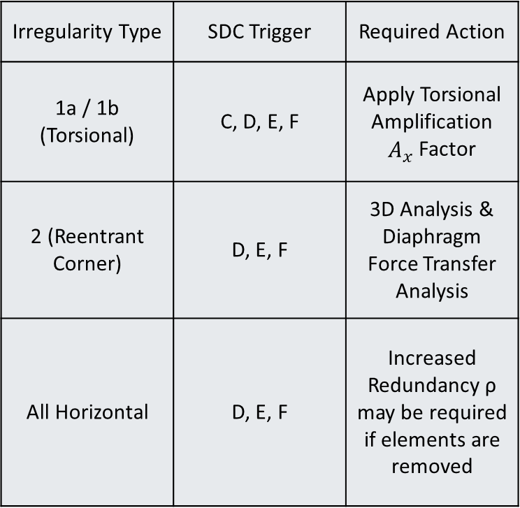
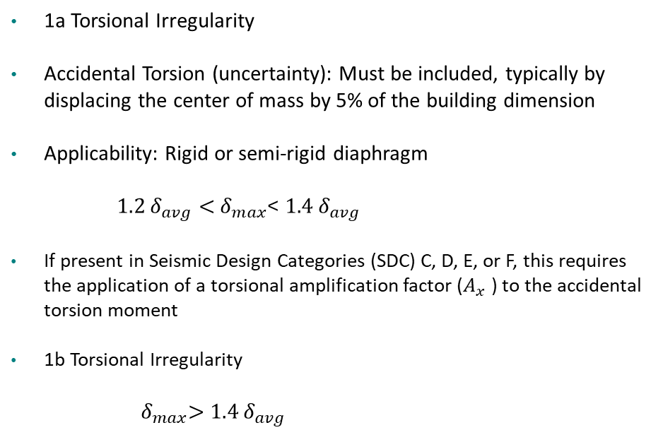
Vibrationdata
Irregularity Types
1a Torsional Irregularity
Accidental Torsion (uncertainty): Must be included, typically by displacing the center of mass by 5% of the building dimension
Applicability: Rigid or semi-rigid diaphragm
$1.2 δ_{avg}<{ δ}_{max}$< $1.4 δ_{avg}$
If present in Seismic Design Categories (SDC) C, D, E, or F, this requires the application of a torsional amplification factor ($A_{x}$ ) to the accidental torsion moment
1b Torsional Irregularity
${ δ}_{max}>$ $1.4 δ_{avg}$
Irregularity Type | SDC Trigger | Required Action
1a / 1b (Torsional) | C, D, E, F | Apply Torsional Amplification $A_{x}$ Factor
2 (Reentrant Corner) | D, E, F | 3D Analysis & Diaphragm Force Transfer Analysis
All Horizontal | D, E, F | Increased Redundancy ρ may be required if elements are removed

Slide 50
Irregularity Types (cont)
Vibrationdata
Type 2: Reentrant Corners
  Definition: Occurs in L, T, U, or H-shaped buildings where the "projections" (the wings) are longer than 15% of the total plan dimension in that direction
  The Risk: The "inside corner" of the building becomes a stress concentration point where the two wings pull in different directions
  Type 3: Diaphragm Discontinuity
  Definition: Occurs when the floor system (the diaphragm) has large cutouts or open areas (like a massive atrium) that exceed 50% of the total gross area, or when the stiffness of the floor changes by more than 50% from one story to the next
  The Risk: The floor isn't "stiff" enough to transfer the seismic forces to the walls or frames
  Type 4: Out-of-Plane Offsets
  Definition: Occurs when there is a "jog" in the lateral force path. For example, a shear wall on the 3rd floor does not sit directly above the shear wall on the 2nd floor.
  The Risk: This creates massive "overturning" forces on the floor system that has to bridge the gap between the two walls.

Slide 51
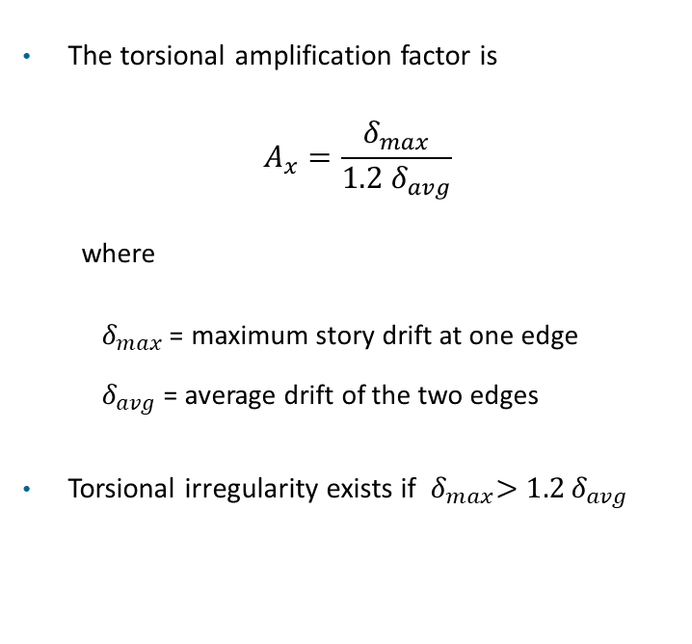
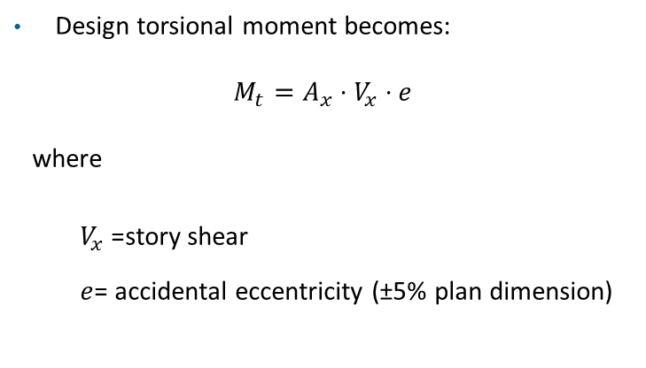
Vibrationdata
Torsional Amplification Factor
The torsional amplification factor is
$$A_{x}=\frac{δ_{max}}{1.2{ δ}_{avg}}$$
where
  $δ_{max}$= maximum story drift at one edge
  $δ_{avg}$= average drift of the two edges
Torsional irregularity exists if ${ δ}_{max}>1.2 δ_{avg}$
Design torsional moment becomes:
$$M_{t}=A_{x}⋅V_{x}⋅e$$
where
  $V_{x}$= story shear
  $e$= accidental eccentricity (±5% plan dimension)
The 5% is taken on the plan dimension of the structure perpendicular to the direction of the applied lateral force (0.05B for load along L, 0.05L for load along B
5% of the diameter for a circular plan
The overall bounding dimension for an irregular footprint)
It is applied as a ±e shift of the center of mass and is added on top of any inherent eccentricity

Slide 52
Vibrationdata
Accidental Torsion
Plan view, rigid diaphragm, top-looking down)
Torsion the model cannot predict: uncertain mass distribution, stiffness shifts from cracking and nonstructural elements, rotational ground motion
δ_{max}
δ_{min}
ASCE 7-22 §12.8.4.2: displace the center of mass ±5% of the plan dimension perpendicular to the applied load, in each orthogonal direction
0.05 L
M_{ta}
M_{ta} = ±0.05 L V
CM
Added to the inherent torsion from any real eccentricity between center of mass and center of rigidity (CR)
Frame A
CM displaced
Frame B
Check the edge drifts under the offset:
δ_{max} > 1.2 δ_{avg} Type 1a δ_{max} > 1.4 δ_{avg} Type 1b
V
SDC C through F: amplify the accidental torsion by
A_{x} = ( δ_{max} / 1.2 δ_{avg} )² ≤ 3.0
L
Rigid and semi-rigid diaphragms only: a flexible diaphragm cannot transfer torsional shear between frames, so each line takes its tributary load
Edge drifts differ: the 5% offset twists the diaphragm even when CM and CR coincide

Slide 53
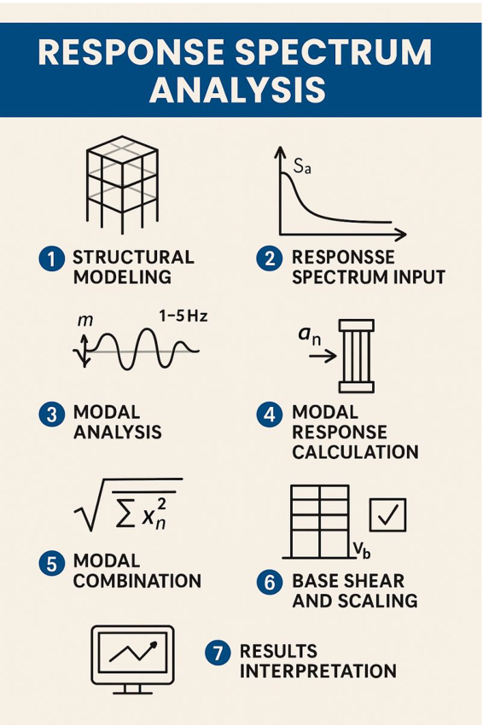
Vibrationdata
Source: linkedin.com/posts/mohdabdulmannankhan_response-spectrum-analysis-rsa-is-a-seismic-activity-7328031801552134145-Jghn/
53

Slide 54
Vibrationdata
Response Spectrum Analysis
Step |  | Result
1 | Structural modeling | [M], [K] and damping ratio
2 | Spectrum input | S_{a}(T) × I_{e} / R
3 | Modal analysis | T_{n}, φ_{n}, Γ_{n} for each mode
4 | Modal response | Peak response of each mode
5 | Modal combination | SRSS or CQC total
6 | Base shear scaling | V_{b} scaled to ELF value
7 | Interpretation | Unsigned envelope values
1. Structural modeling Mass, stiffness and damping; carry enough modes to capture the required seismic mass participation
2. Spectrum input The design spectrum is the peak response of a 5%-damped SDOF versus period, scaled by I_{e} / R. I_{e} is the importance factor. R is the response modification factor
3. Modal analysis Each mode is an SDOF with its own period, mode shape and participation factor
4. Modal response Read S_{a} at each modal period; multiply by participation factor and mode shape
5. Modal combination Modal peaks do not occur at the same instant. SRSS for well-separated modes, CQC when modes are closely spaced
6. Base shear scaling Combined base shear is scaled up to the equivalent lateral force value where it falls short (ASCE 7-16 and later)
7. Interpretation Combined results have lost their signs; treat them as envelopes, not as a force set in equilibrium
Source: linkedin.com/posts/mohdabdulmannankhan_response-spectrum-analysis-rsa-is-a-seismic-activity-7328031801552134145-Jghn/
53

Slide 55
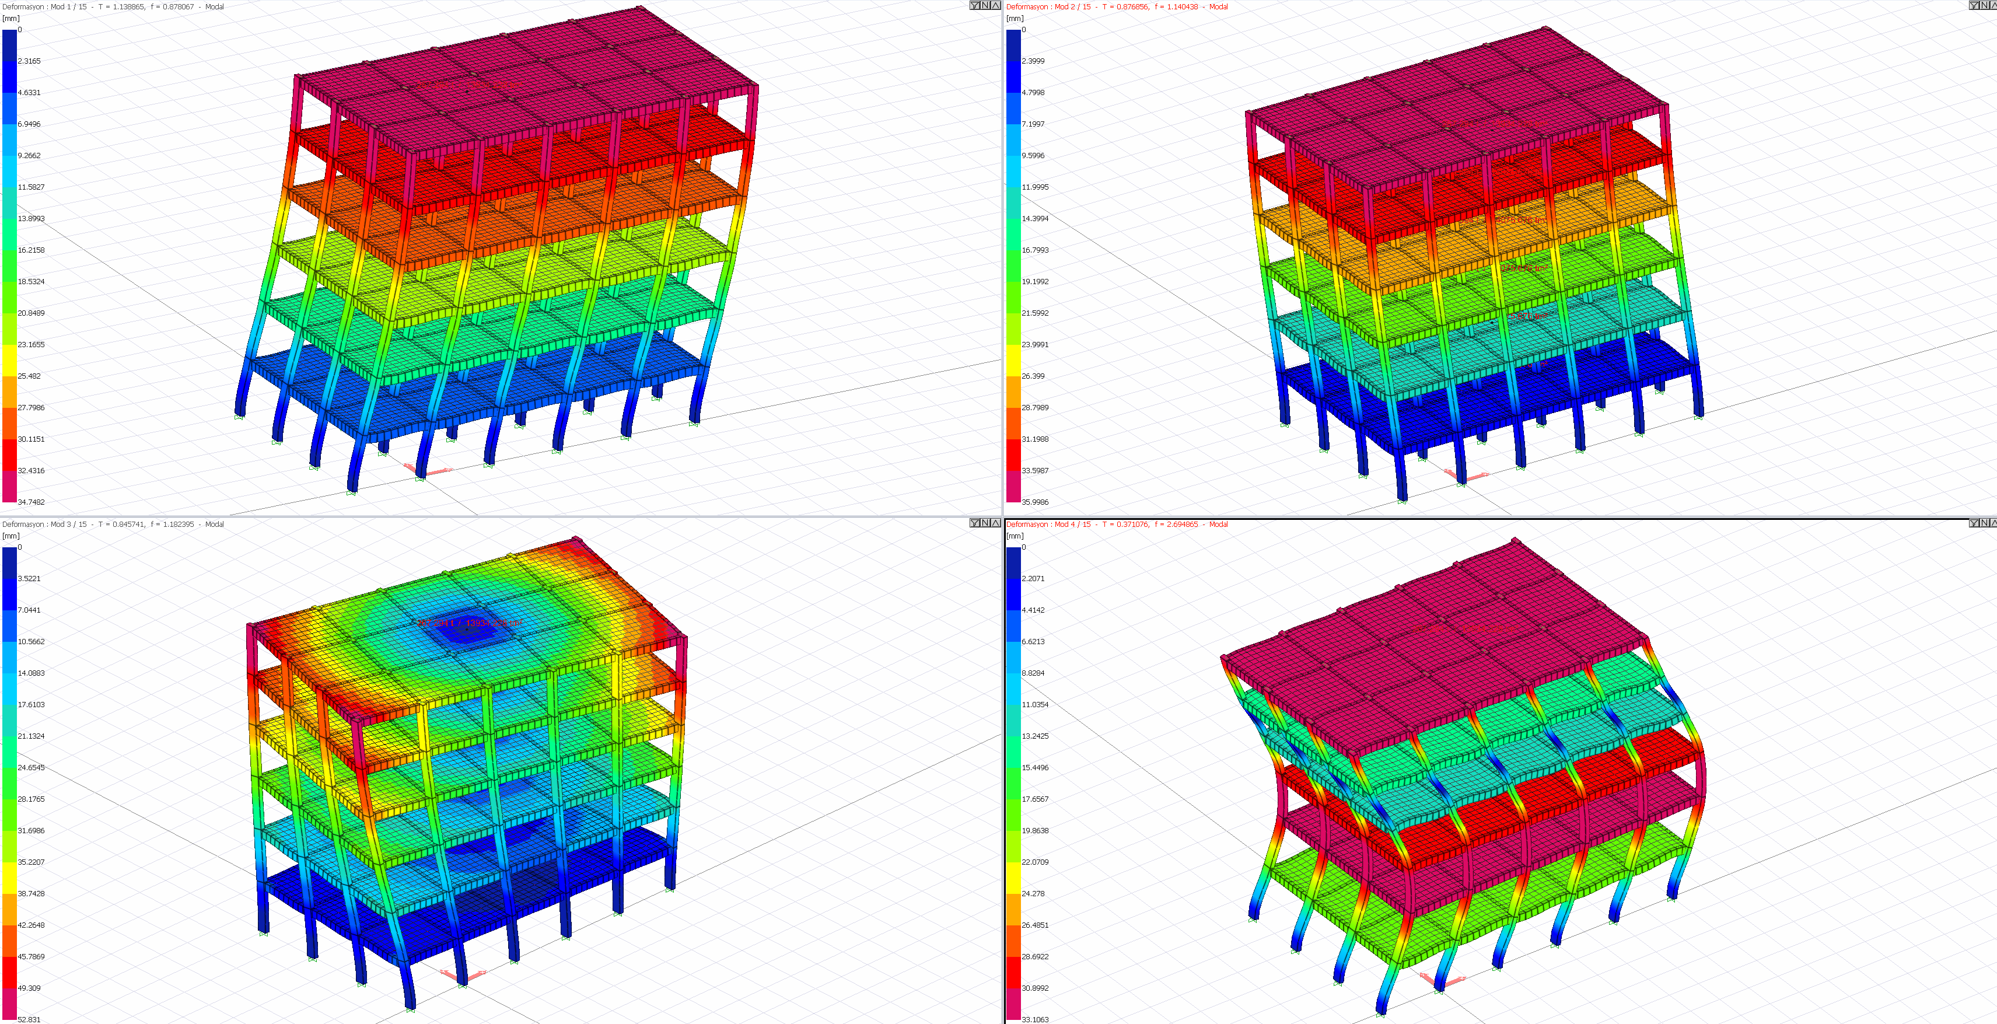
Vibrationdata
Modal Analysis
ASCE 7-22 §12.9
Required when:
  Structure is irregular
  Torsional irregularity or extreme torsion
  T > limits
  SDC D, E, F and exceeds height limits
Modal analysis better captures:
  Higher mode effects
  Irregular mass/stiffness
  Tall buildings
https://help.idecad.com/ideCAD/mode-shapes-and-modal-vibration-periods

Slide 56
Vibrationdata
Modal Response Spectrum Analysis (MRSA)
Solves eigenvalue problem → natural frequencies & mode shapes
Generalized eigenvalue problem
{K − ω²M} φ = 0
Computes modal participation factors
K, M
global stiffness and mass matrices
Extracts spectral accelerations from design spectrum
ω², φ
eigenvalue and eigenvector (mode shape), one pair per DOF
Combines modal responses (SRSS or CQC)
Modal base shear contribution
Square-root-of-the-sum-of-the-squares (SRSS)
V_{n} = Γ_{n} M_{n} S_{a}(T_{n})
V_{n}
base shear carried by mode n
Complete Quadratic Combination (CQC)
Γ_{n}
participation factor, φ_{n}^{T}M r / φ_{n}^{T}M φ_{n}
Captures higher-mode effects and torsion
M_{n}
modal excitation factor, φ_{n}^{T}M r (mass units)
Γ_{n}M_{n}
effective modal mass M_{n}*; sum over all modes = total mass
S_{a}(T_{n})
design spectral acceleration at T_{n} = 2π/ω_{n}
r
influence vector, unit base motion in the input direction
φ_{n}
mode shape n; Γ_{n}M_{n} is independent of its scaling
Base shear from the ELF method is the single-mode case: V = C_{s}W with M₁* ≈ W/g
55

Slide 57
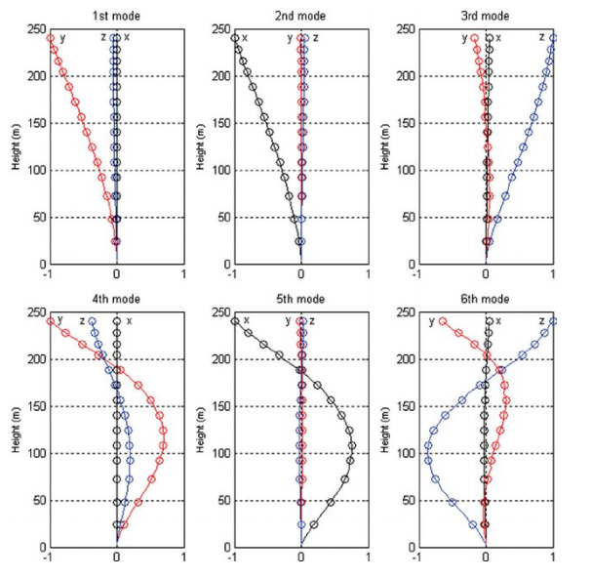
Vibrationdata
MRSA
Include sufficient modes to capture ≥ 90% mass participation
Include accidental torsion
Apply torsional amplification factor Ax when required
Use 5% damping unless otherwise justified
Image courtesy of K.T. Tse

Slide 58
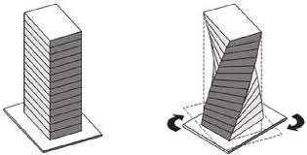
Vibrationdata
ELF & MRSA Comparison
ELF Equivalent Lateral Force | MRSA Modal Response Spectrum Analysis
Assumes dominant first mode | Includes multiple modes
Cannot capture torsion properly | Includes rotational DOF
Limited for tall buildings | Accurate for higher-mode response
Static force pattern | Dynamic modal superposition

Slide 59
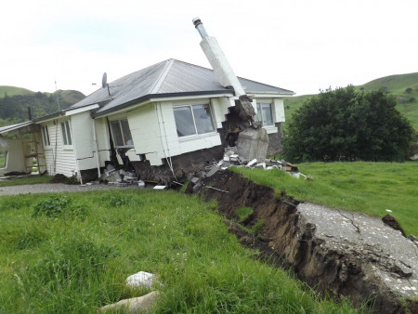
Vibrationdata
Near Fault Effects, SDC F
Located near major active faults
Large spectral accelerations (high SDS and/or SD1)
Often governed by long-period ground motion effects
Strong potential for pulse-like ground motions
Velocity Pulses (Near-Fault Directivity)
  Caused by rupture propagation toward the site
  Produces large, concentrated velocity pulse
  Energy delivered in one or two strong cycles
  Can dramatically increase displacement demand
Bluff Station, Kēkerengū Valley, Kaikoura, New Zealand earthquake 2016
https://www.tasman.govt.nz/my-region/environment/environmental-management/natural-hazards/geological-hazards/earthquake-faults

Slide 60
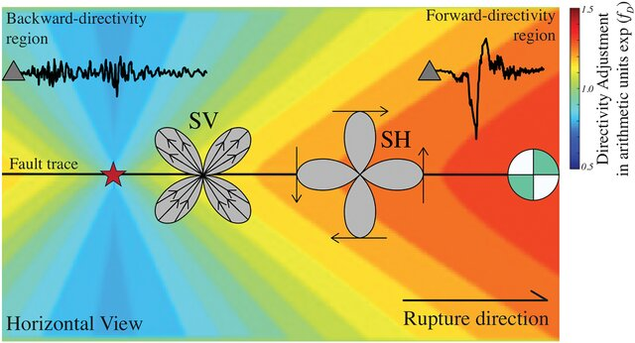
Vibrationdata
Near Fault Effects, SDC F
Circle with green & white quadrants is a “beachball”
Fault type (strike-slip, normal, reverse, oblique)
Forward (red): the rupture races toward the site at nearly the shear wave speed, so the energy arrives almost all at once as a short, strong pulse
Backward (blue): the rupture runs away from the site, so the energy is spread out in time. The shaking lasts longer but is weaker. Think of the pitch of a siren as it approaches, then recedes (Doppler shift)
In this earthquake radiation pattern (horizontal view), SV and SH refer to the two types of S-waves (shear waves), distinguished by their particle motion direction
SV Wave — Shear Vertical
SH Wave — Shear Horizontal

Slide 61
Vibrationdata
Shear Wave Speed and Rupture Speed
Quantity | Typical Value
V_{s} at earthquake depth | 3.0 to 3.8 km/s, typically 3.5
Rupture speed V_{r} | 2.5 to 3.0 km/s, or 0.7 to 0.9 V_{s}
Ordinary rupture limit | Rayleigh wave speed, about 0.92 V_{s}
Supershear rupture | Up to about √2 V_{s} ≈ 5 km/s. Izmit 1999, Kunlun 2001, Denali 2002, Palu 2018
Slow tsunami earthquake | 1 to 1.5 km/s. Nicaragua 1992
Near-surface V_{s30} (site class) | Under 180 m/s soft soil; 760 to 1500 m/s rock
Worked Example: 50 km Rupture
V_{r} = 2.8 km/s and V_{s} = 3.5 km/s
Rupture duration: 50 / 2.8 ≈ 18 s
S-wave travel time along the fault: 50 / 3.5 ≈ 14 s
Rupture direction
Fault, 50 km
Site behind
18 + 14 ≈ 32 s
Longer, weaker shaking
Site ahead
18 − 14 ≈ 4 s
Short, strong pulse
Directivity factor ≈ 1 / ( 1 − (V_{r} / V_{s}) cos θ ). For V_{r} / V_{s} = 0.8, the factor is 5 straight ahead and 0.56 straight behind
The same energy arrives in a window eight times shorter on the forward side. That is the near-fault pulse
61

Slide 62
Vibrationdata
Supershear Rupture
An ordinary rupture is limited by the Rayleigh wave speed, about 0.92 V_{s}. A supershear rupture jumps past V_{s} and runs at 5 to 6 km/s, between √2 V_{s} and the P-wave speed
The S waves cannot get ahead of the rupture. Their wavefronts merge into a Mach front, the seismic counterpart of a sonic boom: sin θ = V_{s} / V_{r}
Shaking on the Mach front decays slowly with distance, so strong motion reaches farther from the fault
The fault-parallel motion becomes as large as, or larger than, the fault-normal motion. An ordinary directivity pulse is mainly fault-normal
Favored by long, straight, mature strike-slip faults. The rupture usually starts subshear and makes the transition after running some distance
Mach front
S wavefronts
Rupture direction
Ruptured fault
Rupture tip
Plan view. S wavefronts from earlier rupture positions pile up along the Mach front. Drawn for V_{r} = √2 V_{s}, which gives a 45° Mach angle
Documented cases: Izmit 1999 (M 7.6), Kunlun 2001 (M 7.8), Denali 2002 (M 7.9), Palu 2018 (M 7.5), Myanmar 2025 (M 7.7). The Myanmar rupture ran roughly 500 km along the Sagaing Fault, most of it at more than 5 km/s
62

Slide 63
Vibrationdata
Redundancy Factor ρ
The Redundancy Factor (ρ) increases seismic design forces when a structure lacks sufficient load-path redundancy
Base shear review
A building is redundant if:
  Multiple lateral-force-resisting elements share load
  Loss of one element does not cause disproportionate failure
  More than two lines of resistance per direction (typical threshold)
V = ρ C_{S} W
V | Seismic base shear, the total design lateral force at the base of the structure
ρ | Redundancy factor, either 1.0 or 1.3
C_{S} | Seismic response coefficient, set by the design spectrum, the response modification factor R and the importance factor I_{e}
W | Effective seismic weight: dead load plus the applicable portions of other loads
Condition | ρ Value
Adequate redundancy | 1.0
Limited redundancy | 1.3
Applies primarily to Seismic Design Categories (SDC) D, E and F
61

Slide 64
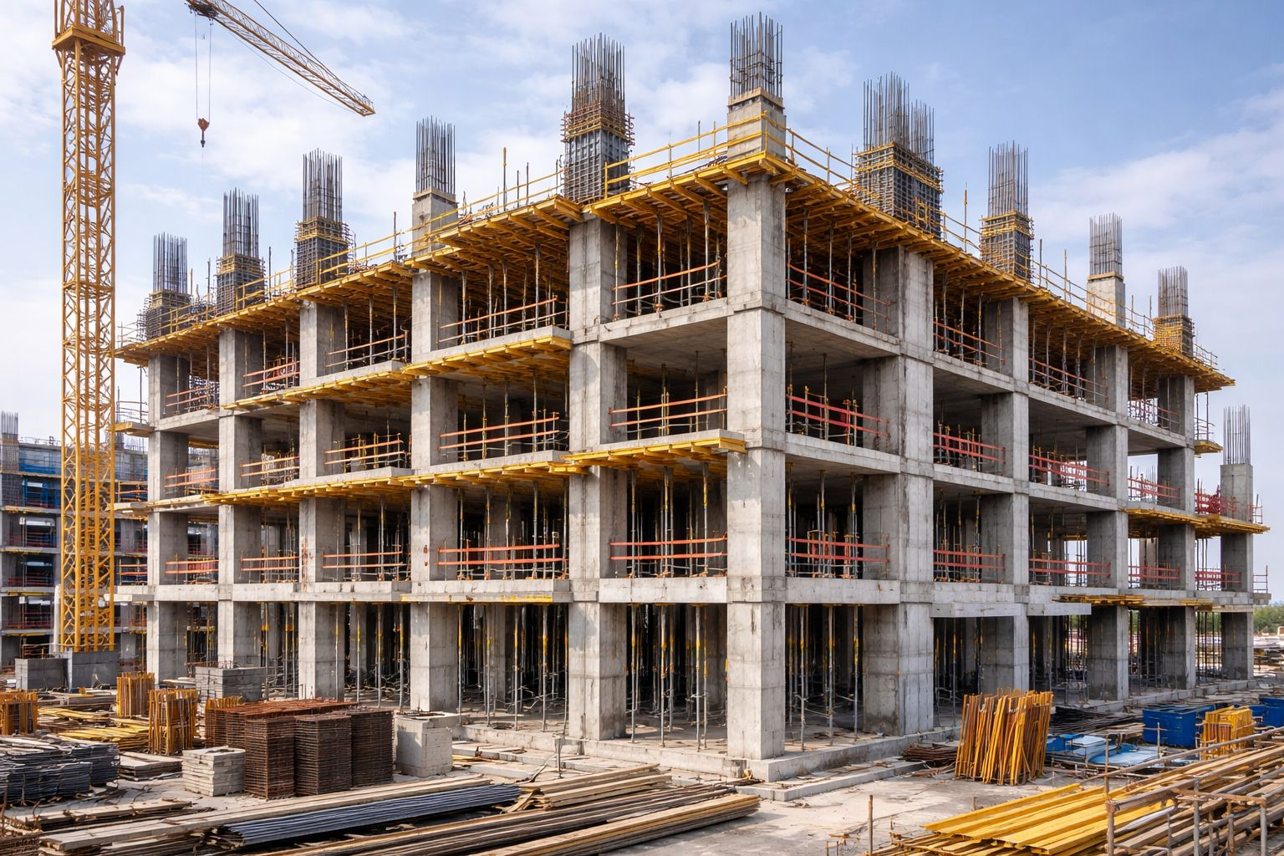
Vibrationdata
Structural Redundancy
High redundancy reinforced concrete moment frame building under construction.
Multiple moment frames in both directions provide distributed lateral load paths.
Loss or yielding of a single column or beam can be redistributed to adjacent bays.
Continuous beam-column framing supports ductile plastic hinge formation across many members.
Floor slabs act as diaphragms to transfer seismic forces to multiple frame lines.
https://www.facebook.com/groups/705929013755256/posts/1632814721066676/

Slide 65
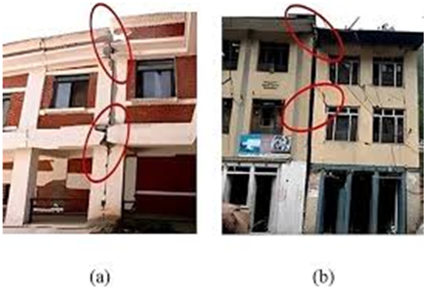
Vibrationdata
Seismic Separation Gap
To prevent pounding (structural collision) between adjacent buildings or different parts of the same building during an earthquake
Pounding can cause localized crushing, shear failure in columns, or even progressive collapse
Minimum Separation Distance (δ_{M})
Each building must be set back from the property line by a distance at least equal to its Maximum Displacement (δ_{M}), calculated at each floor level
Assessing seismic gap in adjacent RC buildings post Gorkha earthquake in Nepal, Aviral Upadhayay, et al.
Seismic Force-Resisting System | R | C_{d}
Steel special moment frame | 8 | 5.5
Steel ordinary moment frame | 3.5 | 3
Special RC moment frame | 8 | 5.5
Ordinary RC moment frame | 3 | 2.5
Steel special concentrically braced frame | 6 | 5
Steel eccentrically braced frame | 8 | 4
Special RC shear wall (building frame) | 6 | 5
Light-frame wood shear wall (bearing wall) | 6.5 | 4
C_{d} δ_{xe}
δ_{M} =
I_{e}
δ_{xe}: Deflection determined by elastic analysis
C_{d}: Deflection Amplification Factor (see table)
I_{e}: Importance Factor
Values from ASCE 7 Table 12.2-1. R is the response modification coefficient
65

Slide 66
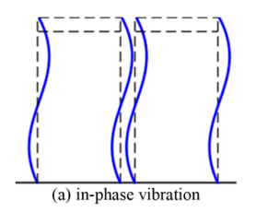
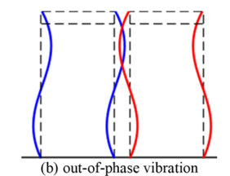
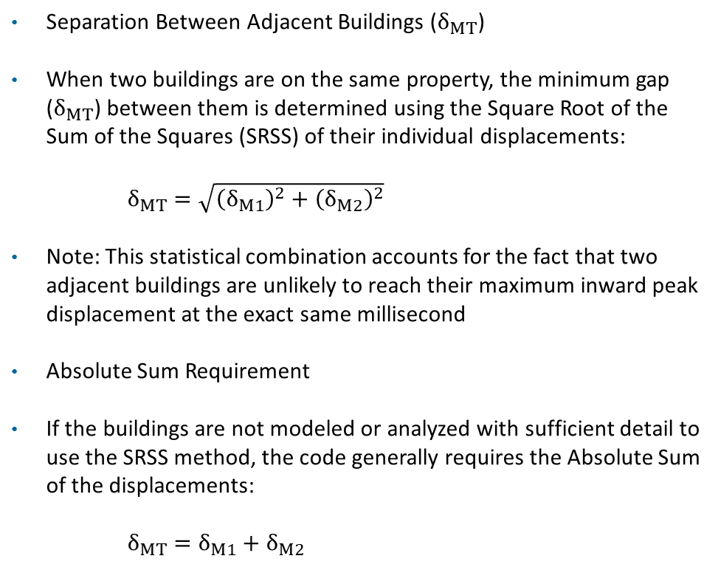
Vibrationdata
Seismic Separation Gap (cont)
Separation Between Adjacent Buildings ($δ_{MT}$)
When two buildings are on the same property, the minimum gap ($δ_{MT}$) between them is determined using the Square Root of the Sum of the Squares (SRSS) of their individual displacements:
$δ_{MT}=\sqrt{{\left(δ_{M1}\right)}^{2}+{\left(δ_{M2}\right)}^{2}}$
Note: This statistical combination accounts for the fact that two adjacent buildings are unlikely to reach their maximum inward peak displacement at the exact same millisecond
Absolute Sum Requirement
If the buildings are not modeled or analyzed with sufficient detail to use the SRSS method, the code generally requires the Absolute Sum of the displacements:
$δ_{MT}=δ_{M1}+δ_{M2}$

