Slide 1
VIBRATIONDATA
Propellant Valve Failures
Fault trees, oxygen ignition, and vibration-driven fatigue
A main propellant valve is a lightly damped spring-mass system carrying the full
flow, with no functional redundancy available behind it.
Revision — August 2026
Notes:
Framing slide. The deck is deliberately generic — the methods apply to any cryogenic or storable main propellant valve, not to one specific engine or incident.

Slide 2
SCOPE
What this package covers
The material is generic. Nothing here is specific to any one engine program.
Fault tree structure
Oxygen ignition
Vibration and fatigue
Top event definition
Functional decomposition
Minimal cut sets
Common cause across a cluster
The kindling chain
Four ignition mechanisms
Promoted combustion
Materials and cleanliness
Turbopump excitation
Valve resonances and chatter
Damage across firings
Verification gaps
vibrationdata
2
Notes:
Three sections. The first is method; the second is what makes an oxidizer valve different from a generic valve; the third is where structural dynamics enters. The third section is the one most often left out of a valve fault tree.

Slide 3
MOTIVATION
Why a valve earns its own fault tree
What makes it exposed
What you cannot do about it
Carries the full propellant flow
Moving parts in the flow stream
Actuated during the most severe transient
Sequencing errors propagate instantly
Sits at a high-vibration station
No parallel redundancy — a second main valve is a second leak path
No graceful degradation; partial function is often worse than none
Limited instrumentation inside the flow path
Failure evidence is frequently consumed by the event
vibrationdata
3
Notes:
The central asymmetry: the valve is a single point of failure by construction, and adding redundancy makes things worse rather than better. Reliability therefore has to be bought through process control and verification, not through architecture. This is why the fault tree is qualitative first.

Slide 4
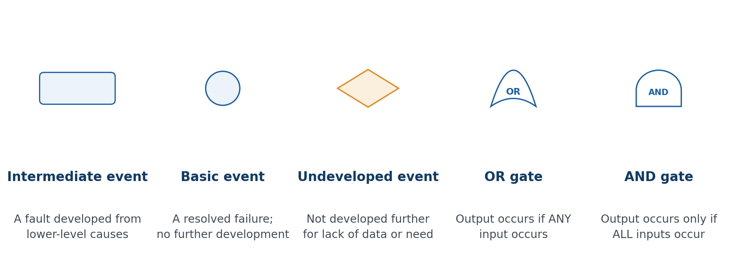
METHOD
Fault tree symbology
vibrationdata
4
Notes:
A fault tree is deductive: it starts at the undesired outcome and works downward through logic gates to resolved causes — unlike an FMEA, which works forward from a cause.

Slide 5
METHOD
Defining the top event
The discipline here pays for itself. Everything below inherits the scope you set at the top.
Name the failure, the phase, and the consequence — all three. "Valve fails" is not a top event.
Bound it in time. A valve fault during chilldown, during the start transient, and at steady mainstage produce different trees.
State the success criterion it negates. If the requirement is a stroke time band, the top event is departure from that band, not simply failing to move.
Keep the consequence at one level. Mixing "valve malfunctions" with "vehicle is lost" in one tree merges two analyses.
Worked example used throughout: loss of flow control at the main oxidizer valve during the start transient, resulting in loss of engine.
vibrationdata
5
Notes:
A sloppy top event is the most common way an FTA goes wrong, and it is invisible afterward because everything below it looks rigorous. Ask whether two engineers given only the top event statement would build the same first tier. If not, it is not specific enough.

Slide 6
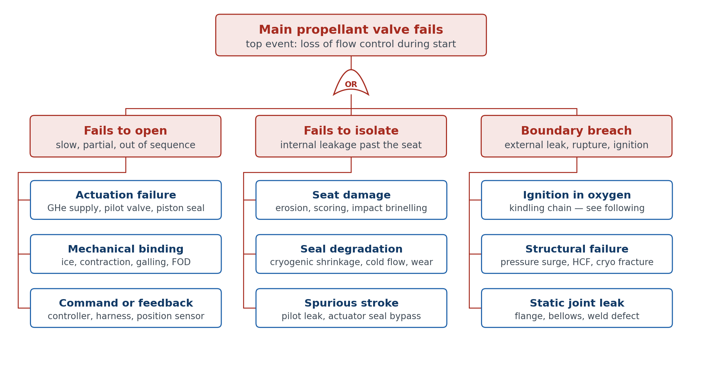
STRUCTURE
First-tier decomposition is functional
vibrationdata
6
Notes:
Never start with a parts list. Start with what the component is required to do: a valve fails to open, fails to isolate, or fails to contain. Every physical cause lands under one of those three.

Slide 7
BRANCH ONE
Fails to open, or opens off-nominally
Three families. Note that only the third is detectable by conventional health monitoring.
Actuation
Mechanical binding
Command and feedback
Helium supply pressure low or lost
Pilot or solenoid valve fault
Actuator piston seal bypass
Hydraulic fluid frozen by a nearby cryogenic leak
Return spring set or fractured
Differential thermal contraction at the guide
Moisture ice in a stem bore
Galling of ball, gate, or poppet on seat
Contamination or FOD wedged in the stroke
Controller output not issued
Harness or connector open
Sequencer logic fault
Position sensor drift driving a closed loop to the wrong place
vibrationdata
7
Notes:
The consequence of this branch is usually a mixture ratio excursion. Oxidizer lead and lag sequencing is what keeps unburned propellant from accumulating; a valve that strokes late or stalls part open defeats it. Note that a frozen hydraulic line is a demonstrated failure path — a cryogenic leak somewhere else in the engine can disable an actuator with no fault in the valve itself.

Slide 8
BRANCH TWO
Fails to isolate
Seat and closure
Consequence
Erosion or wire drawing across the seat
Scoring from entrained particles
Brinelling from repeated impact seating
Misalignment or seat distortion under bolt load
Seat wear accumulated over firings
Oxidizer where it does not belong during chilldown and prestart
Propellant accumulation ahead of ignition
External release onto pad structure or into a confined compartment
Leak rate drift is progressive — it is a wear-out mode, not a random one
vibrationdata
8
Notes:
Internal leakage is the quiet failure. It rarely announces itself, it degrades monotonically with cycles, and the acceptance test that would catch it is usually run at ambient temperature where the seal behaves differently. Treat leak rate as a trended parameter across the unit's firing history rather than a pass or fail at acceptance.

Slide 9
BRANCH TWO
Why cryogenic seals drift
Seal behavior at temperature is a materials problem the fault tree has to inherit, not solve.
Polymer seat seals contract far more than the metal they seat against. PTFE and PCTFE contraction from ambient to 90 K is on the order of 2 percent, against roughly 0.3 percent for stainless.
The mismatch unloads the seat. A seal qualified at ambient can arrive at operating temperature with a fraction of its design contact stress.
Cold flow and compression set accumulate. Each thermal cycle under seat load moves material, and the recovery is incomplete.
Elastomer damping disappears. Below the glass transition the seal stops absorbing energy — relevant later when we come to amplification factors.
The practical consequence: an ambient leak check is not a cryogenic leak check, and the two can diverge with age in opposite directions.
vibrationdata
9
Notes:
This slide is the bridge between the isolation branch and the dynamics section. The loss of polymer damping at cryogenic temperature shows up again when we estimate Q for the fatigue calculation.

Slide 10
BRANCH THREE
Loss of pressure boundary
Structural
Ignition
Pressure surge from rapid closure
High cycle fatigue at a weld toe or fillet
Cryogenic embrittlement and fracture
Cavitation erosion of the flow path
Bellows convolution fatigue
Only present in an oxidizing service
Turns a mechanical fault into an energetic one
Consumes the evidence that would have identified the initiator
Treated in detail in the next section
vibrationdata
10
Notes:
This is the branch where an oxidizer valve stops resembling a hydraulic valve. Everything in the left column could be written for any high pressure valve. The right column exists only because the working fluid is an oxidizer, and it changes both the consequence and the investigability of the failure.

Slide 11
SECTION TWO
Ignition in oxygen systems
The branch that converts a valve malfunction into an energetic event — and the one that has no analogue in fuel or hydraulic service.

Slide 12
OXYGEN
What changes when the fluid is an oxidizer
The governing references are ASTM MNL36 and the ASTM G-series guides listed at the end.
Materials that are inert in air will burn. In high pressure oxygen, stainless steel and aluminum both sustain combustion once ignited.
The oxidizer is already present in unlimited supply. There is no mixing requirement and no flammability limit to fall outside of.
Ignition energies are small. Mechanisms that are harmless in any other service become credible initiators.
The reaction is self-feeding. A burning nonmetal kindles the metal around it, and the metal sustains the reaction on its own.
Consequence is not proportional to cause. A single liberated particle can destroy the component and everything downstream of it.
vibrationdata
12
Notes:
This slide sets up why the ignition branch cannot be handled by ordinary reliability reasoning. The probability structure is different: the initiating events are common, and what suppresses them is the absence of one of the other two legs of the AND gate.

Slide 13
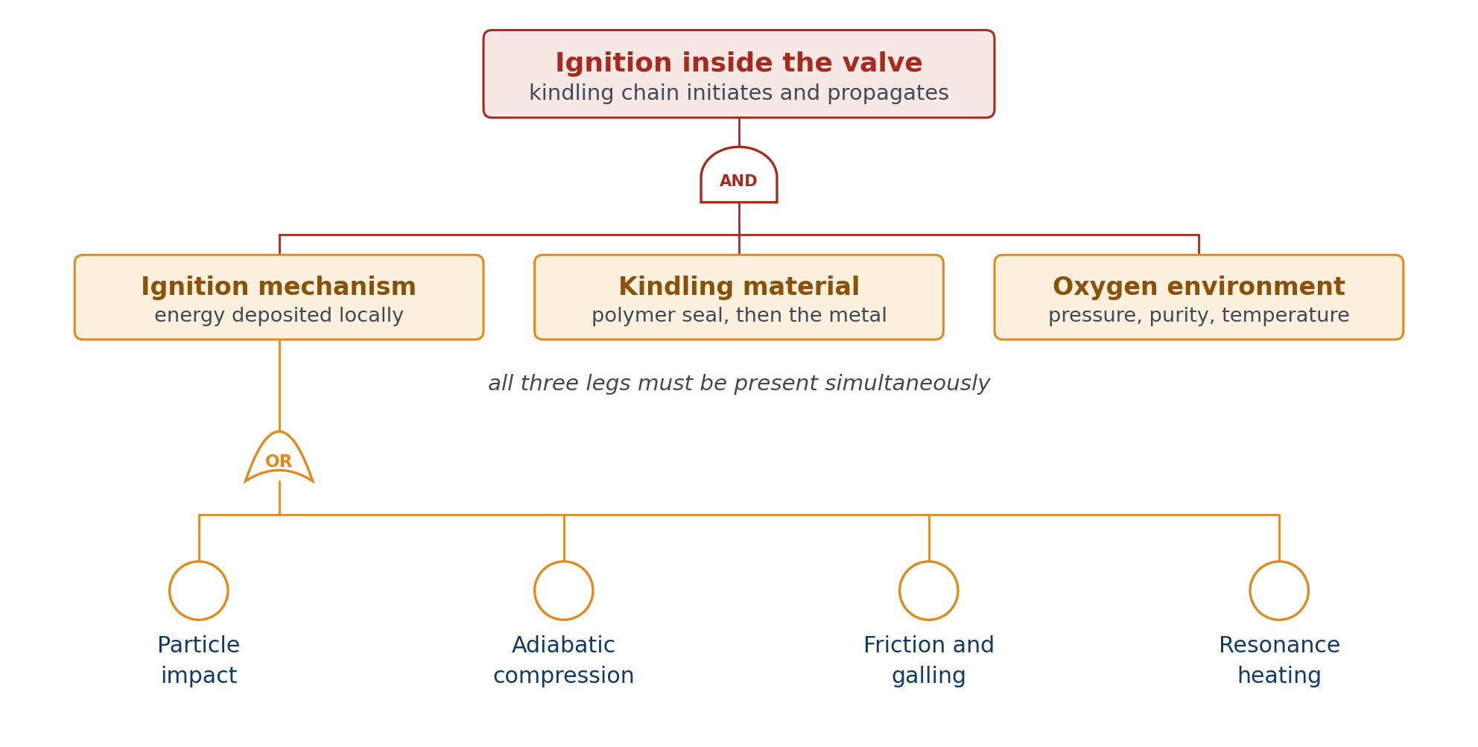
OXYGEN
The kindling chain is an AND gate
vibrationdata
13
Notes:
Ignition requires all three legs at once. This matters because you cannot add redundancy to a main valve — but you can break a leg of this gate. Every practical mitigation in oxygen system design is an attack on one of the three.

Slide 14
MECHANISM ONE
Particle impact ignition
Design guidance on velocity limits and impingement geometry is in ASTM G88.
How it works
Where the particles come from
A particle entrained in the flow strikes an impingement site
Kinetic energy converts to local heat at the contact
The particle itself may ignite, or the target surface does
Velocity is the dominant variable, and thresholds are low
Manufacturing debris not removed by cleaning
Weld spatter and machining chips
Galling and fretting products generated in service
Spall liberated by a fatigue crack
Upstream filter breakthrough
vibrationdata
14
Notes:
The last two items in the right column are the important ones for this deck, because they connect the vibration section to this branch. A valve that chatters generates its own particles. That makes vibration an initiator for ignition, not an alternative explanation to it.

Slide 15
MECHANISM TWO
Adiabatic compression
No defect required. This mechanism is a property of the design, not of the unit.
The signature failure of a fast-acting oxidizer valve. Rapid opening compresses the gas ahead of the pressure front.
The process is essentially isentropic, so the temperature rise follows from the pressure ratio alone — not from any friction or contact.
A dead-ended downstream volume is the trap. The compressed slug has nowhere to go and heats a fixed pocket of gas.
Resulting temperatures readily exceed the autoignition temperature of any nonmetal exposed in that cavity.
The design variables are opening rate, downstream volume, and whether nonmetals are exposed to the dead end. All three are changeable without redesigning the valve function.
vibrationdata
15
Notes:
This is the mechanism most amenable to a small hardware change, which is why valve modifications after an oxygen system mishap so often turn out to be ramp rate or internal volume changes rather than a new valve. Worth noting that this mechanism requires no defect, no wear, and no contamination — a perfectly built valve can do it.

Slide 16
MECHANISMS THREE AND FOUR
Friction, galling, and resonance heating
Friction and galling
Resonance heating
Rubbing between poppet and guide, or ball on seat
Heat generated at the contact with no path to reject it
Aggravated by any condition that produces repeated contact
Chatter is the worst case — high contact frequency at high load
Also generates the particles for mechanism one
Sonic flow into a closed cavity sets up a standing wave
Cyclic compression at the closed end heats a fixed gas pocket
Heating rate is high and localized
Cavity geometry is the controlling variable
Relevant to tee branches, gauge ports, and blind passages
vibrationdata
16
Notes:
Both of these are geometry-and-motion problems rather than materials problems. The friction mechanism is where the dynamics section connects most directly: a self-excited poppet produces exactly the repeated high-load contact this mechanism requires.

Slide 17
OXYGEN
Promoted combustion and materials selection
Ignition of a nonmetal kindles the metal around it. Selection has to consider the assembly.
Material class | Behavior in high pressure oxygen | Typical role
Fluoropolymers (PTFE, PCTFE) | Ignite readily; act as the kindling | Seats, seals, backups
Aluminum alloys | Burn and sustain combustion | Avoid in the flow path
Austenitic stainless | Will sustain combustion at pressure | Acceptable only with margin
Nickel-copper (Monel) | Highly burn resistant | Preferred for internals
Nickel alloys (Inconel 600, 625) | Highly burn resistant | Preferred for internals
Copper alloys | Burn resistant | Seats, sacrificial parts
vibrationdata
17
Notes:
The kindling chain is the reason materials selection is not a component-by-component decision. A burn-resistant valve body does not help if a polymer seal ignites inside it and the resulting flame is enough to start the metal. The assessment has to be done on the assembly and its worst-case exposure, which is what a formal oxygen compatibility assessment does.

Slide 18
OXYGEN
Cleanliness is a design variable, not housekeeping
Reference: ASTM G93 for cleaning methods and verification.
The particle that initiates mechanism one is often far below what a visual inspection resolves. Cleanliness has to be specified numerically and verified.
Specify to a standard — IEST-STD-CC1246 or equivalent — with a stated level, a sampling method, and an acceptance criterion.
Cleaning agent compatibility matters as much as the cleaning. Residual hydrocarbon is itself kindling.
Cleanliness is perishable. Assembly, test, transport, and rework all reintroduce particles, so verification has to be tied to the last operation before service.
In-service generation defeats initial cleanliness. Galling, fretting, and cavitation erosion produce particles after the last verification point — which is the argument for controlling the dynamics.
vibrationdata
18
Notes:
The last bullet is the one that usually gets missed. A program can execute the cleanliness specification perfectly and still deliver particles to the flow stream, because the valve generates them itself once it starts operating. This is the second link between the vibration section and the ignition branch.

Slide 19
EVALUATION
Minimal cut sets: order one dominates
What the tree returns
What follows from that
A large number of order-one cut sets — single events sufficient on their own
Very few higher-order sets, because there is little redundancy to exploit
The ignition branch is the exception: its AND gate gives genuine order-three sets
Quantification adds little. The qualitative cut set list is the deliverable
Reliability is bought through process control, screening, and acceptance test
Mitigation means attacking the basic events themselves, not adding architecture
Prioritize basic events by fan-out — how many cut sets they appear in
vibrationdata
19
Notes:
The fan-out point in the last bullet is worth dwelling on. A basic event that appears in one cut set is worth one mitigation. A basic event that appears in cut sets under three different branches is worth three, and it is also the one most likely to be the actual initiator when something goes wrong. We identify one such event in the next section.

Slide 20
EVALUATION
Common cause in a multi-engine cluster
The three cases are not distinguishable from the failure itself — only from the fleet.
Independence is the assumption that fails first. Engines in a cluster share a design, a manufacturing process, a supply chain, and an operating environment.
If the initiator is a design characteristic, the coupling factor is effectively unity — every unit is exposed, and clustering provides no benefit at all.
If the initiator is a random part defect, the units are close to independent and cluster redundancy behaves as intended.
If the initiator is wear-out, the exposed population is bounded by usage rather than by design — units above some accumulated cycle count.
These three cases call for completely different corrective actions: redesign, screening, or a service life limit. Distinguishing them is the point of the investigation.
vibrationdata
20
Notes:
This slide is the practical payoff of the whole tree. The corrective action depends entirely on which of the three cases you are in, and the tree structure is what tells you which evidence would discriminate between them. The wear-out case is the one the dynamics section addresses.

Slide 21
SECTION THREE
Vibration and fatigue
Where the valve stops being a reliability block diagram element and starts being a lightly damped structure in a severe dynamic environment.

Slide 22
ENVIRONMENT
What the turbopump puts into the valve
Three families of source, with different predictability and different spectral character.
Tonal
Broadband and quasi-tonal
Instabilities
Shaft rate and harmonics from residual unbalance
Impeller and inducer blade passing
Diffuser and volute vane interaction
Tones migrate with speed and throttle
Inducer cavitation, broadband plus rotating cavitation
Turbulent flow noise in the discharge
Combustion coupling through the manifold
Strongly non-Gaussian content
Subsynchronous whirl from seals and bearings
Rotating stall
Longitudinal feed system coupling
Bearing defect frequencies
vibrationdata
22
Notes:
Notice that only the first column is predictable from geometry alone. The second and third columns depend on operating point, and they are the ones that change between the qualification unit and the flight unit. They are also the sources that produce high kurtosis, which becomes important two sections from now.

Slide 23
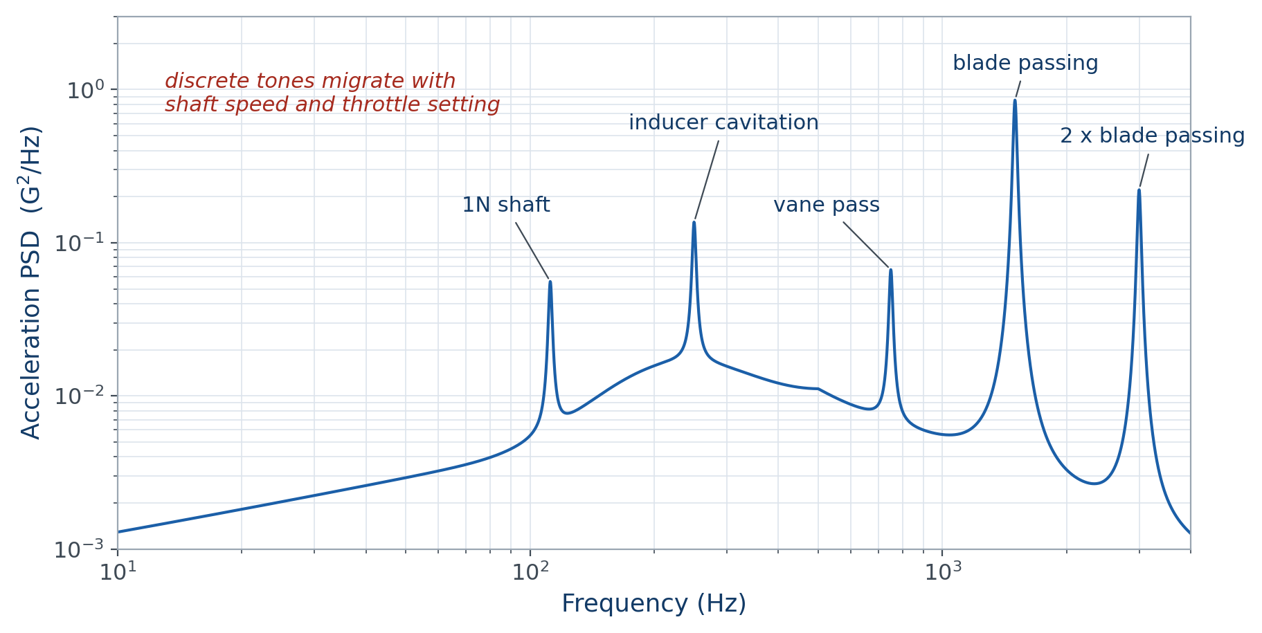
ENVIRONMENT
The spectrum at the valve station
vibrationdata
23
Notes:
This is not a clean broadband floor. It is sine on random with tones that move. A single enveloping PSD used for both analysis and test hides the tonal structure entirely, and the tonal structure is what drives the damage.

Slide 24
ENVIRONMENT
Two load paths, only one of which gets tested
The fluid-borne path is the one that matters and the one that is not tested.
Structure borne
Fluid borne
Enters through the valve mounting and the duct flanges
Excites body, bracket, and bellows modes
This is the path a shaker reproduces
Characterized by an interface acceleration PSD
Dynamic pressure fluctuation acting on the poppet face directly
Bypasses the mount entirely — no transmissibility involved
Drives the poppet degree of freedom, which is the unstable one
Almost never included in component qualification
vibrationdata
24
Notes:
This is the single most important slide in the environment section. The fluid-borne path loads the exact degree of freedom that goes unstable, and a base-input shaker test cannot apply it. A valve can pass qualification and still be dynamically unacceptable, because the qualification never exercised the failure mode.

Slide 25
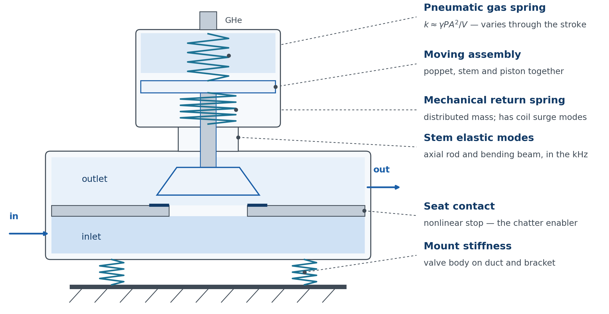
DYNAMICS
The valve is a spring-mass system by design
vibrationdata
25
Notes:
Not a metaphor. The spring rate and the moving mass are both specified numbers, so a natural frequency exists whether or not anyone computed it — and there are several such systems in one valve.

Slide 26
DYNAMICS
Four spring-mass systems, four frequency bands
Order of magnitude only. The point is the separation, not the values.
System | Stiffness source | Typical band | Principal risk
Poppet rigid body | Return spring plus gas spring | Tens of Hz | Flow-induced chatter
Coil surge | Spring wire in longitudinal wave | Several hundred Hz to low kHz | Spring fatigue, seat load loss
Body, bracket, bellows | Mount and duct stiffness | Hundreds of Hz | Blade passing coincidence
Stem elastic modes | Stem as a rod or beam | kHz for axial | High cycle fatigue
vibrationdata
26
Notes:
The gap between the first and last rows is large, and the middle two rows sit right in it — which is exactly where blade passing energy concentrates. That is where to look first. Note also that the first row's natural frequency is not a fixed number, because the gas spring contribution varies through the stroke.

Slide 27
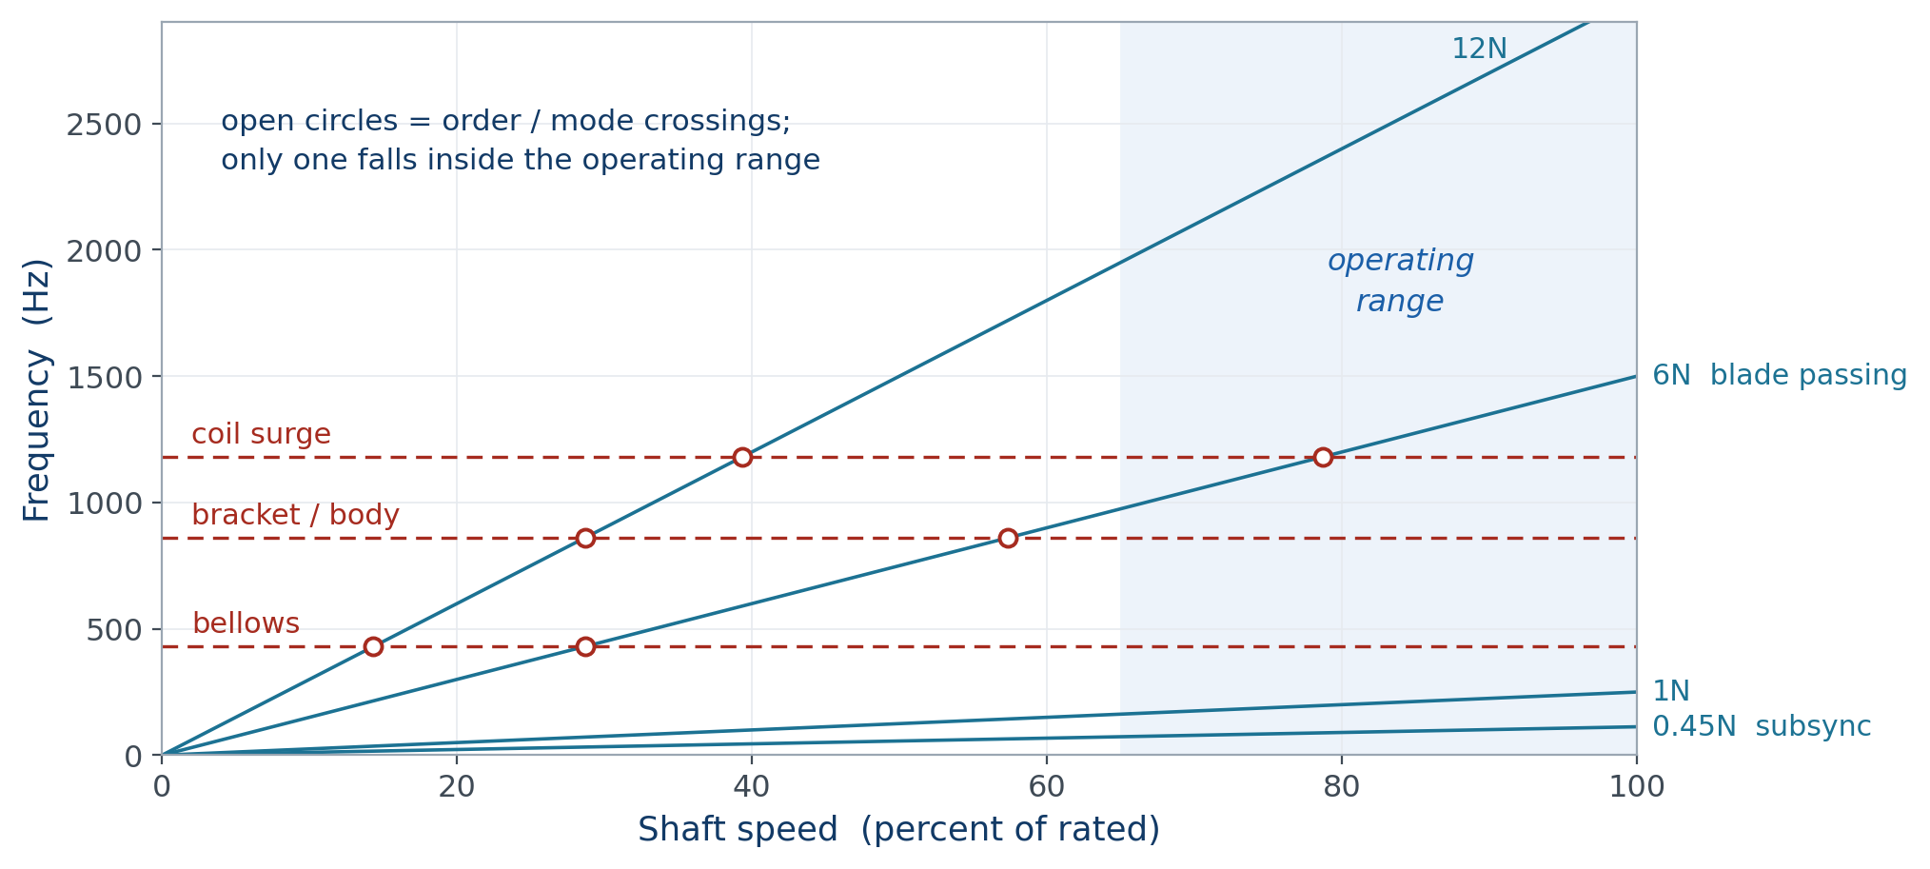
DYNAMICS
Interference diagram: where the crossings fall
vibrationdata
27
Notes:
Frequency separation is the first line of defense, but the tones sweep through the whole range during start and shutdown, so separation over the full envelope is often impossible. What you can control is where the crossings fall and how long you dwell there.

Slide 28
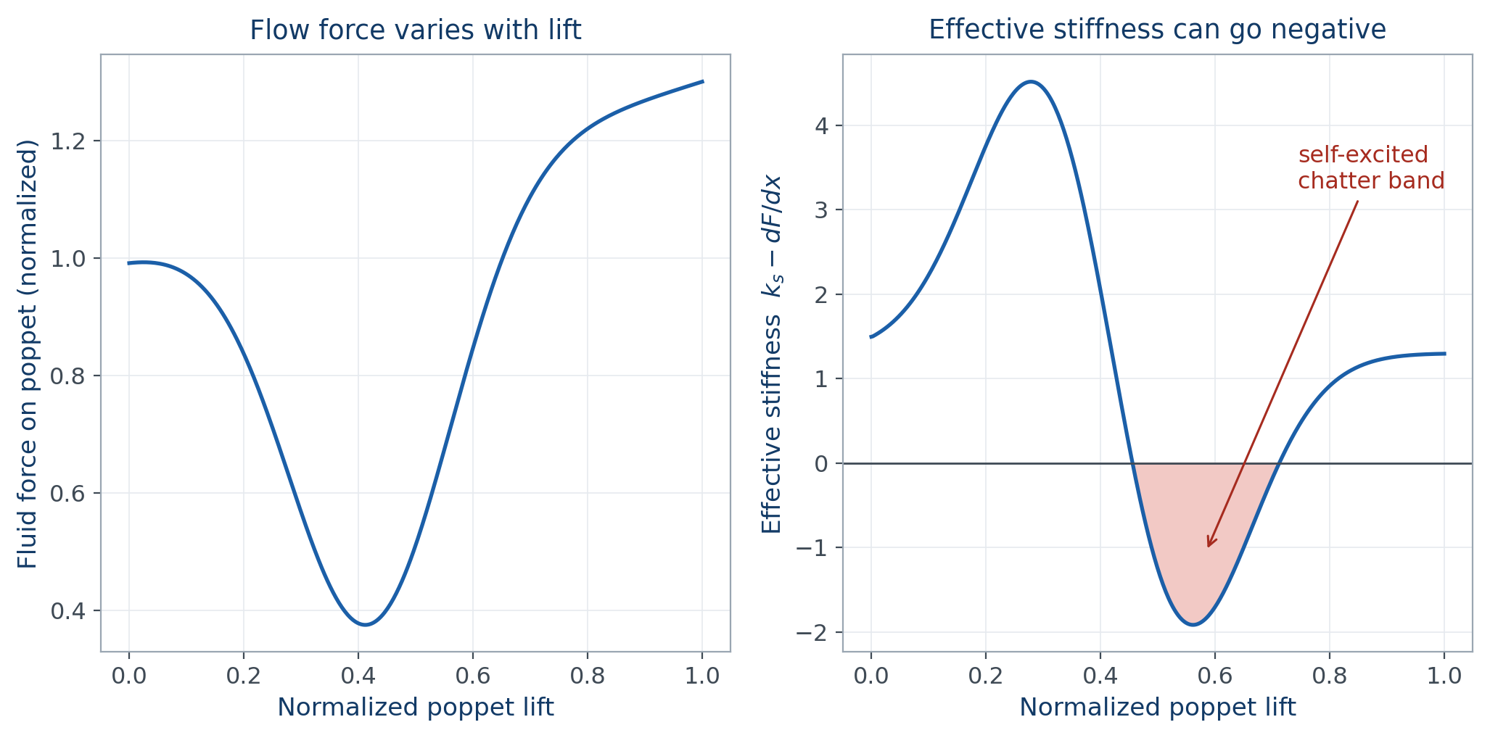
DYNAMICS
Flow-induced instability: poppet chatter
vibrationdata
28
Notes:
The fluid force on the poppet depends on poppet position, because lift changes both the flow area and the pressure distribution across the face. Where the slope of that curve exceeds the spring rate, the effective stiffness goes negative and the system self-excites. No external tone is required.

Slide 29
DYNAMICS
Why chatter is the event worth chasing
This is the cross-cutting basic event identified earlier by fan-out.
It requires no defect, no wear, and no external excitation. It is a property of the internal geometry and the operating point.
It is aggravated by compressible or two-phase flow at the seat — which is precisely the condition during cryogenic chilldown.
It hammers the poppet on the seat at the natural frequency, producing repeated high-load contact.
That single behavior feeds three separate branches of the fault tree: mechanical impact ignition, particle generation, and seat wear.
It is also directly testable in a component flow rig, which makes it a high-value basic event to resolve early.
vibrationdata
29
Notes:
Fan-out plus testability is what makes this the event to spend effort on. Most basic events in this tree are either hard to test or affect only one branch. This one is neither.

Slide 30
DYNAMICS
Coil surge: the spring has its own modes
The mechanism
Design practice
The spring is a distributed system, not a massless element
Longitudinal waves travel along the wire between the coils
At surge, coils resonate against each other independently of the poppet
Consequences are coil clash, spring fatigue, and transient loss of seat load
Valvetrain rule of thumb keeps surge frequency roughly ten to thirteen times the cycling rate
That yardstick does not transfer here — the excitation is continuous, not cyclic
Check surge frequency directly against the pump tones and their harmonics
Variable pitch and damper coils shift or spoil the surge modes
vibrationdata
30
Notes:
Coil surge is routinely missed because the spring is modeled as a stiffness with no mass. It shows up as spring wire fatigue with no other explanation, and the fracture location — partway along the coil rather than at an end — is the giveaway.

Slide 31
DYNAMICS
The pneumatic actuator stiffness is not a constant
One reported natural frequency is not enough. Ask what stroke position and supply state.
The actuator gas volume behaves as a spring with rate on the order of gamma times P times A squared, divided by V.
Volume changes through the stroke, so the stiffness changes through the stroke. The assembly natural frequency sweeps as the valve moves.
Supply pressure and helium temperature both shift it again, so the frequency varies across the operating envelope and with prestart conditions.
Supply line inertance adds a second oscillator. Long pilot lines can put its natural frequency low enough to couple with the mechanical mode.
The observable symptom of that coupling is position hunting or an oscillatory stroke — which is often misdiagnosed as a controller tuning problem.
vibrationdata
31
Notes:
The practical consequence is that a single reported natural frequency for the valve assembly is meaningless without stating the stroke position and the supply state it was measured at. Ask for the conditions whenever you are handed one number.

Slide 32
DYNAMICS
Cryogenic and fluid corrections do not all go one way
A room temperature modal survey misleads in two directions at once.
Effect | Direction | Magnitude | Consequence for the estimate
Elastic modulus rise at 90 K | Frequency up | Roughly 5 to 10 percent | Small; shifts crossings
Fluid added mass on the poppet | Frequency down | Geometry dependent | Dry modal test overpredicts
Loss of polymer damping | Amplification up | Can be a factor of two or more | Dominates the damage estimate
Joint preload change with temperature | Either | Configuration dependent | Changes both frequency and Q
vibrationdata
32
Notes:
The first two effects partially cancel and are second order. The third does not cancel and is not second order. An ambient modal survey can get the frequency close and the amplification badly wrong, and only one of those two errors matters much.

Slide 33
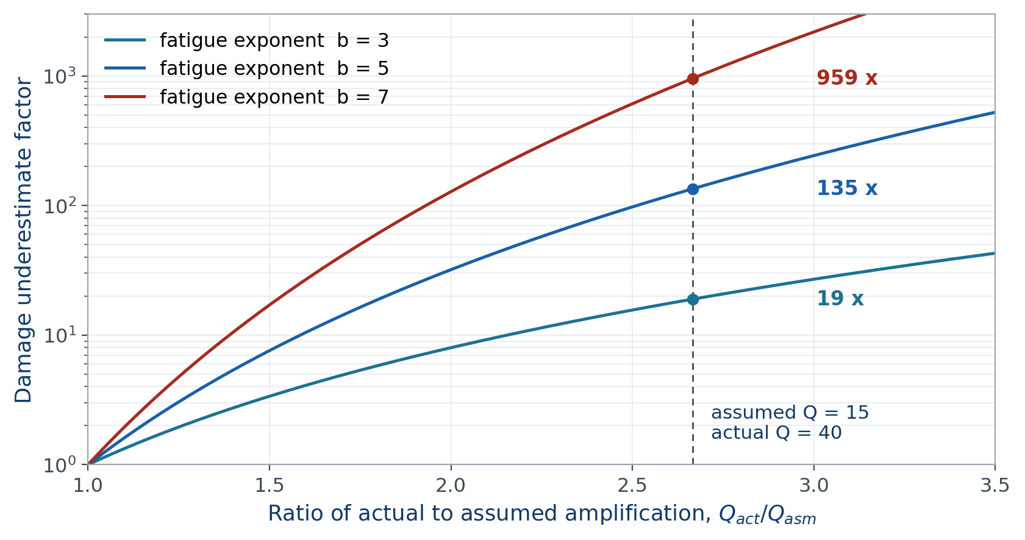
DYNAMICS
Why the amplification factor dominates the estimate
vibrationdata
33
Notes:
Fatigue damage scales as stress to the fatigue exponent, and response amplitude at resonance scales with Q. An error in Q is therefore raised to the fifth power for a typical steel. This single parameter swamps every other conservatism in the analysis.

Slide 34
SECTION THREE, CONTINUED
Accumulated damage
The basic event probability is not constant. It is a function of how the unit has been used, which is not something classical fault tree quantification accommodates.

Slide 35
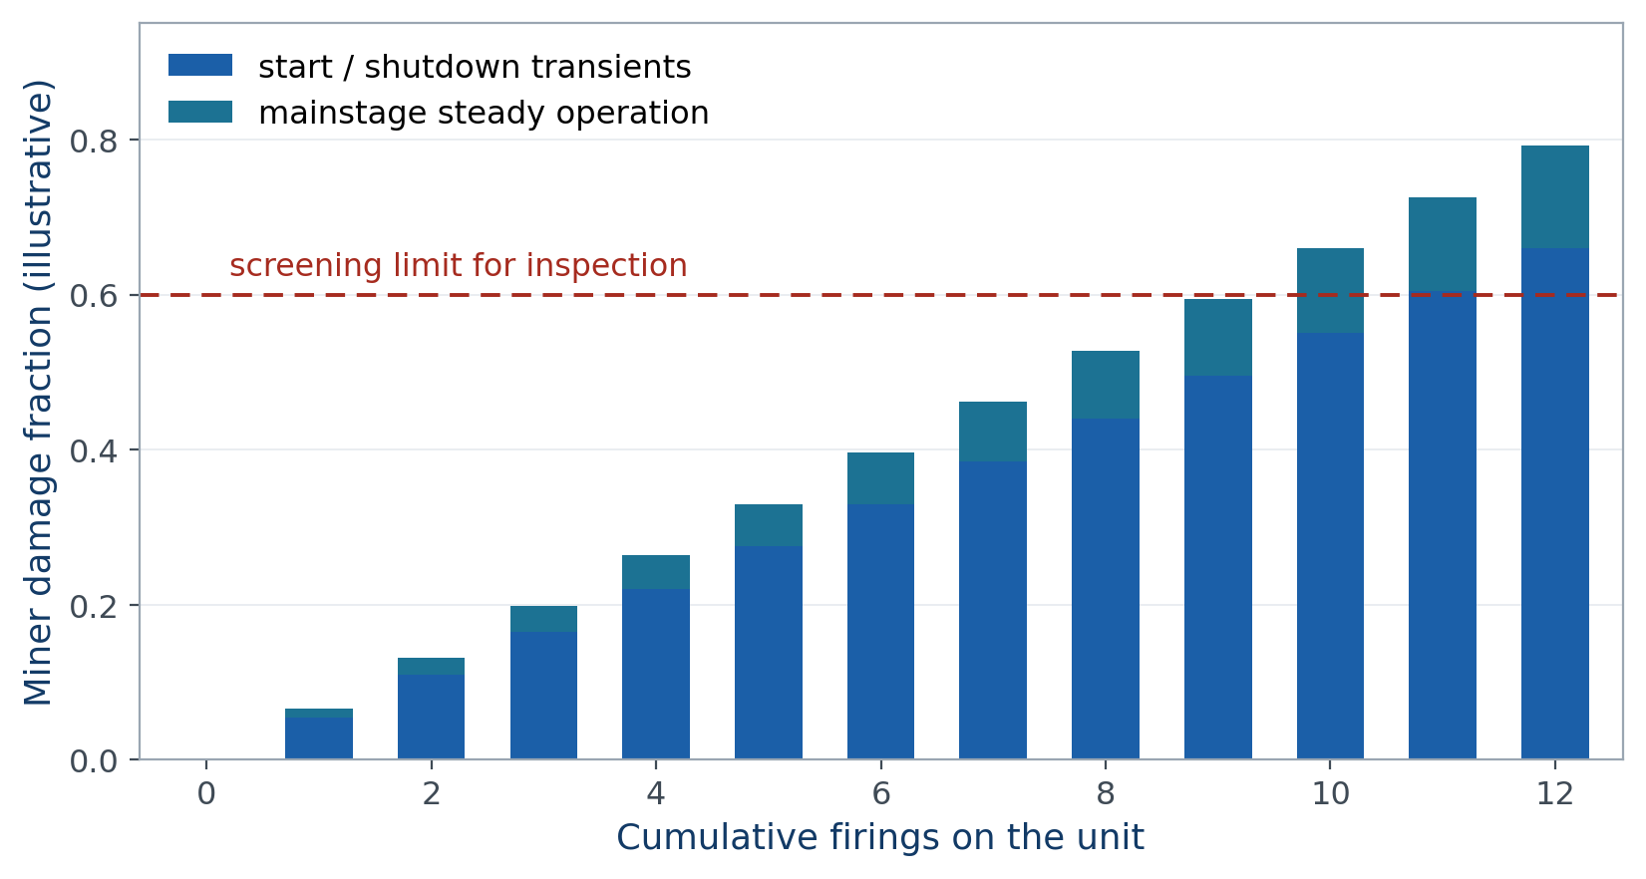
FATIGUE
Damage accumulates across the firing history
vibrationdata
35
Notes:
Acceptance firings, engine qualification, stage-level static fire, flight, and refire all deposit damage in the same hardware. A given unit carries a damage index, and the probability of the structural basic event is a monotonic function of that index rather than a rate.

Slide 36
FATIGUE
Transients usually dominate the accumulation
Damage scales with firings, not with seconds. This is a testable prediction.
Start and shutdown are short but contain the resonance sweep, the pressure surge from valve stroking, and the thermal shock of chilldown.
Damage per second during a transient can exceed mainstage by orders of magnitude, so damage scales with the number of firings more than with total run time.
That gives a testable discriminator. If damage tracks firing count rather than accumulated seconds, the transient is the driver.
Sweep rate matters. Cycles accumulated at peak response scale roughly inversely with the rate of change of the exciting frequency, so a slow throttle ramp can be worse than a fast one.
Dwell correction is the right accounting. Time spent at the power level where a tone parks on a mode is the fatigue-relevant parameter, not total burn duration.
vibrationdata
36
Notes:
The counterintuitive item is the fourth. Programs often slow a ramp to be gentle on the hardware and increase the damage by doing so, because the number of cycles accumulated while passing through the resonance goes up.

Slide 37
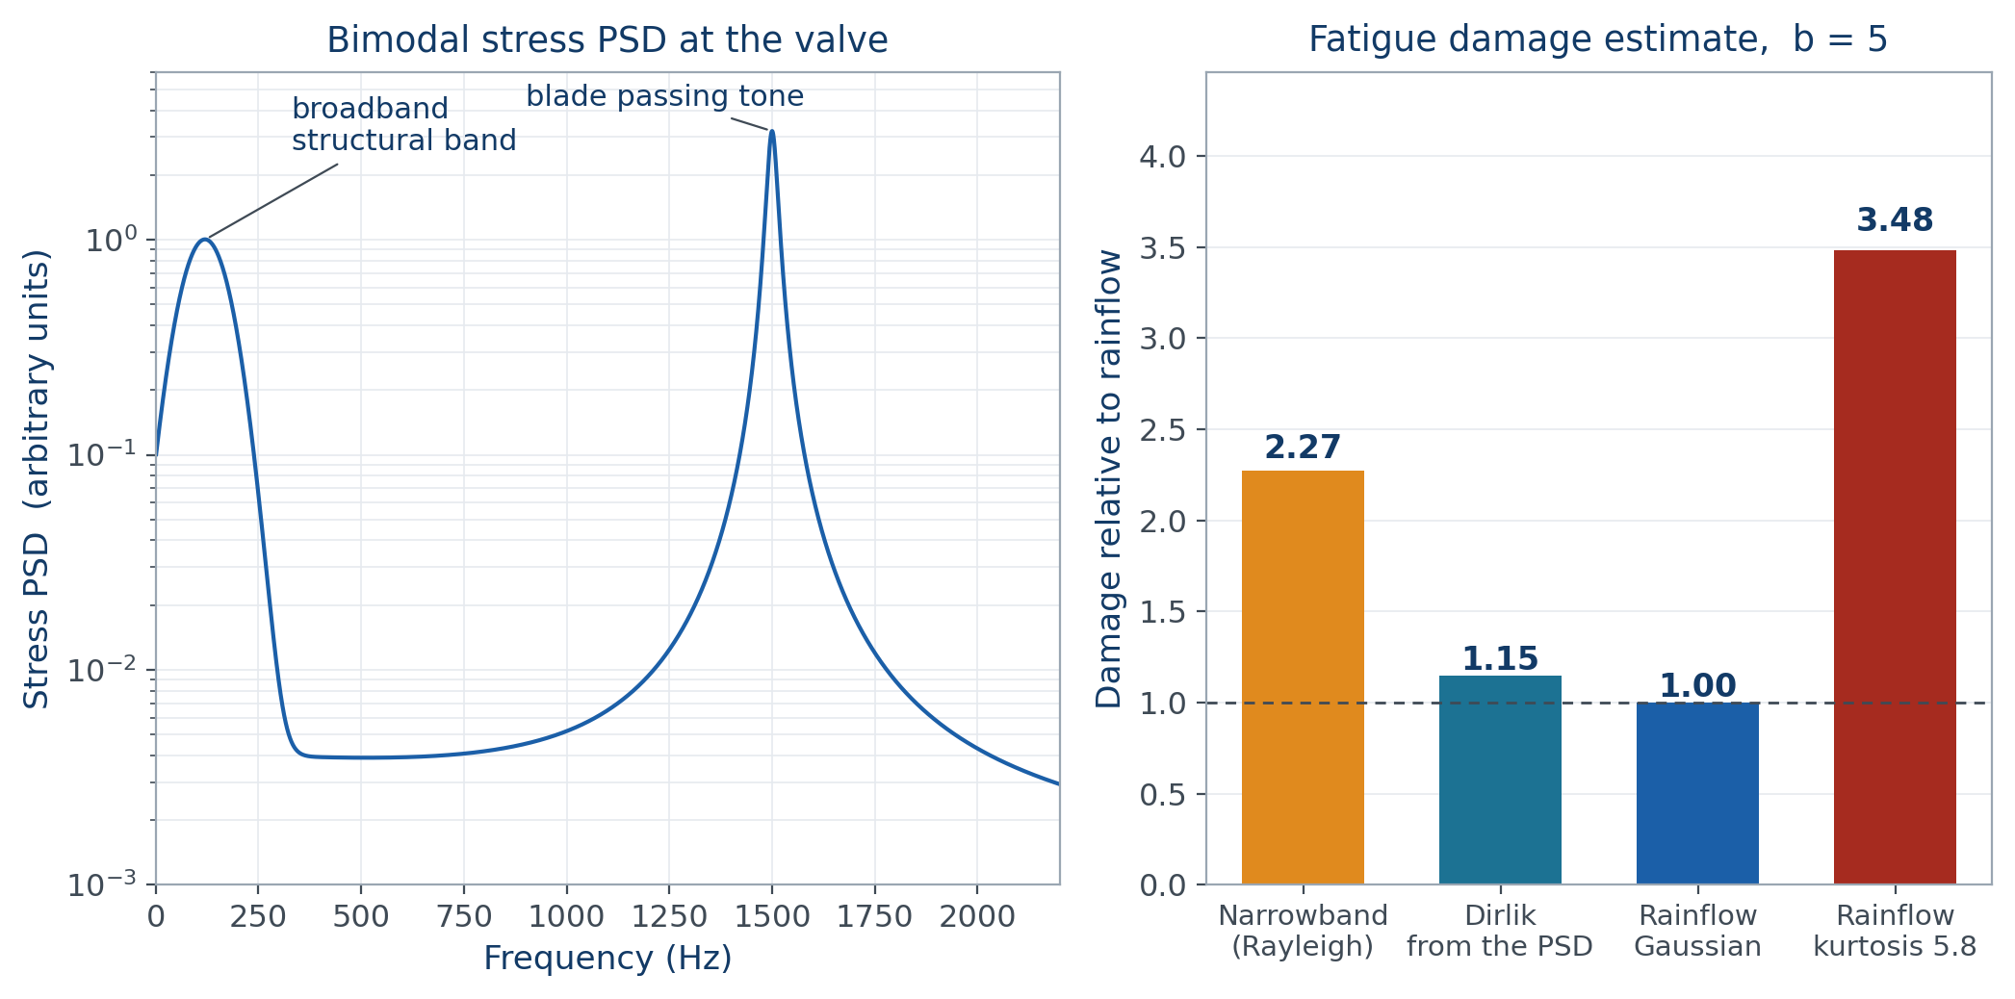
FATIGUE
Spectral damage methods and the Gaussian assumption
vibrationdata
37
Notes:
Narrowband Rayleigh is conservative by roughly two. Dirlik lands within fifteen percent of rainflow. But the same PSD realized with kurtosis near six gives three and a half times the damage, and no PSD-based method can see it.

Slide 38
FATIGUE
What the comparison actually tells you
The usual instinct — reach for a better spectral method — solves the smaller problem.
The choice among spectral methods is a second-order argument for this kind of spectrum. Dirlik handles a bimodal shape better than its reputation suggests.
The Gaussian assumption is the first-order error. Cavitation and combustion coupling drive kurtosis well above three, and the damage penalty is large.
No method based on the PSD alone can recover it. Kurtosis is a property of the phase relationships that the PSD throws away.
The practical answer is to keep time histories where the environment is suspected to be non-Gaussian, and to rainflow them directly.
Where only a PSD is available, treat the spectral estimate as a lower bound and carry an explicit non-Gaussian factor rather than burying it in a generic margin.
vibrationdata
38
Notes:
This corrects a common expectation. Engineers often reach for a better spectral method when the real problem is that the process is not Gaussian. Improving the spectral method is refining a fifteen percent error while a two-hundred-fifty percent error sits untouched.

Slide 39
FATIGUE
Screen first with stress and velocity
A screening tool, not a substitute for the detailed calculation.
Before any cycle counting, the stress-velocity relationship gives a fast bound. Peak stress is approximately density times wave speed times velocity.
The input is the measured or predicted velocity response at the component, which is often available long before a stress model is.
The result is compared against the endurance limit expressed in the same terms. Many structural metals reach the endurance limit at a pseudo-velocity in the neighborhood of one hundred inches per second.
If the implied stress is well below that, the fatigue branch can be closed out and the effort moved elsewhere.
If it is close, the detailed accounting is warranted — and the modal survey conditions become the thing to verify first.
vibrationdata
39
Notes:
The value of the screen is triage. Detailed fatigue accounting is expensive and often gets applied to components that were never at risk, while the component that was at risk waits. The velocity screen sorts them in an afternoon.

Slide 40
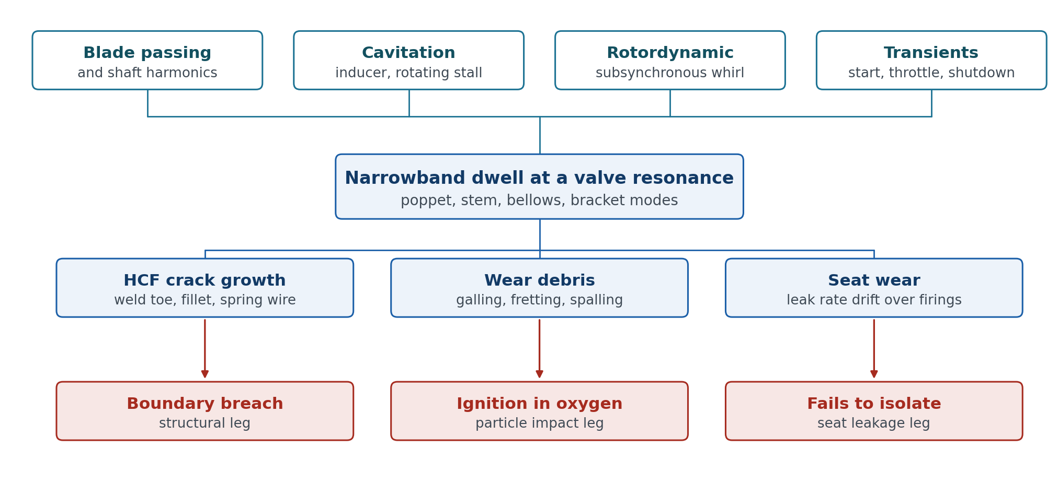
SYNTHESIS
Vibration is a cross-cutting initiator
vibrationdata
40
Notes:
Vibration and accumulated damage are not a fourth branch alongside the functional three. They feed all three. This is why the vibration environment belongs in the fault tree rather than in a separate loads document that the reliability analyst never reads.

Slide 41
SYNTHESIS
What the recovered hardware can tell you
Fatigue and ignition are serial, not competing. The evidence for the first can be destroyed by the second.
Evidence | Indicates | Caution
Beach marks, striations, ratchet origins | Progressive fatigue | Origin may be consumed if ignition followed
Dimpled rupture | Single overload | Can be secondary to another failure
Melted, oxidized, resolidified metal | Ignition reached that location | Destroys the initiating evidence
Fretting scars, galling transfer | Relative motion under load | Strongest indicator of the chatter path
Seat leak rate trend across the fleet | Wear-out versus random | Requires the firing history to interpret
vibrationdata
41
Notes:
The awkward case is fatigue-initiated ignition, where the fatigue origin is consumed by the event it caused. In that situation the usable evidence shifts to the unfailed hardware — sister units and the rest of the fleet — inspected at the same locations. Whether the findings correlate with firing count is the single most informative result available.

Slide 42
VERIFICATION
What component qualification does not cover
What a base-input shaker test verifies
What it cannot verify
Bracket and mount integrity
Body and bellows structural modes
Fastener and joint retention
Survival of the interface environment
Fluid-borne pressure loading on the poppet face
Seat contact preload and differential pressure across the closure
Cryogenic stiffness and damping state
Flow-induced instability of the poppet degree of freedom
Anything above roughly two kilohertz, where fixture and armature resonances dominate
vibrationdata
42
Notes:
A valve that passes a room temperature base-input PSD test has demonstrated that the bracket will not crack. It has demonstrated nothing about whether the poppet will go unstable at partial throttle in cryogenic service. Those are different questions and they need different tests.

Slide 43
VERIFICATION
What closes the open branches
Each of the three closes a branch that qualification testing leaves open.
Cold flow rig
Cold modal survey
Fleet inspection
Representative upstream duct and downstream volume
Instrumented for poppet position and internal dynamic pressure
Swept across throttle and inlet condition
Closes the chatter branch directly
Flight configuration and joint preload
At operating temperature, not ambient
Reports amplification, not just frequency
Repeated at several stroke positions
Sister units at the same locations
Correlate findings against firing count
Trend seat leak rate rather than pass or fail
Discriminates wear-out from design cause
vibrationdata
43
Notes:
Three tests, each aimed at a specific open branch. The fleet inspection is the cheapest and is usually the one that tells you which corrective action is appropriate — redesign, screening, or a life limit.

Slide 44
SUMMARY
What to carry away
Define the top event with failure, phase, and consequence. Decompose the first tier functionally, never by parts list.
In an oxidizing service, the ignition branch is an AND gate. Mitigation means breaking a leg of it, because redundancy is unavailable.
The valve is a spring-mass system with several distinct resonances. Poppet chatter needs no external excitation and feeds three branches at once.
Amplification factor dominates the fatigue estimate, and an ambient modal survey gets it wrong in the unconservative direction.
The Gaussian assumption is a larger error than the choice of spectral damage method. Keep time histories where kurtosis is suspected.
Vibration is a cross-cutting initiator, not a separate branch. It belongs inside the fault tree.
vibrationdata
44
Notes:
If one item survives from this deck, make it the third. The chatter mechanism is under-recognized, it is not covered by conventional qualification, and it is the single basic event with the highest fan-out in the tree.

Slide 45
REFERENCES
Sources and further reading
NASA, Fault Tree Handbook with Aerospace Applications, 2002 — the canonical treatment of the method.
ASTM MNL36, Safe Use of Oxygen and Oxygen Systems, and the ASTM G-series: G88 system design, G94 metals, G63 nonmetals, G93 cleaning.
NASA-STD-6001, flammability and compatibility testing behind the kindling chain logic.
Dirlik, T., Application of Computers in Fatigue Analysis, University of Warwick, 1985. Tovo and Benasciutti for the bimodal correction.
NASA-HDBK-7005, Dynamic Environmental Criteria, for the environment derivation and flight-to-flight variation.
Vibrationdata tutorials and free ebooks: blog.vibrationdata.com/2025/11/27/toms-ebooks/
vibrationdata
45
Notes:
The ASTM oxygen material is the least familiar to most structural dynamicists and the most immediately useful if you work anywhere near an oxidizer system.

Slide 46
VIBRATIONDATA
Questions
Tom Irvine — vibrationdata

