Slide 1
THE 2026 VENEZUELA EARTHQUAKE DOUBLET
A Structural Dynamics Case Study — Mechanisms, Failure Modes, and Lessons Learned
24 June 2026 — M7.2 followed 39 seconds later by M7.5
Nearly every mechanism we teach appeared in one event: rupture directivity, soft-soil site amplification, resonance with building fundamental periods, soft-story collapse, non-ductile concrete — and the accumulated-damage problem of back-to-back shaking.
Reconnaissance is ongoing. Casualty and damage figures remain provisional and are evolving.
AT A GLANCE
3,889 confirmed dead
16,000+ injured
~800 buildings collapsed
189 completely leveled
$37 B direct damages
as of 9 July 2026; USGS PAGER projects final fatalities may exceed 10,000
Tom Irvine | Vibrationdata | July 2026

Slide 2
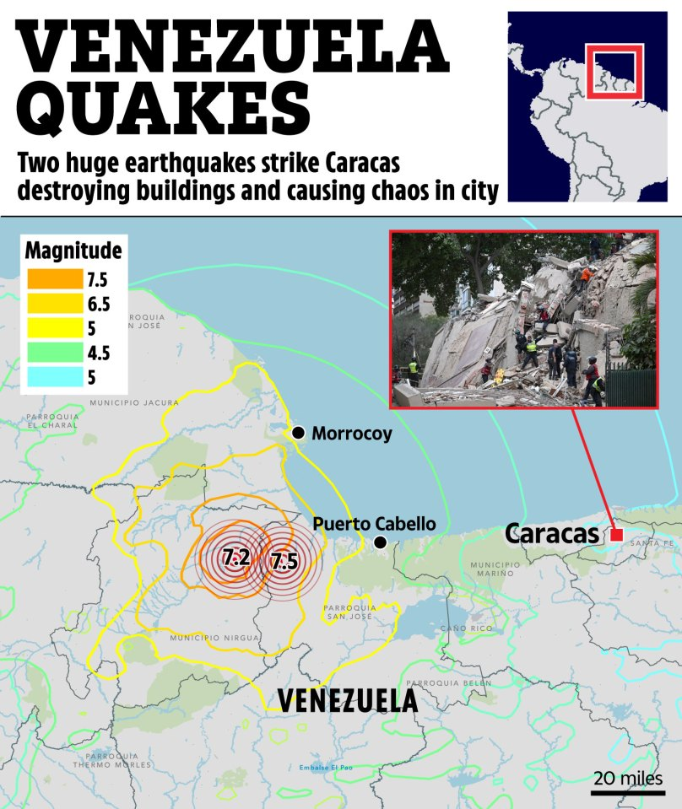
The circles mark rupture initiation, ~160 km west of Caracas
The M7.5 then ruptured ~175 km eastward — toward the city
Epicentral distance badly understates the demand; what governs is rupture distance to the fault plane, and the plane extended nearly to Caracas
The eastward direction also placed the capital in the forward-directivity lobe
https://www.thesun.co.uk/news/39546906/satellite-pics-venezuela-earthquake-destruction/

Slide 3
The Event — Source Parameters
Two major ruptures from essentially the same epicentral area, 39 seconds apart. USGS formally treats the M7.2 as a foreshock of the M7.5 mainshock.
Parameter | Foreshock | Mainshock
Origin time (UTC) | 22:04:33 | 22:05:12 (+39 s)
Local time | 6:04 PM | 6:05 PM
Magnitude | M 7.2 | M 7.5
Focal depth | ~20.3 km | ~10 km (shallower)
Location | Near San Felipe, Yaracuy | Near Yumare, Yaracuy
Distance to Caracas | ~160 km west | ~160 km west
Mechanism | Shallow strike-slip | Shallow strike-slip
USGS event ID | us6000t7zc | us6000t7zp
Rupture Geometry (USGS)
• Fault plane ~175 km long × 20 km wide.
• Propagated UNILATERALLY EASTWARD from an onshore epicenter, along the coast — toward the Caracas–La Guaira urban corridor.
• Started in the eastern Boconó or western San Sebastián system, then ran offshore onto the San Sebastián fault.
• The offshore segment is why tsunami alerts reached Puerto Rico and the USVI.
Historical Context
The 39 seconds is the whole story. No occupant could evacuate. No structure could be inspected. No degraded building could be tagged. The larger event arrived while the first one was still ringing down — which converts a strength problem into a damage-accumulation problem (see slide 9).
• Strongest Venezuelan earthquake since 1900 (M7.7).
• Only seven M6+ events within 250 km in the past century — a long, quiet loading interval.
Vibrationdata | Tom Irvine | blog.vibrationdata.com
2

Slide 4
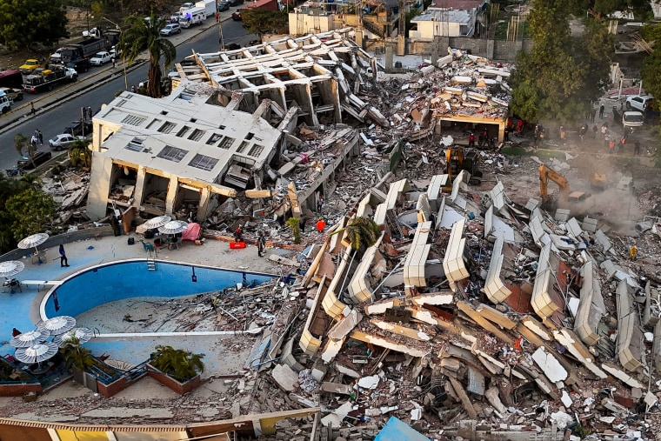
At left, a multi-story reinforced-concrete building has lost its ground level
This is soft-story collapse: an open ground floor with fewer walls and columns than the levels above concentrates the entire interstory drift demand into a single level.
At right, a complete pancake collapse: floor slabs stacked flat on one another with minimal void space and almost no surviving vertical elements between them
This is column hinging rather than beam hinging

Slide 5
Tectonic Setting — A Distributed Transpressional Boundary
Northern Venezuela is not a single fault line. It is a 1,300 km wide zone of distributed right-lateral shear between the Caribbean and South American plates.
The Boconó–San Sebastián–El Pilar System
Precedent on This Boundary
• Right-lateral (dextral) strike-slip with a compressional component — transpression.
• Extends >1,300 km from the Venezuelan Andes to Trinidad, transferring slip east via the Los Bajos and Warm Springs faults.
• Accommodates roughly 10 mm/yr of the ~20 mm/yr plate motion — the rest is taken up on parallel strands.
• The doublet struck where the NE-trending Boconó system converges with the E–W San Sebastián system — one of the most structurally complex corners of the entire boundary.
Why complexity matters
A fault junction hosts multiple segments at different orientations and different states of stress. That is precisely the geometry that permits one rupture to load and trigger a neighbor — the mechanism behind the doublet.
1812 Caracas
The earthquake that devastated the city during the independence war is also believed to have comprised at least two large subevents. This plate boundary has produced multi-event ruptures before.
1900 M7.7
The prior benchmark for the largest Venezuelan earthquake, now surpassed.
1967 Caracas
Prompted the modern seismic code. Soft-story collapse dominated the damage — the same mode that dominated in 2026, 59 years later.
September 2025 M6.2 + M6.3 doublet
WSW of the 2026 epicenter. One fatality, 110+ injuries, extensive damage in Zulia and Lara. The region had already demonstrated doublet behavior nine months earlier.
The Boconó–San Sebastián–El Pilar System
Vibrationdata | Tom Irvine | blog.vibrationdata.com
3

Slide 6
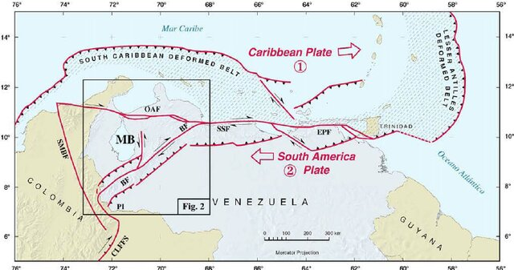

Slide 7
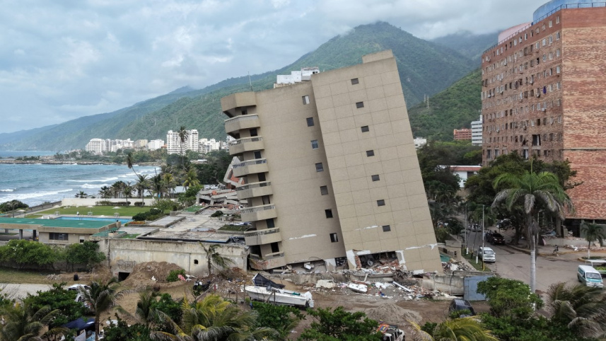
A La Guaira tower rotated bodily at its base while the superstructure stayed square — the signature of foundation failure in soft, saturated coastal alluvium, not of structural collapse
The same soils that amplified the shaking also lost their bearing capacity beneath it
https://www.thedailystar.net/news/environment/climate-crisis/natural-disaster/news/venezuela-quake-death-toll-rises-4490-4222606

Slide 8
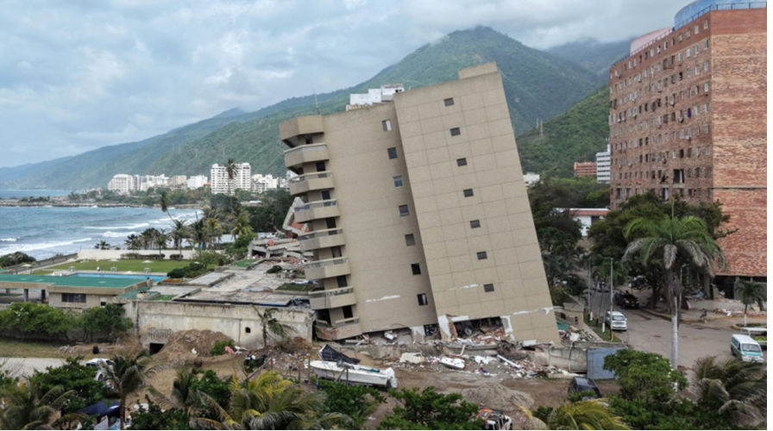
LA GUAIRA TOWER — DESIGN MITIGATION
Foundation rotation in saturated coastal alluvium, Venezuela M7.2/M7.5 doublet
PRIMARY FIX — FOUNDATION REDESIGN
Deep foundations — driven or bored piles carrying load through the liquefiable alluvium into competent strata
Stiff mat foundation with embedment, in place of isolated spread footings
Grade beams tying footings so they cannot settle independently
GROUND IMPROVEMENT — IF SHALLOW FOOTINGS RETAINED
Densification: stone columns, vibro-compaction, dynamic compaction
Drainage: gravel or wick drains to dissipate excess pore pressure
Jet or compaction grouting; excavate and replace thin weak layers
Bodily rotation at the base with the superstructure square — the signature of bearing failure, not structural collapse.
DESIGN PROCESS
Site-specific response analysis — soft coastal alluvium classifies as Site Class E/F
Liquefaction triggering evaluation (Seed–Idriss / Boulanger–Idriss) from SPT or CPT data at design PGA
KEY POINT The superstructure performed well. The frame had enough integrity to survive a large base rotation as a rigid body. The deficiency was upstream — in the geotechnical investigation and foundation design.
Photo: thedailystar.net — Venezuela quake coverage | Tom Irvine, VibrationData | blog.vibrationdata.com
Notes:
La Guaira tower, Venezuela earthquake doublet. Failure mode is geotechnical rather than structural: bearing capacity loss in saturated coastal alluvium produced bodily rotation. Mitigations are foundation redesign (piles, mat, grade beams) or ground improvement (densification, drainage, grouting), plus site-specific response and liquefaction triggering analysis in design.

Slide 9
Doublet Mechanics — Stress Triggering
A doublet is two earthquakes of similar magnitude, nearly coincident in time and location. They are uncommon precisely because they require two fault segments to be simultaneously near critical stress.
The Triggering Hypothesis
Competing Rupture Interpretations
The prevailing interpretation is static and dynamic stress triggering:
• The first rupture raised the Coulomb failure stress on an adjacent, shallower segment.
• That segment — already close to failure after a long loading interval — broke 39 seconds later.
• Dynamic (transient wave) stresses may also have contributed at such short delay.
The source models do not fully agree — and the disagreement is instructive.
USGS — two discrete events
M7.2 foreshock + M7.5 mainshock. Finite fault: 175 × 20 km, unilateral east.
INGV — one composite rupture, Mw 7.6
Inverting Sentinel-1 InSAR, the surface deformation from the two events is indistinguishable. Modeled as a single rupture with two energy-release episodes over ~210 × 30 km, Morón to NE of Caracas.
GEOSCOPE / IPGP (SCARDEC) — Mw 7.8 cascade
Treats the entire moment release from 22:04:32 UTC as one prolonged, uninterrupted cascading rupture — several strong pulses over roughly two minutes.
For the structural engineer the distinction is academic: either way, the demand arrived as a long, multi-pulse input on a structure with one budget of ductility.
The Nearest Recent Analog
2023 Kahramanmaraş (Turkey/Syria): M7.8 followed nine hours later by M7.5. Nearly 60,000 dead. The same signature — buildings weakened by the first event were finished off by the second.
Vibrationdata | Tom Irvine | blog.vibrationdata.com
4

Slide 10
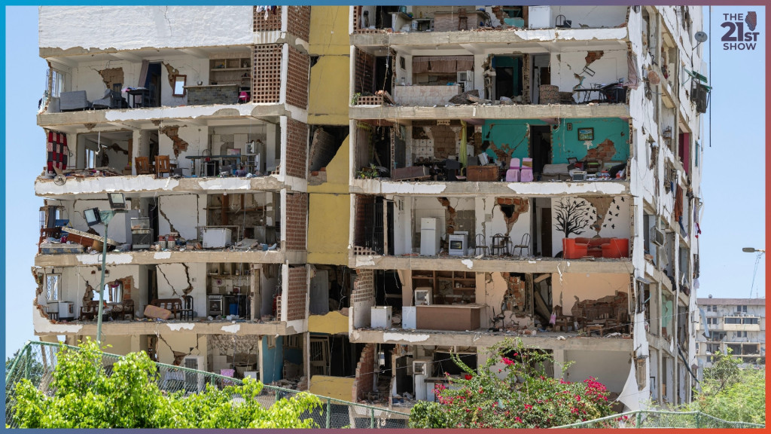
Unreinforced masonry infill shaken clear of a concrete frame that remained standing
The walls were designed as non-structural, but they are heavy, brittle, and bonded to the frame — so they attract load they cannot carry, then shed it
The frame survived; the building did not
https://will.illinois.edu/21stshow/story/after-earthquakes-illinois-man-worries-over-countrymen-in-venezuela

Slide 11
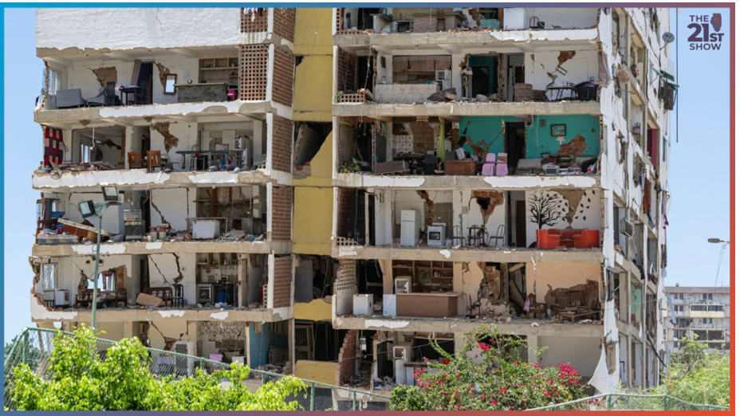
UNREINFORCED MASONRY INFILL — MITIGATION
Breaking the unintended composite action between infill and frame
ISOLATE THE INFILL — PREFERRED FOR NEW DESIGN
Gap detailing — compressible seam of 20 to 40 mm, sized for design story drift, at the beam soffit and column faces. No diagonal compression strut forms
Out-of-plane restraint at those gaps — sliding clips or dowels in slotted holes. Omitting this is why isolated infills topple
Sub-panel the wall with intermediate ties or bond beams to limit unbraced slenderness
REINFORCE THE INFILL — PREFERRED FOR RETROFIT
Bed-joint wire reinforcement plus vertical bars in grouted cells
Confined masonry — tie-columns and tie-beams cast against completed masonry
Welded wire mesh with shotcrete, ferrocement, or FRP overlay, anchored to the frame
Infill shaken clear of a frame that remained standing. The frame survived; the building did not.
KEY POINT Two competing lateral systems were never reconciled. The frame was designed to deform; the walls were built rigid. The stiffer one takes load first — here it was the one with no capacity and no ductility. Commit to the walls as structure, or genuinely detach them.
Photo: will.illinois.edu / The 21st Show — Venezuela earthquake coverage | Tom Irvine, VibrationData | blog.vibrationdata.com
Notes:
Infill failure mode: unreinforced masonry, bonded to the frame, unmodeled. The wall attracts load it cannot carry, cracks, loses coherence, then sheds out of plane. Two coherent strategies: isolate with drift gaps plus out-of-plane restraint, or reinforce and model the infill as part of the lateral system. The failure is the halfway condition.

Slide 12
COULD REINFORCING BARS HAVE BEEN IN THE ORIGINAL DESIGN?
Yes — reinforced infill masonry was established practice long before this building was designed
WHAT COULD HAVE BEEN ON THE ORIGINAL DRAWINGS
THE IMPORTANT CAVEAT
Bed-joint reinforcement — 2-wire ladder or truss wire every second or third course, roughly 400 to 600 mm vertical spacing. Negligible cost at construction. Holds the panel together after first cracking
Vertical bars in grouted cells — one bar every 800 to 1200 mm, hooked into the beam above and the slab below. Converts a wall that topples into one that spans vertically like a one-way slab
Confined masonry tie-columns and tie-beams — concrete cast against completed masonry so mortar keys into it. Standard practice across Latin America and codified in the Venezuelan COVENIN standards
Frame anchorage — dowels or wall ties from column faces into bed joints, developing the panel edge rather than butting it against the concrete
Reinforcement solves out-of-plane collapse very effectively. It does not solve the in-plane interaction problem
A reinforced, bonded infill is still stiff. It still forms a compression strut, still shifts the building period, and still creates short-column and soft-story hazards where the layout is irregular
TWO COHERENT STRATEGIES
Reinforce and account for it — bars plus explicit modeling of the infill as part of the lateral system
Isolate and restrain — drift gaps for in-plane freedom, plus connections and reinforcement for out-of-plane demand only
RETROFIT OF EXISTING STOCK
Embedded steel becomes surface treatment — mesh and shotcrete overlays, near-surface-mounted bars in cut grooves, or FRP strips
Less efficient than getting it right originally, but the same mechanics
KEY POINT Reinforcement appears in both strategies, for different reasons. What fails is the third option that was actually built — unreinforced, bonded, and unmodeled.
Tom Irvine, VibrationData | blog.vibrationdata.com | Free ebooks: blog.vibrationdata.com/2025/11/27/toms-ebooks/
Notes:
Reinforcing bars were available and codified long before this construction. Bed-joint wire, vertical bars in grouted cells, confined masonry tie elements, and frame anchorage are all low cost at construction time. The caveat: reinforcement addresses out-of-plane collapse but leaves the in-plane stiffness and irregularity problems untouched, so it must be paired with explicit modeling.

Slide 13
DESIGN PROCESS — THE ROOT ERROR
Treating masonry as nonstructural dead load
MODEL THE INFILL
CHECK OUT-OF-PLANE DEMAND EXPLICITLY
Equivalent diagonal strut models per FEMA 356, ASCE 41, or Eurocode 8 provisions
Captures the added stiffness and the resulting period shift
Captures torsional eccentricity from irregular wall layouts
Captures the short-column effect, where partial-height infill leaves a stub column that fails in shear
Use the floor acceleration at each level, not the ground motion
Upper-story infill sees strong amplification and governs the panel design
ENFORCE REGULARITY
Infill must not be concentrated on some faces and absent on others — that is a torsional irregularity
Infill must not be absent at ground level for retail or parking — that is a soft story
KEY POINT The frame survived; the building did not. Life safety and post-event functionality were both lost to elements the analysis never included. Whichever lateral system is stiffer takes the load first — so the infill must either be modeled and detailed as structure, or genuinely detached from it. The halfway condition is the failure mode.
Tom Irvine, VibrationData | blog.vibrationdata.com | Free ebooks: blog.vibrationdata.com/2025/11/27/toms-ebooks/
Notes:
Design process failures: not modeling the infill, checking out-of-plane demand against ground motion rather than floor acceleration, and permitting plan and elevation irregularity in the wall layout. Equivalent strut models in ASCE 41 and Eurocode 8 capture period shift, torsion, and short-column effects.

Slide 14
Why the Ground Motion Was So Damaging — Three Compounding Factors
None of these mechanisms is exotic. Each is taught in every earthquake engineering course. They arrived together.
① Shallow Depth
② Rupture Directivity
③ Site Amplification
10–20 km focal depth.
A crustal rupture delivers its energy almost directly to the surface, with very little geometric attenuation.
Contrast with a deep subduction event, which spreads and dissipates energy over a much longer travel path before it reaches the built environment.
The mainshock was the SHALLOWER of the two (10 km vs 20 km) — and the larger. The worst possible pairing.
Rupture ran east — at the cities.
Unilateral propagation toward La Guaira and Caracas means sites in the forward direction receive seismic radiation compressed in time.
The result is a short, high-amplitude VELOCITY PULSE rather than a long train of small cycles.
Forward-directivity pulses are especially punishing: they concentrate the entire energy demand into one or two large displacement excursions, giving the structure no opportunity to dissipate energy gradually.
This is the seismic analogue of a shock pulse rather than a random vibration exposure.
Soft, saturated alluvium.
Much of La Guaira and parts of Caracas sit on soft alluvium and reclaimed land, trapped between the coastal mountains and the sea.
A soft soil column both AMPLIFIES the motion and LENGTHENS its predominant period.
Loose sand and gravel slowed the waves while increasing their amplitude; partial soil softening under strong shaking made it worse still.
Microsoft AI for Good Lab: satellite analysis of Catia La Mar found ~1/3 of its ~30,000 structures damaged.
Vibrationdata | Tom Irvine | blog.vibrationdata.com
5

Slide 15
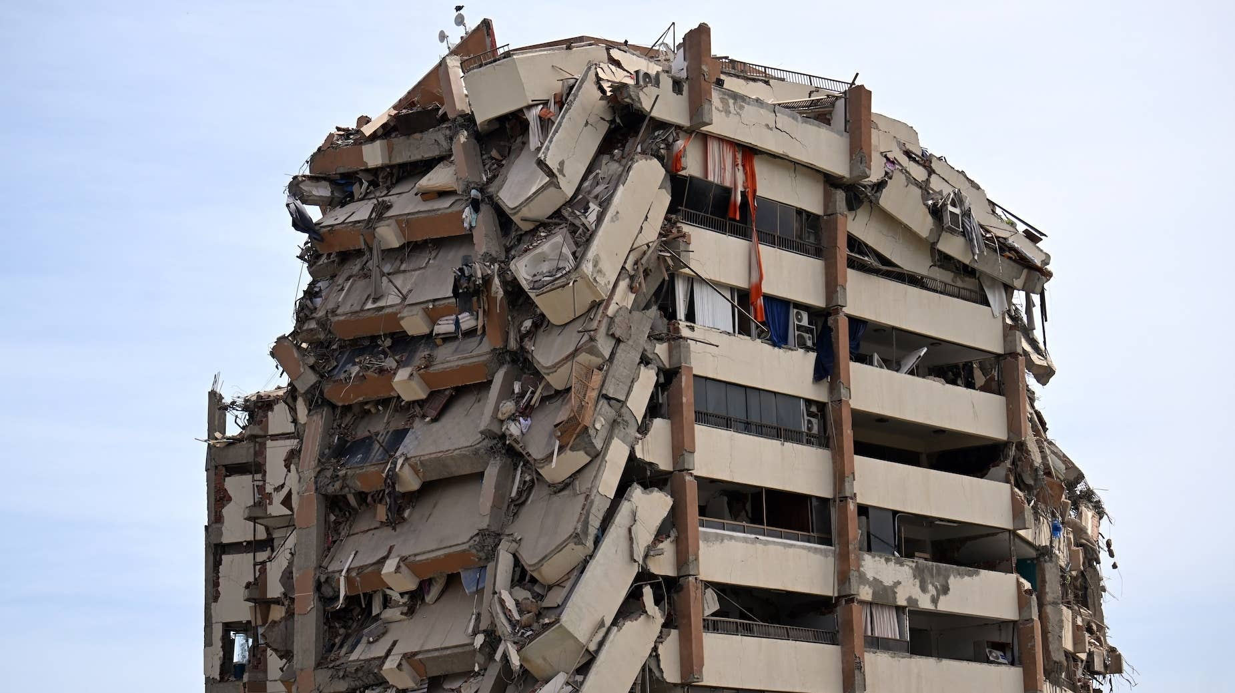
Two bay of columns on opposite sides failed and the floors above cascaded straight down through that line, while the adjacent bay stood plumb
The clean vertical fracture is a measure of how little redundancy existed across it — no alternate load path caught the falling slabs
In a ductile frame, damage spreads and is absorbed; here it propagated
https://www.surfer.com/news/venezuela-earthquake-ocean-footage-video

Slide 16
Resonance — When the Site Period Meets the Building Period
Site amplification alone is not lethal. It becomes lethal when the amplified band coincides with the fundamental period of the building stock sitting on it.
The Period-Matching Problem
The Cruel Second-Order Effect
The familiar rule of thumb for the fundamental period of an N-story building:
A damaged structure is a SOFTER structure. Cracked concrete and yielded reinforcement reduce stiffness, which LENGTHENS the natural period.
On a soft-soil site, period lengthening can move a building FURTHER INTO the amplified band rather than out of it. The first shock can tune the structure to the second.
Tₙ ≈ 0.1 N seconds
• A 5–15 story building therefore has Tₙ ≈ 0.5–1.5 seconds.
• That band is squarely where deep soft-soil sites concentrate their amplified response.
• When the site period matches the structure period, the building is driven near resonance — displacement demand grows with each cycle, like a swing pushed at exactly the right moment.
• La Guaira and Caracas are full of mid-rise construction on exactly this kind of soil.
Familiar Territory
This is the same physics as any base-excited SDOF problem: a transmissibility peak at the coincidence of forcing and natural frequency, with the peak amplitude set by damping.
The difference is that a building's “damping” in a major earthquake is largely HYSTERETIC — it is bought with permanent damage.
Vibrationdata | Tom Irvine | blog.vibrationdata.com
6

Slide 17
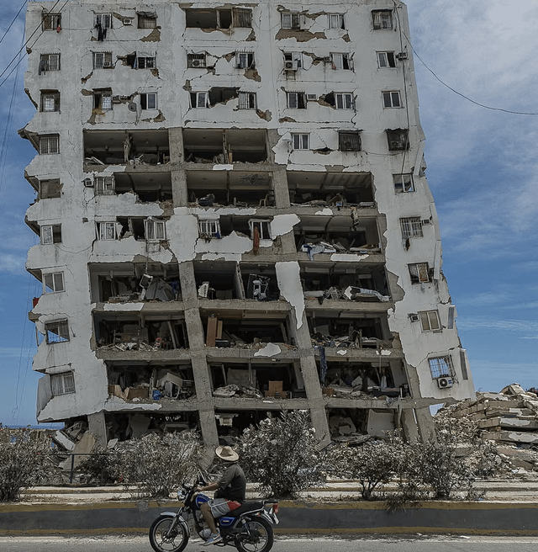
The damage gradient — intact above, gutted below — traces the interstory drift profile
Drift demand accumulates toward the base, and drift ratio Δ/h, not peak acceleration, is what damages a frame
The permanent lean says the lower columns yielded and stayed yielded
The ductility capacity has been well spent, and none of it is coming back
A conditional success: The frame met its life-safety objective — it deformed inelastically rather than pancaking, and people got out
https://www.reddit.com/r/StructuralEngineering/comments/1uj8ub1/textbook_capacity_design_venezuela_earthquakes/

Slide 18
Structural Failure Mode ① — Soft-Story (Weak-Story) Collapse
The single most common configuration flaw in the collapse inventory — and one of the best-understood, most economically fixable defects in earthquake engineering.
The Mechanism
This Is Not a New Discovery
Many collapsed buildings had open ground floors — garages, retail, parking — with far fewer walls and columns than the stories above.
A lateral stiffness discontinuity at one level does not share drift. It CONCENTRATES the entire interstory drift demand into that single story.
The ground-floor columns must absorb the displacement that would otherwise be distributed over the full height of the building.
When those columns fail, the stories above pancake. There is no alternate load path.
Stanford's Eduardo Miranda: soft stories are prevalent in Venezuela, and combined with soft soils they are a recipe for collapse.
Soft-story collapse dominated the 1967 Caracas earthquake — the event that prompted Venezuela's modern seismic code.
It has dominated the damage in countless earthquakes since, worldwide.
It is a SOLVED problem that keeps killing people.
The Fix Is Known and Cheap
• Add moment frames or shear walls at the open level. Jacket the columns.
• Los Angeles and San Francisco have MANDATORY soft-story retrofit ordinances.
• Screening a building inventory for this one configuration flaw is among the highest-leverage seismic interventions available anywhere.
Vibrationdata | Tom Irvine | blog.vibrationdata.com
7

Slide 19
Structural Failure Mode ② — Non-Ductile Reinforced Concrete
A large fraction of the Caracas building stock dates from the 1950s–60s boom — built before modern seismic detailing existed.
What Modern Detailing Buys You
Why Old Concrete Fails Brittlely
Capacity design: “strong column, weak beam.”
The intended behavior is that plastic hinges form in the BEAMS, dissipating energy hysteretically through many inelastic cycles, while the COLUMNS remain essentially elastic and the gravity load system survives.
This requires confinement reinforcement (closely spaced, properly anchored transverse hoops), competent beam-column joint detailing, and a deliberate strength hierarchy.
Without that hierarchy:
Hinges form in the COLUMNS instead. And a column hinge is not an energy-dissipation mechanism — it is a story-collapse mechanism.
Inadequate confinement.
Widely spaced ties with 90° hooks that open under load. The core concrete is unconfined, so it crushes and spalls, and the longitudinal bars buckle.
Poor joint detailing.
Beam-column joints with no transverse steel shear off before either member reaches capacity.
Smooth bars, short laps, corrosion.
Bond failure and lap splice pullout eliminate the composite action the design assumed.
Net result:
Little to no ductility capacity. The structure has essentially one elastic cycle of resistance, then it loses gravity load capacity. There is no reserve for a second shock.
Vibrationdata | Tom Irvine | blog.vibrationdata.com
8

Slide 20
The Doublet Problem — Damage Accumulation and Low-Cycle Fatigue
The 39-second spacing converts a strength problem into a cumulative-damage problem. This is the slide that connects the event to our usual territory.
The Ductility Budget
This Is Low-Cycle Fatigue
A code-designed building survives a major earthquake by responding INELASTICALLY. It trades permanent damage for survival. The ductility demand ratio:
Not an S-N problem.
A small number of very large inelastic strain reversals in the reinforcing steel and concrete. Damage accumulates in a Coffin–Manson sense, not a high-cycle Basquin sense.
μ = δ_{max} / δ_{yield}
Miner-type summation applies.
Cumulative damage concepts from fatigue analysis map directly onto why doublets and strong aftershock sequences are disproportionately lethal compared with a single shock of the same peak intensity.
μ ductility demand ratio, dimensionless δmax peak inelastic displacement reached during the event, measured as roof drift or story drift δyield displacement at first significant yield, where the idealized force-displacement curve departs from linear
Typical ductility capacity.
Unreinforced masonry 1.0 to 1.5. Ordinary RC moment frame 2 to 3. Special RC moment frame 5 to 8. Special steel moment frame 6 to 10. If the first shock spent two-thirds of that budget, the second event met a different structure than the one that was designed.
After the first shock, many structures were STANDING BUT DEGRADED:
Cracked concrete, yielded reinforcement
Reduced stiffness, lengthened period
A substantial share of the inelastic budget already spent
The test-engineering framing.
This is a response-spectrum and damage-accumulation problem in which the test sequence was applied TWICE to a specimen qualified — at best — for ONE exposure. No test engineer would accept that as a pass.
The M7.5 arrived 39 seconds later — before any occupant could evacuate, before any structure could be assessed, and before anyone could know that the building's capacity was no longer what the drawings said.
Turkey 2023 showed the identical signature: buildings weakened by the first event were finished by the second.
Vibrationdata | Tom Irvine | blog.vibrationdata.com
9
Notes:
Ductility demand ratio mu equals delta max over delta yield. Delta max is the peak inelastic displacement reached during the event. Delta yield is the displacement at first significant yield on the idealized force-displacement curve. The ratio is dimensionless. Typical capacities: unreinforced masonry 1.0 to 1.5, ordinary RC moment frame 2 to 3, special RC moment frame 5 to 8, special steel moment frame 6 to 10. Note that the ASCE 7 R factor is related but not identical, since R also embeds overstrength and redundancy. The doublet argument turns on what fraction of the ductility budget the first shock consumed, with no stiffness recovery and no opportunity for assessment before the second event.

Slide 21
Code Adequacy vs. Code Enforcement
The dominant story does not appear to be the content of the code. It appears to be enforcement, stock vulnerability, and construction quality.
The Code May be Part of the Problem, But not the Whole Problem
The Chile–Haiti Contrast, Again
Venezuela revised its seismic code after the 1967 Caracas earthquake. The current standard, COVENIN 1756, incorporates modern provisions aligned with international practice, including ACI-style concrete detailing.
The NZSEE reconnaissance team's comparison of the code's PGA zonation against USGS ShakeMap contours will be an important benchmark of whether the MAPPED HAZARD was actually exceeded.
Event | Magnitude | Deaths
Chile 2010 | M 8.8 | ~525
Haiti 2010 | M 7.0 | hundreds of thousands
Venezuela 2026 | M 7.5 | 3,889+ (evolving)
Fatality counts track building stock vulnerability and code enforcement far more closely than they track magnitude.
Chile released roughly 500 times the energy of Haiti and killed a tiny fraction as many people. The variable was not the earthquake. It was the buildings.
Venezuela 2026 lands, tragically, closer to the Haiti end of that spectrum in its hardest-hit districts — roughly 80% of buildings in parts of La Guaira collapsed or were severely damaged.
What Engineers Are Reporting
• Post-1999 public housing built rapidly with limited inspection and quality control.
• Older buildings never retrofitted.
Most troubling: a few RECENTLY DESIGNED, CODE-CONFORMING buildings also collapsed — which local engineers say warrants review of design and construction practice itself.
Vibrationdata | Tom Irvine | blog.vibrationdata.com
10

Slide 22
Lessons Learned (1 of 2)
Nothing about the physics of 24 June was exotic. Every mechanism was documented in prior earthquakes and taught in every earthquake engineering course.
① Retrofit the Existing Stock
② Soft Stories Keep Killing
③ Site Effects Must Flow Through
The code only protects NEW construction.
The deadliest buildings were built before, or outside, the modern code. Seismic risk reduction in a country like Venezuela is overwhelmingly a RETROFIT problem.
The toolkit:
• Add shear walls or bracing
• Jacket columns
• Close soft stories
• Base isolation and supplemental damping for critical facilities
Bristol's Raffaele De Risi: base-isolated hospitals and power plants can remain not merely standing but OPERATIONAL — a performance level demonstrated repeatedly in recent earthquakes.
A solved problem, unsolved in practice.
The engineering fixes — moment frames or shear walls at the open level — are well understood and relatively economical.
Jurisdictions including Los Angeles and San Francisco have MANDATORY soft-story retrofit ordinances.
Screening a building inventory for this single configuration flaw is among the highest-leverage seismic interventions available.
It requires no analysis — only a walk-around. That is what makes the continued fatality count so difficult to accept.
Microzonation is not an academic product.
Building dense mid-rise housing on soft coastal alluvium concentrates period-matched demand exactly where the vulnerable buildings are.
Microzonation maps EXISTED for Caracas.
The lesson is that microzonation must flow through to design forces and land-use decisions — not sit in a report.
A hazard map that does not change what gets built, or how, has not reduced any risk.
Vibrationdata | Tom Irvine | blog.vibrationdata.com
11

Slide 23
Lessons Learned (2 of 2)
The doublet's 39-second spacing added a cruel damage-accumulation twist — but the dominant variable, as always, was the vulnerability of the built environment.
④ Damage-Accumulation Thinking
⑤ QC Is a Structural Element
⑥ Post-Event Mobilization
Design assumes ONE design-level event.
Assessment frameworks largely do too. Doublets and strong aftershock sequences violate that assumption directly.
What is needed:
• Rapid tagging (safe / restricted / unsafe) before reoccupation
• Performance-based methods that account for REDUCED capacity under aftershocks
• Mainshock-aftershock fragility — an active research area awaiting codification
Venezuela 2026 will become a benchmark dataset for exactly this.
A code without inspection is a suggestion.
Reports of rapid, poorly inspected public housing construction, corrosion, and absent quality control describe capacity that existed ON PAPER but not IN THE FIELD.
The collapse of some reportedly code-conforming recent buildings argues for forensic review of:
• Design practice
• Materials
• As-built conformance
The reconnaissance reports over the next year will be essential reading.
Preparedness is not only search-and-rescue.
Venezuelan engineers and universities offered rapid assessment support that was slow to be taken up.
Meanwhile residents reoccupied or sheltered near damaged structures — under ongoing aftershocks.
Pre-arranged protocols for engineer-led rapid safety evaluation (ATC-20 style) are as much a preparedness item as SAR capacity.
The engineers were available. The protocol to deploy them was not.
Vibrationdata | Tom Irvine | blog.vibrationdata.com
12

Slide 24
Open Questions — What the Reconnaissance Should Answer
This event will generate the datasets that answer several questions our field has been arguing about for years.
The Analyses to Wait For
For Our Community Specifically
Recorded response spectra vs. COVENIN 1756 design spectra.
The central question: was the mapped hazard EXCEEDED, or was the hazard right and the buildings wrong? These are very different policy conclusions.
Directivity pulse characterization.
Velocity pulse period and amplitude in the forward direction — and whether pulse period matched mid-rise Tₙ.
The source model dispute.
Two events (USGS), one composite Mw 7.6 (INGV InSAR), or a single cascading Mw 7.8 (GEOSCOPE SCARDEC)? The strong-motion records should discriminate.
Forensics on the code-conforming collapses.
If modern buildings failed, was it design, materials, workmanship — or a demand that genuinely exceeded the code basis?
The doublet is a natural experiment in cumulative damage that no laboratory would be permitted to run.
Mainshock-aftershock fragility curves, calibrated against a real two-shock sequence on a real building inventory, are the deliverable.
The framework already exists in fatigue analysis — Miner summation over inelastic excursions, Coffin–Manson strain-life. The gap is codification into seismic assessment practice.
Closing thought. Earthquakes don't kill people; buildings do. There will be another event on this fault system. The engineering community's job is to make sure it meets a different building stock.
Vibrationdata | Tom Irvine | blog.vibrationdata.com
13

Slide 25
Sources and Further Reading
Reconnaissance is ongoing. Casualty, damage, and source-model figures are provisional and continue to evolve.
Primary Sources
Commentary and Analysis
USGS event pages
M7.2 foreshock (us6000t7zc); M7.5 mainshock (us6000t7zp)
earthquake.usgs.gov/earthquakes/eventpage/us6000t7zp/executive
NZSEE Venezuela Earthquake Reconnaissance Team (VERT)
Report Version 1.0, July 2026 — nzsee.org.nz
INGV (Italy)
Sentinel-1 InSAR inversion; composite Mw 7.6 rupture model
GEOSCOPE / IPGP — SCARDEC
Alternative single-rupture cascade model, Mw 7.8
COVENIN 1756
Venezuelan seismic design code (post-1967 Caracas)
• Eos — Venezuelan Earthquakes Struck in a Complex Zone of Faults
• The Conversation — Expert Q&A, Raffaele De Risi (Bristol) on the building collapses
• Loughborough University — Dr. Andre Jesus (structural dynamics) on directivity and site effects
• Miyamoto International — Venezuela's Strongest Earthquake in 125 Years
• AP / Reuters — reporting on substandard construction and risky geography
Related Vibrationdata Material
Free ebooks (shock & vibration response spectra, fatigue damage accumulation):
blog.vibrationdata.com/2025/11/27/toms-ebooks/
Seismic & Earthquake Engineering class — course series begins September 2026.
Vibrationdata | Tom Irvine | blog.vibrationdata.com
14

