Slide 1
VIBRATIONDATA
THE 2026 KUMAMOTO
EARTHQUAKE
Kyushu, Japan | 28 July 2026, 16:27 JST | Mⱼ 7.1 / Mw 6.8
An Engineering Review: Successes, Failures, and Lessons Learned
Tom Irvine — Vibrationdata
Prepared 30 July 2026
PRELIMINARY — based on agency and press reporting current to 30 July 2026.
Figures will change as official damage surveys and strong-motion records are released.
Notes:
Opening frame. Emphasize that the event is three days old and every number is provisional.

Slide 2
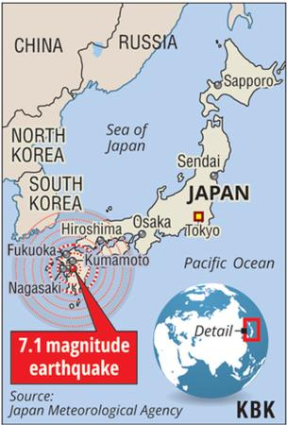
July 28, 2026
A magnitude 7.1 earthquake struck Japan's Kumamoto region, leading to a tsunami advisory for the Ariake Sea and Yatsushiro Sea
34 confirmed fatalities
Over 80 to 120 people have been reported injured, with several in serious condition

Slide 3
SCOPE AND GROUND RULES
What this package does, and what it deliberately does not do
PURPOSE
SOURCES
NOT YET AVAILABLE
Capture the structural-dynamics lessons while the event is fresh
Separate primary seismic failures from secondary and cascading ones
Frame observations in terms usable by US practitioners
JMA, MLIT, FDMA, Kumamoto Prefecture bulletins
USGS event page and finite-fault model
JR Kyushu, NEXCO West, Kyushu Electric operator notices
Wire reporting: Kyodo, Reuters, NHK, Japan Times
Official damaged-building counts (still 'under investigation')
K-NET / KiK-net processed record set
Cause determination for the mall explosion
Any peer-reviewed reconnaissance report
A note on discipline. Casualty and outage counts in the first 72 hours are the number published by one particular body, current at one particular time. Different agencies count differently — Japan reports 'cardiopulmonary arrest' separately from confirmed death, and deaths under investigation for disaster linkage are tallied apart from confirmed ones. Numbers in this package carry their source and timestamp for that reason.
Engineering interpretation, dimensional estimates, and all first-principles calculations in this package are the author's, not the agencies'.
Where an inference is drawn beyond what has been reported, it is flagged as an inference.
Vibrationdata | 2026 Kumamoto Earthquake, Kyushu, Japan | July 28, 2026
2
Notes:
Set expectations. This is a fast-turnaround technical review, not a reconnaissance report.

Slide 4
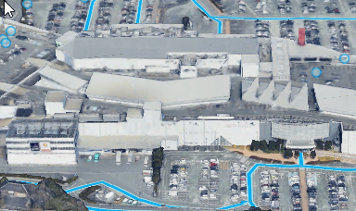
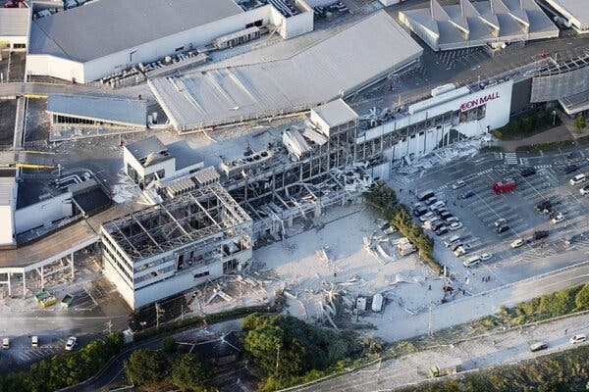
Google Earth Image before Quake
Damage from Quake & Gas Leak Explosion
Quake collapsed part of the second floor
A gas explosion followed roughly 50 minutes later, after ~3,000 shoppers had already been evacuated
The complex had reopened June 13, 2026 after a rebuild following the 2016 Kumamoto earthquake, with seismic reinforcement — seismic upgrades provide no capacity against internal uplift and outward blast loading

Slide 5
TWO EVENTS, TWO MECHANISMS
Aeon Mall Kumamoto • Kashima Town, Kumamoto Prefecture • 28 July 2026
16:27
~16:57
~17:17
M 7.1 (JMA) earthquake
Max seismic intensity 7 in the prefecture
Approx. 3,000 customers evacuated
to the parking lot
Gas explosion
Cause still under investigation
1
SEISMIC PHASE
2
DEFLAGRATION PHASE
JMA magnitude 7.1; maximum seismic intensity 7 recorded in parts of the prefecture
Partial collapse of the second floor
Damage distributed across the structure — the signature of ground motion
Complex had reopened 13 June 2026 after a post-2016 rebuild that included seismic reinforcement
Roof deck and cladding stripped from one bay group; primary steel frame left standing
Damage sharply localized — adjacent roof planes undeformed
Radial debris field across the parking lot and into the tree line
Pulverized gypsum and concrete fines blanketing pavement and vehicles
Notes:
Sequence matters: the earthquake collapsed part of the second floor, but the explosion roughly 50 minutes later produced most of the visible destruction. Localization plus a radial debris field are the discriminators between blast and seismic damage.

Slide 6
THREE BARRIERS — AND WHY SHUTOFF ALONE IS NOT ENOUGH
Layered mitigation for a seismically induced gas release in a large enclosed retail volume
1
PREVENT THE LEAK
2
ISOLATE THE SUPPLY
3
DILUTE THE CLOUD
Flexible loops or bellows where piping crosses seismic joints between structurally independent blocks
Threaded small-bore steel is the classic failure point — the thread removes wall section and fails brittly in bending
Anchor gas-fired appliances; unrestrained ranges and water heaters slide and tear their connectors
Place flexibility deliberately — rigid bracing into a stiff frame plus a hard connection to a flexibly supported rooftop unit concentrates all drift at one fitting
Japan already leads here: microcomputer meters trip on seismic intensity, excess flow, and abnormal flow duration
Utility SI-value sensors isolate at block level
The limit: meter shutoff stops replenishment but does not empty the piping downstream of the break
Residual line inventory in a complex this size can alone reach a stoichiometric cloud
Fix: automatic zone valves at every tenant branch, with purge to atmosphere
Methane LEL ≈ 5% v/v — modest forced ventilation holds a leak well below it
Post-quake, HVAC trips and the building seals itself; this one was air-conditioned and largely closed after evacuation
Define a post-earthquake purge mode: dampers open, exhaust on emergency power
Combustible-gas detection interlocked to zone isolation, not merely to an alarm panel
Battery backup — utility power is least reliable exactly when it is needed
SPECTRAL INTENSITY — THE TRIP CRITERION
SI = (1/2.4) ∫ PSV(T, ζ = 0.20) dT over 0.1 – 2.5 s — Japanese gas utilities isolate near SI ≈ 60 kine. Housner spectral intensity, not PGA, because it weights the velocity content that actually damages piping.
Notes:
The instructive part is that Japan already has the best gas-isolation infrastructure in the world, and the event still happened. That points downstream of the meter: zone-level isolation, ventilation, and detection interlocks.

Slide 7
THE STRUCTURE VENTED. THE PROTOCOL DID NOT.
Explosion venting behaved well; the losses came from re-entry control
1
STRUCTURAL RESPONSE
~3,000
customers evacuated within about 30 minutes
The lightweight roof deck and cladding acted as an unplanned deflagration vent — which is why the primary frame survived rather than progressively collapsing
Design it deliberately (NFPA 68 logic): specify deck pull-off capacity over gas-served areas so venting direction is controlled
Locate gas-fired equipment on perimeter bays that vent outward, away from egress paths — not in interior cores
Provide tie forces and alternate load paths so localized column loss does not propagate
Caution: reports of a supersonic pressure wave remain unconfirmed. Intact, neatly parked vehicles argue against a far-field detonation; local flame acceleration in congested space fits the evidence better.
50 min
from earthquake to explosion
3
employees killed inside the building
RE-ENTRY CONTROL — THE CHEAPEST ITEM ON THE LIST
Post-quake exclusion zones must include staff — no re-entry for stock, cash, or securing the store until gas is confirmed isolated and the building surveyed. Headcount accountability at the muster point: the operator believed all employees were out, and only later learned some had stayed or returned.
Notes:
Bottom line: the structure survived the earthquake and vented the blast. The fatalities came from a fifty-minute gap in re-entry control, which is an operational fix rather than an engineering one.

Slide 8
THE EVENT AT A GLANCE
Shindo (震度, literally "degree of shaking")
As reported through the evening of 30 July 2026
Mⱼ 7.1
10–16 km
Shindo 7
~15 s
34
JMA magnitude
(USGS Mww 6.8)
Hypocentral depth
(flash → provisional)
Max JMA intensity
Uki City, Hikawa Town
Rupture duration
USGS finite-fault model
Deaths reported
(incl. under investigation)
PARAMETER
VALUE
SOURCE / NOTE
Origin time
28 July 2026, 16:27:15 JST (07:27 UTC)
JMA — late afternoon, pre-rush hour
Epicenter
~5 km east of Uto, 32.682°N 130.722°E
USGS; south of Kumamoto City
Mechanism
Strike-slip, NE-trending fault plane
Consistent with Futagawa–Hinagu system
Peak ground acceleration
0.705 g at Mashiki; ~1.7 g peak reported
USGS station value; Japan strong-motion network
Peak ground velocity
94.3 cm/s at Yatsushiro
USGS — the more damage-relevant metric
Tsunami
Advisory issued 16:29, lifted 18:10 same day
Ariake and Yatsushiro Seas
Aftershocks
48 events at shindo ≥3 within 20 hours
MLIT 5th report, 12:00 on 29 July
Vibrationdata | 2026 Kumamoto Earthquake, Kyushu, Japan | July 28, 2026
3
Notes:
Note the two very different PGA figures - a station value versus a network peak. Always ask which station, which component, which processing.

Slide 9
TECTONIC SETTING
Central Kyushu sits at the southwest terminus of the Median Tectonic Line
Kumamoto lies at the southern end of Japan's longest fault system, where the Median Tectonic Line forks at the Beppu–Haneyama Fault Zone.
The Beppu–Shimabara graben is an actively extending crustal block; earthquake epicenters have historically migrated west to east across it.
The Futagawa Fault (north) and Hinagu Fault (south) form the local strike-slip system. The 2016 sequence ruptured the northern Hinagu and the Futagawa.
Current working hypothesis (S. Sakai, ERI, University of Tokyo): the 2026 event slipped the southern Hinagu Fault, loaded by Coulomb stress transfer from the 2016 ruptures.
SCHEMATIC — FAULT GEOMETRY
Median Tectonic Line trend
Hinagu Fault, southern segment — 2026 rupture, ~40 × 15 km
Futagawa Fault — ruptured in the 2016 sequence
Epicenter, ~5 km east of Uto
Why this matters to the designer. A shallow (10–16 km) strike-slip rupture directly beneath a populated basin is the near-field case. Site-to-source distance is small, the rupture is short in duration, and the motion is dominated by a small number of large velocity excursions rather than by long stationary shaking. Design spectra anchored on far-field records systematically understate this condition. The 2016 sequence made the same point in the same prefecture ten years earlier.
Vibrationdata | 2026 Kumamoto Earthquake, Kyushu, Japan | July 28, 2026
4
Notes:
Schematic only - not to scale, not a substitute for the published fault maps.

Slide 10
RUPTURE AND SOURCE PARAMETERS
USGS finite-fault model, preliminary
RUPTURE GEOMETRY
SLIP DISTRIBUTION
MAGNITUDE BOOKKEEPING
Slip distributed over approximately 40 × 15 km
Northeast-trending fault plane
Bilateral propagation — outward NE and SW from the hypocenter
Complete in just over 15 seconds
Maximum slip ~2 m, inferred at ~5 km depth near the hypocenter
Slip tapers strongly toward the surface
Near-surface displacement peaked near 0.9 m
Buried-rupture character limits surface fault rupture hazard
JMA magnitude Mⱼ 7.1 — the domestic scale
USGS moment magnitude Mww 6.8; JMA moment tensor also gives Mw 6.8
Same earthquake, different definitions — not a discrepancy
Depth revised 10 km (flash) to 16 km (provisional) by JMA
ENERGY AND DURATION — A SANITY CHECK
A 15-second rupture on a 40 km fault implies an average rupture velocity of roughly 1.3 km/s if unilateral — but the model is bilateral, so each front travels ~20 km, giving ~1.3–2.5 km/s depending on the asymmetry. That is a normal sub-shear rupture speed for a crustal strike-slip event.
Strong-motion duration at a near-field site is therefore short: on the order of 10–20 seconds of significant shaking, not the 100+ seconds of a subduction megathrust. Cycle counts are low, and that has direct consequences for how you treat cumulative damage — see the aftershock discussion later in this package.
Mw 6.8 releases roughly 1/6 the seismic moment of the Mw 7.0 mainshock of 2016. The observed damage is correspondingly less severe, but not proportionally so, because the controlling variable at a given site is local intensity, not magnitude.
Vibrationdata | 2026 Kumamoto Earthquake, Kyushu, Japan | July 28, 2026
5
Notes:
The rupture velocity arithmetic is the author's own, from the published geometry and duration.

Slide 11
RECORDED GROUND MOTION
Intensity distribution and peak parameters
JMA INTENSITY
LOCATIONS
PEAK PARAMETERS
Shindo 7 (max)
Uki City, Hikawa Town
Shindo 6-upper
Yatsushiro, Uto, Misato, Mashiki,
PGA 0.705 g — Mashiki station (USGS)
PGA ~1.7 g — peak on Japan's strong-motion seismograph network
PGV 94.26 cm/s — Yatsushiro station (USGS)
For reference: 2016 mainshock PGA 1.83 g; foreshock 1.61 g
Kumamoto City Minami-ku
Shindo 5-upper
Kikuyo (TSMC JASM site)
Shindo 5
Miyazaki, Kagoshima, Nagasaki, Saga, Fukuoka
Aftershock max
Shindo 5-lower
Read the PGA numbers carefully. 0.705 g and 1.7 g are not the same kind of quantity. One is a named-station value from one network; the other is the maximum across a dense national array of well over a thousand instruments, and very likely a resultant or a site with strong local amplification. Quoting a network maximum as 'the PGA of the earthquake' is a common and serious error.
WHAT SHINDO 7 MEANS PHYSICALLY
At JMA intensity 7, people cannot remain standing and may be thrown; unsecured furniture topples or is tossed; reinforced concrete walls may collapse. This was the first shindo 7 recorded in Japan since the Noto Peninsula earthquake of January 2024.
Vibrationdata | 2026 Kumamoto Earthquake, Kyushu, Japan | July 28, 2026
6
Notes:
Emphasize the instrumentation point - a national dense array is why Japan can even report a 1.7 g peak.

Slide 12
WHY VELOCITY, NOT ACCELERATION
The stress–velocity relationship applied to a 94 cm/s ground motion
σ = ρ c V
THE CAVEAT THAT MATTERS
94.3 cm/sec is FREE-FIELD GROUND velocity, not the velocity of any structural member
The relevant V is the response velocity of the element, which for a lightly damped structure tuned near the excitation can be several times the ground value
ρcV is a plane-wave result; for beam bending a mode-shape coefficient applies, typically pushing the estimate upward
Treat 5,400 psi as an order-of-magnitude floor, not a design number
stress = mass density × wave speed × velocity
For a plane wave in an elastic medium, stress is proportional to particle velocity through the acoustic impedance ρc — a material constant, independent of frequency.
For steel: ρc ≈ 146 psi per in/sec (39.7 MPa per m/sec).
A structural response velocity of 94.3 cm/sec (37.1 in/sec) therefore maps to roughly 5,400 psi (37 MPa) of dynamic stress.
Acceleration alone tells you almost nothing about stress without also knowing frequency. Velocity carries the stress information directly.
THE PRACTICAL CONSEQUENCE
This is why PGV correlates better with observed damage than PGA does, why Japanese intensity is computed from a filtered acceleration record rather than raw peak, and why a pseudo-velocity response spectrum is the right first tool for looking at a near-field record. A 2 g spike at 40 Hz breaks nothing. A 1 g pulse at 1 Hz — the same acceleration, forty times the velocity — flattens a building.
Vibrationdata | 2026 Kumamoto Earthquake, Kyushu, Japan | July 28, 2026
7
Notes:
This is the Vibrationdata through-line. Rev Q, the stress-velocity relationship, applied to a live event.

Slide 13
NEAR-FIELD CHARACTER AND RESPONSE SPECTRA
What a shallow crustal strike-slip rupture does to a spectrum
PULSE-LIKE MOTION
SPECTRAL CONSEQUENCE
WHAT THE DAMAGE PATTERN SUGGESTS
Shallow rupture at close distance produces a small number of large velocity excursions
Directivity concentrates energy in the direction of rupture propagation
Fault-normal component typically exceeds fault-parallel
Energy arrives in a short, intense burst rather than a long stationary train
Velocity pulses put a broad hump in the 0.5–2 sec period band (0.5–2 Hz)
That band contains mid-rise buildings, tall slender stacks, elevated highway piers, and long-period equipment mounts
Code design spectra built from broadband far-field data may not envelope this hump
A collapsed industrial chimney and a partial mall floor collapse are both consistent with strong 0.5–2 Hz demand
Widespread cracked-but-standing modern construction is consistent with short duration and few damaging cycles
INFERENCE — to be tested against the released records
THE TEST TO RUN WHEN THE RECORDS ARE PUBLISHED
Pull the K-NET and KiK-net records for Uki, Hikawa, Yatsushiro, and Mashiki. Compute pseudo-velocity response spectra at 5% damping, both horizontal components, and overlay the Japanese and ASCE 7-22 design spectra on the same axes.
Then integrate the acceleration twice and look at the displacement time history directly — a fling step or a coherent velocity pulse shows up there far more clearly than in any spectrum.
Finally, compare the 2026 spectra against the 2016 Mashiki record. Same fault system, same prefecture, ten years apart: a rare controlled comparison.
Vibrationdata | 2026 Kumamoto Earthquake, Kyushu, Japan | July 28, 2026
8
Notes:
This slide is the to-do list. It is what turns a news summary into engineering.

Slide 14
2016 AND 2026 COMPARED
Same prefecture, same fault system, very different outcome
2016
2026
Shindo 7 events
2 (in 28 hours)
1
Mainshock Mⱼ
7.3
7.1
Deaths
277 (incl. indirect)
34 (provisional)
Injured
2,809
Hundreds
Time of day
01:25
16:27
The honest reading. The 2026 death toll is roughly an eighth of 2016's at a comparable magnitude. Some of that is engineering — a decade of post-2016 retrofit and replacement in the same prefecture. Some of it is luck: one shindo 7 instead of two, an afternoon rather than 01:25 when everyone was asleep in older houses, and a rupture that did not repeat. And a meaningful share of the 2016 total was indirect deaths accumulated over months in shelters — a category the 2026 count has barely begun to accrue, with 35 °C heat and a possible typhoon ahead. Do not declare victory on a three-day-old number.
Vibrationdata | 2026 Kumamoto Earthquake, Kyushu, Japan | July 28, 2026
9
Notes:
The indirect-death caveat is important. In 2016 indirect deaths eventually exceeded direct ones.

Slide 15
WHAT WORKED
Systems that absorbed a shindo 7 and kept their function — and why
10

Slide 16
SUCCESS: NUCLEAR PLANT RESPONSE
Sendai and Genkai stations, no abnormalities
WHAT HAPPENED
WHY IT WORKED
Kyushu Electric reported no abnormalities at the Sendai station (Satsumasendai, Kagoshima) or the Genkai station (Saga)
Radiation levels around both stations unchanged
Japan's Nuclear Regulation Authority notified the IAEA that Sendai was undamaged
Both stations are on the same island, in adjacent prefectures, and both felt the event
Post-Fukushima licensing basis raised design ground motion (Ss) substantially at both sites
Safety-class SSCs are qualified to a site-specific spectrum well above the general building code
Automatic scram on seismic trip is a proven, instrumented function
Rapid public confirmation through NRA and IAEA channels prevented an information vacuum
THE TRANSFERABLE LESSON
Nuclear seismic qualification is the one domain where the industry routinely does what the rest of us only talk about: it defines a site-specific design basis from geology rather than from a map-derived code value, it qualifies equipment by test rather than by analogy, it instruments the plant so the actual demand is known within minutes, and it publishes the result. Every one of those four practices is available to any critical facility. Data centers, hospitals, telecom switches, and semiconductor fabs all have the same need and almost never have all four. Notice also what the plants did NOT have to do: they did not have to guess. A triggered accelerograph told them what they had been subjected to, so 'no abnormalities' was a measurement, not an opinion.
Vibrationdata | 2026 Kumamoto Earthquake, Kyushu, Japan | July 28, 2026
11
Notes:
Contrast this with the mall, where nobody knew what the building had experienced.

Slide 17
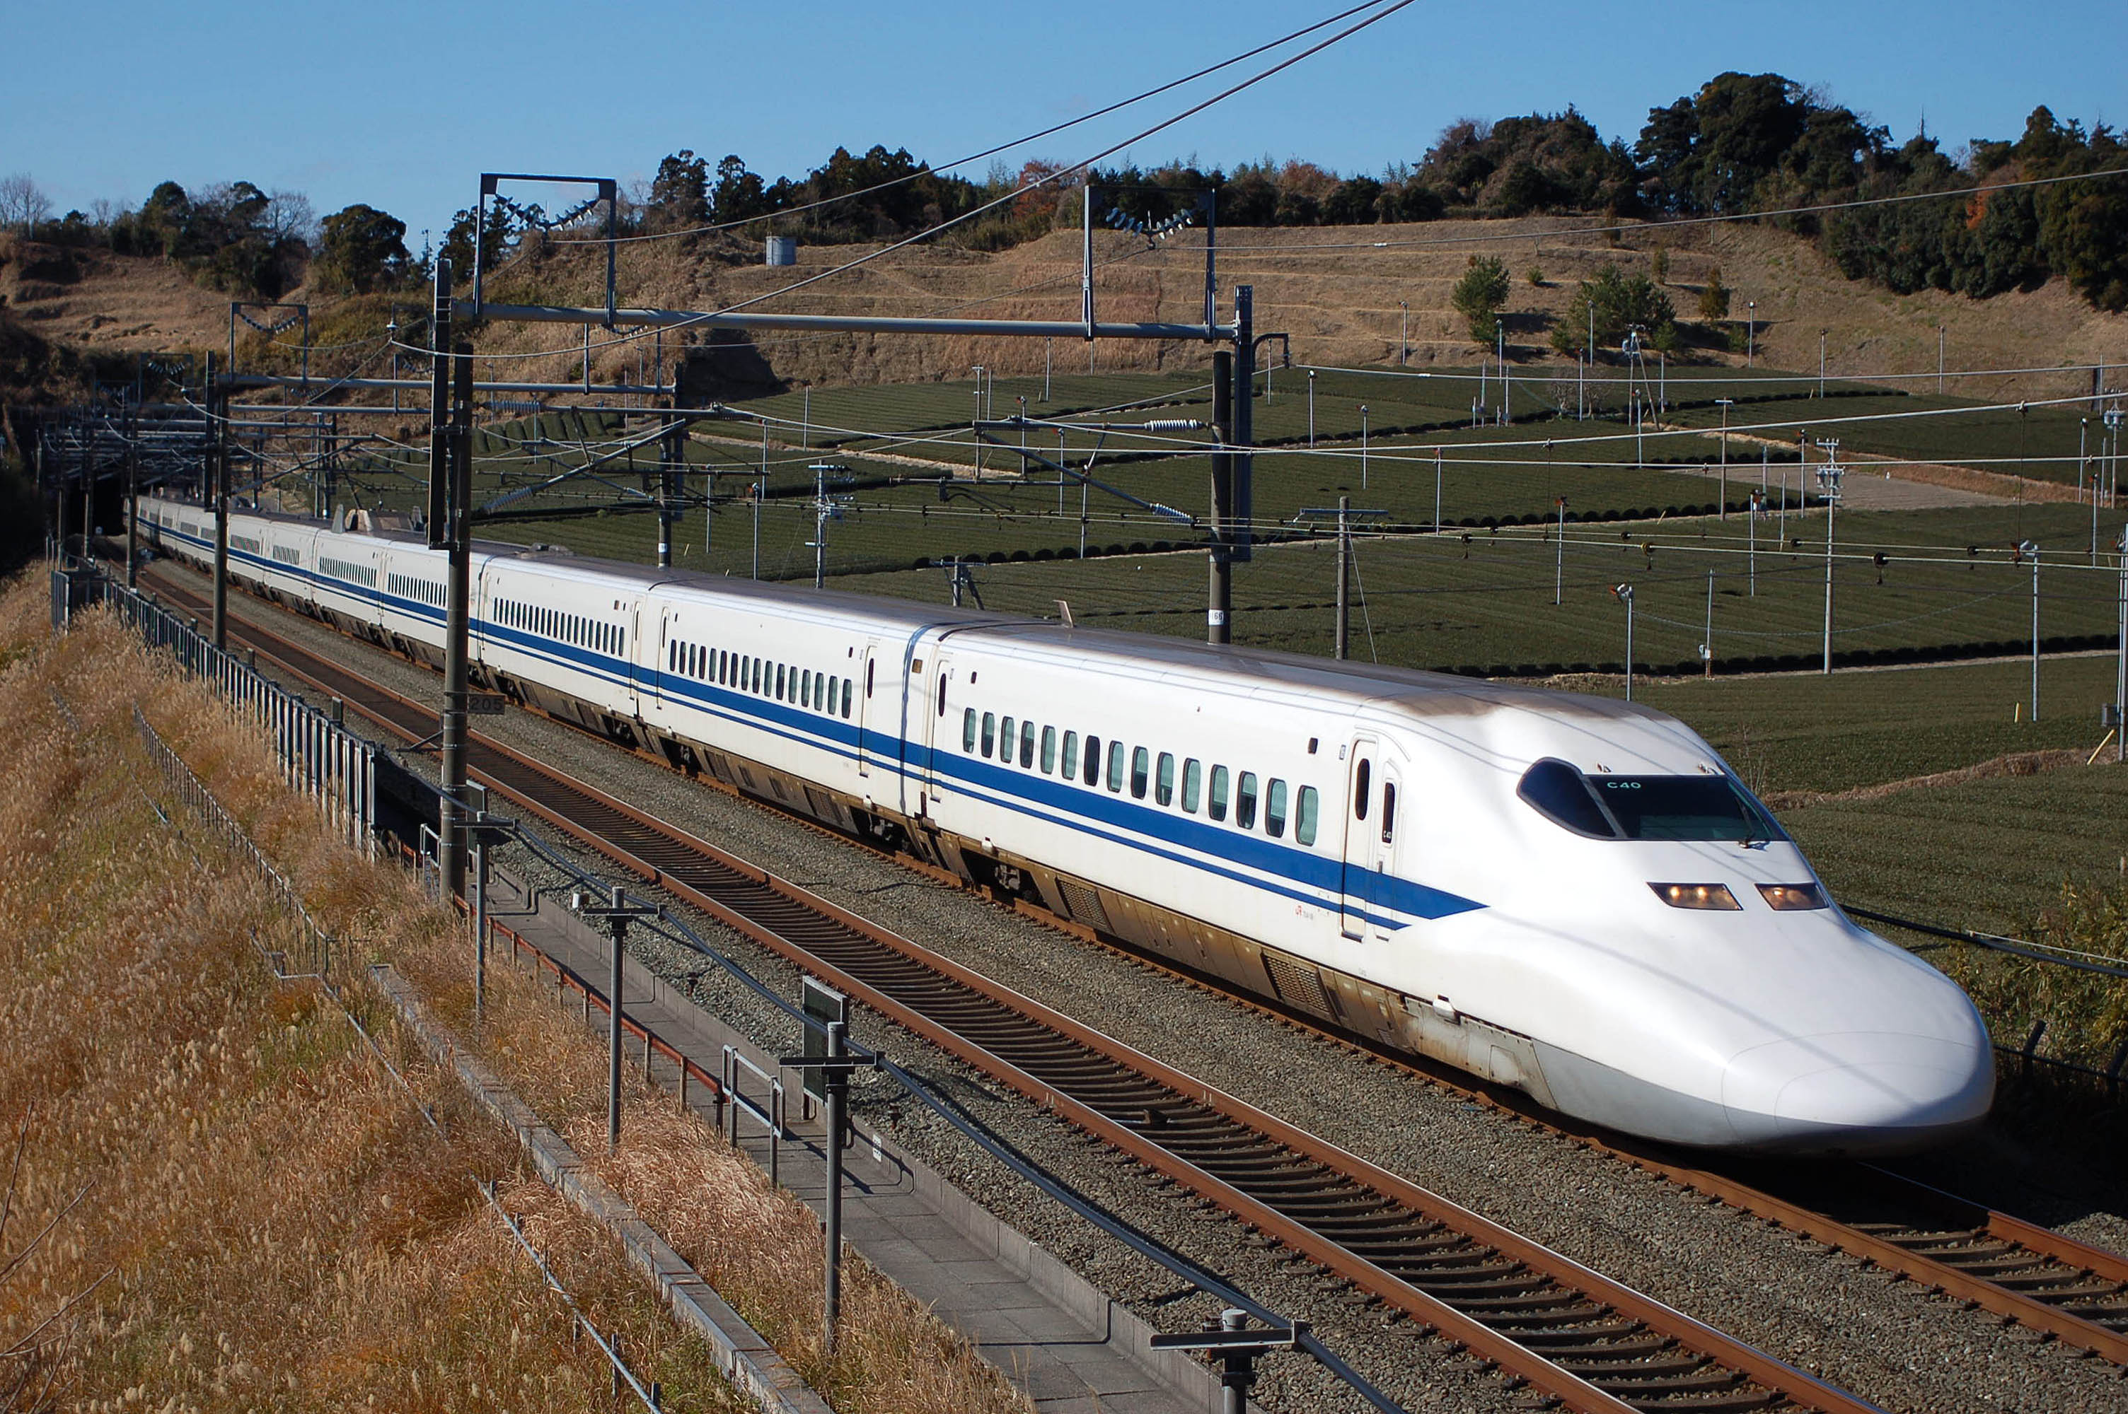
Shinkansen Train

Slide 18
SUCCESS: NO SHINKANSEN DERAILMENT
Over 200 reports of snapped rail and collapsed sound barriers — and not one train off the track
0
200+
12
~26 hr
Shinkansen derailments
Reports of snapped rail and
downed sound barriers
Injuries on trains or at
Shin-Yatsushiro Station
To first partial line reopening
(Hakata–Chikugo-Funagoya)
THE DEFENCE IN DEPTH THAT PAID OFF
WHAT STILL BROKE
Coastal and trackside seismometers trigger power cut and emergency braking on P-wave detection, before the S-wave arrives
Post-Chuetsu (2004) derailment-prevention hardware: L-shaped guides, rail-overturning restraints, vehicle guide devices
Viaduct column jacketing and retrofit programs across the network
Conservative resumption policy — full line inspection before any service restart
A freight train derailed near Yatsushiro Station — conventional line, not Shinkansen
Bent rails at a Kumamoto depot and between Matsubashi and Ogawa on the Kagoshima Main Line
Sound barrier collapses — a non-structural element that becomes a track obstruction
Whole Kyushu Shinkansen suspended; Kumamoto–Kagoshima-Chuo still closed on day 3
The distinction is the point: the track was damaged in more than two hundred places and the vehicles still stayed on it. That is the signature of a system designed so that the failure of the infrastructure does not become the failure of the train.
Vibrationdata | 2026 Kumamoto Earthquake, Kyushu, Japan | July 28, 2026
12
Notes:
Sound barriers are the nonstructural lesson here - they did their acoustic job for decades and then fell on the track.

Slide 19
SUCCESS: SEMICONDUCTOR AND INDUSTRIAL PLANT
Shindo 5-upper at Kikuyo, and the fab structure held
TSMC / JASM, KIKUYO
THE PART THAT TAKES LONGER
WHY FABS ARE DIFFERENT
Site recorded shindo 5-upper (TSMC cited max seismic intensity 5)
Structural inspection confirmed no damage affecting building safety
Water supply, power, and workplace safety systems functioning normally
Fab 2 construction site unaffected; work resumed the following day
TSMC noted that the relatively high seismic force means a significant period is needed for inspection and CALIBRATION
Tool-level realignment, not structural repair, is the schedule driver
Tokyo Electron halted two Kumamoto plants; Sony, Fujifilm evacuated; Honda paused motorcycle production
A fab is designed to micro-g vibration criteria (VC curves) for lithography, far tighter than any life-safety requirement
Waffle-slab floors, isolated tool plinths, and massive foundations give it enormous seismic reserve as a by-product
The binding constraint is nanometre-scale alignment, not collapse
THE VIBRATION ENGINEER'S OBSERVATION
This is a useful case of a structure over-designed for one reason performing well for an entirely different one. Nobody sized a JASM waffle slab for a magnitude 7 earthquake — it was sized so that a stepper could resolve features a few nanometres across while forklifts run on the floor below. The seismic margin came free. The inverse should worry you: a facility with no ambient-vibration requirement has none of that free margin, and its equipment anchorage is exactly as good as somebody remembered to make it. Also note where the recovery time actually went. The building was cleared in a day. The tools will take considerably longer, because 'undamaged' and 'in calibration' are different states.
Vibrationdata | 2026 Kumamoto Earthquake, Kyushu, Japan | July 28, 2026
13
Notes:
VC curves - the fab is designed to VC-E or tighter in lithography bays.

Slide 20
SUCCESS: WARNING, EVACUATION, AND MOBILIZATION
The organizational machinery moved faster than the structures failed
16:27
Earthquake origin time
ALSO WORKED
16:28
Prime Minister's Office response office established — one minute
Earthquake early warning and Safety tips push alerts in 15 languages
24-hour prefectural interpreting line for foreign residents
Landslide warning thresholds provisionally lowered to 70–80% of normal
16:29
Tsunami advisory issued for the Ariake and Yatsushiro Seas
~16:57
Aeon Mall reports all ~3,000 customers evacuated — within 30 minutes
18:10
Tsunami advisory lifted, correctly and promptly
18:20
Extraordinary Disaster Management HQ established, chaired by the PM
THE HARD LIMIT
Day 2
SDF deployment raised from ~3,600 to ~4,600 personnel
For a rupture directly beneath you, warning time is near zero
EEW protects the far field; the near field gets the P-wave and the S-wave almost together
In 2016, most people in the strongest shaking received no warning at all
Evacuating three thousand people from a shopping mall in half an hour is a genuine achievement. It is also the reason this slide sits next to the one that follows.
Vibrationdata | 2026 Kumamoto Earthquake, Kyushu, Japan | July 28, 2026
14
Notes:
Deliberate juxtaposition - the evacuation succeeded, and then the building exploded 80 minutes later.

Slide 21
WHAT FAILED
Where the losses actually occurred — and almost none of them were primary seismic collapse
15

Slide 22
FAILURE: AEON MALL KASHIMA
The building survived the earthquake and was destroyed eighty minutes later
16:27
Earthquake. Mall shaken; structure stands. Staff begin evacuation.
REPORTED CAUSE
~16:57
Approximately 3,000 customers confirmed evacuated to the parking lot.
No official cause determination has been issued
Operator investigating a possible gas leak
Responders reported the smell of gas at the site
Around 2,700 staff worked the site; ~200 tenants; 5,000-car parking deck
~17:47
Explosion tears through the building. Second floor partially collapses.
Night 1
Responders hold back — aftershock and further-collapse risk.
Day 2–3
11 people extracted. At least 7 dead. Around 170 SDF personnel on site.
WHY IT KILLED
The lesson, stated plainly. Life safety did not end when the shaking stopped. An eighty-minute gap between the event and the fatal consequence is enough time to have isolated utilities, swept the building for occupants, and enforced a cordon — and the gap is precisely where the system failed. Seismic gas shutoff exists in Japan at the meter; it evidently did not cover whatever line leaked here. Post-event utility isolation and occupant accountability are engineering requirements, not housekeeping.
Customers were out. Staff were not — the fatalities were people still inside working
The blast, not the shaking, brought down the floor and exposed the steel frame
Aftershock risk delayed entry, extending time-to-rescue
Vibrationdata | 2026 Kumamoto Earthquake, Kyushu, Japan | July 28, 2026
16
Notes:
Kobe 1995 is the precedent - fire and gas following the shaking caused a large share of the loss.

Slide 23
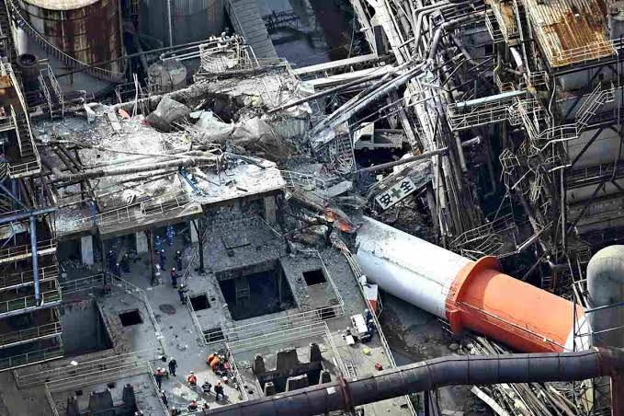
Chimney Mid Section Collapse at Paper Factory

Slide 24
PARTIAL COLLAPSE, NOT A TOPPLE
Nippon Paper Industries, Yatsushiro Mill • 28 July 2026 • five killed, seven rescued from the debris
1
WHAT THE EVIDENCE SHOWS
2
CANDIDATE MECHANISMS
Reporting describes a partial collapse — an upper section broke off and fell onto mill buildings and infrastructure
The fallen segment's near end is a torn fracture surface, not a base flange or anchor ring
The stack base and lower shell remain standing in the aerial view
Implication: a shell capacity failure at elevation, not anchor bolt or foundation failure
The mill lies close to the epicenter; maximum shindo 7 was recorded in the prefecture
Higher-mode moment demand in the upper third — exactly where a first-mode taper leaves the shell thinnest
Thickness step between plate courses acting as a geometric stress riser
Internal corrosion thinning from acidic flue gas — non-uniform and invisible from outside
High-cycle fatigue at circumferential welds from decades of vortex-induced vibration
Possible residual low-cycle damage from the 2016 M 7.3 event in the same region
FRACTURE
Schematic. An upper section breaks off; the base and lower shell remain standing.
STATUS
The cause has not been established and the investigation is ongoing. Everything on these slides is generic stack vulnerability, not a finding about this structure.
Notes:
The base-versus-mid-height distinction drives the whole diagnosis. A base failure points at anchor bolts and foundation. A break at elevation points at shell capacity, which is a different design check and a different retrofit.

Slide 25
WHY A STACK IS A DIFFICULT SEISMIC PROBLEM
Low damping, a long fundamental period, and no alternate load path
1
DYNAMIC CHARACTERISTICS
Damping is very low — roughly 0.5 to 1% of critical for welded steel stacks, lower still when unlined. Spectra that assume 5% badly overstate the reduction.
Fundamental period of a 60 to 100 m self-supporting steel stack falls near 1 to 2.5 s
Near-fault Kumamoto motions carry large long-period velocity pulse content in that band, as the 2016 Mashiki records showed
No redundancy — a cantilever has one load path and no alternate route once a section is lost
Vertical ground motion modulates the axial–moment interaction at the section being checked for buckling
Schematic, for illustration only. Higher modes push substantial moment into the upper shell — precisely where a first-mode taper leaves the least thickness.
DESIGN PRACTICE
ACI 307 and CICIND both require multi-mode response spectrum analysis for exactly this reason. An equivalent-static or single-mode check is systematically unconservative through the upper third of the shell.
Notes:
The key point of the chart: a first-mode design taper and the true multi-mode demand diverge most in the upper shell. Ratios approaching two are realistic for a slender stack.

Slide 26
ASSESS, RETROFIT, AND MOVE THE PEOPLE
Two structural levers and one that matters more than either
1
ASSESS
2
RETROFIT
3
MOVE THE PEOPLE
Operational modal analysis — ambient vibration testing gives actual frequencies and damping to check against the design model, and sets a baseline for change detection
UT thickness mapping weighted to condensation zones, the breaching opening, and every thickness step — not just the base
MT or PT on circumferential welds at course transitions
Anchor bolt tension, condition, and grout line
Re-rate after every significant event; a visual survey is not sufficient
Add damping — the highest-leverage move on a 1% damped cantilever. A tuned mass damper at the top is often already justified for vortex shedding.
Guy the stack: converts a cantilever to a multi-span system, cuts mid-height moment, and shifts the period out of the pulse band
Reinforce critical courses; add stiffening rings at thickness transitions and at the breaching opening
Strip obsolete platforms and ductwork — tip mass is disproportionately expensive in modal terms
The stack failing is a structural problem. Where it lands is what killed five people.
Keep control rooms, MCCs, break rooms, and routine work positions outside a one-stack-height radius
Automatic evacuation of the fall zone on an SI or intensity trigger, with re-entry barred until inspection
Aftershocks finish partially damaged stacks — exactly when responders are underneath
Assess a fractured shell by drone or telephoto from 200 m before anyone re-enters
BOTTOM LINE
Stacks fail at the section the designer treated as non-critical — and they kill people standing where nobody planned for the stack to land.
Notes:
Same structure as the mall conclusion: the engineering fixes are real, but the consequence-side fix is cheaper, faster, and saves more lives.

Slide 27
FAILURE: INDUSTRIAL CHIMNEY COLLAPSE
Nippon Paper Industries mill, Yatsushiro — the single deadliest structure in this event
8
10
1
Shindo 6+
Killed by the chimney collapse
Rescued from the site
Still missing
Recorded intensity at Yatsushiro
PGV 94.3 cm/s
WHY TALL SLENDER STACKS ARE A KNOWN SEISMIC PROBLEM
DYNAMICS
DEMAND
THE HARD QUESTION
A stack is a tall cantilever: one dominant mode, very little redundancy, no alternate load path
Uniform cantilever: f₁ = (1.875² / 2π) √(EI / mL⁴)
A 50–80 m industrial stack typically lands near 0.4–1.0 Hz — inside the near-field velocity pulse band
Damping is low, often 2–3% for a bare RC or steel stack
Base overturning moment scales with height × mass × spectral acceleration — all three are unfavourable
Higher modes contribute meaningfully to shear near mid-height, which is where stacks often crack
Vertical ground motion adds axial demand on a section already governed by flexural tension
No occupancy inside means the failure consequence is entirely on what stands below it
Industrial stacks are frequently legacy assets that predate the current code and sit outside routine retrofit programs
They are inspected for corrosion and lining condition far more often than they are re-analyzed for seismic demand
Their footprint of consequence — the radius they can fall into — is rarely kept clear
INFERENCE: worth asking of every stack in a seismic region
Vibrationdata | 2026 Kumamoto Earthquake, Kyushu, Japan | July 28, 2026
17
Notes:
Formula is for a uniform cantilever; a real tapered stack needs a proper model. The point is the frequency band, not the number.

Slide 28
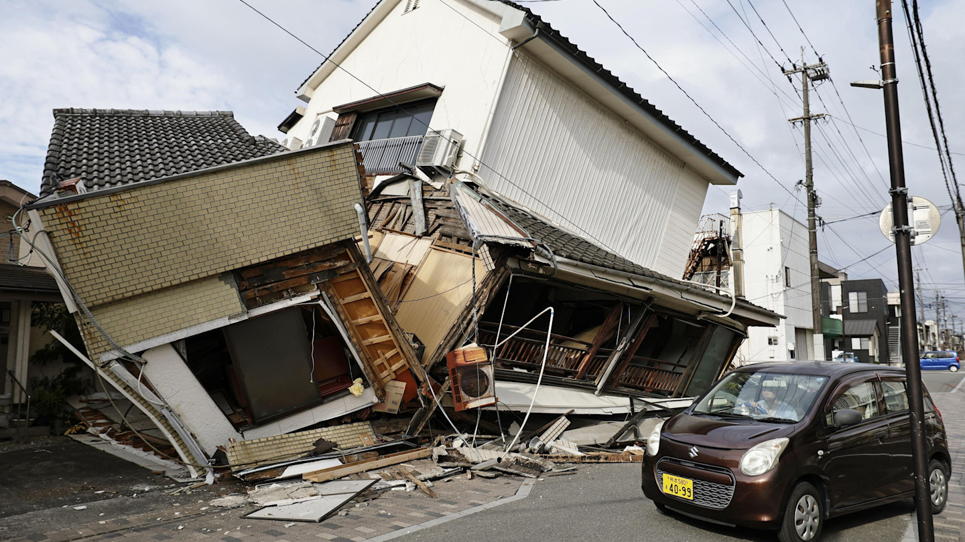
https://www.ft.com/content/28e9fc2c-cf51-46d6-87ff-efa0e61dcb9b?syn-25a6b1a6=1

Slide 29
FAILURE: LEGACY CONSTRUCTION AND HERITAGE STRUCTURES
The oldest things broke first — again
RESIDENTIAL
HERITAGE
NON-STRUCTURAL
At least 12 homes collapsed (Kumamoto Prefectural Police)
Two house collapses in Uki left five people missing
A house collapse in Yatsushiro killed one
No official damaged-building count yet — the prefecture lists it as under investigation
Kumamoto Castle outer walls damaged again, with visible dust clouds; site closed
The worship hall of the 19th-century Yatsushiro-gu shrine damaged
A shrine collapse reported elsewhere in the prefecture
Castle stonework was still under reconstruction from the 2016 damage
Ceiling sections collapsed at Aeon Mall Uki — a different Aeon site from Kashima
A shop exterior wall collapsed in Kumamoto City
Sound barriers down along rail alignments
Furniture overturning is characteristic at shindo 7
THE PATTERN IS NOT A MYSTERY
THE CEILING PROBLEM
Traditional Japanese wood-frame houses carry heavy clay tile roofs on light, flexible frames — a large mass at the top of a soft first storey, which is the textbook soft-storey collapse mechanism. Japan has known this since 1995 and has run subsidized retrofit programs for thirty years. Dry-stacked castle revetments have no tensile capacity at all and shed stone whenever the base accelerates hard. None of this is new information. The failures are concentrated in exactly the stock the codes cannot reach retroactively.
Japan tightened suspended-ceiling rules after the 2011 Tohoku collapses. A ceiling failure at Aeon Mall Uki says the legacy stock is still out there. The US analogue is ASCE 7 Chapter 13 — the same components, the same tendency to be treated as an architectural item rather than a structural one.
Vibrationdata | 2026 Kumamoto Earthquake, Kyushu, Japan | July 28, 2026
18
Notes:
Nonstructural components dominate injury counts and business interruption in almost every modern earthquake.

Slide 30
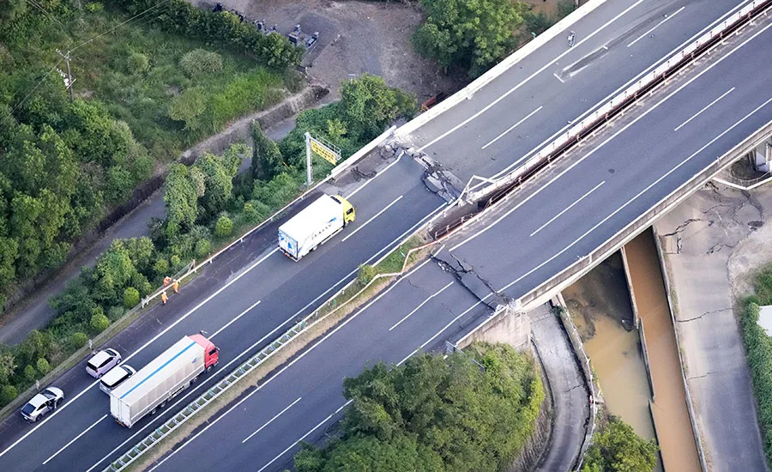
Transverse crack and vertical offset at the abutment — the approach fill has dropped relative to the bridge deck, with the barrier kinked and pulled apart at the same joint
Superstructure looks intact: no unseating, no visible pier distress, girders still bearing. The damage is entirely at the transition
Classic stiffness discontinuity — a pile-founded abutment on a dense stratum next to compacted fill on native soil. The two respond differently to shaking and part company at the joint
The lined channel below says the water table is high; elevated pore pressure in the fill is the obvious thing to check (inference, not proven by the photo)
A functional failure, not a structural one
The bridge would carry load today, but a 100–200 mm step at highway speed is a fatal hazard, so the road closes regardless
Post-Kobe retrofit bought the superstructure — seat width extension, unseating devices, restrainers, pier jacketing.
https://www.enr.com/articles/63387-magnitude-68-earthquake-rattles-southern-japan

Slide 31
FAILURE: TRANSPORT AND LIFELINE INFRASTRUCTURE
Function lost across a wide area, with slow and uneven restoration
HIGHWAY
110.8 km of expressway closed across three routes (NEXCO West, day 2)
MLIT reported 17 closed sections; large cracks on major roads including an elevated highway
NEXCO stated there was no prospect of lifting closures at that time
AIR, SEA, AND BUS
Kumamoto Airport runway temporarily closed; 14 flights cancelled on day 2
27 intercity bus routes suspended across nine operators
Kumamoto Ferry cancelled all sailings for hull repairs
EVACUATION LOAD
465 shelters open with 9,872 evacuees. Evacuation orders covered 222,250 people in 107,032 households across three cities and three towns, with the stronger 'emergency safety securing' instruction issued to a further 92,743 people.
Water outages outnumbered power outages by nearly two to one, and water is the harder utility to restore — buried, brittle, and leaking at every joint the ground displaced. In a 35 °C heat wave it is also the one that matters most.
Vibrationdata | 2026 Kumamoto Earthquake, Kyushu, Japan | July 28, 2026
19
Notes:
Buried pipeline damage tracks ground strain and permanent displacement, not peak acceleration.

Slide 32
CROSS-CUTTING: AFTERSHOCKS AND CUMULATIVE DAMAGE
The JMA warned of a second shindo 7 for a full week
THE JMA ADVISORY, PARAPHRASED
Be alert to earthquakes of up to around shindo 7 for about one week from the mainshock
Strong shaking is especially likely in the first two to three days
The activity zone is wide; depending on where an event occurs, shaking may EXCEED the mainshock
In 2016 this region recorded shindo 7 twice within 28 hours — the only such sequence in JMA observational history
THE FATIGUE ENGINEER'S FRAMING
A structure that survived the mainshock is not the structure that was there before it. Cracked concrete, yielded reinforcement, loosened connections, and degraded hysteresis all mean reduced stiffness, a lengthened fundamental period, and less capacity to absorb the next event. This is low-cycle fatigue with a very small number of very large cycles — a regime where a linear Miner's-rule accumulation is a poor model and the damage is better described by ductility demand and energy dissipated. Practically: the aftershock demand should be checked against the DAMAGED structure, not the as-designed one. That is exactly why Japan runs a red / yellow / green emergency risk assessment before re-occupancy, and why the JMA's advice is to stay out of damaged buildings even when they are still standing.
Vibrationdata | 2026 Kumamoto Earthquake, Kyushu, Japan | July 28, 2026
20
Notes:
Sequential-event capacity loss is an active research area and is not well handled by current codes.

Slide 33
CROSS-CUTTING: COMPOUNDING HAZARDS
Heat, then a typhoon — the disaster is not over when the shaking stops
EXTREME HEAT
TYPHOON RISK
HEALTH CASCADE
Highs of 35 °C or above forecast 29 July through 5 August; 40 °C expected on 2 August
Tens of thousands of households without power or water in that heat
300 spot coolers airlifted from Iruma Air Base; ~300 more air conditioning units pledged
Shelters starting to run short of emergency food on day 3
MLIT noted Typhoon No. 13 may affect Japan the following week
Landslide warning thresholds already provisionally lowered to 70–80% of normal in 26 municipalities
Rain on shaken slopes is the classic secondary killer
Damaged roofs and tarped buildings have no weather envelope
Deep vein thrombosis from sleeping in cars — a documented cause of death in 2016
Heatstroke and dehydration among elderly evacuees
Medical teams touring shelters specifically to screen for both
These become 'disaster-related deaths' weeks later
MULTI-HAZARD IS THE NORMAL CASE, NOT THE EDGE CASE
We design for the earthquake. The region then has to live through the earthquake plus a heat wave plus a typhoon plus a week of aftershocks, simultaneously, with degraded lifelines. In 2016 Kumamoto, indirect deaths eventually exceeded direct ones. Any resilience metric that stops at 'did the building collapse' is measuring the wrong thing. The right questions are: how long until water is back, can the building be occupied in August without air conditioning, and does the roof still keep rain out when the storm arrives.
Vibrationdata | 2026 Kumamoto Earthquake, Kyushu, Japan | July 28, 2026
21
Notes:
This is the slide that connects structural engineering to actual outcomes.

Slide 34
LESSONS LEARNED — TECHNICAL
What a structural dynamicist should take from this event
01
Velocity is the damage parameter.
PGV 94 cm/s tells you more about what the ground did to structures than either PGA figure. Compute pseudo-velocity spectra from the records when they are released, and read them against σ = ρcV.
02
Near-field is a different design problem.
A shallow crustal rupture under a basin delivers a small number of large velocity pulses in the 0.5–2 second band. Broadband code spectra built on far-field data can miss this. Check the 0.5–2 Hz range explicitly.
03
Tall slender cantilevers remain the exposed class.
The single deadliest structure was an industrial chimney. One mode, no redundancy, low damping, and a frequency that sits right in the pulse band — and typically a legacy asset outside any retrofit program.
04
Non-structural failure dominates the injury and downtime counts.
Ceilings, sound barriers, exterior wall panels, furniture, and equipment anchorage. None of these threaten collapse; all of them cause injuries, block access, and stop operations.
05
Post-event capacity is not design capacity.
With a one-week shindo 7 advisory in force, aftershock demand must be assessed against the damaged structure. Reduced stiffness, lengthened period, degraded hysteresis — and no code gives you a clean method for it.
Vibrationdata | 2026 Kumamoto Earthquake, Kyushu, Japan | July 28, 2026
22
Notes:
Five technical takeaways. Item 1 is the Vibrationdata thesis.

Slide 35
LESSONS LEARNED — OPERATIONAL
The engineering was mostly adequate. The gaps were procedural.
THE EIGHTY-MINUTE GAP
INSTRUMENT YOUR OWN FACILITY
Evacuation of customers was fast and effective. Utility isolation and staff accountability were not.
Seismic gas shutoff at the meter does not cover every line in a large commercial building
Nobody should be inside a shindo-7 building 80 minutes later without a completed structural and utility sweep
ACTION: write post-event utility isolation and occupant accountability into the emergency plan, with named responsibility
The nuclear stations could say 'no abnormalities' because they measured it
The fab could clear its structure in a day because it knew its demand
A few triggered accelerographs and a pre-agreed threshold matrix convert a guess into a decision
ACTION: define, in advance, what intensity triggers what inspection and who authorizes re-entry
RECOVERY TIME LIVES IN THE EQUIPMENT
COMMUNICATE THE UNCERTAINTY
TSMC cleared the building quickly; tool inspection and calibration is the long pole
'Undamaged' and 'back in tolerance' are different states with very different schedules
ACTION: budget recovery time for calibration and realignment, not just structural repair
Multiple agencies published different casualty counts on day 2, all correct under their own definitions
Every figure was stamped with its issuing body and its as-of time — which is what made them usable
ACTION: timestamp and attribute every number in your own damage reporting
Vibrationdata | 2026 Kumamoto Earthquake, Kyushu, Japan | July 28, 2026
23
Notes:
The operational lessons are transferable to any large facility anywhere.

Slide 36
RECOMMENDATIONS AND OPEN ITEMS
What to do now, and what to watch for
FOR PRACTITIONERS
OPEN ITEMS TO TRACK
Inventory the tall slender cantilevers on your sites — stacks, towers, silos, antenna masts — and check when each was last analyzed rather than last inspected.
Verify that the fall radius of each is clear of occupied space.
Re-read ASCE 7-22 Chapter 13 against your actual installed condition, not the drawings. Ceilings, cladding, and equipment anchorage are where the injuries are.
Confirm that automatic seismic gas and fuel shutoff covers the whole distribution system, not just the service meter.
Official cause determination for the Aeon Mall Kashima explosion.
Investigation findings on the Nippon Paper chimney — age, construction type, and retrofit history.
K-NET and KiK-net processed records for Uki, Hikawa, Yatsushiro, and Mashiki.
Kumamoto Prefecture's damaged-building survey once it moves past 'under investigation'.
Whether the one-week shindo 7 advisory window closes without a second large event.
THE SUMMARY JUDGEMENT
Japan's seismic engineering did what it was built to do. A magnitude 7.1 rupture directly beneath a populated basin, at the top of the intensity scale, with over two hundred rail defects and 110 km of expressway closed — and no bullet train left the rails, no reactor reported an abnormality, and the modern building stock largely stood. Almost every death came from three sources: a secondary explosion, one legacy industrial cantilever, and old houses. That is not a code failure. It is a failure to reach the assets the code cannot retroactively touch, and a failure of procedure in the hour after the shaking stopped.
Vibrationdata | 2026 Kumamoto Earthquake, Kyushu, Japan | July 28, 2026
24
Notes:
Closing argument. Deliver this one slowly.

Slide 37
SOURCES
All figures current to 30 July 2026 and subject to revision
Japan Meteorological Agency — seismic activity information for the 2026 Kumamoto Earthquake; multilingual portal
USGS — event page, moment tensor, ShakeMap, and finite-fault model
MLIT — damage reports, 5th report (14:00 JST, 29 July 2026)
Fire and Disaster Management Agency — damage and emergency response reports through the 16th report
Kumamoto Prefecture — disaster headquarters meeting minutes
JR Kyushu — operating status notices; NEXCO West — closure reports
Kyushu Electric Power — outage and nuclear station statements; IAEA notification
Japan Times, NHK, Kyodo, Reuters, NPR, CBS, Al Jazeera, Nikkei Asia — contemporaneous reporting
TrendForce and Nikkei Asia — TSMC / JASM and semiconductor supply-chain status
Japansoso — attributed and timestamped compilation of Japanese agency releases
Tom Irvine | Vibrationdata
Free ebooks on shock and vibration response spectra, the stress–velocity relationship, and related topics:
https://blog.vibrationdata.com/2025/11/27/toms-ebooks/
Engineering interpretation and all first-principles calculations herein are the author's own.
Vibrationdata | 2026 Kumamoto Earthquake, Kyushu, Japan | July 28, 2026
25
Notes:
Close with the ebooks link as usual.

