Slide 1
Seiche & Slosh
Revision B
By Tom Irvine

Slide 2
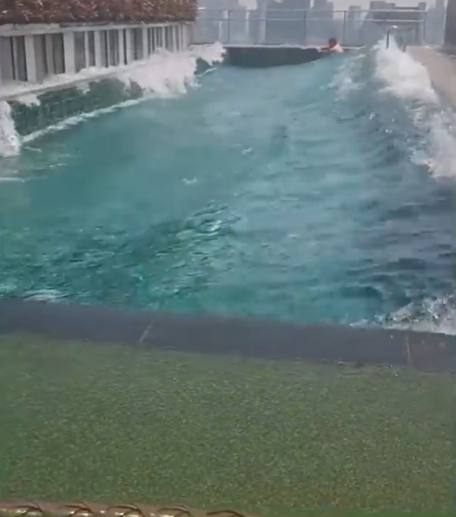
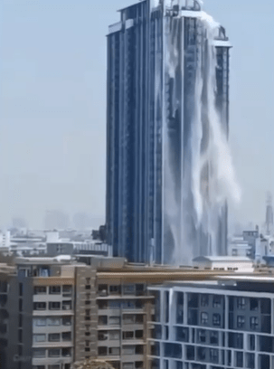
Myanmar Earthquake 2025 Rooftop Pool Slosh
https://www.youtube.com/shorts/k6D1DwWet4c
https://www.youtube.com/watch?v=5eIi4pZRB0Ys://www.youtube.com/watch?v=5eIi4pZRB0Y

Slide 3
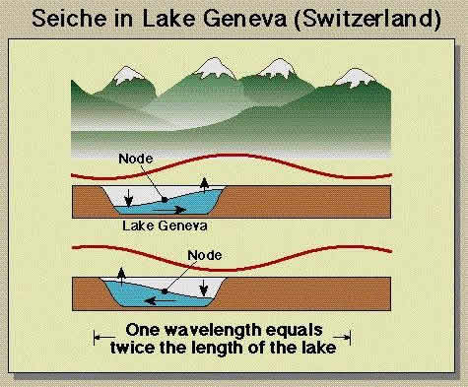
Seiche
Vibrationdata
A seiche is a standing wave oscillation in an enclosed or partially enclosed body of water (lake, reservoir, harbor, swimming pool)
It can be triggered by earthquakes, atmospheric pressure changes, or strong winds
In earthquakes, the oscillation occurs because ground shaking tilts or accelerates the water basin
Horizontal ground motion causes the water mass to slosh back and forth
If the forcing frequency is close to the natural sloshing period of the basin, the motion can be amplified.
After the earthquake stops, the water may continue oscillating for minutes to hours
Seiches were observed in swimming pools across the U.S. during the 1964 Alaska earthquake

Slide 4
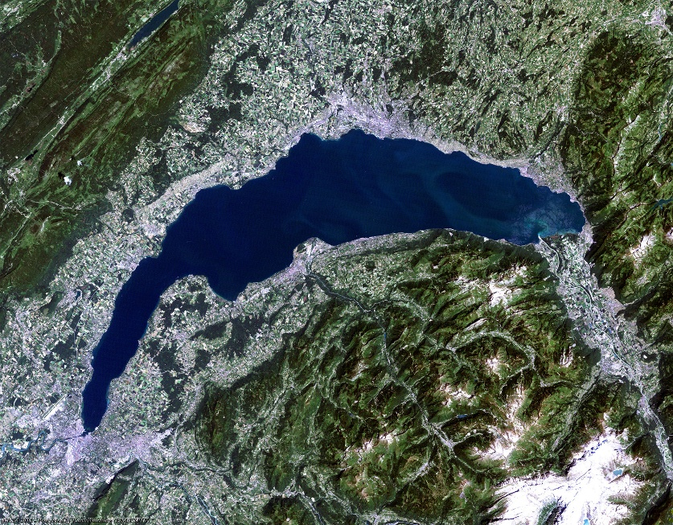
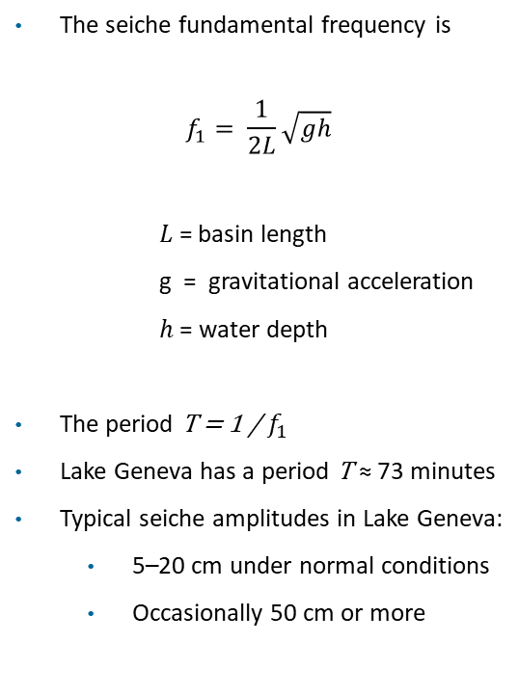
Seiche
Vibrationdata
The seiche fundamental frequency is
$$f_{1}= \frac{1}{2L}\sqrt{gh}$$
𝐿 = basin length
g = gravitational acceleration
ℎ = water depth
The period T = 1 / $f_{1}$
Lake Geneva has a period T ≈ 73 minutes
Typical seiche amplitudes in Lake Geneva:
  5–20 cm under normal conditions
  Occasionally 50 cm or more
https://earth.esa.int/eogateway/gallery/lake-geneva

Slide 5
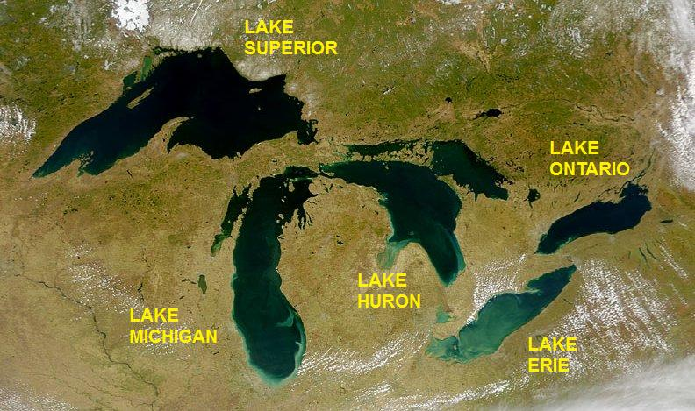
Seiche Periods, Great Lakes
Lake | Approx. Length (km) | Fundamental Seiche Period (hours)
Lake Superior | 560 | 7–8
Lake Michigan | 494 | 4–5
Lake Huron | 332 | 3–4
Lake Erie | 388 | 2–3
Lake Ontario | 311 | 2–3
Seiches in the Great Lakes are essentially always present at some low level. The lakes are large enough that they're constantly being nudged by passing weather: pressure gradients, wind stress, and the general "sloshing" that any large enclosed basin does

Slide 6
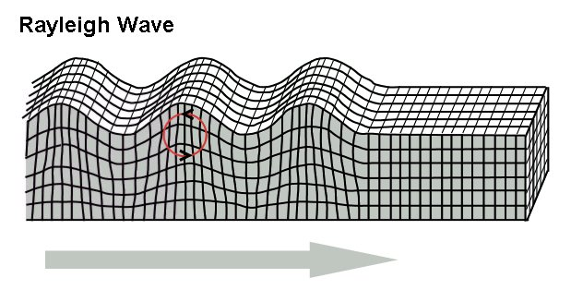
Seiche Excitation
When a Rayleigh surface wave passes:
The ground motion includes vertical and horizontal displacement
The ground motion produces a temporary tilt of the basin floor
The resulting pressure gradient triggers a standing pressure wave
This is essentially an initial-condition excitation rather than a resonance
Earthquakes can trigger seiches, but the excitation occurs as an impulse rather than sustained resonance because the frequency mismatch is extremely large
The impulse comes from the arrival of long-period surface waves, especially Rayleigh waves
Earthquake shaking is usually a broadband transient input, not a steady sinusoid
A basin can respond strongly to the impulsive component
Long natural periods mean the water may continue oscillating long after the shaking ends
Direct resonance with the dominant structural-frequency content of the earthquake is usually unlikely for very large lakes

Slide 7
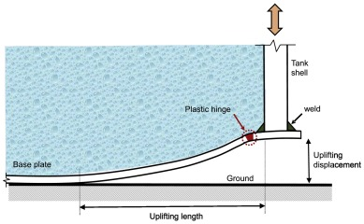
Damage Modes
Vibrationdata
During earthquakes, liquid stored in tanks oscillates — a phenomenon known as sloshing or the convective response
Sloshing can cause:
  Roof damage from liquid impact on floating or fixed roofs
  Spills over tank walls leading to environmental release or fire
  Increased base shear and overturning moment
  Tank uplift and anchor failure in unanchored tanks
  Tank buckling modes
Chatzopoulou, et al, Low-cycle fatigue of fillet-welded steel plate connections
https://www.sciencedirect.com/science/article/abs/pii/S0143974X20309317

Slide 8
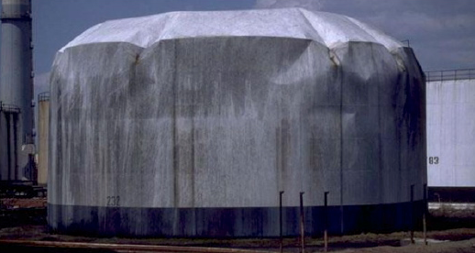
Slosh
Vibrationdata
Buckling of the top part of a liquid storage tank caused by liquid sloshing during an earthquake, Turkey 1999
This is elastic-plastic shell instability caused by compressive hoop stress generated by the hydrodynamic sloshing pressure
https://shellbuckling.com/presentations/compoundStructures/pages/page_93.html
During earthquakes, liquid stored in tanks oscillates — a phenomenon known as sloshing or the convective response
Sloshing can cause:
  Roof damage from liquid impact on floating or fixed roofs
  Spills over tank walls leading to environmental release or fire
  Increased base shear and overturning moment
  Tank uplift and anchor failure in unanchored tanks

Slide 9
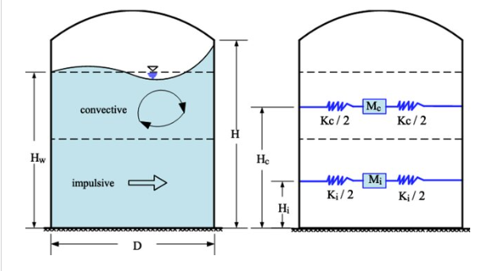
Two-Mass Spring Model
Vibrationdata
Instead of complex fluid simulations, engineers represent the liquid as a system of discrete masses to calculate the forces and torques exerted on the tank
The slosh Housner two-mass model (also referred to as a two-pendulum or multi-mass-spring model) is a simplified mechanical analogy used to predict the dynamic behavior of liquid in a moving container, such as a tank
The model separates the liquid response into impulsive and convective (sloshing) components with a conceptual (not physical) dividing line
The convective layer undergoes sloshing motion while the impulsive layer remains rigidly attached to the tank
https://www.researchgate.net/publication/380601432_Seismic_performance_assessment_of_an_existing_anchored_and_a_self-anchored_liquid_storage_tank_in_high_seismic_regions

Slide 10
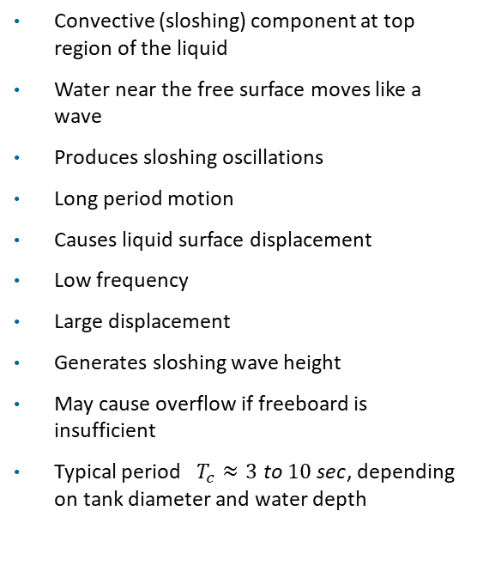
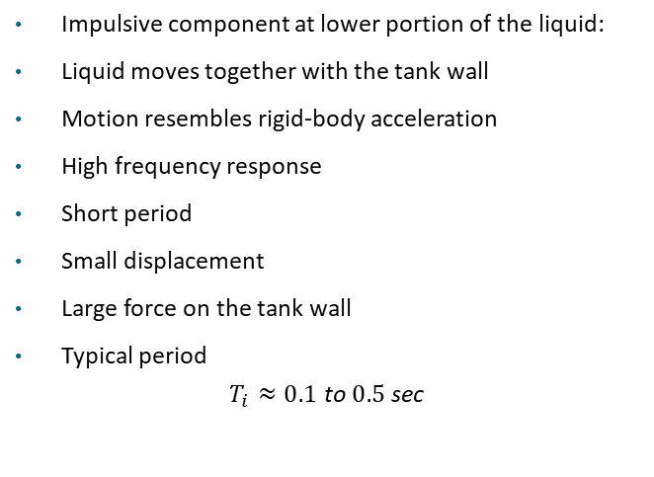
Liquid Physical Behavior
Vibrationdata
Convective (sloshing) component at top region of the liquid
Water near the free surface moves like a wave
Produces sloshing oscillations
Long period motion
Causes liquid surface displacement
Low frequency
Large displacement
Generates sloshing wave height
May cause overflow if freeboard is insufficient
Typical period $T_{c}≈3 \text{to} 10 \text{sec}$, depending on tank diameter and water depth
Impulsive component at lower portion of the liquid:
Liquid moves together with the tank wall
Motion resembles rigid-body acceleration
High frequency response
Short period
Small displacement
Large force on the tank wall
Typical period
$$T_{i}≈0.1 \text{to} 0.5 \text{sec}$$

Slide 11
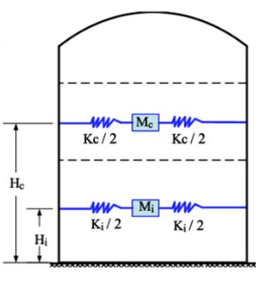
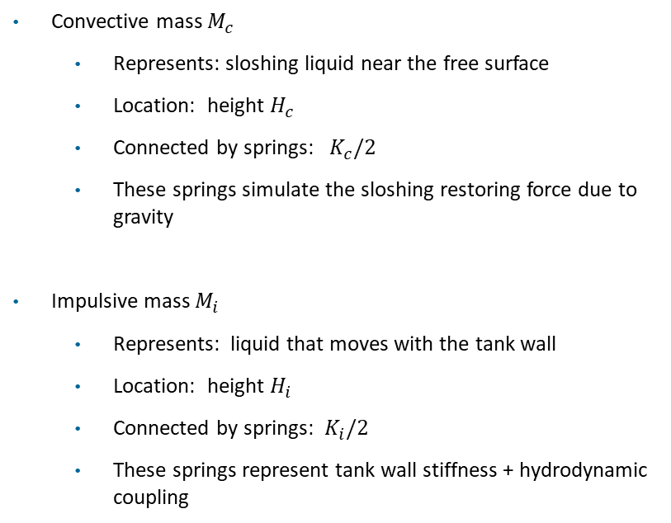
Lumped Parameters
Vibrationdata
Convective mass $M_{c}$
  Represents: sloshing liquid near the free surface
  Location: height $H_{c}$
  Connected by springs: $K_{c}/2$
  These springs simulate the sloshing restoring force due to gravity
Impulsive mass $M_{i}$
  Represents: liquid that moves with the tank wall
  Location: height $H_{i}$
  Connected by springs: $K_{i}/2$
  These springs represent tank wall stiffness + hydrodynamic coupling

Slide 12
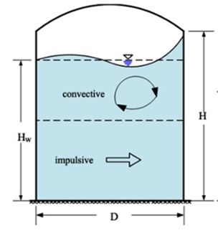
Slosh Effects
Vibrationdata
Convective component mainly drives:
  free-surface displacement
  roof impact
  overflow
  freeboard requirements
Impulsive component mainly drives:
  base shear
  overturning moment
  shell compression
  anchor forces

Slide 13
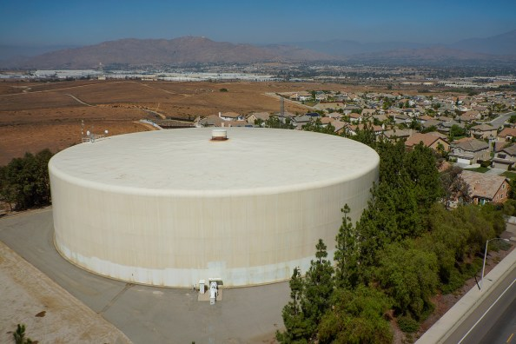
Community Water Tank
Vibrationdata
https://yoursocaltapwater.org/2018/05/31/water-reservoirs-storing-water-for-our-communities/

Slide 14
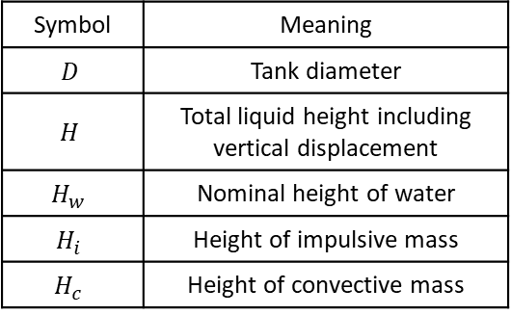
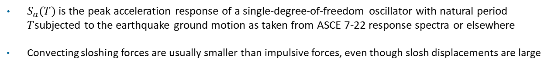
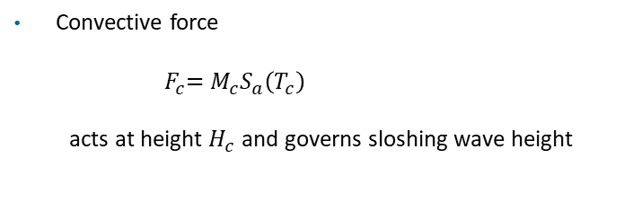
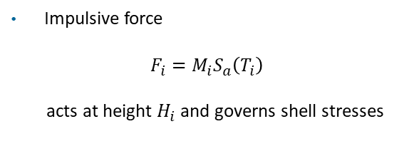
Heights & Forces
Vibrationdata
These heights determine the overturning moment applied to the tank
Symbol | Meaning
$$D$$ | Tank diameter
$$H$$ | Total liquid height including vertical displacement
$$H_{w}$$ | Nominal height of water
$$H_{i}$$ | Height of impulsive mass
$$H_{c}$$ | Height of convective mass
Impulsive force
$$F_{i}=M_{i}S_{a}\left(T_{i}\right)$$
acts at height $H_{i}$ and governs shell stresses
Convective force
$${ F}_{c}=M_{c}S_{a}\left(T_{c}\right)$$
acts at height $H_{c}$ and governs sloshing wave height
$S_{a}(T)$ is the peak acceleration response of a single-degree-of-freedom oscillator with natural period $T$subjected to the earthquake ground motion as taken from ASCE 7-22 response spectra or elsewhere
Convecting sloshing forces are usually smaller than impulsive forces, even though slosh displacements are large

Slide 15

Heights & Forces
Vibrationdata
The total base shear $V$is the sum of impulsive and convective components:
$V=F_{i}$ + $F_{c}$
The base shear is used for anchorage & shell shear
The overturning moment is
$M_{0}=F_{i} H_{i}$+ $F_{c} H_{c}$
The Overturning moment is used for:
  uplift / anchorage design
  shell compressive stress check
  foundation stability

Slide 16
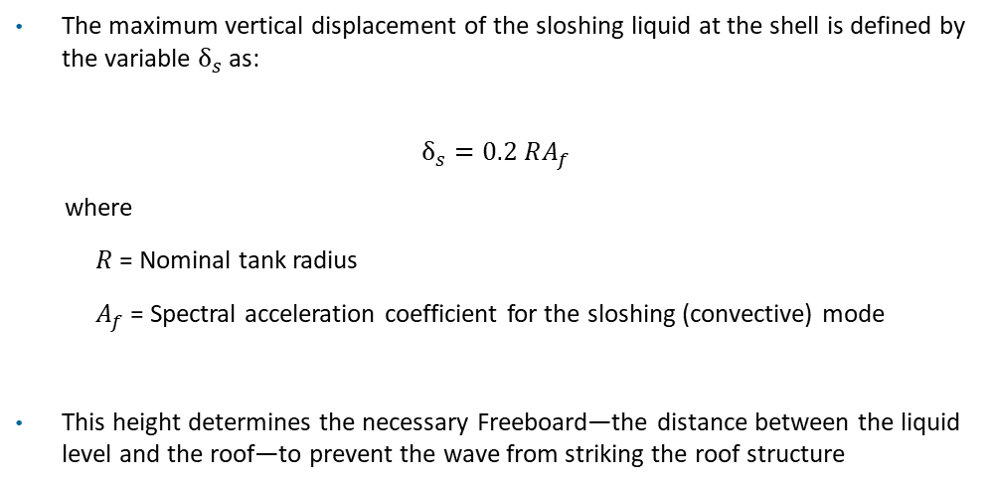
Slosh Wave Height
Vibrationdata
The maximum vertical displacement of the sloshing liquid at the shell is defined by the variable $δ_{s}$ as:
$$δ_{s}=0.2 RA_{f}$$
where
  $R$ = Nominal tank radius
  $A_{f}$= Spectral acceleration coefficient for the sloshing (convective) mode
This height determines the necessary Freeboard—the distance between the liquid level and the roof—to prevent the wave from striking the roof structure

Slide 17
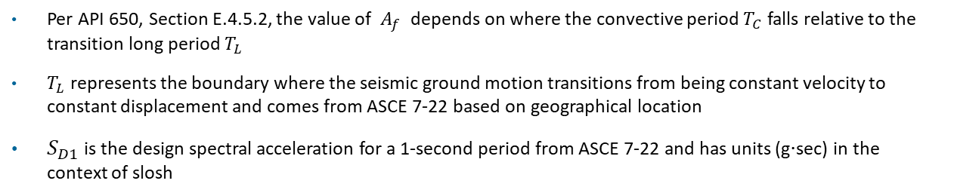
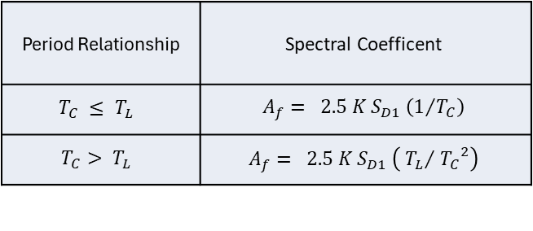
Slosh Spectral Coefficient
Vibrationdata
Per API 650, Section E.4.5.2, the value of $A_{f}$ depends on where the convective period $T_{C}$falls relative to the transition long period $T_{L}$
$T_{L}$represents the boundary where the seismic ground motion transitions from being constant velocity to constant displacement and comes from ASCE 7-22 based on geographical location
$S_{D1}$ is the design spectral acceleration for a 1-second period from ASCE 7-22 and has units (g⋅sec) in the context of slosh
Period Relationship | Spectral Coefficent
$$T_{C} ≤ T_{L}$$ | $$A_{f}= 2.5 K S_{D1} \left(1/{T_{C}}\right)$$
$$T_{C}> T_{L}$$ | $$A_{f}= 2.5 K S_{D1} \left({{ T}_{L}}/{{{ T}_{C}}^{2}}\right)$$
Seismic Use Group (SUG) | Importance Factor (K) | Description
SUG I | 1.0 | Standard storage tanks (not high-risk)
SUG II | 1.25 | Tanks storing hazardous materials that could impact the public if leaked
SUG III | 1.5 | Essential tanks (fire water for a hospital, emergency fuel, etc.)

Slide 18
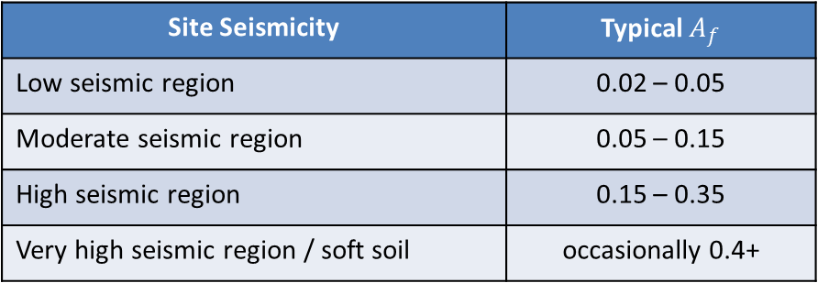
Slosh Spectral Coefficient
Vibrationdata
Site Seismicity | Typical $A_{f}$
Low seismic region | 0.02 – 0.05
Moderate seismic region | 0.05 – 0.15
High seismic region | 0.15 – 0.35
Very high seismic region / soft soil | occasionally 0.4+

Slide 19
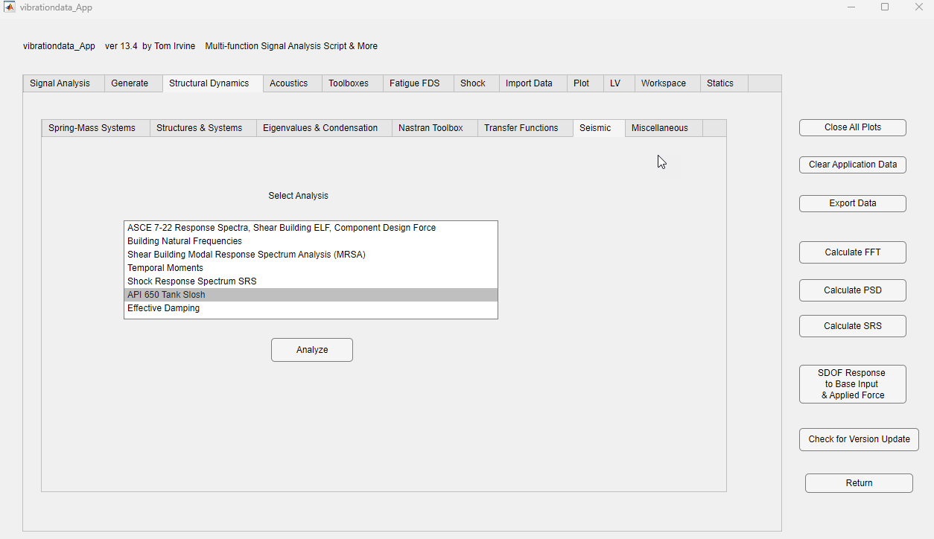

Slide 20
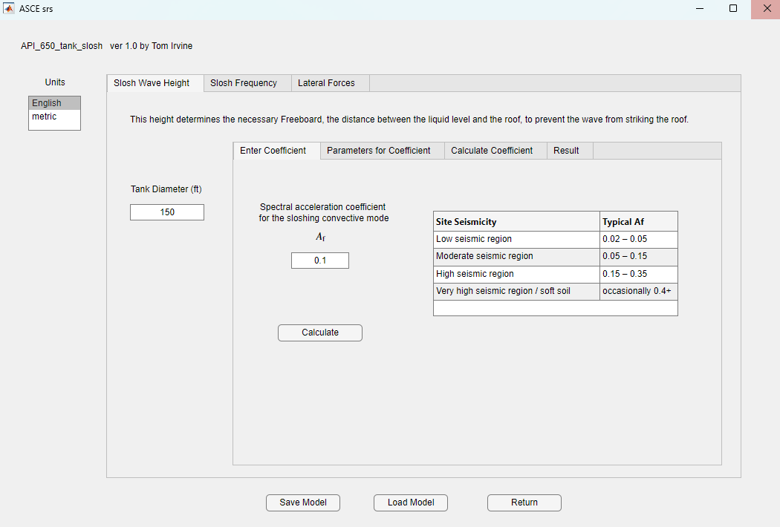

Slide 21
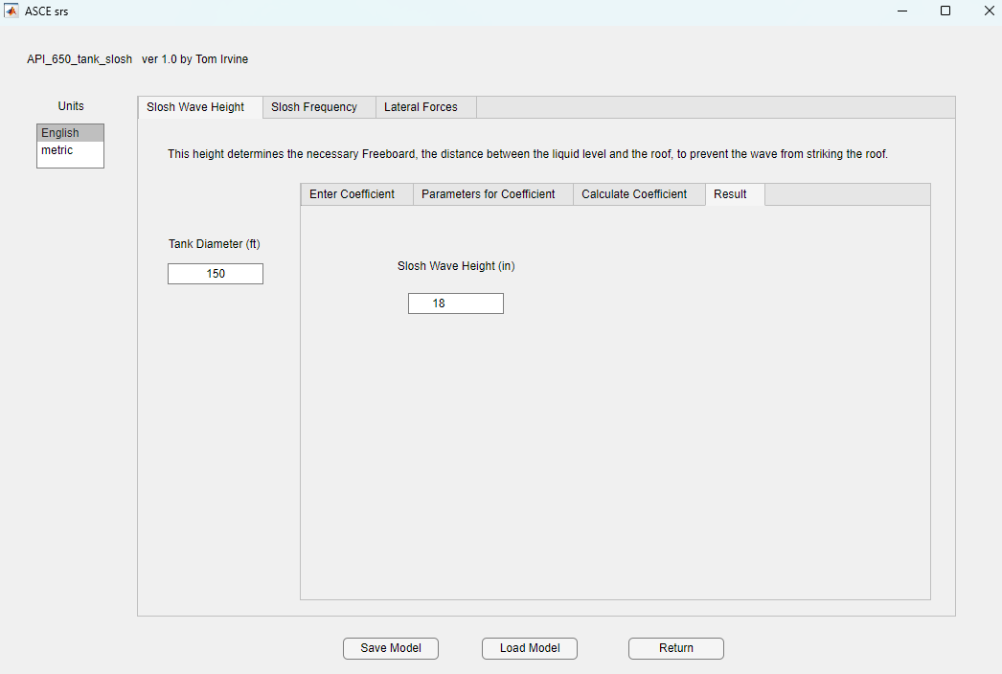

Slide 22
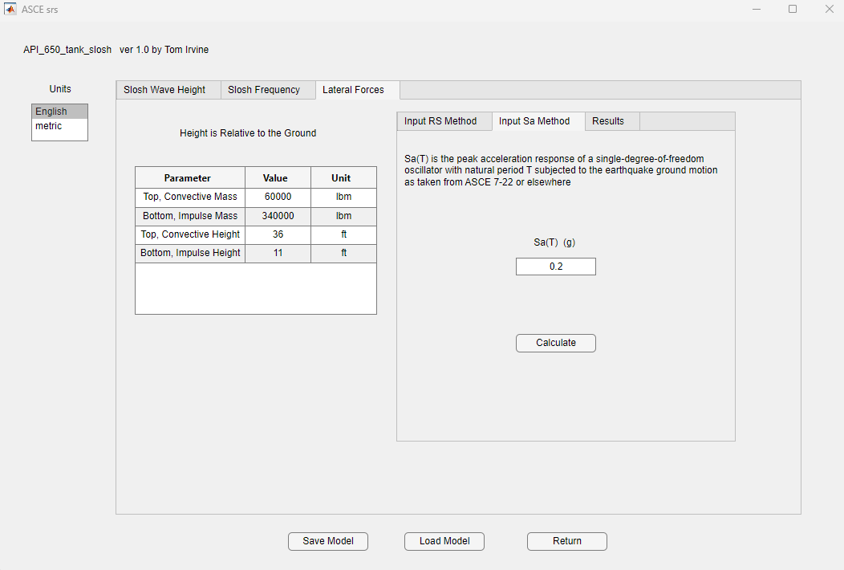

Slide 23
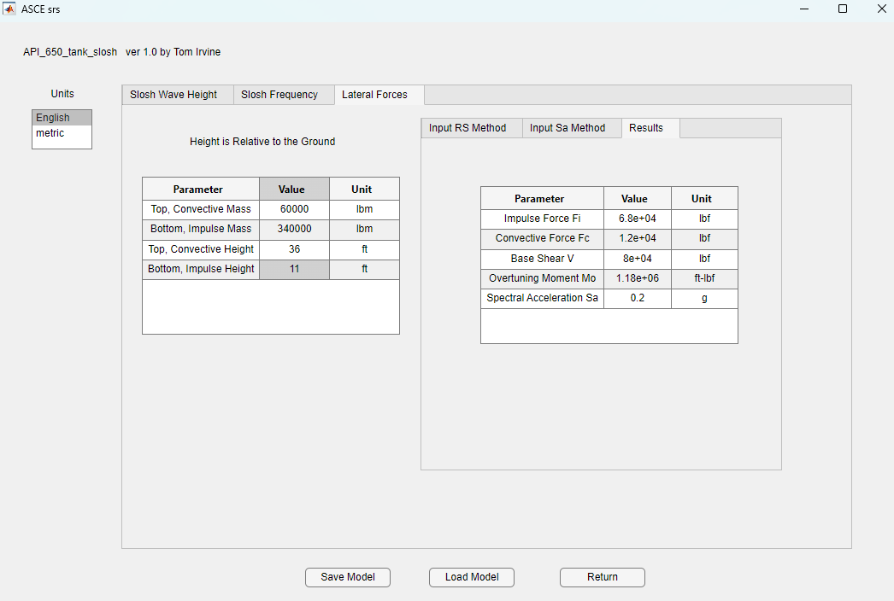

Slide 24
Results Use
Vibrationdata
Base Shear (V)
  Sliding check
  Anchor / shell-to-bottom design
Overturning Moment (Mo)
  Anchor bolt tension
  Uplift & soil bearing pressure
  Typically governing
Impulsive Force (Fi)
  Shell stress, API 650 Appendix E, primary contributor
  Hoop stress from hydrodynamic pressure
  Anchor demand
Convective Force (Fc)
  Sloshing effects
  Freeboard / roof impact

Slide 25
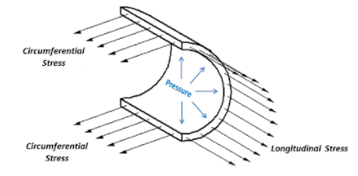
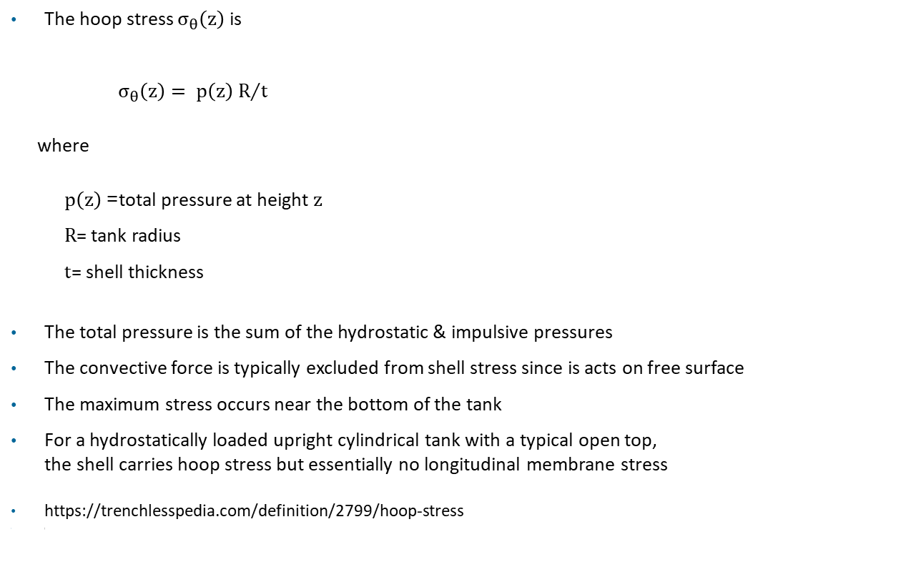
Hoop & Longitudinal Stresses
Vibrationdata
The hoop stress $σ_{θ}\left(z\right)$ is
$σ_{θ}\left(z\right)= {p\left(z\right) R}/t$
where
  $p\left(z\right)$= total pressure at height $z$
  $R$= tank radius
  $t$= shell thickness
The total pressure is the sum of the hydrostatic & impulsive pressures
The convective force is typically excluded from shell stress since is acts on free surface
The maximum stress occurs near the bottom of the tank
For a hydrostatically loaded upright cylindrical tank with a typical open top,
the shell carries hoop stress but essentially no longitudinal membrane stress
https://trenchlesspedia.com/definition/2799/hoop-stress
)

Slide 26
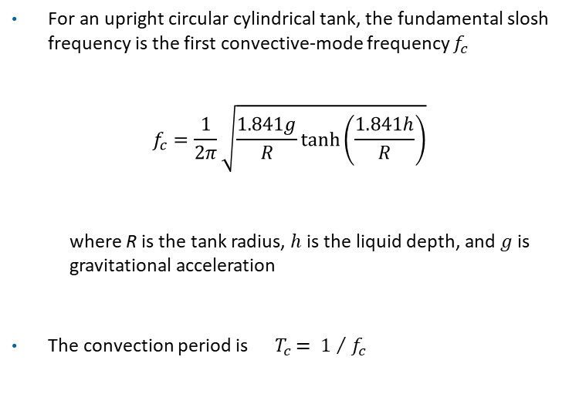
Slosh Frequency, Upright Cylindrical Tank
Vibrationdata
For an upright circular cylindrical tank, the fundamental slosh frequency is the first convective-mode frequency $f_{c}$
$$f_{c}=\frac{1}{2π}\sqrt{\frac{1.841g}{R}\tanh\left(\frac{1.841h}{R}\right)}$$
  where R is the tank radius, $h$is the liquid depth, and $g$ is gravitational acceleration
  The convection period is${ T}_{c }= {1 }/{ f_{c}}$
F. Dodge, The New “Dynamic Behavior of Liquids in Moving Containers,” Southwest Research Institute

Slide 27

Slosh Frequency, Spherical Tank
Vibrationdata
For a partially-filled spherical tank
$$f_{n}≈\frac{1}{2π}\sqrt{\frac{g}{R_{eff}}}$$
where $R_{eff}$ is radius of curvature at the free surface
Assume $R_{eff}$ $=R$for a first-order approximation

Slide 29
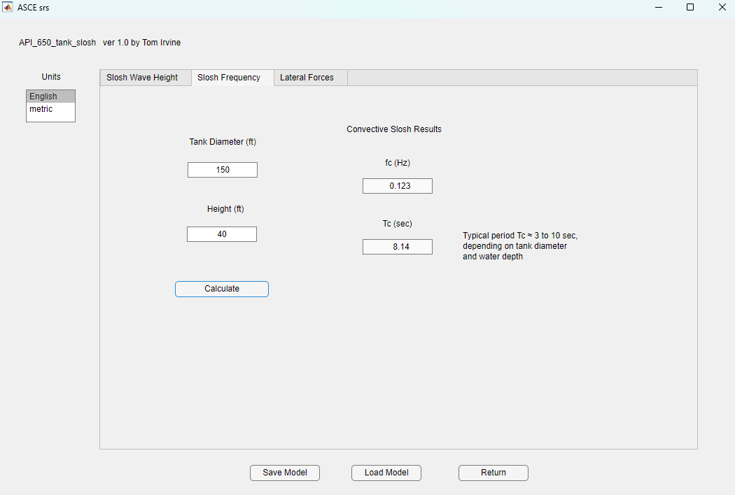

Slide 30
Tank Anchoring
Vibrationdata
Feature | Anchored Tank | Self-Anchored Tank
Anchors | Anchor bolts to foundation | None
Uplift | Prevented or limited | Allowed
Rocking | Minimal | Significant
Seismic resistance | Bolt tension + weight | Weight only
Failure concern | Anchor bolt tension | Shell buckling
Typical use | Smaller or tall tanks in high seismic areas | Large oil tanks with heavy contents
Practical Observation
Most large crude oil tanks are self-anchored because:
  The liquid mass is enormous
  The weight alone usually prevents overturning
  Anchors would be extremely large and expensive
API 650 Appendix E explicitly checks uplift for unanchored tanks and determines whether anchors are required
Two main seismic limits are evaluated:
  Shell compression (elephant foot buckling)
  Bottom plate uplift
If uplift exceeds allowable limits → anchors must be added

Slide 31
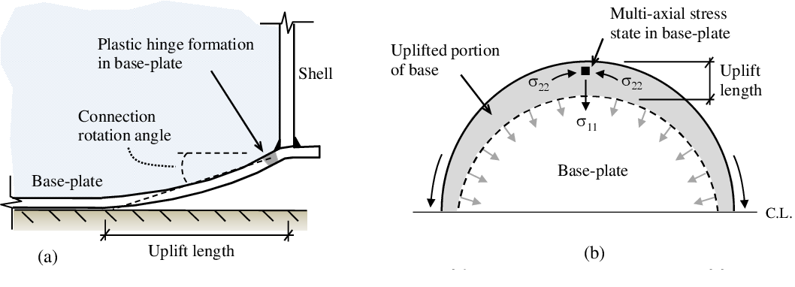
Tank Uplift
Vibrationdata
https://www.semanticscholar.org/paper/Fatigue-analysis-of-unanchored-steel-liquid-storage-Prinz-Nussbaumer/510d4c9ec76caf132d5a2c4ea46ca50e137b277e

Slide 32
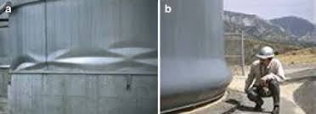
Buckling Notes
Vibrationdata
Diamond buckling left & elephant foot buckling right
The sloshing wave creates localized pressure at the top of the shell
If the shell is too thin, the "slap" of the wave can cause elephant foot buckling at the bottom or diamond buckling at the top
https://www.researchgate.net/publication/267156935_Reliability_of_Base-Isolated_Liquid_Storage_Tanks_under_Horizontal_Base_Excitation/figures

Slide 33
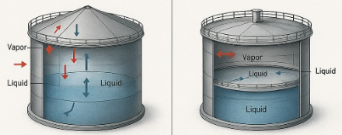
Tank Roofs
Vibrationdata
Fixed Roof Floating Roof
Floating roofs eliminate the free liquid surface, effectively suppressing convective sloshing loads that are a primary cause of earthquake-related tank damage such as roof seal fires and liquid overflow
However, floating roofs increase the impulsive hydrodynamic loads on the tank shell and foundation, since more of the liquid mass moves rigidly with the shell rather than sloshing independently
The roof structure itself becomes a seismic vulnerability — support legs, seals, drains, and rolling ladders are all susceptible to earthquake damage, and a sunken floating roof can trigger a catastrophic full-surface fire
Overall, floating roofs represent a trade-off rather than a net seismic improvement, and design standards such as API 650 Appendix E require special seismic detailing to manage their unique failure modes in earthquake-prone locations
https://www.instagram.com/p/DNDq7hnhnGf/

Slide 34
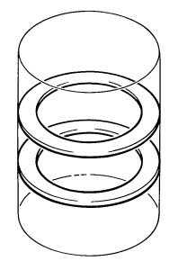
Damping Notes
Vibrationdata
Sloshing effects are calculated using a lower damping value (usually 0.5%) compared to the structural impulsive mass (5%), because liquid friction is much lower than structural damping
Liquids like Liquefied Natural Gas (LNG) and water have very low kinematic viscosity, leading to minimal internal friction during oscillation
The 0.5% damping value is a realistic or even slightly conservative estimate for the convective (sloshing) component for low viscosity liquids
High-Viscosity Liquids (Crude Oil): Heavier crude oils possess higher kinematic viscosity, which increases energy dissipation as the liquid layers slide against each other and the tank walls
For these "heavy" contents, the actual damping may be slightly higher than 0.5%, though design codes like API 650 often maintain the lower value to ensure a conservative safety margin for wave height and freeboard requirements
Internal Baffles act as "energy sinks" by forcing the liquid through small openings or around obstructions, artificially increasing the damping ratio far beyond the natural 0.5%
Annular Ring Baffles
NASA SP 8031

Slide 35
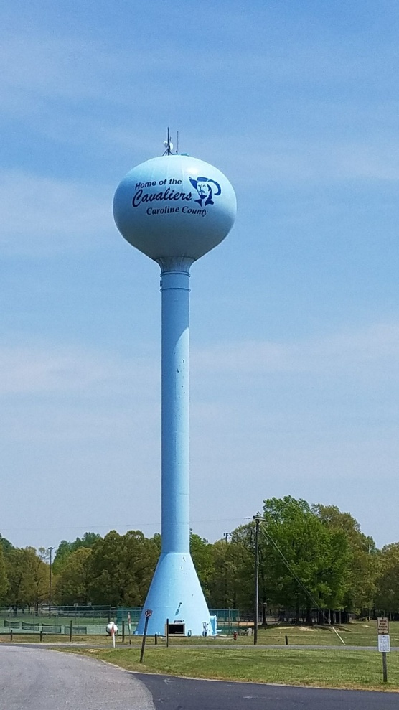
Water Towers
Vibrationdata
Water towers are not just tanks — they are flexible structures
Tank mass is elevated
Tower acts like a cantilever
Strong dynamic amplification
Governing behavior = structure + fluid coupling

Slide 36
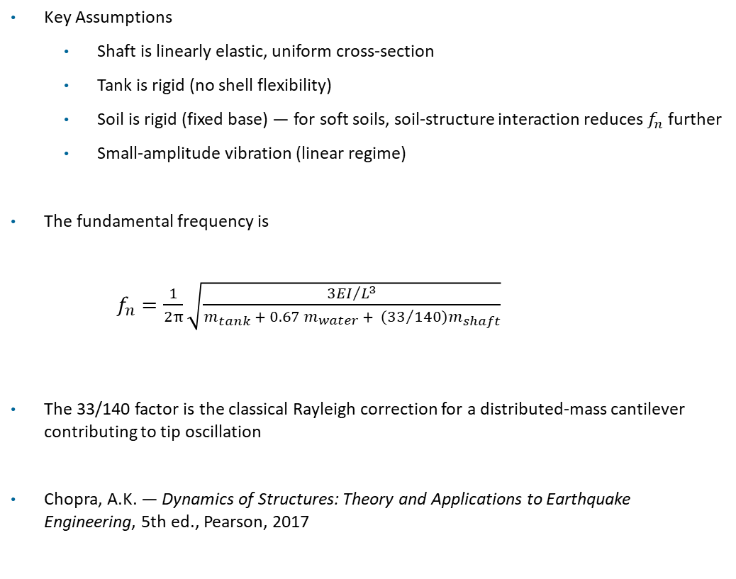
Water Tower Natural Frequency
Vibrationdata
Key Assumptions
  Shaft is linearly elastic, uniform cross-section
  Tank is rigid (no shell flexibility)
  Soil is rigid (fixed base) — for soft soils, soil-structure interaction reduces $f_{n}$ further
  Small-amplitude vibration (linear regime)
The fundamental frequency is
$f_{n}=\frac{1}{2π}\sqrt{\frac{{3EI}/{L^{3}}}{m_{tank} + 0.67 m_{water} + \left({33}/{140}\right)m_{shaft}}}$
The 33/140 factor is the classical Rayleigh correction for a distributed-mass cantilever contributing to tip oscillation
Chopra, A.K. — Dynamics of Structures: Theory and Applications to Earthquake Engineering, 5th ed., Pearson, 2017

Slide 37
Seiche & Slosh Mitigation — Tanks
Vibrationdata
Concern for LNG tanks, petroleum tanks, and large water reservoirs
Increase freeboard to prevent overtopping
Freeboard is the vertical distance between the normal liquid surface and the top edge of the container
Install internal baffles to dissipate wave energy
Strengthen walls and tank shells for sloshing loads
Provide anchorage and strong foundations
Perform dynamic sloshing analysis during seismic design
Account for both impulsive and convective (sloshing) mass components
Guard against elastic-plastic shell buckling (e.g. “elephant’s foot”) from compressive hoop stress
Design codes include formulas for seismic sloshing height
  API 650 Appendix E
  Eurocode 8 Part 4
  AWWA D100 / D110 and ACI 350.3

Slide 38
Seiche & Slosh Mitigation — Harbors
Vibrationdata
Concern for harbors, marinas, and enclosed or semi-enclosed basins
Seiches excited by wind, atmospheric pressure jumps, tsunamis, and meteotsunamis
Resonance occurs when forcing period matches the basin’s natural seiche period
Modify basin geometry to avoid resonance
Design harbors with wave-damping geometry
Use breakwaters and absorbing boundaries to reduce reflected wave energy
Maintain adequate berth clearance and mooring design for surge motions
Provide freeboard on quay walls and bulkheads to prevent overtopping
Perform basin response analysis to identify amplification (harbor resonance / “harbor paradox”)
Monitor with water-level gauges to capture seiche and meteotsunami events

Slide 39
Meteotsunami
Vibrationdata
A tsunami-like wave driven by atmospheric forcing, not seabed motion (the name means “meteorological tsunami”)
Triggered by a moving pressure or wind disturbance — squall line, fast cold front, derecho, or pressure jump
Amplified by Proudman resonance: the disturbance travels near the long-wave speed √(g·h), pumping energy into the wave over a long fetch
Most efficient over broad, shallow continental shelves
Further amplified at the coast when a bay or harbor seiche period matches the incoming wave period (harbor resonance)
Explains why specific harbors are struck repeatedly while neighboring coast stays calm
Typical signature: water-level swings of tens of cm up to ~2 m, strong harbor currents, periods of minutes to tens of minutes
Often arrives on an otherwise calm day, after the storm has passed or while it is far offshore
Documented in the Mediterranean (rissaga, šćiga), the Great Lakes, and the U.S. East and Gulf coasts

