Slide 1




VIBRATIONDATA TECHNICAL BRIEFING
Spacecraft On-Orbit Vibration Revision B
Microvibration & Jitter: Design • Analysis • Testing • Mitigation
Reaction Wheels
Cryocoolers
Mechanisms
Structural Path
Source: Tom Irvine, “Spacecraft On-orbit Vibration,” Vibrationdata Blog, June 12, 2014 (blog.vibrationdata.com)
Vibrationdata

Slide 2



Briefing Roadmap
Vibrationdata
Four parts: the full jitter problem from root cause to flight mitigation
1
Foundations
What jitter is, how it degrades optical performance, and the source taxonomy
2
Design
Architectural strategies: isolation, structural stiffness, mechanism choice
3
Analysis
Disturbance modeling, transfer paths, and line-of-sight error budgets
4
Testing & Mitigation
Ground verification challenges and flight-proven suppression methods
Spacecraft On-Orbit Vibration | blog.vibrationdata.com
2

Slide 3
Acronyms and Abbreviations
Vibrationdata
Key terms used throughout this briefing (1 of 2)
ACS
Attitude Control System
FRF
Frequency Response Function
ASD
Acceleration Spectral Density
FSM
Fast Steering Mirror
CB
Craig-Bampton (substructuring)
GNC
Guidance, Navigation & Control
CBE
Current Best Estimate
HST
Hubble Space Telescope
CLD
Constrained-Layer Damping (a.k.a. CDL)
IFOV
Instantaneous Field of View
CMG
Control Momentum Gyro
IR
Infrared
CSD
Cross-Spectral Density
JWST
James Webb Space Telescope
DOF
Degree of Freedom
LFT
Linear Fractional Transformation
ECSS
European Cooperation for Space Standardization
LOS
Line of Sight
FE / FEM
Finite Element / Finite Element Model
Spacecraft On-Orbit Vibration | blog.vibrationdata.com
3

Slide 4
Acronyms and Abbreviations
Vibrationdata
Key terms used throughout this briefing (2 of 2)
LSS
Large Space Structure
RWA
Reaction Wheel Assembly
MLI
Multi-Layer Insulation
SADM
Solar Array Drive Mechanism
MTF
Modulation Transfer Function
SDM
Structural Dynamics Model
MVIS
Miniature Vibration Isolation System
STOP
Structural-Thermal-Optical Performance
NICMOS
Near-Infrared Camera / Multi-Object Spectrometer
TMD
Tuned Mass Damper
NTRS
NASA Technical Reports Server
TPA
Transfer Path Analysis
PSD
Power Spectral Density
TVac
Thermal Vacuum (test)
RF
Radio Frequency
VISS
Vibration Isolation & Suppression System
RMS
Root Mean Square
WFE
Wavefront Error
RSS
Root Sum Square
Spacecraft On-Orbit Vibration | blog.vibrationdata.com
4

Slide 5
PART 1
Foundations
Defining microvibration / jitter and why it is a whole-spacecraft problem
5

Slide 6
What Is Spacecraft Jitter?
Vibrationdata
Low-level, self-induced vibration generated by the spacecraft's own moving parts on orbit
Definition
Why It Matters
Vibration the spacecraft generates internally once it reaches orbit and becomes operational — distinct from pre-launch transport or powered-flight loads
Predominantly sinusoidal with integer harmonics (from rotating machinery); broadband random content from bearing noise and cryocooler compressors is also present
Amplitudes are typically in the micro-g range (10−6 to 10−3 g), yet they couple directly into sensitive payload performance because optical instruments have nano-radian pointing requirements
ECSS-E-HB-32-26A frames the working microvibration band as roughly 1 Hz up to 500–1000 Hz — below ~1 Hz the ACS can compensate; above ~1 kHz structural attenuation is sufficient
Degrades line-of-sight pointing for optical instruments, laser communication terminals, and interferometric baselines
Smears imagery and broadens the point-spread function on Earth-observation and astronomical platforms during integration time
Couples into structural resonances, amplifying otherwise small disturbance forces by an order of magnitude or more
Unlike launch loads, jitter is continuous and operationally persistent — it must be managed for mission life, not survived once
Spacecraft On-Orbit Vibration | blog.vibrationdata.com
6

Slide 7



A System-Level Problem
Vibrationdata
Jitter must be solved across the full source → structure → sensor chain
Disturbance
Source
Structural
Transfer Path
Isolation /
Damping
Sensitive
Payload
Wheel, cryocooler,
mechanism
Bus, booms,
mounting structure
Passive or active
attenuation
Optics, sensors,
pointing system
Takeaway: Effective jitter control requires coordinated attention at every link in this chain — not a single fix at the source.
Spacecraft On-Orbit Vibration | blog.vibrationdata.com
7

Slide 8


Four System-Level Suppression Strategies
Vibrationdata
How jitter can be addressed at the spacecraft system level
Reduce Payload Sensitivity
Reduce Transmissibility
Design the payload to tolerate microvibration, or mechanically isolate it from the rest of the spacecraft bus
Design the spacecraft structure itself to attenuate disturbance transmission from source to payload
Post-Process Imagery
Reduce Source Noise
Mitigate residual jitter effects after the fact through image processing and reconstruction
Manage microvibration by lowering the mechanical noise generated at the source, or isolating the noise source itself
Spacecraft On-Orbit Vibration | blog.vibrationdata.com
8

Slide 9

Effects of Jitter on Optical Instruments
Vibrationdata
How line-of-sight motion at the focal plane degrades imaging, pointing, and laser performance
Imaging Degradation
Pointing & Coherent-Optics Effects
Line-of-sight motion during an exposure smears the point-spread function, reducing modulation transfer function (MTF) at high spatial frequency
Jitter components faster than the detector integration time blur the image; components slower than integration time appear as frame-to-frame pointing error instead
Push-broom and scanning imagers are especially sensitive because cross-track jitter directly mis-registers successive image lines
For diffraction-limited optics, jitter approaching a fraction of the diffraction-limited spot size can dominate the total error budget over optical aberrations
Fine star trackers and guide-camera loops can be driven by the same structural jitter they are trying to measure, coupling sensor noise back into the control loop
Free-space laser communication terminals lose link margin rapidly as pointing jitter approaches the transmit beam divergence angle
Long-baseline or segmented-mirror telescopes accumulate differential jitter between segments as wavefront error, not just simple image blur
Interferometric and coronagraphic instruments are sensitive to jitter-induced optical path-length changes of a small fraction of a wavelength
Spacecraft On-Orbit Vibration | blog.vibrationdata.com
9

Slide 10
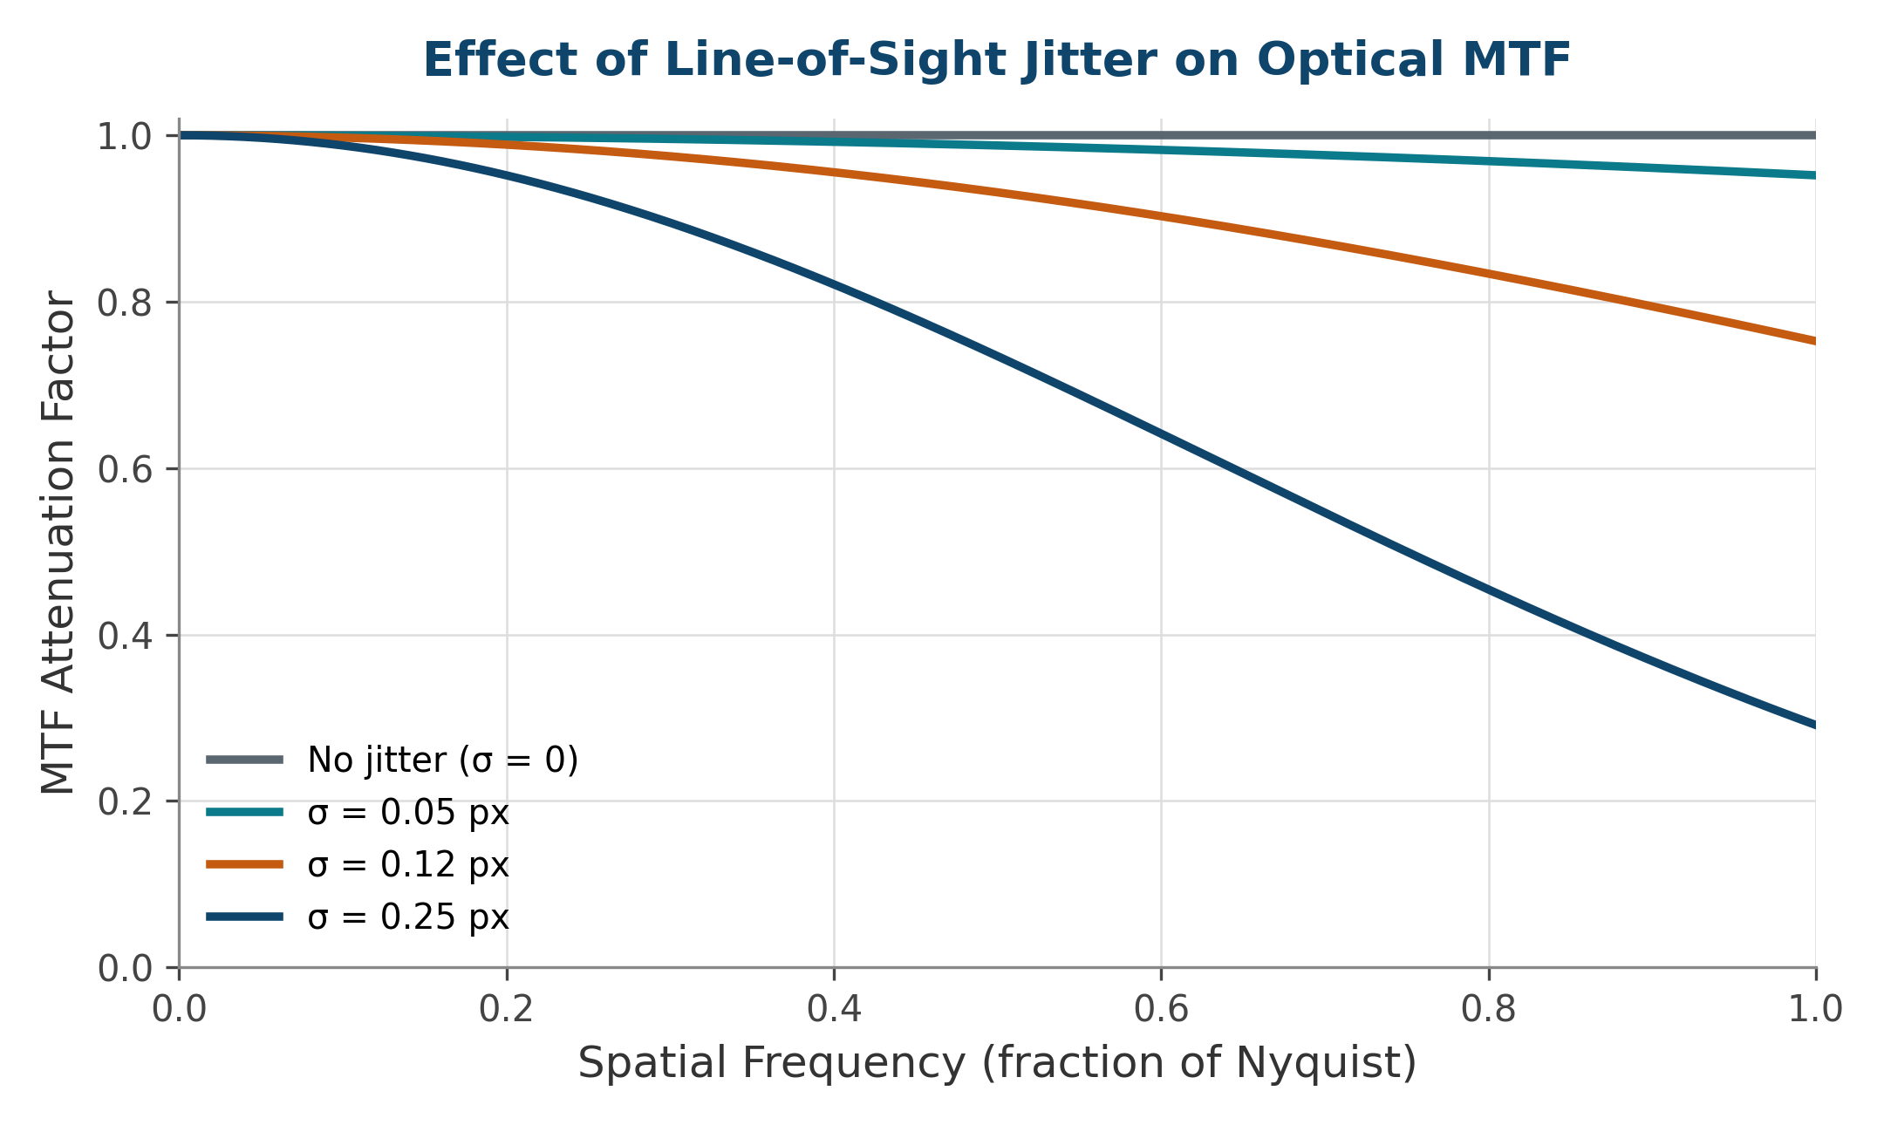
Quantifying the Impact:
Modulation Transfer Function vs. Jitter Amplitude
Vibrationdata
Even sub-pixel line-of-sight jitter measurably reduces contrast at high spatial frequency
Reading the Curve
Curves show the MTF attenuation factor contributed by random (Gaussian) jitter alone, for several jitter standard deviations expressed as a fraction of one detector pixel / IFOV
Attenuation is negligible at low spatial frequency but grows sharply approaching Nyquist — fine image detail is lost first
A jitter σ of just 0.1–0.2 pixel can already cut high-frequency MTF by 20–40%, which is why fine-pointing requirements are often stated in milli-pixels or microradians
This MTF loss multiplies with the optical system's own diffraction- and aberration-limited MTF — jitter is rarely the only contributor, but it is often the most controllable one
Spacecraft On-Orbit Vibration | blog.vibrationdata.com
10

Slide 11


Microvibration Source Taxonomy
Vibrationdata
Per ECSS-E-HB-32-26A: harmonic and transient disturbance sources on a typical spacecraft
Harmonic / Rotating Sources
Transient / Non-Moving Sources
Reaction wheels
Control momentum gyros
Gyroscopes
Solar array drive mechanisms
Antenna pointing mechanisms
Mirror scan mechanisms
Cryogenic coolers
Micro-thrusters, gas flow regulators
Latch valves
Heat pipes
Relays, RF switches
Sudden stress release (“thermal snap”)
Clank phenomena (e.g., MLI foil buckling)
Spacecraft On-Orbit Vibration | blog.vibrationdata.com
11

Slide 12
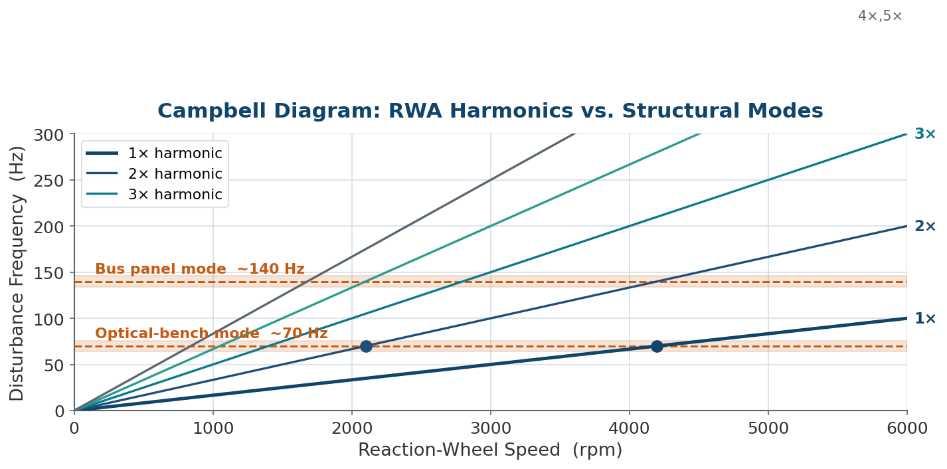
Microvibration Source Frequency Map
Vibrationdata
Where each disturbance lands on the frequency axis — and where the payload is most vulnerable
Reading the Map
Each rotating source paints a fan of lines: forcing frequency = wheel speed × harmonic index, so the disturbance sweeps as the wheel changes speed
Payload-sensitive structural modes are horizontal bands — trouble occurs where a harmonic line crosses a mode
Cryocooler tones sit at fixed frequencies (20–60 Hz Stirling); Brayton turbines live far above the band at 3–13 kHz
The crossing points define the wheel speeds to avoid — the “no-spin zones” quantified later in the Analysis section
Takeaway: Plotting every source on one speed–frequency map turns jitter risk into a geometry problem: keep the harmonic lines off the structural modes.
Spacecraft On-Orbit Vibration | blog.vibrationdata.com
12

Slide 13
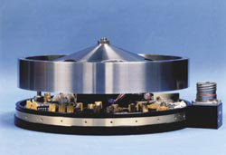
Reaction Wheels: Operating Principle
Vibrationdata
The dominant attitude-control disturbance source on most spacecraft
Flywheels driven by electric motors, commanded by the attitude control computer
Typically, three wheels mounted on mutually perpendicular axes, with a fourth skewed wheel often added for redundancy
Operate per Newton's Third Law and conservation of angular momentum: changing wheel speed exerts a reaction torque on the spacecraft
The acceleration ratio between wheel and spacecraft equals the inverse ratio of their moments of inertia
Especially valuable for very fine pointing — keeping a telescope trained on a star or holding an antenna or laser steady
A representative commercial momentum wheel spans a speed range of ±10,000 rpm (167 Hz); the Kepler telescope's wheels operated between 1000 and 4000 rpm in both directions
Flight reaction / momentum wheel assembly
Takeaway: Because the wheel is the actuator for fine attitude control, its disturbance signature cannot simply be eliminated — it must be managed.
Spacecraft On-Orbit Vibration | blog.vibrationdata.com
13

Slide 14
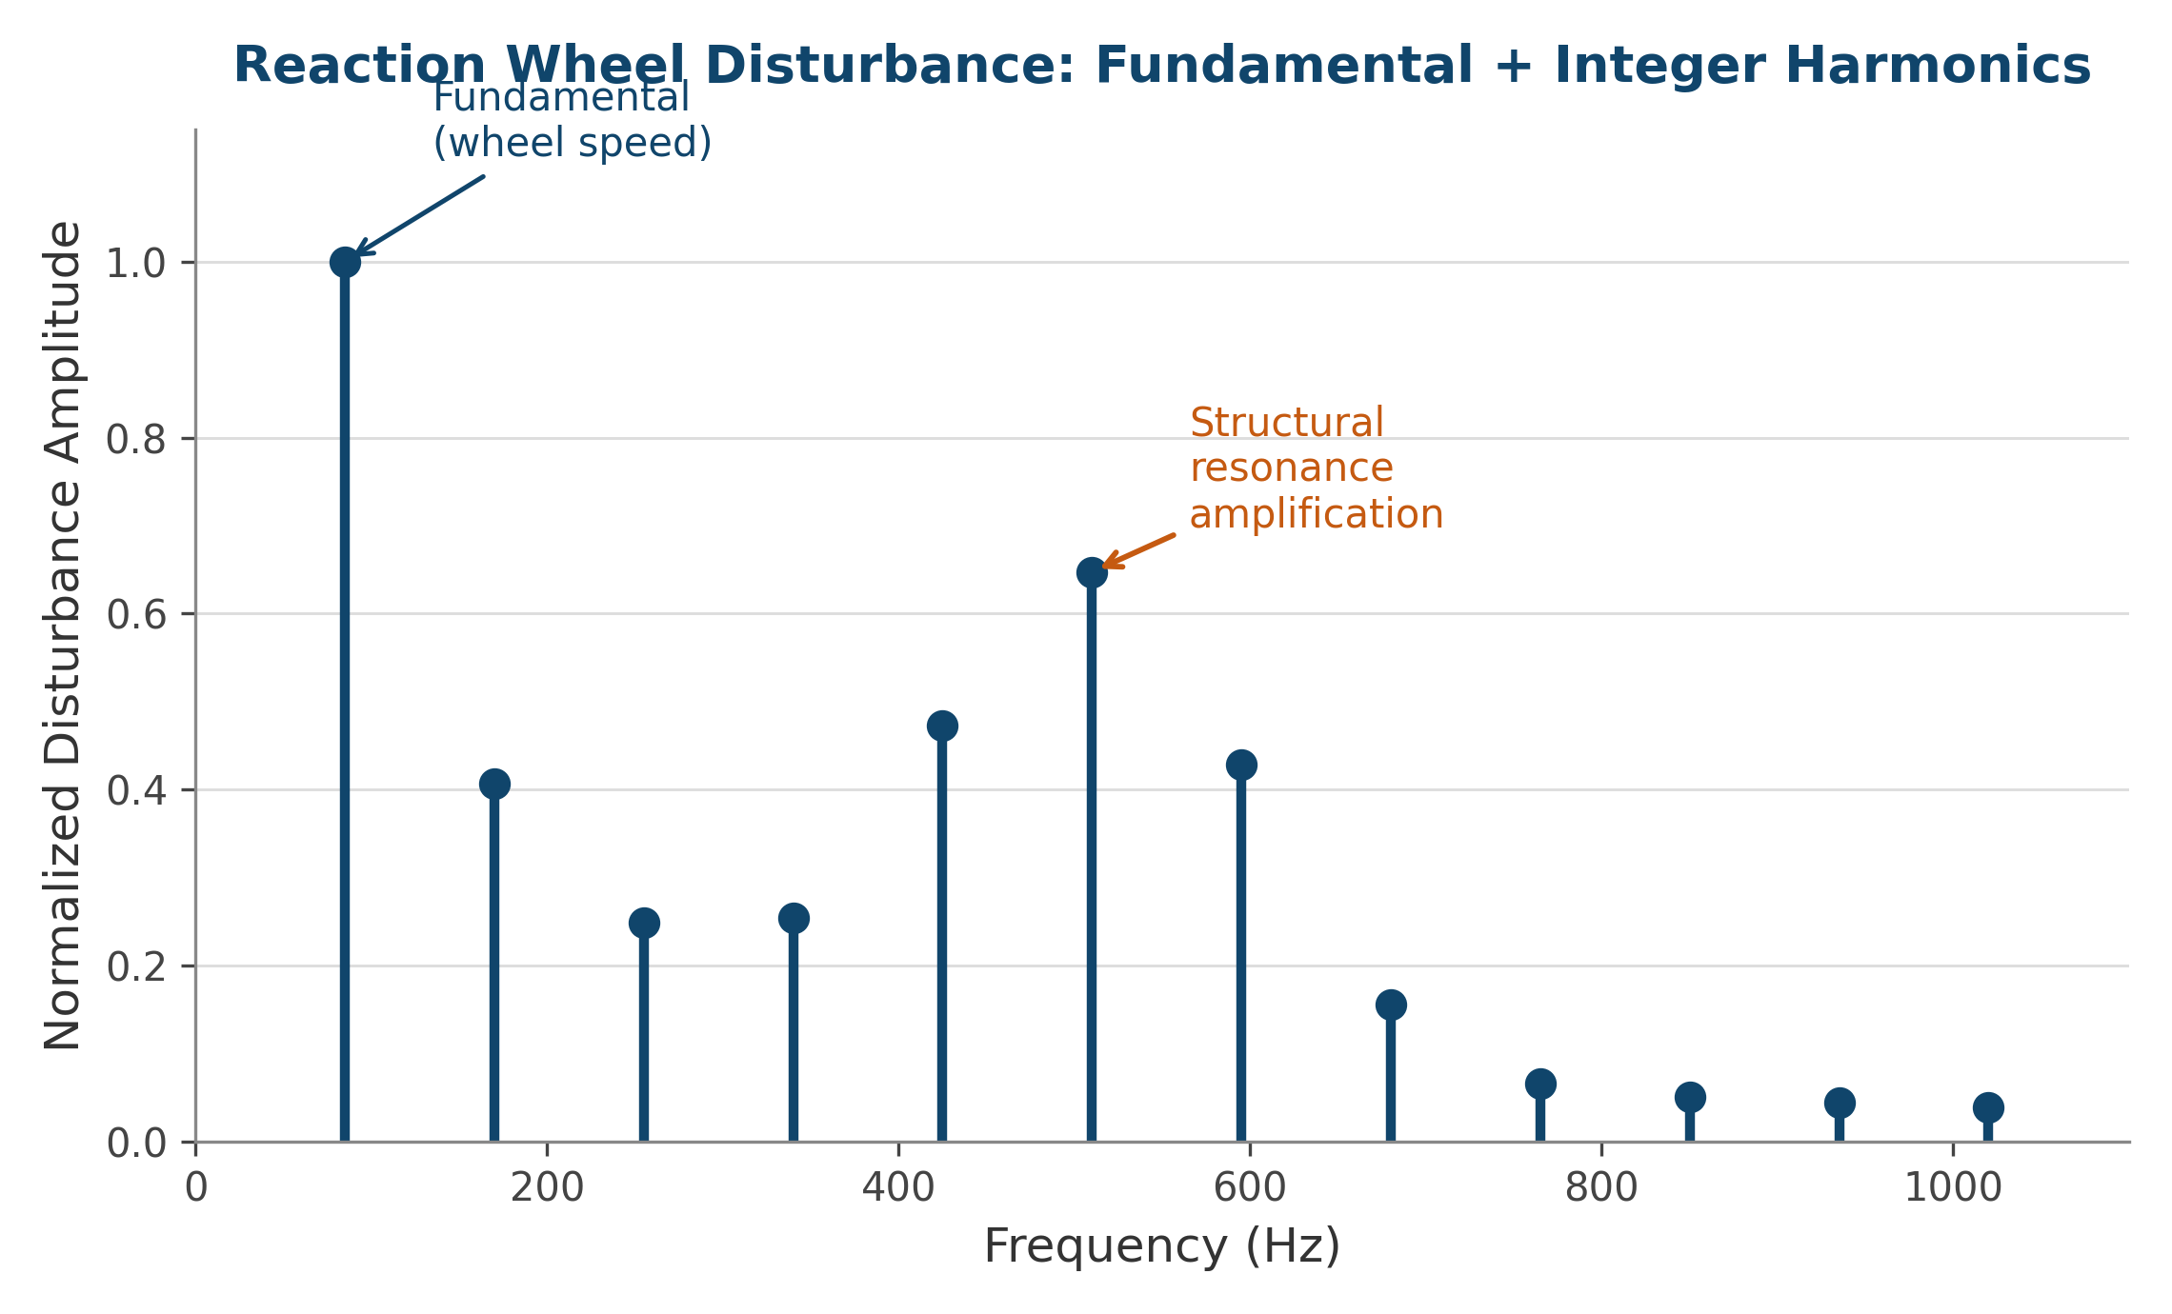
Reaction Wheel Disturbance Spectrum
Vibrationdata
Motor noise, imbalance, and bearing disturbances produce a fundamental plus integer harmonics
Key Mechanisms
Electrical motor noise (commutation, cogging torque)
Static and dynamic mass imbalance at wheel speed
Bearing-induced disturbances and ball-pass frequencies
Forcing occurs at wheel speed and its integer harmonics
Imbalance harmonics can excite structural resonances during angular acceleration through a critical speed
Spacecraft On-Orbit Vibration | blog.vibrationdata.com
14

Slide 15
Reaction Wheel Disturbance Modeling Approaches
Vibrationdata
Three model classes trade test data against rotor-dynamics physics — per Dennehy (NASA NESC), ESMATS 2019
Empirical Model
Analytical Model
Extended (Hybrid) Model
Built from steady-state RW force/torque characterization test data
Represents disturbances as discrete harmonics of wheel speed; amplitudes scale as the square of speed
Captures the tonal “waterfall” signature accurately at the measured speeds
Limitation: ignores internal wheel flexibility, so it severely under-predicts where bearing harmonics meet flywheel structural modes (Masterson, MIT)
Physical model from coupled rotor-dynamics equations of motion (Lagrange or Newton-Euler)
Captures internal flexibilities, gyroscopic effects, and wheel structural modes
Flywheel imbalance modeled as lumped masses on a flexible shaft / bearing supports
Limitation: many parameters must be determined accurately to be predictive
Combines the empirical and analytical models into one representation
Captures all wheel harmonics plus amplifications from structural-mode excitation
Example: validated combined model developed at Bradford Space, tested across several RW types
Now used to predict micro-disturbance performance of future wheel designs
Source: C. J. Dennehy, “A Survey of Reaction Wheel Disturbance Modeling Approaches for Spacecraft Line-of-Sight Jitter Performance Analysis,” Proc. 18th ESMATS, Munich, 2019.
Takeaway: Pick the model class to the jitter requirement: empirical for a quick tonal map, analytical when wheel flexibility matters, and the extended model when a high-performance instrument needs both.
Spacecraft On-Orbit Vibration | blog.vibrationdata.com
15

Slide 16
Rocking Whirl & Practical Modeling Cautions
Vibrationdata
Why wheel flexibility creates speed-dependent resonances — and what test campaigns must account for
Rocking Whirl Resonance
Cautions for Characterization Testing
A spinning, flexible flywheel precesses, exporting a gyroscopic torque through the wheel mounting interface
The rocking-mode natural frequency varies with wheel speed and splits into forward and backward whirl branches (bifurcation)
Resonance occurs where a bearing harmonic line crosses a whirl branch; higher harmonics resonate at lower wheel speeds
Backward whirl dominates jitter — it resonates with all bearing harmonics and at relatively lower frequencies
Conventional analysis that keeps only static/dynamic imbalance misses these resonances and can under-predict in-flight jitter
Boundary conditions plus vacuum, temperature, and gravity all shift measured disturbance levels
A single wheel’s disturbance can worsen after run-in, ADCS use, and system-level shock/vibration tests — re-characterize between major tests
“Identical” wheels from one lot can differ by up to an order of magnitude in PSD — test multiple units and cherry-pick flight wheels
An isolator can worsen things: coupling with wheel gyroscopics adds modes (e.g., Chandra’s nutation found in spin test)
Establish quantitative uncertainty bounds and anchor models with physical test data
Takeaway: For vibration-sensitive observatories, model the coupled RW–spacecraft dynamics (including rocking whirl) and validate against a multi-wheel test campaign — a point estimate from one “typical” wheel is not enough.
Spacecraft On-Orbit Vibration | blog.vibrationdata.com
16

Slide 17
Wheel Saturation and Desaturation
Vibrationdata
Momentum management introduces its own transient disturbance events
1
2
3
4
Momentum Builds
Saturation
Desaturation Burn
Cycle Repeats
External torques (solar pressure, gravity gradient, magnetic) steadily load the wheels
Wheel speed approaches its operational limit and can no longer absorb further momentum
Thrusters fire to offload momentum while wheels are commanded toward rest
As unbalanced torque rebuilds, wheels spin back up toward saturation
Alternative momentum management: magnetorquers (electromagnetic coils) can offload momentum against the Earth's magnetic field without firing thrusters, avoiding the transient plume disturbance and propellant cost of a desaturation burn — though they are limited by orbit altitude and field strength.
Spacecraft On-Orbit Vibration | blog.vibrationdata.com
17

Slide 18
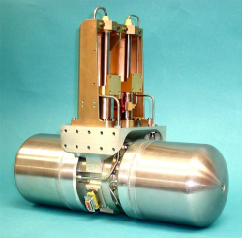
Cryocoolers: Overview
Vibrationdata
Miniature refrigerators that enable cryogenic detector technologies
Cool sensitive spacecraft components to cryogenic temperatures for infrared, gamma-ray, and x-ray detectors
The largest current usage is in Earth Science instruments operating near the boiling point of liquid nitrogen, 77 K (−321°F)
Working fluid is typically hydrogen or helium, cycled from gaseous to liquid form and boiled back to gas
Compressors with rotating and/or reciprocating parts generate vibration as they cycle gas through phase changes
Vibration is typically mitigated with active control — commonly an electromechanical counterbalance mass or a piezoelectric driver
Example Application
JWST MIRI Instrument Cryocooler
Cold head (top) and compressor/precooler assembly (bottom) used to cool the Mid-Infrared Instrument detectors to operating temperature
Spacecraft On-Orbit Vibration | blog.vibrationdata.com
18

Slide 19
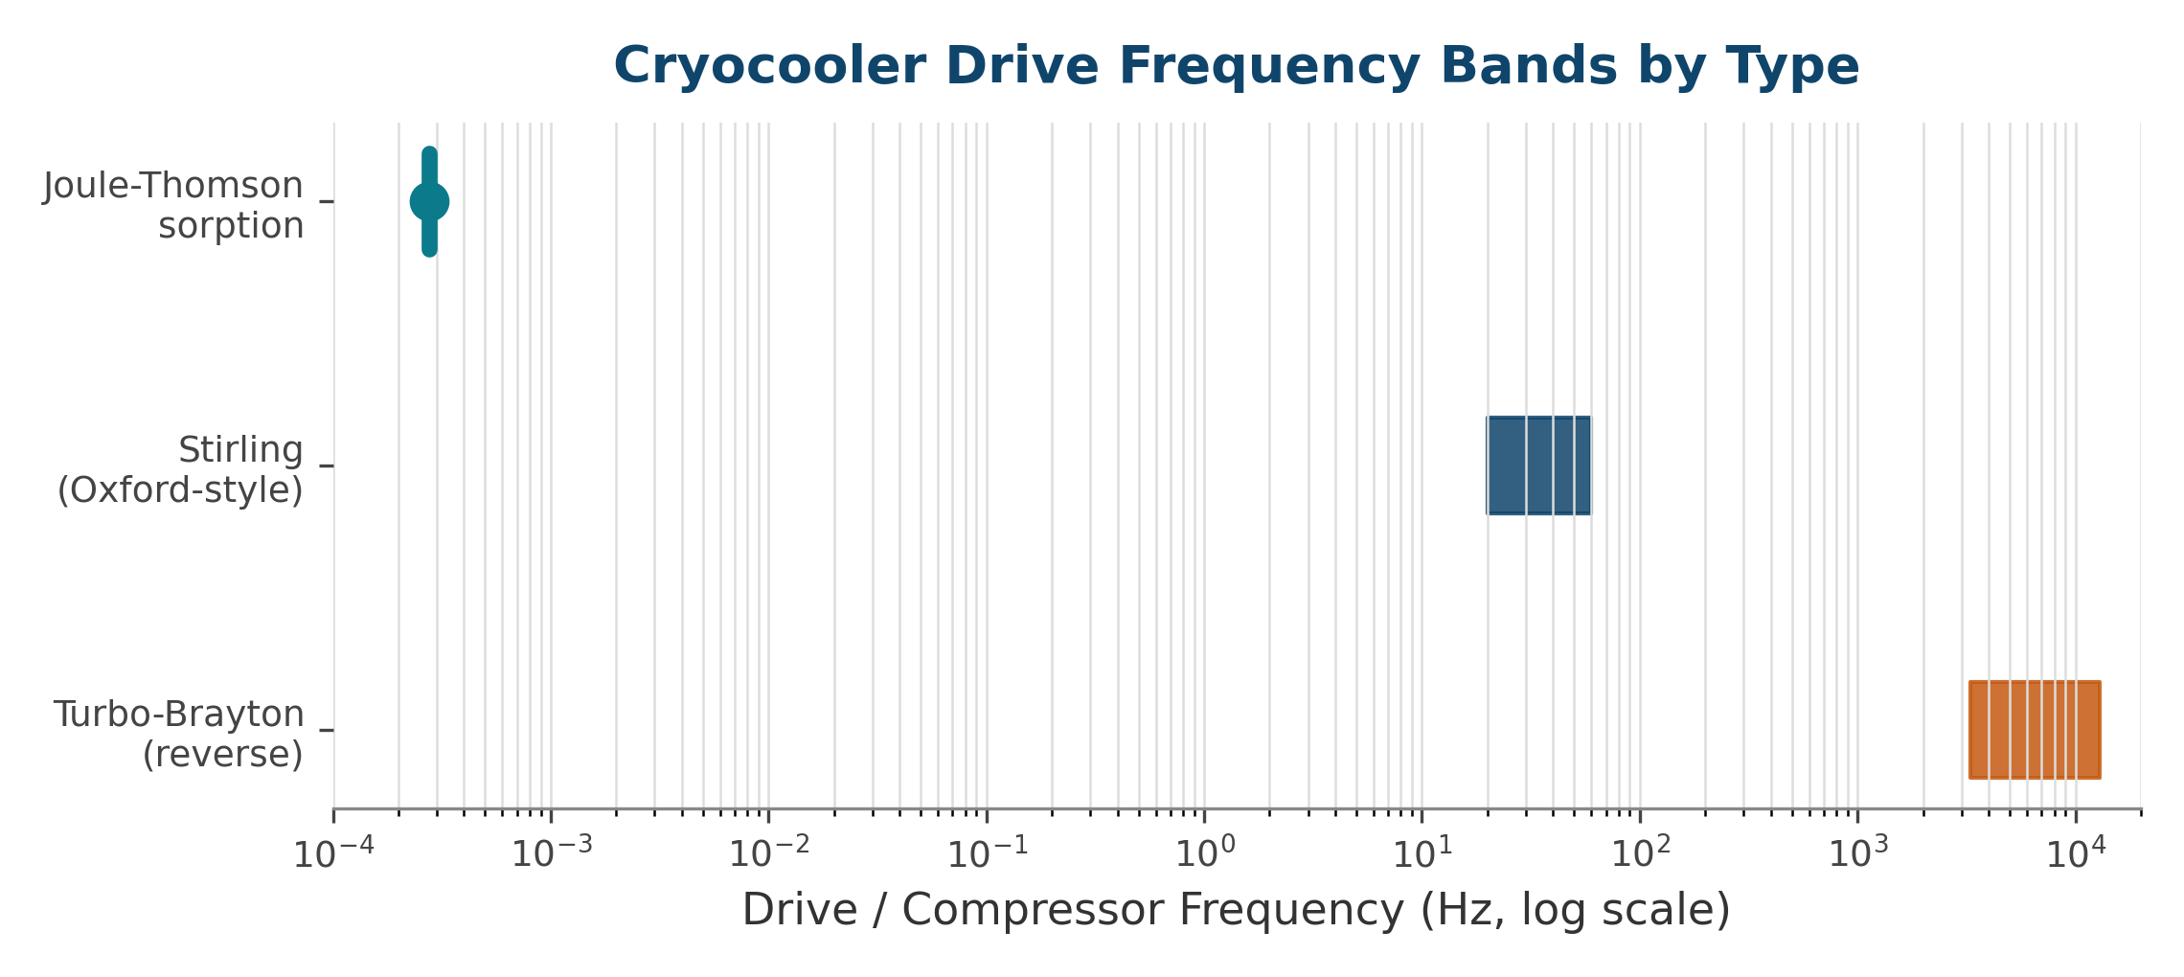
Cryocooler Types and Drive Frequencies
Vibrationdata
Three common cooler architectures span vastly different operating frequency bands
Type | Mechanism | Frequency Range
Joule-Thomson (J-T) Sorption | Solid-state compressor; isenthalpic expansion across a valve | < 1 cycle/hour
Oxford-Style Stirling | One or two pistons; most common cryocooler type | 1200–3600 rpm (20–60 Hz)
Reverse Turbo-Brayton | Tiny high-speed turbines | 200,000–800,000 rpm (3.3–13 kHz)
Spacecraft On-Orbit Vibration | blog.vibrationdata.com
19

Slide 20
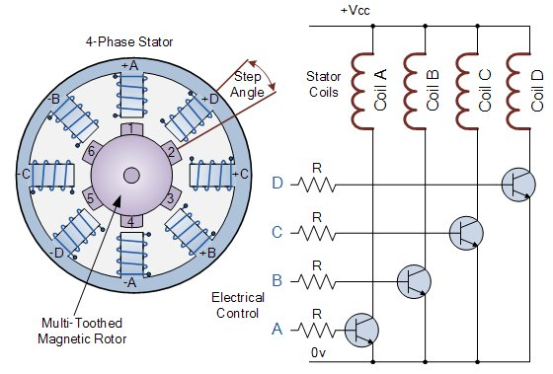
Stepper Motors
Vibrationdata
Brushless DC motors that divide rotation into discrete commandable steps
Typical Applications
Driving solar arrays
Pointing antennas
Mobile mirror drives
Hold-down and release mechanisms
Disturbance Mechanism
Position is commanded open-loop to a discrete step, without feedback sensing, as long as the motor is properly sized to the load
The motor itself, plus any accompanying gear meshing, generates transient vibration as force and torque disturbances
Transmitted force can degrade the quality of optical images recorded by a camera elsewhere on the spacecraft
4-phase stepper: stator coils energized in sequence step the multi-toothed magnetic rotor — each transition is a small, discrete torque impulse
Spacecraft On-Orbit Vibration | blog.vibrationdata.com
20

Slide 21
Dithering: Commanded Micro-Vibration
Vibrationdata
A deliberately injected small oscillation that linearizes friction — useful by design, but a disturbance source the jitter budget must carry
Why Dither Is Introduced
Why It Is a Jitter Concern
Stiction control: a small commanded oscillation keeps a bearing, gimbal, or valve in continuous micro-motion so it never sticks — breaking static friction before it sets
Friction linearization: dither converts a hard, discontinuous Coulomb friction characteristic into a smoother effective one, improving pointing resolution and control-loop behavior
Microstepping & backlash: stepper-driven antenna, mirror, and solar-array drives use dither to smooth discrete steps and take up gear lash, reducing peak transient impulse
Where it appears: antenna pointing mechanisms, scan/filter-wheel and fast-steering-mirror drives, gimbaled solar-array drive mechanisms (SADMs), and some valve and actuator designs
Dither is tonal by construction: it injects a force/torque line at the dither frequency plus harmonics — a deterministic disturbance the LOS budget must account for like any wheel line
Risk peaks when the dither line, or one of its harmonics, coincides with a structural mode on the path between the mechanism and a sensitive payload — the same crossing logic as RWA harmonics
It is largely a design choice: dither amplitude and frequency are commandable, so they can be tuned to the minimum that defeats stiction and placed in a frequency gap clear of payload-sensitive modes
Mitigations: gate dither off during sensitive observations or exposures, isolate the mechanism mount, or schedule it like a no-spin zone away from critical structural frequencies
Takeaway: Dither is a self-inflicted but controllable tone — the same harmonic-crossing analysis used for reaction wheels applies, and the cure is to tune, gate, or isolate it rather than tolerate it.
Spacecraft On-Orbit Vibration | blog.vibrationdata.com
21

Slide 22



Non-Moving Disturbance Sources
Vibrationdata
Vibration can arise even without continuously rotating or reciprocating hardware
Electronics & Sensors
Thermal Snap
Switching transients and relay/RF-switch actuation generate brief mechanical impulses
Sudden release of stored strain energy at structural interfaces — joints, latches, hinges — as thermal loads shift
Thermally-Induced Bending
Clank Phenomena
Solar arrays, antennas, and other deployables flex as they cross the orbital terminator and experience sudden temperature change
Electromagnetic force effects and buckling of multi-layer insulation (MLI) foil produce impulsive transients
Spacecraft On-Orbit Vibration | blog.vibrationdata.com
22

Slide 23

PART 2
Design
Architectural choices that prevent jitter problems before they reach hardware
23

Slide 24
Design Decision Logic: Choosing the Intervention
Vibrationdata
A single flow that ties source selection, isolation, and structural design together
Is the disturbance above the ACS control bandwidth (>1 Hz)?
NO — ≤ 1 Hz
YES — > 1 Hz
Let the ACS Absorb It
Quiet the Source
Isolate & Detune the Path
Slow drifts and bias are corrected by the attitude-control loop
No mechanical mitigation needed in this band
Verify the loop has authority and bandwidth margin
Higher wheel-balance grade; active cooler balancers
Closed-loop stepper control; slower slew profiles
Cheapest fix when feasible — less energy to manage downstream
Soft-mount the payload or the source (passive / active)
Separate source and payload structural modes (≥2×)
Add damping at high modal-strain-energy nodes
Reserve sway space for the isolator stroke
Takeaway: Most jitter problems are solved by a combination of all three branches — the flow shows which lever to reach for first, not the only lever to pull.
Spacecraft On-Orbit Vibration | blog.vibrationdata.com
24

Slide 25




Design Philosophy: Where to Intervene
Vibrationdata
Jitter mitigation is most effective — and least costly — the earlier it is designed in
Concept
Architecture
Detailed Design
Verification
Select mechanisms and source hardware with inherently lower disturbance signatures
Locate sensitive payloads away from disturbance sources; plan structural load paths
Size isolators, dampers, and stiffness to meet allocated transmissibility budgets
Confirm performance by test and analysis before committing to flight hardware
Takeaway: Cost of fixing a jitter problem grows roughly an order of magnitude at each stage moved to the right — design decisions made early carry the most leverage.
Spacecraft On-Orbit Vibration | blog.vibrationdata.com
25

Slide 26

Design Strategy: Payload Isolation
Vibrationdata
Mechanically decouple the sensitive payload from the disturbance-generating bus
Mount the sensitive instrument on a dedicated isolation platform rather than rigidly to the spacecraft structure
Passive isolators (elastomeric, wire-rope, or spring-and-damper) attenuate disturbance above their corner frequency
Isolator corner frequency must sit well below the lowest critical disturbance frequency — typically the reaction wheel speed range
Lowering the corner frequency to gain jitter attenuation increases the relative displacement the isolator must accommodate across its full operating envelope, not just at resonance
Soft isolation can conflict with launch-load stiffness requirements; many designs use launch locks, motion-limiting snubbers, or stroke stops to bound relative displacement during ascent
Multi-axis isolation (6-DOF platforms) addresses coupled translational and rotational disturbance paths simultaneously, but must budget relative displacement in every axis independently
Relative Displacement Trade
Softer isolation
= better jitter attenuation
but larger relative
displacement (sway space)
and slower settling after
maneuvers or slews.
Stiffer mounting
= faster settling
but higher disturbance
transmission to payload.
Spacecraft On-Orbit Vibration | blog.vibrationdata.com
26

Slide 27
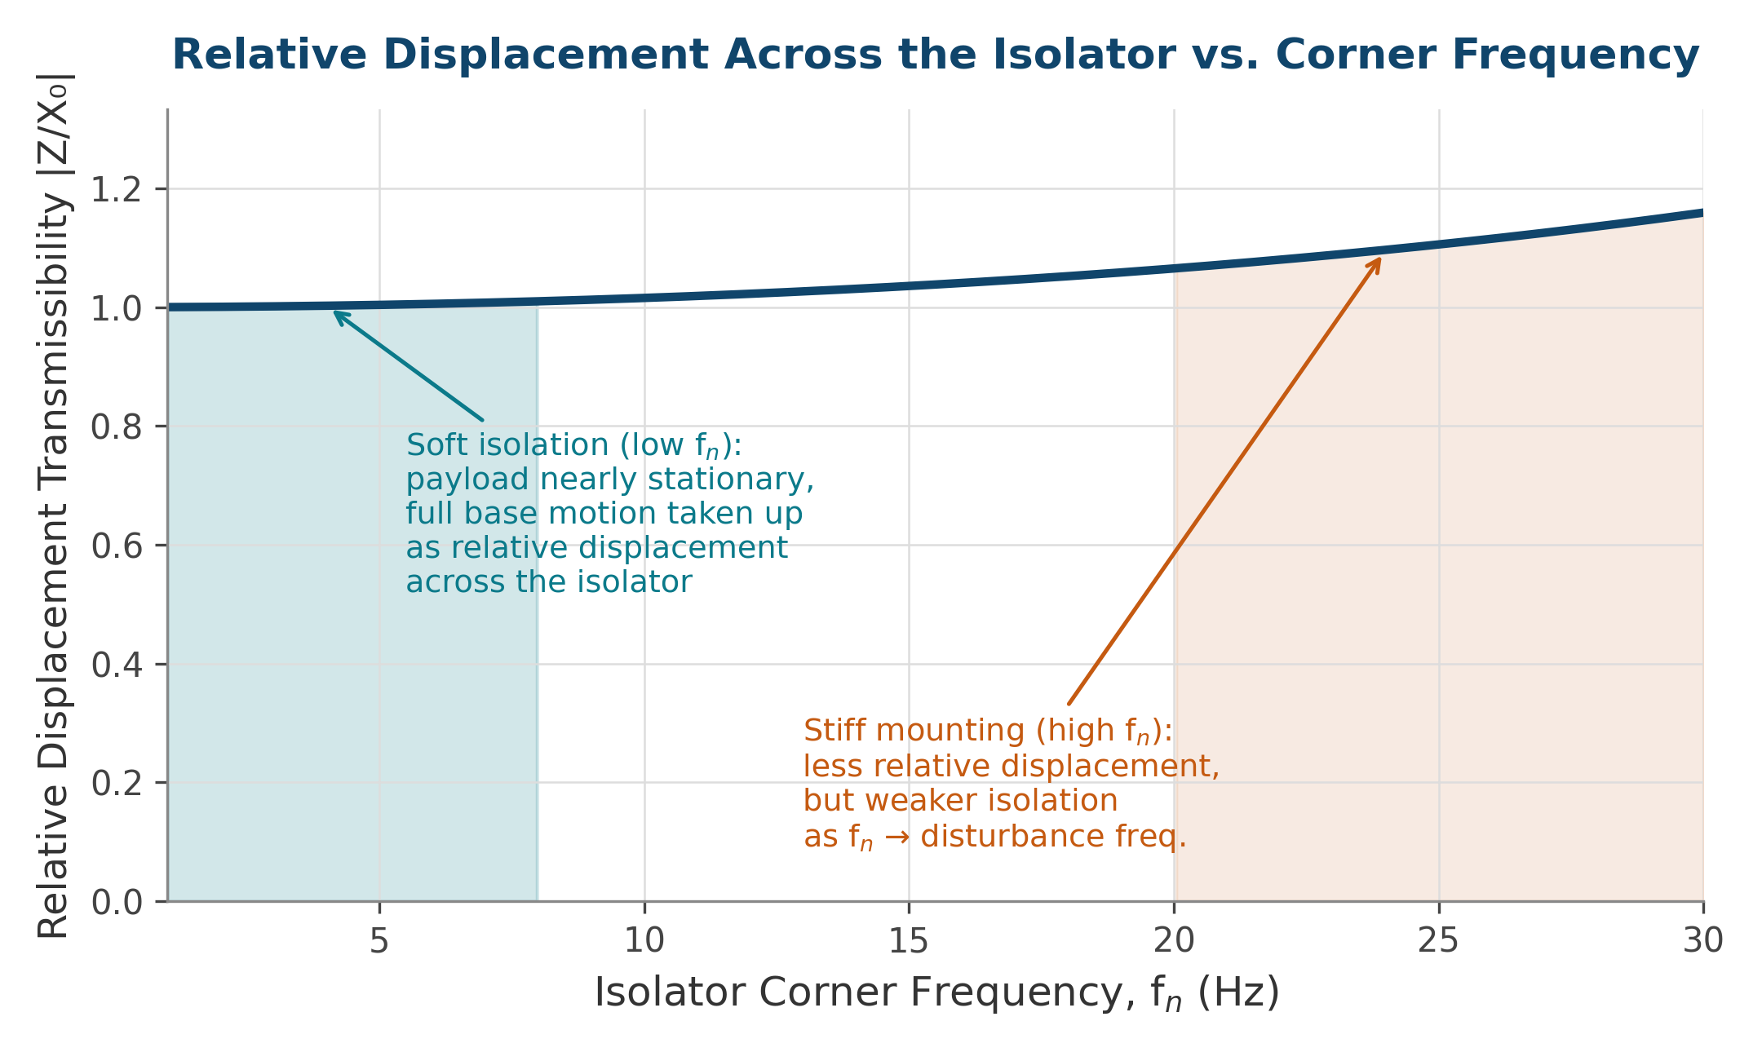
Relative Displacement and Isolator Selection
Vibrationdata
Closing the corner-frequency trade with a real device that survives vacuum and on-orbit temperature swings
.
Isolators Suited to Vacuum / Thermal Extremes
D-strut / viscous three-parameter strut
Honeywell-heritage strut combining a soft spring in parallel with a viscous-fluid damper; flight-proven on HST (reaction wheel isolation), VISS, and MVIS. Damping fluid must be selected for stable viscosity from cryogenic to elevated temperature, and bellows-sealed against vacuum exposure.
Wire-rope isolator
All-metal stranded-cable element; damping is Coulomb friction between strands. No elastomer to outgas or embrittle, making it tolerant of wide temperature swings and hard vacuum, though stiffness and damping vary somewhat with input amplitude and require test-based characterization.
Viscoelastic-damped strut (constrained-layer)
Titanium or graphite-epoxy flexures with a constrained viscoelastic damping layer, as used on JWST's instrument isolators. Requires a low-outgassing, radiation-tolerant viscoelastic formulation whose loss factor is characterized over the full flight temperature range, since elastomer damping is intrinsically temperature- and frequency-dependent.
Design rule: size the isolator's working stroke (or the structure's keep-out / sway-space envelope) to the predicted relative displacement at the softest corner frequency under consideration, with margin for fabrication and thermal offset — not just the on-orbit micro-g amplitude.
Spacecraft On-Orbit Vibration | blog.vibrationdata.com
27

Slide 28
Design Strategy: Structural Transmissibility
Vibrationdata
Shape the spacecraft structure itself to attenuate the path from source to sensor
Separate disturbance-source mounting frequencies from payload-sensitive frequencies — avoid coincident structural modes along the transfer path; a frequency separation ratio of at least 2× is a common rule of thumb
Increase local stiffness and mass at the source mount to reduce coupled motion into the bus structure; a stiff, well-isolated source mount can reduce transmitted force by 10–20 dB without a dedicated isolator
Add structural damping (viscoelastic constrained layers, tuned mass dampers) at node locations identified by transfer-path analysis, where modal strain energy density is highest
Route load paths so that disturbance energy is directed away from, rather than through, sensitive instrument mounts — orthogonal load paths between RWAs and optical bench are particularly effective
Avoid placing reaction wheels, cryocoolers, or other rotating machinery on panels that share a structural mode with the payload bench — stiffened close-out ribs can detune a shared panel mode by 30–60%
Maintain mass budget discipline: added stiffening mass is only effective if it shifts the mode, not just the mode shape — target modifications where modal effective mass is highest
Takeaway: Modal separation between source and payload mounting structure is often the single most cost-effective structural design lever for jitter.
Spacecraft On-Orbit Vibration | blog.vibrationdata.com
28

Slide 29
Design Strategy: Source Selection
Vibrationdata
Choosing inherently quieter hardware reduces the disturbance the rest of the system must absorb
Design Lever | Application
Higher wheel-balance grade | Reaction / momentum wheels — tighter static and dynamic balance specs reduce imbalance harmonics
Active cooler balancers | Cryocoolers — electromechanical counterbalance mass or piezo driver cancels compressor-induced force
Magnetorquer-first momentum control | Reduces frequency of thruster desaturation burns and their transient disturbance
Closed-loop stepper control | Stepper-driven mechanisms — feedback sensing allows smoother, lower-impulse motion profiles
Slower mechanism slew profiles | Antenna / mirror pointing drives — trades settling time for reduced peak transient force
Spacecraft On-Orbit Vibration | blog.vibrationdata.com
29

Slide 30
Active & Hybrid Jitter Control
Vibrationdata
When passive isolation is not enough: adding sensors, actuators, and a control loop
Why Go Active
Active Techniques
Passive isolators cannot attenuate below their corner frequency and amplify at resonance — active control fills exactly that gap
Active systems add low-frequency disturbance rejection and can null specific tonal lines that a passive mount passes through
Penalty: actuators, sensors, power, control electronics, and the risk of closed-loop instability
Used when the LOS budget cannot be met passively — high-resolution imaging and laser-comm terminals are the usual drivers
Fast steering mirror (FSM): a small actuated mirror closes the residual line-of-sight loop downstream of the structure
Active isolation platform: voice-coil or piezo actuators on a Stewart (hexapod) frame cancel motion in 6 DOF
Feed-forward cancellation: a wheel-speed tachometer signal predicts the harmonic and drives an anti-phase force
Active counterbalancer: piezo / electromagnetic mass cancels the cryocooler compressor force at its source
Takeaway: Active control buys low-frequency and tonal rejection that passive mounts physically cannot — at the cost of power, complexity, and a stability budget.
Spacecraft On-Orbit Vibration | blog.vibrationdata.com
30

Slide 31
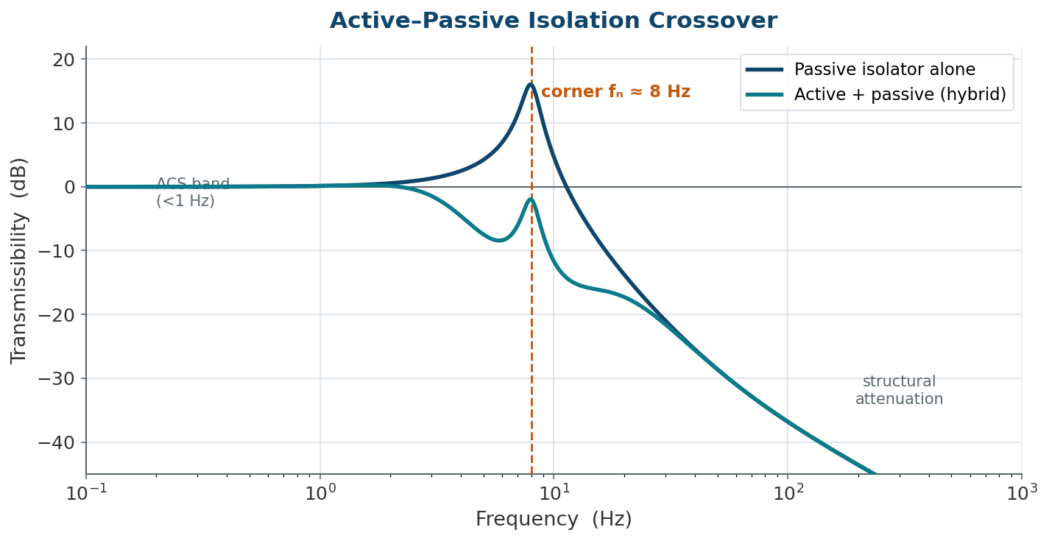
Active–Passive Crossover Strategy
Vibrationdata
Pair each method where it works best: active below the corner, passive above
Reading the Curve
Below the isolator corner the passive mount does nothing and amplifies at resonance — the active loop suppresses that peak
Above the corner the passive roll-off (~40 dB/decade) already does the work, so the active loop hands off
The hybrid curve keeps the passive high-frequency attenuation while removing the resonant amplification
Crossover frequency is a design choice: push it higher for more active authority, lower to save actuator effort and power
Takeaway: The best architectures are hybrid — active control owns the resonance and the sub-corner band; the passive mount owns the high-frequency roll-off.
Spacecraft On-Orbit Vibration | blog.vibrationdata.com
31

Slide 32
Design Section Summary
Vibrationdata
Four complementary design levers, applied together rather than in isolation
Isolate the Payload
Separate the Modes
Soft-mount sensitive instruments; manage the launch-lock trade
Keep source and payload structural frequencies apart
Pick Quieter Hardware
Manage Momentum Smartly
Specify balance grades, active balancers, closed-loop control
Favor magnetorquers to reduce desaturation transient frequency
Spacecraft On-Orbit Vibration | blog.vibrationdata.com
32

Slide 33

PART 3
Analysis
Predicting jitter response before hardware is built or tested
33

Slide 34
Disturbance Modeling Approach
Vibrationdata
Representing source forces so they can be propagated through a structural model
Source Characterization by Type
Multi-Source Coherence Treatment
Reaction wheels: empirical harmonic coefficient tables (Ci) measured on a dynamometer — amplitude of each harmonic = Ci × Ω², where Ω is wheel speed in rad/s
Cryocoolers: fixed-frequency line spectra plus broadband noise floor; noise floor modeled empirically as speed-dependent polynomial (Blaurock 2009)
Stepper motors and latch/valve events: transient force-torque time histories captured by multi-axis load cell at the mount interface
Thermal snap / clank: statistical impulsive loads bounded from heritage data or finite-element contact analysis
Multiple disturbance sources (three RWAs, one cryocooler) act simultaneously — they are rarely coherent at a single frequency, so root-sum-square (RSS) combination is the default
If sources share a structural path or drive frequency, partial coherence can increase response by up to 6 dB above RSS — cross-spectral density treatment is then required
Broadband noise contributions are combined in power (PSD addition), while deterministic harmonics are combined as phasors if coherence data exists, or as upper-bound RSS otherwise
Disturbance models must be validated against spin-table or TVac force-measurement data before insertion into the system model — an unvalidated model can be optimistic by 2–5×
Takeaway: The fidelity of the jitter prediction can never exceed the fidelity of the underlying disturbance model — garbage in, garbage out.
Spacecraft On-Orbit Vibration | blog.vibrationdata.com
34

Slide 35
Force-to-Jitter Transfer Path Analysis
Vibrationdata
Standard FE methods apply — but with several adaptations specific to the micro-g amplitude regime
Workflow
Jitter-Specific FE Adaptations
Build a structural FE model spanning source mount to sensitive payload mount; include isolators, flexible appendages, and any non-structural mass that participates in the transfer path
Apply disturbance force/torque model at the source interface node(s) and compute frequency response functions (FRFs) via modal superposition
For harmonic sources (RWA): evaluate FRF at each harmonic frequency as wheel speed sweeps — resonance crossings produce transient peak responses that may exceed steady-state predictions
For broadband/random sources (noise floor): convolve disturbance PSD with |H(f)|² (output PSD = disturbance PSD × FRF squared), then integrate to RMS
Propagate nodal response to optical LOS using the instrument optical sensitivity matrix
Compare RSS of all contributors against the allocated jitter requirement with appropriate margin
On-orbit boundary conditions: the spacecraft floats free — the model must use free-free or inertia-relief boundary conditions, not a fixed base as in launch-load analysis
Micro-g amplitude regime: elastomeric isolator stiffness is amplitude-dependent; at micro-g excitation levels it may be 3–10× stiffer than its 1g static value, requiring amplitude-corrected material properties
Modal density: jitter analysis typically extends to 500–1000 Hz, requiring a denser mode set and higher mesh resolution than standard mode-survey correlation models
Damping uncertainty: structural damping at micro-g amplitudes is poorly characterized; sensitivity studies spanning at least 0.3–3× nominal damping are standard practice
Craig-Bampton + residual vectors: necessary to accurately capture quasi-static response from high-frequency disturbances applied above the modal cutoff of each substructure
Takeaway: Standard FE machinery is reused, but jitter analysis adds jitter-specific inputs, on-orbit boundary conditions, and a micro-g amplitude regime that standard launch-load practice does not address.
Spacecraft On-Orbit Vibration | blog.vibrationdata.com
35

Slide 36

STOP Analysis: The Jitter-Specific Model Chain
Vibrationdata
Integrated Structural–Thermal–Optical Performance analysis links FE, thermal, and ray-trace models
What makes STOP jitter-specific: the optical sensitivity matrix and its derivation from the ray-trace model is unique to jitter work — it does not appear in standard launch-load or modal analysis.
Disturbance
Model
Structural
FE Model
Optical
Sensitivity
Matrix
LOS / WFE
Prediction
Empirical harmonic tables + broadband noise floor from component test
On-orbit free-free BC; CB/Guyan reduction; micro-g amplitude-corrected isolator stiffness
Jacobian from structural DOFs to LOS/WFE; derived from ray-trace model (Zemax, Code V)
RSS of harmonic + random + thermal contributors; compared to allocated jitter budget
Spacecraft On-Orbit Vibration | blog.vibrationdata.com
36

Slide 37
Harmonic Sweep vs. PSD Random Analysis
Vibrationdata
Choosing the right computational approach for each disturbance class
Harmonic Sweep Analysis
PSD / Random Vibration Analysis
Used when the disturbance is deterministic and tonal: RWA imbalance harmonics, cryocooler piston frequency and its integer multiples
Sweep wheel speed across the operational range; evaluate FRF at each harmonic frequency f = i×Ω/2π (i = harmonic index, Ω = spin rate in rad/s)
Resonance crossings produce amplified peak responses that must be bounded; peak depends on sweep rate, damping, and structural modal density
Output: peak and RMS LOS amplitude as a function of wheel speed; used to identify “no-spin-zone” speed exclusion bands
Limitation: cannot capture broadband noise or stochastic disturbances; deterministic phase is unknown, so amplitudes are combined as RSS across harmonics
Used for broadband noise floor (RWA bearing noise, cryocooler broadband), jitter from acoustic environments, and thermally induced random disturbances
Response PSD at the optical bench: Sₓₓ(f) = |H(f)|² × S_{ff}(f), where H(f) is the structural FRF and S_{ff} is the disturbance input PSD
RMS jitter = √∫ Sₓₓ(f) df integrated over the relevant frequency band; dominant contribution usually near structural resonances
Multi-input systems require a cross-spectral density matrix: S_out = H × S_in × Hᴴ, where H is the matrix of FRFs between all inputs and the output
Limitation: requires well-characterized broadband disturbance PSDs; these are harder to measure at micro-g levels than harmonic amplitudes
Takeaway: In practice both methods are run together: harmonic sweep for tonal RWA lines, PSD analysis for the noise floor — the combined RSS gives total predicted jitter.
Spacecraft On-Orbit Vibration | blog.vibrationdata.com
37

Slide 38
Passive Isolator Transmissibility Analysis
Vibrationdata
Damping ratio governs both resonant amplification and high-frequency roll-off
Reading the Curve
Below resonance: transmissibility ≈ 1, isolator has little effect
Near resonance (f = fₙ): amplification peaks; low damping ζ produces the largest, sharpest peak
Above resonance: transmissibility rolls off near 40 dB/decade for light damping
Heavier damping reduces the resonant peak but also degrades high-frequency attenuation
Spacecraft On-Orbit Vibration | blog.vibrationdata.com
38

Slide 39
Line-of-Sight (LOS) Error Budget
Vibrationdata
Translating predicted micro-g structural motion into pointing or image-quality performance
Optical Sensitivity Matrix
Budget Structure and Typical Values
A Jacobian A relating structural DOFs at the optical bench to LOS error or wavefront error: δLOS = A × δq, where δq is the vector of nodal displacements/rotations
Derived from the ray-trace model (Zemax, Code V) by perturbing each optical element DOF individually and computing the resulting image-plane shift or WFE change
Typically, a sparse matrix: only elements of the primary mirror, secondary mirror, focal-plane assembly, and any intermediate optics carry significant sensitivity coefficients
Sensitivity to rigid-body tilt of the primary mirror is usually the dominant term; translation and higher-order deformation terms are smaller by a factor of f/#
f/# = focal length / aperture diameter
Matrix must be revalidated whenever the optical prescription changes — it is not a one-time deliverable
Total LOS allocation apportioned across: RWA harmonic jitter, RWA broadband noise, cryocooler tonal + broadband, thermal snap transients, control-system tracking error, and unallocated margin
Contributors are combined as RSS under an incoherence assumption; if any two contributors share a structural resonance, coherent addition may apply and RSS is non-conservative
Representative fine-pointing missions: Hubble ≈0.007 arcsec RMS; JWST line-of-sight stability ∼1–2 milli-arcsec (7–14 nrad) RMS over imaging timescales
Budget margin (typically 10–20%) is reserved for un-modeled sources discovered during integration and test — consuming margin early in design is a common program risk
Budget is a living document: updated at each design milestone as disturbance models are refined and test data replaces analysis predictions
Takeaway: An LOS budget is only as credible as its weakest input — every contributor needs either test-correlated data or a conservatively justified bound.
Spacecraft On-Orbit Vibration | blog.vibrationdata.com
39

Slide 40
Jitter Requirements Flow-Down
Vibrationdata
From a mission science requirement down to the unit-level specs hardware is procured against
Mission science requirement
e.g. image MTF / pointing knowledge / link margin
LOS stability / WFE allocation
total RMS jitter budget over the imaging timescale (e.g. ~7–14 nrad RMS)
Split by RSS; hold 10–20% margin for un-modeled sources
RWA harmonic
wheel imbalance lines vs. speed
RWA broadband
bearing / motor noise floor
Cryocooler
compressor tones + broadband
Thermal / transient
snap, clank, desat events
Component disturbance specs
wheel balance grade; cooler balancer authority; allowable force/torque at the mount
Isolator transmissibility specs
corner frequency, roll-off, and allowable sway/stroke at each interface
Takeaway: Every hardware spec a vendor sees should trace upward to the science requirement — Chandra and JWST met spec because the flow-down, not a point analysis, set each isolator's transmissibility target.
Spacecraft On-Orbit Vibration | blog.vibrationdata.com
40

Slide 41
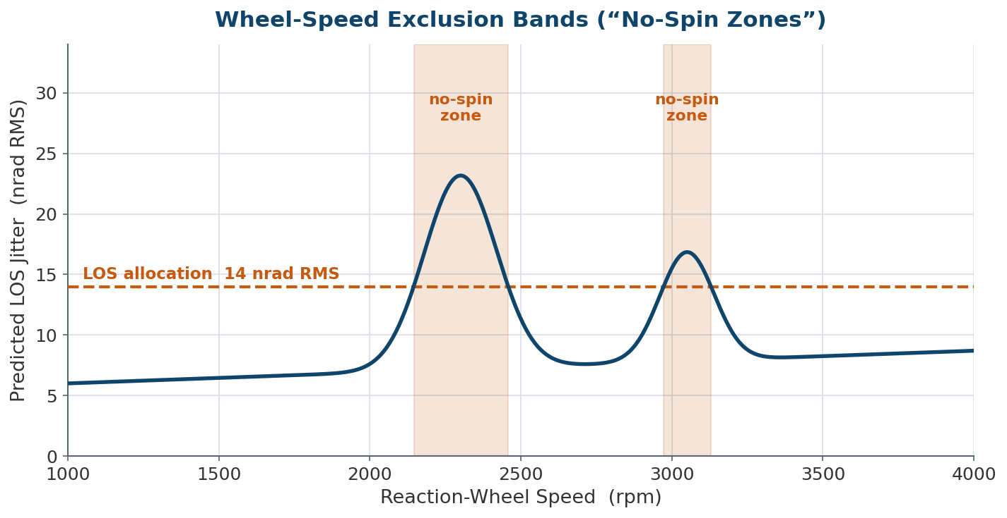
Wheel-Speed Scheduling: No-Spin Zones
Vibrationdata
Turning a resonance-crossing analysis into an operational speed-exclusion table
How It Works
Sweep predicted LOS jitter across the full wheel-speed range from the harmonic-sweep analysis
Wherever a harmonic crossing pushes jitter above the LOS allocation, that speed band is prohibited
Flight software commands wheels to skip the excluded bands — dwelling only at quiet speeds
Trade: fewer available speeds can reduce momentum-management flexibility, so zones are kept as narrow as the analysis allows
Takeaway: A no-spin zone converts a structural resonance problem into a simple operational constraint — the wheel is commanded never to dwell where the crossing lives.
Spacecraft On-Orbit Vibration | blog.vibrationdata.com
41

Slide 42


Analysis Validity Checks
Vibrationdata
Confidence-building steps before trusting a jitter prediction
Model Correlation
Mesh & Reduction Convergence
Compare predicted modal frequencies and shapes against modal survey test data before using the model for jitter prediction
Confirm that Craig-Bampton or Guyan reduction order does not distort the frequency range of interest
Disturbance Model Pedigree
Sensitivity Study
Trace every force input back to a component-level test or a documented, justified analytical source
Vary uncertain parameters (damping, mass properties, mounting stiffness) to bound the predicted response
Spacecraft On-Orbit Vibration | blog.vibrationdata.com
42

Slide 43


Relative Displacement Under Random Vibration
Vibrationdata
Why relative motion — not absolute response — governs clearances, connectors, and optical alignment
$$S_{rel}\left(f\right)=S_{AA}\left(f\right)+S_{BB}\left(f\right)−2⋅Re\left[S_{AB}\left(f\right)\right]$$
The real part of the cross-spectrum (the co-spectrum) is the term that everything turns on — drop it and you are no longer solving the right problem.
It is a correlation problem
Where the cross-spectrum comes from
Two points can each have large absolute displacement yet near-zero relative motion if they move in-phase — and modest absolute response can produce large relative motion if they move out-of-phase.
Setting $Re\left[S_{AB}\right]=0$ (the common 'add the PSDs' shortcut) assumes the responses are uncorrelated. For most structures that is wrong and over-predicts relative motion, forcing needless design iterations.
If the two points move identically $\left(S_{AA}=S_{BB}=S_{AB}\right)$
, the equation collapses to exactly zero — a rigid-body translation produces no relative displacement.
In modal superposition, relative motion sums ${\left(φ_{Ar}−φ_{Br}\right)}^{2}S_{qr}\left(f\right)$ over modes — a mode contributes only where the two points participate differently.
Modal cancellation: if both points move identically in a global mode, that mode adds ZERO to relative displacement no matter how large its absolute response.
Consequence — local-mode dominance: relative response is almost always driven by higher-frequency local modes (board flexing, panel bending), not the low-frequency global modes that dominate acceleration.
Takeaway: Relative displacement is set by how differently two points participate in the modes — so the cross-spectrum, not the larger absolute PSD, decides whether a clearance or connector survives.
Spacecraft On-Orbit Vibration | blog.vibrationdata.com
43

Slide 44



Bounding Relative Motion & Peak Statistics
Vibrationdata
When cross-spectral data is missing, and why the 3σ rule under-predicts the true peak
Coherence by topology
Monte-Carlo phase bound
Beyond 3σ — Rice peaks
Closely spaced points on a stiff part: coherence γ²→1, $S_{AB}$→ $S_{AA}$, destructive cancellation keeps relative motion small.
Disparate substructures (array wing vs. bus; two PCBs on a loose harness): modal participation differs, γ²→0, the cancellation term vanishes and relative motion grows fast.
So the right question is not 'how big is each response' but 'how coupled are these two load paths'.
Given only $S_{AA}$ and $S_{BB}$ (vendor/test data, no FEM):
randomize phase θ ∈[ 0, 2π] and coherence γ ∈ [0, 1] over many trials, integrate ${\text{σ}}_{rel }$, build the CDF.
Worst-case physical envelope fixes γ=1, θ=180°: ${ S}_{rel,max}={\left(\sqrt{S_{AA}}+\sqrt{S_{BB}}\right)}^{2}$
Use it as a screen: survive the unconstrained bound → robust. Fail → go find the true cross-spectral FEA data; unconstrained phase is usually overly conservative.
A 3σ peak is 99.73% per crest — over millions of cycles in a long test, exceeding 3σ is effectively guaranteed.
Use Rice peak statistics:
$${\overline{u}}_{max}=\left[\sqrt{2{\ln{N}}_{0}T}+\frac{0.5772}{\sqrt{2{\ln{N}}_{0}T}}\right]σ_{rel}$$
with N₀ from spectral moments.
Wideband / many-mode response: prefer Dirlik or Wirsching-Light over a blind narrow-band 3σ multiplier.
Takeaway: With no cross-spectrum, bound the answer with the 180°-out-of-phase envelope or a Monte-Carlo screen; once you have $S_{rel}(f)$, size clearances to a Rice peak, not a blanket 3σ.
Spacecraft On-Orbit Vibration | blog.vibrationdata.com
44

Slide 45
Relative Displacement: FEA Practice
Vibrationdata
Solver workarounds, the rotation term analysts forget, and what to monitor
Getting S_rel out of the major solvers
Track relative motion for these
Nastran: Cleanest path — define a relative DOF via MPC or CELAS2 (u_diff = u_A − u_B) and request RANDOM output; the solver handles all cross terms. Else PUNCH S_AA, S_BB, S_AB and post-process the identity.
ANSYS: Use Response PSD Combinations, or RPSD with nodal covariance enabled to pull joint statistics of two nodes directly — no massive time-history dump.
Abaqus: *RANDOM RESPONSE on a modal basis; script the ODB API to recover modal-coordinate spectral densities S_qr, qs and sum with node shape coefficients.
Connector headers
monitor: Axial & shear motion, plug vs. receptacle
Circuit cards (CCAs)
monitor: PCB center vs. stiff chassis frame
Wire / coax harness
monitor: Tie-down mount vs. terminal lug
Optical benches
monitor: Differential rotation between mirror mounts
Don't forget rotation
A small angular response over a long moment arm L can dwarf local translation: u_rel ≈ L·θ. Always evaluate the full 6-DOF relative vector u_rel = u_A − u_B − (θ × L).
Sway clearances
monitor: Rice-max peak vs. physical gap width
Takeaway: Relative-displacement tracking is mandatory, not optional, for connectors, boards, harnesses, optics, and sway gaps — let the modal cross-spectrum do the work so the design is both light and survivable.
Spacecraft On-Orbit Vibration | blog.vibrationdata.com
45

Slide 46

PART 4
Testing & Mitigation
Ground verification challenges and flight-proven suppression techniques
46

Slide 47
Ground Microvibration Test Methods
Vibrationdata
Characterizing disturbance sources and verifying jitter performance before launch
Component-Level Tests
System-Level Tests
Reaction wheel spin-table testing on a dynamometer or force table across the full operational speed range
Cryocooler vibration characterization on a quiet isolated bench, often inside a thermal/vacuum chamber
Stepper-motor and mechanism transient force measurement using a multi-axis force/torque sensor at the mount interface
Integrated spacecraft jitter test with flight-representative disturbance sources operating and a calibrated optical or laser pointing reference
Modal survey test to correlate the structural FE model used for transfer-path predictions
End-to-end LOS stability test with the actual sensor/instrument recording its own pointing performance
Spacecraft On-Orbit Vibration | blog.vibrationdata.com
47

Slide 48
Verification Challenges: 1g vs. 0g
Vibrationdata
Ground test conditions never perfectly replicate the on-orbit environment
Gravity preloads bearings, isolators, and deployable structures differently than the unloaded, free-floating orbital condition
Suspension or air-bearing fixtures used to approximate free-free boundary conditions introduce their own low-frequency dynamics that must be isolated from the data
Ambient ground vibration and acoustic noise floors can mask the very low-amplitude (micro-g) signals of interest, requiring a quiet test facility or careful noise-floor characterization
Thermal/vacuum testing is often necessary because cryocooler and mechanism disturbance signatures change with operating temperature
Test-to-flight correlation typically relies on the structural model: ground test data validates the model, and the validated model is then used to predict the 0g flight condition
Takeaway: Because jitter cannot be fully verified by ground test alone, the analytical model — correlated to test — carries the final burden of flight prediction.
Spacecraft On-Orbit Vibration | blog.vibrationdata.com
48

Slide 49
Flight-Proven Mitigation Techniques
Vibrationdata
Passive and active methods used to suppress jitter once a source is identified
Passive Isolation
Active Counterbalancing
Elastomeric or wire-rope mounts at the source or payload interface attenuate above the isolator corner frequency with no power or control needed
Electromechanical or piezo-driven counter-mass cancels cryocooler compressor force at its source, used widely on JWST-class cryocoolers
Magnetorquer Desaturation
Image Post-Processing
Replaces or supplements thruster desaturation burns, removing a transient disturbance event from the timeline entirely
Residual jitter recorded by onboard gyros or star trackers is used to deconvolve or co-register smeared imagery on the ground
Spacecraft On-Orbit Vibration | blog.vibrationdata.com
49

Slide 50
Measuring Micro-g: Test Instrumentation
Vibrationdata
The sensing and facility problem behind every ground microvibration test
Sensors & References
The Facility Noise Floor
Low-noise seismic accelerometers (force-balance / capacitive) reach the sub-micro-g noise floor that piezo units cannot
Multi-axis force / reaction tables capture the full six-component disturbance at a source mount
Laser interferometers and autocollimators provide a direct optical line-of-sight reference, independent of the structure
Star-tracker or rate-gyro data gives the on-board pointing reference reused later for image post-processing
Building HVAC, foot traffic, and ground motion can exceed the micro-g signal of interest by orders of magnitude
Tests run on a seismically isolated slab or pneumatic optical table, often at night, to lower the ambient floor
The measurement noise floor must be characterized and shown to sit below the disturbance being verified
Thermal-vacuum chambers add their own pumps and cold-head vibration — a disturbance source inside the test itself
Takeaway: You cannot verify a disturbance you cannot measure — micro-g testing is as much a quiet-facility and noise-floor problem as a sensor problem.
Spacecraft On-Orbit Vibration | blog.vibrationdata.com
50

Slide 51
References and Further Reading
Vibrationdata
Key documents, handbooks, and peer-reviewed references for spacecraft jitter engineering
NASA Documents
Dennehy, C. & Alvarez-Salazar, O.S. (2018). “Spacecraft Micro-Vibration: A Survey of Problems, Experiences, Potential Solutions, and Some Lessons Learned.” NASA/TM-2018-220075, Langley Research Center. ntrs.nasa.gov/citations/20180006315
Dennehy, C., Wolf, A.A., & Swanson, D.K. (2021). “Spacecraft Line-of-Sight Jitter Management and Mitigation.” NASA/TM-20210017871. ntrs.nasa.gov/citations/20210017871
NASA NESC Technical Assessment (2025). “Spacecraft Jitter Analysis Engineering.” NASA/TM-20250000899. ntrs.nasa.gov/citations/20250000899
Belvin, W.K. (1995). “Spacecraft Jitter Attenuation Using Embedded Piezoelectric Actuators.” NASA-TM-111574, Langley RC. ntrs.nasa.gov/citations/19960024186
ESA Standards & European Research
ECSS-E-HB-32-26A (2013). “Spacecraft Mechanical Loads Analysis Handbook.” ESA Requirements and Standards Division. Covers microvibration sources, definitions, and analysis approaches.
Calvi, A. et al. (2013). “Microvibration Environment and Testing: Lessons Learned.” European Conference on Spacecraft Structures, Materials & Environmental Testing.
Spacecraft On-Orbit Vibration | blog.vibrationdata.com
51

Slide 52
References and Further Reading (cont)
Vibrationdata
Isolators & Hardware
Davis, L.P. et al. (1994). “D-Strut™: A Three-Parameter Passive Viscous Damper for Spacecraft.” SPIE Smart Structures & Materials, Vol. 2445, pp. 161–175. (Honeywell/HST RWA isolation heritage.)
Davis, L.P. (1986). U.S. Patent 4,760,996, “Damper and Isolator.” Honeywell. (Original D-Strut two-parameter viscous isolator.)
Ross, R.G., Jr. (2003). “Cryocooler Vibration and Microphonics: A Tutorial.” JPL. trs.jpl.nasa.gov (JPL Technical Reports Server).
Textbooks & Irvine References
Irvine, T. (2014). “Spacecraft On-orbit Vibration.” Vibrationdata Blog. blog.vibrationdata.com/2014/06/12/spacecraft-on-orbit-vibration/
Irvine, T. VibrationData MATLAB GUI Package and Technical eBooks. blog.vibrationdata.com/2025/11/27/toms-ebooks/ (SRS, FDS, fatigue, structural dynamics.)
Irvine, T. (2026). “Relative Displacement Between Two Points Under Random Vibration in FEA.” Vibrationdata Blog, June 7, 2026. blog.vibrationdata.com/2026/06/07/relative-displacement-between-two-points-under-random-vibration-in-fea/
Craig, R.R. & Bampton, M.C.C. (1968). “Coupling of Substructures for Dynamic Analysis.” AIAA Journal, 6(7), 1313–1319. (Foundational Craig-Bampton substructuring reference.)
Meirovitch, L. (1997). Principles and Techniques of Vibrations. Prentice Hall. (Standard structural dynamics textbook.)
Spacecraft On-Orbit Vibration | blog.vibrationdata.com
52

Slide 53

PART 5
Worked Examples
Putting numbers on the governing relations — from imbalance force to MTF loss
53

Slide 54
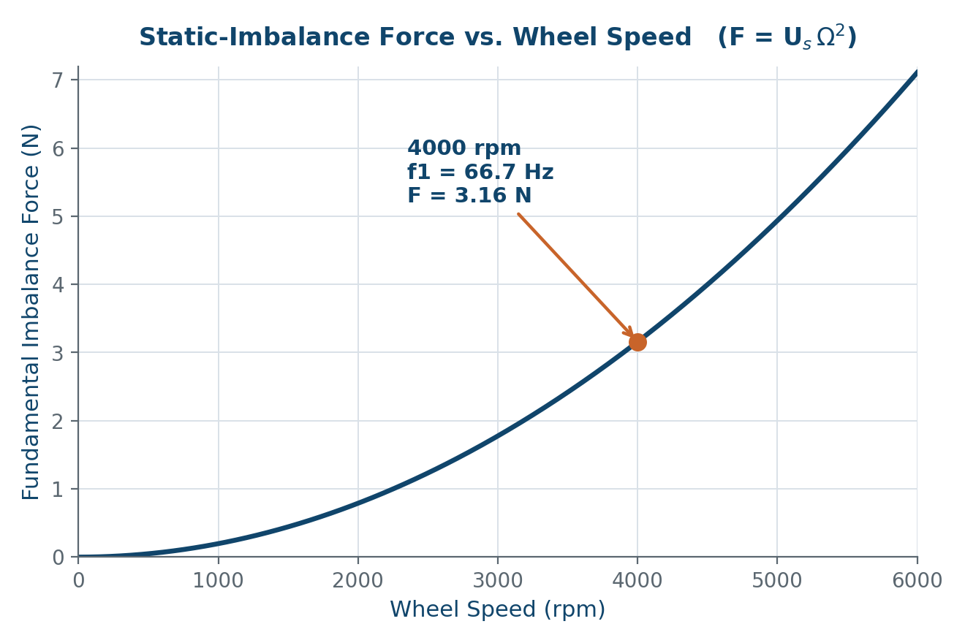
Worked Example: Reaction Wheel Imbalance
Vibrationdata
Putting numbers on the F = Cᵢ·Ω² relation — imbalance force scales with the square of wheel speed
Given
Static imbalance Uₛ = 1.8 g·cm = 1.8×10⁻⁵ kg·m
Dynamic imbalance U_{d} = 80 g·cm² = 8.0×10⁻⁶ kg·m²
Wheel speed = 4000 rpm
Ω = 4000·2π/60
= 418.9 rad/s
f₁ = Ω/2π = 66.7 Hz
F = Uₛ·Ω² = 3.16 N
M = U_d·Ω² = 1.40 N·m
Takeaway: Imbalance force grows with Ω² — doubling wheel speed quadruples the disturbance force.
Spacecraft On-Orbit Vibration | blog.vibrationdata.com
54

Slide 55
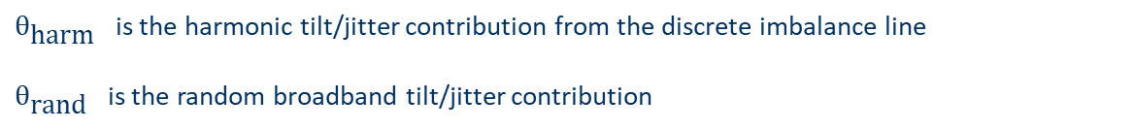
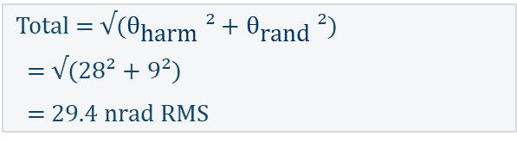
Worked Example: Force → Jitter Through an FRF
Vibrationdata
Carrying the 3.16 N imbalance line through a structural FRF and combining contributors by RSS
Step-by-Step
RSS Combination
Take F = 3.16 N at f₁ = 66.7 Hz from the imbalance example
Mount-to-bench FRF off-resonance: |H| = 1.5 nrad/N
Off-resonance tilt: θ₁ = 3.16 N × 1.5 nrad/N = 4.7 nrad
Near a 70 Hz mode (Q ≈ 6) the FRF rises 6×:
Resonant-crossing tilt: θ₁ = 28 nrad
Broadband random contribution (Miles example): 9 nrad RMS
Total = √($θ_{\text{harm}}$ ² + $θ_{\text{rand}}$ ²)
= √(28² + 9²)
= 29.4 nrad RMS
Compared to Allocation
JWST-class LOS budget: ~7–14 nrad RMS
Predicted 29.4 nrad RMS at the resonance crossing exceeds the allocation by ~2–4×
Result: define a no-spin-zone exclusion band around the 70 Hz crossing
$θ_{\text{harm}}$ is the harmonic tilt/jitter contribution from the discrete imbalance line
$θ_{\text{rand}}$ is the random broadband tilt/jitter contribution
Spacecraft On-Orbit Vibration | blog.vibrationdata.com
55

Slide 56

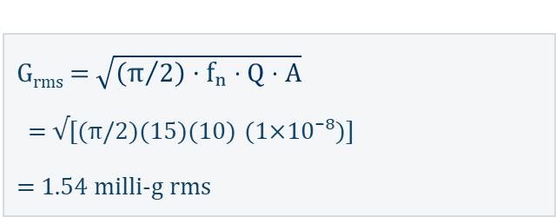
Worked Example: Random Response (Miles)
Vibrationdata
Broadband RMS from a flat input PSD through an isolated
Single-degree-of-freedom (SDOF) System
Given
Flat input A = 1×10⁻⁸ g²/Hz
Isolator fₙ = 15 Hz, ζ = 0.05 (Q = 10)
G_{rms} = $\sqrt{\left({\text{π}}/2\right)⋅\text{f}\text{ₙ}⋅Q⋅A}$
= √[(π/2)(15)(10) (1×10⁻⁸)]
= 1.54 milli-g rms
Corresponding RMS displacement
$Z_{rms}=248.9⋅\left({\text{1}}/{f_{n}^{ 1.5}}\right)⋅\sqrt{\left({\text{π}}/2\right)⋅Q⋅A} mm$
≈ 1.70×10⁻³ mm ≈ 1.70 µm
Links directly to the sway-space trade of the isolation slides
Spacecraft On-Orbit Vibration | blog.vibrationdata.com
56

Slide 57
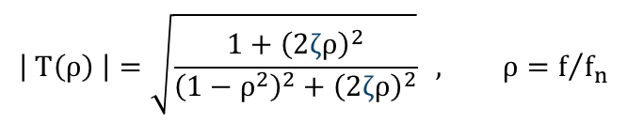
Worked Example: Isolator Transmissibility
Vibrationdata
Hard numbers on the damping trade — evaluating T at the 66.7 Hz wheel line for an fₙ = 15 Hz isolator
$$\left| T\left(ρ\right) \right|=\sqrt{\frac{1+{\left(2\text{ζ}ρ\right)}^{2}}{{\left(1−ρ^{2}\right)}^{2}+{\left(2\text{ζ}ρ\right)}^{2}}} , ρ=f/{f_{n}}$$
High-Frequency Attenuation
ζ = 0.05: T = 0.054 → −25 dB
ζ = 0.20: T = 0.094 → −20.5 dB
Resonant Peak (r = 1)
ζ = 0.05: T ≈ 1/(2ζ) = 10
ζ = 0.20: T ≈ 2.5
Takeaway: Heavier damping cuts the peak ~4× but costs ~5 dB of high-frequency attenuation.
Spacecraft On-Orbit Vibration | blog.vibrationdata.com
57

Slide 58
Worked Example:
Modular Transfer Function Reduction From Jitter
Vibrationdata
The Gaussian-jitter MTF factor MTFⱼ = exp[−2π²σ²f²], evaluated at the Nyquist frequency
At Nyquist (f = 0.5 cyc/px)
MTFⱼ = exp[−2π²σ²f²]
σ = 0.1 px → MTFⱼ = 0.951 (5% loss)
σ = 0.2 px → MTFⱼ = 0.821 (18% loss)
σ = 0.3 px → MTFⱼ = 0.641 (36% loss)
σ is the standard deviation of the line-of-sight jitter displacement, typically expressed in pixels (or in the same spatial units as the spatial frequency f).
Takeaway: Sub-pixel jitter is not negligible — 0.2 px already removes ~18% of contrast at Nyquist, which is why fine-pointing budgets are stated in milli-pixels or nanoradians.
Spacecraft On-Orbit Vibration | blog.vibrationdata.com
58

Slide 59
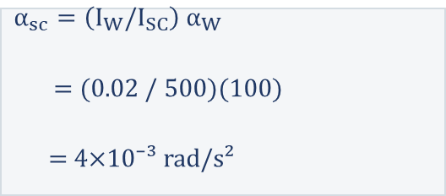
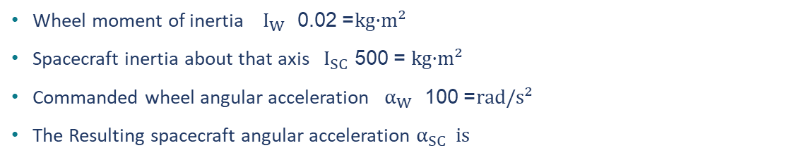
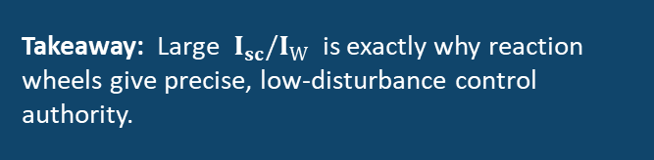
Worked Example: Acceleration Ratio
Vibrationdata
Conservation of angular momentum — the acceleration ratio equals the inverse ratio of moments of inertia
Setup
Wheel moment of inertia $I_{W}$ = 0.02 kg·m²
Spacecraft inertia about that axis ${ I}_{SC}$ = 500 kg·m²
Commanded wheel angular acceleration $α_{W}$ = 100 rad/s²
The Resulting spacecraft angular acceleration $α_{SC} is$
Inertia ratio
25,000 : 1
The spacecraft’s angular acceleration is 25,000× smaller than the wheel’s — the same inverse-inertia leverage that makes a small flywheel an effective fine-pointing actuator.
$$α_{sc}=\left(I_{W}/I_{SC}\right){ α}_{W}$$
= (0.02 / 500)(100)
= 4×10⁻³ rad/s²
Takeaway: Large $I_{sc}/I_{W}$ is exactly why reaction wheels give precise, low-disturbance control authority.
Spacecraft On-Orbit Vibration | blog.vibrationdata.com
59

Slide 60
PART 6
Case Histories
Four flight programs where microvibration drove the design — and one where it ended the mission
60

Slide 61
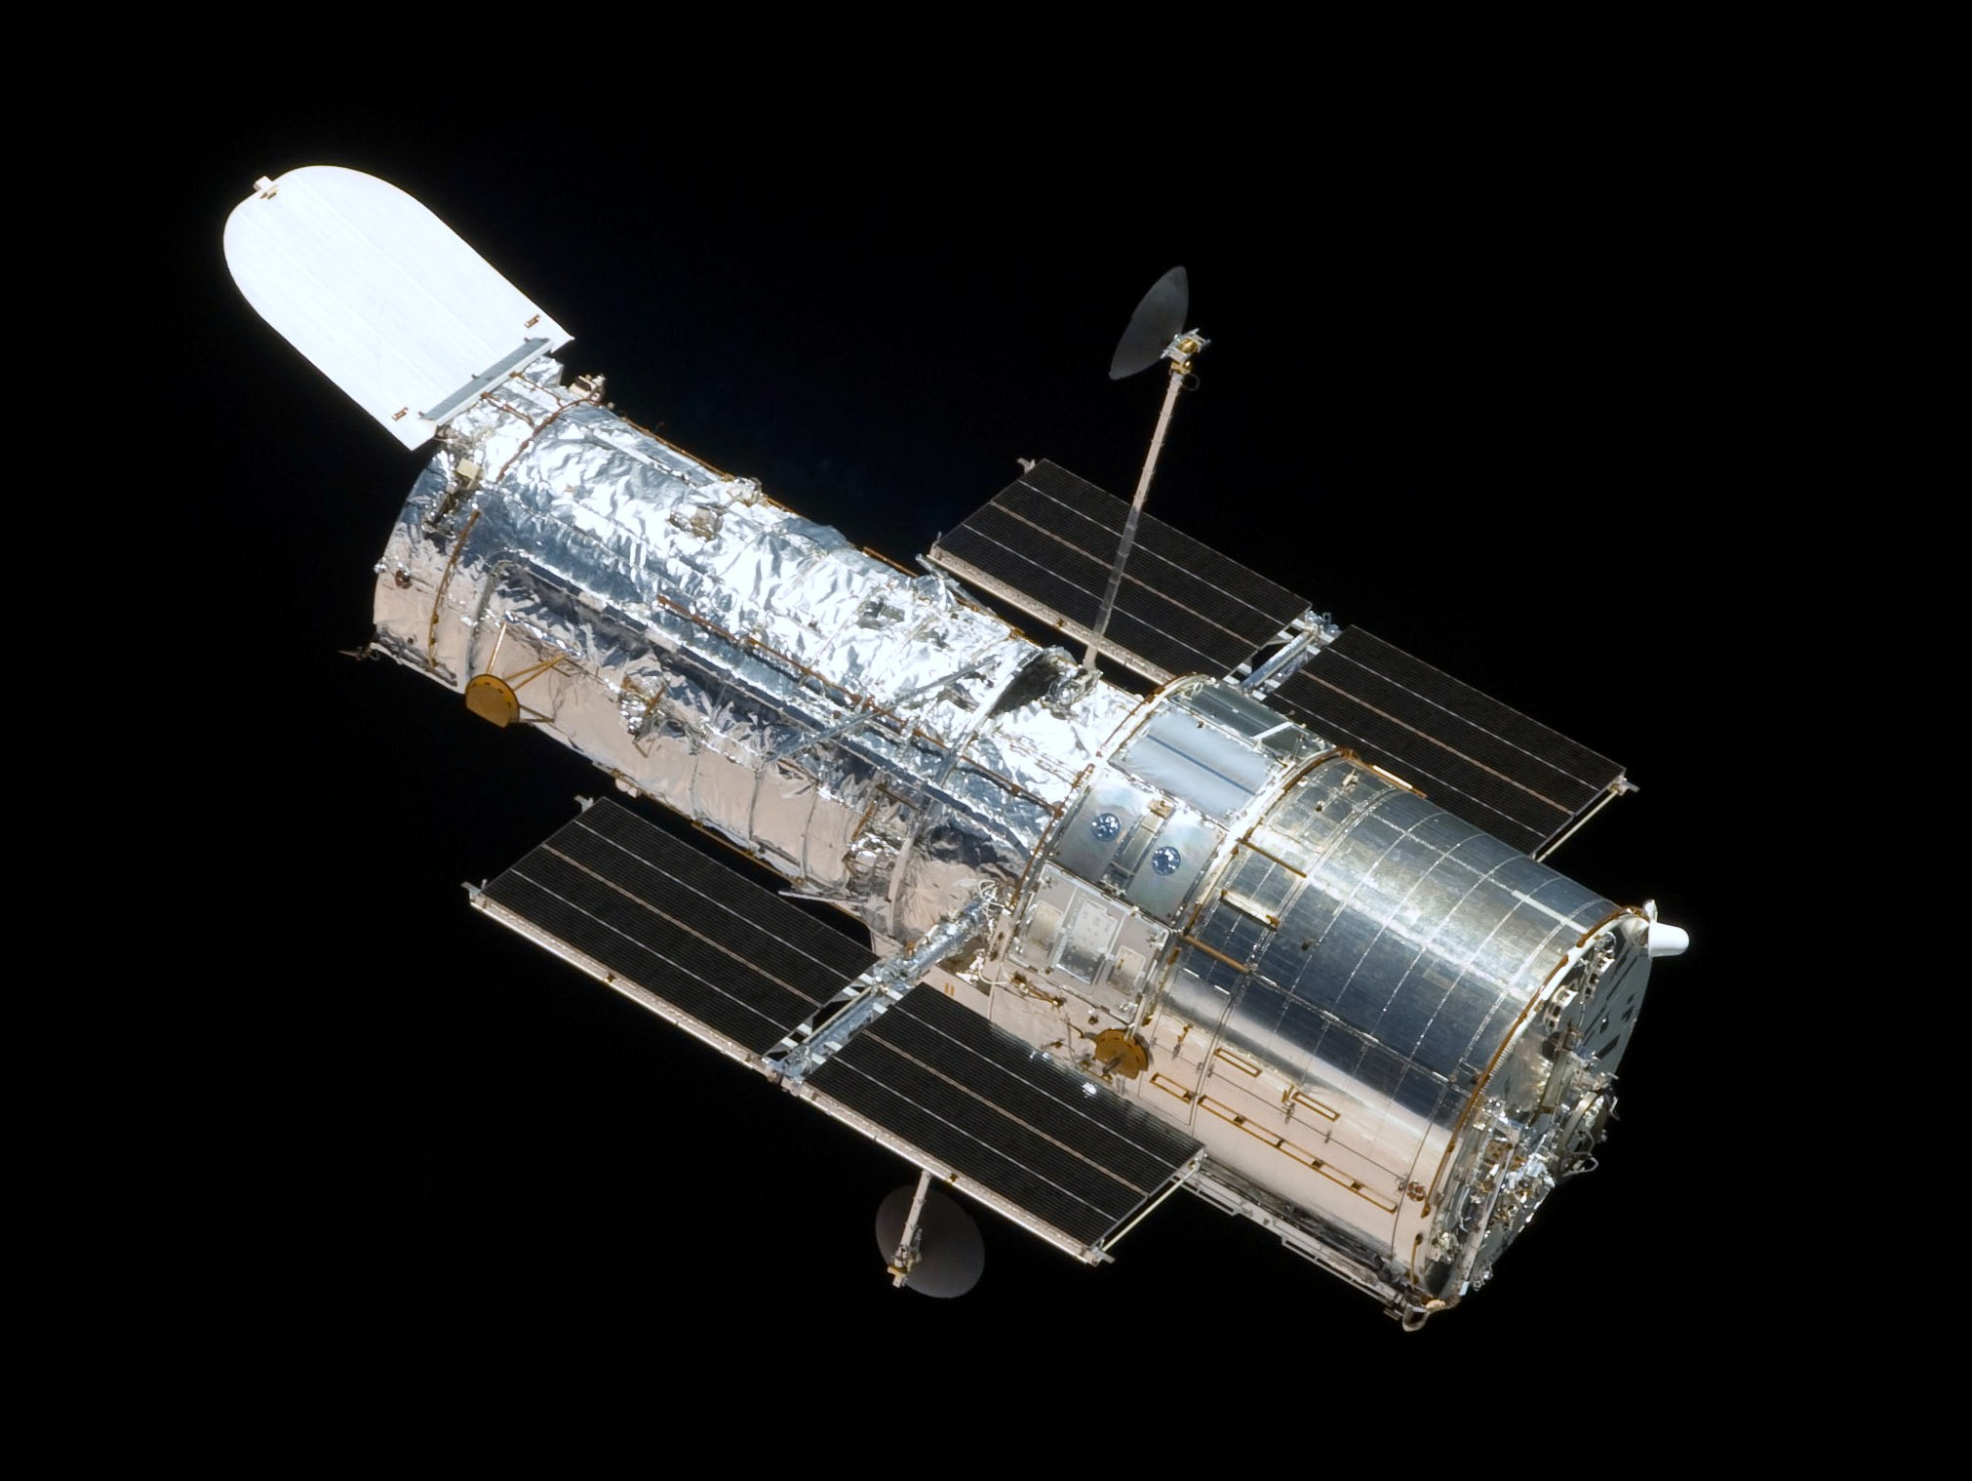
Hubble Space Telescope

Slide 62
Case History: Hubble Solar-Array Thermal Snap
Vibrationdata
The archetype — a thermal disturbance, not a wheel, broke the pointing budget
Hubble Space Telescope
Disturbance
Bi-stem solar-array booms heating unevenly at each day/night terminator crossing — ~30 thermal cycles per day, −150 °C to +200 °C swings.
ROLE
0.007 arcsec pointing-class optical observatory (LEO, 97-min orbit)
Mechanism
Stored thermal/mechanical energy released as an abrupt “snap” that excited the array's primary modes; the body reacted against the flexible arrays — internal vibration was negligible.
ONSET
Jitter seen immediately after April 1990 deployment
FIX FLOWN
Disturbance far exceeded the jitter spec; Fine Guidance Sensors (FGSs) lost interferometric lock, forcing coarse-track mode that prematurely wore the star-selector bearings. Science lost ~1/3 of each orbit.
PCS software (1990) + new ESA arrays, SM1 Dec 1993
Consequence
Takeaway: The dominant disturbance source is not always a reaction wheel — a flexible appendage plus a thermal transient can dominate the entire line-of-sight budget.
Spacecraft On-Orbit Vibration | blog.vibrationdata.com
62

Slide 63
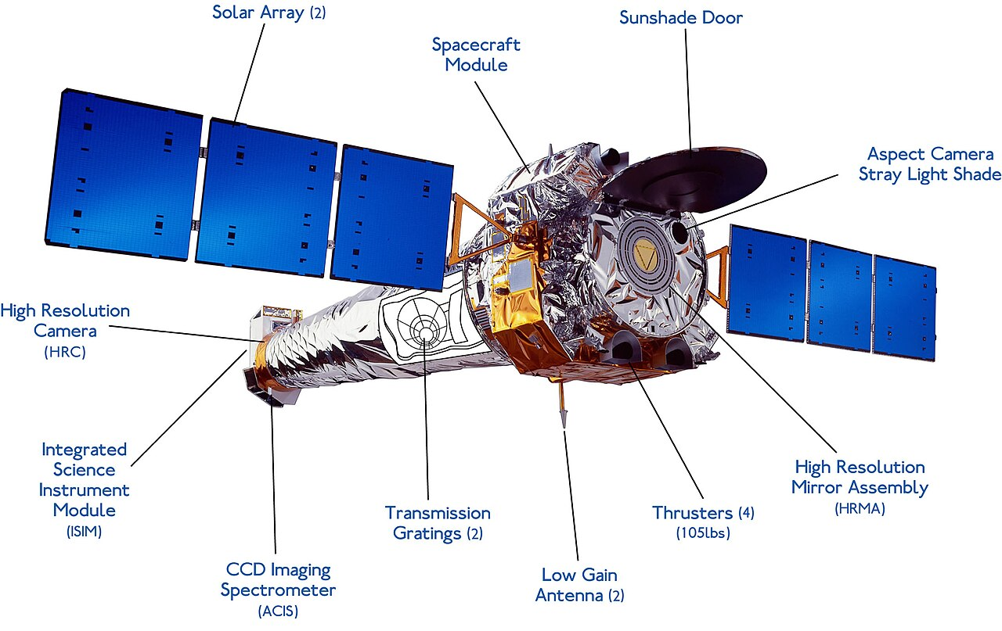
Chandra X-ray Observatory

Slide 64
Case History: Chandra Reaction-Wheel Isolation
Vibrationdata
Designing the disturbance out — passive hexapod isolators at the source
Chandra X-ray Observatory (AXAF)
Disturbance
Reaction-wheel imbalance and bearing tones transmitted from the wheel assemblies into the spacecraft central structure across a broad speed range.
ROLE
Third Great Observatory; grazing-incidence X-ray optics, launched 1999
Solution
A hexapod (6-strut) passive isolator beneath each of the six wheels — unit-level transmissibility requirements were derived top-down from the image-quality flowdown.
SOURCE
Six reaction wheels feeding a jitter-sensitive optical bench
STRATEGY
Wheel jitter at the optics was suppressed enough to meet imaging performance without an active control loop. The same hexapod approach was later carried into JWST's wheel isolator.
Passive vibration isolation at each wheel interface
Outcome
Takeaway: When the source is a known wheel set, a passive isolator sized from a requirement flowdown is often sufficient — and far simpler than active control.
Spacecraft On-Orbit Vibration | blog.vibrationdata.com
64

Slide 65
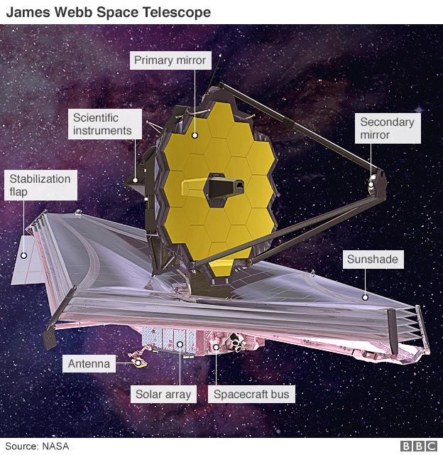
James Webb Space Telescope

Slide 66
Case History: JWST Two-Stage Isolation
Vibrationdata
Layered isolation — wheels and a cryocooler, verified against a hard mas budget
James Webb Space Telescope
Disturbance
Broadband wheel imbalance plus narrowband cryocooler compressor tones — both above the attitude-control bandwidth, so they must be handled mechanically.
ROLE
6.6 m IR observatory at Sun–Earth L2; launched Dec 2021
Solution
Two passive isolation layers: a wheel isolator (≈7 Hz rocking / 12 Hz translation corners) supporting all six wheels, and a 1 Hz isolator at the deployment-tower / bus interface.
SOURCES
Reaction wheels + MIRI cryocooler compressor (≈7 K, JT/pulse-tube)
REQUIREMENT
Commissioning measured ~1.04 mas RMS radial jitter — near the measurement noise floor, well inside the 7 mas spec, with no cryocooler retuning needed.
7 mas RMS radial line-of-sight jitter
Outcome
Takeaway: Stacking isolation stages (wheel-level + spacecraft-level) and reserving wheel-speed/compressor exclusion zones delivered ~7× margin against the flight budget.
Spacecraft On-Orbit Vibration | blog.vibrationdata.com
66

Slide 67
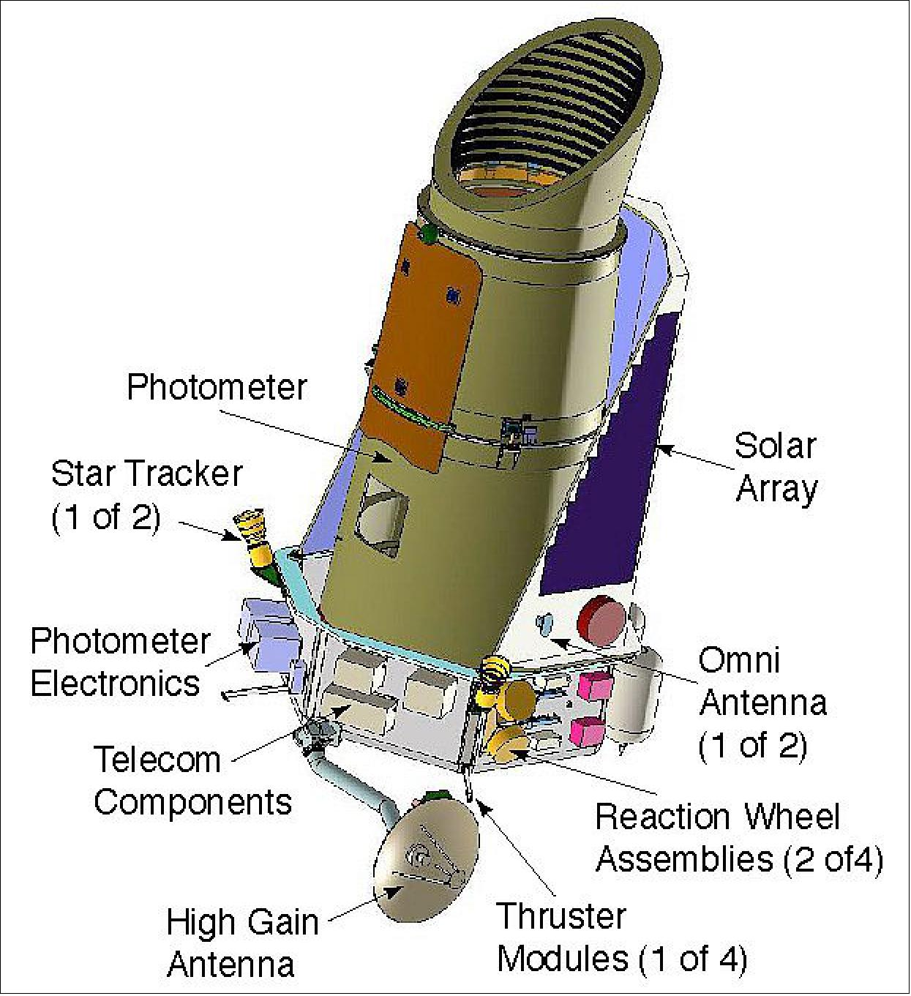
Kepler Space Telescope

Slide 68
Case History: Kepler Reaction-Wheel Loss
Vibrationdata
The other failure mode — when the pointing actuator itself degrades
Kepler Space Telescope
Disturbance
Reaction-wheel bearing friction rose past acceptable levels. Constant friction can be trimmed by the ACS; variable friction cannot — it renders a wheel unusable.
ROLE
0.95 m photometer; ~20 ppm precision on mag-12 stars (6.5 h)
Mechanism
Three good wheels are the minimum for fine three-axis pointing. With only two, solar radiation pressure could no longer be balanced about the boresight without thruster firing.
EVENTS
Wheel #2 failed Jul 2012; wheel #4 failed May 2013
RESULT
Pointing precision degraded by roughly a factor of 3–4, ending precise transit photometry. K2 recovered partial capability by balancing the craft against solar pressure.
Primary mission ended; reborn as the two-wheel K2 mission
Consequence
Takeaway: The disturbance source and the pointing actuator can be the same hardware. Bearing health and wheel redundancy are pointing-budget items, not just reliability items.
Spacecraft On-Orbit Vibration | blog.vibrationdata.com
68

Slide 69
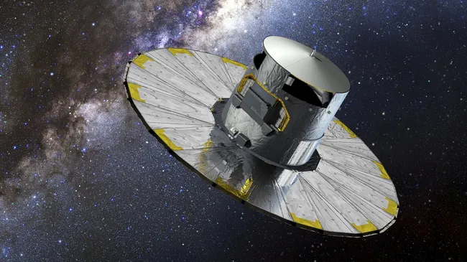
Gaia
ESA astrometry survey at L2 — where the finest pointing sensor on board is the payload itself
69

Slide 70
Case History: Gaia Micro-Clanks
Vibrationdata
When the disturbance can't be designed out — detect it and calibrate it in the data instead
Gaia
Disturbance
Sudden µas-level steps in the attitude angle (“micro-clanks”) every few minutes, plus a basic-angle oscillation in phase with the 6-hour spin — initially mistaken for micrometeoroid hits.
ROLE
µas-class astrometry survey at Sun–Earth L2; launched Dec 2013
Mechanism
Micro-clanks are tiny internal structural adjustments with no net change in angular momentum; the basic-angle drift is thermo-elastic coupling between the sunlit service module and the shaded payload.
DISTURBANCE
Stochastic structural micro-jumps + thermo-elastic basic-angle drift
RESPONSE
Too small and too frequent to isolate or stiffen away — but because Gaia's own payload senses attitude so finely, each event is detected and fit out, so the science is preserved rather than lost.
Detected per-event and removed in astrometric processing
Consequence
Takeaway: Some disturbances are below what any isolator can address — when the payload is also the finest available sensor, the fix is to measure the disturbance and calibrate it out, not to suppress it.
Spacecraft On-Orbit Vibration | blog.vibrationdata.com
70

Slide 71
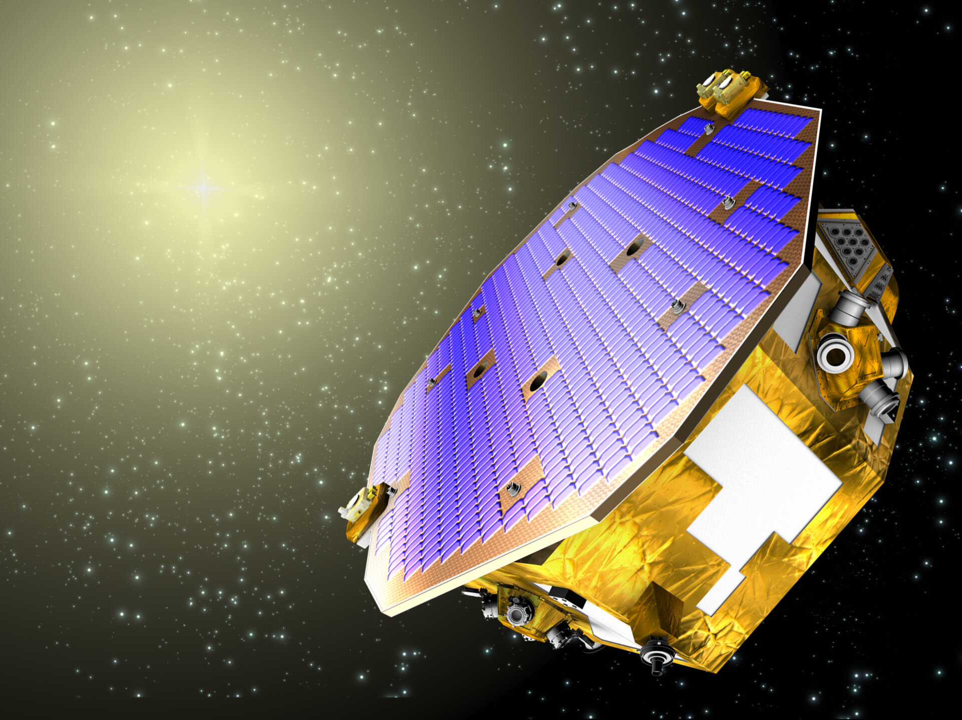
LISA Pathfinder
ESA/NASA gravitational-wave technology demonstrator
— the quietest place ever flown
71

Slide 72
Case History: LISA Pathfinder Drag-Free Control
Vibrationdata
The opposite extreme — actively shielding the payload to the quietest state ever achieved
LISA Pathfinder
Disturbance
Every external force — solar pressure, outgassing, thermal effects — appears as a parasitic acceleration on a test mass that must remain in near-perfect free fall in the milli-hertz band.
ROLE
Gravitational-wave technology demonstrator at L1; launched Dec 2015
Solution
The spacecraft is the shield: a drag-free loop reads the test-mass position by picometer interferometry and commands µN thrusters so the bus continuously shadows the mass.
ARCHITECTURE
Drag-free: spacecraft flies around a free-floating test mass
ACTUATOR
Differential acceleration reached sub-femto-g — the quietest controlled environment ever flown — and the thrusters' own noise was characterized in flight against the test-mass reference.
Micro-Newton cold-gas / colloid thrusters, ~0.1 µN/√Hz noise
Outcome
Takeaway: The lowest disturbance comes from making the spacecraft chase the payload, not the reverse — and the actuator that enables it must itself be characterized as a disturbance source in flight.
Spacecraft On-Orbit Vibration | blog.vibrationdata.com
72

Slide 73
Case-History Synthesis: Six Lessons
Vibrationdata
What each flight program teaches about where microvibration really comes from — and what to do about it
⚡
Hubble
Thermal Snap
⛨
Chandra
Passive Isolation
↔
JWST
Stacked Isolation
Dominant source was a flexible appendage + thermal transient, not a wheel.
→ Budget appendage dynamics and terminator-crossing transients.
Hexapod isolators sized from an image-quality flowdown met spec with no active loop.
→ A passive isolator from a requirement flowdown is often enough.
Wheel-level + spacecraft-level stages plus exclusion zones gave ~7× margin.
→ Layering isolation stages and reserving zones compounds margin.
⚠
Kepler
Actuator Loss
◉
Gaia
Calibrate, Don't Suppress
▣
LISA Pathfinder
Drag-Free Shielding
Variable wheel-bearing friction ended precise pointing — source and actuator were one part.
→ Bearing health and wheel redundancy are pointing-budget items.
Stochastic micro-clanks + thermo-elastic drift were too small to isolate away.
→ When the payload is the finest sensor, detect and calibrate the disturbance out.
Active µN-thruster drag-free control reached sub-femto-g — the quietest ever flown.
→ Make the spacecraft chase the payload; characterize the actuator's own noise.
Takeaway: The source isn't always a wheel, the actuator can be the source, and the answer spans the whole spectrum — suppress, isolate, stack, calibrate, or shield, matched to the disturbance.
Spacecraft On-Orbit Vibration | blog.vibrationdata.com
73

Slide 74
PART 7
Field Questions
Five recurring questions from systems and structures teams — and where current practice can do better
73

Slide 75
The Five Questions
Vibrationdata
Recurring jitter-engineering pain points raised by the systems and structures teams
1
Low-Amplitude Transmission
2
Isolation Design
Modeling jitter transmission to timing/optics when source characterization is weak and damping assumptions (e.g. blanket 0.5%) are arbitrary
Narrow- and wideband isolation for reaction wheels and other sources — "easy to isolate" depends entirely on target frequency and amplitude
3
Deployable Modes & Damping
4
Leveraging High Damping
Characterizing modes and damping of large-format deployables for GNC, pre-flight, without on-orbit data of a similar system
Whether to design to the >2.5% damping repeatedly measured in test — mass savings vs. the risk it is not in-family
5
Subscale Test Validity
Common thread
Each is a case where conservatism is cheap to add but expensive to carry — and where a small amount of the right test data would replace a large, mass-driving margin.
Iterating large flexible spacecraft (Starlink-class) on subscale models — where the approach holds and where it breaks down
Spacecraft On-Orbit Vibration | blog.vibrationdata.com
75

Slide 76
Q1 — Transmission at Low Amplitude
Vibrationdata
Why source-to-victim attenuation is the least trustworthy number in the budget — and what to do instead
Why the blanket 0.5% is unsafe in both directions
A defensible workflow instead of one number
A single transmission loss applied source-to-victim hides where the energy actually goes: at micro-g levels the dominant loss mechanisms are joints, bolted interfaces, brackets, and harness — not material damping (NASA/TM-2018-220075).
Those interface losses are amplitude-dependent. At 2–5× lower input the contact patches micro-slip less, so effective damping can fall and local stiffness can rise — a fixed 0.5% may be optimistic exactly when amplitude is lowest.
Assuming a constant fraction also discards frequency content: attenuation is set by modal overlap and crossings, not by a scalar — two paths with identical 'loss' can differ 10–20 dB at a resonance.
Replace the scalar with a measured or modeled transfer FRF magnitude |H(f)| between source mount and victim, even a coarse one — a 3-point modal tap of the real interface beats an assumed percentage.
Bracket, don't guess: run the prediction across 0.3–3× the nominal interface damping and report the envelope. If the requirement is met across the whole band, the 0.5% debate is moot.
Anchor amplitude dependence with two-level characterization: measure the interface FRF at the flight micro-g level AND one decade higher, and use the lower-amplitude curve for flight.
Where ground validation is 'prohibitively complex,' validate the model — not the system: correlate the interface element alone on a quiet bench, then trust the correlated model for the full path.
Takeaway: At micro-g, the loss lives in the interfaces, it is amplitude-dependent, and it is frequency-shaped — so characterize the interface FRF and bracket the damping, rather than defending a single percentage.
Spacecraft On-Orbit Vibration | blog.vibrationdata.com
76

Slide 77
Q2 — Isolation Is Not Uniformly "Easy"
Vibrationdata
Difficulty scales with the target frequency and amplitude — narrowband and wideband are different problems
Narrowband (tonal)
Wideband (broadband)
What sets the difficulty
Target: discrete RWA harmonics or cryocooler compressor lines.
Cheapest case: a tuned absorber / TMD or notch placed at a known, stable frequency can give deep rejection for little mass.
Breaks down when the line moves — variable wheel speed sweeps the tone across the notch, so a fixed narrowband device needs either speed scheduling or a tunable/active design.
Target: bearing noise floor, multi-source RSS, transient content.
Requires a low corner frequency to cover the whole band — and a low corner means large static deflection and sway space, the real cost.
Passive roll-off is ~40 dB/decade above the corner but does nothing below it and amplifies at it — so wideband almost always implies a launch-lock and stroke budget.
Lowest frequency to isolate → sets corner → sets stroke, sway space, launch-lock.
Amplitude → sets actuator force (active) or stiffness linearity (passive).
Bandwidth → narrow favors absorbers/active notch; wide favors soft mounts.
DOF count → 6-DOF coupling multiplies every budget above.
Takeaway: "Easy to isolate" is only true for a single, stable tone. Cost is driven by the lowest frequency (stroke), the amplitude (actuator/linearity), and the bandwidth — name those three before promising isolation.
Spacecraft On-Orbit Vibration | blog.vibrationdata.com
77

Slide 78
Q3 — Modes & Damping of Large Deployables
Vibrationdata
Frequencies and shapes are tractable pre-flight; damping is the parameter that resists ground characterization
What ground test can give you
Why damping stays uncertain — and the workaround
Modal frequencies and shapes of low-mode deployables correlate well from tap / modal-survey testing — this is the part the team already does well.
A gravity-offloaded or suspended test recovers the mode shapes GNC needs, provided the suspension dynamics are separated from the structural modes in the data.
Sub-structure correlation (Craig-Bampton interface modes) lets the deployable be validated as a component and then assembled into the system model with confidence in f and φ.
Ground damping is dominated by air, suspension friction, and 1-g joint preload — none of which are present on orbit, so the measured ζ is not the flight ζ.
Deployable damping is amplitude-dependent (joint micro-slip, hinge friction) and typically low (a few tenths of a percent to ~1%) with wide scatter — a single number is indefensible.
Best practice: carry damping as a bracketed range in the GNC model (e.g. 0.1–1.0%) and show closed-loop stability across the whole range, rather than designing to a point estimate.
Buy down the uncertainty with a heritage database: every flown deployable that returns modal/damping telemetry should feed a family curve — that is how you escape designing conservatism in.
Takeaway: You can correlate frequencies and shapes on the ground, but flight damping cannot be measured in 1-g — so deliver GNC a damping range and a stability proof across it, and grow a flight-telemetry family to tighten that range over time.
Spacecraft On-Orbit Vibration | blog.vibrationdata.com
78

Slide 79
Q4 — Designing to >2.5% Structural Damping
Vibrationdata
Repeated high damping in test is real mass savings — but only with evidence it is in-family and persistent
The case for it / the mass on the table
The risk and how to bound it
Predicted response scales roughly as 1/ζ near resonance, so going from a conservative 1% to a measured 2.5% can cut resonant jitter ~2.5× — directly buying back isolator stroke, stiffening mass, or margin.
If several platforms repeatedly show >2.5% in model environmental test, that is data, not luck — ignoring it is its own form of poor engineering.
The same damping that helps jitter also helps coupled-loads and acoustic response, so the saving compounds across analyses.
Damping is the least repeatable modal parameter: it depends on amplitude, preload, temperature, and assembly torque, and degrades or shifts unit-to-unit — 'in test' is not 'in family'.
On orbit the 1-g and air contributions vanish, so measured ground damping can be an overestimate for flight — the opposite of conservative.
Defensible policy: design the primary structure to a conservative floor (e.g. 1–1.5%), then take credit for the higher value only where (a) you have ≥N units of consistent data, (b) a documented physical mechanism, and (c) the design still closes at the floor with acceptable—not zero—margin.
Treat the high damping as margin you have earned, not as a load path you depend on — so a not-in-family unit degrades performance gracefully rather than failing the requirement.
Takeaway: High measured damping is worth real mass — but only bank it against a documented mechanism and a unit-to-unit dataset, and keep the design closing at a conservative floor so an out-of-family unit costs margin, not the mission.
Spacecraft On-Orbit Vibration | blog.vibrationdata.com
79

Slide 80
Q5 — Subscale Models of Flexible Spacecraft
Vibrationdata
Geometric similitude carries frequencies and shapes; it does not carry damping or local nonlinear treatments
What scales (use subscale here)
What does NOT scale (where it breaks)
Global linear dynamics: under geometric/material similitude, mode frequencies and shapes scale by known factors — ideal for fast iteration of the bus and deployable layout.
Transfer-path topology: where energy routes, which panels couple to the bench, and the benefit of modal separation all transfer to full scale.
Relative comparisons: 'design A is quieter than design B' is usually preserved even when absolute numbers are not — exactly what rapid iteration needs.
Damping: joint micro-slip, friction, and material loss do not obey geometric similitude — a subscale article's ζ tells you little about full-scale ζ.
Local treatments are the worst case: TMDs, constrained-layer damping (CLD), and micro-slip joints depend on absolute mass ratio, layer thickness, and contact pressure — these must be designed and tested at full scale, on the real interface.
Gravity & vacuum: a benchtop subscale article is sag- and air-loaded differently than the free-floating flight structure, biasing exactly the low-frequency flexible modes of interest.
Takeaway: Iterate global layout and modal separation on subscale freely; validate damping and any local treatment (TMD / CLD / micro-slip) at full scale on the real interface — the parameters that drive the mass saving are precisely the ones that do not scale.
Spacecraft On-Orbit Vibration | blog.vibrationdata.com
80

Slide 81
Synthesis: Replace Margin With the Right Data
Vibrationdata
One recommendation per question — each trades a small, targeted measurement for a large, mass-driving assumption
Q1
Low-amplitude transmission
Characterize the interface FRF and bracket damping 0.3–3×; correlate the interface element on a quiet bench instead of testing the whole system.
Q2
Isolation design
State lowest frequency, amplitude, and bandwidth first; narrowband → absorber/active notch (mind speed sweep), wideband → soft mount + launch-lock + stroke budget.
Q3
Deployable modes & damping
Correlate f and φ on the ground; deliver GNC a damping range with a stability proof across it; grow a flight-telemetry family curve.
Q4
High structural damping
Design to a conservative floor (~1–1.5%); credit >2.5% only with a mechanism, a unit dataset, and graceful out-of-family degradation.
Q5
Subscale validity
Iterate global dynamics on subscale; validate damping and local treatments (TMD/CLD/micro-slip) full scale on the real interface.
Spacecraft On-Orbit Vibration | blog.vibrationdata.com
81

Slide 82
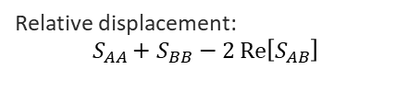

Decision Guide: Match the Method to the Problem
Vibrationdata
A working map from disturbance symptom to analysis method, mitigation lever, and verification
Disturbance / symptom
Analysis method
Primary mitigation
Verification
Tonal RWA line crossing a mode
Harmonic sweep; FRF at each harmonic
Detune modes (≥2×); no-spin zone; wheel isolator
Spin-table + modal survey; correlate FE
Broadband bearing / noise floor
Soft mount (low corner); add damping
Quiet-bench PSD; noise-floor check
PSD random; $\text{output}={\left|H\right|}^{2}⋅S_{ff}$
Cryocooler compressor tones
Harmonic lines + speed-dependent floor
Active counterbalancer; tonal notch
TVac component test at temperature
Clearance / connector / harness
Relative displacement:
$$S_{AA}+S_{BB}−2 Re\left[S_{AB}\right]$$
Stiffen locally; manage relative DOF
Rice-max peak vs. physical gap
Sub-corner / resonant amplification
Active–passive crossover transmissibility
Active loop owns resonance; passive roll-off
Closed-loop stability + HIL test
Appendage / thermal snap transient
Transient + STOP; free-free BC
Budget appendage dynamics; ACS authority
Terminator-crossing model vs. flight
Takeaway: Name the disturbance first — its character (tonal, broadband, transient, or relative) selects the analysis, the lever, and the test. Most real programs run several rows at once and combine the results by RSS.
Spacecraft On-Orbit Vibration | blog.vibrationdata.com
82

