Slide 1
San Andreas Fault
Strain Energy Buildup & Seismic Hazard
Based on new June 2026 research — Journal of Geophysical Research: Solid Earth
By Tom Irvine

Slide 2
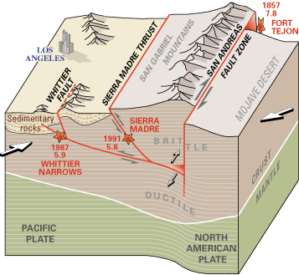
The San Andreas Fault System
VibrationData
Type:
Right-lateral strike-slip fault
Length:
~800 miles (1,300 km) across California
Plates:
Pacific Plate vs. North American Plate
Slip rate:
~2 in/year (5 cm/yr) average
Segments:
Locked (north & south), creeping (central)
Last major S. rupture:
~1680 AD (340+ years ago)
Cross-section schematic showing Pacific and North American plates,
the San Andreas fault zone, and associated thrust faults near Los Angeles.
Cajon Pass is a critical fault junction near Los Angeles where segment behavior determines rupture extent.

Slide 3
Strain Energy Buildup — The Elastic Rebound Model
VibrationData
1 Tectonic Loading
2 Locked & Stressed
3 Rupture & Release
Plate motion drives shear stress into crustal rock at ~5 cm/yr.
Strain accumulates continuously over centuries where the fault is locked — no surface slip occurs.
Friction holds the fault locked.
Elastic strain energy builds like a compressed spring.
Stress magnitude can be quantified via GPS geodesy, seismic moment analysis, and physics-based models.
When shear stress exceeds static friction, the fault ruptures.
Elastic energy converts to seismic wave energy (ground motion) and heat.
Moment magnitude scales with rupture area × average slip.
Seismic Moment: M₀ = μ · A · D where μ = shear modulus, A = rupture area, D = average slip

Slide 4
New Research: Record Stress Levels — June 2026
VibrationData
Fault stress at highest level in 1,000 years — University of Hawaiʻi / Univ. of Bern, JGR: Solid Earth, June 3, 2026
Physics-based simulation
Researchers modeled 1,000 years of earthquake history using geological evidence (radiocarbon-dated sediments, tree rings) to reconstruct accumulated stress.
Unprecedented accumulation
Stress that would normally be released in large earthquakes has continued to accumulate. Present-day levels exceed any point in the past millennium.
Cajon Pass — critical junction
The fault junction near Los Angeles could determine the extent of the next major rupture — whether it stays local or cascades into a multi-segment event.
Not a time prediction
"This is not a prediction of when an earthquake will happen," said lead researcher Burkhard. Findings are for hazard assessment and infrastructure planning.
Source: Burkhard et al. (2026), Journal of Geophysical Research: Solid Earth. University of Hawaiʻi at Mānoa, Univ. of Bern, Northern Arizona Univ., USGS.

Slide 5
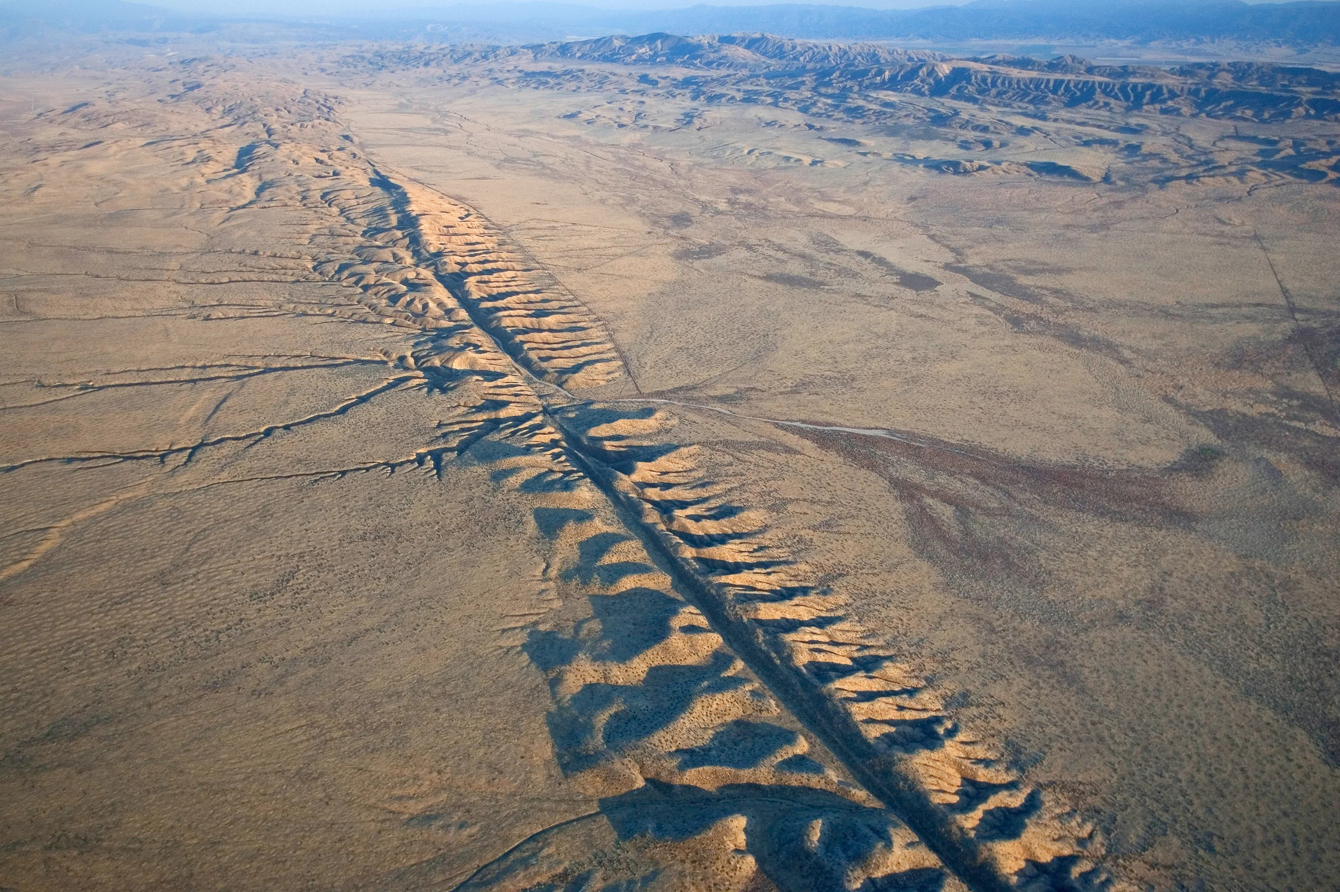
Fault Morphology from the Air
~340 yrs
Since last S. CA rupture
(c. 1680 AD)
M 7.8–8.2
Expected 'Big One'
magnitude range
72%
30-yr probability of
M6.7+ in Bay Area (USGS)
5 cm/yr
Average plate slip
rate (Pacific vs. N. American)
Aerial view of the San Andreas fault trace cutting through the Carrizo Plain, CA.
The linear sag ponds, offset ridges, and pressure ridges are classic surface expressions of strike-slip motion.
VibrationData | vibrationdata.com

Slide 6
Engineering Implications for Structural Design
VibrationData
Ground Motion Intensity
Site Amplification
A M7.8–8.2 rupture on the southern SAF would produce peak ground accelerations of 0.5–1.0g near the fault. Near-fault pulse effects amplify demand on mid-rise structures.
Soft soil and sedimentary basins (e.g., LA basin) amplify shaking by 2–5×. Horizontal-to-Vertical Spectral Ratio (HVSR) measurements and site-specific response spectra are critical for design near the fault.
ASCE 7-22 SDC D/E Sites
Nonstructural Components
Southern California near the SAF typically falls in Seismic Design Category D or E. ASCE 7-22 §11 and §12 govern force levels; NLRHA may be required for irregular structures.
ASCE 7-22 Chapter 13 applies amplified Fp forces for equipment and mechanical systems. Anchor bolt design must account for combined shear and tension under seismic loads.
Fault Rupture Setbacks
Hazard Reassessment
California Alquist-Priolo Act requires 50-ft setback from active fault traces for occupied structures. Fault trench studies may be required to establish the exact rupture zone.
New 2026 research warrants updating probabilistic seismic hazard analyses (PSHA) for affected regions. Ground motion models (GMMs) should reflect record stress accumulation.
Reference: ASCE 7-22, USGS National Seismic Hazard Model, CGS Alquist-Priolo Act, Burkhard et al. (2026) JGR:SE

Slide 7
Rupture Area — Definition & Significance
VibrationData
Rupture Area = Along-Strike Length × Down-Dip Width — the fault plane patch that actually slips during an earthquake
3D Fault Plane Geometry
1
Rupture area is defined on the fault plane in 3D — not at the ground surface. It extends along-strike (horizontal fault length that slips) and down-dip (depth extent into the crust). For a major southern San Andreas rupture, this may be ~300–400 km along strike and ~15–20 km down-dip, giving areas on the order of 5,000–8,000 km².
Seismogenic Zone Depth Limit
2
Rupture is bounded at depth by the brittle–ductile transition, typically at 15–20 km. Below this, rock deforms plastically (creeps) rather than fracturing suddenly. This places a physical upper limit on down-dip rupture width and is a key parameter in ground motion modeling and fault setback analysis.
Slip Distribution & Scaling Relations
3
Slip is not uniform — asperities (high-slip patches) dominate the radiated energy and near-fault ground motion. M₀ = μ·A·D uses average slip D over the full area A. Empirical scaling relations (Wells & Coppersmith 1994; Strasser et al. 2010) let engineers estimate rupture dimensions from a target magnitude for use in PSHA and fault rupture setback decisions.
Ref: Wells & Coppersmith (1994) BSSA; Strasser, Arango & Bommer (2010) SSS; USGS Seismogenic Zone studies

Slide 8
Near-Field Ground Motion — Four Distinct Hazard Components
VibrationData
Surface rupture is only one of four near-fault phenomena. The others are wave-propagation hazards that persist well beyond any practical setback distance.
Static Offset (Permanent Displacement)
Directivity Pulse (Near-Fault Velocity Pulse)
Range: 0 – ~50 ft from trace
Range: 0 – ~10 km from trace
Ground on either side of the fault trace is permanently displaced by 1–10 m. Decays rapidly with distance. This is the specific hazard Alquist-Priolo targets — foundation shearing cannot be engineered against; only setback works.
Rupture propagation toward a site produces a large-amplitude, short-duration velocity pulse. Elliptical Rayleigh-type particle motion in the vertical plane normal to the fault. Especially damaging to structures with periods of 1–4 s. Addressable via NLRHA and base isolation.
Trapped Fault Zone Waves
Fault Zone Soil Amplification (Rayleigh Waves)
Range: 0 – ~200 m (~650 ft) from trace
Range: 0 – ~300 m (~1,000 ft) from trace
Highly fractured, pulverized rock in the fault damage zone acts as a low-velocity waveguide. Seismic energy is trapped and amplified within this corridor. The Alquist-Priolo 50-ft setback does not clear this amplification zone (Li et al.).
Fault zone soils have dramatically reduced Vs (sometimes <200 m/s). Low Vs amplifies Rayleigh wave particle motion — both vertical and horizontal components — close to the trace. HVSR surveys near active faults frequently show anomalously low resonance frequencies in this zone.
Ref: Yong-Gang Li et al. — fault zone trapped waves; ASCE 7-22 near-fault factors; Somerville et al. (1997) directivity model

Slide 9
Alquist-Priolo 50-ft Setback — Coverage & Gaps
VibrationData
50 ft Rupture
~650 ft Trapped waves
~1,000 ft
Rayleigh amplification
~10 km — Directivity pulse zone
← Fault Trace ~10 km → (schematic, not linear scale)
✔ What the 50-ft Setback Covers
✘ What the 50-ft Setback Doesn't Cover
▸ Foundation shearing by surface fault rupture — the one hazard no structural system can survive
✘ Trapped fault zone waves — amplification extends ~200 m (~650 ft) from trace
✘ Rayleigh wave amplification in low-Vs fault soils — significant to ~300 m
▸ Uncertainty in exact fault trace location (minor splays, distributed shear zones)
✘ Near-fault directivity pulse — large velocity pulse extends ~10 km from fault
▸ Permanent static ground offset immediately adjacent to the principal slip surface
✘ Broad ground shaking — managed by ASCE 7-22, not by setback distance
Wave-propagation hazards (trapped waves, Rayleigh amplification, directivity) are addressable through structural design — base isolation, NLRHA, ductile detailing — even where physical setback is impractical.

