Slide 1
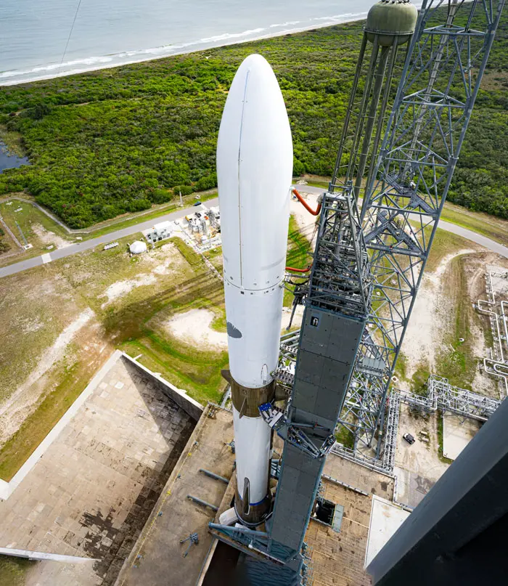
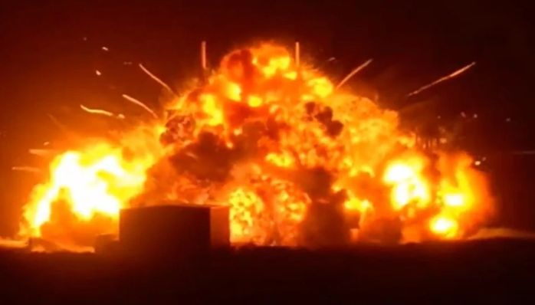
New Glenn Launch Vehicle Vibrationdata
Explosion during prelaunch engine static fire test on May 28, 2026

Slide 2
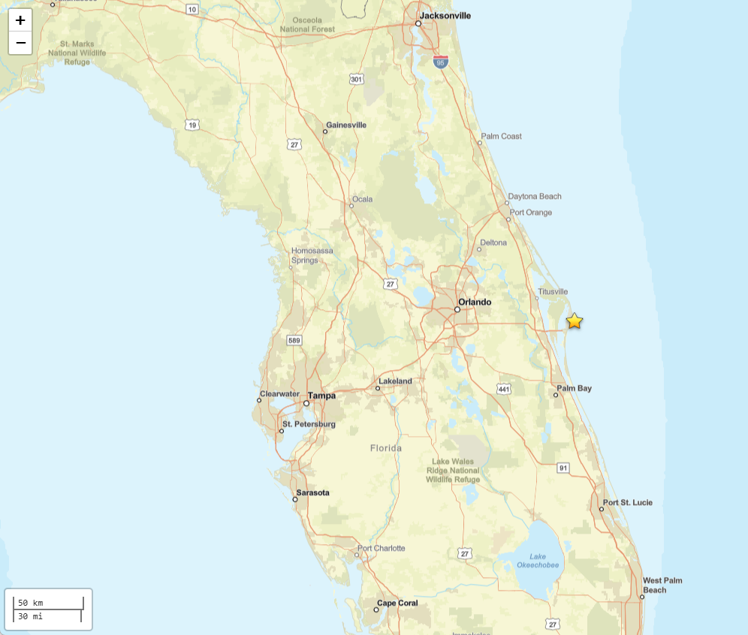
M 2.5 Accidental Explosion - Blue Origin New Glenn Rocket Explosion Vibrationdata
The Blue Origin New Glenn rocket explosion generated seismic waves that traveled through the Earth and were detected on three seismographic stations
The most distant station was 220 km (135 miles) from the rocket
The estimated magnitude of M2.5 is not directly comparable to an earthquake because the rocket explosion was not contained within the Earth, resulting in less efficient energy coupling
The event location is fixed to the explosion site
Homes shook and windows rattles in nearby Cape Canaveral and Cocoa Beach, with residents turning to social media to report the event
That is a clear indicator of significant acoustic/blast overpressure propagating several miles from Launch Complex 36
https://earthquake.usgs.gov/earthquakes/eventpage/us7000spdd/executive

Slide 3
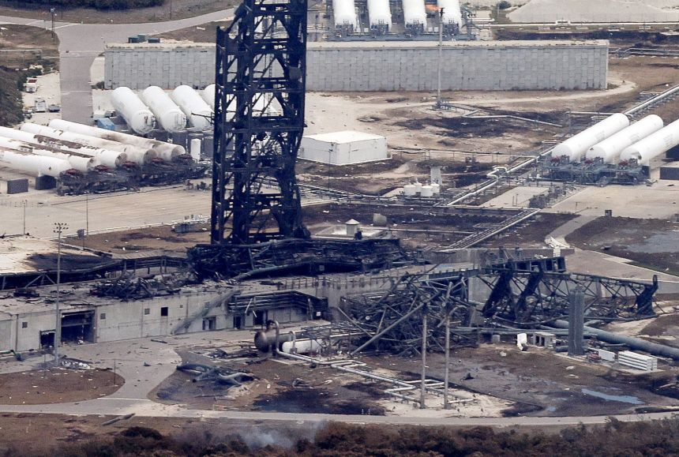
Damaged Launch Pad Vibrationdata

Slide 4
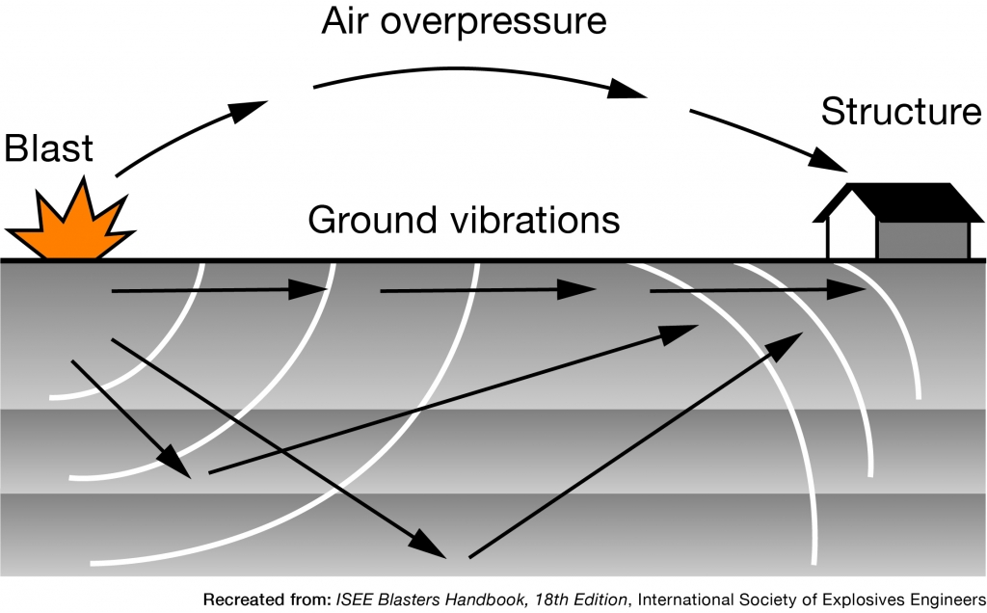
Overpressure-to-Seismic Coupling
Vibrationdata
Rayleigh waves (R-waves) — the dominant component for surface blasting
Retrograde elliptical particle motion (combined vertical and horizontal)

Slide 5
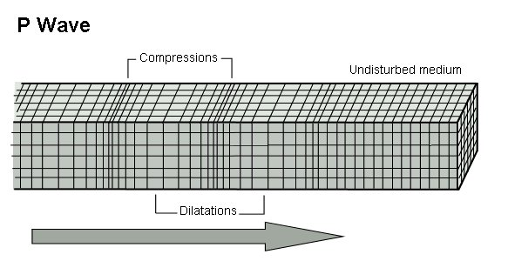
Seismic P-Wave
The primary wave, or P-wave, is a body wave that can propagate through the Earth’s core
This wave can also travel through water
The P-wave is also a sound wave
It thus has longitudinal motion
Note that the P-wave is the fastest of the four waveforms
Typical P-wave velocity 5 to 8 km/s
Airborne sound speed is 0.34 km/s

Slide 6
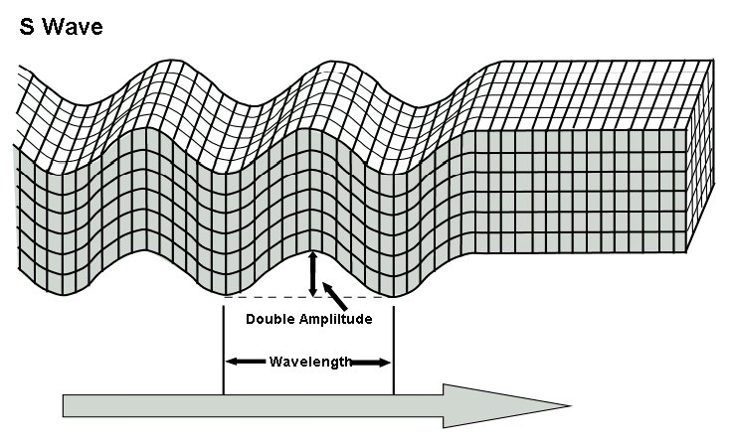
Seismic S-Wave
The secondary wave, or S-wave, is a shear wave
It is a type of body wave
The S-wave produces an amplitude disturbance that is at right angles to the direction of propagation
Note that water cannot withstand a shear force
S-waves thus do not propagate in water
S waves travel about 60% the speed of P waves

Slide 7
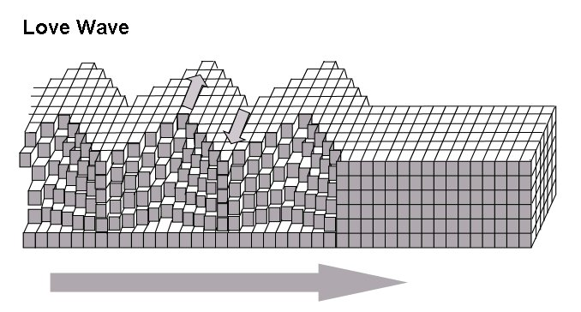
Seismic Love Wave
Love waves are shearing horizontal waves
The motion of a Love wave is similar to the motion of a secondary wave except that Love wave only travel along the surface of the Earth
Love waves do not propagate in water
Typical Love wave velocity 2 to 6 km/s

Slide 8
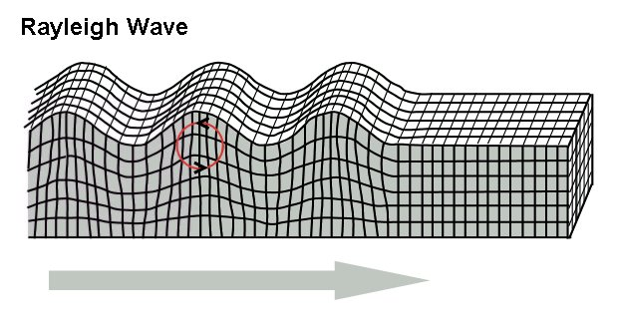
Seismic Rayleigh Wave
Rayleigh waves travel along the surface of the Earth
Rayleigh waves produce retrograde elliptical motion
The ground motion is thus both horizontal and vertical
The motion of Rayleigh waves is similar to the motion of ocean waves except that ocean waves are prograde
Typical Rayleigh wave velocity ~3 km/s

