Slide 1
Mindanao, Philippines, Earthquake
Magnitude 7.8
June 7, 2026
By Tom Irvine

Slide 2
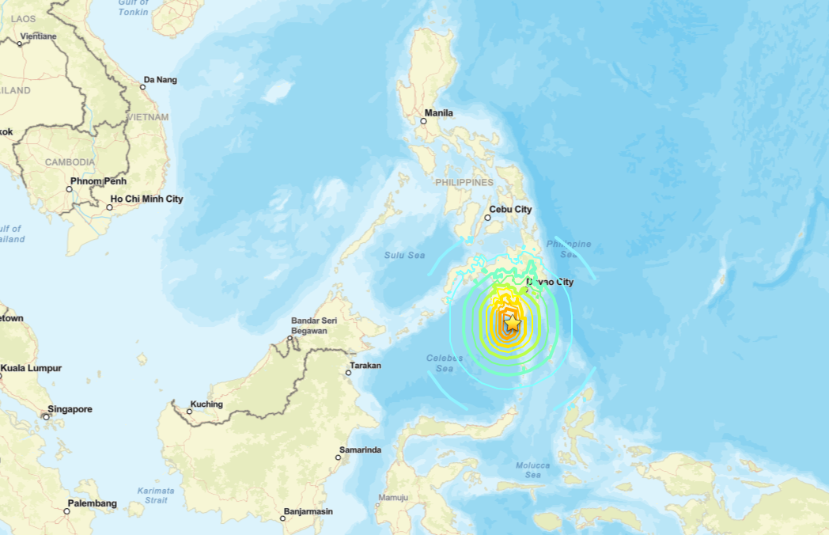

Slide 3
A powerful magnitude 7.8 earthquake struck offshore near Sarangani Province, Mindanao, Philippines, on June 8, 2026, making it one of the strongest earthquakes to hit the region in decades
The earthquake caused significant loss of life, with reports indicating at least 55 fatalities, more than 1000 injuries, and tens of thousands of displaced residents
Severe damage occurred in General Santos City, where multiple buildings collapsed, including commercial structures, and thousands of homes were damaged
The event triggered tsunami warnings across the Philippines and neighboring countries, prompting coastal evacuations before the warnings were later canceled after only minor waves were observed
Numerous aftershocks followed the main shock, with authorities reporting hundreds of aftershocks and warning residents to avoid damaged structures
The earthquake was associated with tectonic activity near the Cotabato Trench and caused secondary hazards including landslides, infrastructure damage, school closures, power outages, and disruptions to transportation and communications

Slide 4
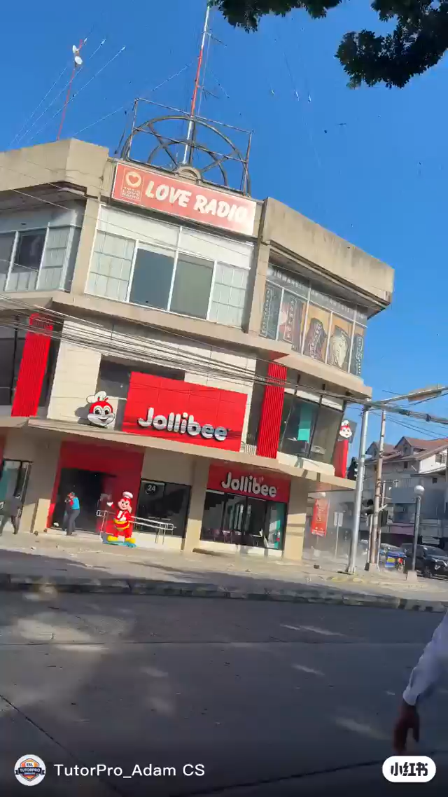
Note the classic soft-story configuration: the entire ground floor is open commercial frontage with no shear walls
The heavy masonry upper stories create a large seismic mass at height acting on extremely weak ground-floor columns
Corner geometry adds torsional vulnerability.
The lateral rotation of the upper block as a unit confirms soft-story mechanism, not pancake collapse
The forward tipping and base dust cloud are consistent with ground-floor column shear failure combined with possible foundation movement
Short-column effect from the partial-height storefront panels is a likely contributor
Click on image to play video

Slide 5
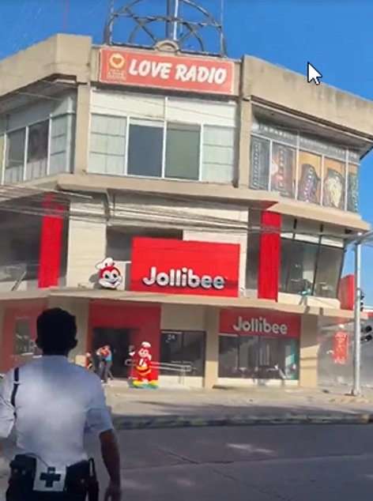
Mindanao Earthquake — Jollibee Building, Before Collapse
Vibrationdata
Observed Structural Vulnerabilities
Soft-story ground floor
  Large open storefront — Jollibee facade spans nearly full width with minimal concrete shear wall
  Ground floor lateral stiffness far below upper stories → story mechanism failure
Heavy upper-floor mass
  Solid masonry or RC upper floors with Love Radio billboard structure add significant seismic mass at height
  Increases overturning demand on the weak ground-floor columns
Corner / irregular plan geometry
  Building sits at a street corner — two open facade faces, columns concentrated at corners only
  Torsional irregularity amplifies demand on corner columns under bi-directional shaking
Pre-code RC construction
  Likely pre-1992 NSCP — inadequate column confinement ties, low concrete grade, poor joint detailing
  Columns designed for gravity loads only; no capacity design for seismic ductility
1

Slide 6
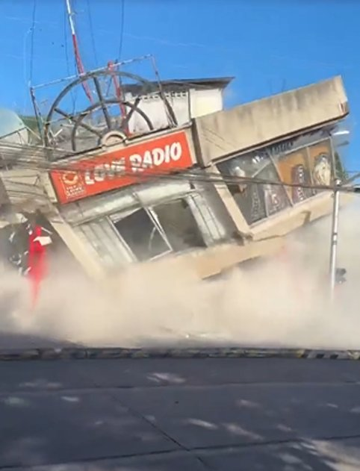
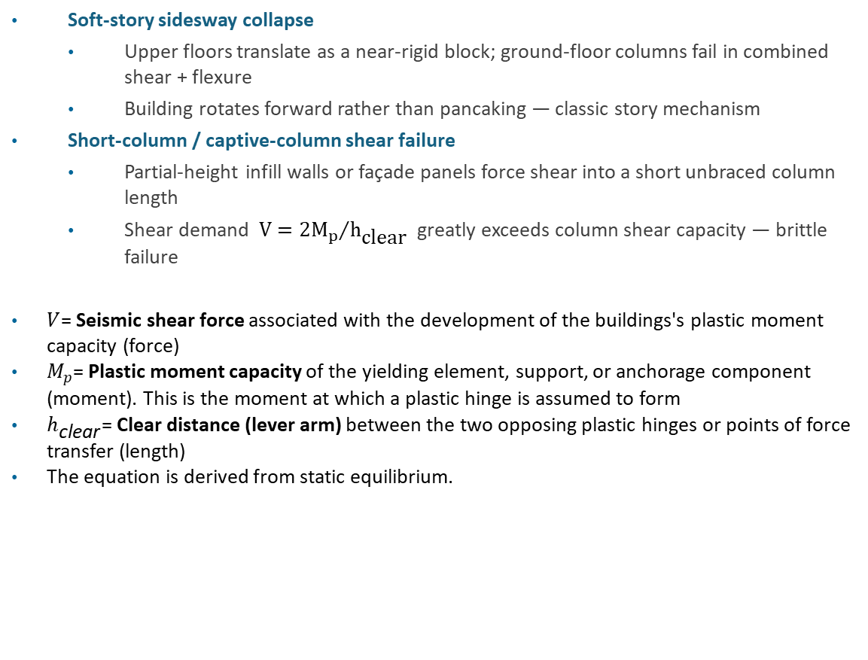
Mindanao Earthquake — Jollibee Building, Collapse Mechanisms
Vibrationdata
Observed Failure Modes
Soft-story sidesway collapse
  Upper floors translate as a near-rigid block; ground-floor columns fail in combined shear + flexure
  Building rotates forward rather than pancaking — classic story mechanism
Short-column / captive-column shear failure
  Partial-height infill walls or façade panels force shear into a short unbraced column length
  Shear demand $V={2M_{p}}/{h_{\text{clear}}}$greatly exceeds column shear capacity — brittle failure
$V$= Seismic shear force associated with the development of the buildings's plastic moment capacity (force)
$M_{p}$= Plastic moment capacity of the yielding element, support, or anchorage component (moment). This is the moment at which a plastic hinge is assumed to form
$h_{\text{clear}}$= Clear distance (lever arm) between the two opposing plastic hinges or points of force transfer (length)
The equation is derived from static equilibrium.
2

Slide 7
Mindanao Earthquake — Jollibee Building, Collapse Mechanisms (cont)
Vibrationdata
Observed Failure Modes
Column splice / joint failure
  Poorly confined beam-column joints lose load path; spalling and rebar buckling visible in collapse dust cloud
Possible foundation contribution
  Lateral translation of base suggests soil may have lost bearing or liquefied locally
  Coastal Mindanao soils are susceptible to liquefaction and lateral spreading
Design lesson — ASCE 7-22 / NSCP 2015
  Strong-column/weak-beam hierarchy and confinement detailing prevent soft-story collapse
2

