Slide 1
Vibrationdata
ASCE 7-22 Seismic Anchor Bolt Design
Revision A
By Tom Irvine
1

Slide 2
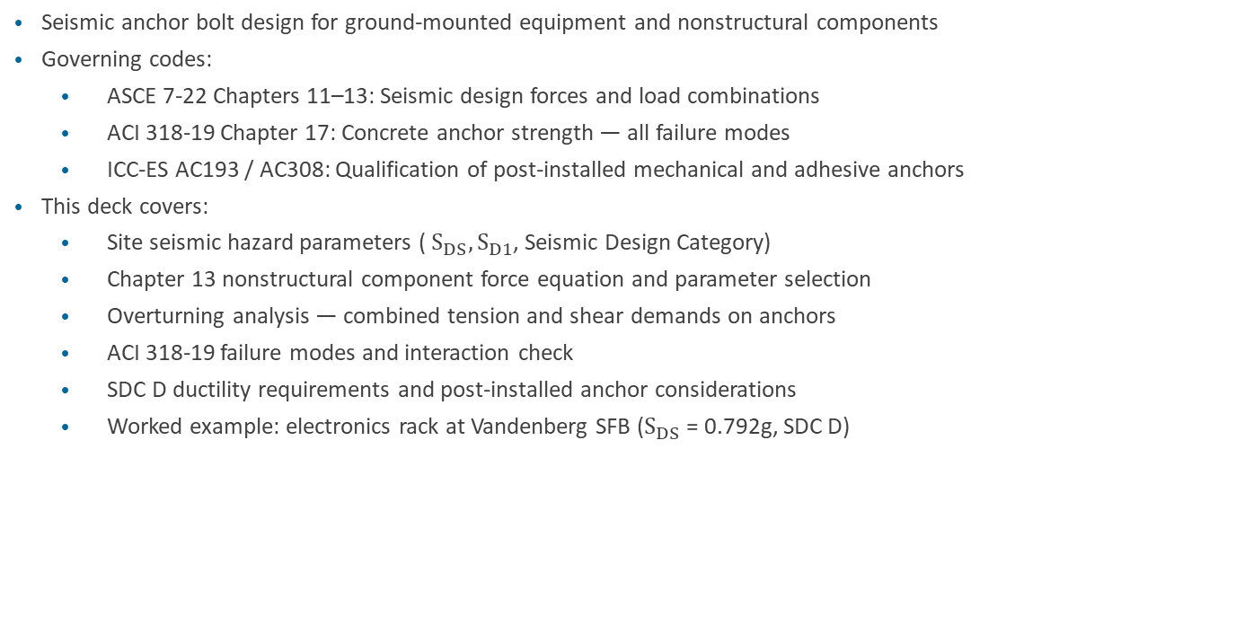
Overview
Vibrationdata
Seismic anchor bolt design for ground-mounted equipment and nonstructural components
Governing codes:
  ASCE 7-22 Chapters 11–13: Seismic design forces and load combinations
  ACI 318-19 Chapter 17: Concrete anchor strength — all failure modes
  ICC-ES AC193 / AC308: Qualification of post-installed mechanical and adhesive anchors
This deck covers:
  Site seismic hazard parameters ( $S_{DS},S_{D1}$, Seismic Design Category)
  Chapter 13 nonstructural component force equation and parameter selection
  Overturning analysis — combined tension and shear demands on anchors
  ACI 318-19 failure modes and interaction check
  SDC D ductility requirements and post-installed anchor considerations
  Worked example: electronics rack at Vandenberg SFB ($S_{DS}$ = 0.792g, SDC D)
2

Slide 3
Regulatory Framework
Vibrationdata
ASCE 7-22 is the primary loading standard adopted by IBC 2021
  Chapter 11: Seismic ground motion values and site classification
  Chapter 12: Seismic design requirements for building structures
  Chapter 13: Seismic design of nonstructural components
  Chapter 15: Nonbuilding structures (equipment skids, tanks, frames)
ACI 318-19 Chapter 17 governs all anchor design to concrete
  Steel failure modes: tension fracture (§17.6.1), shear fracture (§17.7.1)
  Concrete failure modes: breakout (§17.6.2), pullout (§17.6.3), pryout (§17.7.3)
  Combined tension + shear interaction check (§17.8)
Post-installed anchor qualification standards:
  ICC-ES AC193: mechanical (expansion) anchors — Seismic Category 1 required for SDC C–F
  ICC-ES AC308: adhesive anchors — temperature and sustained-load knockdown apply
3

Slide 4
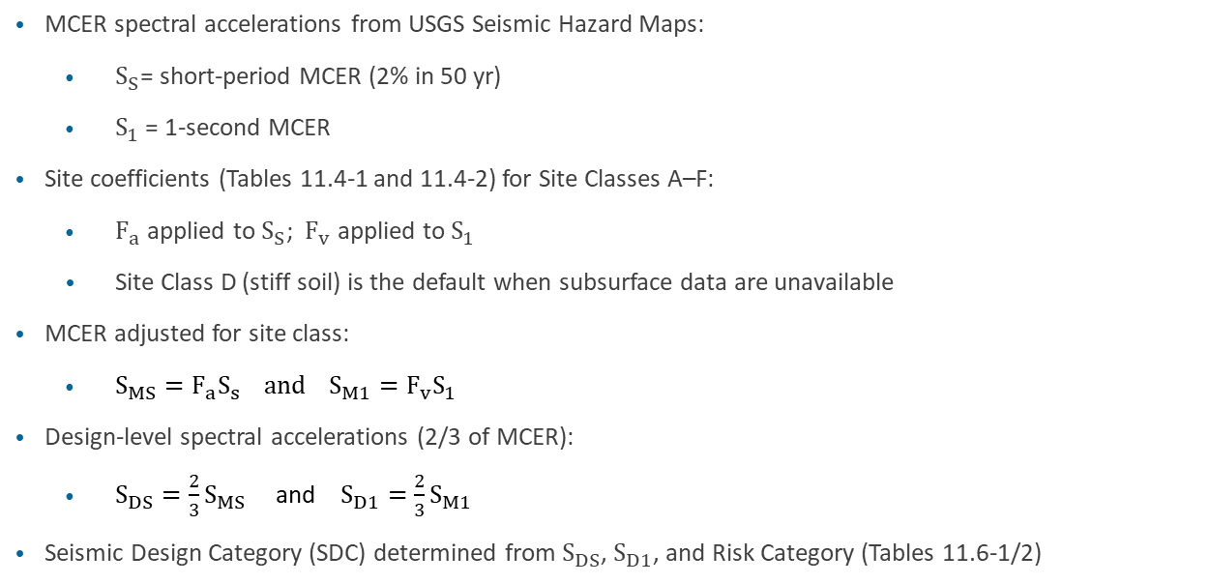
Site Seismic Hazard — ASCE 7-22 §11.4
Vibrationdata
MCER spectral accelerations from USGS Seismic Hazard Maps:
  $S_{S}$= short-period MCER (2% in 50 yr)
  $S_{1}$= 1-second MCER
Site coefficients (Tables 11.4-1 and 11.4-2) for Site Classes A–F:
  $F_{a}$ applied to $S_{S}$; ${ F}_{v}$ applied to $S_{1}$
  Site Class D (stiff soil) is the default when subsurface data are unavailable
MCER adjusted for site class:
  $S_{MS}=F_{a}S_{s} and S_{M1}=F_{v}S_{1}$
Design-level spectral accelerations (2/3 of MCER):
  $S_{DS}=\frac{2}{3}S_{MS}$ and $S_{D1}=\frac{2}{3}S_{M1}$
Seismic Design Category (SDC) determined from $S_{DS}$, $S_{D1}$, and Risk Category (Tables 11.6-1/2)
4

Slide 5

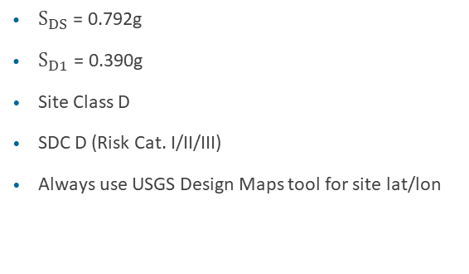
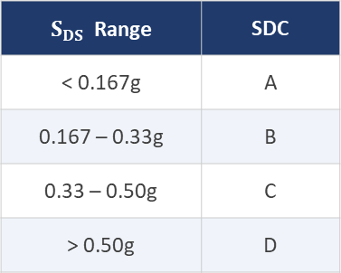
Site Seismic Hazard — ASCE 7-22 §11.4
Vibrationdata
SDC from $S_{DS}$ (Risk Cat. I/II):
Vandenberg SFB example:
$S_{DS}$ Range | SDC
< 0.167g | A
0.167 – 0.33g | B
0.33 – 0.50g | C
> 0.50g | D
$S_{DS}$ = 0.792g
$S_{D1}$ = 0.390g
Site Class D
SDC D (Risk Cat. I/II/III)
Always use USGS Design Maps tool for site lat/lon
4

Slide 6

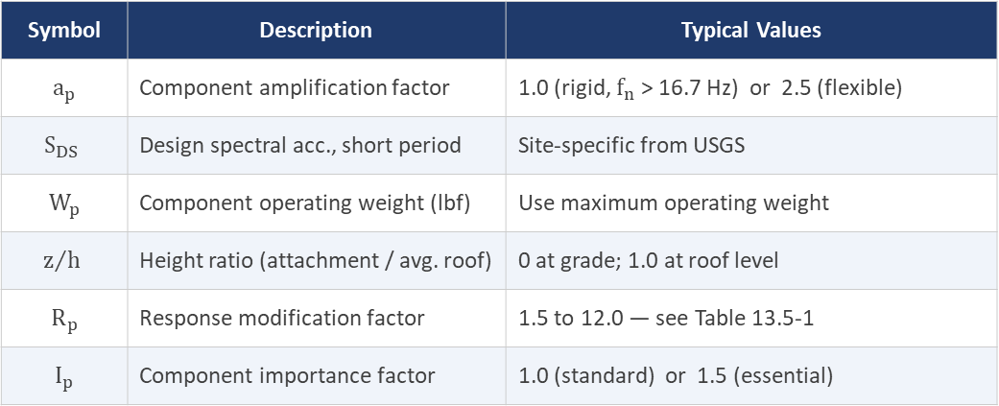
Chapter 13 — Nonstructural Component Force
Vibrationdata
$$F_{p}=\frac{0.4 a_{p} S_{DS} W_{p}\left(1+\frac{2z}{h}\right)}{R_{p}/I_{p}}$$
Symbol | Description | Typical Values
$a_{p}$ | Component amplification factor | 1.0 (rigid, $f_{n}$ > 16.7 Hz) or 2.5 (flexible)
$$S_{DS}$$ | Design spectral acc., short period | Site-specific from USGS
$W_{p}$ | Component operating weight (lbf) | Use maximum operating weight
$$z/h$$ | Height ratio (attachment / avg. roof) | 0 at grade; 1.0 at roof level
$R_{p}$ | Response modification factor | 1.5 to 12.0 — see Table 13.5-1
$I_{p}$ | Component importance factor | 1.0 (standard) or 1.5 (essential)
5

Slide 7
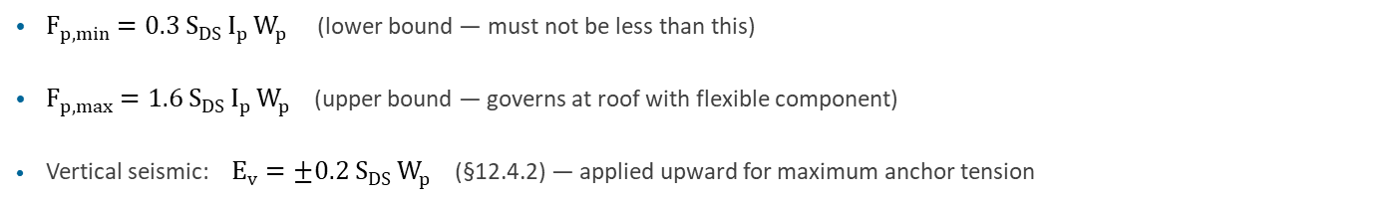
Chapter 13 — Nonstructural Component Force (cont)
Vibrationdata
Limits (Eqs. 13.3-3 and 13.3-4):
$F_{p,min}=0.3 S_{DS} I_{p} W_{p}$ (lower bound — must not be less than this)
$F_{p,max}=1.6 S_{DS} I_{p} W_{p}$ (upper bound — governs at roof with flexible component)
Vertical seismic: $E_{v}=±0.2 S_{DS} W_{p}$ (§12.4.2) — applied upward for maximum anchor tension
5

Slide 8
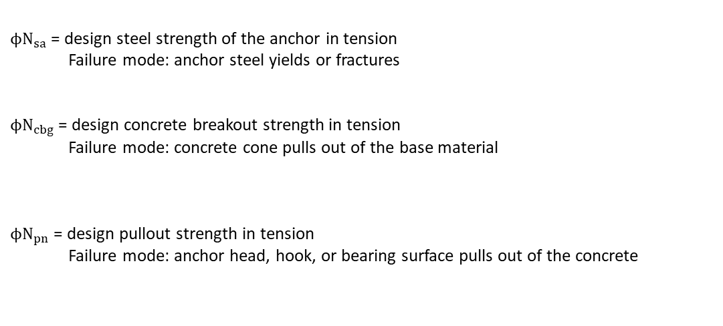
Anchor System Design Strengths for Tension, ACI Notation
Vibrationdata
$ϕN_{sa}$ = design steel strength of the anchor in tension
  Failure mode: anchor steel yields or fractures
$ϕN_{cbg}$ = design concrete breakout strength in tension
  Failure mode: concrete cone pulls out of the base material
$ϕN_{pn}$ = design pullout strength in tension
  Failure mode: anchor head, hook, or bearing surface pulls out of the concrete
16

Slide 9

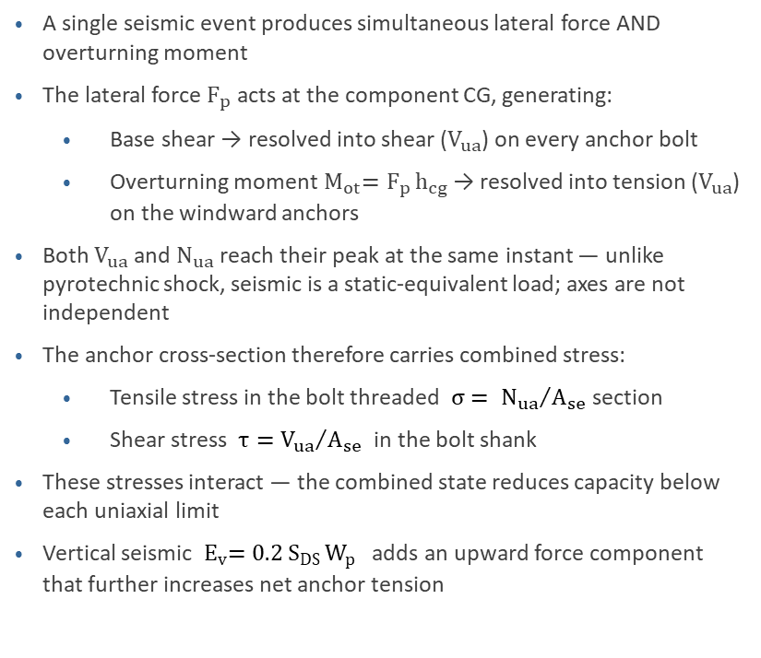


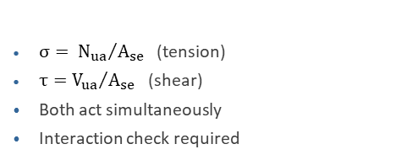


Multiaxial Anchor Stress — Combined Tension and Shear
Vibrationdata
A single seismic event produces simultaneous lateral force AND overturning moment
The lateral force $F_{p}$ acts at the component CG, generating:
  Base shear → resolved into shear ($V_{ua}$) on every anchor bolt
  Overturning moment${ M}_{ot}=F_{p} h_{cg}$ → resolved into tension ($V_{ua}$) on the windward anchors
Both $V_{ua}$ and $N_{ua}$ reach their peak at the same instant — unlike pyrotechnic shock, seismic is a static-equivalent load; axes are not independent
The anchor cross-section therefore carries combined stress:
  Tensile stress in the bolt threaded$σ= {N_{ua}}/{A_{se}}$ section
  Shear stress $τ={V_{ua}}/{A_{se}}$ in the bolt shank
These stresses interact — the combined state reduces capacity below each uniaxial limit
Vertical seismic ${ E}_{v}=0.2 S_{DS} W_{p}$ adds an upward force component that further increases net anchor tension
Equipment
$$W_{p}$$
Inertial Force $F_{p}$
CG
$$h_{cg}$$
$$N_{ua}$$
(tension)
$${ M}_{ot}=F_{p} h_{cg}$$
$V_{ua}$ (shear, all anchors)
(compression)
Anchor stress state:
$σ= {N_{ua}}/{A_{se}}$ (tension)
$τ={V_{ua}}/{A_{se}}$ (shear)
Both act simultaneously
Interaction check required
7

Slide 10
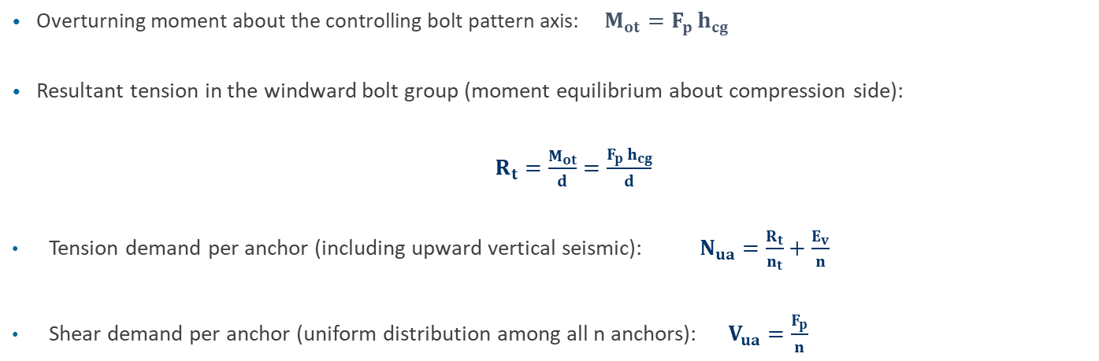
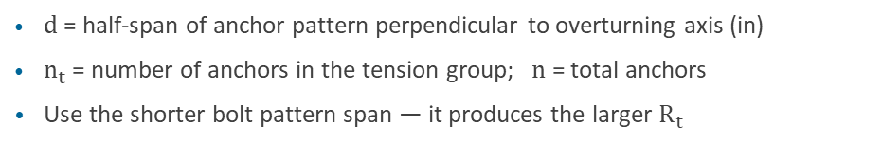
Overturning Analysis — Equilibrium Equations
Vibrationdata
Overturning moment about the controlling bolt pattern axis: $M_{ot}=F_{p} h_{cg}$
Resultant tension in the windward bolt group (moment equilibrium about compression side):
$R_{t}=\frac{M_{ot}}{d}=\frac{F_{p} h_{cg}}{d}$
Tension demand per anchor (including upward vertical seismic): $N_{ua}=\frac{R_{t}}{n_{t}}+\frac{E_{v}}{n}$
Shear demand per anchor (uniform distribution among all n anchors): $V_{ua}=\frac{F_{p}}{n}$
d = half-span of anchor pattern perpendicular to overturning axis (in)
$n_{t}$ = number of anchors in the tension group; n = total anchors
Use the shorter bolt pattern span — it produces the larger $R_{t}$
8

Slide 11
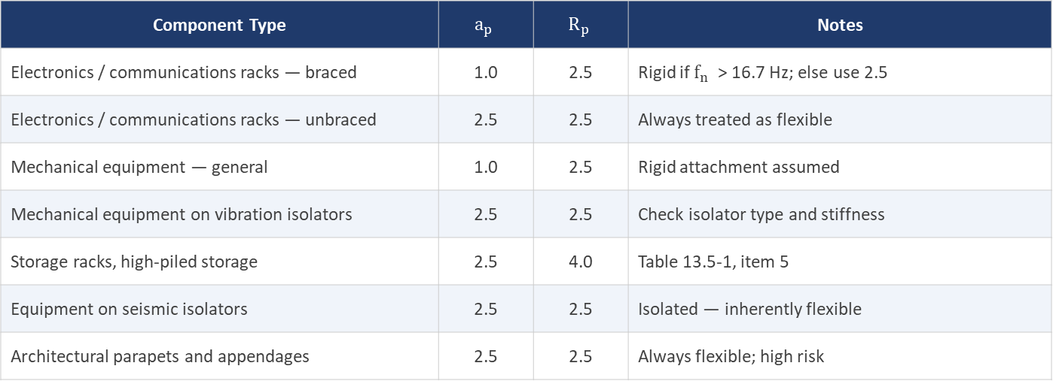
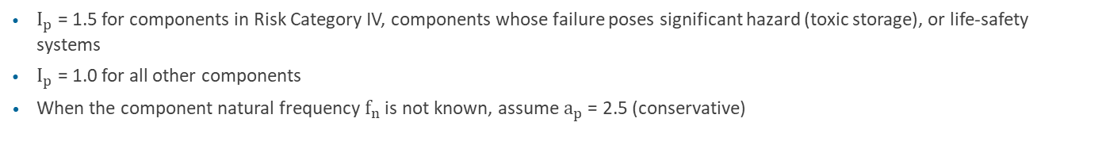
Component Parameters — ASCE 7-22 Table 13.5-1 (Selected)
Vibrationdata
Component Type | $$a_{p}$$ | $$R_{p}$$ | Notes
Electronics / communications racks — braced | 1.0 | 2.5 | Rigid if $f_{n}$ > 16.7 Hz; else use 2.5
Electronics / communications racks — unbraced | 2.5 | 2.5 | Always treated as flexible
Mechanical equipment — general | 1.0 | 2.5 | Rigid attachment assumed
Mechanical equipment on vibration isolators | 2.5 | 2.5 | Check isolator type and stiffness
Storage racks, high-piled storage | 2.5 | 4.0 | Table 13.5-1, item 5
Equipment on seismic isolators | 2.5 | 2.5 | Isolated — inherently flexible
Architectural parapets and appendages | 2.5 | 2.5 | Always flexible; high risk
$I_{p}$ = 1.5 for components in Risk Category IV, components whose failure poses significant hazard (toxic storage), or life-safety systems
$I_{p}$ = 1.0 for all other components
When the component natural frequency $f_{n}$ is not known, assume $a_{p}$ = 2.5 (conservative)
6

Slide 12
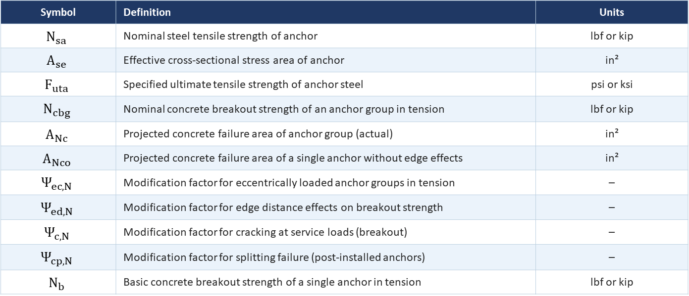
ACI 318-19 Chapter 17 — Concrete Anchor Failure Modes
Vibrationdata
Variable Definitions (1 of 2)
Symbol | Definition | Units
$$N_{sa}$$ | Nominal steel tensile strength of anchor | lbf or kip
$$A_{se}$$ | Effective cross-sectional stress area of anchor | in²
$$F_{uta}$$ | Specified ultimate tensile strength of anchor steel | psi or ksi
$$N_{cbg}$$ | Nominal concrete breakout strength of an anchor group in tension | lbf or kip
$$A_{Nc}$$ | Projected concrete failure area of anchor group (actual) | in²
$$A_{Nco}$$ | Projected concrete failure area of a single anchor without edge effects | in²
$$Ψ_{ec,N}$$ | Modification factor for eccentrically loaded anchor groups in tension | –
$$Ψ_{ed,N}$$ | Modification factor for edge distance effects on breakout strength | –
$$Ψ_{c,N}$$ | Modification factor for cracking at service loads (breakout) | –
$$Ψ_{cp,N}$$ | Modification factor for splitting failure (post-installed anchors) | –
$$N_{b}$$ | Basic concrete breakout strength of a single anchor in tension | lbf or kip
10

Slide 13
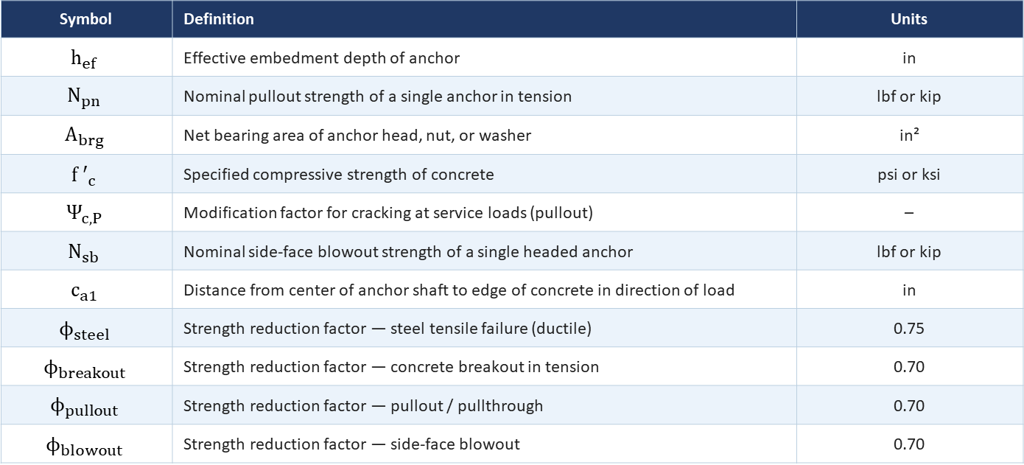
ACI 318-19 Chapter 17 — Concrete Anchor Failure Modes
Vibrationdata
Variable Definitions (2 of 2)
Symbol | Definition | Units
$$h_{ef}$$ | Effective embedment depth of anchor | in
$$N_{pn}$$ | Nominal pullout strength of a single anchor in tension | lbf or kip
$$A_{brg}$$ | Net bearing area of anchor head, nut, or washer | in²
$$f ′_{c}$$ | Specified compressive strength of concrete | psi or ksi
$$Ψ_{c,P}$$ | Modification factor for cracking at service loads (pullout) | –
$$N_{sb}$$ | Nominal side-face blowout strength of a single headed anchor | lbf or kip
$$c_{a1}$$ | Distance from center of anchor shaft to edge of concrete in direction of load | in
$$ϕ_{steel}$$ | Strength reduction factor — steel tensile failure (ductile) | 0.75
$$ϕ_{breakout}$$ | Strength reduction factor — concrete breakout in tension | 0.70
$$ϕ_{pullout}$$ | Strength reduction factor — pullout / pullthrough | 0.70
$$ϕ_{blowout}$$ | Strength reduction factor — side-face blowout | 0.70
11

Slide 14
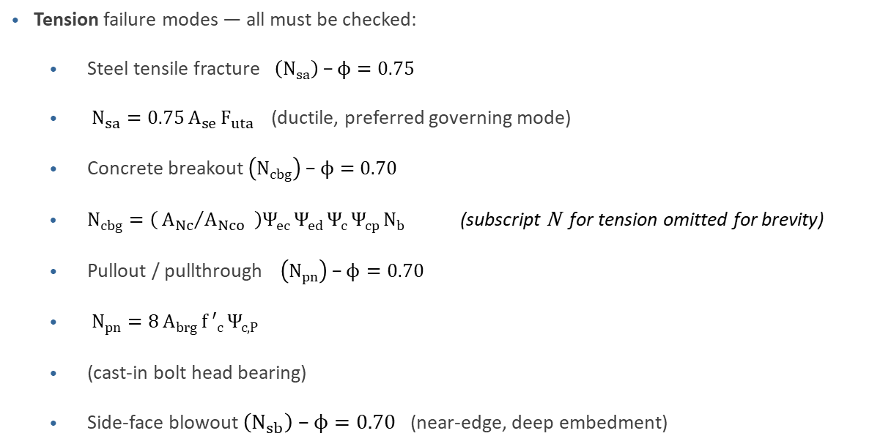
ACI 318-19 Chapter 17 — Concrete Anchor Failure Modes
Vibrationdata
Tension failure modes — all must be checked:
  Steel tensile fracture $\left(N_{sa}\right)\text{ − }ϕ=0.75$
  $N_{sa}=0.75 A_{se} F_{uta}$(ductile, preferred governing mode)
  Concrete breakout $\left(N_{cbg}\right) \text{−} ϕ=0.70$
  $N_{cbg}=\left( {A_{Nc}}/{A_{Nco}} \right)Ψ_{ec} Ψ_{ed} Ψ_{c} Ψ_{cp} N_{b}$ (subscript N for tension omitted for brevity)
  Pullout / pullthrough $\left(N_{pn}\right) \text{−} ϕ=0.70$
  $N_{pn}=8 A_{brg} f ′_{c} Ψ_{c,P}$
  (cast-in bolt head bearing)
  Side-face blowout $\left(N_{sb}\right)\text{ − }ϕ=0.70$ (near-edge, deep embedment)
9

Slide 15
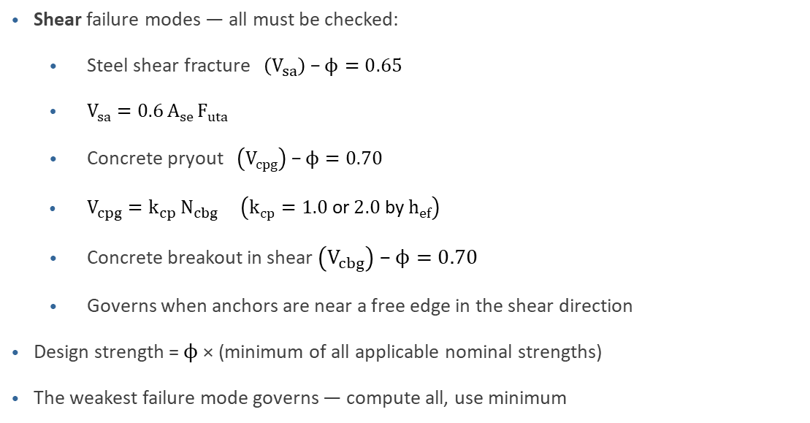
ACI 318-19 Chapter 17 — Concrete Anchor Failure Modes
Vibrationdata
Shear failure modes — all must be checked:
  Steel shear fracture $\left(V_{sa}\right) \text{−} ϕ=0.65$
  $V_{sa}=0.6 A_{se} F_{uta}$
  Concrete pryout $\left(V_{cpg}\right) \text{−} ϕ=0.70$
  $V_{cpg}=k_{cp} N_{cbg}$ $\left(k_{cp}=1.0 \text{or} 2.0 \text{by} h_{ef}\right)$
  Concrete breakout in shear $\left(V_{cbg}\right)\text{ − }ϕ=0.70$
  Governs when anchors are near a free edge in the shear direction
Design strength = $ϕ$ × (minimum of all applicable nominal strengths)
The weakest failure mode governs — compute all, use minimum
9

Slide 16
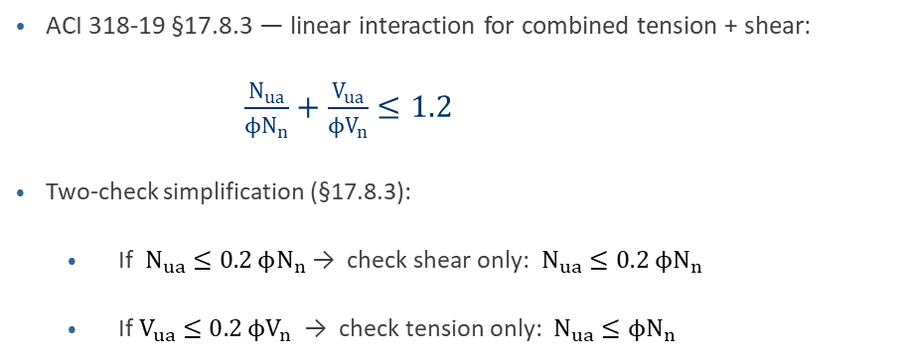
Combined Tension and Shear — ACI 318-19 §17.8
Vibrationdata
ACI 318-19 §17.8.3 — linear interaction for combined tension + shear:
      $\frac{N_{ua}}{ϕN_{n}}+\frac{V_{ua}}{ϕV_{n}}≤1.2$
Two-check simplification (§17.8.3):
  If $N_{ua}≤0.2 ϕN_{n}$→ check shear only: $N_{ua}≤0.2 ϕN_{n}$
  If $V_{ua}≤0.2 ϕV_{n}$ → check tension only: $N_{ua}≤ϕN_{n}$
10

Slide 17
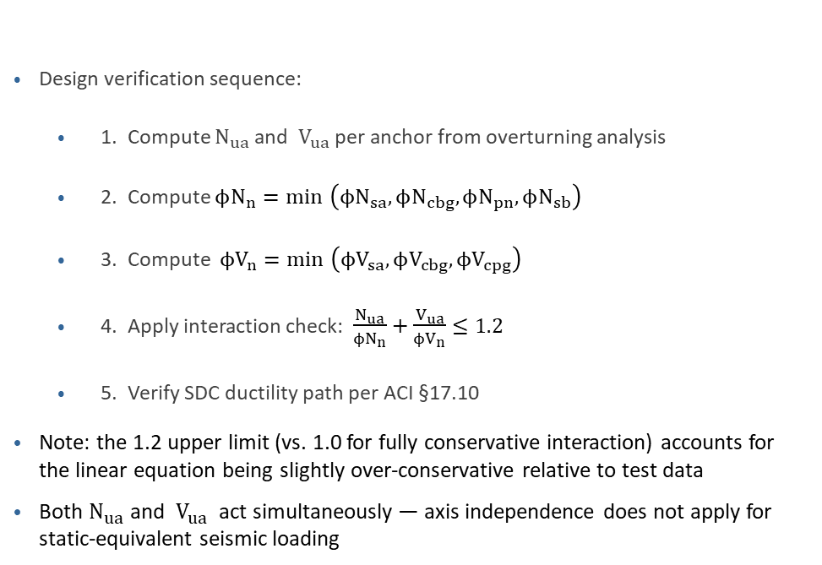
Combined Tension and Shear — ACI 318-19 §17.8 (cont)
Vibrationdata
Design verification sequence:
  1. Compute $N_{ua}$ and $V_{ua}$ per anchor from overturning analysis
  2. Compute $ϕN_{n}=\min{​}\left(ϕN_{sa}, ϕN_{cbg}, ϕN_{pn}, ϕN_{sb}\right)$
  3. Compute $ϕV_{n}=\min{​}\left(ϕV_{sa}, ϕV_{cbg}, ϕV_{cpg}\right)$
  4. Apply interaction check: $\frac{N_{ua}}{ϕN_{n}}+\frac{V_{ua}}{ϕV_{n}}≤1.2$
  5. Verify SDC ductility path per ACI §17.10
Note: the 1.2 upper limit (vs. 1.0 for fully conservative interaction) accounts for the linear equation being slightly over-conservative relative to test data
Both $N_{ua}$ and $V_{ua}$ act simultaneously — axis independence does not apply for static-equivalent seismic loading
10

Slide 18

Concrete Breakout in Tension — ACI 318-19 §17.6.2
Vibrationdata
Basic single-anchor breakout (Eq. 17.6.2.2a, in-lbf units):
$$N_{b}=k_{c}\sqrt{f{ ′}_{c}} h_{ef}^{1.5} \left[ k_{c}=24\text{ (}\text{cast}\text{−}\text{in}\text{)}, 16\text{ (}\text{post}\text{−}\text{installed}\text{)} \right]$$
Group breakout (Eq. 17.6.2.1b) with five modification factors:
$$N_{cbg}=\left({A_{Nc}}/{A_{Nco}}\right)Ψ_{ec,N}Ψ_{ed,N}Ψ_{c,N}Ψ_{cp,N}{ N}_{b}$$
11

Slide 19
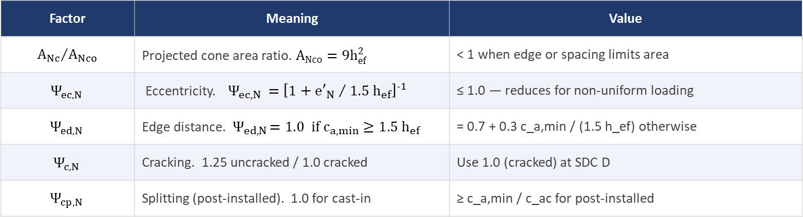
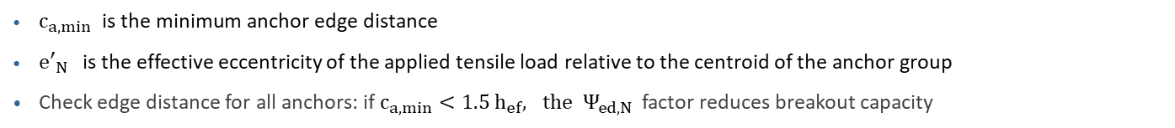
Concrete Breakout in Tension — ACI 318-19 §17.6.2 (cont)
Vibrationdata
Factor | Meaning | Value
$${A_{Nc}}/{A_{Nco}}$$ | Projected cone area ratio. $A_{Nco}=9h_{ef}^{2}$ | < 1 when edge or spacing limits area
$$Ψ_{ec,N}$$ | Eccentricity. $Ψ_{ec,N} ={\left[1+{e′_{N} }/{ 1.5{ h}_{ef}}\right]}^{-1}$ | ≤ 1.0 — reduces for non-uniform loading
$$Ψ_{ed,N}$$ | Edge distance.${ Ψ}_{ed,N} =1.0 \text{if} c_{a,min}≥1.5 h_{ef}$ | = 0.7 + 0.3 c_a,min / (1.5 h_ef) otherwise
$$Ψ_{c,N}$$ | Cracking. 1.25 uncracked / 1.0 cracked | Use 1.0 (cracked) at SDC D
$$Ψ_{cp,N}$$ | Splitting (post-installed). 1.0 for cast-in | ≥ c_a,min / c_ac for post-installed
$c_{a,min} \text{is} \text{the} \text{minimum} \text{anchor} \text{edge} \text{distance}$
$e′_{N}$is the effective eccentricity of the applied tensile load relative to the centroid of the anchor group
Check edge distance for all anchors: if $c_{a,min}<1.5 h_{ef}, the Ψ_{ed,N}$ factor reduces breakout capacity
11

Slide 20

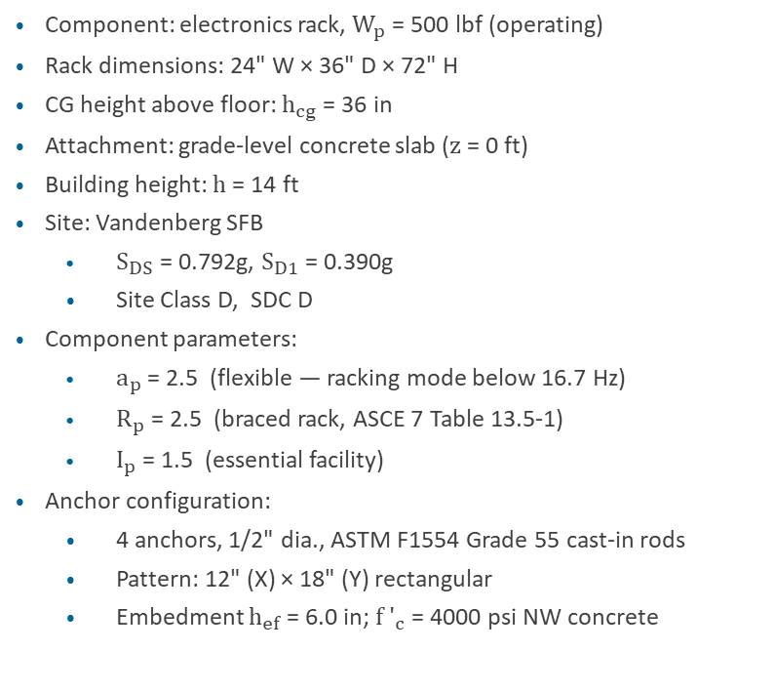




Worked Example — Problem Description
Vibrationdata
Component: electronics rack, $W_{p}$ = 500 lbf (operating)
Rack dimensions: 24" W × 36" D × 72" H
CG height above floor: $h_{cg}$ = 36 in
Attachment: grade-level concrete slab (z = 0 ft)
Building height: h = 14 ft
Site: Vandenberg SFB
  $S_{DS}$ = 0.792g, $S_{D1}$ = 0.390g
  Site Class D, SDC D
Component parameters:
  $a_{p}$ = 2.5 (flexible — racking mode below 16.7 Hz)
  $R_{p}$ = 2.5 (braced rack, ASCE 7 Table 13.5-1)
  $I_{p}$ = 1.5 (essential facility)
Anchor configuration:
  4 anchors, 1/2" dia., ASTM F1554 Grade 55 cast-in rods
  Pattern: 12" (X) × 18" (Y) rectangular
  Embedment $h_{ef}$ = 6.0 in; ${f ′}_{c}$ = 4000 psi NW concrete
Electronics Rack
$$W_{p}=500 lbf$$
Inertial Force $F_{p}$
CG $h_{cg}$= 36"
Tension ($N_{ua}$)
$V_{ua}$ (shear)
Compression
Concrete slab (${f '}_{c}$ = 4000 psi)
Plan view — 12" × 18" pattern
12

Slide 21
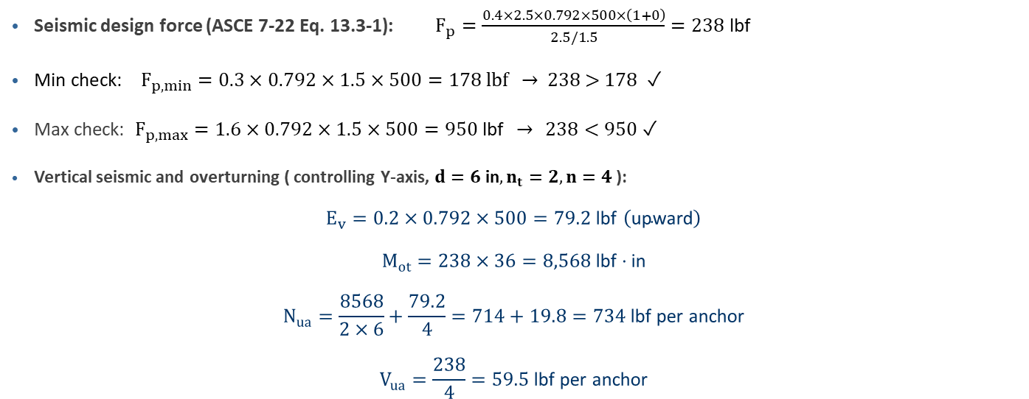
Worked Example — Force and Anchor Demands
Vibrationdata
Seismic design force (ASCE 7-22 Eq. 13.3-1): $F_{p}=\frac{0.4×2.5×0.792×500×\left(1+0\right)}{2.5/1.5}=238 \text{lbf}$
$\text{Min} \text{check}\text{: } F_{p,min}=0.3×0.792×1.5×500=178 \text{lbf} \text{→ 238 > 178 }\text{✓}$
Max check: $F_{p,max}=1.6×0.792×1.5×500=950 \text{lbf} → 238<950$ $\text{✓}$
Vertical seismic and overturning ( controlling Y-axis, $d=6 \text{in},n_{t}=2,n=4$):
$$E_{v}=0.2×0.792×500=79.2 \text{lbf} \left(\text{upward}\right)$$
$$M_{ot}=238×36=8,568 \text{lbf}⋅\text{in}$$
$$N_{ua}=\frac{8568}{2×6}+\frac{79.2}{4}=714+19.8=734 \text{lbf} \text{per} \text{anchor}$$
$$V_{ua}=\frac{238}{4}=59.5 \text{lbf} \text{per} \text{anchor}$$
Both $N_{ua}$ and $V_{ua}$ act on the same anchor simultaneously — the interaction check must account for the combined multiaxial stress state
13

Slide 22
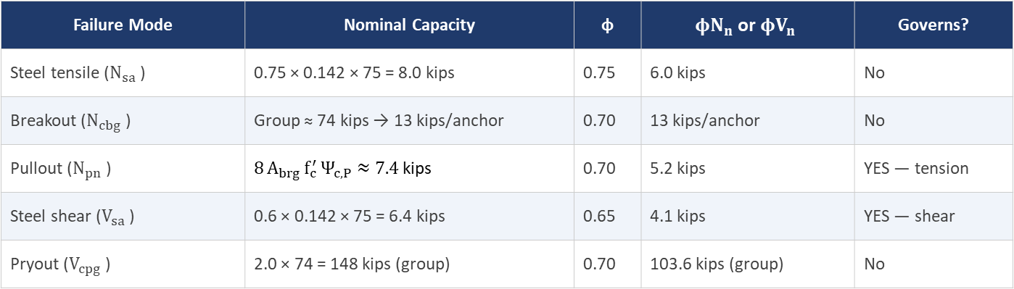
Worked Example — ACI 318-19 Anchor Capacity
Vibrationdata
Anchor: ½" ASTM F1554 Gr. 55 cast-in, $h_{ef}=6 \text{in}, f′_{c}=4000 \text{psi} \left(\text{NW}\right),{ A}_{se}=0.142 {\text{in}}^{2},F_{uta}=75 \text{ksi}$
Failure Mode | Nominal Capacity | φ | $$φN_{n} \text{or} φV_{n}$$ | Governs?
Steel tensile ($N_{sa}$ ) | 0.75 × 0.142 × 75 = 8.0 kips | 0.75 | 6.0 kips | No
Breakout ($N_{cbg}$ ) | Group ≈ 74 kips → 13 kips/anchor | 0.70 | 13 kips/anchor | No
Pullout ($N_{pn}$ ) | $$8 A_{brg} f_{c}^{′} Ψ_{c,P}≈7.4 \text{kips}$$ | 0.70 | 5.2 kips | YES — tension
Steel shear ($V_{sa}$ ) | 0.6 × 0.142 × 75 = 6.4 kips | 0.65 | 4.1 kips | YES — shear
Pryout ($V_{cpg}$ ) | 2.0 × 74 = 148 kips (group) | 0.70 | 103.6 kips (group) | No
Controlling capacities: $ϕN_{n}=5.2 \text{kips}$(pullout) , $ϕV_{n}=4.1 \text{kips}$ (steel shear)
14

Slide 23
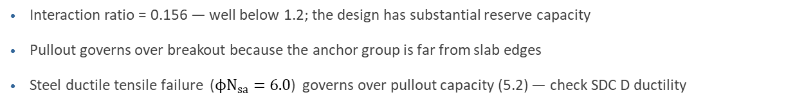
Worked Example — ACI 318-19 Anchor Capacity (cont)
Vibrationdata
$$\frac{N_{ua}}{ϕN_{n}}+\frac{V_{ua}}{ϕV_{n}}=\frac{0.734}{5.2}+\frac{0.0595}{4.1}=0.141+0.015=0.156≤1.2 ✓$$
Interaction ratio = 0.156 — well below 1.2; the design has substantial reserve capacity
Pullout governs over breakout because the anchor group is far from slab edges
Steel ductile tensile failure ($ϕN_{sa}=6.0$) governs over pullout capacity (5.2) — check SDC D ductility
14

Slide 24
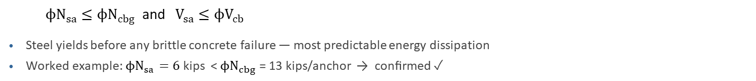
SDC D Special Requirements — ACI 318-19 §17.10
Vibrationdata
At SDC C through F, the anchor connection must satisfy one of three ductility paths:
Option A — Ductile Steel Governs (preferred)
$$ϕN_{sa}≤ϕN_{cbg} \text{and}{ V}_{sa}≤ϕV_{cb}$$
Steel yields before any brittle concrete failure — most predictable energy dissipation
Worked example: $ϕN_{sa}=6$ kips < $ϕN_{cbg}$ = 13 kips/anchor → confirmed ✓
Option B — Group Ductility
Concrete group capacity must exceed steel yield force by a ductility factor
Less common for equipment anchorage; requires careful calculation
Option C — Overstrength (Ω₀ = 2.0)
Design anchors for $Ω_{0}×F_{p}$ where $Ω_{0}=2.0$ (ASCE 7-22 Table 12.2-1)
Required when ductility cannot be demonstrated (non-ductile post-installed, breakout governs)
Doubles the design demand — often drives redesign to cast-in or larger-diameter rods
Worked example satisfies Option A — no overstrength factor needed for this cast-in anchor configuration
15

Slide 25
Post-Installed Anchors
Vibrationdata
Mechanical (expansion) anchors — ICC-ES AC193:
  Torque-controlled or displacement-controlled types
  Must achieve Seismic Category 1 for SDC C–F
  Category 1 = tested in cracked concrete with seismic cyclic shear loading
  Examples: Hilti Kwik Bolt TZ, Simpson Strong-Bolt
Adhesive (chemical) anchors — ICC-ES AC308:
  Temperature knockdown factor for elevated-temperature service
  Sustained tensile load reduction factor must be applied
  Must achieve Category 1 (cracked concrete) for SDC C–F
  Examples: Hilti HIT-RE 500, Simpson SET-XP
16

Slide 26
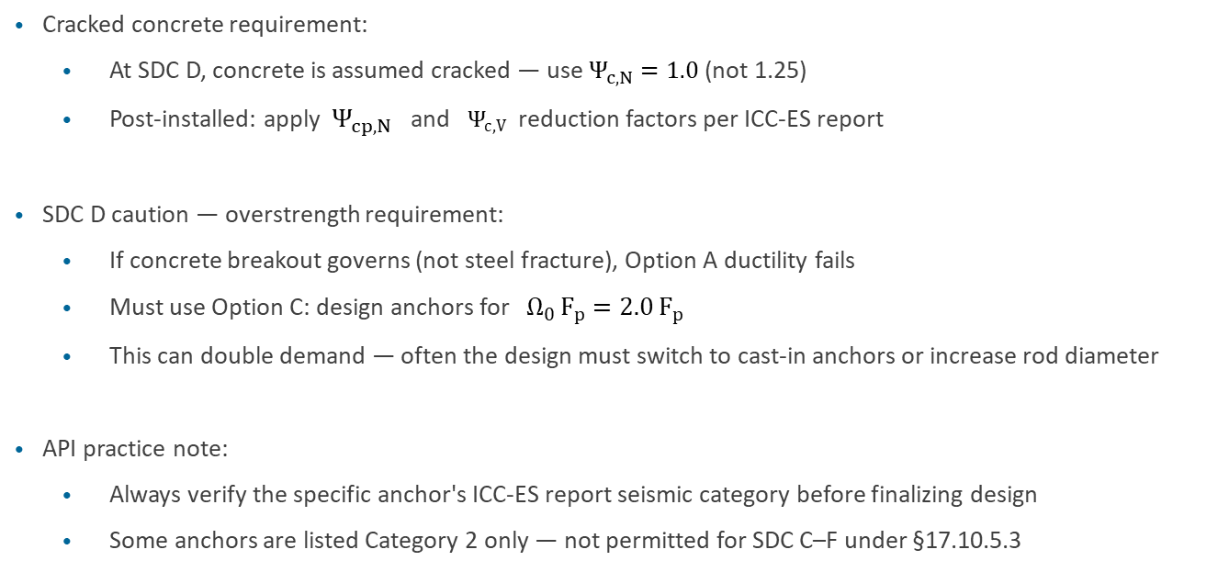
Post-Installed Anchors
Vibrationdata
Cracked concrete requirement:
  At SDC D, concrete is assumed cracked — use $Ψ_{c,N}=1.0$(not 1.25)
  Post-installed: apply ${ Ψ}_{cp,N}$ and $Ψ_{c,V}$ reduction factors per ICC-ES report
SDC D caution — overstrength requirement:
  If concrete breakout governs (not steel fracture), Option A ductility fails
  Must use Option C: design anchors for $Ω_{0} F_{p}=2.0 F_{p}$
  This can double demand — often the design must switch to cast-in anchors or increase rod diameter
API practice note:
  Always verify the specific anchor's ICC-ES report seismic category before finalizing design
  Some anchors are listed Category 2 only — not permitted for SDC C–F under §17.10.5.3
16

Slide 27
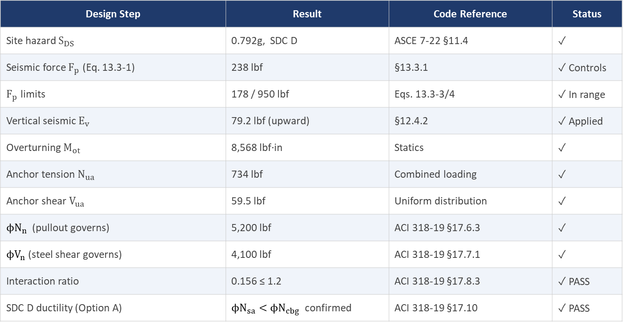
Worked Example — Summary of Results
Vibrationdata
Design Step | Result | Code Reference | Status
Site hazard $S_{DS}$ | 0.792g, SDC D | ASCE 7-22 §11.4 | ✓
Seismic force $F_{p}$ (Eq. 13.3-1) | 238 lbf | §13.3.1 | ✓ Controls
$F_{p}$ limits | 178 / 950 lbf | Eqs. 13.3-3/4 | ✓ In range
Vertical seismic $E_{v}$ | 79.2 lbf (upward) | §12.4.2 | ✓ Applied
Overturning $M_{ot}$ | 8,568 lbf·in | Statics | ✓
Anchor tension $N_{ua}$ | 734 lbf | Combined loading | ✓
Anchor shear $V_{ua}$ | 59.5 lbf | Uniform distribution | ✓
$ϕN_{n}$ (pullout governs) | 5,200 lbf | ACI 318-19 §17.6.3 | ✓
$ϕV_{n}$ (steel shear governs) | 4,100 lbf | ACI 318-19 §17.7.1 | ✓
Interaction ratio | 0.156 ≤ 1.2 | ACI 318-19 §17.8.3 | ✓ PASS
SDC D ductility (Option A) | $ϕN_{sa}<ϕN_{cbg}$ confirmed | ACI 318-19 §17.10 | ✓ PASS
17

Slide 28
Worked Example — Summary of Results (cont)
Vibrationdata
The controlling failure mode is pullout (tension) and steel fracture (shear) — both are non-brittle or ductile for cast-in anchors
The combined interaction ratio of 0.156 indicates the ½" anchors are substantially adequate; a smaller rod diameter could be explored if construction permits
17

Slide 29
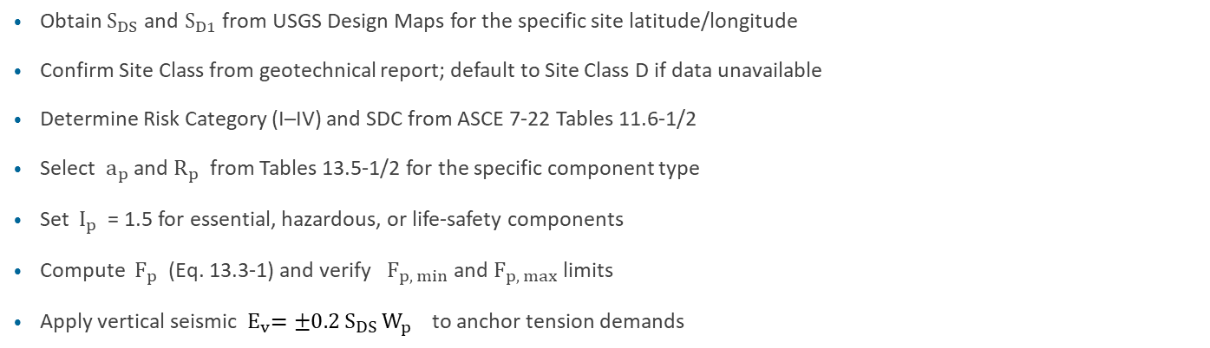
Design Checklist — ASCE 7-22 Seismic Anchor Bolt Analysis
Vibrationdata
Obtain $S_{DS}$ and $S_{D1}$ from USGS Design Maps for the specific site latitude/longitude
Confirm Site Class from geotechnical report; default to Site Class D if data unavailable
Determine Risk Category (I–IV) and SDC from ASCE 7-22 Tables 11.6-1/2
Select ${ a}_{p}$ and $R_{p}$ from Tables 13.5-1/2 for the specific component type
Set $I_{p}$ = 1.5 for essential, hazardous, or life-safety components
Compute $F_{p}$ (Eq. 13.3-1) and verify $F_{p, min}$ and $F_{p, max}$ limits
Apply vertical seismic ${ E}_{v}=±0.2 S_{DS} W_{p}$ to anchor tension demands
18

Slide 30
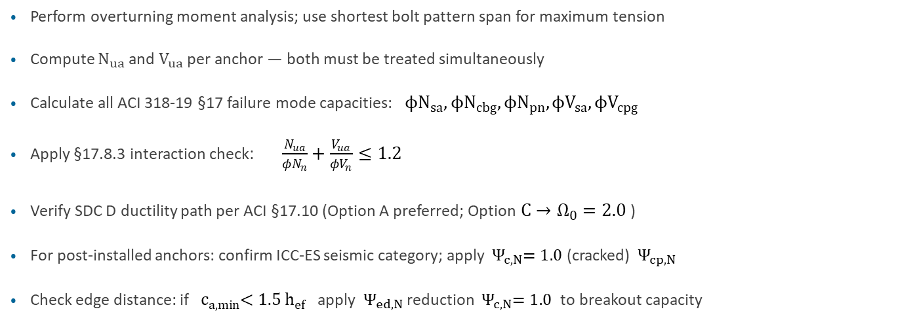
Design Checklist — ASCE 7-22 Seismic Anchor Bolt Analysis
Vibrationdata
Perform overturning moment analysis; use shortest bolt pattern span for maximum tension
Compute $N_{ua}$ and $V_{ua}$ per anchor — both must be treated simultaneously
Calculate all ACI 318-19 §17 failure mode capacities: $ϕN_{sa}, ϕN_{cbg}, ϕN_{pn}, ϕV_{sa}, ϕV_{cpg}$
Apply §17.8.3 interaction check: $\frac{N_{ua}}{φN_{n}}+\frac{V_{ua}}{φV_{n}}≤1.2$
Verify SDC D ductility path per ACI §17.10 (Option A preferred; Option $C→Ω_{0}=2.0$ )
For post-installed anchors: confirm ICC-ES seismic category; apply ${ Ψ}_{c,N}=1.0$ (cracked) ${ Ψ}_{cp,N}$
Check edge distance: if ${ c}_{a,min}<1.5 h_{ef}$ apply ${ Ψ}_{ed,N}$ reduction ${ Ψ}_{c,N}=1.0$ to breakout capacity
18

