Slide 1
Vibrationdata
Multi-degree-of-freedom System
Shock Response Spectrum
Revision F

Slide 2
Introduction
Vibrationdata
The Shock Response Spectrum (SRS) can be extended to multi-degree-of-freedom systems
There are two options each requires a starting normal modes analysis
  Modal transient analysis using synthesized waveform
  Approximation techniques using participation factors and normal modes (modal combination methods)
The second method is called Modal Response Spectrum Analysis (MRSA) in earthquake engineering
It is a dynamic analysis method used in seismic design, including procedures referenced in ASCE 7-22 Chapter 12
Both method assume linearity

Slide 3
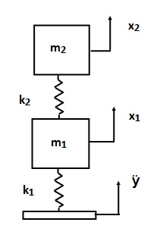
Two-dof System Subjected to Base Excitation
Vibrationdata
Damping will be applied as modal damping

Slide 4


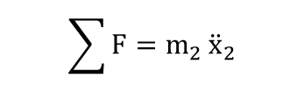
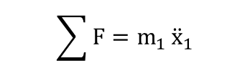
Free-Body Diagrams
k₂ ( x₂ - x₁ )
x₂
m₂
x₁
m₁
k₂ (x₂-x₁)
k₁ ( x₁ - y )
$$\sum{F=m_{1}}{\ddot{x}}_{1}$$
$$\sum{F=m_{2}}{\ddot{x}}_{2}$$
$$m_{1}{\ddot{x}}_{1}{+\left(k_{1}+k_{2}\right)x}_{1}−k_{2}x_{2}=k_{1}y$$
$$m_{2}{\ddot{x}}_{2}{+k_{2}x}_{2}−k_{2}x_{1}=0$$

Slide 5
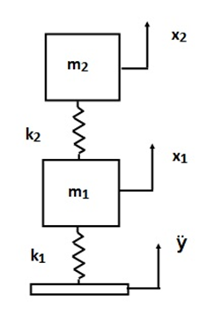
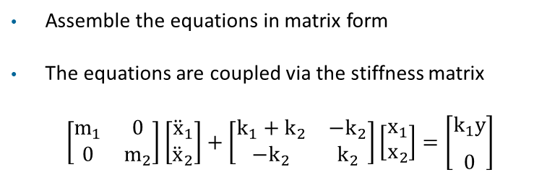
Global Equations of Motion
Vibrationdata
Assemble the equations in matrix form
The equations are coupled via the stiffness matrix
$$\left[\begin{matrix}m_{1} & 0 \\ 0 & m_{2}\end{matrix}\right]\left[\begin{matrix}{\ddot{x}}_{1} \\ {\ddot{x}}_{2}\end{matrix}\right]+\left[\begin{matrix}k_{1}+k_{2} & −k_{2} \\ −k_{2} & k_{2}\end{matrix}\right]\left[\begin{matrix}x_{1} \\ x_{2}\end{matrix}\right]=\left[\begin{aligned}k_{1}y \\ \begin{matrix} \\ 0\end{matrix}\end{aligned}\right]$$

Slide 6

Relative Displacement Substitution
Vibrationdata
Define relative displacement terms as follows
$$z_{1}=x_{1}−y$$
$z_{2}=x_{2} −$ $y$
$$x_{1}=z_{1}+y$$
$$x_{2}=z_{2}+y$$
The resulting equation of motion is
$$\left[\begin{matrix}m_{1} & 0 \\ 0 & m_{2}\end{matrix}\right]\left[\begin{matrix}{\ddot{z}}_{1} \\ {\ddot{z}}_{2}\end{matrix}\right]+\left[\begin{matrix}k_{1}+k_{2} & −k_{2} \\ −k_{2} & k_{2}\end{matrix}\right]\left[\begin{matrix}z_{1} \\ z_{2}\end{matrix}\right]=\left[\begin{aligned}{−m}_{1}\ddot{y} \\ {−m}_{2}\ddot{y}\begin{matrix} \\ \end{matrix}\end{aligned}\right]$$
This works for some simple systems. Enforced acceleration method is required for other systems.

Slide 7

General Form
Vibrationdata
The equation of motion is
$$M \overline{\ddot{z}}+K \overline{z}=\overline{F}$$
where
$$M=\left[\begin{matrix}m_{1} & 0 \\ 0 & m_{2}\end{matrix}\right], K=\left[\begin{matrix}k_{1}+k_{2} & −k_{2} \\ −k_{2} & k_{2}\end{matrix}\right], \overline{F}=\left[\begin{aligned}{−m}_{1}\ddot{y} \\ {−m}_{2}\ddot{y}\begin{matrix} \\ \end{matrix}\end{aligned}\right]$$
$$\overline{z}=\left[\begin{aligned}z_{1} \\ z_{2}\begin{matrix} \\ \end{matrix}\end{aligned}\right]$$

Slide 8
Decoupling
Vibrationdata
Decouple equation of motion using eigenvalues and eigenvectors
The natural frequencies are calculated from the eigenvalues
The eigenvectors are the “orthogonal normal modes”
Details given in accompanying reference papers

Slide 9
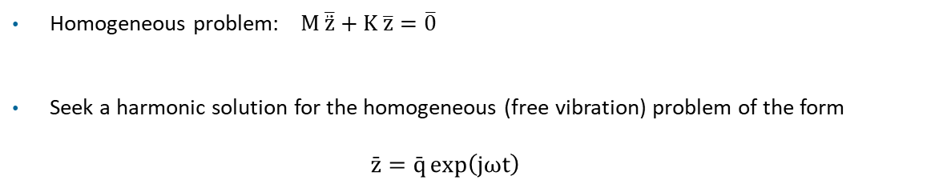
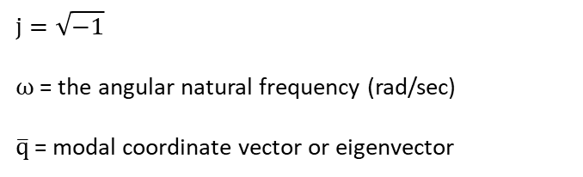
Proposed Solution
Vibrationdata
Homogeneous problem: $M \overline{\ddot{z}}+K \overline{z}=\overline{0}$
Seek a harmonic solution for the homogeneous (free vibration) problem of the form
  $$\bar{z}=\bar{q}\exp\left(jωt\right)$$
where
$$j=\sqrt{−1}$$
ω = the angular natural frequency (rad/sec)
$\overline{q}$= modal coordinate vector or eigenvector

Slide 10
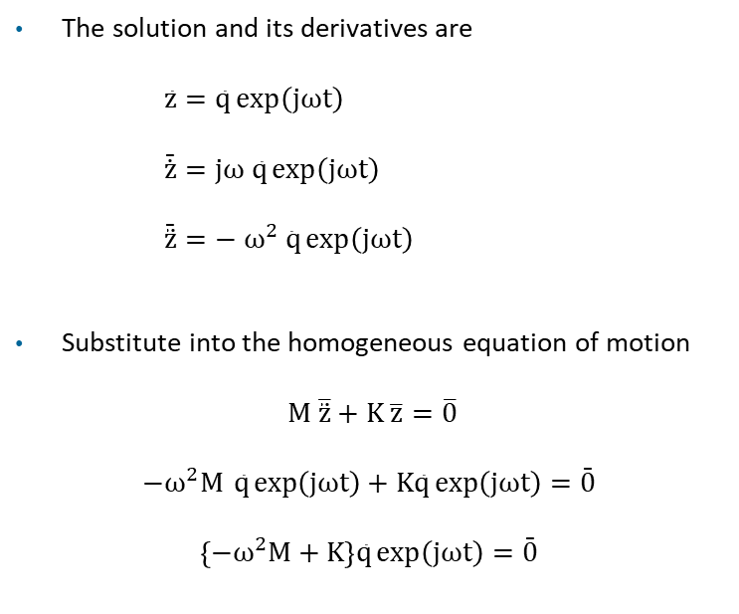
Solution Development
Vibrationdata
The solution and its derivatives are
    $$\bar{z}=\bar{q}\exp\left(jωt\right)$$
    $$\bar{\dot{z}}=jω \bar{q}\exp\left(jωt\right)$$
    $$\bar{\ddot{z}}=− ω^{2}\bar{ q}\exp\left(jωt\right)$$
Substitute into the homogeneous equation of motion
$M \overline{\ddot{z}}+K \overline{z}=\overline{0}$
$$−ω^{2}M \bar{q}\exp\left(jωt\right)+K\bar{q}\exp\left(jωt\right)=\bar{0}$$
$\left\{−ω^{2}M+K\right\}\bar{q}\exp\left(jωt\right)=\bar{0}$

Slide 11
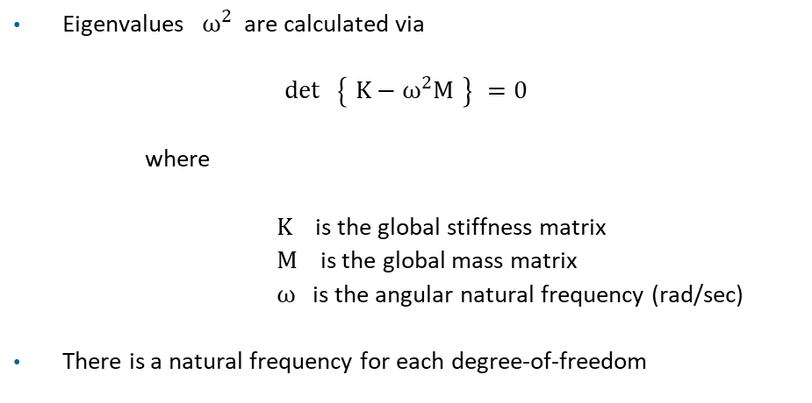
Generalized Eigenvalue Problem
Vibrationdata
Eigenvalues $ω^{2}$ are calculated via
$$\det{ }\left\{ K−ω^{2}M \right\} =0$$
where
K is the global stiffness matrix
M is the global mass matrix
ω is the angular natural frequency (rad/sec)
There is a natural frequency for each degree-of-freedom

Slide 12
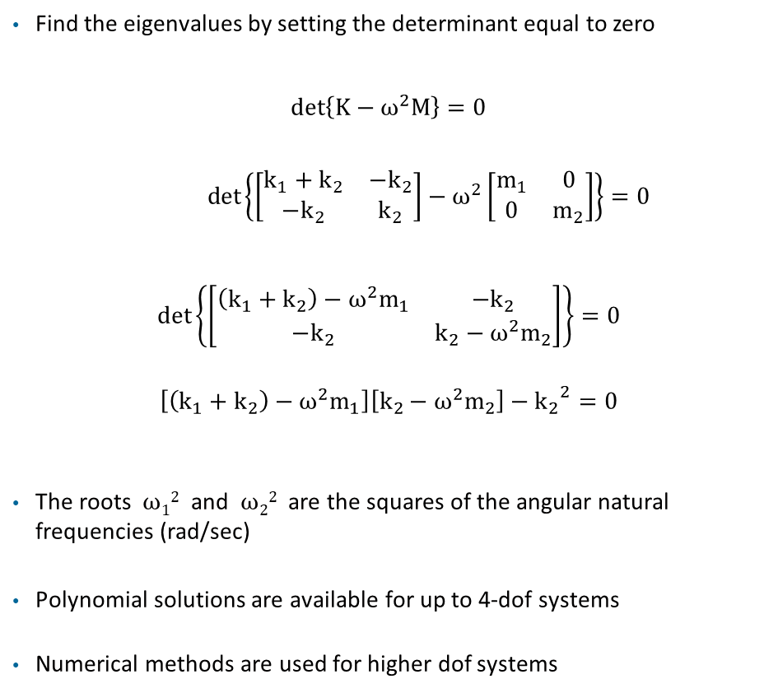
Solve for Eigenvalues
Vibrationdata
Find the eigenvalues by setting the determinant equal to zero
$$det\left\{K−ω^{2}M\right\}=0$$
$\det\left\{\left[\begin{matrix}k_{1}+k_{2} & −k_{2} \\ −k_{2} & k_{2}\end{matrix}\right]−ω^{2}\left[\begin{matrix}m_{1} & 0 \\ 0 & m_{2}\end{matrix}\right]\right\}=0$
$$\det\left\{\left[\begin{matrix}\left(k_{1}+k_{2}\right)−ω^{2}m_{1} & −k_{2} \\ −k_{2} & k_{2}−ω^{2}m_{2}\end{matrix}\right]\right\}=0$$
$$\left[\left(k_{1}+k_{2}\right)−ω^{2}m_{1}\right]\left[k_{2}−ω^{2}m_{2}\right]−{k_{2}}^{2}=0$$
The roots ω₁² and ω₂² are the squares of the angular natural frequencies (rad/sec)
Polynomial solutions are available for up to 4-dof systems
Numerical methods are used for higher dof systems

Slide 13
Generalized Eigenvalue
Vibrationdata
Numerical methods
  Cholesky reduction (most common in structural dynamics)
  QZ (Generalized Schur decomposition)
  Iterative methods (large sparse systems)
  Lanczos method (symmetric problems)
  Arnoldi method (non-symmetric problems)
  Shift-and-invert methods
  Rayleigh quotient–based methods
  Householder reduction → tridiagonal (symmetric case) or Hessenberg (general case)
  QR algorithm
Matlab uses public domain Lapack numerical library: https://www.netlib.org/lapack/

Slide 14
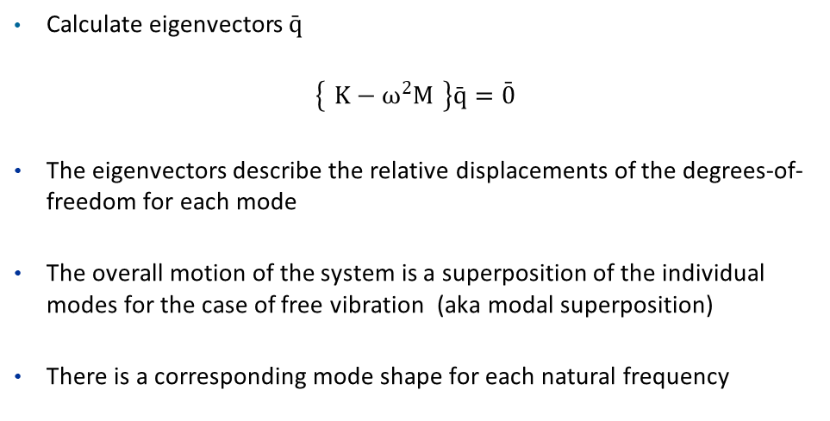
Generalized Eigenvalue Problem (cont)
Vibrationdata
Calculate eigenvectors $\bar{q}$
$$\left\{ K−ω^{2}M \right\}\bar{q}=\bar{0}$$
The eigenvectors describe the relative displacements of the degrees-of-freedom for each mode
The overall motion of the system is a superposition of the individual modes for the case of free vibration (aka modal superposition)
There is a corresponding mode shape for each natural frequency

Slide 15
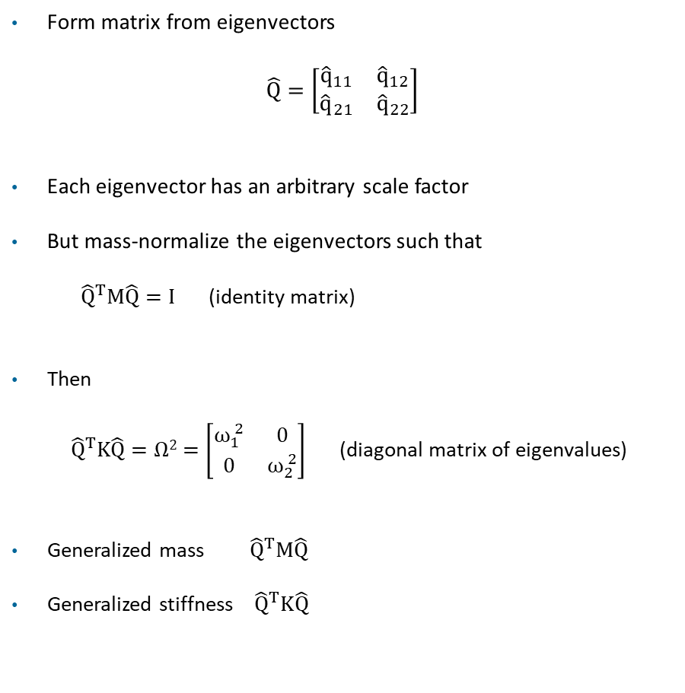
Eigenvector Relationship
Vibrationdata
Form matrix from eigenvectors
$$\hat{Q}=\left[\begin{matrix}{\hat{q}}_{11} & {\hat{q}}_{12} \\ {\hat{q}}_{21} & {\hat{q}}_{22}\end{matrix}\right]$$
Each eigenvector has an arbitrary scale factor
But mass-normalize the eigenvectors such that
${ \hat{Q}}^{T}M\hat{Q}=I$ (identity matrix)
Then
${\hat{Q}}^{T}K\hat{Q}=Ω2$ $=\left[\begin{matrix}ω_{1}^{ 2} & 0 \\ 0 & ω_{2}^{ 2}\end{matrix}\right]$ (diagonal matrix of eigenvalues)
Generalized mass ${ \hat{Q}}^{T}M\hat{Q}$
Generalized stiffness ${\hat{Q}}^{T}K\hat{Q}$
Column 1 is mode 1
Column 2 is mode 2
Row 1 is dof 1
Row 2 is dof 2

Slide 16

Decouple Equation of Motion
Vibrationdata
Coupled equation of motion
$M \overline{\ddot{z}}+K \overline{z}=\overline{F}$
Define a modal displacement coordinate $\bar{η}$
$\bar{z}=\hat{Q} \bar{η}$
Substitute into the equation of motion
$M \hat{Q }\overline{\ddot{η}} + K \hat{Q }\overline{η}= \overline{F}$
Premultiply by ${\hat{Q}}^{T}$
${\hat{Q} }^{T}M \hat{Q }\overline{\ddot{η}} + {\hat{Q} }^{T}K \hat{Q }\overline{η}= {\hat{Q} }^{T}\overline{F}$
Orthogonality relationships yields
$I \overline{\ddot{η}}+ Ω2 \overline{η}= {\hat{Q} }^{T}\overline{F}$

Slide 17
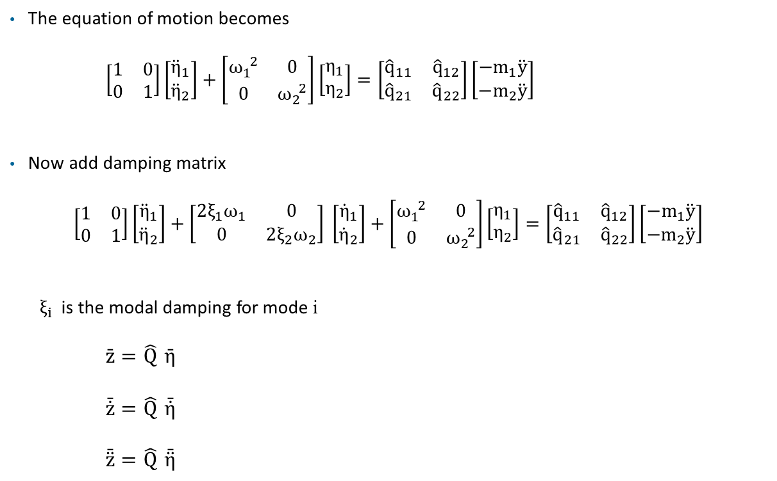

Modal Equations of Motion
Vibrationdata
The equation of motion becomes
$\left[\begin{matrix}1 & 0 \\ 0 & 1\end{matrix}\right]\left[\begin{matrix}{\ddot{η}}_{1} \\ {\ddot{η}}_{2}\end{matrix}\right]+\left[\begin{matrix}ω_{1}^{ 2} & 0 \\ 0 & ω_{2}^{ 2}\end{matrix}\right]\left[\begin{matrix}η_{1} \\ η_{2}\end{matrix}\right]=\left[\begin{matrix}{\hat{q}}_{11} & {\hat{q}}_{12} \\ {\hat{q}}_{21} & {\hat{q}}_{22}\end{matrix}\right]\left[\begin{matrix}{−m}_{1}\ddot{y} \\ −m_{2}\ddot{y}\end{matrix}\right]$
Now add damping matrix
$$\left[\begin{matrix}1 & 0 \\ 0 & 1\end{matrix}\right]\left[\begin{matrix}{\ddot{η}}_{1} \\ {\ddot{η}}_{2}\end{matrix}\right]+\left[\begin{matrix}2ξ_{1}ω_{1} & 0 \\ 0 & 2ξ_{2}ω_{2}\end{matrix}\right] \left[\begin{matrix}{\dot{η}}_{1} \\ {\dot{η}}_{2}\end{matrix}\right]+\left[\begin{matrix}ω_{1}^{ 2} & 0 \\ 0 & ω_{2}^{ 2}\end{matrix}\right]\left[\begin{matrix}η_{1} \\ η_{2}\end{matrix}\right]=\left[\begin{matrix}{\hat{q}}_{11} & {\hat{q}}_{12} \\ {\hat{q}}_{21} & {\hat{q}}_{22}\end{matrix}\right]\left[\begin{matrix}{−m}_{1}\ddot{y} \\ −m_{2}\ddot{y}\end{matrix}\right]$$
$ξ_{i}$ is the modal damping for mode i
    $$\bar{z}=\hat{Q} \bar{η}$$
    $$\bar{\dot{z}}=\hat{Q} \bar{\dot{η}}$$
    $$\bar{\ddot{z}}=\hat{Q} \bar{\ddot{η}}$$
$$x_{1}=z_{1}+y$$
$$x_{2}=z_{2}+y$$

Slide 18
Candidate Methods, Time Domain Seismic Response
Method | Stability | Accuracy | Nonlinear | Cost/step | Notes for earthquake use
Laplace transform | Exact | Exact | No | N/A | Requires closed-form forcing. Recorded accelerograms have none — disqualifying.
Runge-Kutta (RK4) | Conditional | 4th order | Yes | High | Unstable for stiff MDOF systems. Non-symplectic — energy drift over long records.
Central difference | Conditional | 2nd order | Yes | Low | Explicit workhorse for highly nonlinear problems (LS-DYNA). Δt limited by highest mode.
Newmark-β (γ=½, β=¼) | Unconditional | 2nd order | Yes | Medium | Workhorse for nonlinear time-history. Iterates cleanly through yielding and hysteresis.
HHT-α / generalized-α | Unconditional | 2nd order | Yes | Medium | Adds tunable numerical damping for spurious high-frequency modes. Common in modern FE codes.
Digital recursive filter | Excellent | Machine | Linear only | Very low | Closed-form recursion under piecewise-linear forcing at constant Δt.

Slide 19
Participation Factors
Vibrationdata
Participation factors and effective modal mass values can be calculated from the eigenvectors and mass matrix
These factors represent how “excitable” each mode is for base excitation
Please read:
https://blog.vibrationdata.com/2026/02/07/effective-modal-mass-and-modal-participation-factors/

Slide 20

Participation Factors for Example
Vibrationdata
The expanded equation of motion is
$$\left[\begin{matrix}1 & 0 \\ 0 & 1\end{matrix}\right]\left[\begin{matrix}{\ddot{η}}_{1} \\ {\ddot{η}}_{2}\end{matrix}\right]+\left[\begin{matrix}2ξ_{1}ω_{1} & 0 \\ 0 & 2ξ_{2}ω_{2}\end{matrix}\right] \left[\begin{matrix}{\dot{η}}_{1} \\ {\dot{η}}_{2}\end{matrix}\right]+\left[\begin{matrix}ω_{1}^{ 2} & 0 \\ 0 & ω_{2}^{ 2}\end{matrix}\right]\left[\begin{matrix}η_{1} \\ η_{2}\end{matrix}\right]=\left[\begin{matrix}{\hat{q}}_{11} & {\hat{q}}_{12} \\ {\hat{q}}_{21} & {\hat{q}}_{22}\end{matrix}\right]\left[\begin{matrix}{−m}_{1}\ddot{y} \\ −m_{2}\ddot{y}\end{matrix}\right]$$
  ${ Γ}_{i}$ is the participation factor for mode i
  ${\ddot{η}}_{i}$ $+ 2ξ_{i}ω_{i}$ ${\dot{η}}_{i}$ + $ω_{i}^{ 2}$ $η_{i}$ = $Γ_{i} \ddot{y}$
  For the two-dof example in this unit
    $\left[\begin{matrix}Γ_{1} \\ Γ_{2}\end{matrix}\right]= \left[\begin{matrix}{\hat{q}}_{11} & {\hat{q}}_{21} \\ {\hat{q}}_{12} & {\hat{q}}_{22}\end{matrix}\right] \left[\begin{matrix}−m_{1} \\ −m_{2}\end{matrix}\right]$

Slide 21
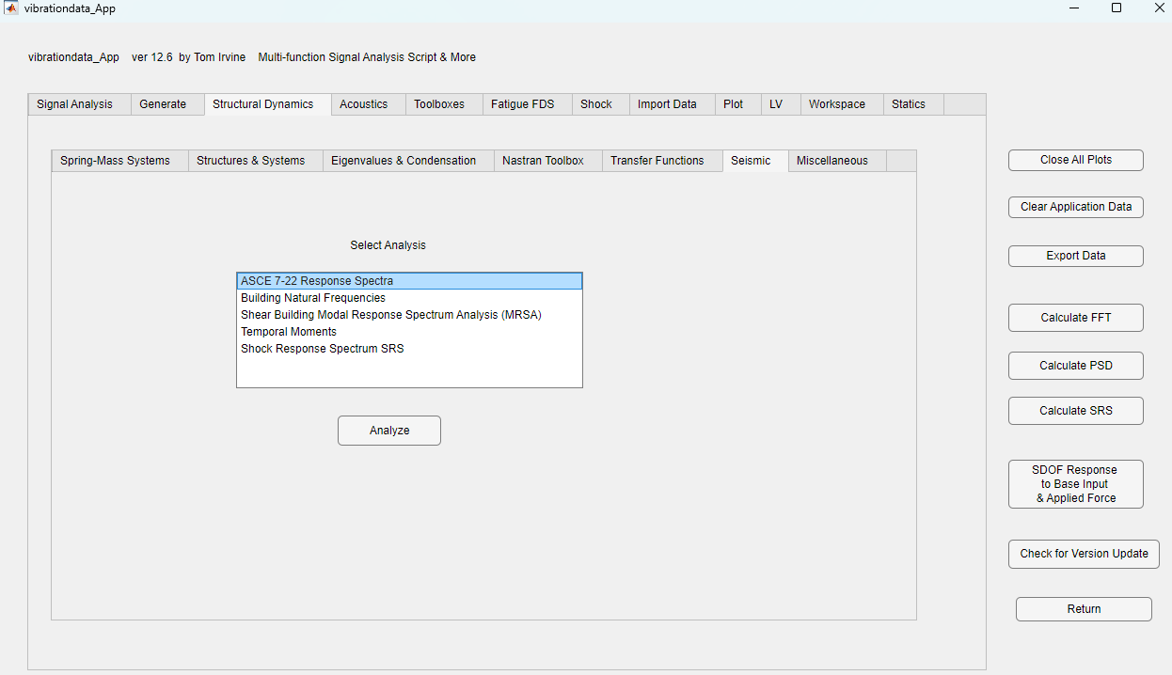

Slide 22
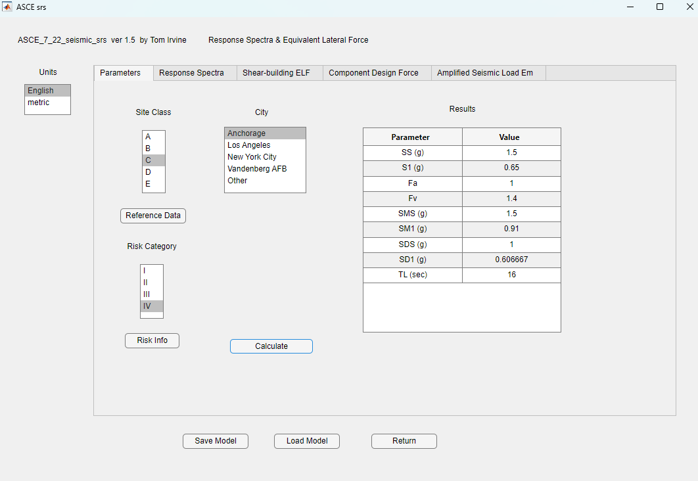

Slide 23
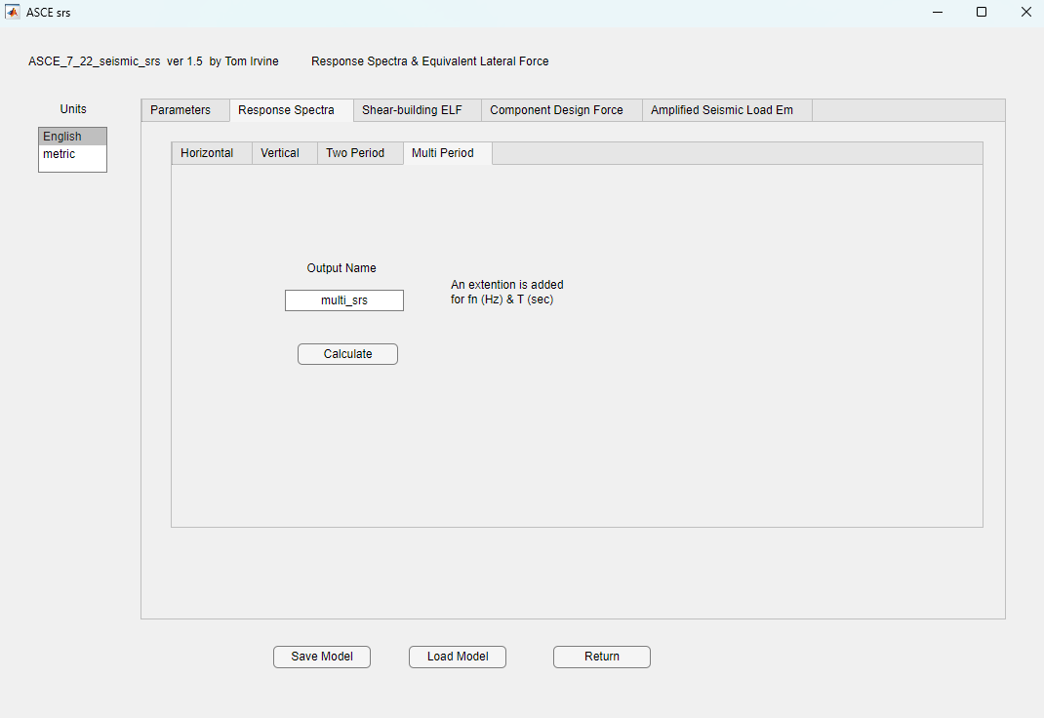

Slide 25
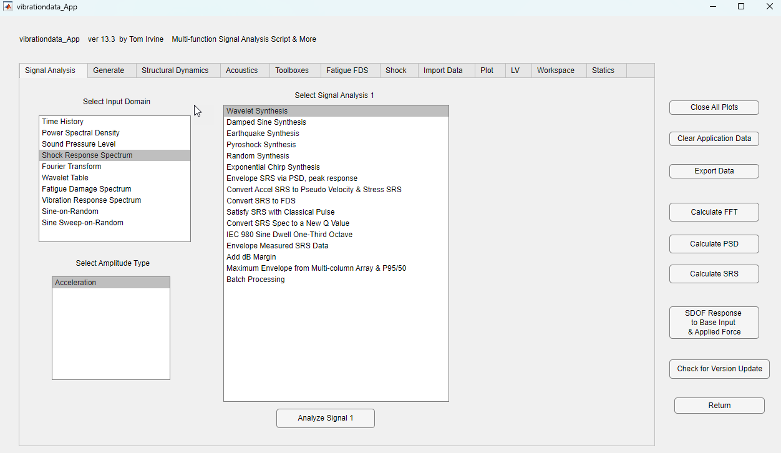

Slide 26
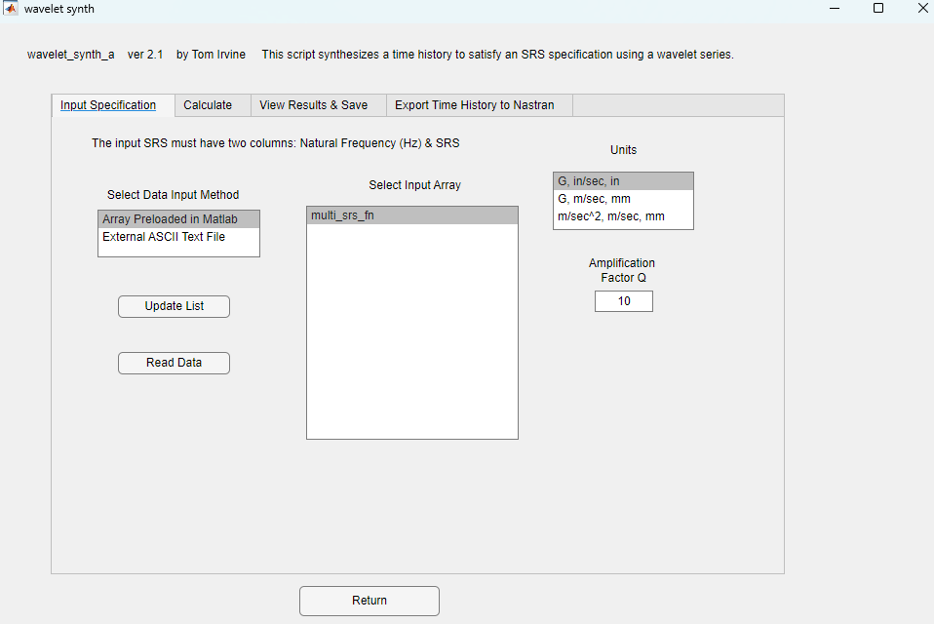
Q=10 is the same
as 5% damping

Slide 27
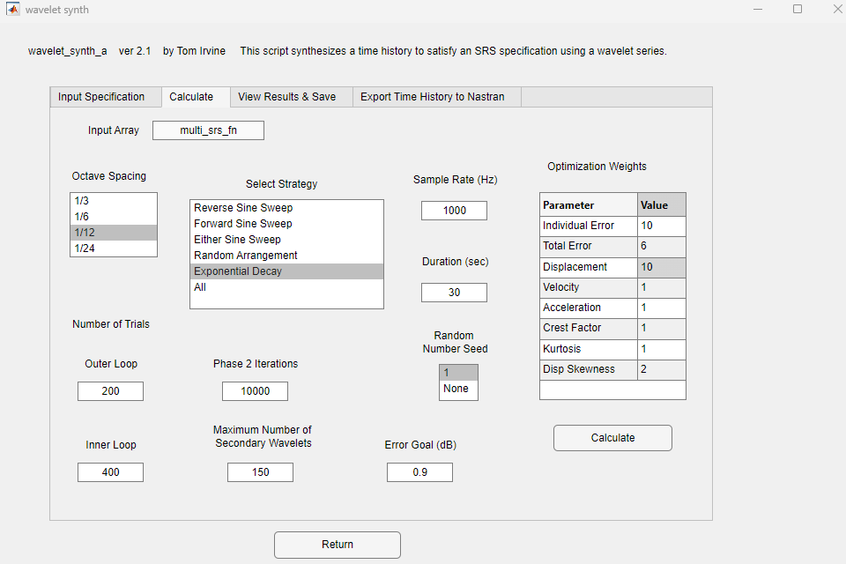

Slide 28
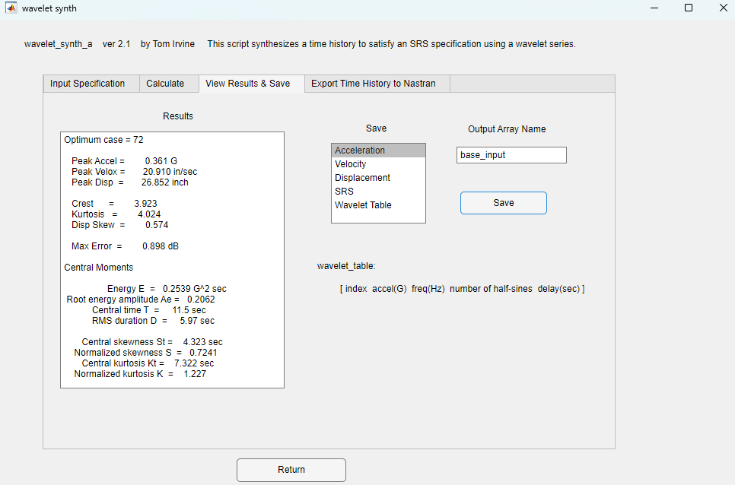

Slide 31
MDOF Estimation for SRS, Modal Combination Methods
Method | Description | Application
ABSSUM | absolute sum method | Highly conservative upper-bound combination
SRSS | square-root-of-the-sum-of-the-squares | Standard for systems with well-separated modal frequencies (Δf/f > 0.2). Appropriate for simple, lightly coupled MDOF structures.
CQC | Complete Quadratic Combination | Preferred for closely spaced modal frequencies or moderate damping (ξ ≈ 0.02–0.10). Recommended by ASCE 7 and IEEE 344 for seismic or dynamic response analyses.
NRL | Naval Research Laboratory method | Used in shock qualification standards (e.g., MIL-STD-810H, MIL-STD-1540). Suitable when empirical data or coupling information is available for transient or SRS testing.

Slide 32


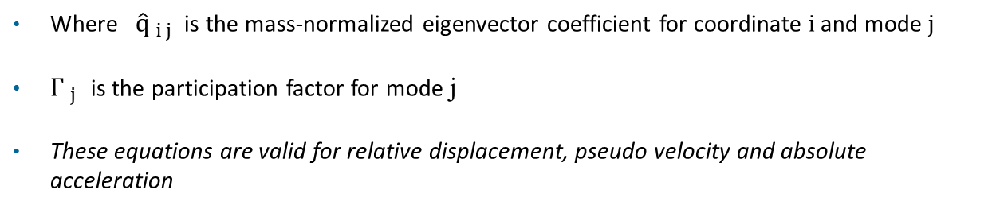

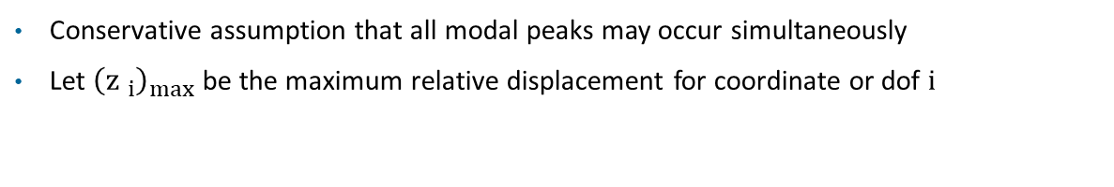
ABSSUM Method
Vibrationdata
Conservative assumption that all modal peaks may occur simultaneously
Let ${\left({z }_{i}\right)}_{max}$ be the maximum relative displacement for coordinate or dof i
$${\left({z }_{i}\right)}_{max} ≤\sum_{j = 1}^{N}{\left|{\hat{q}}_{ i j}\right| \left|{\left({η }_{j}\right)}_{max}\right|}$$
${\left({η }_{j}\right)}_{max}$ = ${ Γ}_{ j}$ ${\left({D }_{j}\right)}_{max}$
Pick D values directly from Relative Displacement SRS curve for mode j’s natural frequency
$${\left({z }_{i}\right)}_{max} ≤\sum_{j = 1}^{N}{\left|{\hat{q}}_{ i j}\right| \left|Γ_{ j}\right| \left|{\left({D }_{j}\right)}_{max}\right|}$$
Where ${\hat{q}}_{ i j}$ is the mass-normalized eigenvector coefficient for coordinate i and mode j
$Γ_{ j}$ is the participation factor for mode j
These equations are valid for relative displacement, pseudo velocity and absolute acceleration

Slide 33
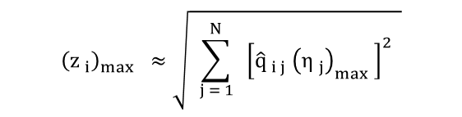
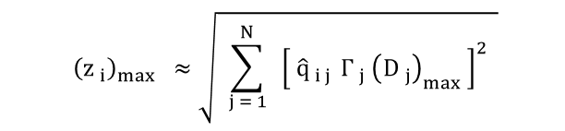
SRSS Method
Vibrationdata
$${\left({z }_{i}\right)}_{max} ≈\sqrt{ \sum_{j = 1}^{N}{ { \left[{\hat{q}}_{ i j} {\left({η }_{j}\right)}_{max} \right]}^{2} }}$$
Pick D values directly off of Relative Displacement SRS curve
$${\left({z }_{i}\right)}_{max} ≈\sqrt{ \sum_{j = 1}^{N}{ { \left[ {\hat{q}}_{ i j }Γ_{ j}{ \left({D }_{j}\right)}_{max} \right]}^{2} }}$$
These equations are valid for relative displacement, pseudo velocity and absolute acceleration

Slide 34
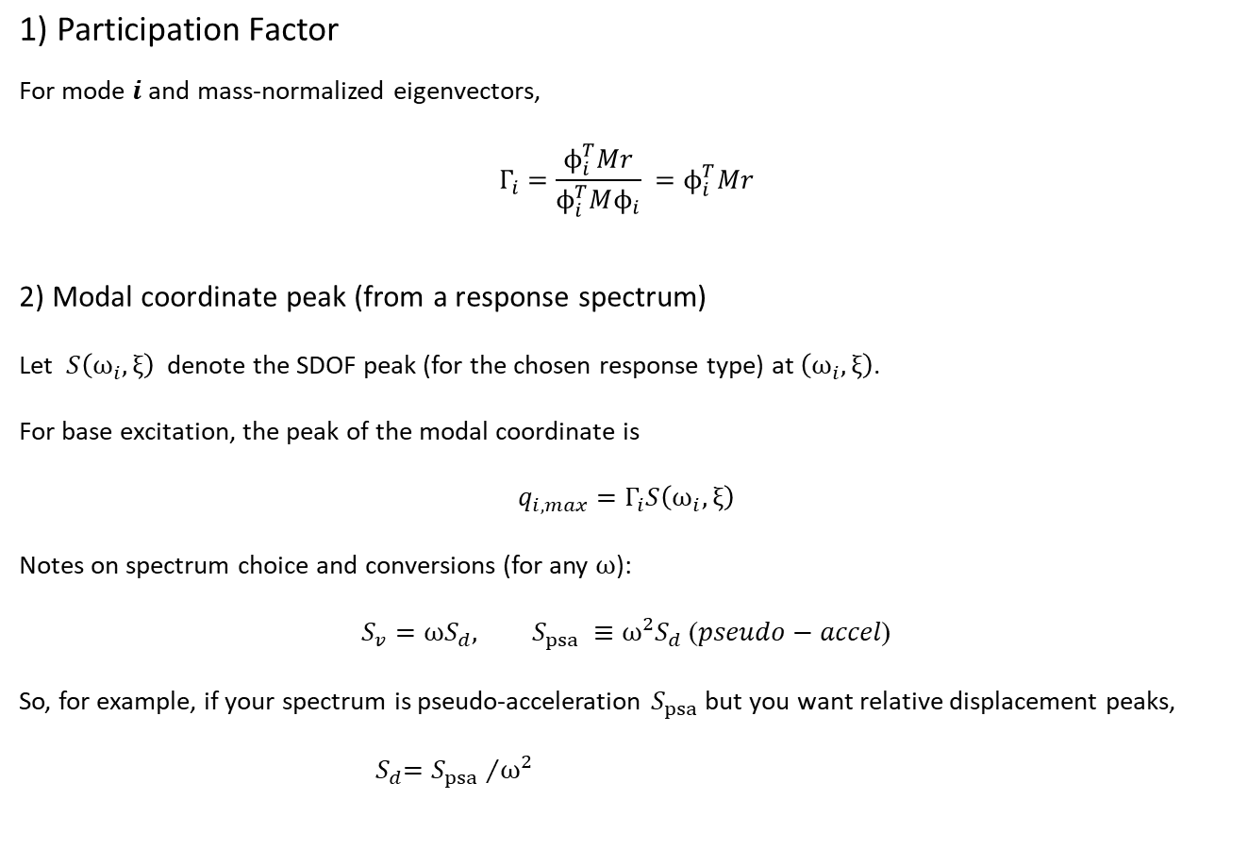
CQC Method
Vibrationdata
$$\text{1) }\text{Participation} \text{Factor}$$
For mode $i$ and mass-normalized eigenvectors,
$$Γ_{i}=\frac{ϕ_{i}^{T}Mr}{ϕ_{i}^{T}Mϕ_{i}} =ϕ_{i}^{T}Mr$$
2) Modal coordinate peak (from a response spectrum)
Let $S\left(ω_{i},ξ\right)$ denote the SDOF peak (for the chosen response type) at $\left(ω_{i},ξ\right)$.
For base excitation, the peak of the modal coordinate is
$$q_{i,max}=Γ_{i}S\left(ω_{i},ξ\right)$$
Notes on spectrum choice and conversions (for any $ω$):
$$S_{v}=ωS_{d}, S_{psa} ≡ω^{2}S_{d} \text{(}pseudo−accel\text{)}$$
So, for example, if your spectrum is pseudo-acceleration $S_{psa}$but you want relative displacement peaks,
${ S}_{d}={S_{psa} }/{ω^{2}}$

Slide 35
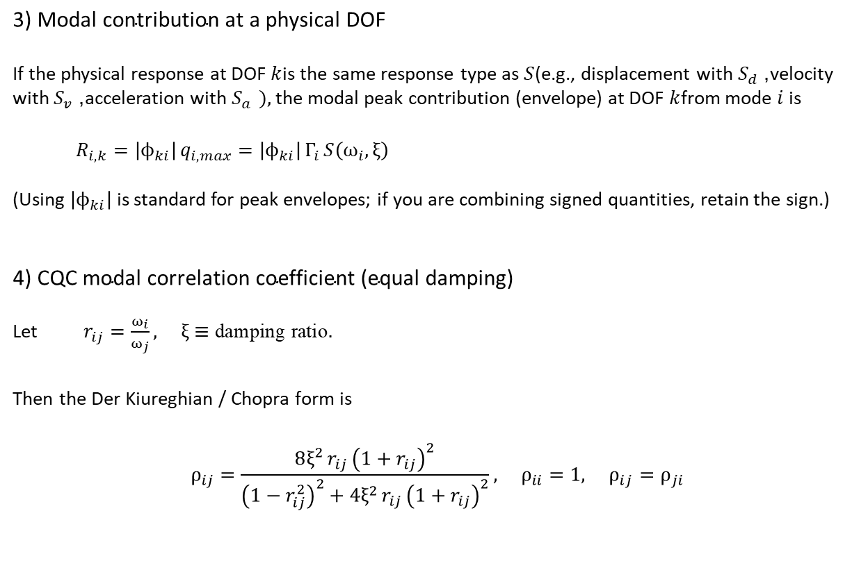
CQC Method (cont)
Vibrationdata
$$\text{3) }\text{Modal} \text{contribution} \text{at} \text{a} \text{physical} \text{DOF}$$
If the physical response at DOF $k$is the same response type as $S$(e.g., displacement with $S_{d}$, velocity with $S_{v}$, acceleration with $S_{a }),$the modal peak contribution (envelope) at DOF $k$from mode $i$ is
$$R_{i,k}=\left|ϕ_{ki}\right| q_{i,max}=\left|ϕ_{ki}\right| Γ_{i} S\left(ω_{i},ξ\right)$$
(Using $\left|ϕ_{ki}\right|$is standard for peak envelopes; if you are combining signed quantities, retain the sign.)
$\text{4}\text{) }\text{CQC} \text{modal} \text{correlation} \text{coefficient}\text{ (}\text{equal} \text{damping}\text{)}$
Let $r_{ij}=\frac{ω_{i}}{ω_{j}}, ξ≡\text{damping} \text{ratio}.$
$$\text{Then} \text{the} \text{Der} \text{Kiureghian}\text{ / }\text{Chopra} \text{form} \text{is}$$
$$ρ_{ij}=\frac{8ξ^{2} r_{ij} {\left(1+r_{ij}\right)}^{2}}{{\left(1−r_{ij}^{2}\right)}^{2}+4ξ^{2} r_{ij} {\left(1+r_{ij}\right)}^{2}}, ρ_{ii}=1, ρ_{ij}=ρ_{ji}$$

Slide 36
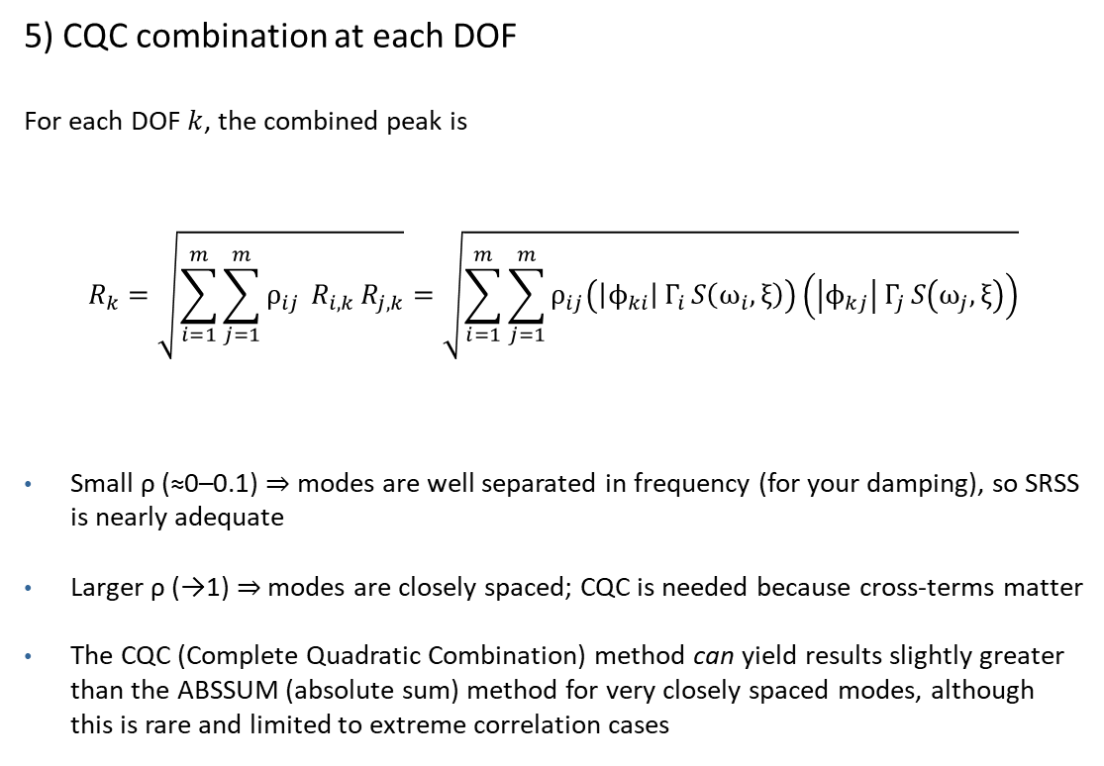
CQC Method (cont)
Vibrationdata
5) CQC combination at each DOF
For each DOF $k$, the combined peak is
$$R_{k}=\sqrt{\sum_{i=1}^{m}{\sum_{j=1}^{m}{ρ_{ij}}} R_{i,k} R_{j,k}}=\sqrt{\sum_{i=1}^{m}{\sum_{j=1}^{m}{ρ_{ij}\left(\left|ϕ_{ki}\right| Γ_{i} S\left(ω_{i},ξ\right)\right)\left(\left|ϕ_{kj}\right| Γ_{j} S\left(ω_{j},ξ\right)\right)}}}$$
Small ρ (≈0–0.1) ⇒ modes are well separated in frequency (for your damping), so SRSS is nearly adequate
Larger ρ (→1) ⇒ modes are closely spaced; CQC is needed because cross-terms matter
The CQC (Complete Quadratic Combination) method can yield results slightly greater than the ABSSUM (absolute sum) method for very closely spaced modes, although this is rare and limited to extreme correlation cases

Slide 37
Example: 4-dof Shear Building Model
Vibrationdata
x₄
m₄
Story | Mass (lbm) | Stiffness (lbf/in) | Height (ft)
1 | 1.6e6 | 3.5e6 | 15
2 | 1.6e6 | 3.2e6 | 30
3 | 1.6e6 | 2.8e6 | 45
4 | 1.4e6 | 2.4e6 | 60
k₄
m₃
x₃
k₃
x₂
m_{a,2}
m₂
k₂
x₁
m_{a,1}
m₁
5% damping for all modes
Perform normal modes analysis
k₁
ӱ

Slide 38
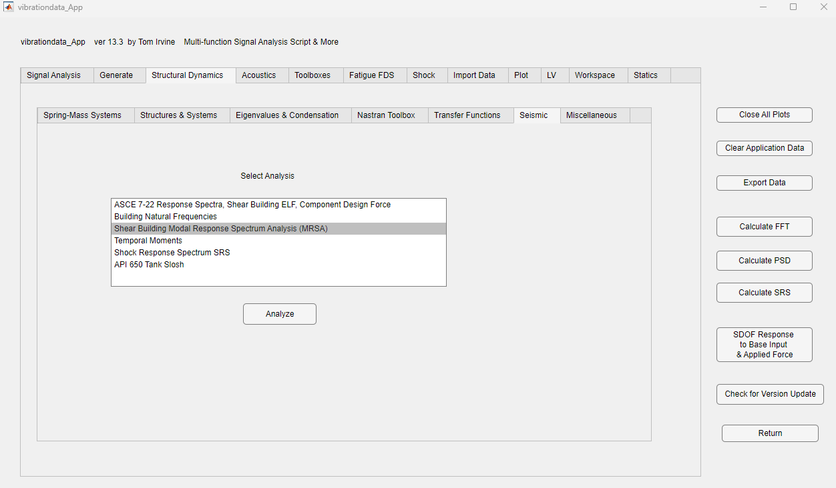

Slide 39
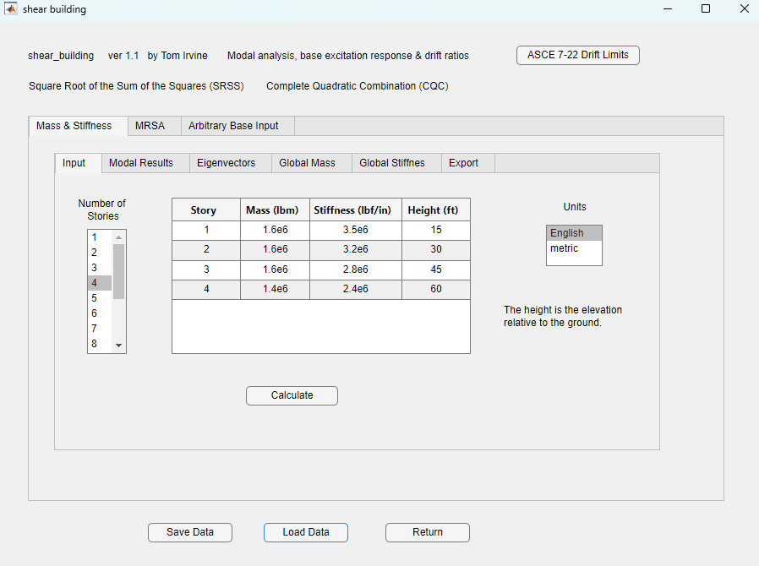

Slide 40
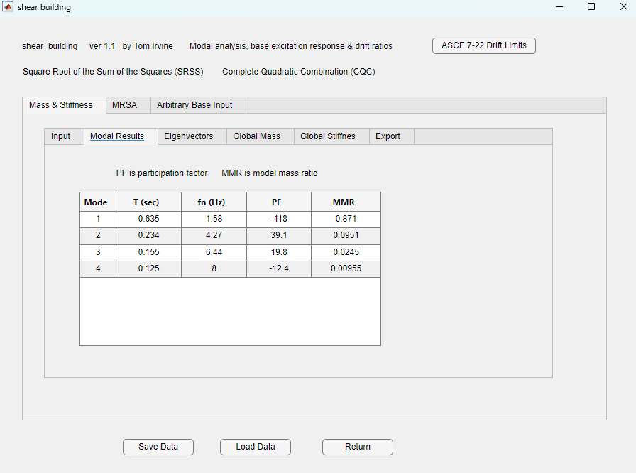

Slide 41
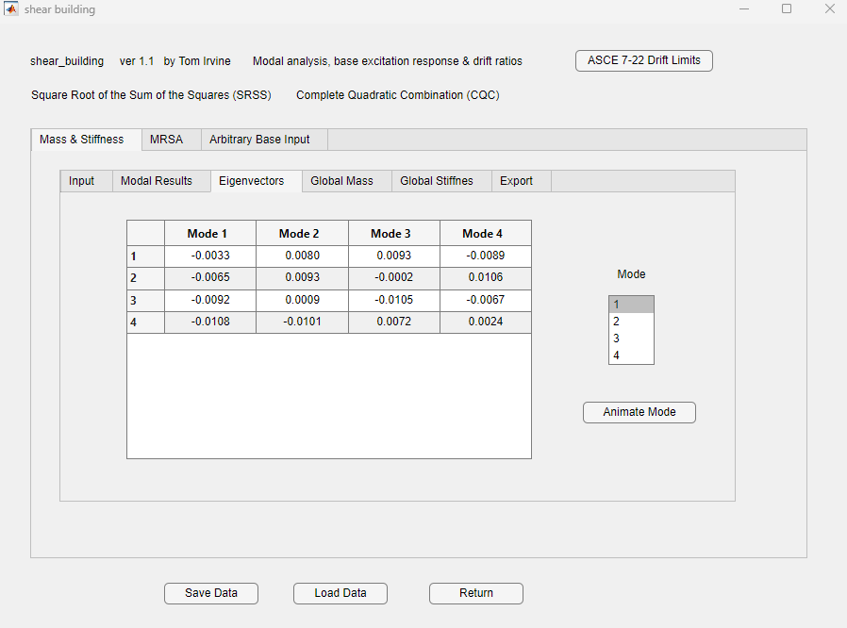

Slide 42
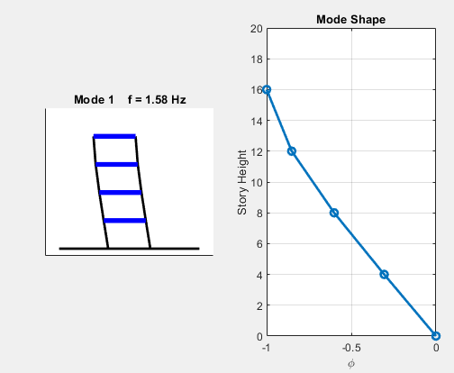

Slide 43
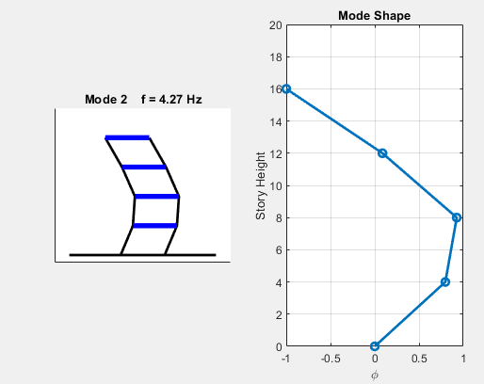

Slide 44
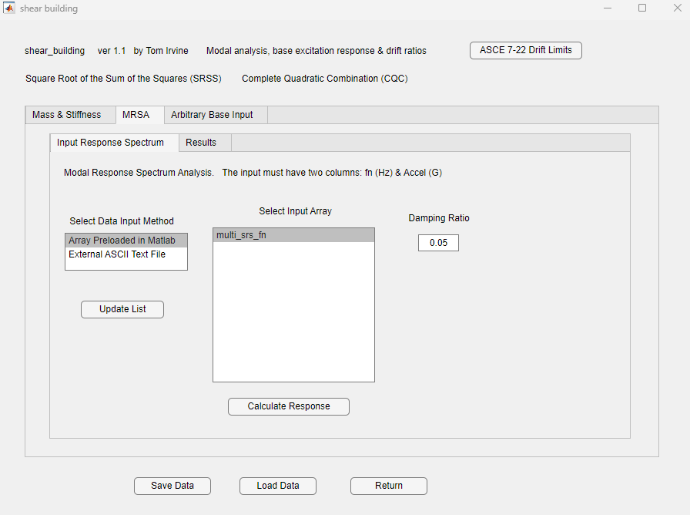

Slide 45
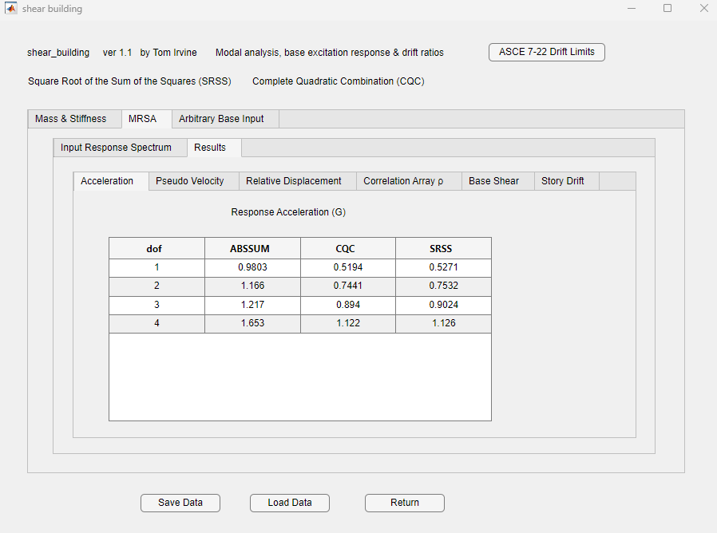

Slide 46
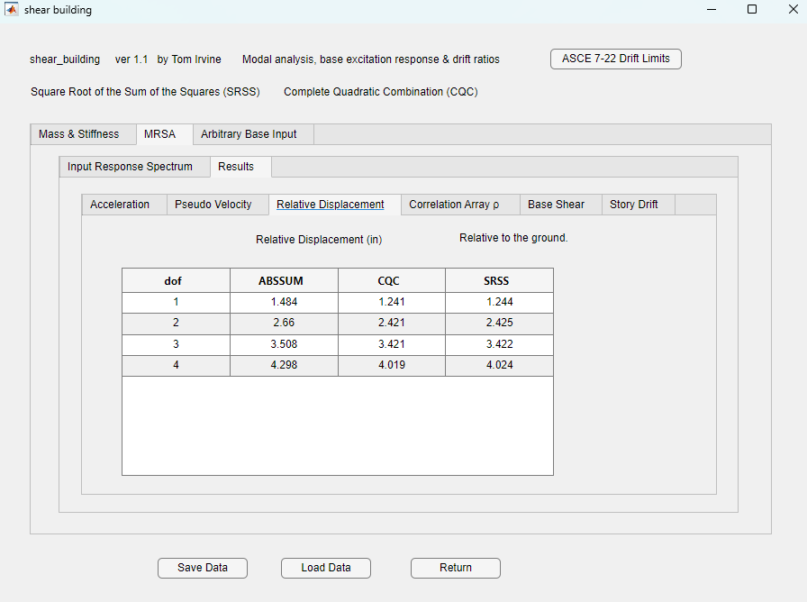

Slide 47
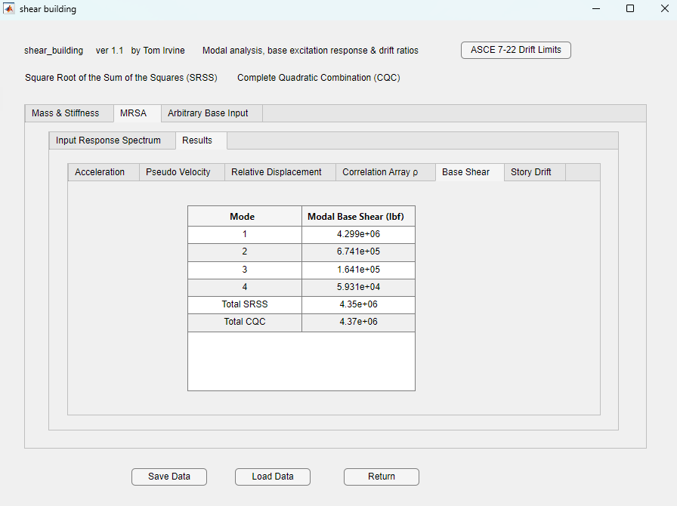

Slide 48
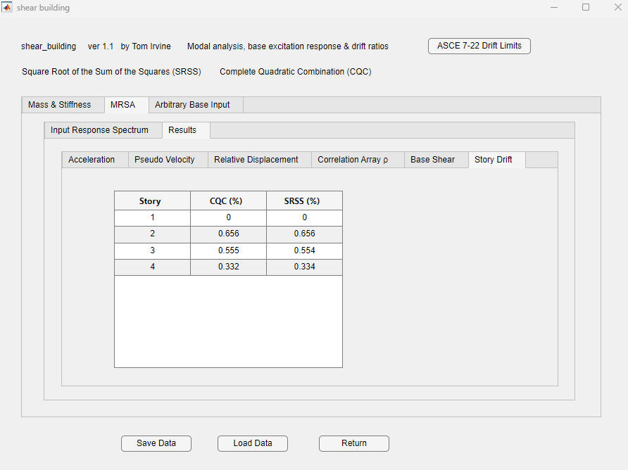
ASCE 7-22 allows 1.0% for Risk Category IV for general structures

Slide 49
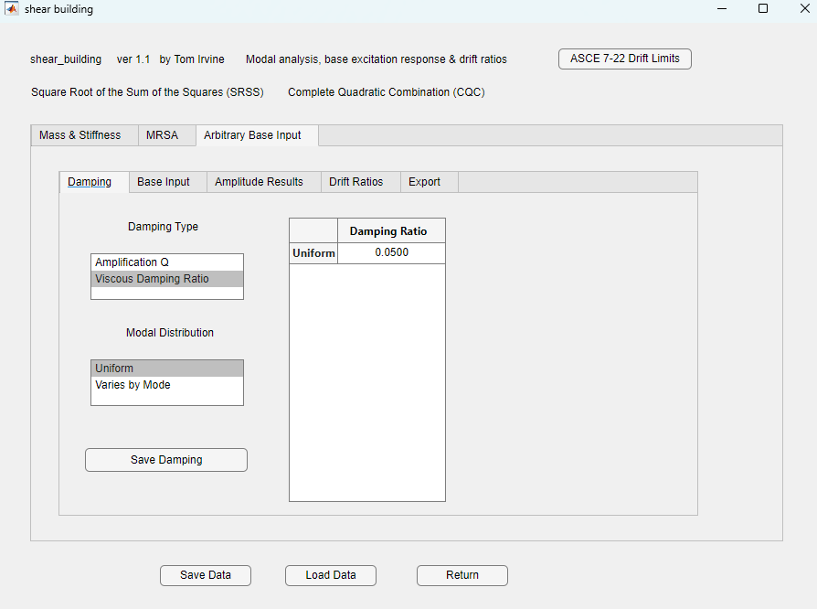


Slide 50
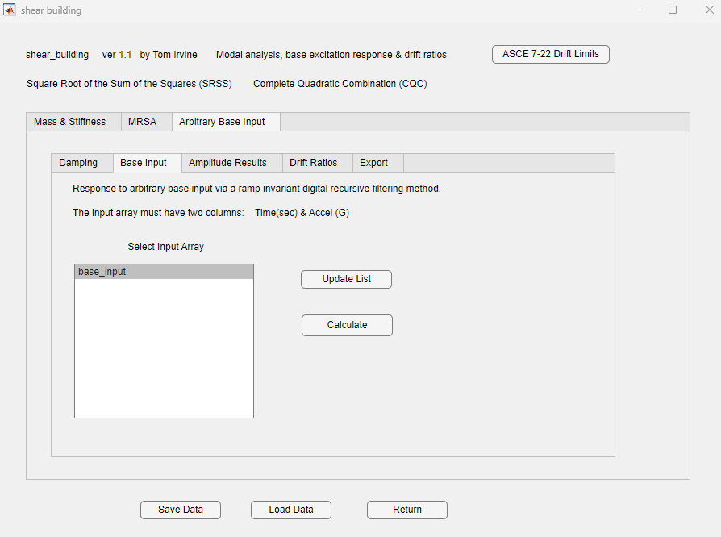

Slide 51
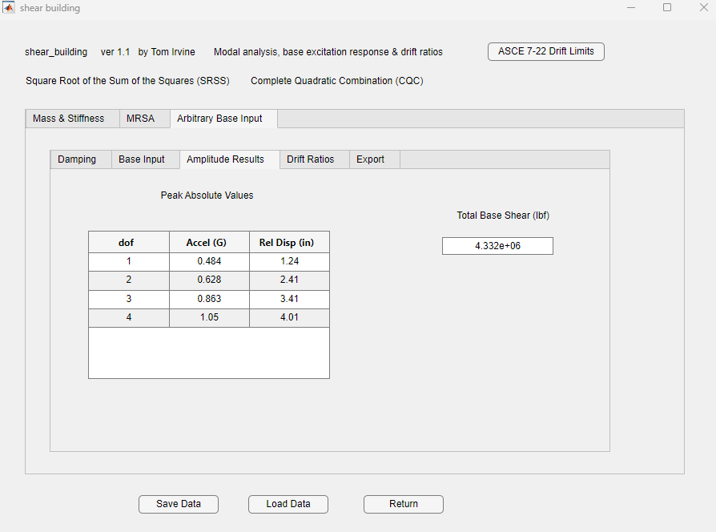

Slide 52
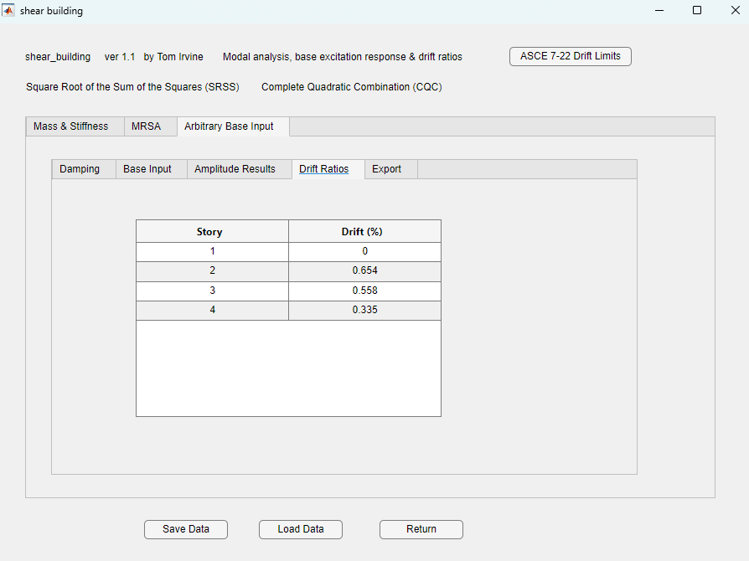

Slide 56
Story Drift Comparison
Story | MRSA CQC Drift (%) | Modal Transient Drift (%)
1 | 0 | 0
2 | 0.656 | 0.654
3 | 0.555 | 0.558
4 | 0.332 | 0.335
Excellent agreement
Parseval’s theorem explains why: modal energy computed in frequency-domain methods can match the full time-domain transient response

Slide 57
SRS Specification Q Concerns
The shock response of a physical coordinate in a multiple-degree-of-freedom system can be approximated as the summation response of a series of single-degree-of-freedom systems
(modal superposition)
This method works best if the specification SRS has the same Q as the component’s modes
The goal is to use modal combination methods to avoid computation time for a full modal transient analysis
For example, the specification is typically Q=10 but the structure may have modes with Q=20
The higher Q yields a higher SRS, but there is no exact direct scaling method
Use conservative approach loosely based on Miles’ equation

Slide 58

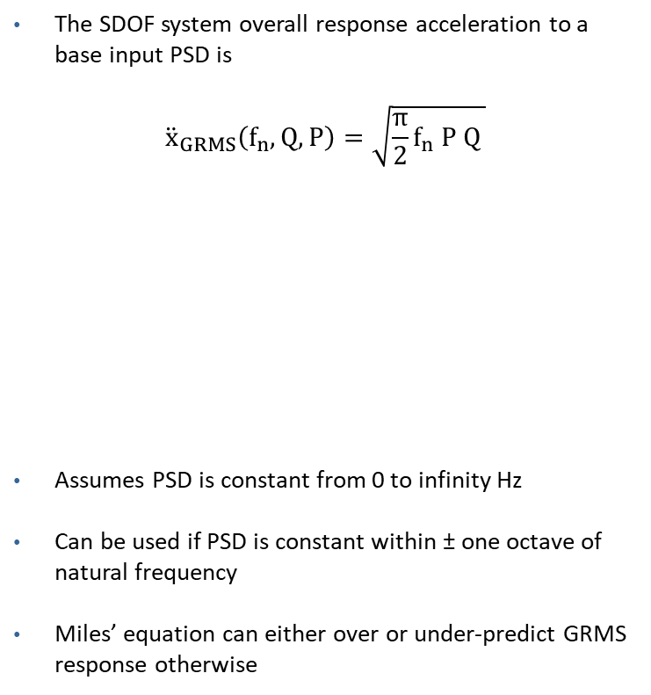
Miles Equation for Base Input PSD Applied to Response Spectrum (RS)
The SDOF system overall response acceleration to a base input PSD is
$${\ddot{x}}_{GRMS}\left(f_{n},Q, P\right)=\sqrt{{\frac{π}{2}f}_{n} P Q }$$
Assumes PSD is constant from 0 to infinity Hz
Can be used if PSD is constant within ± one octave of natural frequency
Miles’ equation can either over or under-predict GRMS response otherwise
Make the conservative assumption that
$$\frac{{RS}_{2}}{{RS}_{1}}=\sqrt{ \frac{Q_{2}}{Q_{1}} }$$
$${RS}_{2}={RS}_{1}\sqrt{ \frac{Q_{2}}{Q_{1}} }$$
where ${ Q}_{2}$ > $Q_{1}$
Note that
$$Q=1/{\left(2 ξ\right)}$$
where
f_{n} = natural frequency
P = PSD level at f_{n}
Q = amplification factor

