Slide 1
SEISMIC DESIGN OF
Architectural Glazing
Story Drift, Glass Fallout & Component Forces
Displacement limits across three orthogonal axes — U.S. (ASCE 7 / AAMA) and European (EN 1998-1) practice
Tom Irvine
Vibration & Structural Dynamics • vibrationdata
vibrationdata
1

Slide 2



ORIENTATION
Three Orthogonal Axes of Demand
Glazing in an earthquake sees demand in all three axes, but the failure mechanisms — and the governing code checks — are different in each.
DRIFT
FORCE
COMBO
In-Plane (X)
Out-of-Plane (Y)
Vertical (Z)
Interstory drift / racking
Inertial component force
Vertical seismic effect
Frame shears as floors displace laterally relative to one another. Glass must ride out the drift or fall out. THE dominant glazing concern.
Panel mass accelerates normal to its plane. An inertial-force problem governing anchorage and structural-silicone bite.
Secondary for glass itself; enters load combinations and governs horizontal facade members (sunshades, spandrels, canopies).
vibrationdata
2

Slide 3
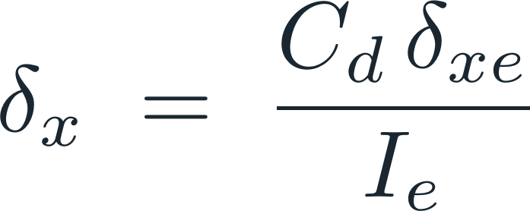





AXIS 1 · IN-PLANE — U.S. PRACTICE
Design Story Drift (ASCE 7, Ch. 12)
The elastic analysis runs on reduced design forces; the deflection amplification factor restores the expected inelastic displacement.
ALLOWABLE STORY DRIFT Δa
ASCE 7 Table 12.12-1 — varies with structure type & Risk Category
0.025 hsx
Most structures, Risk Cat. I–II
0.020 hsx
Risk Category III
elastic deflection from analysis
0.015 hsx
Risk Category IV
deflection amplification factor of the SFRS
seismic importance factor
0.010 hsx
Masonry shear-wall (cantilever)
design story drift over the story
SFRS = Seismic Force-Resisting System
Δ ≤ Δa ( hsx = story height )
vibrationdata
3

Slide 4


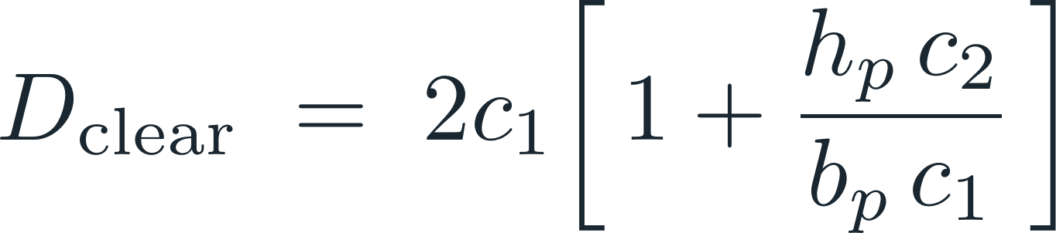




AXIS 1 · IN-PLANE — U.S. PRACTICE
The Glass Fallout Check (ASCE 7 §13.5.9)
Glass is an architectural component. It must demonstrate a fallout drift that exceeds the design displacement demand — with an explicit 25% margin.
Δfallout = drift causing glass fallout (AAMA 501.6 test)
Dp = relative seismic displacement the glass must accommodate
…OR SATISFY AN EXEMPTION
1 · Clearance exemption — glass floats within its frame
2 · Fully tempered monolithic glass
Risk Cat. I–III, ≤ 10 ft above a walking surface
3 · Laminated annealed/heat-strengthened glass
Interlayer ≥ 0.030 in., mechanically captured in the glazing pocket
= pane height
= vertical edge clearance
= pane width
= horizontal edge clearance
vibrationdata
4

Slide 5



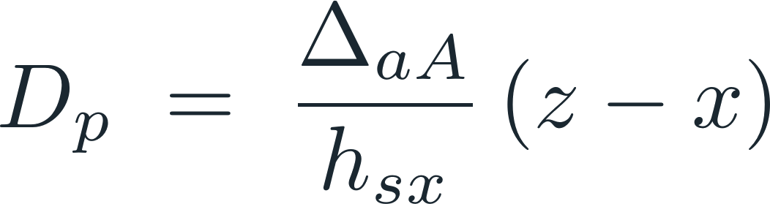
AXIS 1 · IN-PLANE — U.S. PRACTICE
Relative Seismic Displacement, Dp
Dp is the displacement demand the glazing must absorb — the relative movement between its two attachment points. ASCE 7 §13.3.2 defines it; for glazing the value is the design drift over the supporting story.
GENERAL — TWO POINTS ON THE SAME STRUCTURE
FOR A ONE-STORY PANEL
A glazing unit spanning a single story takes Dp as the design interstory drift over that story height:
deflection at higher attachment, level x
deflection at lower attachment, level y
BOUNDED BY THE ALLOWABLE DRIFT
Then check: Δfallout ≥ 1.25 Ie Dp
…or the clearance exemption Dclear ≥ 1.25 Dp from the previous slide.
hsx = story height • (z − x) spans one story for a typical glazed unit, so Dp reduces to the interstory drift.
vibrationdata
5

Slide 6


AXIS 1 · IN-PLANE — QUALIFICATION
Racking Test Methods (AAMA)
AAMA 501.4
AAMA 501.6
Serviceability at design drift
Drift causing glass fallout
Static interstory-drift test for curtain wall & storefront under seismic and wind drift. Demonstrates the system survives the design-level event intact — no glass breakage, no gasket disengagement, no permanent frame damage.
Crescendo (increasing-amplitude) racking of a full-scale specimen until glass falls out. Yields the empirical Δfallout fed into the §13.5.9 inequality. (Despite the legacy 'Dynamic' title, it is a stepped-displacement protocol.)
Lower bar: design-level event
Failure threshold: Δfallout
501.4 proves the system endures the design drift; 501.6 finds the drift at which it catastrophically fails. The code fallout check uses the 501.6 result against the 1.25-amplified demand.
vibrationdata
6

Slide 7
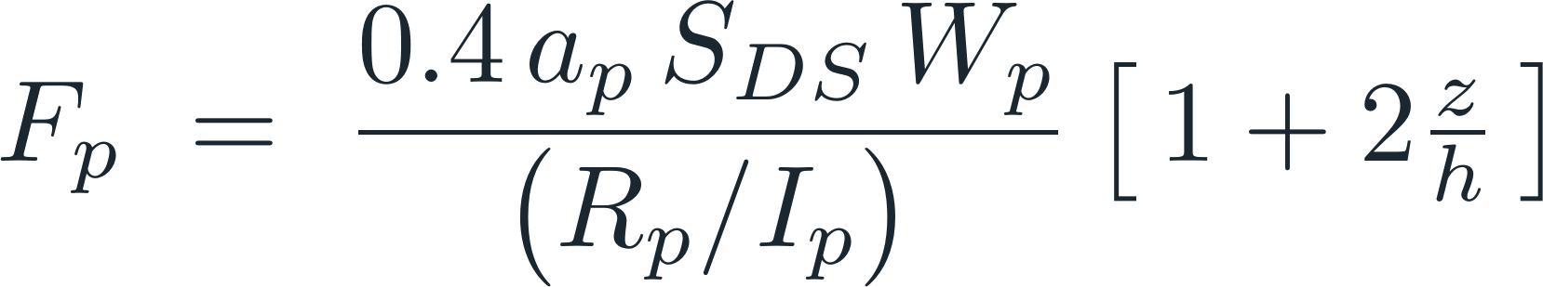







AXIS 2 · OUT-OF-PLANE — U.S. PRACTICE
Component Force (ASCE 7 §13.3.1)
Not a drift problem — an inertial one. The panel and frame must resist their own mass accelerating normal to the facade. Governs anchorage and structural-silicone bite.
THE (1 + 2z/h) TERM
Floor accelerations amplify up the building. A component at the roof (z/h = 1) sees a factor of 3 — three times the base demand.
×3
×2
component amplification factor
component response modification factor
×1
short-period design spectral acceleration
component operating weight
component importance factor
z/h=0
z/h=.5
z/h=1
attachment height / roof height
vibrationdata
7

Slide 8



AXIS 3 · VERTICAL — U.S. PRACTICE
Vertical Seismic Load Effect
Rarely controls the glass or its in-plane framing — but it rides through the load combinations and governs horizontally-spanning facade members.
WHERE IT MATTERS FOR FACADES
Sunshades & light shelves
cantilevered horizontal members carry direct vertical demand
Spandrel & canopy framing
long horizontal spans hung off the facade
Connections
vertical demand combines with horizontal at anchors
vertical seismic load effect
short-period design spectral acceleration
dead load
vibrationdata
8

Slide 9





AXIS 1 · IN-PLANE — EUROPEAN PRACTICE
EN 1998-1 (Eurocode 8) Drift Limits
Eurocode 8 ties the interstory-drift limit to how the non-structural elements are attached. The damage-limitation check uses the 'frequent' (serviceability) earthquake.
0.5 %
Brittle non-structural elements
fixed to the structure (typical glazing)
design interstory drift
reduction factor — 0.5 (class I–II), 0.4 (III–IV)
0.75 %
Ductile non-structural elements
story height
fixed to the structure
Limit applies to dr·ν, expressed as a drift ratio (% of story height). For ordinary glazing fixed to the frame, the 0.5% brittle limit usually governs.
1.0 %
Isolated / decoupled elements
not interfering with deformations
vibrationdata
9

Slide 10
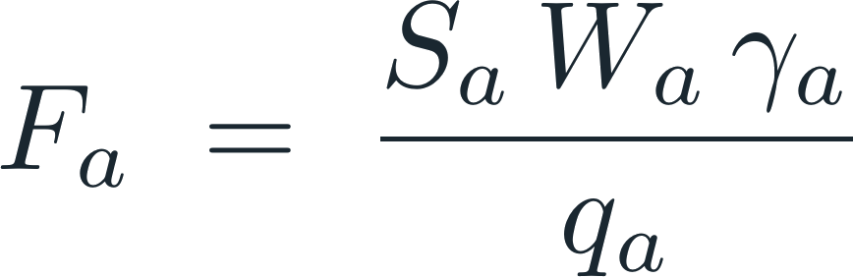
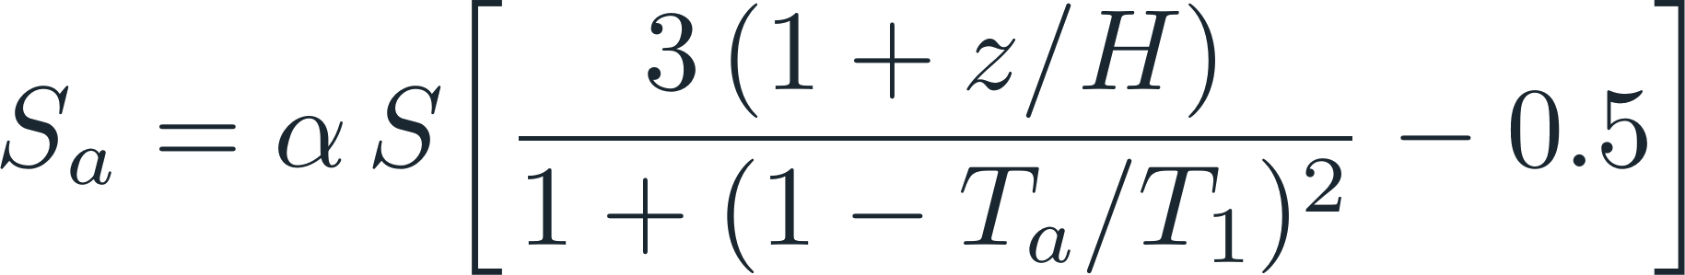









AXIS 2 · OUT-OF-PLANE — EUROPEAN PRACTICE
EN 1998-1 Non-Structural Element Force
Eurocode 8 §4.3.5 applies a horizontal force Fa at the element's center of mass. The seismic coefficient Sa carries the same up-the-height amplification as ASCE 7.
(lower bound)
seismic coefficient for the element
weight of the element
importance factor of the element
behaviour factor of the element (1.0 or 2.0)
ratio ag / g (design ground accel.)
soil factor
element / structure fundamental period
element height / building height
qa = 2.0 for facade panels & glazing on the building face; the (1 + z/H) term mirrors ASCE 7's height amplification.
vibrationdata
10

Slide 11
SIDE BY SIDE (1 OF 2)
U.S. vs. European Framework
Aspect | U.S. (ASCE 7 / AAMA) | Europe (EN 1998-1)
Governing document | ASCE 7 Ch. 12 (drift) & Ch. 13 (components) | EN 1998-1 §4.3.4 (drift) & §4.3.5 (elements)
In-plane limit basis | Δa per Table 12.12-1 (0.010–0.025 hsx) | Drift ratio by attachment: 0.5 / 0.75 / 1.0 %
Reference event | Design earthquake (with Cd amplification) | 'Frequent' earthquake (ν = 0.5 / 0.4)
Glass fallout check | Explicit, test-verified margin (AAMA 501.6) | No equivalent explicit fallout inequality
Qualification test | AAMA 501.4 (serviceability) & 501.6 (fallout) | Product standard EN 13830; no fallout test
Vertical effect basis | Always in load combinations | Only where vertical spectrum avg > 0.25 g
Governing equations compared on the next slide. Key divergence: the U.S. mandates a test-verified fallout margin; Eurocode 8 controls glazing via the drift-ratio limit.
vibrationdata
11

Slide 12
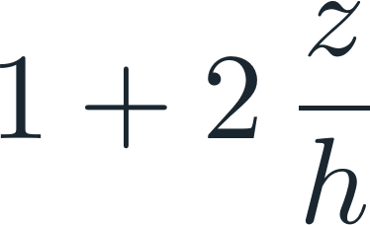
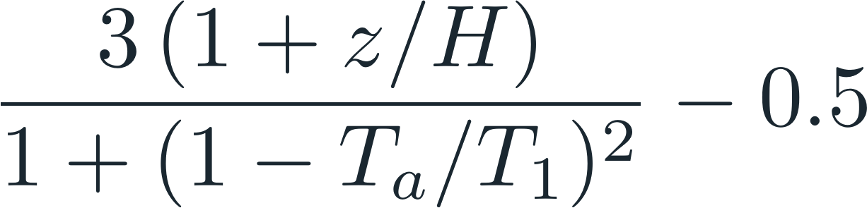
SIDE BY SIDE (2 OF 2)
Governing Equations Compared
U.S. (ASCE 7 / AAMA)
Europe (EN 1998-1)
Glass fallout
check
No equivalent explicit
fallout inequality
Out-of-plane
force
Height
amplification
Vertical
effect
Vertical elastic spectrum
where avg > 0.25 g
Both frameworks amplify out-of-plane demand up the building height; only ASCE 7 ties glass retention to a physical fallout test.
vibrationdata
12

Slide 13
PRACTICE
Design-Check Workflow
1
2
3
4
5
Extract design drift
Compute Dp
Fallout or clearance
Out-of-plane force
Vertical in combos
Get interstory drift Δ from analysis, scaled Cd/Ie (ASCE) or dr·ν (EC8).
Relative seismic displacement the glazing must accommodate over the story.
Verify Δfallout ≥ 1.25 Ie Dp (501.6 test) OR clearance Dclear ≥ 1.25 Dp.
Check Fp (or Fa) for framing anchorage & structural-silicone bite.
Carry Ev through load combinations for horizontal facade members.
Same logical flow on both sides of the Atlantic — only the coefficients and the explicit fallout test differ.
vibrationdata
13

Slide 14
REFERENCE
Standards & Key Takeaways
TAKEAWAYS
UNITED STATES
ASCE 7 Minimum Design Loads & Associated Criteria — Ch. 12 (drift), Ch. 13 (components)
AAMA 501.4 Static drift serviceability test method
AAMA 501.6 Seismic drift causing glass fallout
ASTM E2026 / E1300 Building performance & glass design
In-plane drift is the dominant glazing concern
the glass must ride out racking or fall out
The 1.25 factor is the explicit U.S. safety margin
tested fallout drift must beat demand by 25%
Out-of-plane is an inertial-force problem
both codes amplify demand up the height
EC8 controls glazing via the drift-ratio limit
0.5% brittle limit typically governs glazing
Confirm the governing code edition before citing
ASCE 7-22 reformulated the component-force method
EUROPE
EN 1998-1 Eurocode 8 — §4.3.4 drift limitation, §4.3.5 non-structural elements
EN 13830 Curtain walling — product standard
EN 12152 / 12154 Air permeability & watertightness of curtain walls
EN 16612 Lateral load resistance of glass panes
vibrationdata
14

