Slide 1
Vibrationdata
ASCE 7-22, Ch 18,
Seismic Design for Damping
Provisions, design procedures, and prototype testing for supplemental damping in the seismic load-resisting system
By Tom Irvine

Slide 2
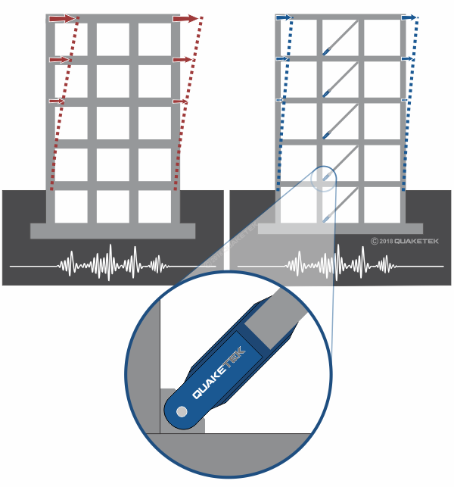
Vibrationdata
Introduction
Damping is a Mechanism that dissipates energy
Converts mechanical energy to heat
Reduces:
  Response amplitude
  Resonance effects
Key idea: with low damping, resonant response can become unacceptably large

Slide 3
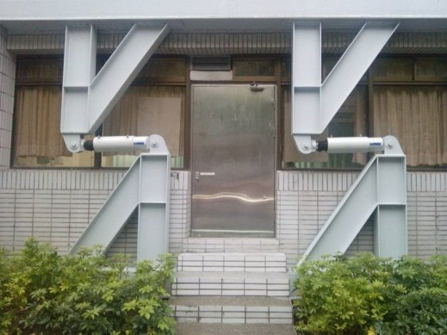

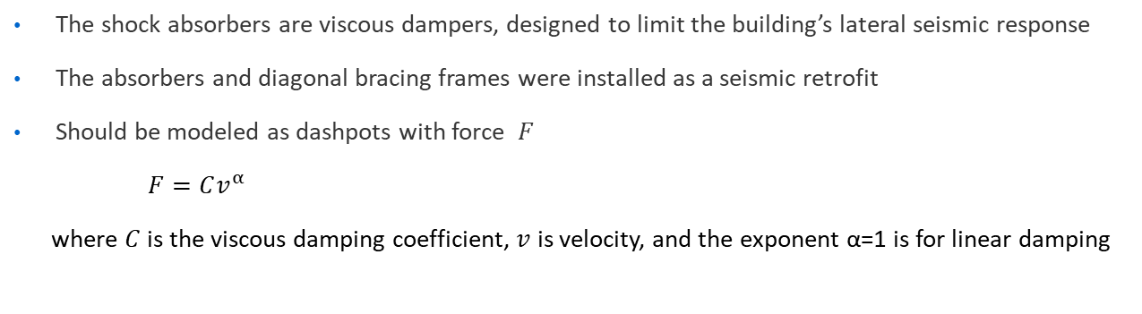
Taipei City Hospital
Vibrationdata
The shock absorbers are viscous dampers, designed to limit the building’s lateral seismic response
The absorbers and diagonal bracing frames were installed as a seismic retrofit
Should be modeled as dashpots with force $F$
$F=Cv^{α}$
where $C$ is the viscous damping coefficient, $v$ is velocity, and the exponent α=1 is for linear damping

Slide 4

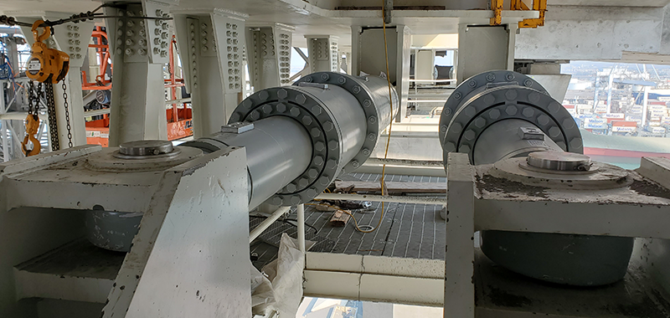
Long Beach Bridge Vibrationdata
Left: Cable Stayed Bridge, Long Beach, CA (background)
Right: Seismic dampers below road deck

Slide 5
Scope Vibrationdata
What Chapter 18 covers
Structures with a damping system that operates in parallel with — and supplements — the conventional seismic force-resisting system (SFRS)
Key principle
The SFRS alone must still satisfy the strength and stability requirements of Ch. 12
The damping system reduces demands but does not replace a code-compliant SFRS
Permitted damping device types
Velocity-dependent (fluid viscous, viscoelastic), displacement-dependent (metallic yielding, friction), and combinations thereof

Slide 6
Vibrationdata
Rationale
01
02
03
Reduce inelastic demand
Lower drift & acceleration
Performance-based design
Dissipation by dampers lowers displacement and ductility demands on the primary structure, improving expected post-earthquake performance.
Story drift and floor acceleration are both reduced — beneficial for nonstructural components and content protection.
Damping enables tailored performance objectives beyond life safety, including immediate occupancy targets.
Trade-off: added cost and complexity of devices, connections, and required prototype/production testing.

Slide 7
Vibrationdata
Terms
Term | Definition
Damping System (DS) | Collection of dampers, bracing, and connecting elements that transmits forces between the structure and dampers.
Seismic Force-Resisting System (SFRS) | Primary lateral system designed per Ch. 12 — must remain code-compliant independent of the DS.
Effective Damping (β) | Total damping in the fundamental mode: inherent + hysteretic + viscous contributions from devices.
Damping Coefficient (B) | Spectral-response reduction factor as a function of effective damping; see Table 18.7-1.
Displacement-Dependent Device | Force is primarily a function of relative displacement (e.g., metallic yielding, friction).
Velocity-Dependent Device | Force is primarily a function of relative velocity (e.g., fluid viscous, viscoelastic).

Slide 8
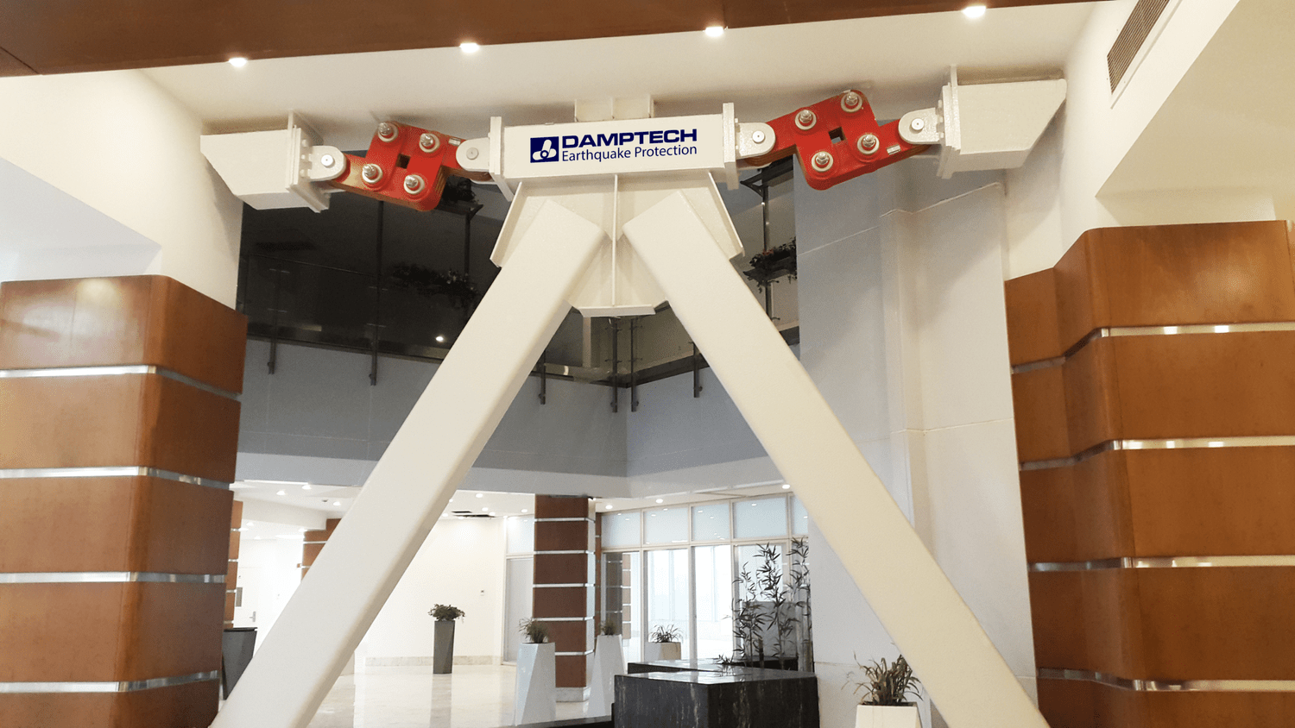
Vibrationdata
System Configuration & Redundancy
Two-system framework
Ch. 18 treats the SFRS and DS as two interacting systems
Each has its own design forces, detailing, and acceptance criteria
Minimum device count
At least two damping devices in each principal direction at every story where dampers are used, configured to resist torsion (per 18.2.4.1)
Redundancy
Loss of any one device must not reduce DS capacity in any direction by more than 50%
When a lateral external force excites a frame structure with a large force, the top of the frame structure starts to displace horizontally due to this force
The V-bracing system and the frictional forces developed between the frictional surfaces of the red steel plates and friction pad materials will resist the horizontal motion

Slide 9
Damper Device Types Vibrationdata
Supplemental devices are grouped by what activates them — relative velocity or relative displacement. This drives their hysteresis, phasing, and how they enter the effective-damping sum.
Velocity-dependent
Displacement-dependent
force ∝ velocity · adds damping
force ∝ displacement · damping & stiff
Fluid viscous damper
Piston forces silicone fluid through orifices. Force is out of phase with displacement — adds no stiffness, and re-centers the structure after the event.
Governs the max-velocity load stage · elliptical loop
Metallic yielding (ADAS / TADAS, BRB)
Mild steel yields in flexure or axially (buckling-restrained brace). Stable, repeatable hysteresis; adds stiffness; may require replacement after a major event.
Governs the max-displacement load stage · bilinear loop
Viscoelastic damper (velocity + displacement)
Polymer layers sheared between steel plates. Dissipates energy even at low amplitudes where yielding devices stay inactive; mildly rate- and temperature-dependent.
Hybrid behavior — contributes to both load stages
Friction damper
Energy dissipated by sliding between clamped surfaces at a preset slip load. Rectangular (Coulomb) loop; delivers a near-constant force output once it begins to slip.
Rate-independent · displacement-activated

Slide 10
Damper Frame Configurations
How the device couples to interstory drift. The configuration sets how much of the story drift (or a multiple of it) the damper actually sees.
Diagonal brace
Simplest. Device sees the horizontal drift projected along the diagonal.
Chevron / V-brace
Device sits above the V apex; captures the full interstory drift directly.
Toggle / scissor
Linkage amplifies small drift into a larger device stroke — efficient in stiff frames.
— frame — brace — damper device
Configuration choice trades off fabrication simplicity against drift amplification; toggle/scissor systems suit low-drift, stiff structures where a direct brace would under-stroke the device.

Slide 11
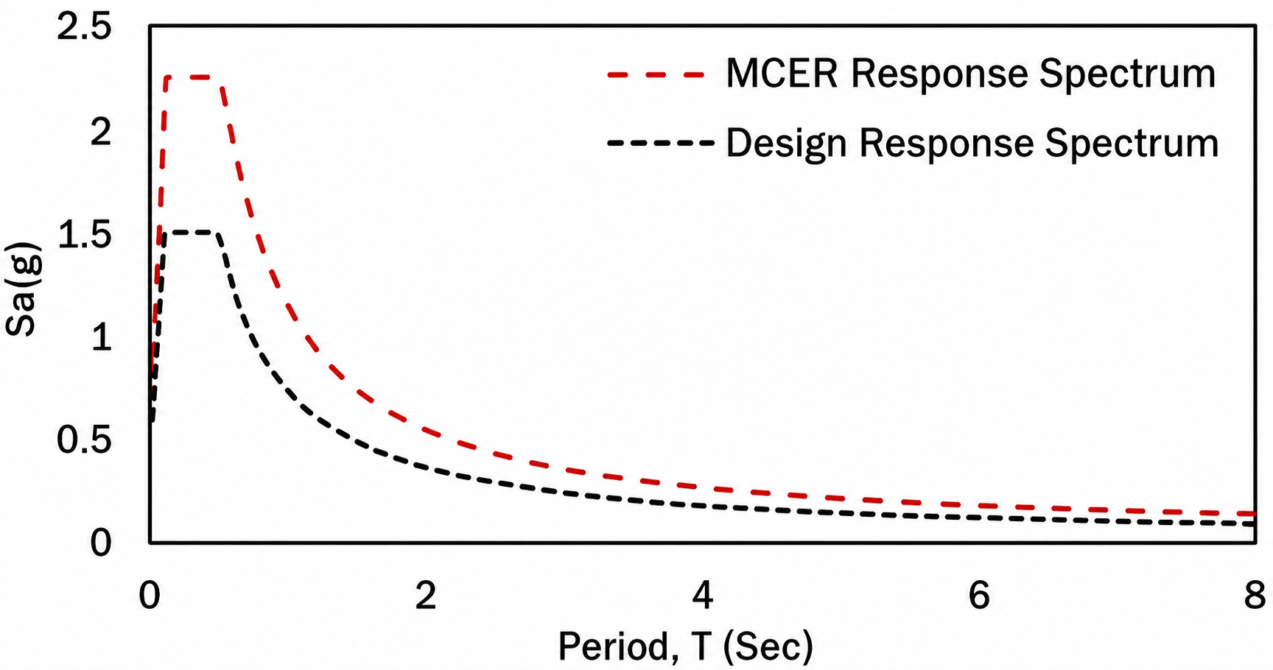
Vibrationdata
Seismic Hazards & Ground Motion
Two demand levels are explicitly evaluated
Design Earthquake (DE)
Two-thirds of the MCE_R spectrum
SFRS strength and DS forces are checked at this level
Maximum Considered Earthquake (MCER)
Risk-targeted MCE
Used for damper displacement/velocity capacity and to verify stability of the SFRS at the larger demand
Ground motion records, Nonlinear Response History Analysis (NLRH)
Minimum of 7 pairs of horizontal records, scaled per Ch. 16 to match the target spectrum across the period range of interest
Average response governs

Slide 12
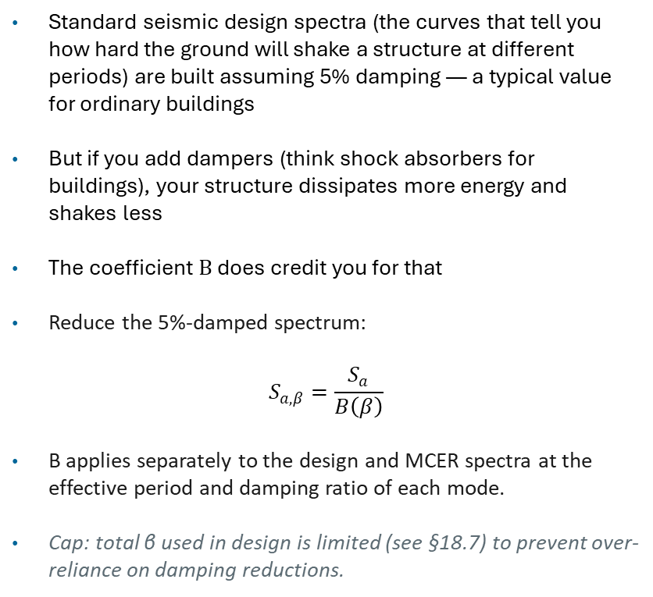
Damping Coefficient B vs. Effective Damping β
Vibrationdata
Standard seismic design spectra (the curves that tell you how hard the ground will shake a structure at different periods) are built assuming 5% damping — a typical value for ordinary buildings
But if you add dampers (think shock absorbers for buildings), your structure dissipates more energy and shakes less
The coefficient B does credit you for that
Reduce the 5%-damped spectrum:
$$S_{a,β}=\frac{S_{a}}{B\left(β\right)}$$
B applies separately to the design and MCER spectra at the effective period and damping ratio of each mode.
Cap: total β used in design is limited (see §18.7) to prevent over-reliance on damping reductions.

Slide 13
Damping Coefficient B — Table 18.7-1
Vibrationdata
Converts effective damping β into the spectral-reduction factor B. Divide the 5%-damped spectral acceleration by B to obtain the design value. Interpolate linearly for intermediate β.
Effective damping β (% of critical) | B factor
≤ 2 | 0.8
5 | 1.0
10 | 1.2
20 | 1.5
30 | 1.7
40 | 1.9
50 | 2.0
60 | 2.1
70 | 2.2
80 | 2.3
90 | 2.4
≥ 100 | 2.5
How it is applied
Reduced spectral acceleration = Sₐ (5%) / B
Higher β → larger B → greater reduction.
B is capped — the table levels off as β grows, reflecting diminishing returns at high damping.
Two B's in Chapter 18
Bᵥ₊ᵢ (inherent + viscous only) sets the minimum base-shear floor of §18.2.1.1 — hysteretic damping is not credited here.
B at total β (inherent + viscous + hysteretic) reduces the design spectrum used for displacement and DS-force demands.
Source: ASCE/SEI 7-22, Table 18.7-1 (B as a function of effective damping β). Values carried forward from ASCE 7-05/-16. Linear interpolation permitted between tabulated points.

Slide 14

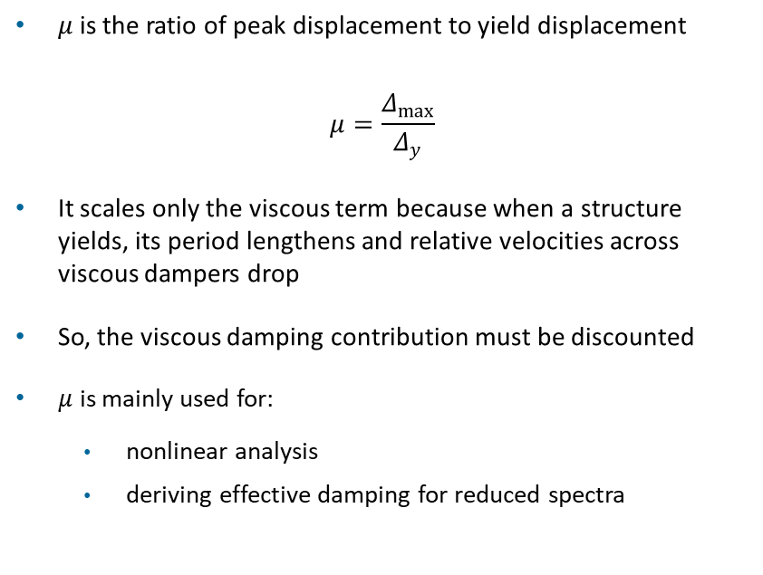
Vibrationdata
Effective Ductility Parameter $μ$
Structural Behavior Level | μ (Ductility Ratio) | Description
Elastic | 1.0 | No yielding; linear behavior
Slightly inelastic | 1.5 – 2 | Minor yielding, essentially elastic response
Moderately ductile | 2 – 4 | Typical design-level response for many systems
Ductile (code-designed systems) | 4 – 6 | Special moment frames, ductile systems
Highly ductile | 6 – 8 | Significant plastic deformation capacity
$μ$ is the ratio of peak displacement to yield displacement
$$μ=\frac{Δ_{max}}{Δ_{y}}$$
It scales only the viscous term because when a structure yields, its period lengthens and relative velocities across viscous dampers drop
So, the viscous damping contribution must be discounted
$μ$ is mainly used for:
  nonlinear analysis
  deriving effective damping for reduced spectra

Slide 15
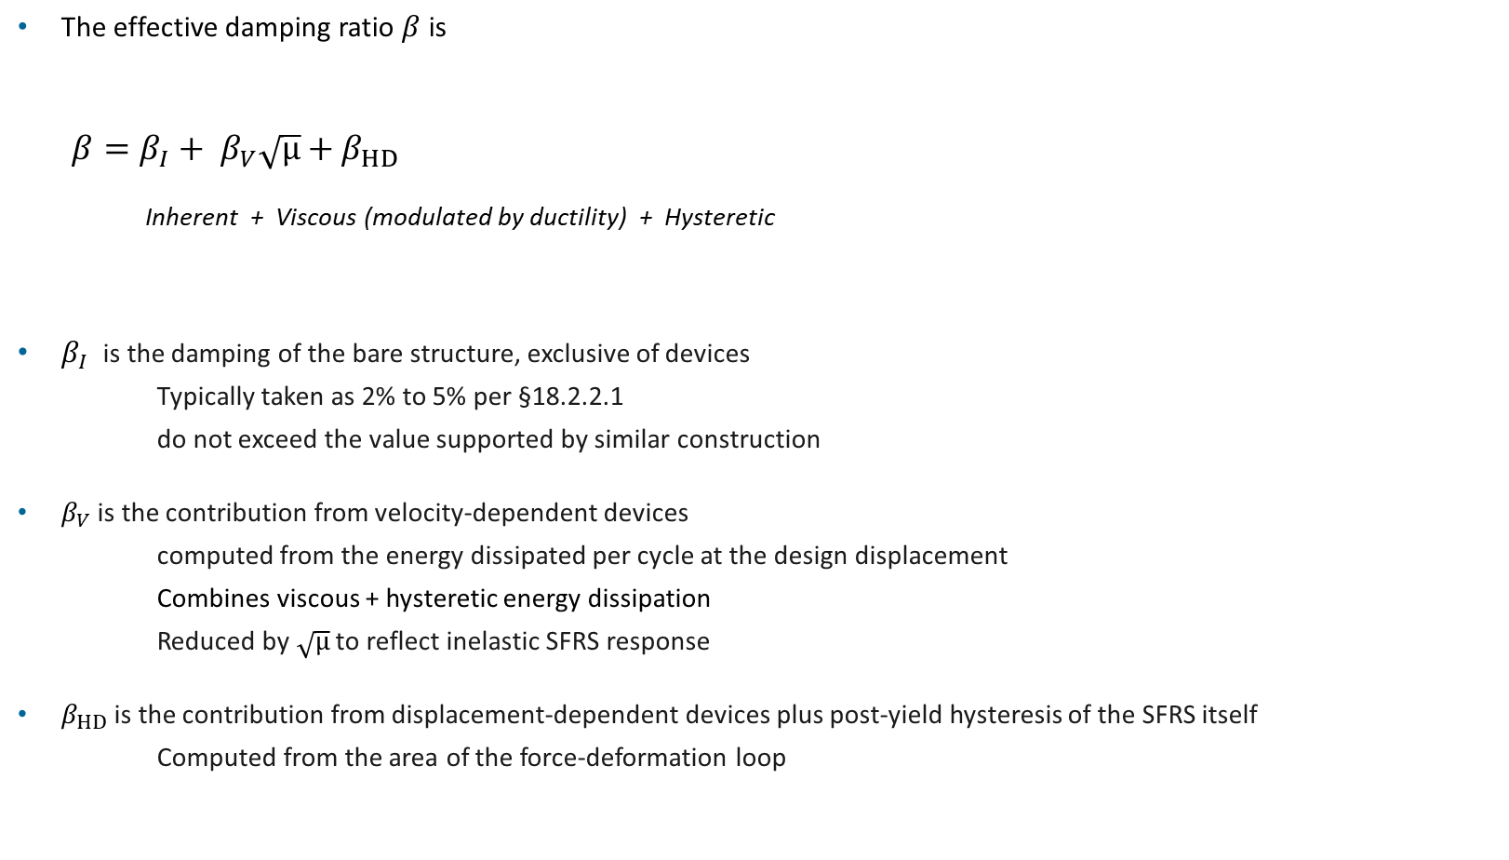
Component of Effective Damping
Vibrationdata
The effective damping ratio $β$is
$${β=β}_{I}+ β_{V}\sqrt{μ}+β_{HD}$$
Inherent + Viscous (modulated by ductility) + Hysteretic
$β_{I}$is the damping of the bare structure, exclusive of devices
Typically taken as 2% to 5% per §18.2.2.1
do not exceed the value supported by similar construction
$β_{V}$is the contribution from velocity-dependent devices
computed from the energy dissipated per cycle at the design displacement
Combines viscous + hysteretic energy dissipation
Reduced by $\sqrt{μ}$ to reflect inelastic SFRS response
$β_{HD}$is the contribution from displacement-dependent devices plus post-yield hysteresis of the SFRS itself
Computed from the area of the force-deformation loop

Slide 16

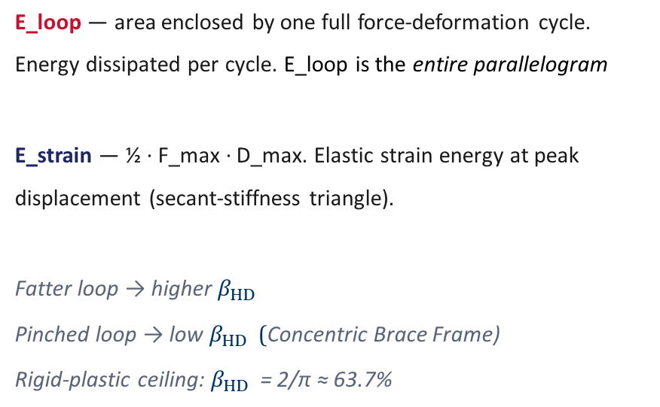
Vibrationdata
Hysteresis Loop $β_{HD}$ $=\frac{1}{\text{4}\text{π}}$ $\left({E_{loop}}/{E_{strain}}\right)$
Bilinear hysteresis loop (force vs. displacement) Reading the loop
E_loop — area enclosed by one full force-deformation cycle. Energy dissipated per cycle. E_loop is the entire parallelogram
E_strain — ½ · F_max · D_max. Elastic strain energy at peak displacement (secant-stiffness triangle).
Fatter loop → higher $β_{HD}$
Pinched loop → low $β_{HD}$ (Concentric Brace Frame)
Rigid-plastic ceiling: $β_{HD}$ = 2/π ≈ 63.7%
E_loop
E_strain
Force
−D_max
+D_max
Displacement
Note: Idealized bilinear loop shown. Real devices and SFRS components produce loops that are rounded, pinched, or asymmetric — affecting E_loop without changing E_strain.

Slide 17

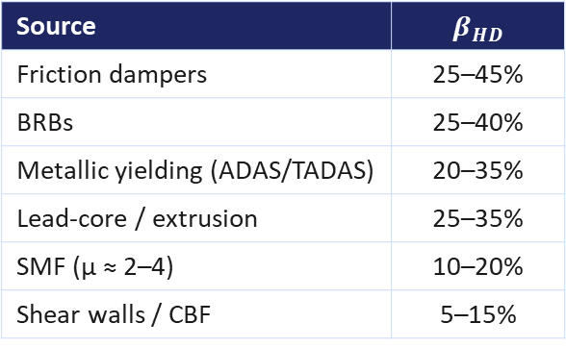
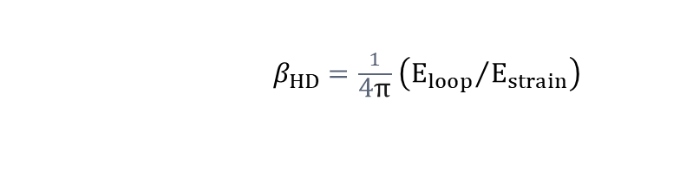
Vibrationdata
Hysteresis $β_{HD}$
$β_{HD}$ $=\frac{1}{\text{4}\text{π}}$ $\left({E_{loop}}/{E_{strain}}\right)$
Typical Values
What it captures
Displacement-dependent devices
BRBs, friction dampers, metallic yielding plates, lead-extrusion devices.
Post-yield hysteresis of the SFRS
Energy dissipated by the primary lateral system once it yields — moment frames, BRBFs, shear walls.
Computed via Jacobsen
Area of the force-deformation loop normalized by the strain energy at design displacement.
Source | $β_{HD}$
Friction dampers | 25–45%
BRBs | 25–40%
Metallic yielding (ADAS/TADAS) | 20–35%
Lead-core / extrusion | 25–35%
SMF (μ ≈ 2–4) | 10–20%
Shear walls / CBF | 5–15%
Practical cap: ASCE 7 §18.2.2.2 limits $β_{V}\sqrt{μ}+β_{HD}$ to roughly 30% — Jacobsen's equivalence breaks down at higher damping. Rigid-plastic loop ceiling: $β_{HD}$ = 2/π ≈ 63.7%.

Slide 18
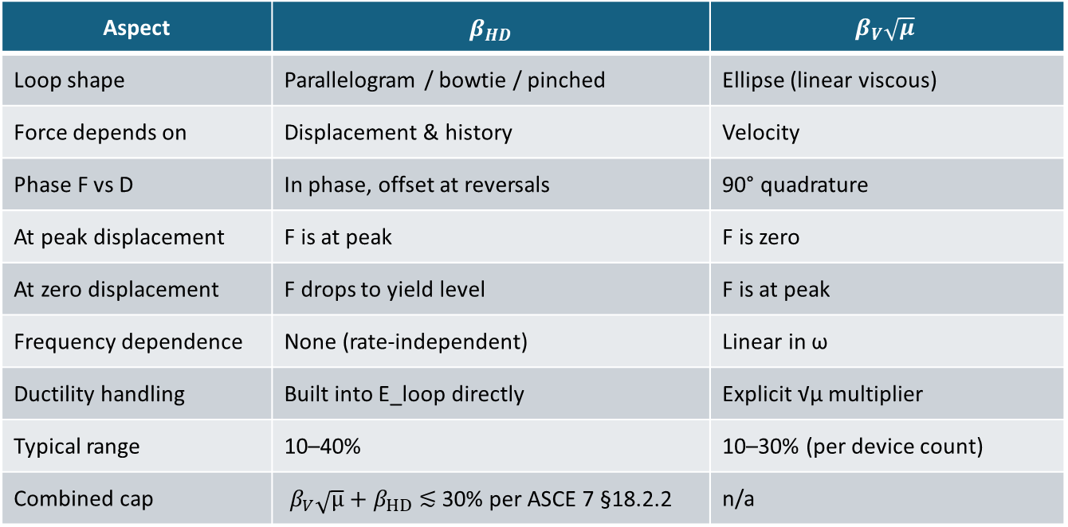
Parameter Comparison Vibrationdata
Aspect | $β_{HD}$ | $$β_{V}\sqrt{μ}$$
Loop shape | Parallelogram / bowtie / pinched | Ellipse (linear viscous)
Force depends on | Displacement & history | Velocity
Phase F vs D | In phase, offset at reversals | 90° quadrature
At peak displacement | F is at peak | F is zero
At zero displacement | F drops to yield level | F is at peak
Frequency dependence | None (rate-independent) | Linear in ω
Ductility handling | Built into E_loop directly | Explicit √μ multiplier
Typical range | 10–40% | 10–30% (per device count)
Combined cap | $β_{V}\sqrt{μ}+β_{HD}$ ≲ 30% per ASCE 7 §18.2.2 | n/a

Slide 19
Design Forces in the Damping System Vibrationdata
Force-controlled vs. deformation-controlled
Elements of the DS (braces, gussets, connection plates, anchorage, columns supporting devices) are designed as force-controlled — they must remain essentially elastic when the devices deliver their maximum expected force.
Three governing load cases (§18.4.1)
Stage of max displacement
Peak relative displacement; velocity ≈ 0. Force is dominated by displacement-dependent devices.
Stage of max velocity
Peak relative velocity; displacement ≈ 0. Force is dominated by velocity-dependent devices.
Stage of max acceleration
Combination of the two — required because both devices contribute simultaneously near peak floor acceleration.

Slide 20
SECTIONS 18.2.1.1 & 18.4
Vibrationdata
Minimum Base Shear on the Seismic Force-Resisting System (SFRS)
Floor on the SFRS demand
Despite the damping reduction, the SFRS base shear used for member design cannot fall below the limits in §18.2.1.1:
V_min = max ( V/B_V+I , 0.75 V )
where V is the Ch. 12 base shear with the applicable R, and B_V+I is the damping coefficient for inherent + viscous damping only (hysteretic contributions are not credited in the floor).
Why the floor matters
Ensures a baseline lateral capacity if the damping system underperforms, is taken out of service, or experiences device-specific failures. The DS is supplemental — not a substitute.
ASCE 7-22 Ch. 18 — Seismic Design for Damping
11 / 14

Slide 21
Choosing the Analysis Procedure Vibrationdata
Nonlinear response history (§18.3) is the default and is always permitted. The simplified linear procedures may be used only when the structure meets every eligibility condition of §18.2.3.
Equivalent Lateral Force
§18.7.2 — simplest
Response Spectrum
§18.7.1 — captures higher modes
Nonlinear Response History
§18.3 — always permitted / default
Permitted only if ALL hold:
At least two damping devices per story, each principal direction
Effective damping ≤ 35% of critical in the fundamental mode
SFRS has no plan or vertical irregularities
Floor/roof diaphragms are rigid
No outrigger / spine systems; regular, well-distributed devices
Wider applicability than ELF if:
At least two damping devices per story, each principal direction
Effective damping ≤ 35% of critical
Devices behave essentially linearly at the design level
Modal combination (CQC) over the period range of interest
Some irregularity tolerated where ELF is not
Required whenever the simplified limits are not met:
Effective damping above 35%
Nonlinear / rate- or amplitude-dependent devices
Plan or vertical irregularity, flexible diaphragms
≥ 7 ground-motion pairs at DE and MCEᵣ; average governs
Checks DS forces at all three loading stages
Bottom line: the simplified procedures are screening and preliminary-design tools for regular, lightly-to-moderately damped buildings. Final verification of an actual damped structure almost always returns to nonlinear response history.
Source: ASCE/SEI 7-22 §18.2.3 (Procedure Selection), §18.3 (NLRH), §18.7 (Alternate Procedures). Eligibility thresholds carried forward from ASCE 7-16; verify exact values against the standard before use.

Slide 22
Vibrationdata
SECTION 18.6
Prototype Testing of Damping Devices
Two full-size prototypes of each device type and size must be tested before production.
Test | Purpose | Acceptance
Data-record cycle (low amplitude) | Verify storage / loss stiffness at service amplitudes | Within ±15% of design value
Sequence & cycles at MCE_R amplitude | Demonstrate stable hysteresis at the maximum demand | Loop area within ±15% of the average
Fatigue / wind cycles | Confirm capacity for cumulative wind & service demand | No degradation or leakage
Temperature & velocity sensitivity | Bound device response across operating range | Properties within bounding analysis envelope
Production testing (§18.6.2) is performed on at least 100% or a representative sample of all production devices.
ASCE 7-22 Ch. 18 — Seismic Design for Damping
12 / 14

Slide 23
Vibrationdata
PRACTICE
Typical Design Workflow
1
Code SFRS first
2
Target performance
3
Preliminary sizing
Design the SFRS to satisfy Ch. 12 without crediting the Damping System (DS). Establish the baseline period, R, and capacity.
Set drift, acceleration, and ductility targets. Pick device type(s) and a preliminary damping ratio β.
Use Response Spectrum Analysis (RSA) or Equivalent Later Force (ELF) (within §18.3 limits) to size dampers and bracing. Iterate β and device placement.
4
NLRH verification
5
Force-controlled check
6
Test program
Run nonlinear response history at Design Earthquake (DE) and MCE_R with ≥ 7 pairs of motions. Check DS forces at all three stages.
Design DS elements for maximum device forces × overstrength. Confirm SFRS min base shear is met.
Define prototype and production tests for the specifying engineer of record. Coordinate with the device supplier.
ASCE 7-22 Ch. 18 — Seismic Design for Damping
13 / 14

Slide 24
SUMMARY
Vibrationdata
Key Takeaways
01
The damping system is supplemental. The SFRS must still be designed and detailed to Ch. 12, and a minimum base shear floor (§18.2.1.1) protects against DS underperformance.
02
Nonlinear response history (NLRH) at both DE and MCE_R is the governing analysis. Simplified procedures (RSA, ELF) apply only inside strict regularity and device-linearity limits.
03
Effective damping is the sum of inherent, viscous (scaled by √μ), and hysteretic contributions. Table 18.7-1 converts β to the spectrum reduction coefficient B.
04
DS components — braces, gussets, connections, anchorages — are force-controlled and designed for maximum expected device forces at three loading stages (max disp, max vel, max accel).
05
Prototype and production testing per §18.6 is mandatory. Devices must show stable, repeatable hysteresis within ±15% bounds before installation.
06
Practical impact: drift, acceleration, and ductility demands can be substantially reduced — at the cost of analysis effort, peer review, and a coordinated testing program.
ASCE 7-22 Ch. 18 — Seismic Design for Damping
14 / 14

Slide 25
Worked Example — Effective Damping to Demand Reduction Vibrationdata
Given — 10-story steel SMF with fluid viscous dampers
Inherent damping βI = 3% Ductility μ = 3 (√μ = 1.73)
Viscous device damping (at μ=1) βV0 = 9%
Hysteretic (devices + SFRS post-yield) βHD = 12%
RESULT
β ≈ 20%
B ≈ 1.50 → ~33% lower design demand
1
Modulate viscous damping by ductility
βV = βV0 / √μ = 9% / 1.73 = 5.2%
Reading the result
2
Sum the three contributions
β = βI + βV + βHD = 3 + 5.2 + 12 = 20.2%
Hysteretic damping dominates the total — typical when the SFRS yields and devices are displacement-active.
The √μ penalty cut the viscous contribution from 9% to ~5%; ignoring it would overstate β.
For the minimum base-shear floor (§18.2.1.1) only βI + βV = 8.2% is credited → BV+I ≈ 1.16, a much smaller reduction.
3
Look up B from Table 18.7-1 (interpolate)
β = 20% → B = 1.50; β = 30% → B = 1.70
At 20.2%: B ≈ 1.50
4
Reduce the 5%-damped design spectrum
Sa,design = Sa(5%) / B = Sa(5%) / 1.50
→ a 33% reduction in design acceleration
Note: illustrative values only. Actual β contributions come from the force-deformation loops verified by NLRH and prototype testing.
Method per ASCE/SEI 7-22 §18.7 effective-damping composition; B from Table 18.7-1. √μ modulation applies to the viscous term only.

Slide 26
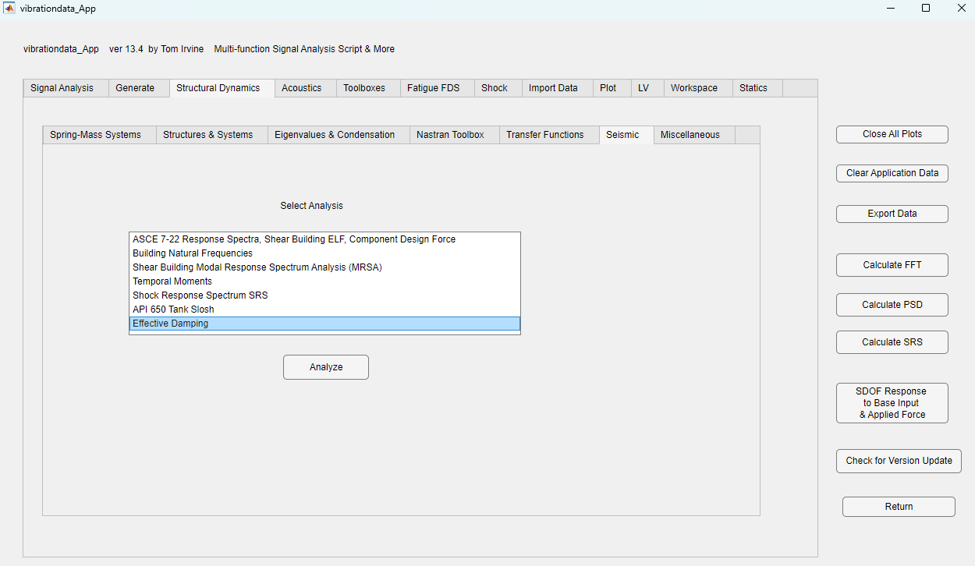

Slide 27
