Slide 1
Seismic Shock Response Spectra
Complex Oscillating Shock Pulse
Revision B

Slide 2
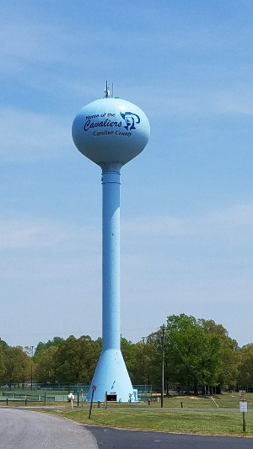
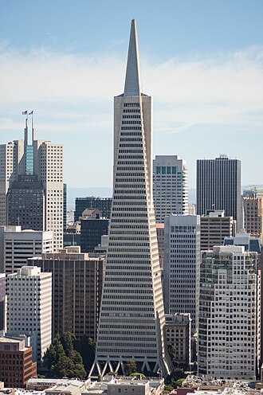
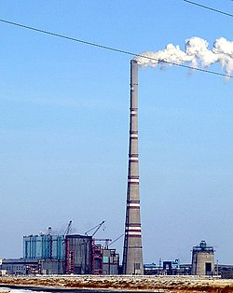
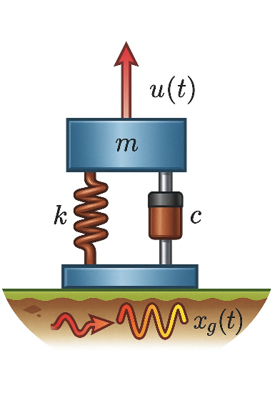
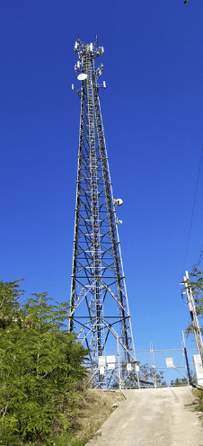
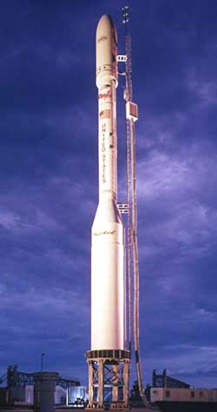
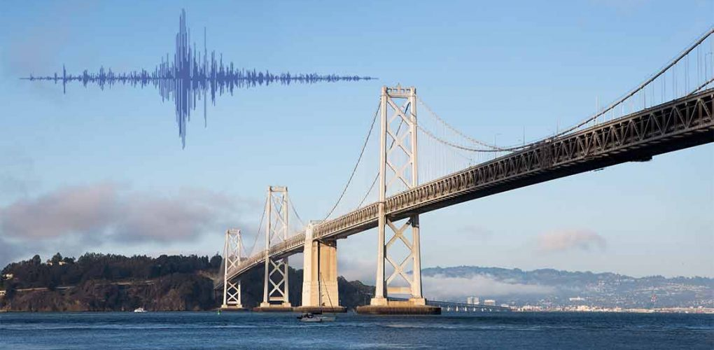

Slide 3
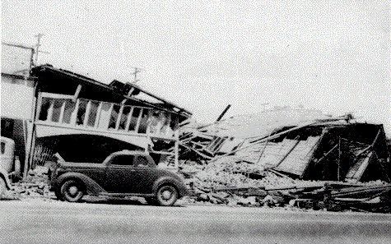
El Centro, Imperial Valley, Earthquake
Nine people were killed by the May 1940 Imperial Valley earthquake. At Imperial, 80 percent of the buildings were damaged to some degree. In the business district of Brawley, all structures were damaged, and about 50 percent had to be condemned. The shock caused 40 miles of surface faulting on the Imperial Fault, part of the San Andreas system in southern California. Total damage has been estimated at about $6 million. The magnitude was 7.1.

Slide 4
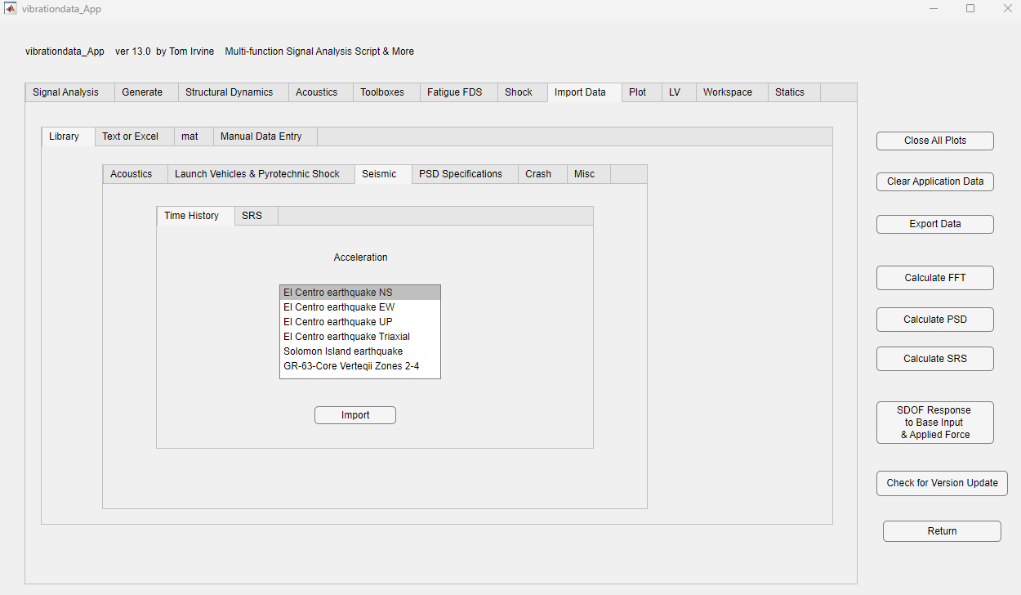

Slide 5
El Centro, Imperial Valley, Earthquake

Slide 6
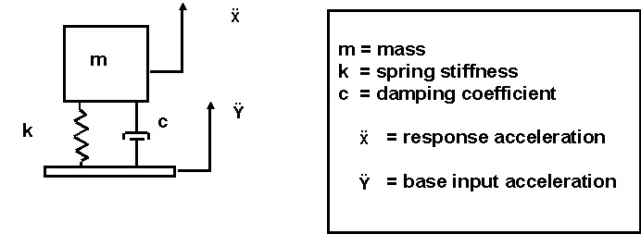
SDOF System Subjected to Base Excitation

Slide 7
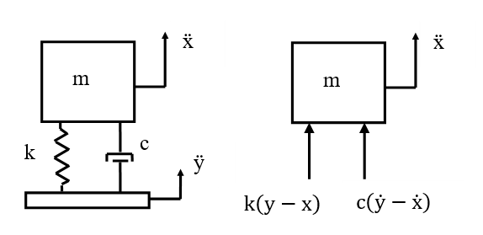
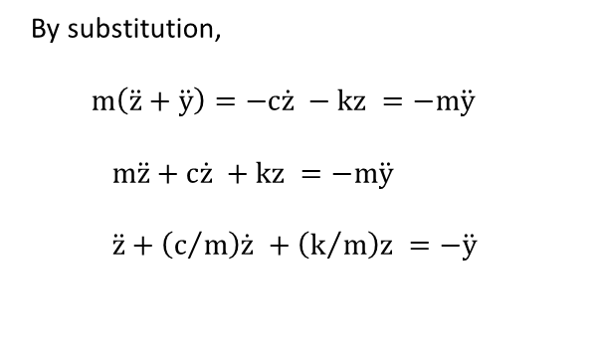
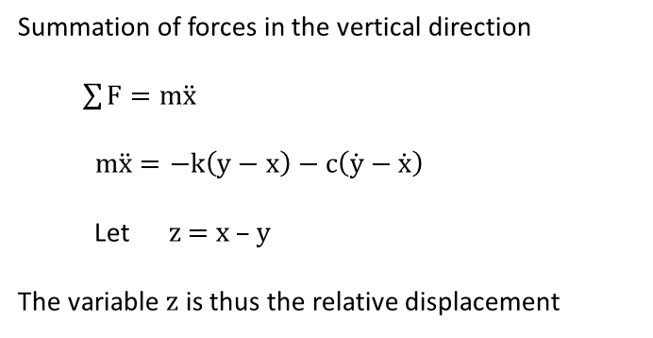
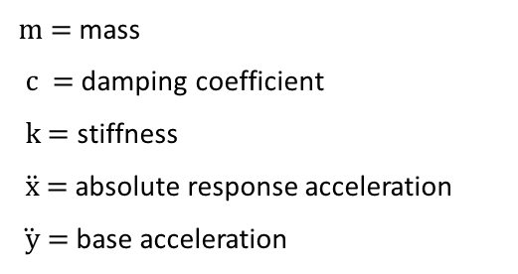
SDOF System Subjected to Base Excitation
Vibrationdata
m = mass
c = damping coefficient
k = stiffness
$\ddot{x}$ = absolute response acceleration
$\ddot{ y}$ = base acceleration
Summation of forces in the vertical direction
$\sum{F=m\ddot{x}}$
$$m\ddot{x}=−k\left(y−x\right)−c\left(\dot{y}−\dot{x}\right)$$
Let z = x – y
The variable z is thus the relative displacement
By substitution,
$m\left(\ddot{z}+\ddot{y}\right)=−c\dot{z} −kz =−m\ddot{y}$
$m\ddot{z}+c\dot{z} +kz =−m\ddot{y}$
$$\ddot{z}+\left(c/m\right)\dot{z} +\left(k/m\right)z =−\ddot{y}$$
7
Notes:
7

Slide 8

Equation of Motion
Vibrationdata
By convention,
$$c/m\text{ = }\text{2 }\text{ξ} {\text{ω}}_{\text{n}}$$
$${ k}/m\text{ =}{ {\text{ω}}_{\text{n}}}^{2}$$
where
${\text{ω}}_{\text{n}}$ is the angular natural frequency (rad/sec)
$\text{ξ}$ is the viscous damping ratio
Substituting the convention terms into equation,
$\ddot{z}+2{\text{ξω}}_{\text{n}}\dot{z} +{ {\text{ω}}_{\text{n}}}^{2}z =−\ddot{y}$
This is a second-order, linear, non-homogenous, ordinary differential equation with constant coefficients.
8
Notes:
8

Slide 9


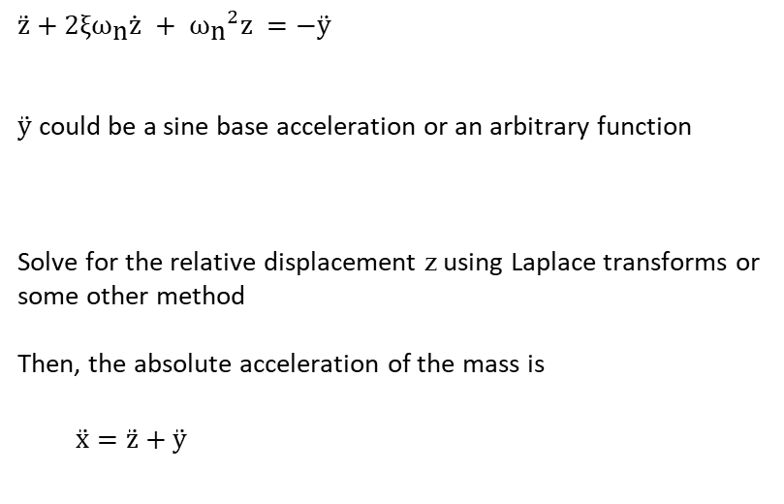
Equation of Motion (cont)
Vibrationdata
$$\ddot{z}+2{\text{ξω}}_{\text{n}}\dot{z} +{ {\text{ω}}_{\text{n}}}^{2}z =−\ddot{y}$$
$\ddot{y}$ could be a sine base acceleration or an arbitrary function
Solve for the relative displacement z using Laplace transforms or some other method
Then, the absolute acceleration of the mass is
$\ddot{x}=\ddot{z}+\ddot{y}$
9
Notes:
9

Slide 10
Algorithm
Problems with arbitrary base excitation are solved using a convolution integral
The convolution integral is represented by the Smallwood ramp invariant digital recursive filtering relationship for numerical efficiency
https://blog.vibrationdata.com/2013/04/22/david-o-smallwood-papers/

Slide 11
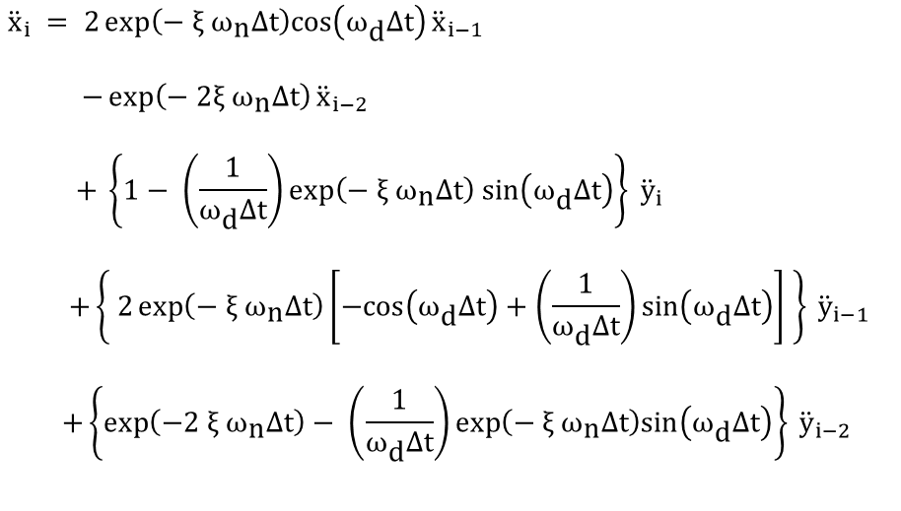
Smallwood Digital Recursive Filtering Relationship
$${\ddot{x}}_{i} = 2\exp\left(− \text{ξ} {\text{ω}}_{\text{n}}Δt\right)cos\left({\text{ω}}_{\text{d}}Δt\right){\ddot{x}}_{i−1 }$$ $$−\exp\left(−\text{ 2}\text{ξ} {\text{ω}}_{\text{n}}Δt\right){\ddot{x}}_{i−2}$$
$$+ \left\{1− \left(\frac{1}{{\text{ω}}_{\text{d}}Δt}\right)exp\left(− \text{ξ} {\text{ω}}_{\text{n}}Δt\right) sin\left({\text{ω}}_{\text{d}}Δt\right)\right\} {\ddot{y}}_{i}$$
$$+\left\{ 2\exp\left(− \text{ξ} {\text{ω}}_{\text{n}}Δt\right)\left[−cos\left({\text{ω}}_{\text{d}}Δt\right)+\left(\frac{1}{{\text{ω}}_{\text{d}}Δt}\right)sin\left({\text{ω}}_{\text{d}}Δt\right)\right] \right\} {\ddot{y}}_{i−1}$$
$$+\left\{\exp\left(−2 \text{ξ} {\text{ω}}_{\text{n}}Δt\right)− \left(\frac{1}{{\text{ω}}_{\text{d}}Δt}\right)\exp\left(− \text{ξ} {\text{ω}}_{\text{n}}Δt\right)sin\left({\text{ω}}_{\text{d}}Δt\right)\right\} {\ddot{y}}_{i−2 }$$
where ${\text{ω}}_{ \text{d}}={ \text{ω}}_{ \text{n}} \sqrt{1−{\text{ξ}}^{2}}$ and Δt is the time step

Slide 12
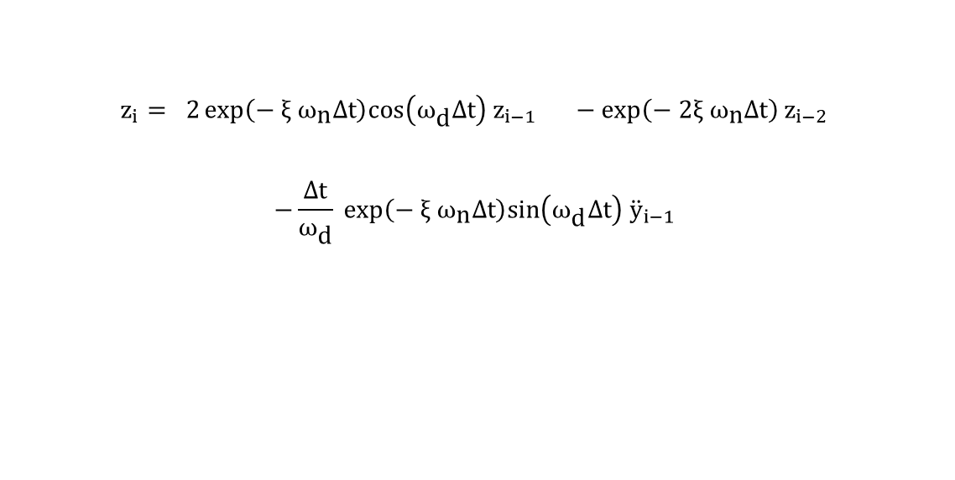
Relative Displacement
Vibrationdata
$$z_{i}= 2\exp\left(− \text{ξ} {\text{ω}}_{\text{n}}Δt\right)cos\left({\text{ω}}_{\text{d}}Δt\right)z_{i−1 }−\exp\left(−\text{ 2}\text{ξ} {\text{ω}}_{\text{n}}Δt\right)z_{i−2}$$ $$−\frac{Δt}{{\text{ω}}_{\text{d}}} \exp\left(− \text{ξ} {\text{ω}}_{\text{n}}Δt\right)sin\left({\text{ω}}_{\text{d}}Δt\right){ \ddot{y}}_{i−1}$$
12
Notes:
12

Slide 13
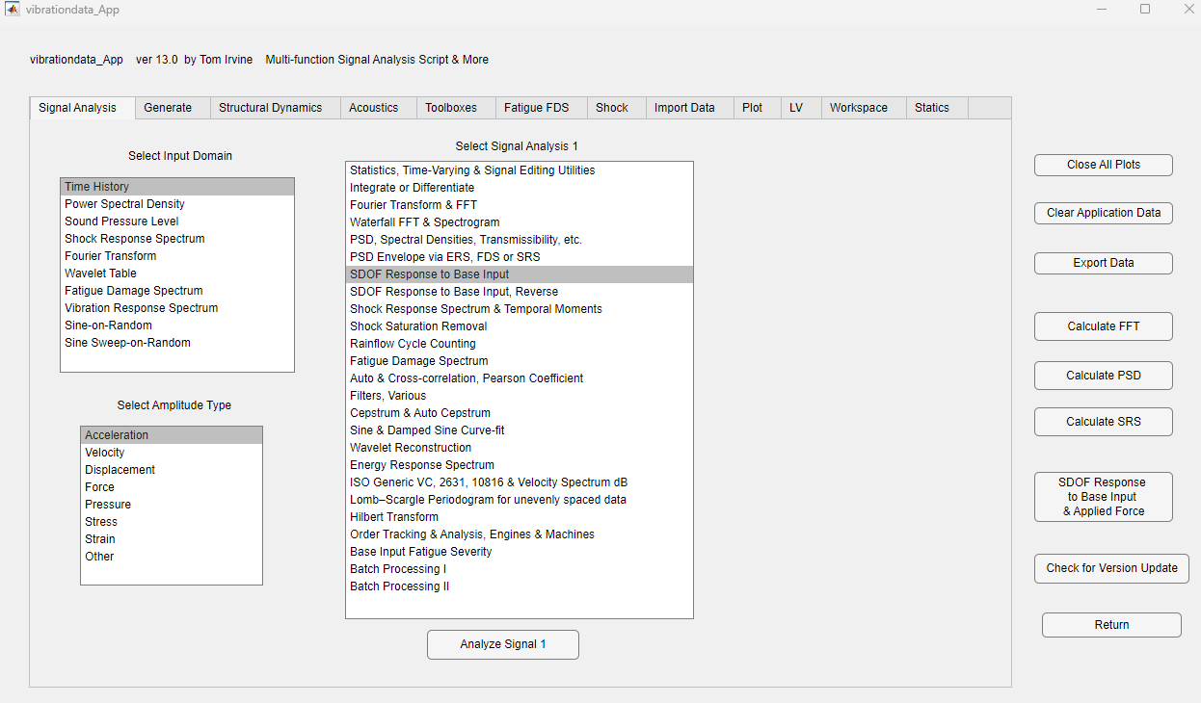

Slide 14
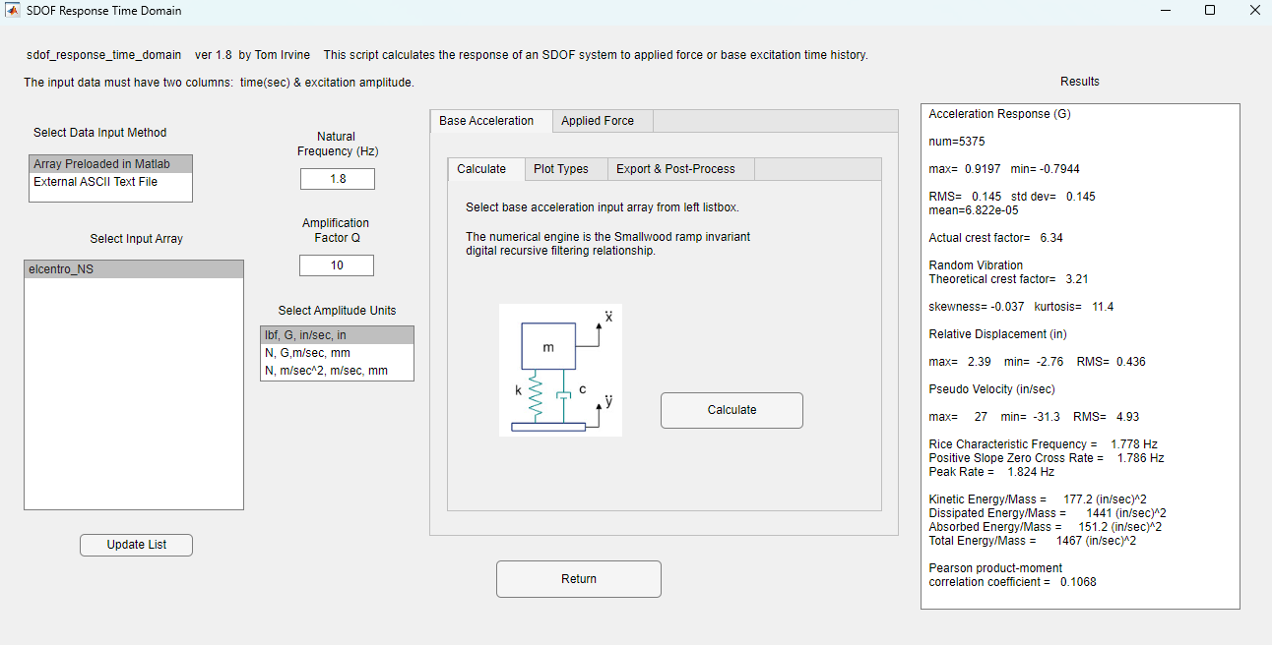

Slide 15
El Centro Earthquake Exercise I
Peak Response Accel = 0.92 G

Slide 16
El Centro Earthquake Exercise I
Peak Rel Disp = 2.8 in

Slide 17
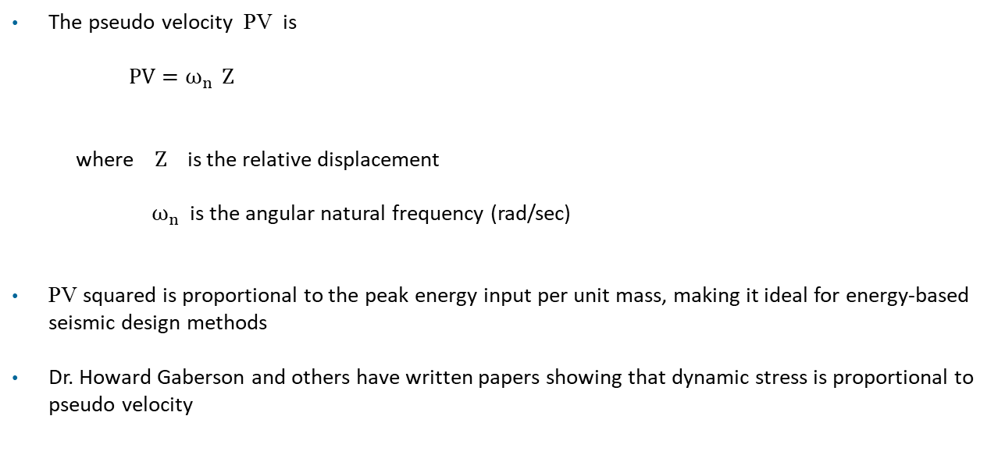
Pseudo Velocity
The pseudo velocity PV is
$$PV=ω_{n} Z$$
where Z is the relative displacement
$ω_{n}$ is the angular natural frequency (rad/sec)
PV squared is proportional to the peak energy input per unit mass, making it ideal for energy-based seismic design methods
Dr. Howard Gaberson and others have written papers showing that dynamic stress is proportional to pseudo velocity

Slide 18
Pseudo Velocity
Dr. Howard Gaberson and others have written papers showing that dynamic stress is proportional to pseudo velocity
Pseudo velocity is the key link between ground motion and structural demand — for a given earthquake response spectrum, PV directly indicates the strain energy stored per unit mass in a SDOF oscillator, making it more physically meaningful than spectral acceleration or displacement alone
Peak ground velocity (PGV) approximates PV in the velocity-sensitive region of the spectrum — for lightly damped structures with natural periods between ~0.2 sec and ~2 sec (covering most building and bridge structures)
PV ≈ PGV, provides a rapid damage estimate directly from the recorded ground motion without requiring a full response spectrum analysis

Slide 19
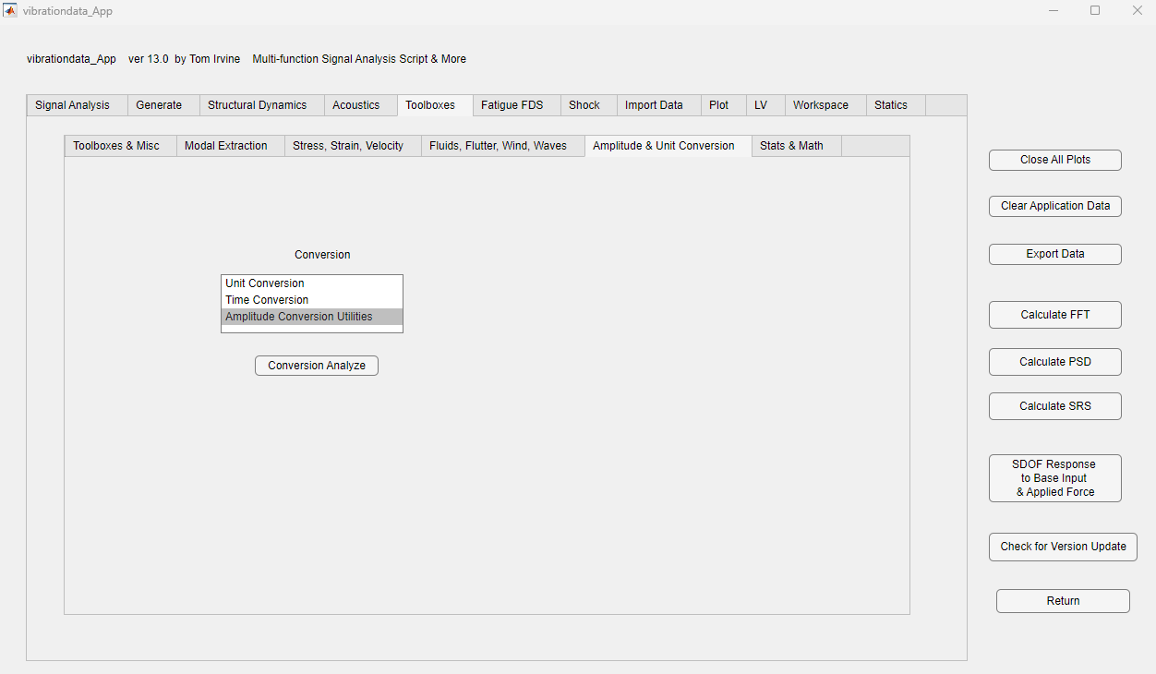

Slide 20
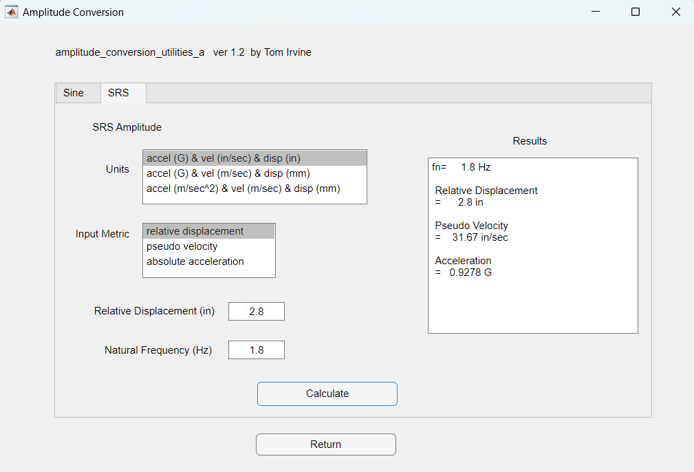

Slide 21
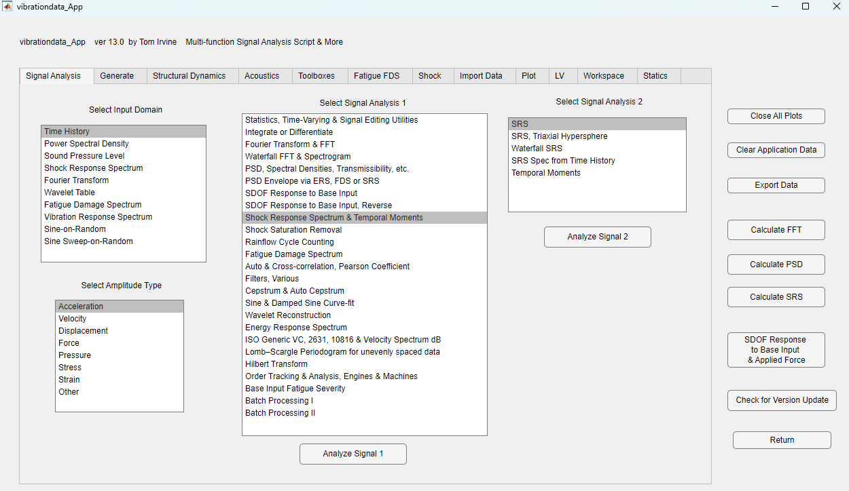

Slide 22
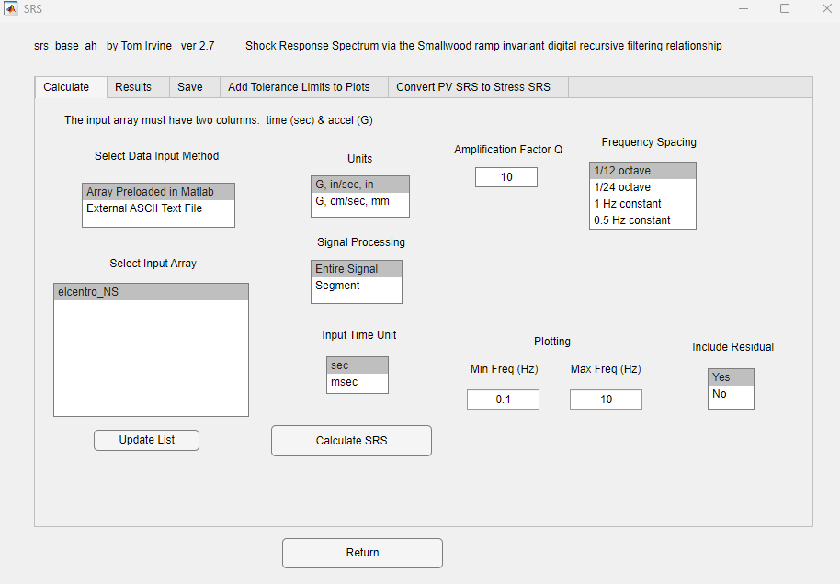

Slide 23
El Centro Earthquake SRS

Slide 24
El Centro Earthquake SRS

Slide 25
El Centro Earthquake SRS

Slide 26
El Centro NS
fn = 1.8 Hz
Accel = 0.92 G
Vel = 31 in/sec
Rel Disp = 2.8 in

Slide 27
El Centro Earthquake SRS, Q=50, 1% damping
Assume light damping for conservatism
Highest SRS peak is 1.5 G
Add some uncertainty margin ~ 3 dB
Derive equivalent static load of 2 G
Equivalent static load derived so that civil engineers do not have to calculate natural frequency

Slide 28
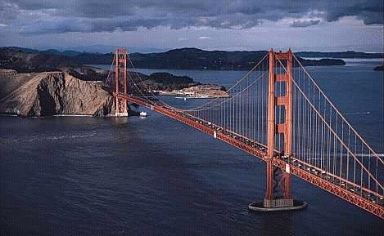
Golden Gate Bridge
Note that current Caltrans standards require bridges to withstand an equivalent static earthquake force (EQ) of 2.0 G
May be based on El Centro SRS peak Accel + dB margin

Slide 29
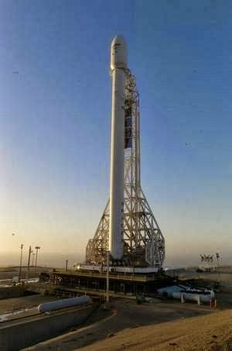
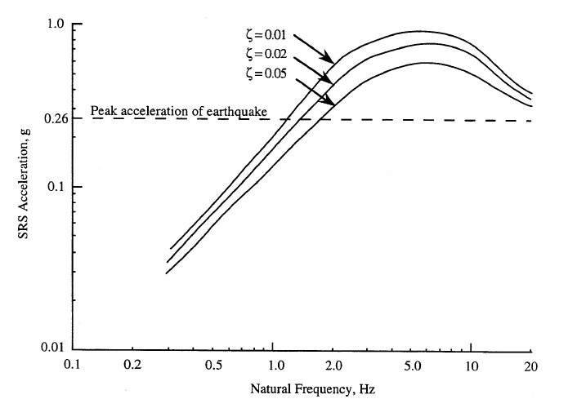
Vandenberg, California SRS
NASA-HDBK-7005, Shock Response Spectrum for Typical Central California Earthquake

