Slide 1
Equipment Seismic
Isolation & Bracing
Revision A
By Tom Irvine

Slide 2
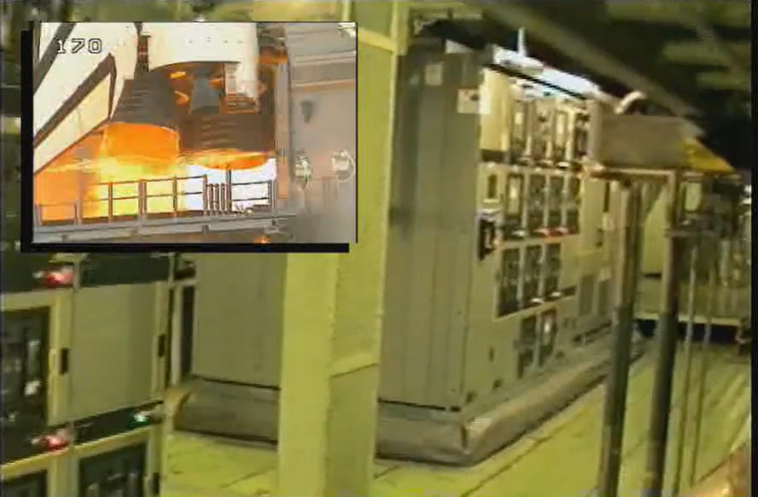
NASA Video
Vibrationdata
The excitation is man-made rather than natural but still representative of base excitation
https://www.youtube.com/watch?v=wN5fjtHnhWA
Notes:
2

Slide 3
Earthquake Videos
Vibrationdata
https://www.youtube.com/watch?v=wuQXWnSnKwQ
https://www.youtube.com/watch?v=ViJSyHgANYk
https://www.youtube.com/watch?v=q7feC-tX1hI
Notes:
3

Slide 4
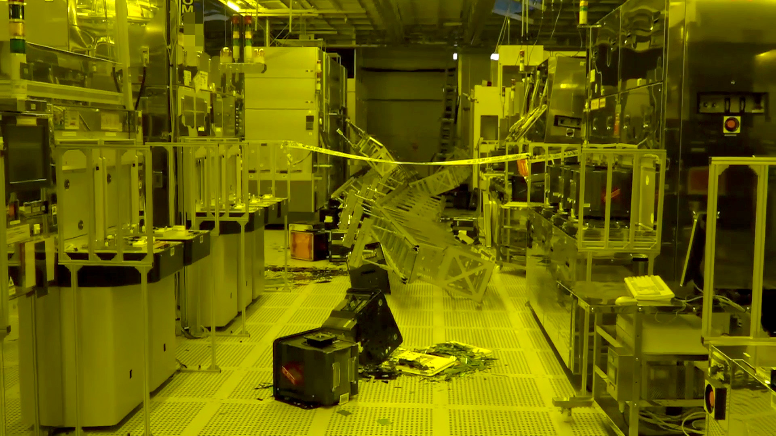
Failure Modes
Vibrationdata
Overturning (high CG)
Sliding (insufficient anchorage)
Anchor failure (tension/shear)
Internal component failure
Cable pullout
Resonance amplification
Impact with restraints (snubbers)
https://lewisbass.com/when-to-consider-adding-seismic-anchoring-to-your-equipment/
Notes:
4

Slide 5
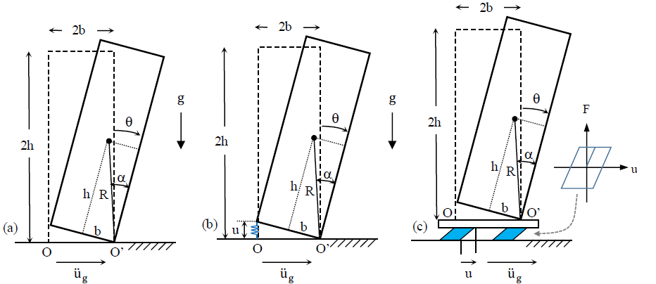
Overturning Risk
Vibrationdata
Schematic view of rigid electrical equipment in rocking motion: a) equipment simply supported on a fixed base; b) equipment anchored to a fixed base; and c) equipment simply supported on a seismically isolated base.
Jaimes, M. A., and Candia, G. (2018). “Overturning risk of rigid electric equipment during Mexican earthquakes.” Proc., 11th U.S. National Conference on Earthquake Engineering, Los Angeles, CA
Notes:
5

Slide 6
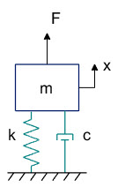
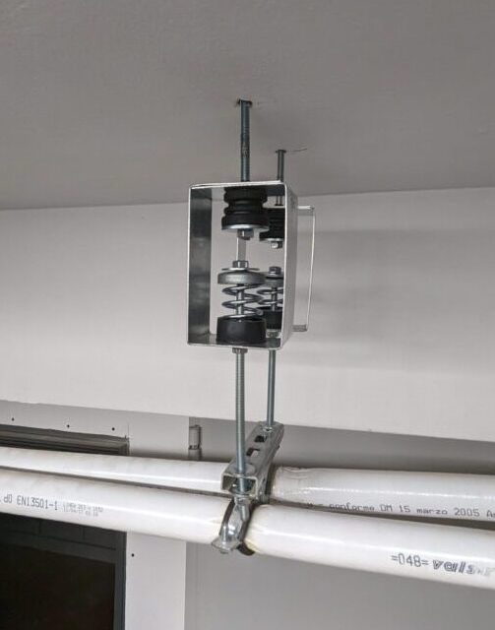
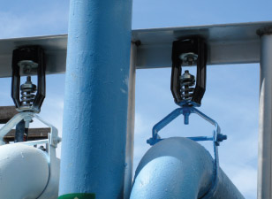
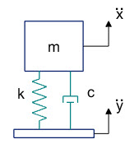
Isolation Hangers
Designed to reduce the transmission of vibration and noise from suspended mechanical equipment such as fans, pumps, air handling units, piping and ductwork
Also used to protect suspended equipment from earthquake excitation

Slide 7
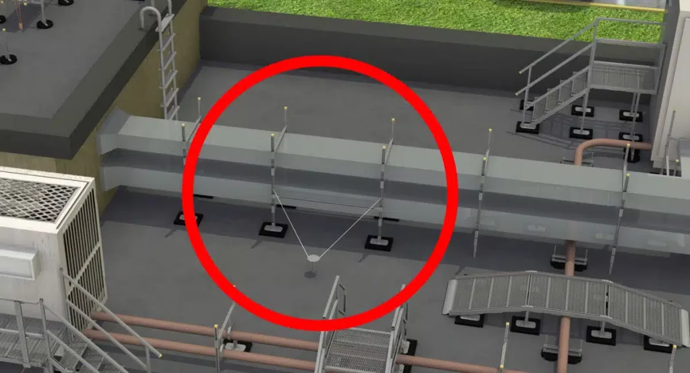
Rooftop Duct Anchoring
https://rooftopsupportsystems.com/navigating-seismic-bracing-requirements-a-comprehensive-guide/
Notes:
7

Slide 8
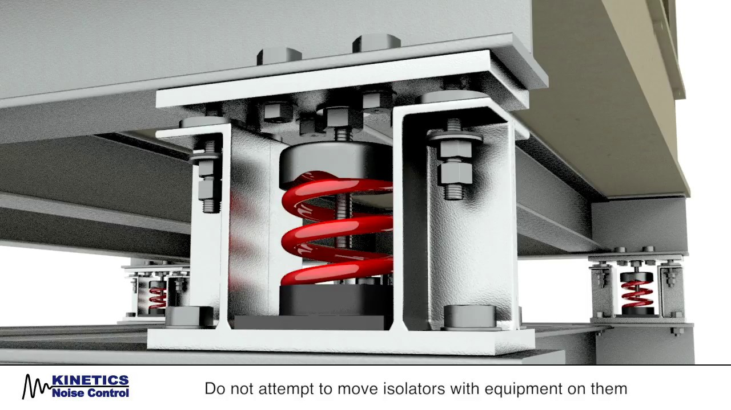
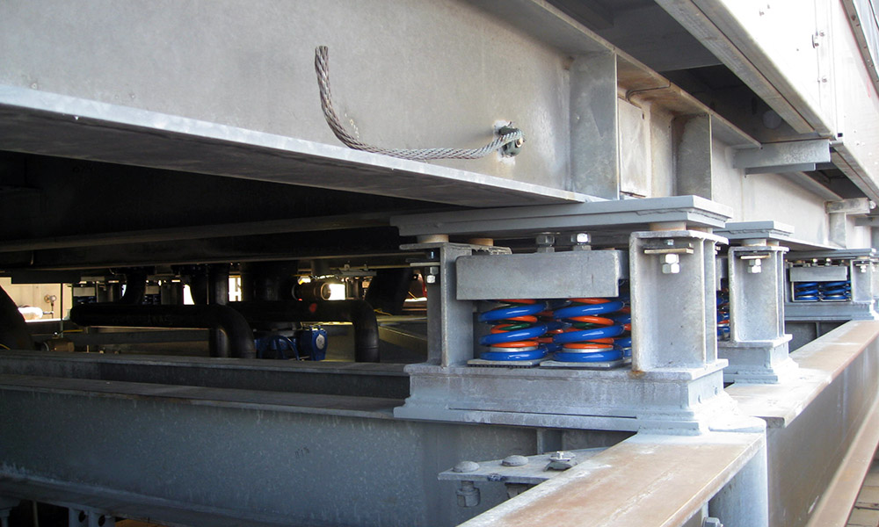
Equipment Racks
Vibrationdata
Rack tipping / overturning
If a rack is not anchored or braced properly, ground shaking can cause it to tip or buckle
Once it starts moving, everything inside shifts and falls
For example, the support structure may deform, causing rails to bend or collapse
A rack can be mounted via isolators and still be anchored using seismic-restrained isolators with snubbers or limit stops
Notes:
8

Slide 9

Equipment Racks (cont)
Vibrationdata
Internal Movement
  Even if the rack remains upright, the shaking moves everything inside: circuit boards, cables, servers, power supplies
  Connectors can loosen
  Power/cable disruption is a concern
Cable / wiring strain, connector failure
  When the rack moves, cables and power/ground connections are stressed
  This can pull on connectors, loosen them, or create intermittent faults
https://www.amcoenclosures.com/
Notes:
9

Slide 10
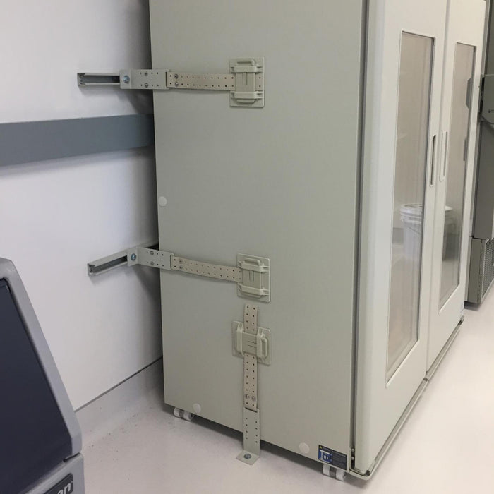
Equipment Racks (cont)
Vibrationdata
Floor or building movement / base isolation issues
  Even if the rack is well mounted, building motion, floor vibrations, or resonance can amplify motion
  Also, non-structural components (like racks) are required by building codes to be anchored or braced in many cases.
Anchoring / bracing
  The rack should be firmly anchored to the floor (and/or wall) with appropriate seismic-rated anchor bolts or braces.
  If the center of gravity is high (heavy equipment up top) or the rack is very tall, the risk increases.
  One article notes: “Any component weighing more than 400 pounds. … Or center of gravity more than 4 feet above the floor” triggers the need for anchoring. lewisbass.com
https://safe-t-proof.com/
Notes:
10

Slide 11
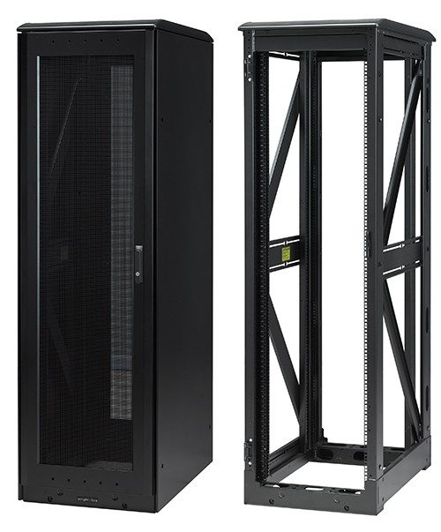
Equipment Racks (cont)
Vibrationdata
Rack structural failure
If the rack itself is not designed for seismic loads, the frame, mounting rails, or anchor points may deform or fail
This can cascade to internal failure of mounted equipment
Bending, twisting, stretch and compression of structural members may occur
Diagonal stiffeners can be installed to reduce dynamic loads
https://www.eaton.com/us/en-us/products/server-racks-enclosures-airflow-management/seismic-cabinets-for-harsh-environments.html
Notes:
11

Slide 12
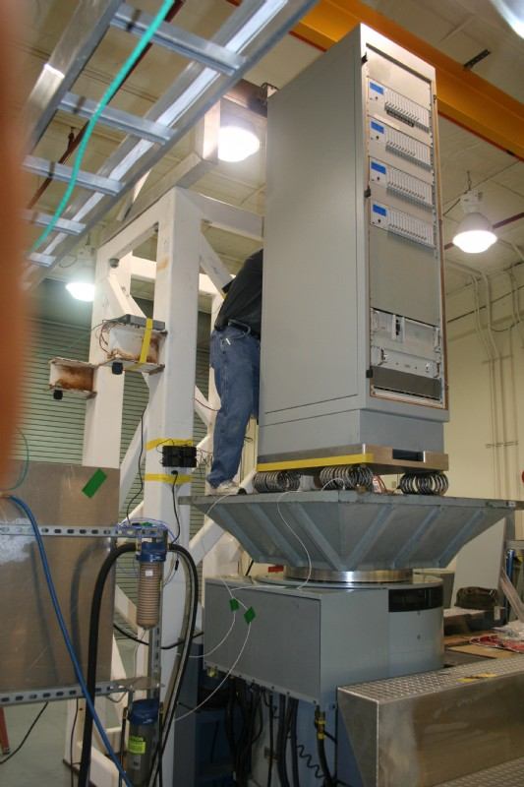
Equipment Racks (cont)
Vibrationdata
Use floor anchors designed for seismic loads (shear and tensile rated)
Rack design and seismic rating
Choose a rack designed for seismic zones (many manufacturers offer “seismic server racks” or “NEBS/Zone-rated racks”)
One article says “Seismic server racks protect servers by transforming potential disaster scenarios into manageable events.”
These racks include features such as reinforced frames, cross-bracing, base plates, and damping/shock absorption systems
Look for compliance with standards like Telcordia GR-63 or building code (e.g., International Building Code (IBC) seismic requirements)
Image: Wire rope isolators reduce transmitted shock and vibration, but tall racks still need displacement restraints so isolation does not become uncontrolled sway
Equipment rack with wire rope isolators,
shaker test, Unholtz-Dickie
Notes:
12

Slide 13
NEBS / Telcordia GR-63
Vibrationdata
Network Equipment-Building System (NEBS)
Set of requirements for telecom equipment reliability
Widely used for data centers, server racks, and critical infrastructure
Telcordia GR-63 (CORE) – Key Standard
Defines physical protection requirements
Includes earthquake (Zone 4) qualification
Applies to:
  Equipment racks / cabinets
  Mounted electronic equipment
  Cable management systems
Notes:
13

Slide 14
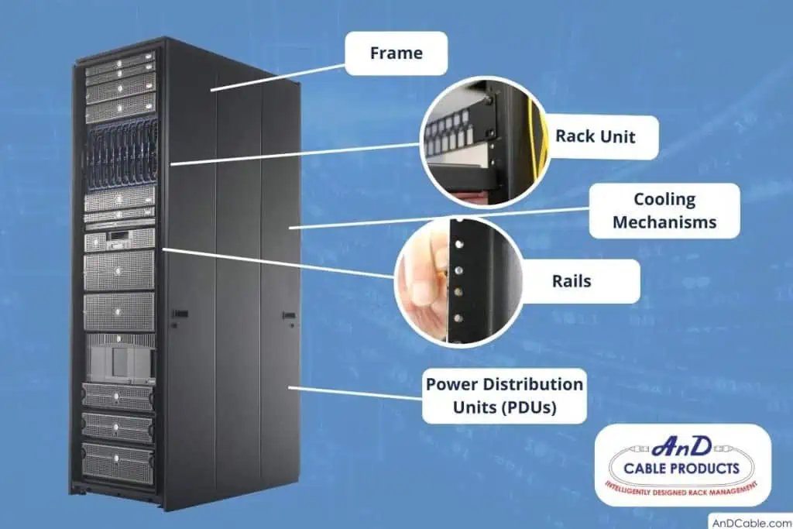
Equipment Racks (cont)
Vibrationdata
Internal load planning and mounting
Place heavier equipment (batteries, UPS, storage) low in the rack so that the center of gravity is low
One article: “… the distribution of equipment inside the cabinet in such a way that the center of gravity is closest to the bottom …”
Use locking rails, mounts and fasteners designed to hold equipment even under seismic motion
Ensure cables are managed/restrained so they do not pull out under motion
Cable & power/wiring management
Secure power distribution units (PDUs) and wiring so they do not shift, loosen or get pulled during motion
Grounding and bonding: though more related to electrical safety than earthquakes, ensuring the rack frame is properly grounded ensures better safety and less risk of damage via stray currents
Notes:
14

Slide 15
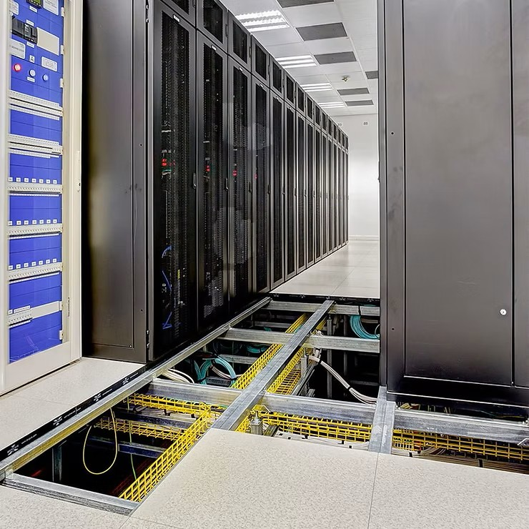
Equipment Racks (cont)
Vibrationdata
Regular inspection & maintenance
  Periodically check anchor bolts, brackets, vibration isolators (if any), cable restraints
  Check clearances: racks should not impede egress or maintenance even after motion
  Test or review the load: if new equipment added changed the weight drastically, the seismic rating/anchoring might need review
Environment & room preparedness
  Consider the room/floor itself: raised floors, floating slabs, etc. can amplify motion
  Ensure that other non-structural items (lighting, ceiling tiles, emergency systems) are braced too — a rack might survive but surrounding damage could knock it offline
https://www.powerinfrastructure.co.za/
Notes:
15

Slide 16
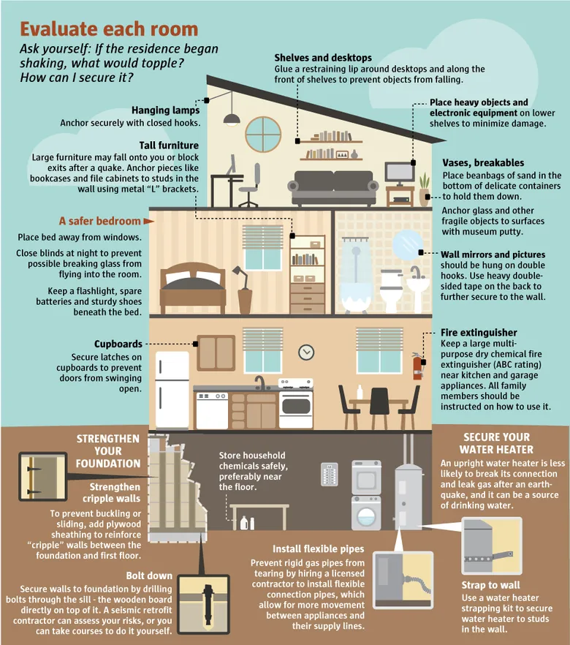
Homes
https://www.seattletimes.com/seattle-news/get-ready-to-rumble-a-guide-to-earthquake-preparedness/

