Slide 1
Vibrationdata
Steinway Tower Vibration Response
111 West 57th Street
By Tom Irvine

Slide 2
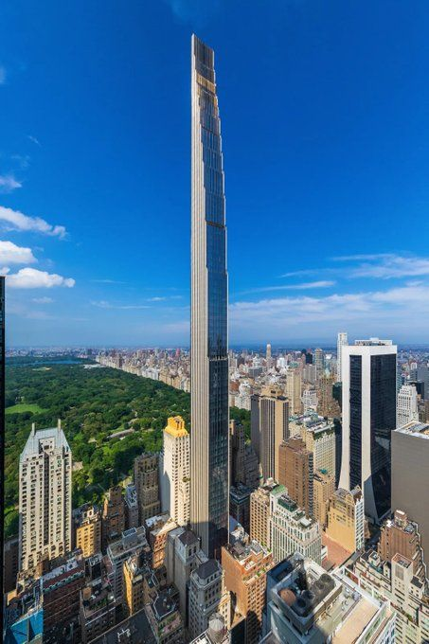
Steinway Tower Introduction
Location: Midtown Manhattan, New York City
Height: ~1,428 ft (435 m) — among the tallest residential buildings in the world
Width at Base: ~ 60 ft (18.3 m)
Slenderness ratio: ~24:1 (extremely slender; one of the most slender skyscrapers ever built)
Use: Ultra-luxury residential tower above historic Steinway Hall
Structural system: Reinforced concrete core + perimeter shear walls
Two 1m-thick shear walls along its east and west sides
The concrete strength ranges between 6,000 and 14,000 pounds per square inch (41,000 and 97,000 kPa)

Slide 3
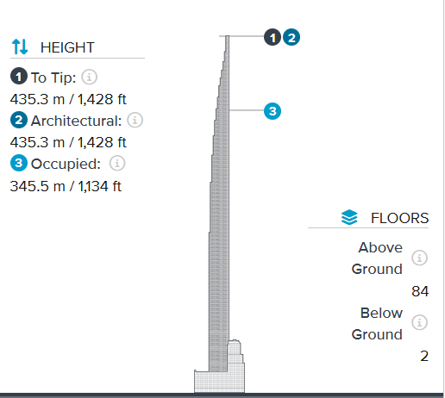
Structural Dynamic Behavior
Fundamental frequency:
Very low due to extreme slenderness (on the order of ~0.1 Hz)
Falls within the range where wind excitation dominates over seismic
Mass & stiffness distribution:
Tall, narrow geometry → low lateral stiffness relative to height
Concentrated core provides torsional resistance, but eccentricities still matter
Damping characteristics:
Intrinsic structural damping is low (~1–2% critical typical)
Tuned Mass Damper (TMD) required to control motion
https://www.skyscrapercenter.com/building/111-west-57th-street/14320

Slide 4
Concrete vs. Steel
Primary system: Reinforced concrete shear wall core
Secondary system: Steel framing (floors, connections)
Behavior:
Acts like a cantilevered concrete tube
With added damping devices (TMD) and foundation anchor
For a building like Steinway Tower:
Reinforced concrete advantages:
Higher mass → better damping
Greater stiffness for drift control
Better performance for low-frequency wind response (~0.1–0.2 Hz)
A pure steel moment frame would:
Be too flexible
Lead to excessive occupant motion
Vibrationdata

Slide 5
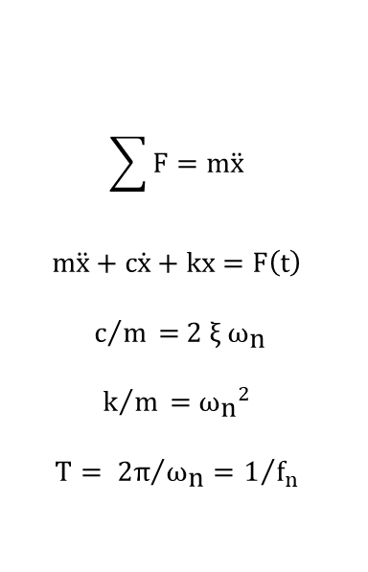
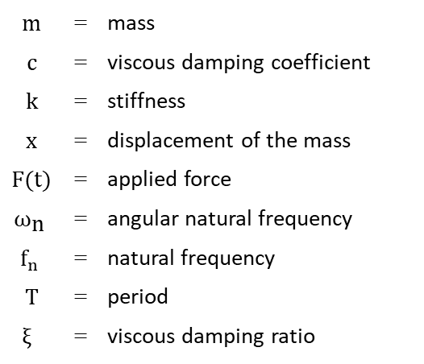
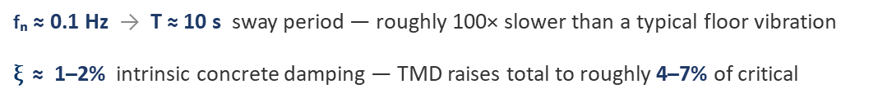
SDOF System, Applied Force
Vibrationdata
m | = | mass
c | = | viscous damping coefficient
k | = | stiffness
x | = | displacement of the mass
$F$(t) | = | applied force
$${\text{ω}}_{\text{n}}$$ | = | angular natural frequency
$$f_{n}$$ | = | natural frequency
T | = | period
$$\text{ξ}$$ | = | viscous damping ratio
F
F
x
x
m
m
k
c
k x
c ẋ
$$\sum{F=m\ddot{x}}$$
$$m\ddot{x}+c\dot{x}+kx=F\left(t\right)$$
$$c/m\text{ = 2 }\text{ξ} {\text{ω}}_{\text{n}}$$
$$k/m\text{ =}{ {\text{ω}}_{\text{n}}}^{2}$$
$${T= 2π}/{{\text{ω}}_{\text{n}}}=1/{f_{n}}$$
Applied to Steinway Tower
fₙ ≈ 0.1 Hz → T ≈ 10 s sway period — roughly 100× slower than a typical floor vibration
$\text{ξ}$≈ 1–2% intrinsic concrete damping — TMD raises total to roughly 4–7% of critical

Slide 6
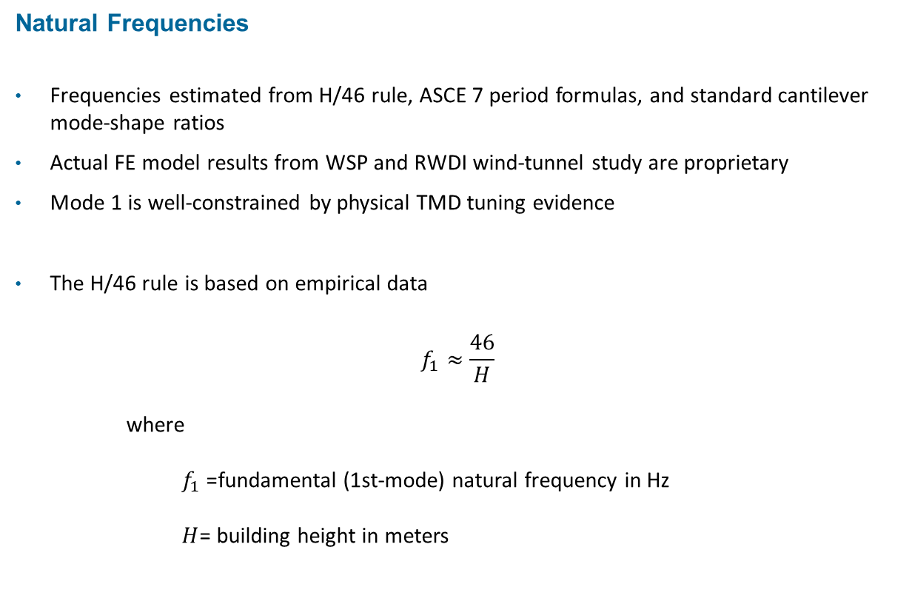
Natural Frequencies
Frequencies estimated from H/46 rule, ASCE 7 period formulas, and standard cantilever mode-shape ratios
Actual FE model results from WSP and RWDI wind-tunnel study are proprietary
Mode 1 is well-constrained by physical TMD tuning evidence
The H/46 rule is based on empirical data
$$f_{1}≈\frac{46}{H}$$
where
$f_{1}$= fundamental (1st-mode) natural frequency in Hz
$H$= building height in meters

Slide 7
Natural Frequencies
Mode | Description | Estimated Frequency (Hz) | Period (s) | Mode shape Character | Basis
1 | 1st bending, N–S (weak axis, across narrow 18 m face) | ~0.10–0.12 | ~8–10 | Cantilever 1st bending; max modal displacement at tip, zero rotation at tip, zero at base | Lowest frequency; TMD tuned here. Governs across-wind response.
2 | 1st bending, E–W (strong axis, across 23 m face) | ~0.13–0.16 | ~6–8 | Cantilever 1st bending along the stiffer shear-wall axis; tip-dominant | Higher than mode 1 because the E–W shear walls give more lateral stiffness.
3 | 1st torsion (twist about vertical axis) | ~0.18–0.25 | ~4–6 | Tip rotates about vertical axis; displacement proportional to distance from core | Narrow plan + eccentric setbacks make torsional stiffness modest. Important for corner accelerations
4 | 2nd bending, N–S | ~0.55–0.70 | ~1.5–1.8 | Single node at ~0.78 H; tip and mid-height move opposite directions | Classical cantilever ratio ≈ 6.27× mode 1.

Slide 8
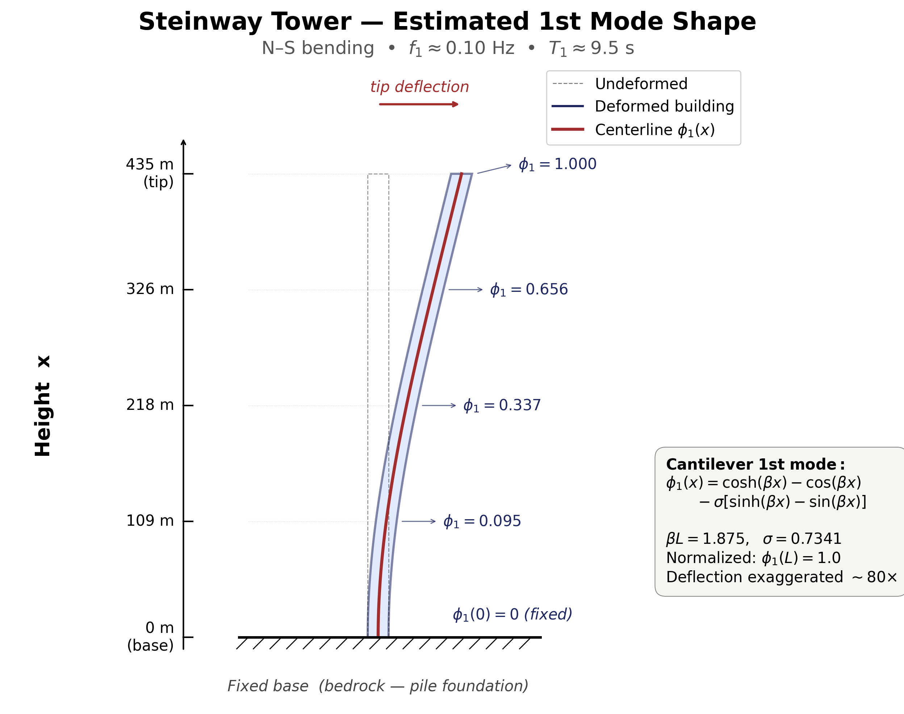

Slide 9
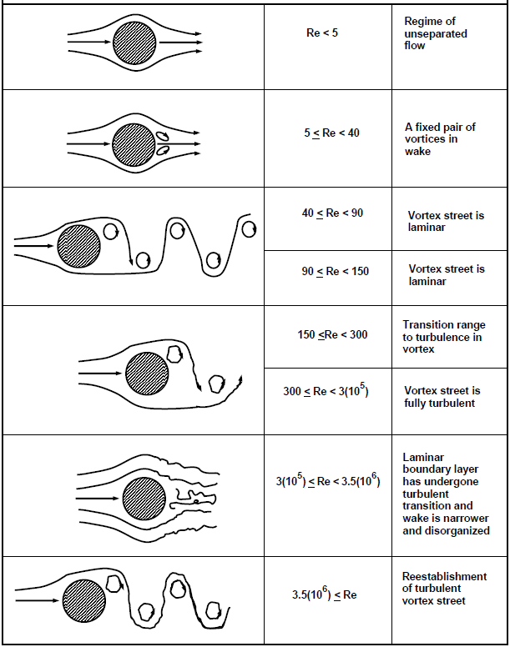
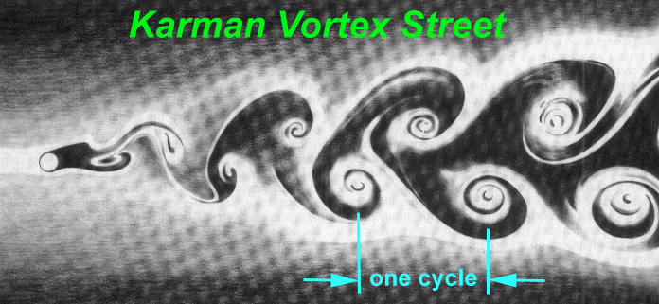
Applied Force or Pressure, Wind or Fluid
Oscillating force in vertical axis
Notes:
9

Slide 10

Strouhal Frequency
Vibrationdata
The Strouhal frequency for air moving over a structure is:
$$f_{s}=\frac{S V}{D}$$
where V is the air velocity,
D is the diameter or width depending on cross-section,
and S is the Strouhal number
Typically, S ≈ 0.2
$D$= across-wind dimension (m) ≈ 18 m for Steinway Tower's narrow face

Slide 11
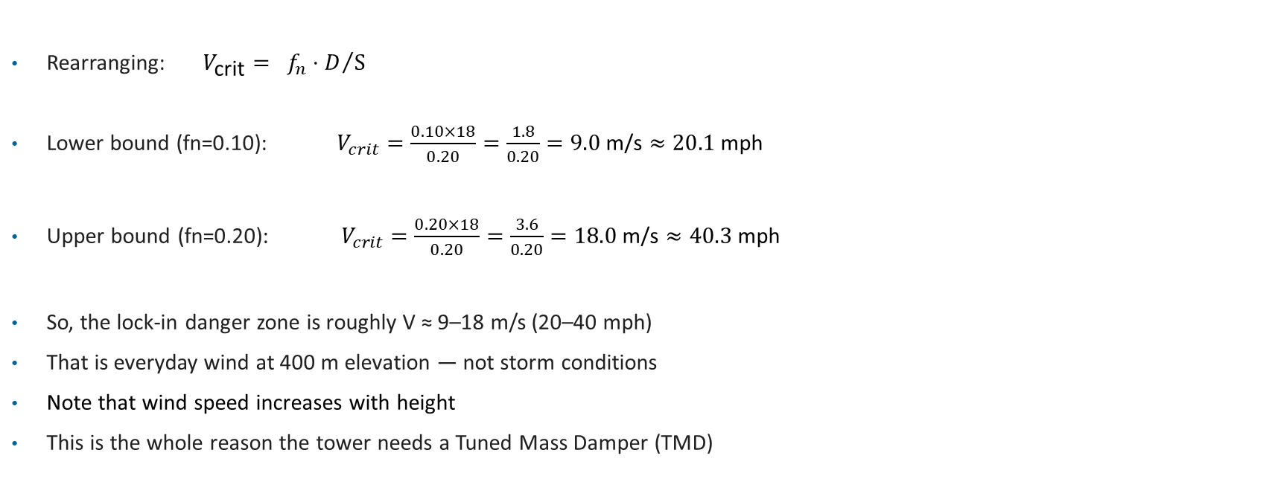
Critical Wind Speed, Lock in Condition
Vibrationdata
Rearranging: $V_{\text{crit}}= {f_{n}⋅D}/S$
Lower bound (fn=0.10): $V_{crit}=\frac{0.10×18}{0.20}=\frac{1.8}{0.20}=9.0 \text{m}\text{/}\text{s}≈20.1 \text{mph}$
Upper bound (fn=0.20): $V_{crit}=\frac{0.20×18}{0.20}=\frac{3.6}{0.20}=18.0 \text{m}\text{/}\text{s}≈40.3 \text{mph}$
So, the lock-in danger zone is roughly V ≈ 9–18 m/s (20–40 mph)
That is everyday wind at 400 m elevation — not storm conditions
Note that wind speed increases with height
This is the whole reason the tower needs a Tuned Mass Damper (TMD)

Slide 12
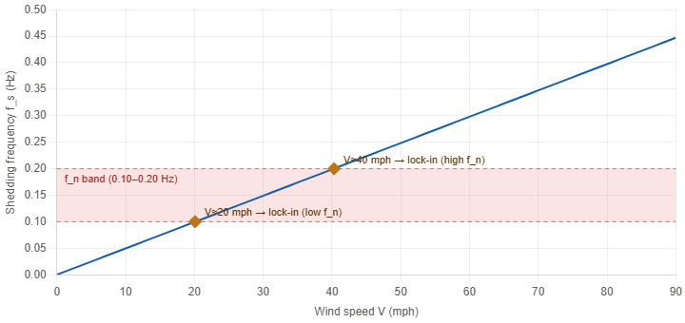
Shedding Frequency vs. Wind Speed
Vibrationdata

Slide 13
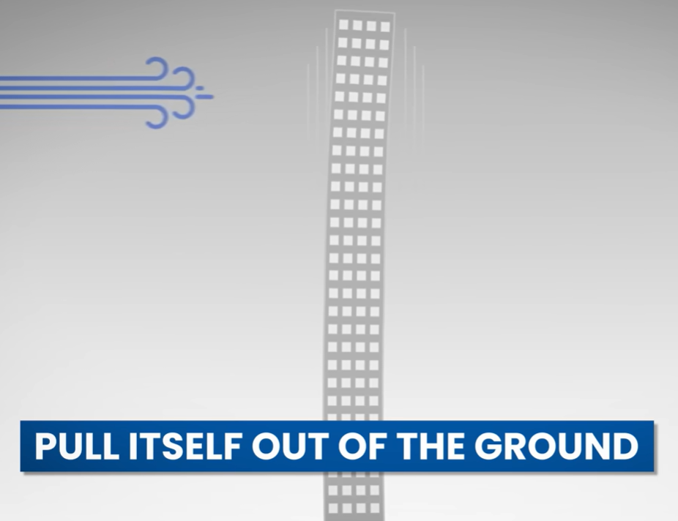
Wind Excitation
Along-wind response
Caused by mean drag forces
Dominates lower-frequency lateral displacement
Wake turbulence & vortex shedding
Alternating vortices induce oscillatory forces
Critical for slender buildings like Steinway Tower
Torsional excitation
Wind asymmetry causes twisting
Important due to narrow plan geometry
Resonance risk
Wind energy can align with the building’s natural frequency
Leads to amplified motion if not controlled
MegaBuilds Signal” https://www.youtube.com/watch?v=-WEtpnKOBjs&t=26s

Slide 14
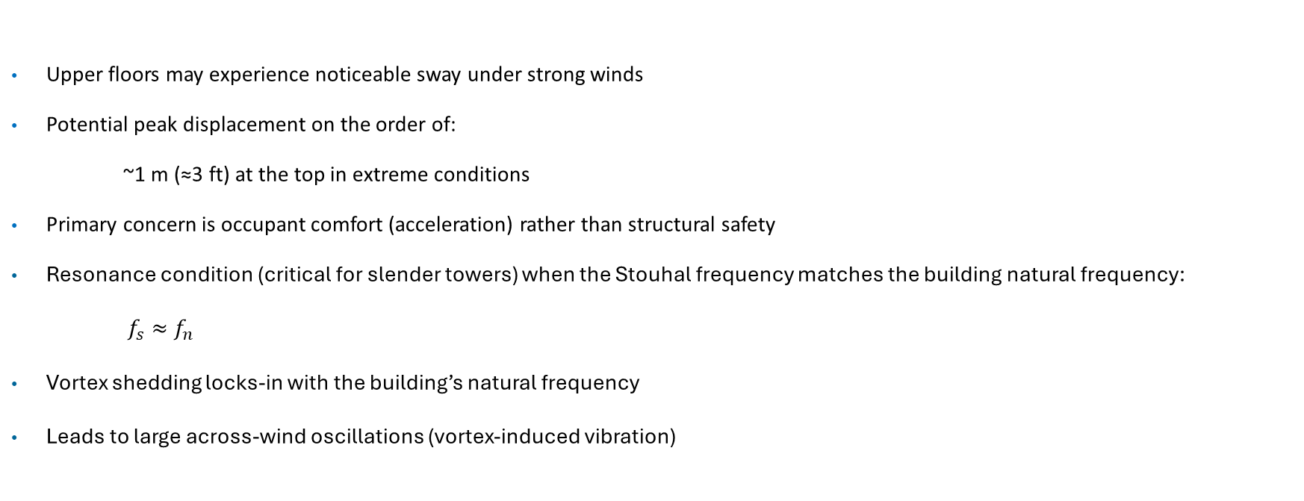
Wind Excitation
Upper floors may experience noticeable sway under strong winds
Potential peak displacement on the order of:
~1 m (≈3 ft) at the top in extreme conditions
Primary concern is occupant comfort (acceleration) rather than structural safety
Resonance condition (critical for slender towers) when the Stouhal frequency matches the building natural frequency:
$f_{s}≈f_{n}$
Vortex shedding locks-in with the building’s natural frequency
Leads to large across-wind oscillations (vortex-induced vibration)

Slide 15
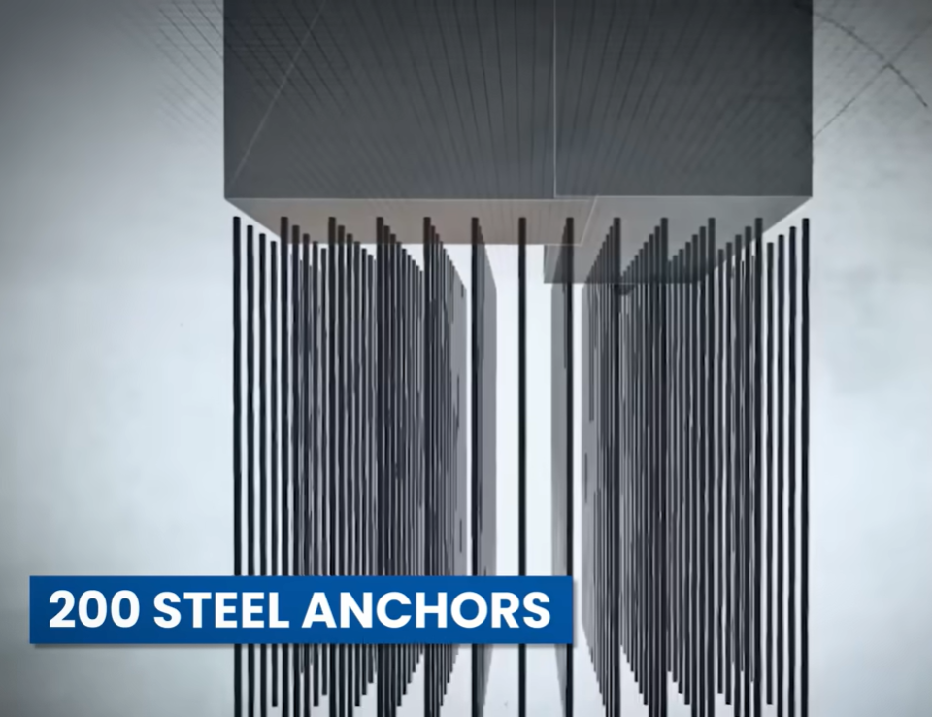
Piles
Pile Depth: The foundation piles extend roughly 100 feet down to reach bedrock
Uplift Protection: The piles are engineered to hold the building down due to the extreme slenderness, preventing it from tipping over rather than just supporting vertical weight
The piles are also beneficial for resisting seismic overturning
MegaBuilds Signal: https://www.youtube.com/watch?v=-WEtpnKOBjs&t=26s

Slide 16
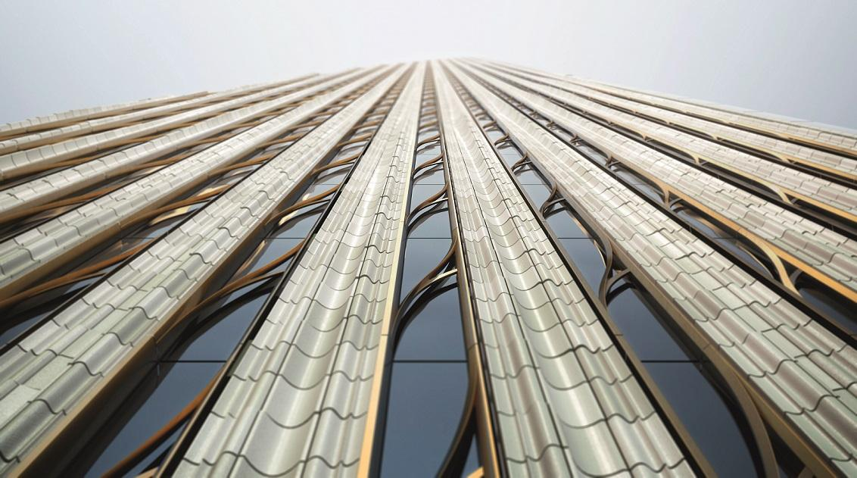
Façade
Strong vertical façade lines (terracotta piers) guide airflow and promote more organized flow along the height
Relatively smooth surface limits large-scale turbulence while small texture adds minor flow disruption
Tapering and setbacks break up coherent vortex formation and reduce across-wind excitation
Non-uniform geometry along height helps de-correlate vortex shedding (avoids synchronized loading)
Extreme slenderness (≈24:1) makes the façade the primary interface controlling wind loading
Façade shape influences flow separation points, directly affecting vortex shedding behavior
Works in combination with structural systems (TMD, blow-through floors) to reduce wind-induced motion

Slide 17
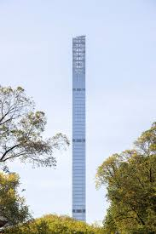
Blow-Through Floors
The Engineering: Steinway Tower has several levels that are entirely open to the exterior
The "Why": These act as pressure relief valves
Instead of the wind hitting a solid wall and creating a massive coherent vortex, the wind "blows through" the building
Impact: This significantly reduces the Across-Wind forces and helps "de-tune" the vortex shedding frequency, making the TMD's job much easier
Open Floors

Slide 18
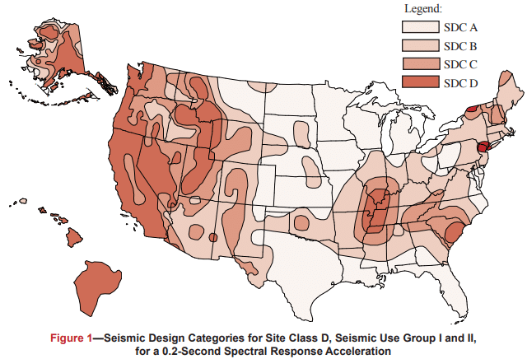
Vibrationdata
Seismic Hazard Map
Each figure is based on Site Class D (the default class when the soil profile is not known) and is applicable to structures assigned to Occupancy Categories I, II, and III (buildings other than high hazard exposure structures)
Note that if the soil profile is known and is lower than D, a correspondingly lower SDC may be realized
For Steinway Tower
Seismic design (SDC D):
Governs strength + ductility + detailing
Wind design:
Governs serviceability + comfort + dynamics
https://www.cmha.org/resource/tek-14-18b/

Slide 19
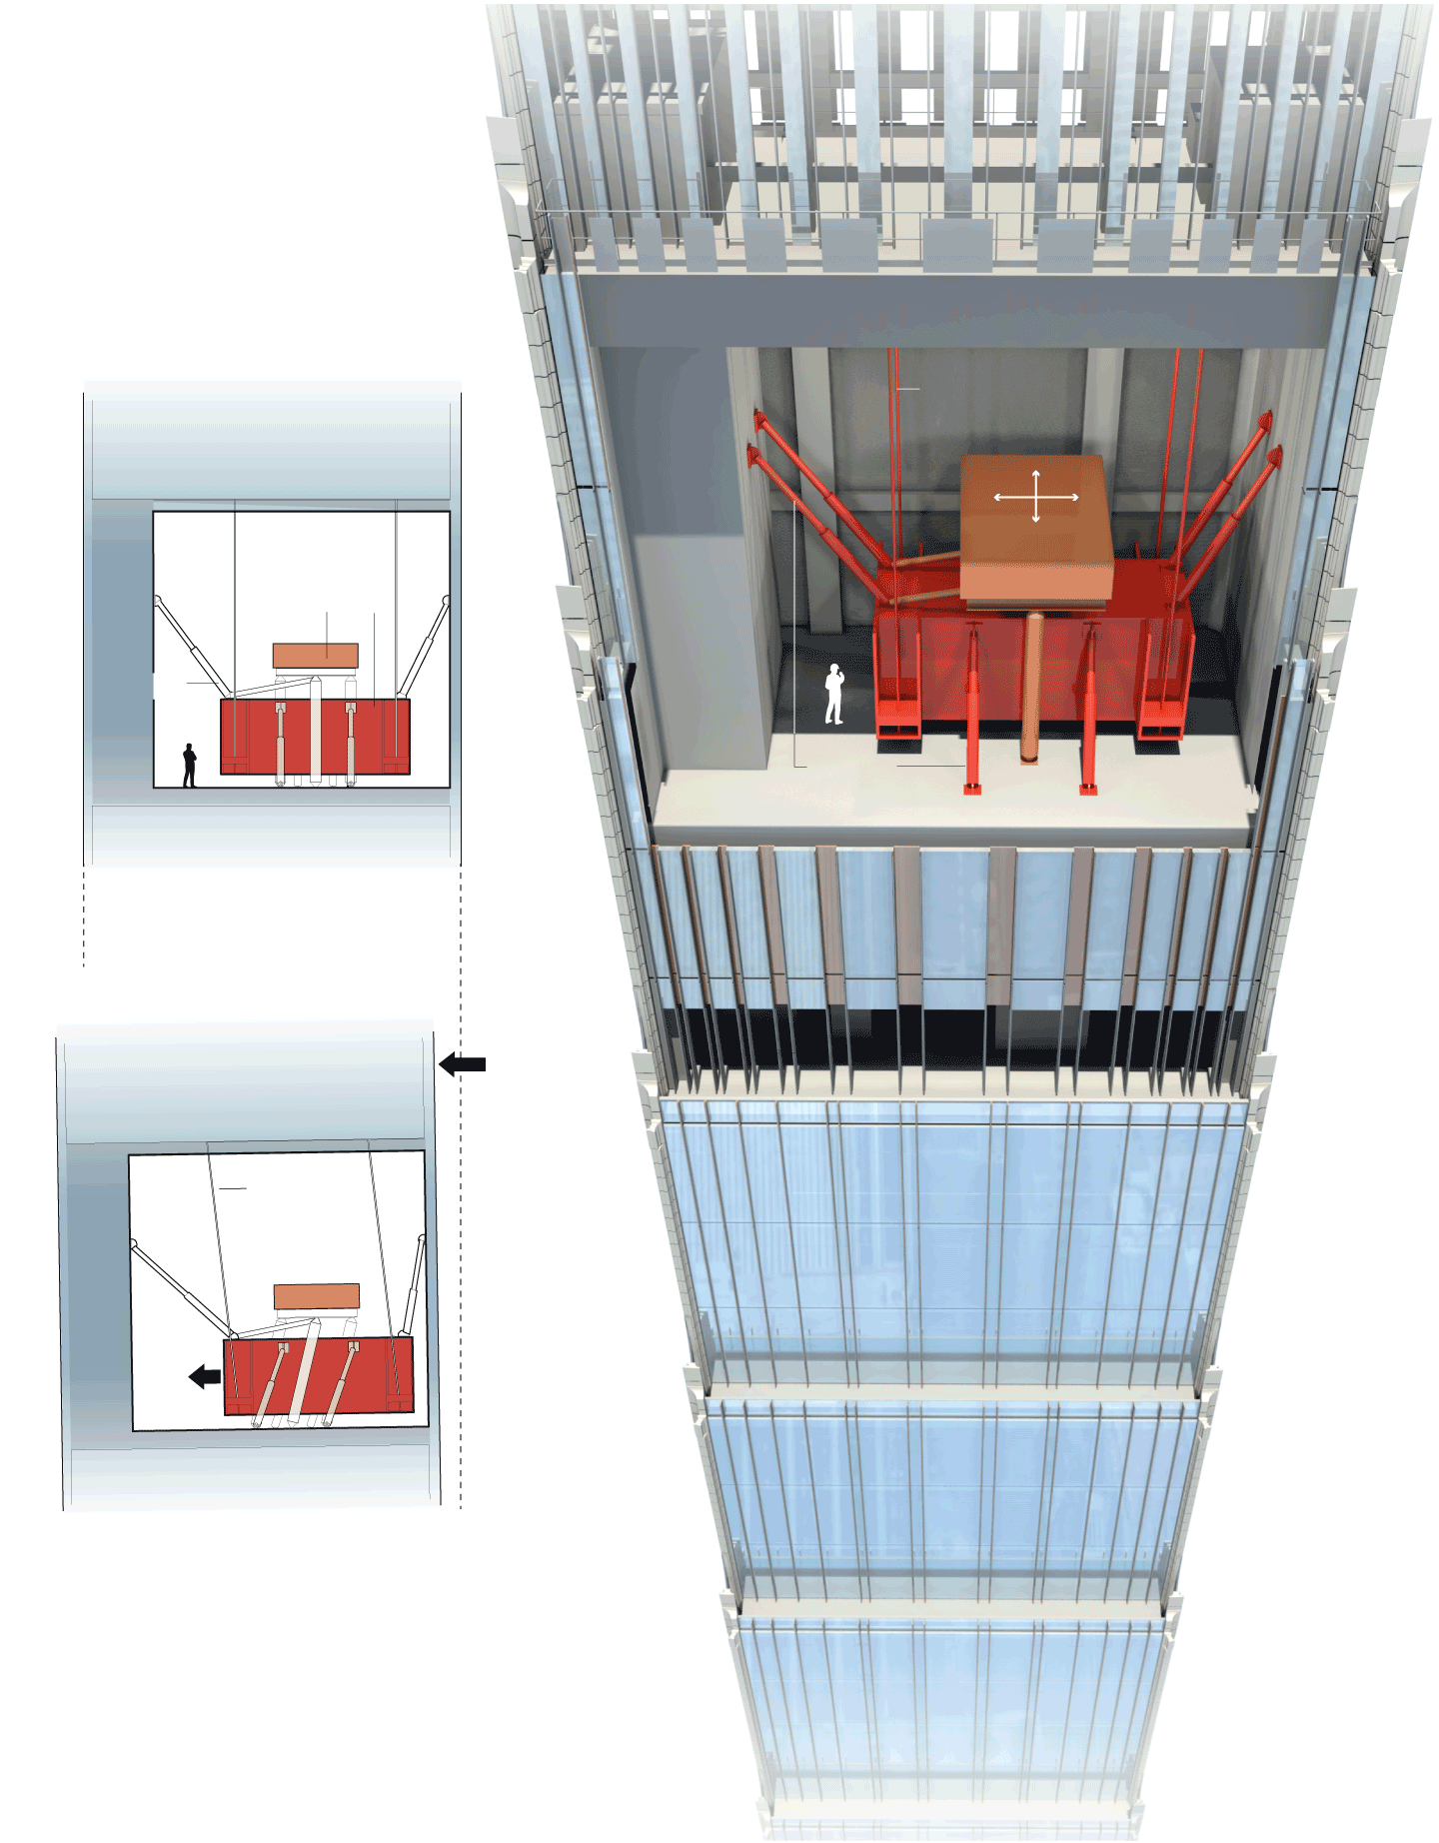
Tuned Mass Damper
Location & Purpose
Installed at the very top of the tower (within the crown/mechanical penthouse)
Primary function: reduce wind- and earthquake-induced motion in an extremely slender structure
Mass & Scale
Approximately 860 metric tonne
Among the heaviest solid tuned mass dampers ever used in a building
Comparable to multiple Statues of Liberty in weight (order-of-magnitude perspective)
Configuration
Consists of large suspended masses (steel weights) with damping elements
Described as a pair of weights with tuned steel plates
Tuned to the building’s fundamental lateral frequency

Slide 20
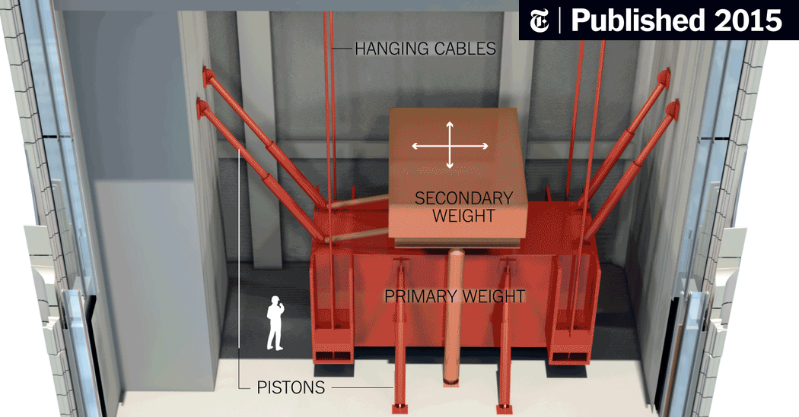
Tuned Mass Damper
Operating Principle
Acts as a dynamic vibration absorber
Moves out of phase with building motion, reducing peak displacement and acceleration
Essentially a giant pendulum system counteracting sway
Why It’s Critical for Steinway Tower
Tower has extreme slenderness ratio (~1:24) → highly sensitive to wind excitation
Without damping, occupants would experience:
Noticeable sway
Possible motion discomfort (especially at upper floors)
Performance Role
Reduces:
Peak lateral displacement
Acceleration (human comfort criteria driver)
Helps meet serviceability limits rather than strength limits

Slide 21
Tuned Mass Damper
Integration with Other Systems
Works in combination with:
Open mechanical floors (wind “slots”) to disrupt vortex shedding
Massive shear wall system for stiffness
Aerodynamic shaping of the façade
Design Philosophy
Represents a necessary technology for “pencil towers”
Enables:
Ultra-slender architecture
High-end residential usability at extreme heights
Key Takeaway (Slide-ready)
“The TMD is not optional—it is essential to make a 1:24 slender skyscraper habitable”
See also: https://structuralengineerhq.com/skinniest-tower-ever/

Slide 22
Wind vs. Earthquake
Feature | Wind Loading | Earthquake Loading
Frequency Range (Hz) | ~0.01 – 1 Hz | ~0.5 – 20 Hz
Relation to Steinway Tower | Overlaps with fundamental mode (~0.1–0.2 Hz) → resonance risk | Mostly higher than fundamental → less dynamic amplification
Nature of Loading | Stochastic random, narrow-band | Broadband, impulsive
Duration | Long (minutes to hours) | Short (seconds to ~1 minute)
Primary Design Driver | Serviceability (acceleration, comfort) | Strength, ductility, detailing

Slide 23
Human Comfort
Occupants are sensitive to acceleration, not displacement
Even large displacements (e.g., ~1 m at the top) may be acceptable
Small accelerations can still be perceptible and uncomfortable
Human Perception Thresholds
~5–10 milli-g → noticeable motion
~15–20 milli-g → uncomfortable for occupants
Prolonged exposure increases sensitivity and discomfort
Relevant Standards & Guidance
ISO 10137 Evaluation of vibration serviceability for occupants

Slide 24
Acoustics
Human comfort criteria extend beyond perceived acceleration (motion sickness)
Even when sway is below physical discomfort thresholds (< 15 milli-g), audible noise from building movement can cause significant occupant anxiety
Primary Sources of Wind-Induced Noise
Architectural Friction: Creaking, popping, or groaning of interior partitions, drywall, and structural connections under lateral and torsional strain
Elevator Dynamics: "Cable slap" against elevator shafts and guide rail friction as the slender tower bends and twists
Aeroacoustics: High-velocity wind howling or whistling through the architectural crown, open mechanical slots, and terracotta façade details
Mechanical noise from HVAC, elevators and domestic water booster pumps

