Slide 1
Wavelet Synthesis
Revision F
Goal:
Synthesize acceleration time history that can be used for a shaker test or for a numerical simulation such as spring-mass or FEA model transient analysis

Slide 2
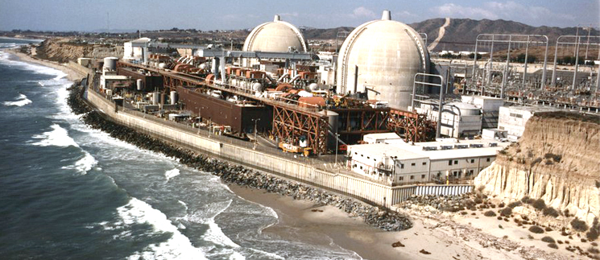
San Onofre Nuclear Power Plant
Nuclear plant equipment must be tested to seismic shock specifications
(San Onofre is decommissioned)

Slide 3
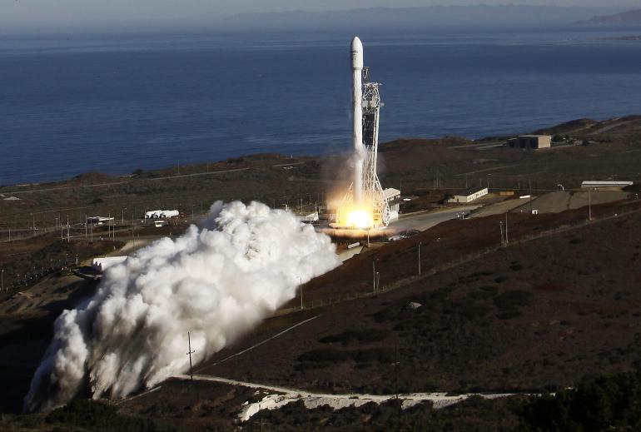
Falcon 9, Launched from Vandenberg
The vehicle as mounted on the pad is a tall cantilever beam
Its ability to withstand seismic events must be verified via analysis
Seismic Zone 4, one of the most seismically active in the U.S

Slide 4
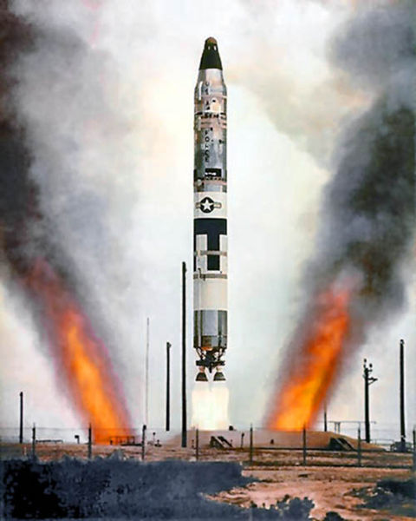
Vandenberg Missile Silos
Vandenberg Space Force Base (VSFB) in California does not have active nuclear missile silos used for operational weapons deployment
Here's the current status:
Vandenberg does have missile silos, but they are used for testing, not for active deployment:
  Intercontinental Ballistic Missile (ICBM) test launches (e.g., Minuteman III) are conducted from silos at VSFB.
  These are non-armed, controlled tests of existing U.S. nuclear deterrent capabilities.
  The base also supports launches of space and defense payloads.
  A missile slated for test launch at Vandenberg Space Force Base typically remains in its silo for several weeks to several months prior to flight, depending on the mission's complexity and test objectives.

Slide 5
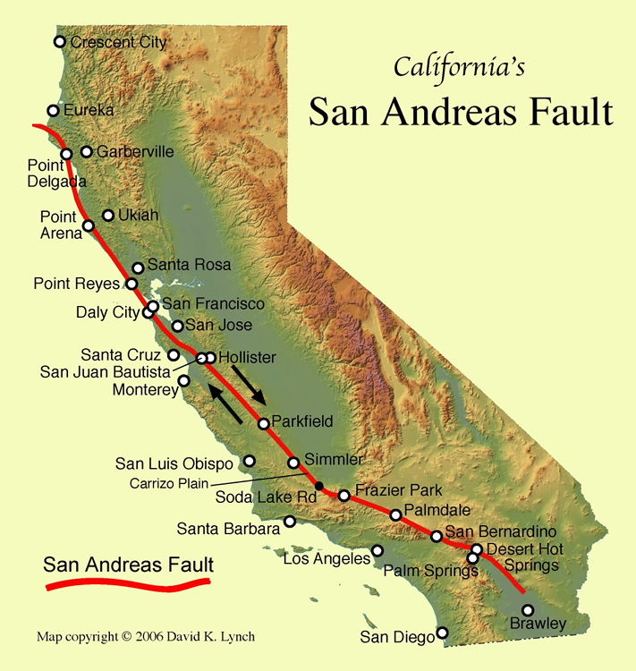
The closest distance from Vandenberg Space Force Base (VSFB) to the San Andreas Fault is approximately 35 to 40 miles (56 to 64 kilometers)

Slide 6
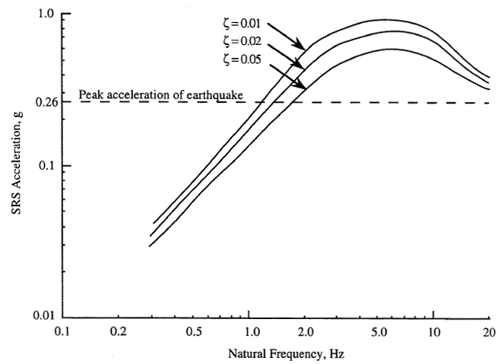
NASA-HDBK-7005, Vandenberg AFB, SRS Specification
Missing:
  phase angle
  duration
  waveform type
  temporal moments
Impossible to recreate original time history due to conservative envelope

Slide 7
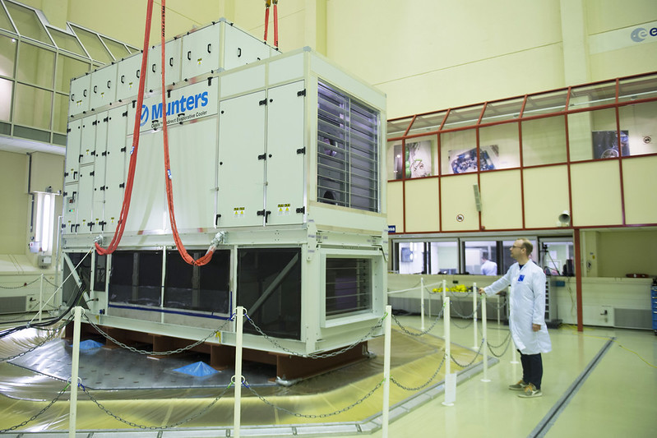
Shaker Shock
A shock test may be performed on a shaker if the shaker’s frequency and amplitude capabilities are sufficient
A time history must be synthesized to meet the SRS specification
Typically, damped sines or wavelets
The net velocity and net displacement must be zero due to shaker limits
Also want zero net conditions for dynamic model analysis to maintain numerical stability
Cooling System, European Space Agency Shaker

Slide 8
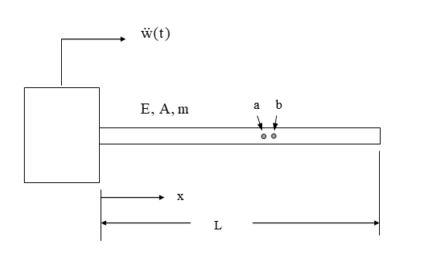
Model Analysis
Assume base excitation of longitudinal rod
Let δ be the relative displacement between two closely-spaced points a & b on the rod
The relative displacement δ maybe << 0.1 inch
Numerical error in stress & stress if δ is superimposed on “ski slope” displacement >> 100 inch

Slide 9
Wavelets & Damped Sines
    A series of wavelets can be synthesized to satisfy an SRS specification for either shaker shock or analytical modeling
    Wavelets by design have zero net displacement and zero net velocity
    Damped sines require compensation pulse
    Assume control computer accepts ASCII text time history file for shock test in following example
    Time Waveform Replication (TWR)
    But note that the SRS does not have a unique time history due to omission of phase, duration and waveform type

Slide 10
Time Waveform Replication
Time Waveform Replication (TWR) is a shaker testing method used in vibration testing to reproduce a specific measured or synthetic acceleration time history on a test article, rather than applying a random or sinusoidal excitation
It is often used for shock, road-load, or flight environment simulation
Time Waveform Replication aims to accurately reproduce a time-domain acceleration waveform (e.g., measured from field conditions like a missile launch, aircraft taxi, or a drop event) using a servo-controlled shaker system
Instead of using the frequency content alone (like random or sine tests), TWR matches the actual time history of acceleration, velocity, or displacement — including transients, shocks, and phase information

Slide 11
Typical Wavelet

Slide 12
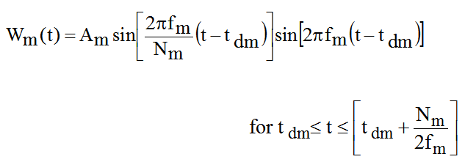
Wavelet Equation
W_{m} (t) = acceleration at time t for wavelet m
A_{m} = acceleration amplitude f _{m} = frequency t _{dm} = delay
N_{m} = number of half-sines, odd integer > 3

Slide 13

Draw inspiration from Rube Goldberg for PSD & SRS synthesis and enveloping techniques

Slide 14
Synthesis Steps, with Trial-and-Error
Step | Description
1 | Choose a waveform type, duration and sample rate
2 | Select natural frequencies, typically 1/12 octave spacing for both synthesis & SRS
3 | Generate a random amplitude, delay, and half-sine number for each wavelet. Constrain the half-sine number to be odd > 3. These parameters form a wavelet table.
4 | Synthesize an acceleration time history from the wavelet table.
5 | Calculate the shock response spectrum of the synthesis.
6 | Compare the shock response spectrum of the synthesis to the specification. Form a scale factor for each frequency.
7 | Scale the wavelet amplitudes. (Note non-linear process)

Slide 15
Synthesis Steps (cont.)
Step | Description
8 | Generate a revised acceleration time history.
9 | Repeat steps 5 through 8 until the SRS error is minimized or an iteration limit is reached.
10 | Calculate the final shock response spectrum error. Also calculate the peak acceleration values. Integrate the signal to obtain velocity, and then again to obtain displacement. Calculate the peak velocity and displacement values.
11 | Repeat steps 3 through 10 many times.
12 | Choose the waveform which gives the lowest combination of SRS error, acceleration, velocity and displacement.

Slide 16
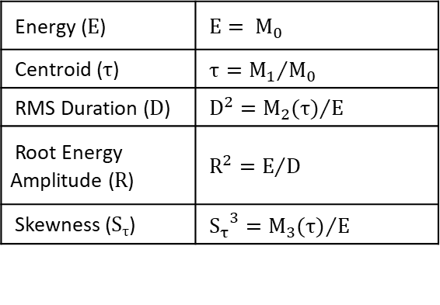
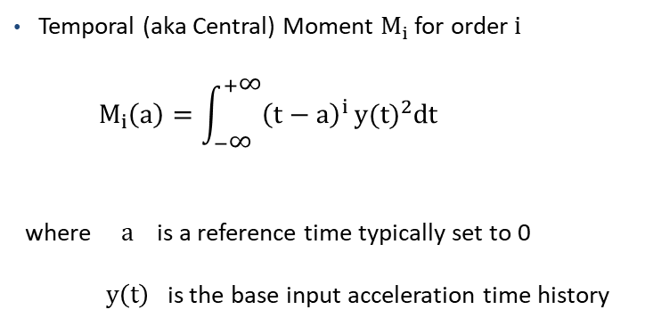
Temporal Moments
Temporal (aka Central) Moment $M_{i}$ for order i
$$M_{i}\left(a\right)=\int_{−\text{∞}}^{+\text{∞}}{{\left(t−a\right)}^{i}}{y(t)}^{2}dt$$
where a is a reference time typically set to 0
$y\left(t\right)$ is the base input acceleration time history
Smallwood et al have written papers claiming that the SRS by itself is insufficient for characterizing shock damage potential
They have recommended that temporal moments also be used in SRS specifications
This recommendation has merit but has not gained traction in industry
https://vibrationdata.wordpress.com/2015/02/18/temporal-moment/
Sample moment parameters are
Energy (E) | ${\text{E}= M}_{0}$
Centroid (τ) | ${τ=M_{1}}/{M_{0}}$
RMS Duration (D) | ${D^{2}=M_{2}(τ)}/E$
Root Energy Amplitude (R) | ${R^{2}=E}/D$
Skewness (S_{τ}) | ${{S_{τ}}^{3}=M_{3}(τ)}/E$

Slide 17
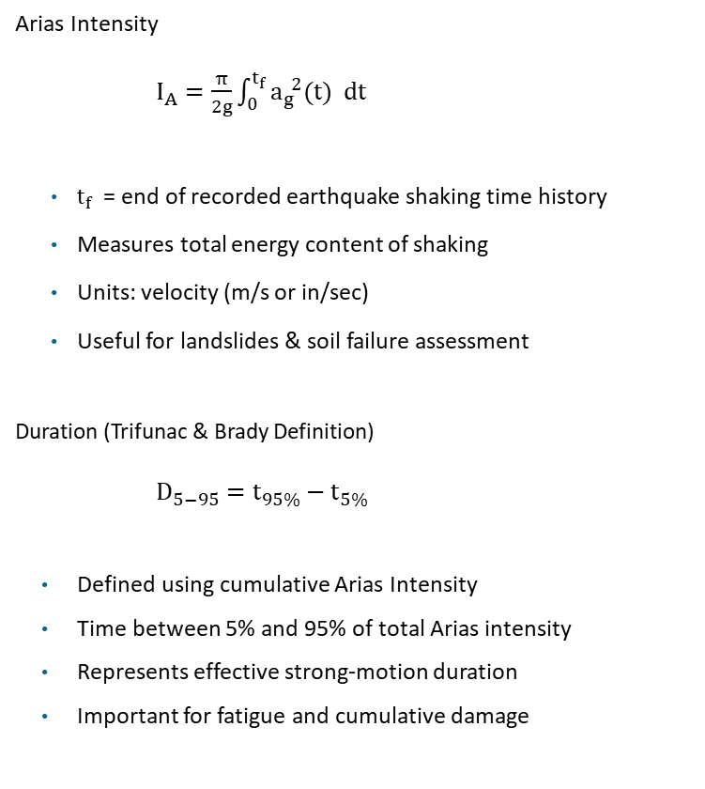
Earthquake Engineering Metrics
Vibrationdata
Arias Intensity
$I_{A}=\frac{π}{2g}\int_{0}^{t_{f}}{a_{g}^{ 2}(t) dt}$
$t_{f}$​ = end of recorded earthquake shaking time history
Measures total energy content of shaking
Units: velocity (m/s or in/sec)
Useful for landslides & soil failure assessment
Duration (Trifunac & Brady Definition)
$D_{5−95}=t_{95\%}−t_{5\%}$
Defined using cumulative Arias Intensity
Time between 5% and 95% of total Arias intensity
Represents effective strong-motion duration
Important for fatigue and cumulative damage
17
Notes:
17

Slide 18
SRS Specification Example
Vandenberg AFB, 1% Damping
Synthesize a series of wavelets as a base input time history
Try three different waveform types
Goals:
  Satisfy the SRS specification within some tolerance bands
  Minimize the displacement, velocity and acceleration of the synthesized base input
Compare damage metrics of each pulse

Slide 19
Synthesis Parameters
The sample rate should be at least ten times higher than the maximum SRS frequency
    The duration should be long enough to capture at least two cycles for the lowest natural frequency
    250 trials will be used in the following examples for brevity
    A higher number of trials should be used for “real” work problems to improve the accuracy

Slide 20
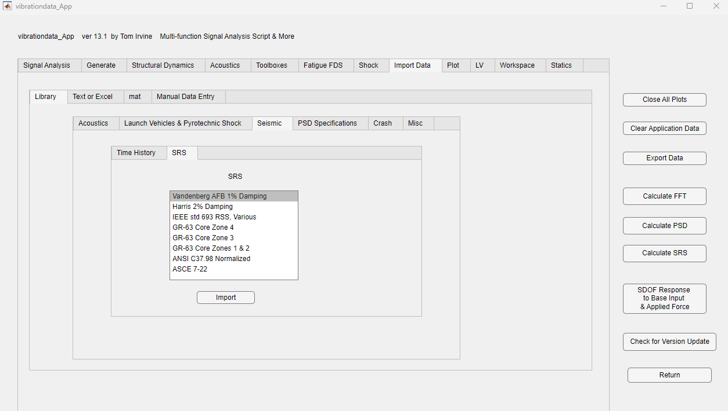

Slide 21
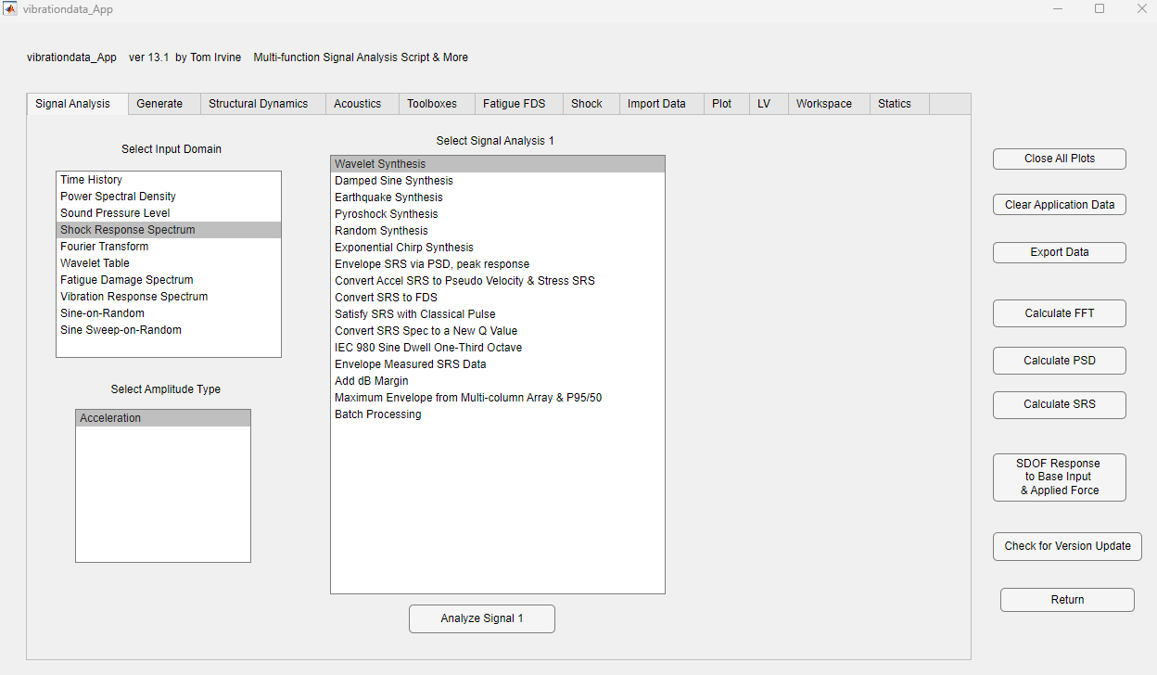

Slide 22
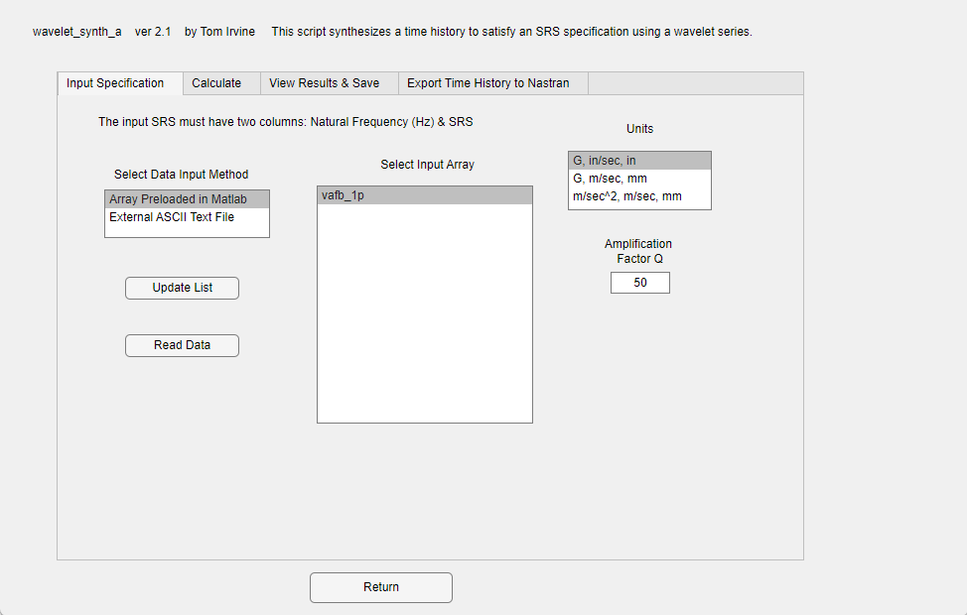

Slide 23
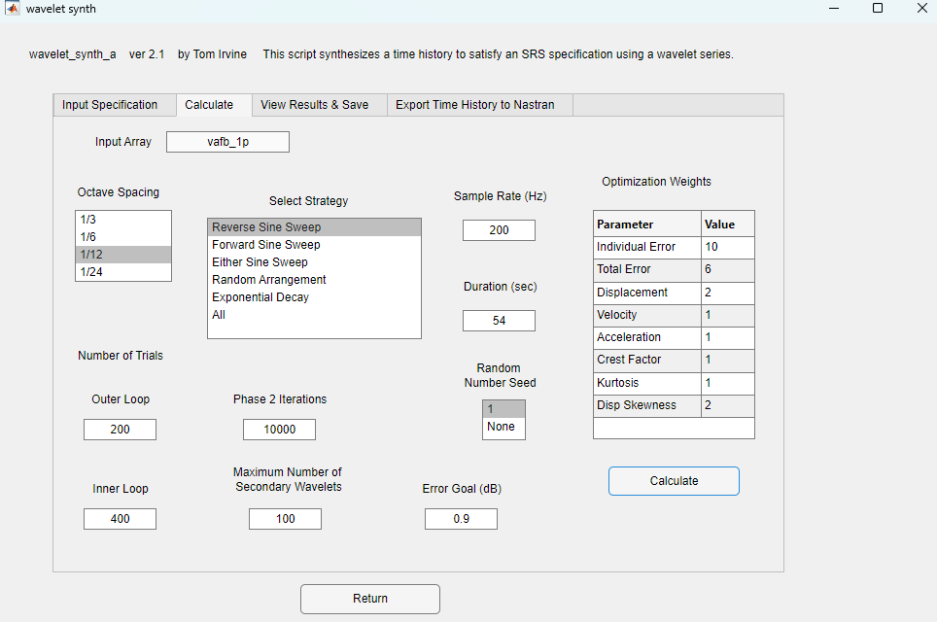

Slide 26
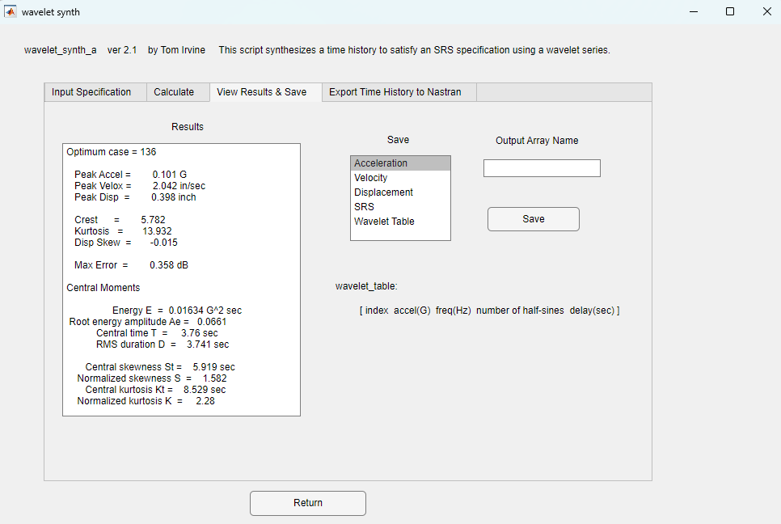

Slide 27
Optimum case = 136
Peak Accel = 0.101 G
Peak Velox = 2.042 in/sec
Peak Disp = 0.398 inch
Crest = 5.782
Kurtosis = 13.932
Disp Skew = -0.015
Max Error = 0.358 dB
Central Moments
Energy E = 0.01634 G^2 sec
Root energy amplitude Ae = 0.0661
Central time T = 3.76 sec
RMS duration D = 3.741 sec
Central skewness St = 5.919 sec
Normalized skewness S = 1.582
Central kurtosis Kt = 8.529 sec
Normalized kurtosis K = 2.28

Slide 28
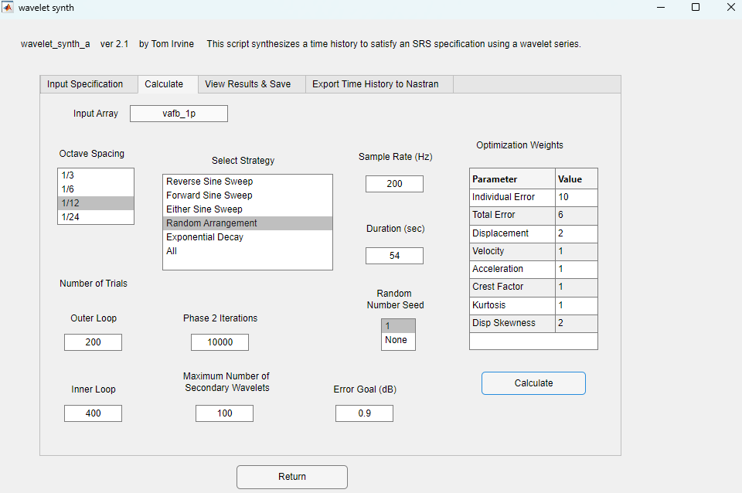

Slide 31
Optimum case = 2
Peak Accel = 0.103 G
Peak Velox = 2.677 in/sec
Peak Disp = 0.724 inch
Crest = 3.791
Kurtosis = 3.656
Disp Skew = -0.230
Max Error = 0.893 dB
Central Moments
Energy E = 0.03989 G^2 sec
Root energy amplitude Ae = 0.05868
Central time T = 29.68 sec
RMS duration D = 11.59 sec
Central skewness St = 2.569 sec
Normalized skewness S = 0.2217
Central kurtosis Kt = 13.82 sec
Normalized kurtosis K = 1.193

Slide 32
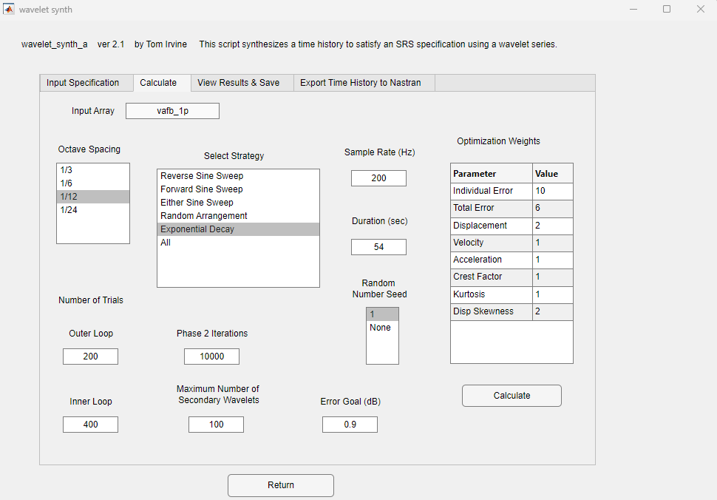

Slide 36
Optimum case = 129
Peak Accel = 0.103 G
Peak Velox = 3.104 in/sec
Peak Disp = 0.608 inch
Crest = 4.571
Kurtosis = 5.693
Disp Skew = -0.018
Max Error = 0.706 dB
Central Moments
Energy E = 0.02719 G^2 sec
Root energy amplitude Ae = 0.06012
Central time T = 13.46 sec
RMS duration D = 7.523 sec
Central skewness St = 7.375 sec
Normalized skewness S = 0.9803
Central kurtosis Kt = 10.67 sec
Normalized kurtosis K = 1.419

Slide 37
Synthesized Time History Comparison
Waveform | Peak Accel (G) | Peak Vel (ips) | Peak Disp (in) | Energy (G^2 sec)
Reverse Sine Sweep | 0.10 | 2.0 | 0.40 | 0.016
Random | 0.10 | 2.7 | 0.72 | 0.040
Exponential Decay | 0.10 | 3.1 | 0.61 | 0.027
The results show that the peak velocity and displacement values and energy levels vary even though each waveform meets with SRS specification within tolerance bands
Consider three identical components are subjected to the above waveforms with one waveform per each unit
The unit subjected to the Reverse Sine Sweep might pass whereas the units exposed to the Random & Exponent Decay might fail on the basis of energy
The acceleration SRS format per current industry standard is inadequate to characterize the true damage potential of shock
Energy, duration & waveform should also be specified

Slide 38
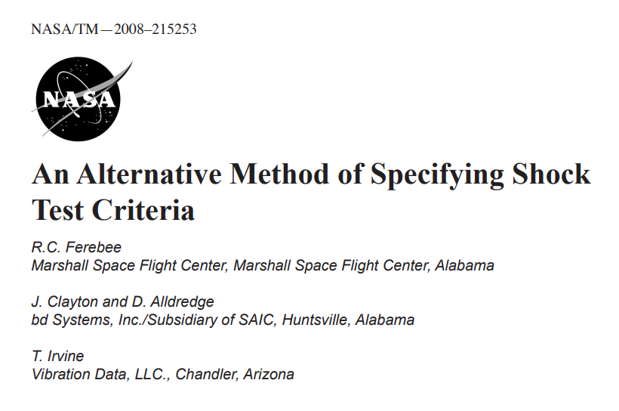
Synthesize a time history to satisfy an SRS specification where the resulting time history “resembles” the measured time history

Slide 39
SRS Synthesis
A given time history has a unique SRS
On the other hand, a given SRS may be satisfied by a variety of base inputs within prescribed tolerance bands
The SRS format thus offers flexibility
A common shaker shock testing approach is to use a burst of wavelets such that the synthesized time history resembles a transient sine sweep with descending frequency (but not representative of a “true” time history)

Slide 40
Synthesis Concerns
The drawback is that the time history used to satisfy the SRS may be very dissimilar from the measured source data
This brings up a number of concerns including linearity and multi-modal response
Some of these concerns can be quantified in terms of the scalar temporal moments which quantify the energy, RMS, skewness and kurtosis
These concerns have led to a desire to synthesize a time history which “resembles” the real-world event while still satisfying the SRS
The purpose of this paper is present a method which uses a measured reference time history as a basis for synthesizing a time history to meet the SRS specification

Slide 41
Method Description, Step 1
The following steps use trial-and-error-random number generation with some built-in convergence
The method is implemented as a function in the Vibrationdata Matlab GUI package
The first step is to decompose the reference time history into a series of wavelets
An acceleration wavelet has zero net velocity and zero net displacement
A series of wavelets likewise has these properties
Wavelets are very amenable to shaker table shock testing and are also convenient for analysis
The examples in the paper use a series of hundreds of wavelets to model a reference time history

Slide 42
Method Description, Step 2
The second step is to randomly vary the wavelet amplitudes so that the modified wavelet series will have an SRS that matches the specification as closely as possible
The number of iterations may be 16000 or so
The modified time history will thus have some distortion relative to the reference, but this is needed to shape the time history so that its SRS meets the new specification
The second step yields an SRS that has some peaks and dips relative to the specification
This is a consequence of trying to adapt a measured time history to a smoothed SRS

Slide 43
Method Description, Step 3
The third step is to add wavelets so that the resulting SRS meets the specification within, say, + 3 dB tolerance limits
The third step also adds some distortion
The amount of distortion depends largely on how much the SRS specification differs from that of the reference data

Slide 44
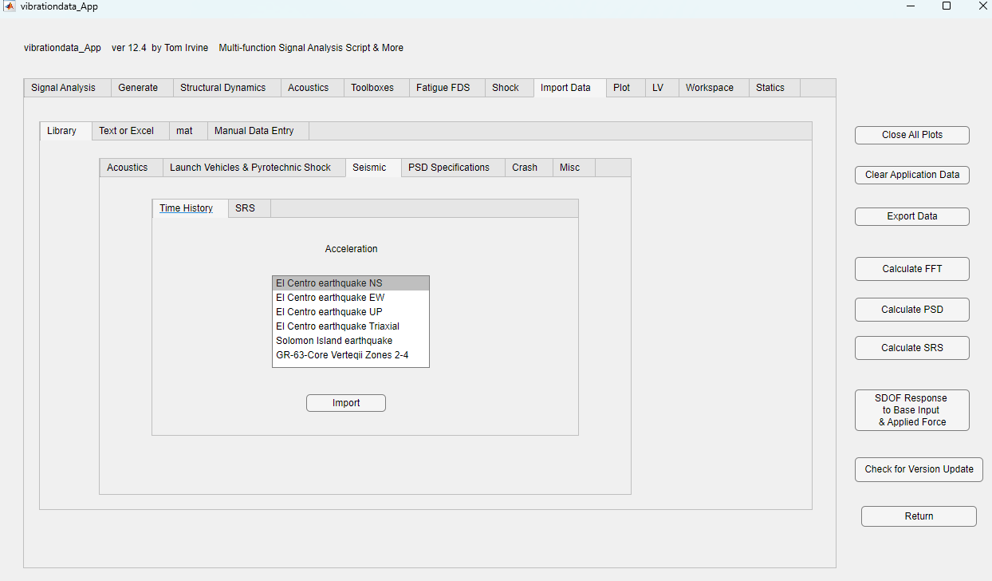

Slide 46
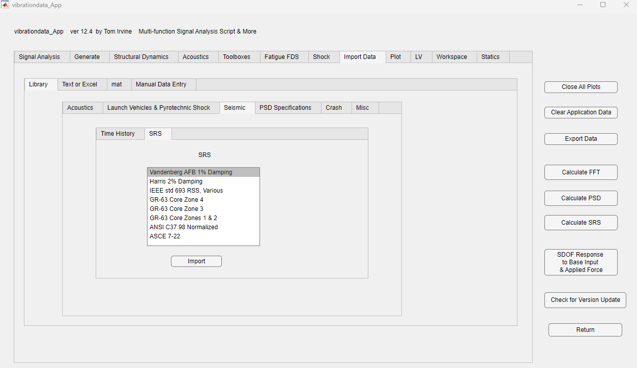

Slide 48
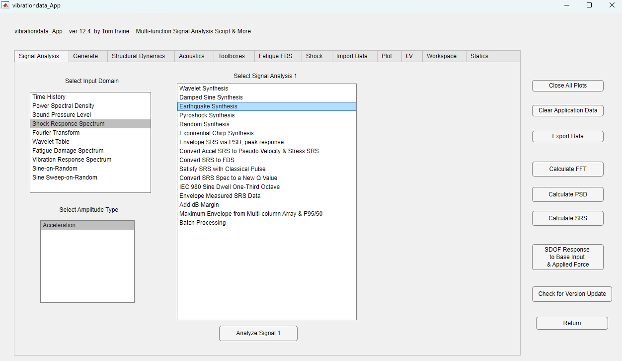

Slide 49
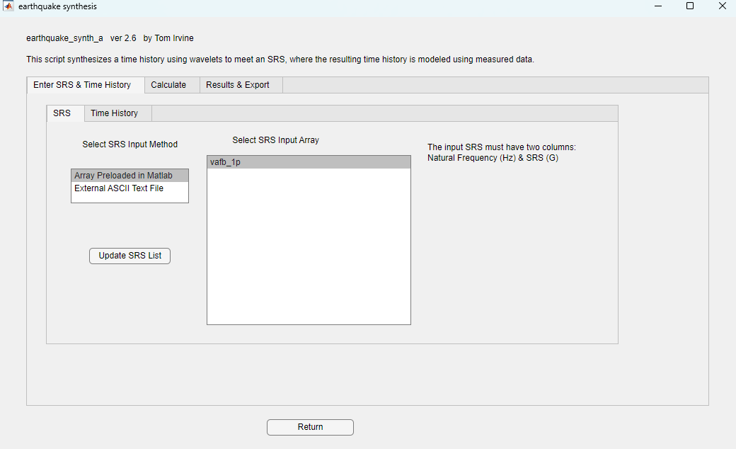

Slide 50
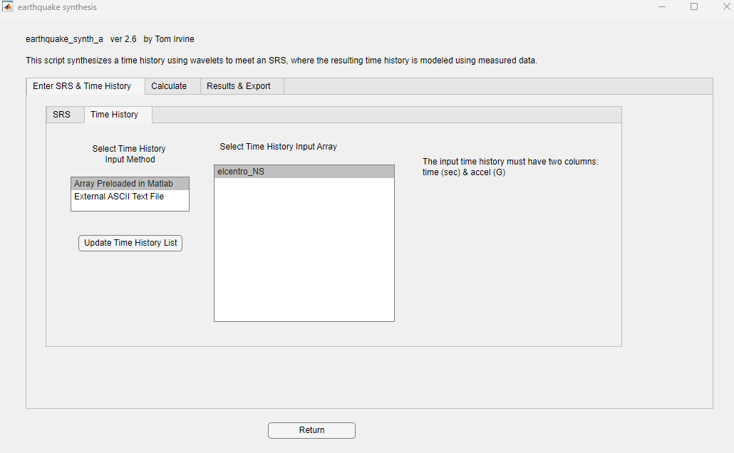

Slide 51
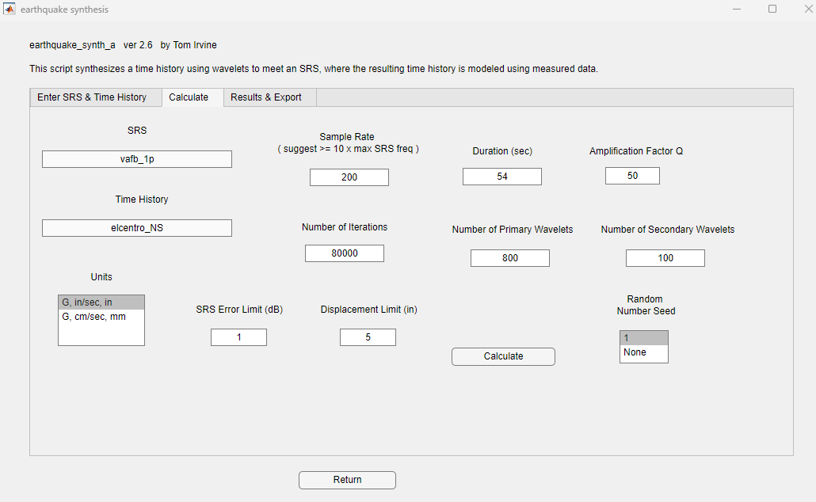

Slide 52
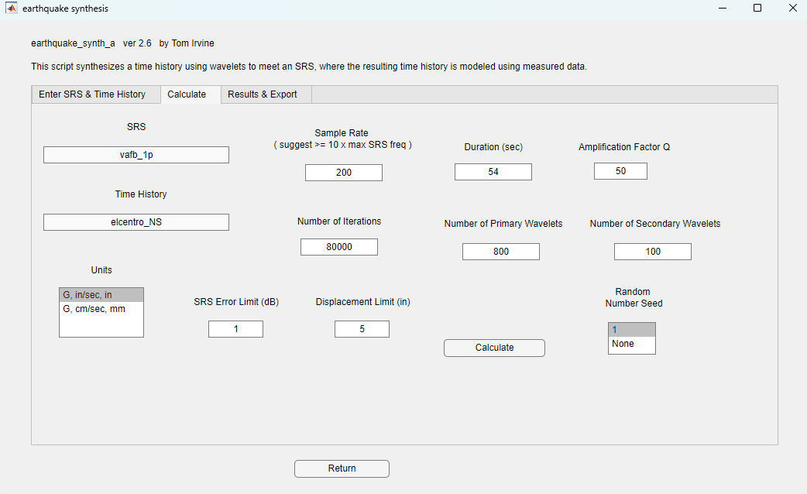

Slide 53
The top time history is the measured El Centro NS data
The middle time history is the wavelet series model
The bottom time history has additional wavelets to improve the SRS match, and it is scaled downward since the El Centro SRS plateau is greater than the specification

Slide 54
The velocity and displacement time histories are well-behaved which is important for both testing and analysis

Slide 55
The SRS of the modified, or synthesized, time history is within + 1 dB of the nominal specification
The method is thus successful in generating an El Centro-like time history to meet the specification

Slide 56
Peak Values & Temporal Moments
Waveform | Peak Accel (G) | Peak Vel (ips) | Peak Disp (in) | Energy (G^2 sec)
Reverse Sine Sweep | 0.10 | 2.0 | 0.40 | 0.016
Random | 0.10 | 2.7 | 0.72 | 0.040
Exponential Decay | 0.10 | 3.1 | 0.61 | 0.027
Modified El Centro | 0.23 | 7.3 | 4.3 | 0.035
The Reverse Sine Sweep synthesis has less energy and thus may cause an “under test” even though its SRS matches the specification

