Slide 1
Vibrationdata
Building Natural Frequencies & Damping
Revision B
By Tom Irvine

Slide 2
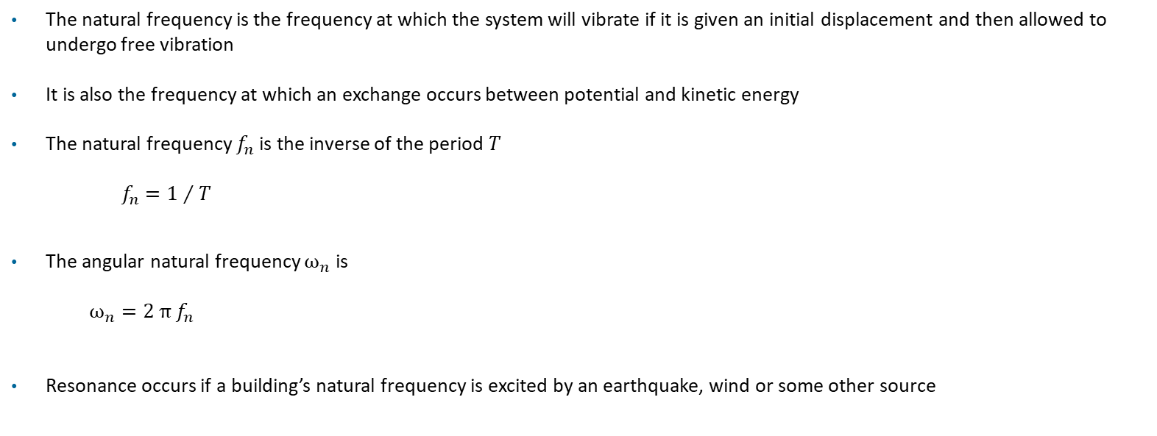
Basic Definitions
Vibrationdata
The natural frequency is the frequency at which the system will vibrate if it is given an initial displacement and then allowed to undergo free vibration
It is also the frequency at which an exchange occurs between potential and kinetic energy
The natural frequency $f_{n}$ is the inverse of the period $T$
$f_{n}={1 }/{ T}$
The angular natural frequency $ω_{n}$ is
$${ω_{n}=2 π f}_{n}$$
Resonance occurs if a building’s natural frequency is excited by an earthquake, wind or some other source
Notes:
2

Slide 3
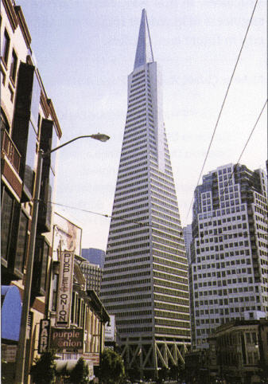
Transamerica Pyramid Building
Vibrationdata
The Transamerica Pyramid is built from a steel frame, with a truss system at the base
The height is 850 ft (260 m)
Amplitude-dependent stiffness degradation and increased damping due to joint friction, connection slip, and soil–structure interaction
Direction | Loma Prieta Earthquake |  | Ambient Vibration
 | fn (Hz) | Damping | fn (Hz) | Damping
North-South | 0.28 | 4.9% | 0.34 | 0.8%
East-West | 0.28 | 2.2% | 0.32 | 1.4%
Çelebi, M., “Dynamic Characteristics of the Transamerica Pyramid Building” Earthquake Spectra, Vol. 7, No. 4, 1991
3
Notes:
3

Slide 4
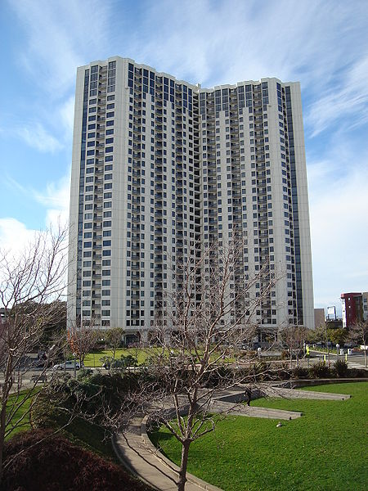
Pacific Park Plaza, Emeryville, CA
Vibrationdata
The Pacific Park Plaza height is 308 ft (94 meters)
It has a reinforced concrete moment-frame/shear-wall structure
For a reinforced concrete moment-frame / shear-wall system:
Microcracks exist even before strong shaking
During earthquake:
Cracks propagate and cycle open/closed
Aggregate interlock creates friction damping
Direction | Loma Prieta Earthquake |  | Ambient Vibration
 | fn (Hz) | Damping | fn (Hz) | Damping
North-South | 0.38 | 11.6% | 0.48 | 0.6%
East-West | 0.38 | 15.5% | 0.48 | 3.4%
Notes:
4

Slide 5

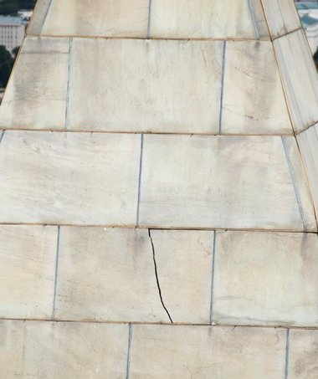
Washington Monument
Vibrationdata
Washington Monument Crack, Earthquake 2011
According to analyses cited by the United States Geological Survey (USGS), the fundamental resonant frequency of the 169 m (555 ft) tall obelisk is about 0.3 Hz
This is its lowest natural mode, corresponding to a very slow sway motion of the whole structure
In addition, smaller parts of the structure (notably the pyramidion at the top) have higher local resonant frequencies in the range of roughly 2.5 Hz to 5 Hz
Notes:
5

Slide 6

Eiffel Tower
Vibrationdata
First lateral bending mode: about 0.32 Hz (period ~3.1 sec)
Second lateral bending mode: about 1.0 Hz.
Torsional mode: around 0.8 Hz (twisting motion)
Earthquake risk is minimal in Paris
The Eiffel Tower is highly responsive to wind, and this is what governs its dynamic behavior
Height (~324 m) + slender lattice structure → low stiffness
Wind produces:
Static deflection (can sway ~10–20 cm)
Dynamic response (gust loading)
The open lattice design reduces drag, which was a brilliant feature by Gustave Eiffel
The first published dynamic characterization was by Castellaro, Perricone, Bartolomei, and Isani (University of Bologna, Engineering Structures, 2016), who measured ambient vibrations using a portable seismometer carried up the tower during a normal visit
Notes:
6

Slide 7
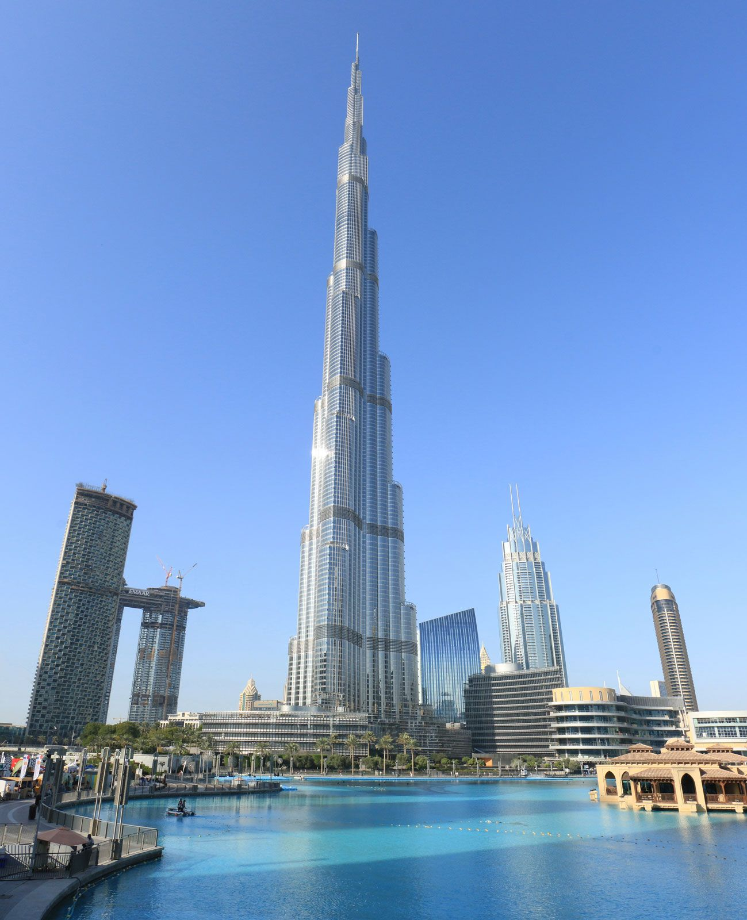
Burj Khalifa

Slide 8
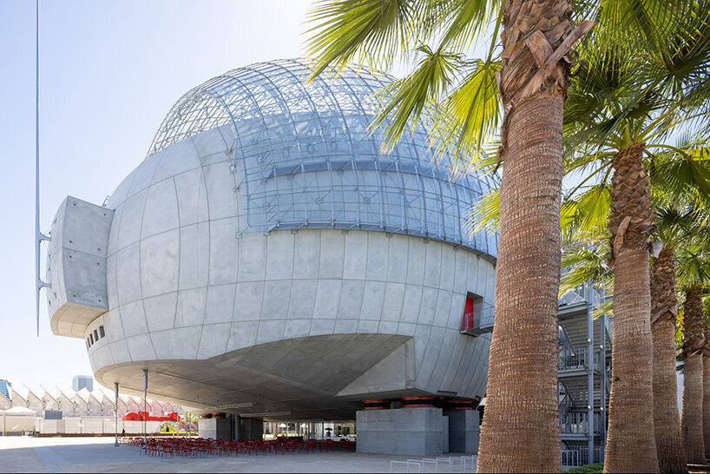
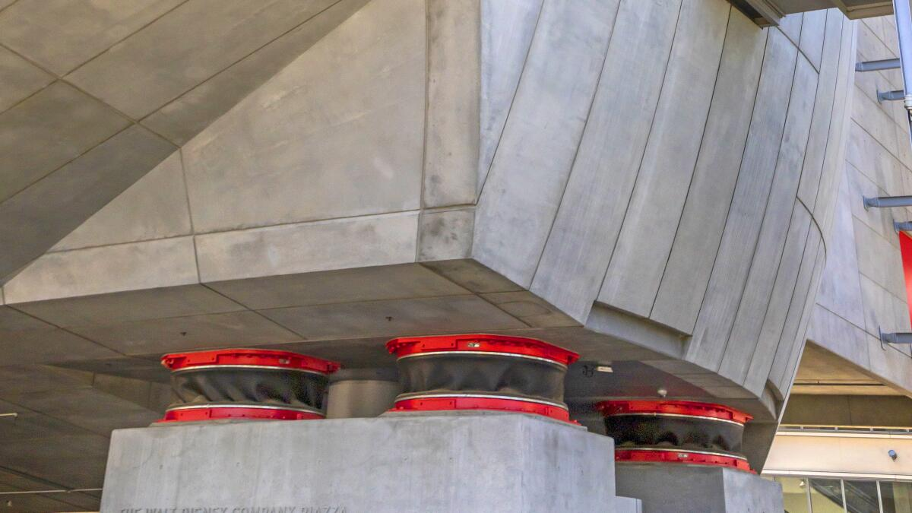
Vibrationdata
Academy Museum of Motion Pictures, Los Angeles
The iconic spherical is supported on seismic isolation bearings to decouple it from ground motion
Isolation shifts the fundamental period to a longer value → reduced acceleration demand on the structure and contents
Isolation simplifies response by making the system behave more like a rigid body
The isolated natural frequency is ~0.3–0.5 Hz
Also, the bearings provide energy dissipation (equivalent viscous damping), reducing response further
Rough estimate is 15% damping

Slide 9

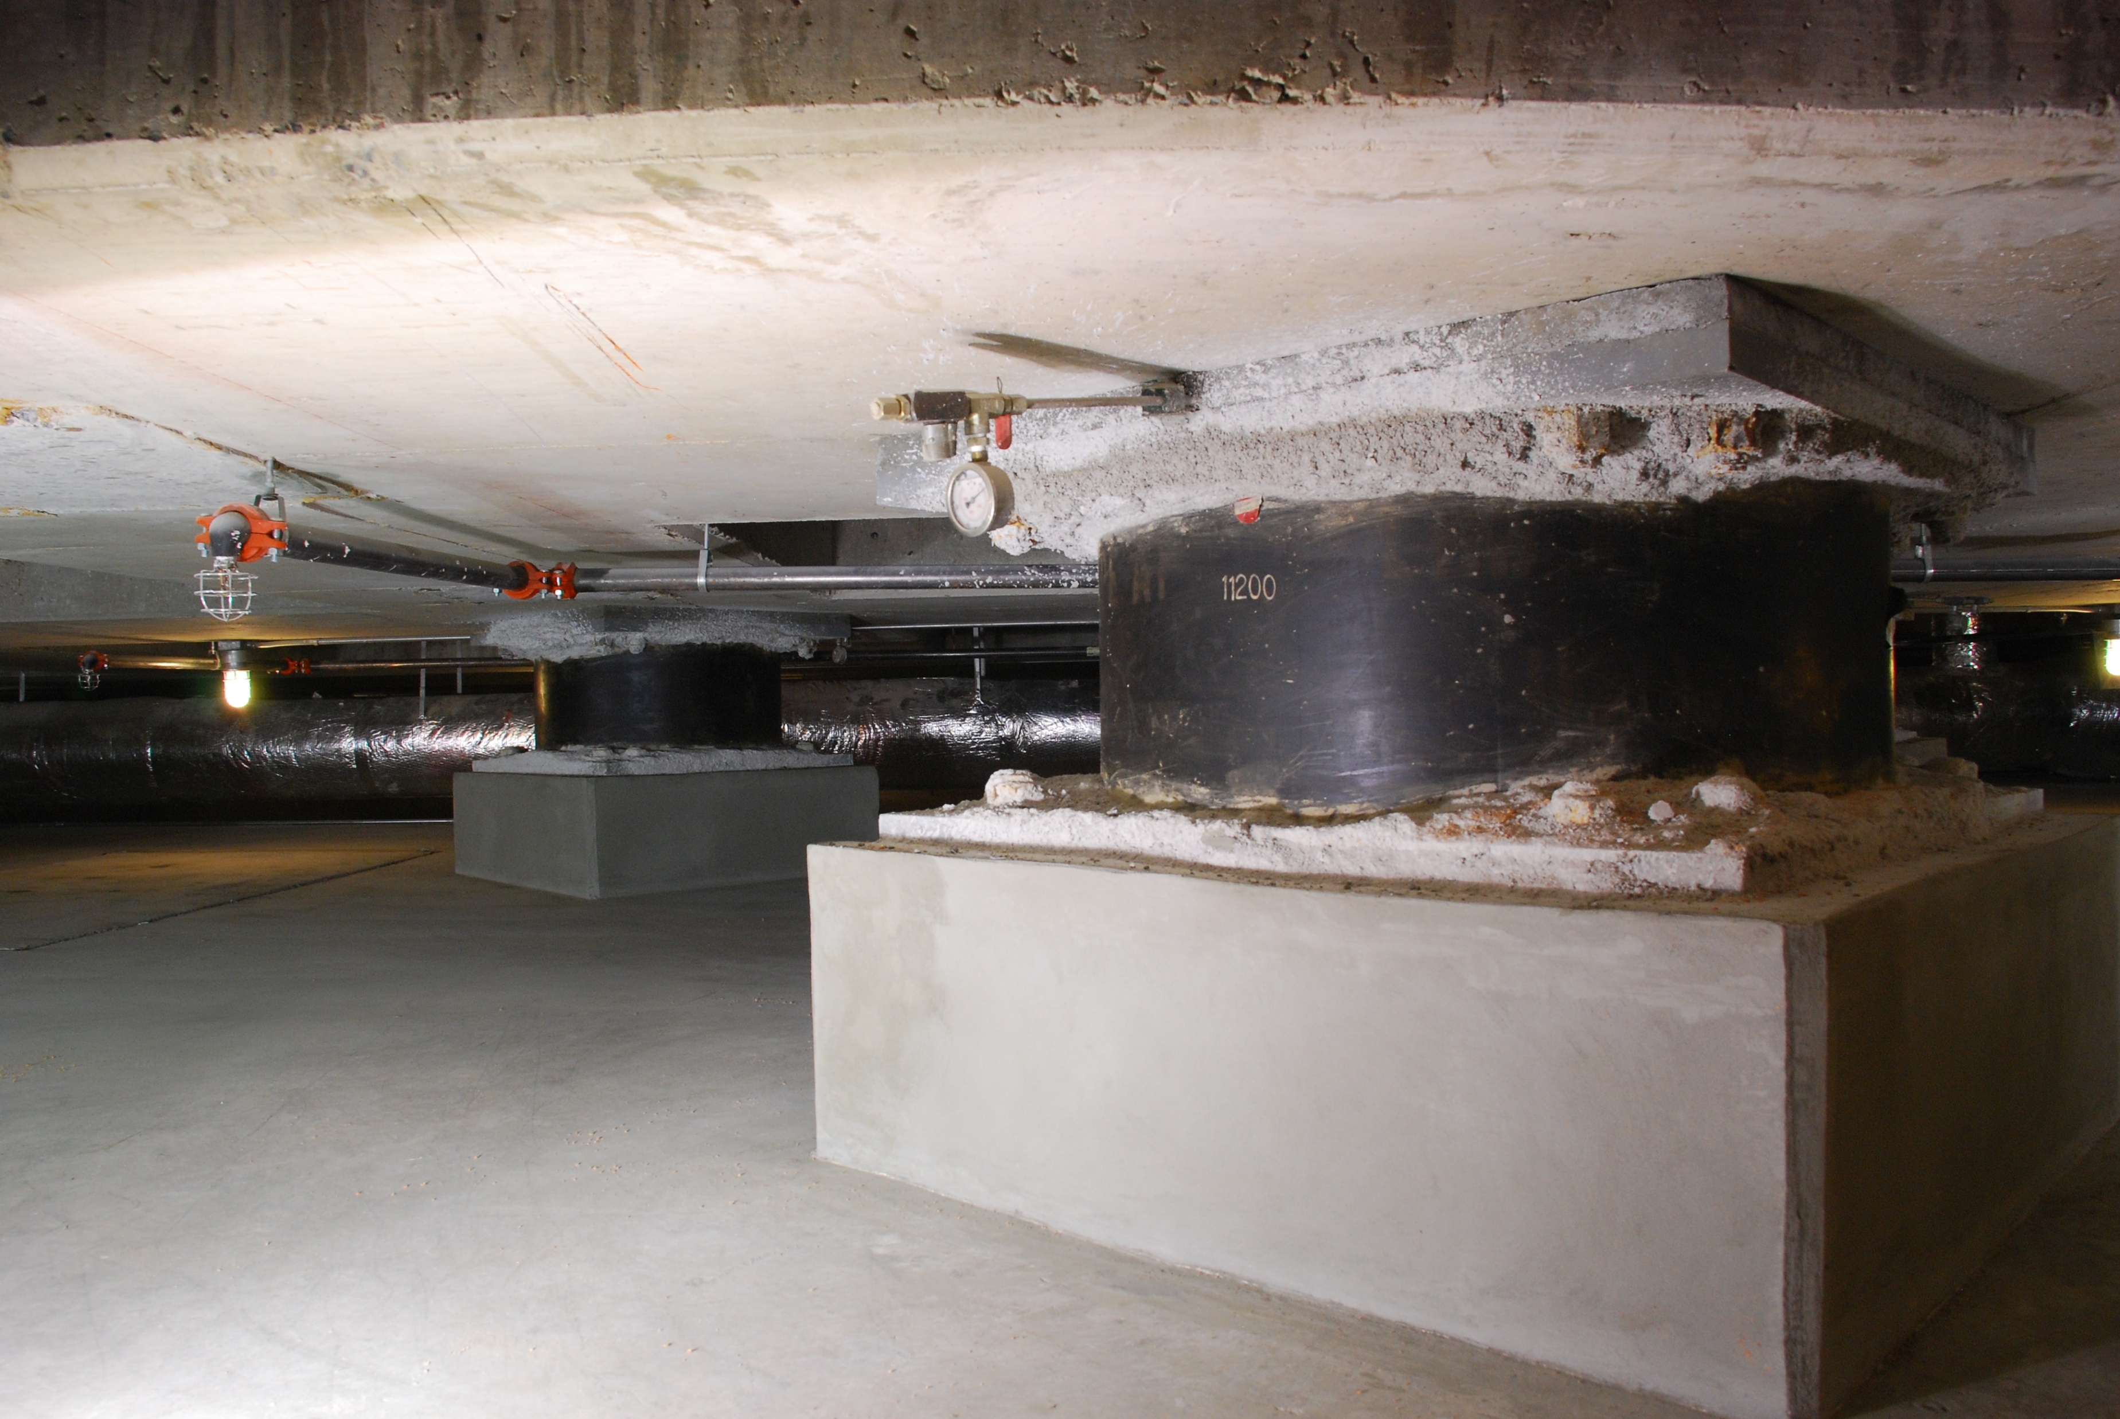
Utah State Capitol, Salt Lake City
Vibrationdata
Historic structure retrofit (2004–2008): The Utah State Capitol was upgraded to modern seismic standards while preserving its historic architecture
Base isolation system installed: The building was separated from its foundation and placed on ~280–300 base isolators (lead-rubber and sliding bearings)
Isolators allow horizontal movement on the order of ±20–30 inches (≈0.5–0.75 m) during strong shaking

Slide 10
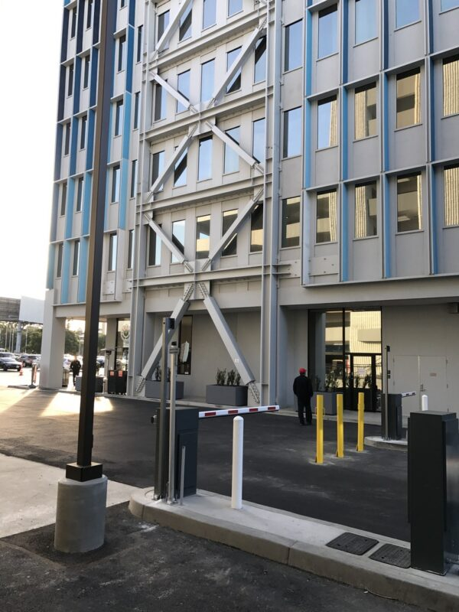
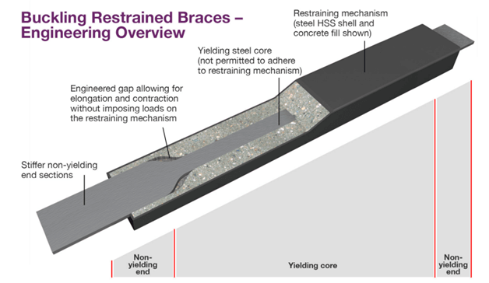
H Hotel, Los Angeles, Seismic Retrofit
Vibrationdata
The primary lateral force-resisting system incorporates Buckling-Restrained Braced Frames (BRBFs)
Unlike conventional braces, these consist of a steel core encased in a concrete-filled steel tube, allowing the brace to yield in both tension and compression without buckling
During a major seismic event, the braces undergo controlled inelastic deformation, absorbing and dissipating the kinetic energy of the earthquake to protect the gravity-load-carrying columns and beams
https://www.tectonus.com/resources/blog/comparing-brbs-tectonus-dmax

Slide 11
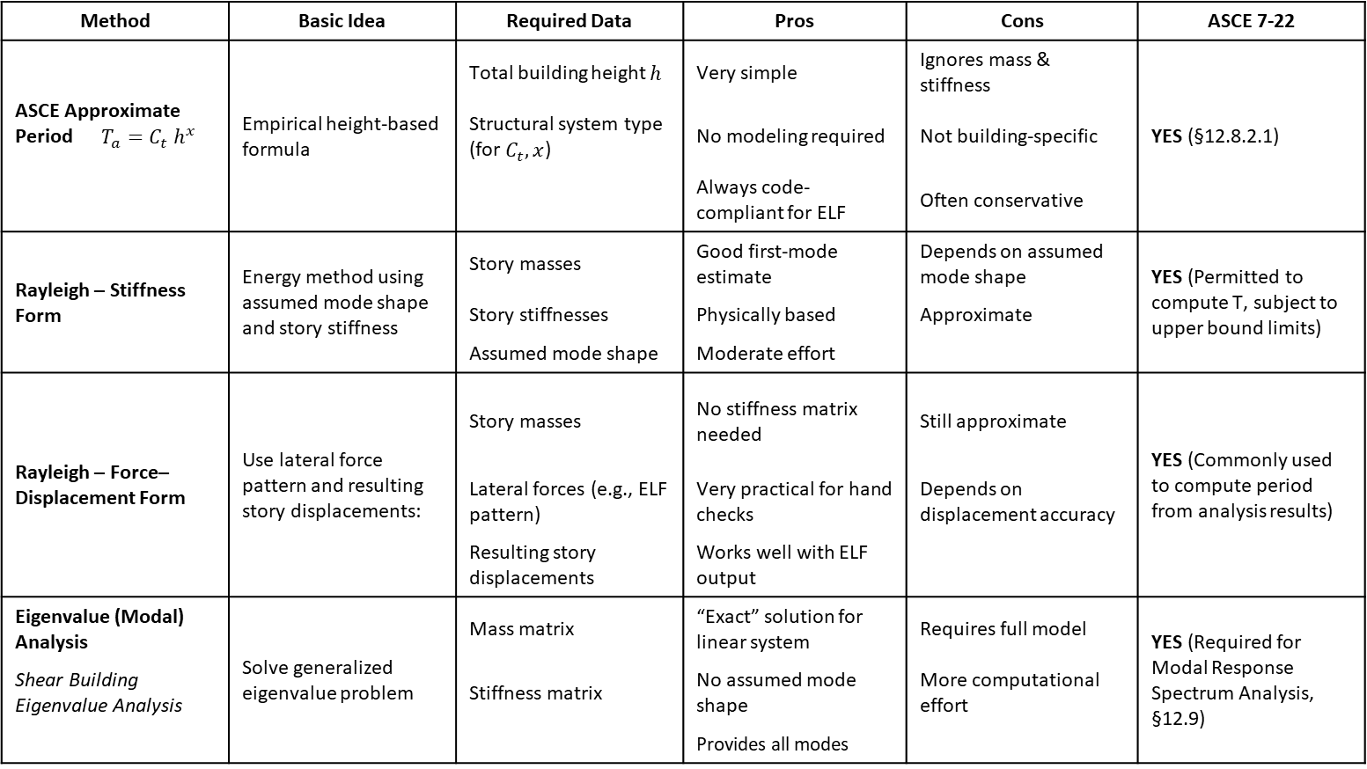
Vibrationdata
Building Period Calculation Methods
Method | Basic Idea | Required Data | Pros | Cons | ASCE 7-22
ASCE Approximate Period $T_{a}=C_{t}{ h}^{x}$ | Empirical height-based formula | Total building height $h$ | Very simple | Ignores mass & stiffness | YES (§12.8.2.1)
 |  | Structural system type (for $C_{t}, x$) | No modeling required | Not building-specific
 |  |  | Always code-compliant for ELF | Often conservative
Rayleigh – Stiffness Form | Energy method using assumed mode shape and story stiffness | Story masses | Good first-mode estimate | Depends on assumed mode shape | YES (Permitted to compute T, subject to upper bound limits)
 |  | Story stiffnesses | Physically based | Approximate
 |  | Assumed mode shape | Moderate effort
Rayleigh – Force–Displacement Form | Use lateral force pattern and resulting story displacements: | Story masses | No stiffness matrix needed | Still approximate | YES (Commonly used to compute period from analysis results)
 |  | Lateral forces (e.g., ELF pattern) | Very practical for hand checks | Depends on displacement accuracy
 |  | Resulting story displacements | Works well with ELF output
Eigenvalue (Modal) Analysis | Solve generalized eigenvalue problem | Mass matrix | “Exact” solution for linear system | Requires full model | YES (Required for Modal Response Spectrum Analysis, §12.9)
Shear Building Eigenvalue Analysis |  | Stiffness matrix | No assumed mode shape | More computational effort
 |  |  | Provides all modes

Slide 12
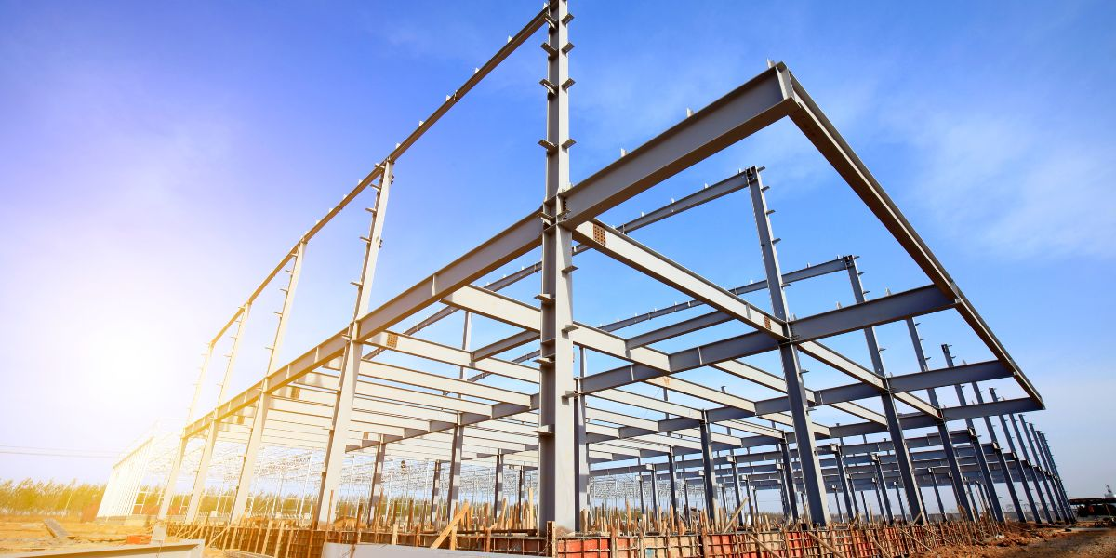
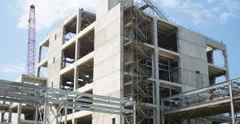
Vibrationdata
_{Typical Natural Frequencies}
System | 3–5 Story | 10–20 Story | 40+ Story
Steel Moment Frame | 1–2 Hz | 0.4–0.8 Hz | 0.1–0.3 Hz
RC Moment Frame | 1.2–2.5 Hz | 0.5–1.0 Hz | 0.15–0.4 Hz
RC Shear Wall | 2–4 Hz | 0.8–1.5 Hz | 0.2–0.5 Hz
Steel Braced Frame | 2–5 Hz | 1–2 Hz | 0.3–0.7 Hz
https://theconstructor.org/structural-engg/shear-wall-types-efficiency/6820/

Slide 13
Vibrationdata
Natural Frequency Non-linearity
Building natural frequencies tend to decrease during an earthquake due to
Microcracking (concrete)
Connection microslip (steel)
Nonstructural element participation
Soil–structure interaction
The natural frequencies often recover or partially recover post-event

Slide 14
U.S. Nuclear Regulatory Commission Damping
Some interfacial friction damping effects also occur in welded joints, but welded joints are much stiffer than the bolted joints
The U.S. Nuclear Regulatory Commission gives the damping ratios for nuclear plant structures
The values are intended for analysis purposes when measured damping values are unavailable.
Damping Values for Steel Buildings, Operating-Basis Earthquake
Joint Type | Damping Ratio
Welded Joints | 2%
Bolted Joints | 5%

Slide 15
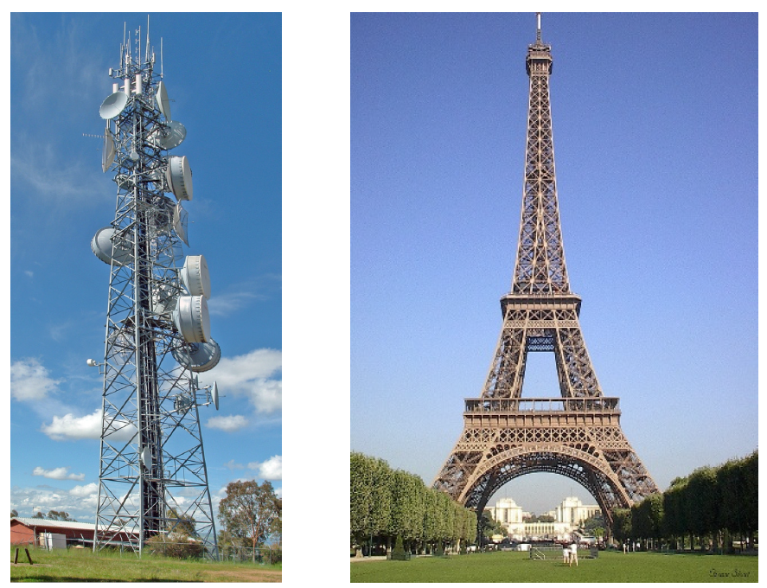
The International Association for Shell and Spatial Structures, IASS 1991
Type | Damping
Fully Welded Steelwork | 1.2%
High Strength Friction Bolted Steelworks | 2.0%
Normal Bolted and Riveted Steelwork | 3.0%

Slide 16
Vibrationdata
Typical Building Damping, Elastic Range
System | Ambient | Strong Motion
Steel Moment Frame | 0.5–2% | 2–5%
RC Moment Frame | 1–3% | 5–15%
Shear Wall | 1–2% | 4–10%
Damping increases with amplitude due to friction, cracking, structure-soil interaction (SSI)

Slide 17
Vibrationdata
Building Period T
Short-period (acceleration-controlled)
Long-period (velocity-controlled)
Influences:
Base shear magnitude
Drift demand
Distribution of lateral forces
Longer T → typically lower design base shear
Shorter T → higher base shear
Rule-of-Thumb Estimate (Quick Screening)
For moment frame buildings:
T ≈ 0.1 × ( number of stories )
fn ≈ 10 x ( number of stories )

Slide 18
Vibrationdata
Building Period T
Building Type | Height | Typical T (sec) | Natural Frequency (Hz)
1–2 Story Wood Frame | 20–30 ft | 0.1 – 0.3 | 3.3 – 10
Low-Rise Masonry (2–3 story) | 25–40 ft | 0.2 – 0.5 | 2 – 5
3–5 Story Steel Moment Frame | 40–70 ft | 0.4 – 0.9 | 1.1 - 2.5
5–10 Story RC Moment Frame | 60–120 ft | 0.6 – 1.5 | 0.67 – 1.7
10–20 Story Steel Moment Frame | 120–250 ft | 1.2 – 3.0 | 0.33 – 0.83
20–40 Story RC Shear Wall Building | 250–500 ft | 2.5 – 5.5 | 0.18 – 0.40
Tall Flexible Steel Frame (40+ stories) | 500–800 ft | 4 – 8 | 0.125 – 0.25
Industrial Steel Braced Frame (1–3 story) | 25–50 ft | 0.2 – 0.6 | 1.7 - 5

Slide 19
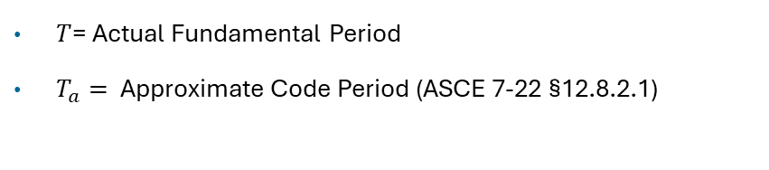
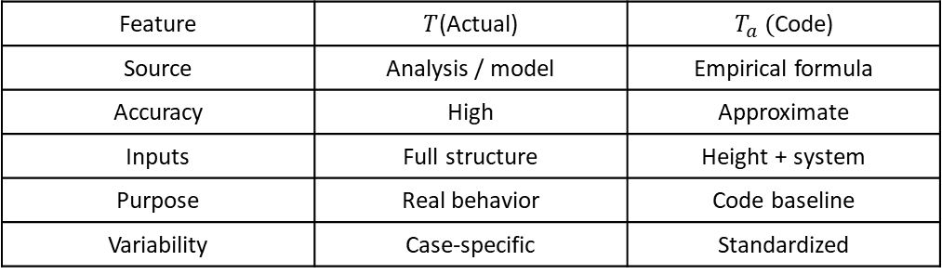
Vibrationdata
Building Period T (cont)
$T$= Actual Fundamental Period
$T_{a}=$ Approximate Code Period (ASCE 7-22 §12.8.2.1)
Feature | $T$(Actual) | $T_{a} ($Code)
Source | Analysis / model | Empirical formula
Accuracy | High | Approximate
Inputs | Full structure | Height + system
Purpose | Real behavior | Code baseline
Variability | Case-specific | Standardized

Slide 20
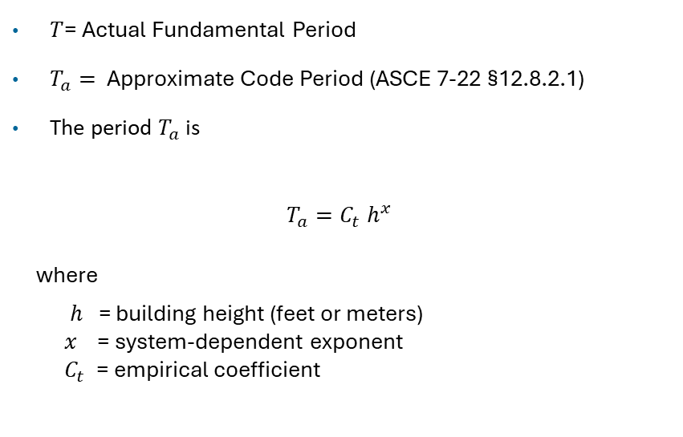
Vibrationdata
Building Period T (cont)
$T$= Actual Fundamental Period
$T_{a}=$ Approximate Code Period (ASCE 7-22 §12.8.2.1)
The period $T_{a}$ is
$$T_{a}=C_{t}{ h}^{x}$$
where
$h$ = building height (feet or meters)
$x$ = system-dependent exponent
${ C}_{t}$ = empirical coefficient
Structural System | C_{t}​ ( sec/ ft^{x} ) | C_{t}​ ​ ​ ( sec/ m^{x} ) | Exponent x
Steel Moment-Resisting Frames | 0.028 | 0.0724 | 0.8
Concrete Moment-Resisting Frames | 0.016 | 0.0466 | 0.9
Eccentrically Braced Steel Frames | 0.03 | 0.0731 | 0.75
All Other Structural Systems | 0.02 | 0.0488 | 0.75

Slide 21
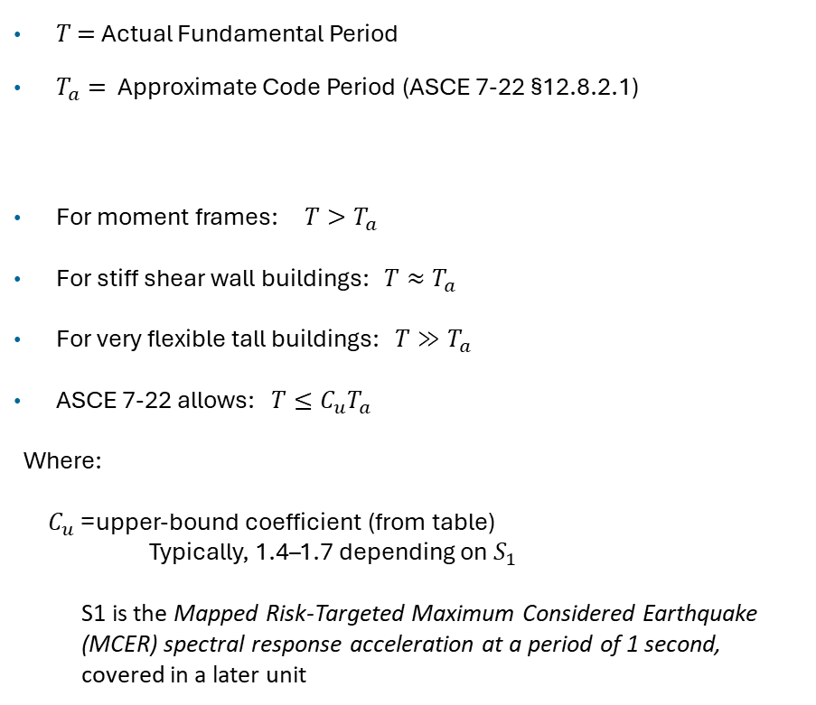
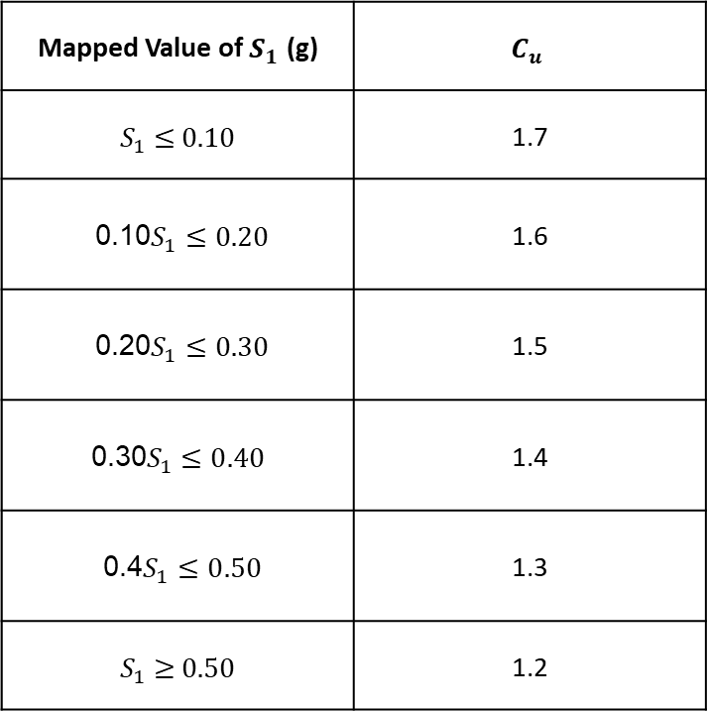
Vibrationdata
Building Period T (cont)
Mapped Value of ​$S_{1}$ (g) | $$C_{u}$$
$S_{1}$ ​≤ 0.10 | 1.7
0.10 $S_{1}≤0.20$ | 1.6
0.20 $S_{1}≤0.30$ | 1.5
0.30$S_{1}≤0.40$ | 1.4
0.4 $S_{1}≤0.50$ | 1.3
$S_{1}$​ ≥ 0.50 | 1.2
$T$ $=$Actual Fundamental Period
$T_{a}=$ Approximate Code Period (ASCE 7-22 §12.8.2.1)
For moment frames: $T>T_{a}$
For stiff shear wall buildings: $T≈T_{a}$
For very flexible tall buildings: $T≫T_{a}$
ASCE 7-22 allows: $T≤C_{u}T_{a}$
Where:
$C_{u}$= upper-bound coefficient (from table)
Typically, 1.4–1.7 depending on $S_{1}$
S1​ is the Mapped Risk-Targeted Maximum Considered Earthquake (MCER) spectral response acceleration at a period of 1 second, covered in a later unit

Slide 22
Vibrationdata
Typical Building Mass Properties
Building Type | Approx. Mass per Floor Area | Approx. Mass per Floor Area | Comments
Low-rise Residential | ~40–50 psf | ~195–244 kg/m² | Light floors/finishes; low structural mass.
Office / Commercial | ~60–70 psf | ~293–342 kg/m² | Concrete slabs + partitions + furnishings.
Industrial / Warehouse | ~125 psf | ~610 kg/m² | Heavier slabs and equipment areas.
Hospital (typical floors) | ~250 psf | ~1,220 kg/m² | Hospital floor design often assumes ~1.5 kPa dead load + 4 kPa live load.
Hospital (operating room corridors) | ~80–100 psf | ~390–488 kg/m² | Operating rooms, labs & heavy corridors may have higher load requirements.
High-rise Concrete / Mixed Use | ~100–120 psf | ~488–586 kg/m² | Includes heavy structure, finishes, MEP. Typical codes vary.
The mass densities include live + dead loads
Dead loads represent the permanent weight of structural elements — slabs, beams, walls, finishes, fixed equipment, etc.
Represent variable weight from occupancy, furniture, storage, and mobile equipment

Slide 23
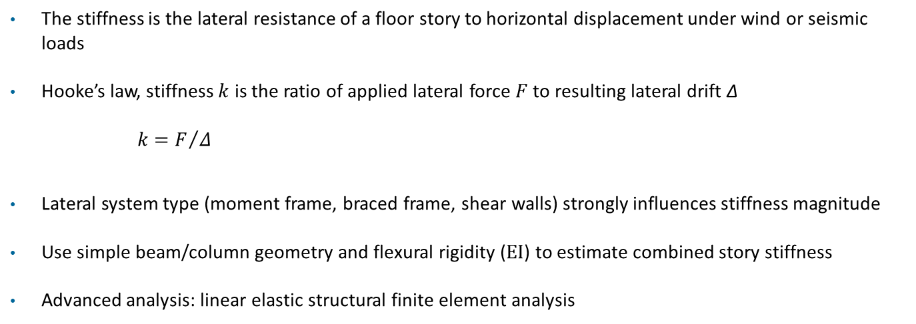
Vibrationdata
_{Lateral Frame Stiffness}
The stiffness is the lateral resistance of a floor story to horizontal displacement under wind or seismic loads
Hooke’s law, stiffness $k$ is the ratio of applied lateral force $F$ to resulting lateral drift Δ
$$k=F/Δ$$
Lateral system type (moment frame, braced frame, shear walls) strongly influences stiffness magnitude
Use simple beam/column geometry and flexural rigidity (EI) to estimate combined story stiffness
Advanced analysis: linear elastic structural finite element analysis

Slide 24
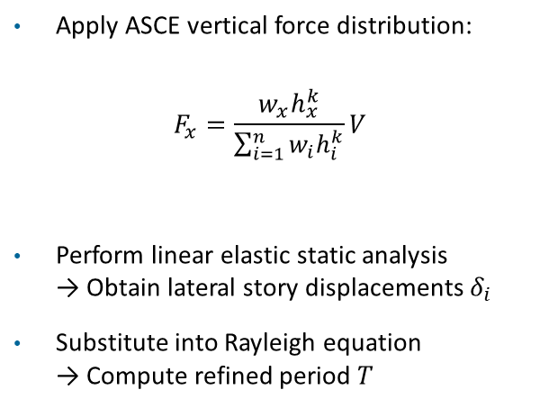
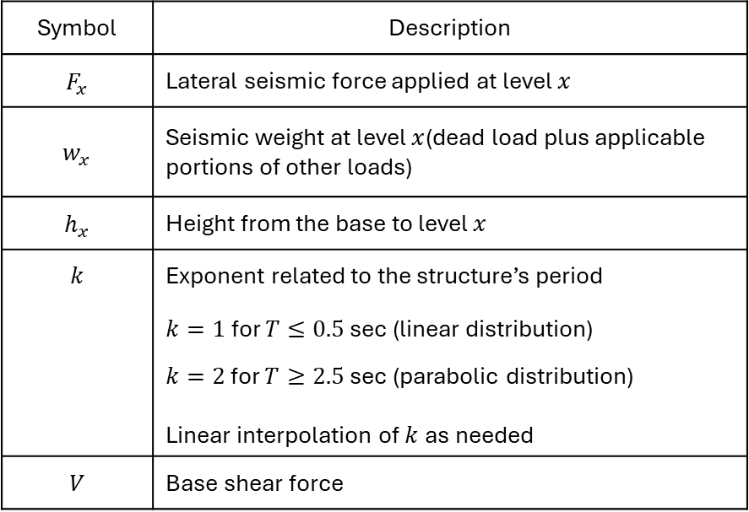
Rayleigh Method for Building Period ASCE 7-22 §12.8.2.1
Vibrationdata
Apply ASCE vertical force distribution:
$$F_{x}=\frac{w_{x}h_{x}^{k}}{\sum_{i=1}^{n}{w_{i}h_{i}^{k}}}V$$
Perform linear elastic static analysis → Obtain lateral story displacements $δ_{i}$
Substitute into Rayleigh equation → Compute refined period $T$
Symbol | Description
$$F_{x}$$ | Lateral seismic force applied at level $x$
$$w_{x}$$ | Seismic weight at level $x$(dead load plus applicable portions of other loads)
$$h_{x}$$ | Height from the base to level $x$
$$k$$ | Exponent related to the structure’s period
 | $k=1$for $T≤0.5$ sec (linear distribution)
 | $k=2$ for $T≥2.5$sec (parabolic distribution) Linear interpolation of $k$as needed
$$V$$ | Base shear force

Slide 25
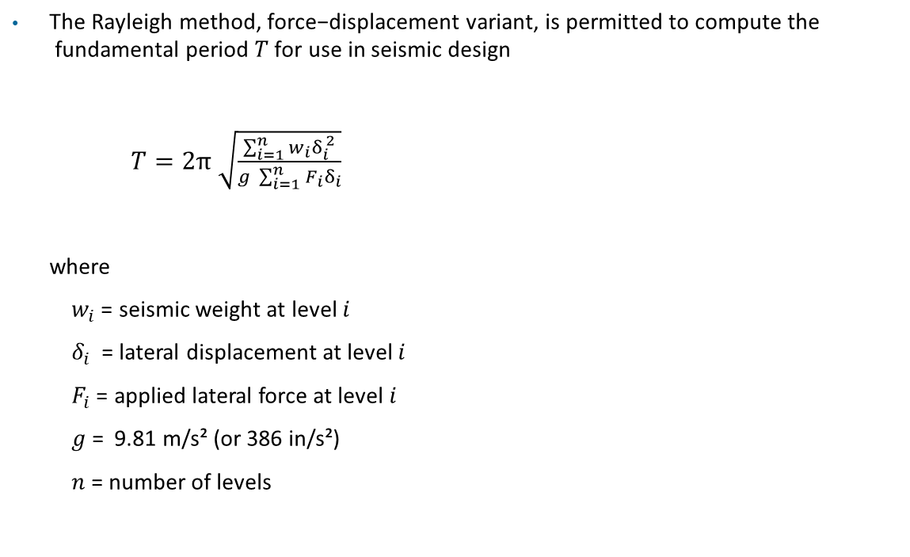
Rayleigh Method for Building Period ASCE 7-22 §12.8.2.1
Vibrationdata
$\text{The} \text{Rayleigh} \text{method}\text{, }\text{force}\text{−}\text{displacement} \text{variant}\text{, }\text{is} \text{permitted} \text{to} \text{compute} \text{the} \text{fundamental} \text{period} T \text{for} \text{use} \text{in} \text{seismic} \text{design}$
$T=2π$ $\sqrt{\frac{\sum_{i=1}^{n}{w_{i}δ_{i}^{ 2}}}{g \sum_{i=1}^{n}{F_{i}δ_{i}}}}$
where
$w_{i}$= seismic weight at level $i$
$δ_{i}$ = lateral displacement at level $i$
$F_{i}$= applied lateral force at level $i$
$g$ = 9.81 m/s² (or 386 in/s²)
$n$ = number of levels

Slide 26
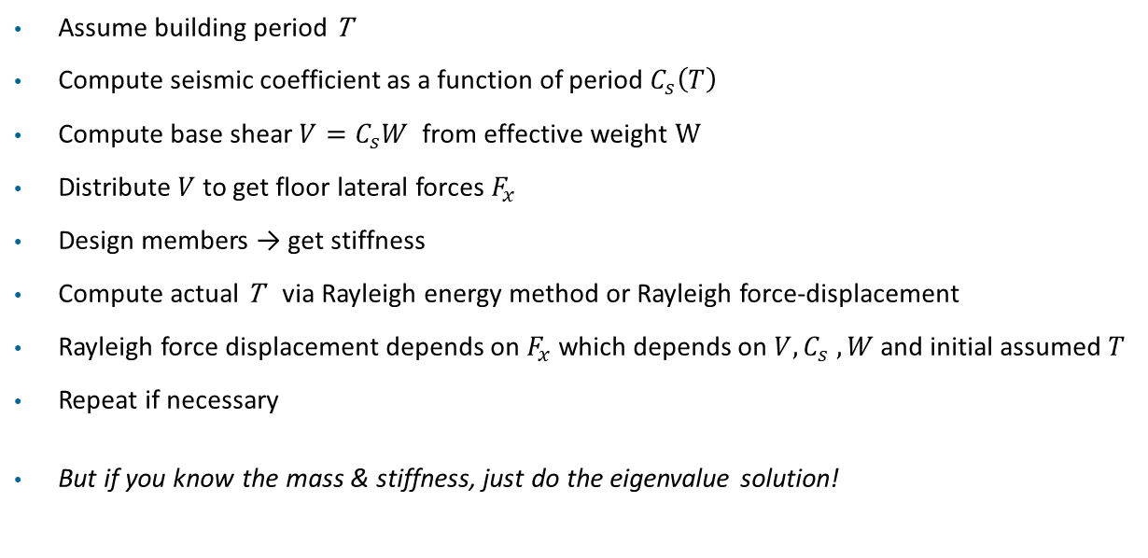
Vibrationdata
Apparent Circular Loop in ASCE 7-22
Assume building period T
Compute seismic coefficient as a function of period $C_{s}\left(T\right)$
Compute base shear $V=C_{s}W \text{from} \text{effective} \text{weight} \text{W}$
Distribute $V$to get floor lateral forces $F_{x}$
Design members → get stiffness
Compute actual T via Rayleigh energy method or Rayleigh force-displacement
Rayleigh force displacement depends on $F_{x}$which depends on $V, C_{s} , W$and initial assumed $T$
Repeat if necessary
But if you know the mass & stiffness, just do the eigenvalue solution!

Slide 27
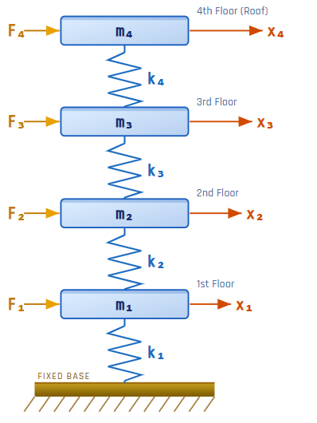
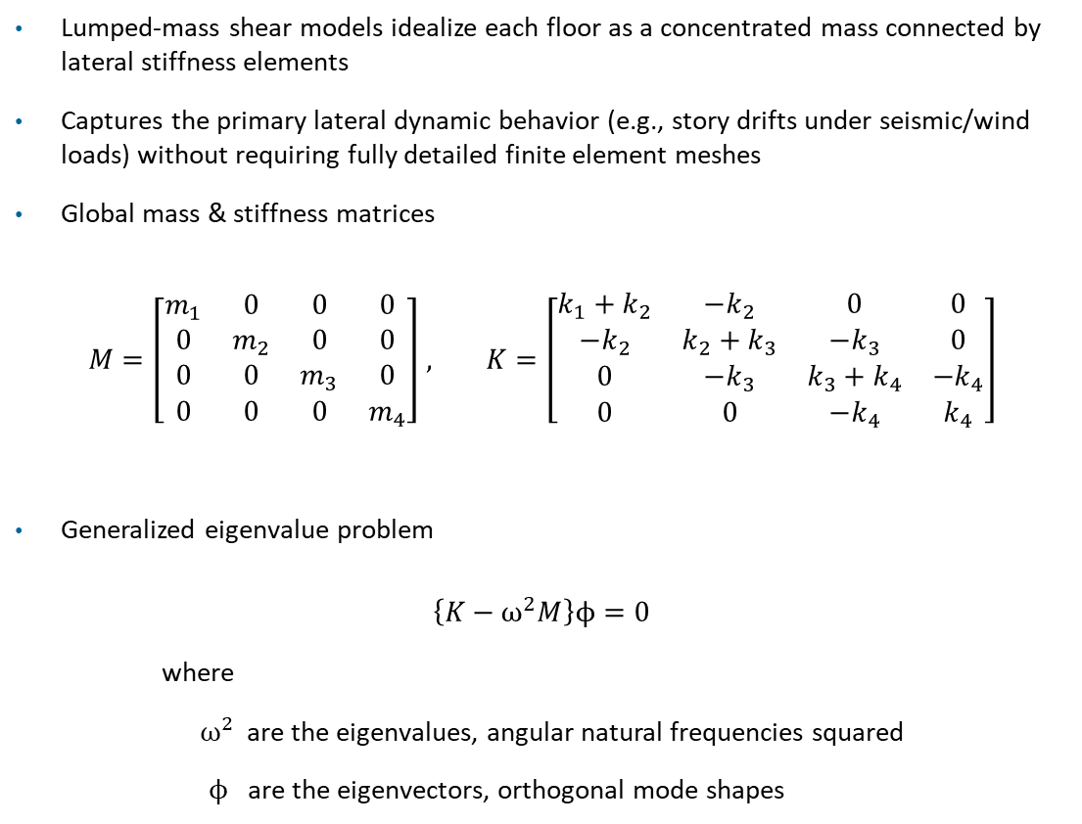
Lumped-Mass Shear Building Model, Four Story Example, Eigenvalue Solution
Vibrationdata
Lumped-mass shear models idealize each floor as a concentrated mass connected by lateral stiffness elements
Captures the primary lateral dynamic behavior (e.g., story drifts under seismic/wind loads) without requiring fully detailed finite element meshes
Global mass & stiffness matrices
$M=\left[\begin{matrix}m_{1} & 0 & 0 & 0 \\ 0 & m_{2} & 0 & 0 \\ 0 & 0 & m_{3} & 0 \\ 0 & 0 & 0 & m_{4}\end{matrix}\right]$ , $K=\left[\begin{matrix}k_{1}+k_{2} & −k_{2} & 0 & 0 \\ −k_{2} & k_{2}+k_{3} & −k_{3} & 0 \\ 0 & −k_{3} & k_{3}+k_{4} & {−k}_{4} \\ 0 & 0 & {−k}_{4} & k_{4}\end{matrix}\right]$
Generalized eigenvalue problem
$$\left\{K−ω^{2}M\right\}ϕ=0$$
where
$ω^{2}$ are the eigenvalues, angular natural frequencies squared
$ϕ$are the eigenvectors, orthogonal mode shapes

Slide 28
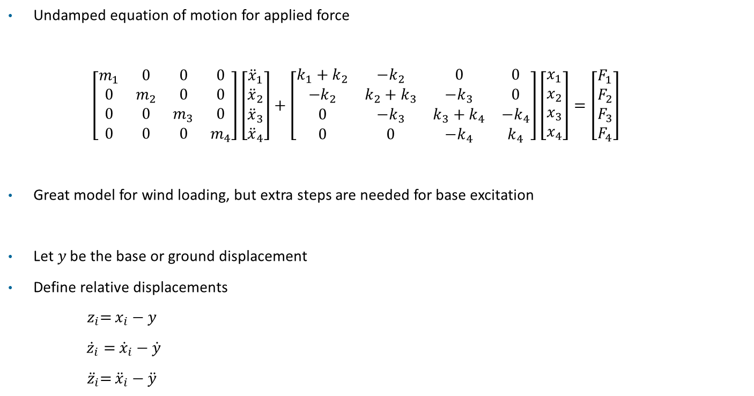
Lumped-Mass Shear Building Model, Four Story Example
Vibrationdata
Undamped equation of motion for applied force
$\left[\begin{matrix}m_{1} & 0 & 0 & 0 \\ 0 & m_{2} & 0 & 0 \\ 0 & 0 & m_{3} & 0 \\ 0 & 0 & 0 & m_{4}\end{matrix}\right]\left[\begin{matrix}{\ddot{x}}_{1} \\ {\ddot{x}}_{2} \\ {\ddot{x}}_{3} \\ {\ddot{x}}_{4}\end{matrix}\right]+\left[\begin{matrix}k_{1}+k_{2} & −k_{2} & 0 & 0 \\ −k_{2} & k_{2}+k_{3} & −k_{3} & 0 \\ 0 & −k_{3} & k_{3}+k_{4} & {−k}_{4} \\ 0 & 0 & {−k}_{4} & k_{4}\end{matrix}\right]\left[\begin{matrix}x_{1} \\ x_{2} \\ x_{3} \\ x_{4}\end{matrix}\right]=\left[\begin{matrix}F_{1} \\ F_{2} \\ F_{3} \\ F_{4}\end{matrix}\right]$
Great model for wind loading, but extra steps are needed for base excitation
Let $y$ be the base or ground displacement
Define relative displacements
${ z}_{i}=$ $x_{i}−y$
${\dot{z}}_{i}=$ ${\dot{x}}_{i}−\dot{y}$
${ \ddot{z}}_{i}=$ ${\ddot{x}}_{i}−\ddot{y}$

Slide 29
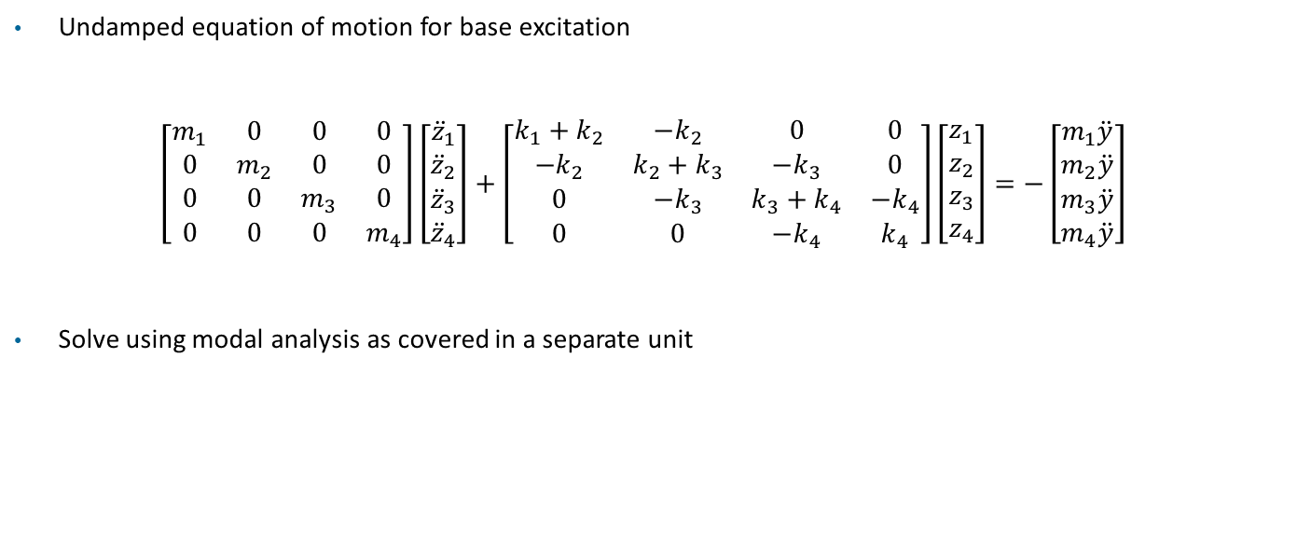
Lumped-Mass Shear Building Model, Four Story Example
Vibrationdata
Undamped equation of motion for base excitation
$\left[\begin{matrix}m_{1} & 0 & 0 & 0 \\ 0 & m_{2} & 0 & 0 \\ 0 & 0 & m_{3} & 0 \\ 0 & 0 & 0 & m_{4}\end{matrix}\right]\left[\begin{matrix}{\ddot{z}}_{1} \\ {\ddot{z}}_{2} \\ {\ddot{z}}_{3} \\ {\ddot{z}}_{4}\end{matrix}\right]+\left[\begin{matrix}k_{1}+k_{2} & −k_{2} & 0 & 0 \\ −k_{2} & k_{2}+k_{3} & −k_{3} & 0 \\ 0 & −k_{3} & k_{3}+k_{4} & {−k}_{4} \\ 0 & 0 & {−k}_{4} & k_{4}\end{matrix}\right]\left[\begin{matrix}z_{1} \\ z_{2} \\ z_{3} \\ z_{4}\end{matrix}\right]=−\left[\begin{matrix}m_{1}\ddot{y} \\ m_{2}\ddot{y} \\ m_{3}\ddot{y} \\ m_{4}\ddot{y}\end{matrix}\right]$
Solve using modal analysis as covered in a separate unit

Slide 30

Rayleigh Energy Method for Building Period
Vibrationdata
$\text{ASCE}\text{ 7−22 §12.8.2.1 }\text{provides} \text{the} \text{Rayleigh} \text{energy} \text{method}$
The total strain energy is set equal to the total kinetic energy
$\text{The} \text{Rayleigh} \text{method}\text{, }\text{energy} \text{variant}\text{, }\text{for} \text{the} \text{angular} \text{natural} \text{frequency} ω \text{and} \text{the} \text{period} \text{T} \text{is}$
$ω_{n}^{ 2} ≈$ $\frac{\sum{k_{i}{\left(u_{i}−u_{i−1}\right)}^{2}}}{\sum{m_{i}} u_{i}^{ 2}}$
$T={2π}/{ω_{n}}$
where
$u$is the fundamental mode shape with arbitrary scale
i is the story number

Slide 31
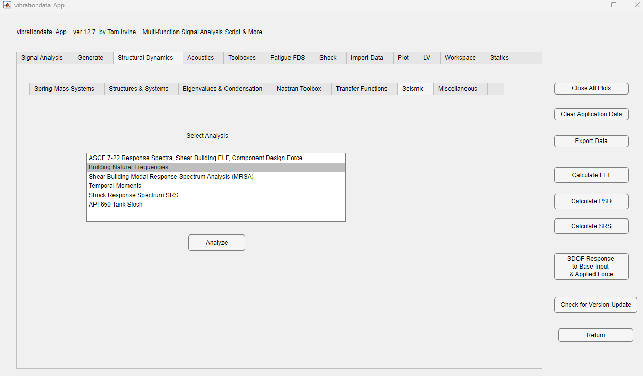

Slide 32
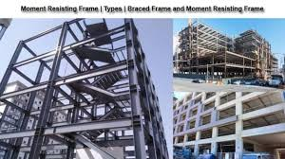
https://www.constructupdate.com/moment-resisting-frame-and-types/

Slide 33
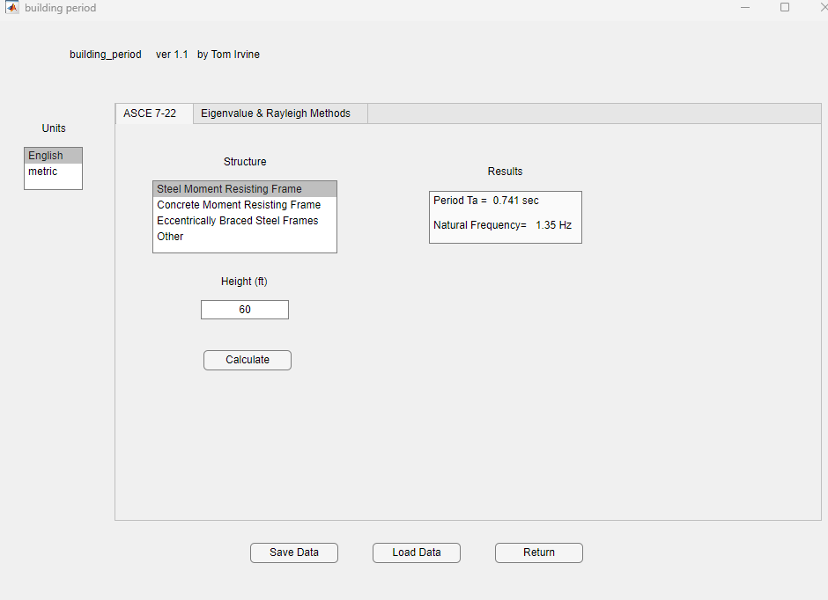

Slide 34
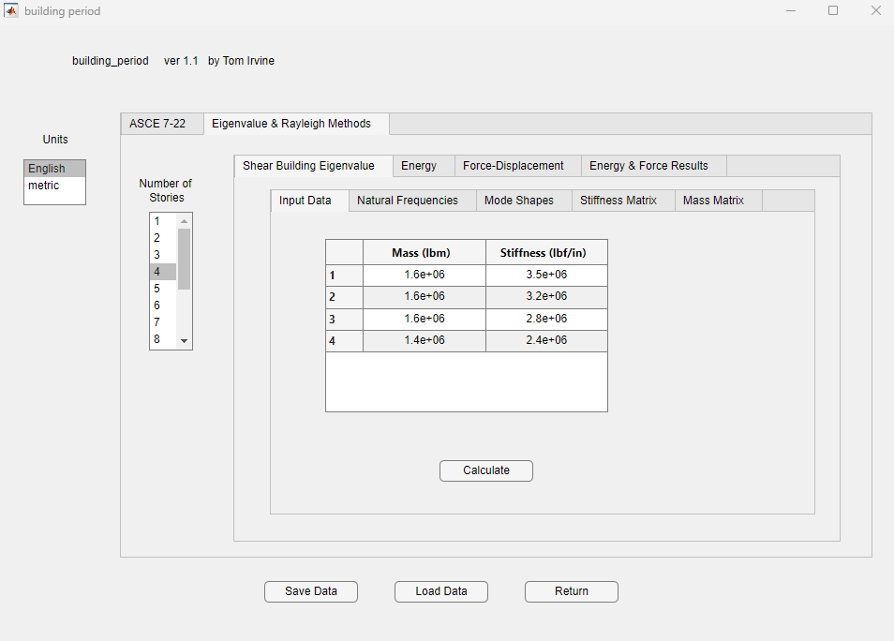

Slide 35
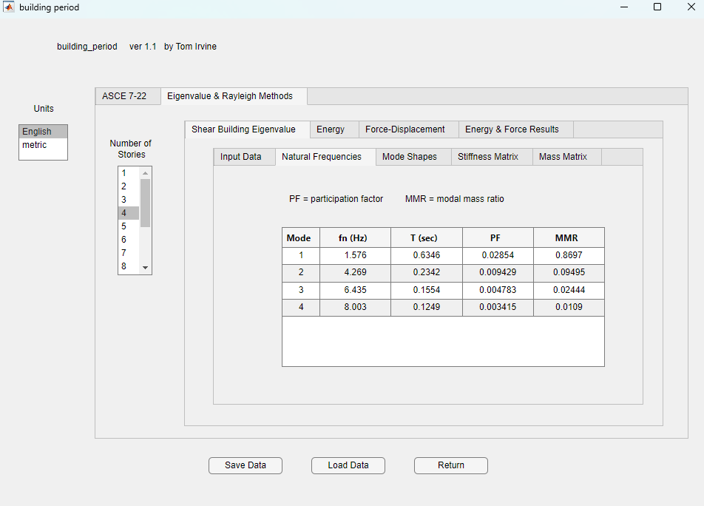

Slide 36
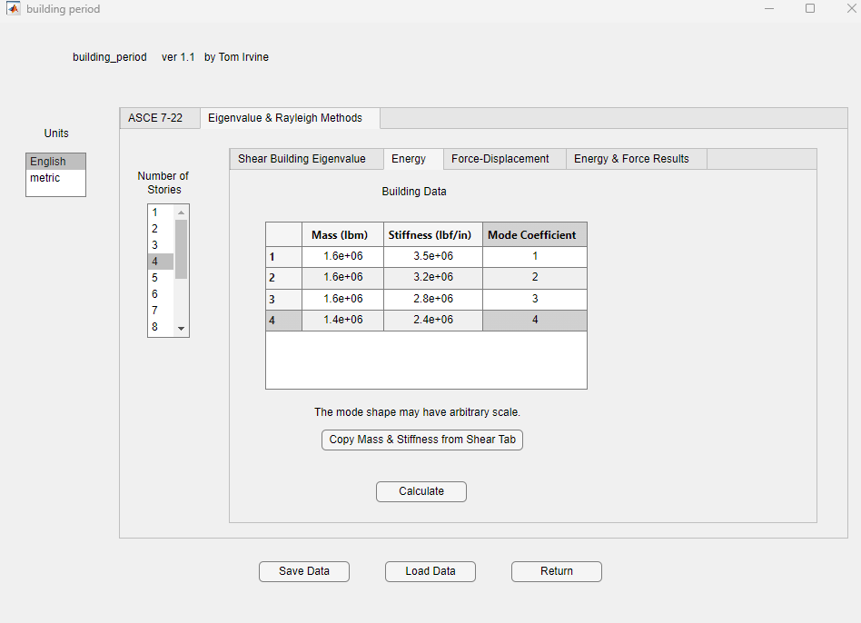

Slide 37
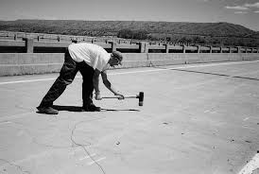
Sledge Hammer Modal Test on Bridge Deck
https://www.researchgate.net/publication/35410218_Decentralization_of_wireless_monitoring_and_control_technologies_for_smart_civil_structures/figures?lo=1

Slide 38
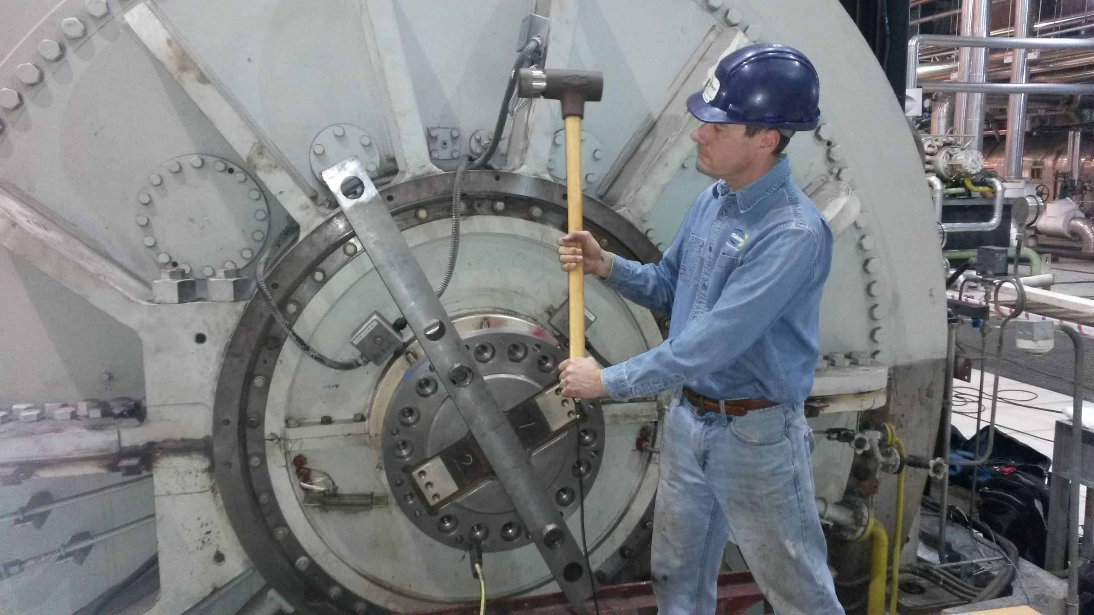
Sledge Hammer Modal Test on Equipment
https://simutechgroup.com/services/physical-testing/modal-vibration-testing/

Slide 39
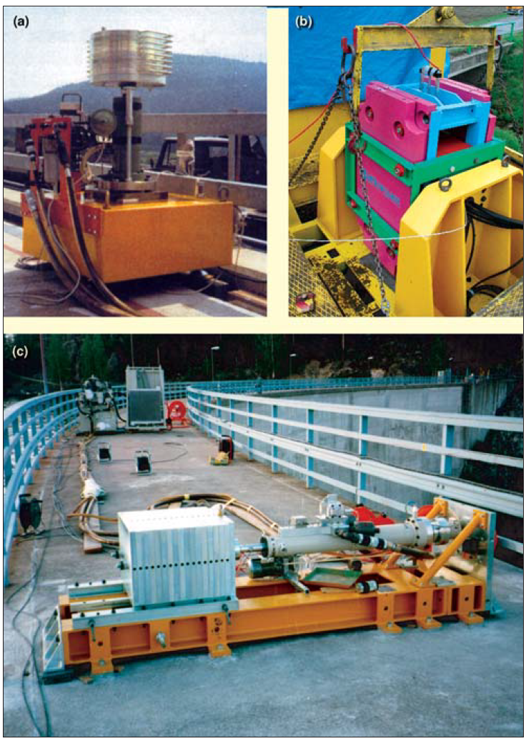
Shaker Modal Test
Experimental Modal Analysis of
Civil Engineering Structures
Álvaro Cunha and Elsa Caetano, University of Porto (FEUP), Portugal

Slide 40
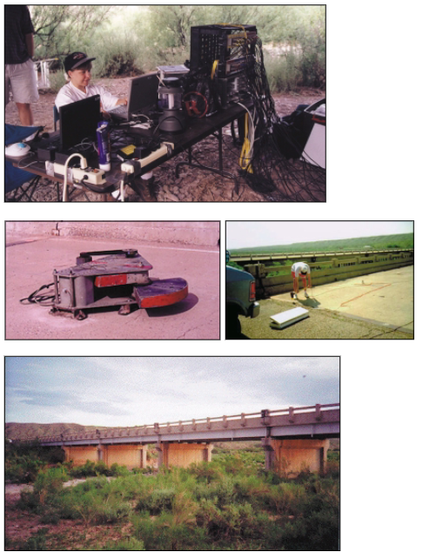
Eccentric Mass Shaker Modal Test
https://www.researchgate.net/publication/236365127_Structural_Health_Monitoring_Studies_of_the_Alamosa_Canyon_and_I-40_Bridges

