Slide 1
ASCE 7-22 Ch 15 Seismic Design Requirements for Nonbuilding Structures
By Tom Irvine

Slide 2
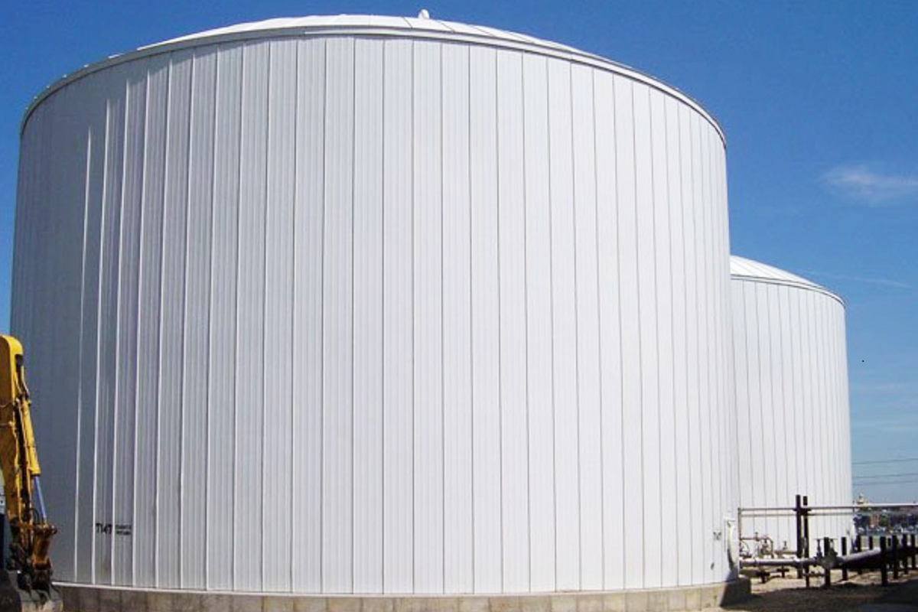

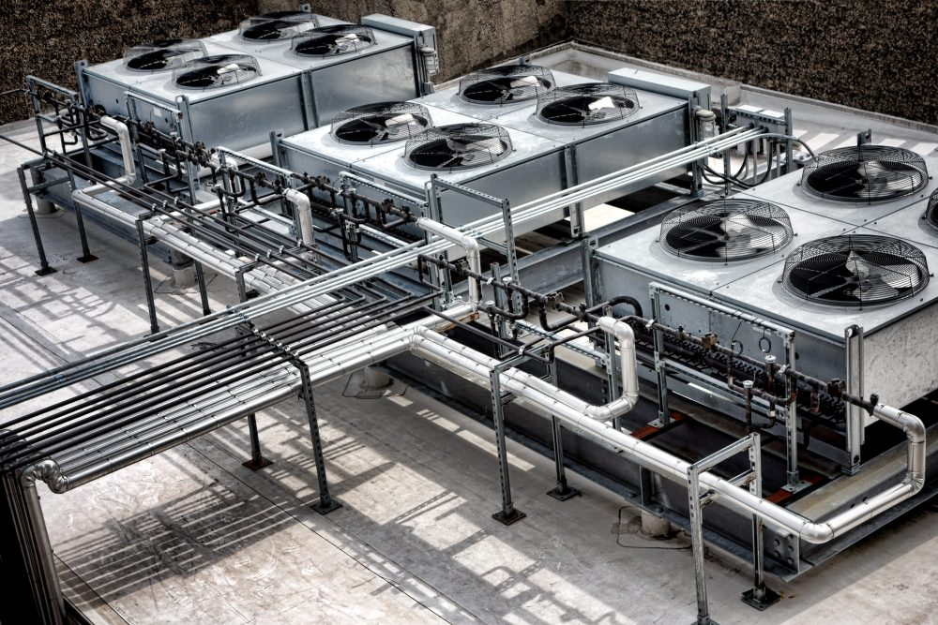
Introduction
Vibrationdata
Structures that are not intended for human occupancy
Tanks (ground-supported, elevated)
Stacks / chimneys
Pipe racks
Towers (telecom, industrial)
Mechanical/equipment frames

Slide 3

Introduction
Vibrationdata
Traditional building rules (Ch. 12) do not apply directly
Nonbuilding structures are
Often highly dynamic
Frequently flexible and lightly damped
Nonbuilding structures often have:
Different mass/stiffness distributions
Significant fluid-structure interaction
Equipment-driven loads
Goal: Provide consistent seismic design framework
Big Peach Water Tower, Clanton, GA

Slide 4
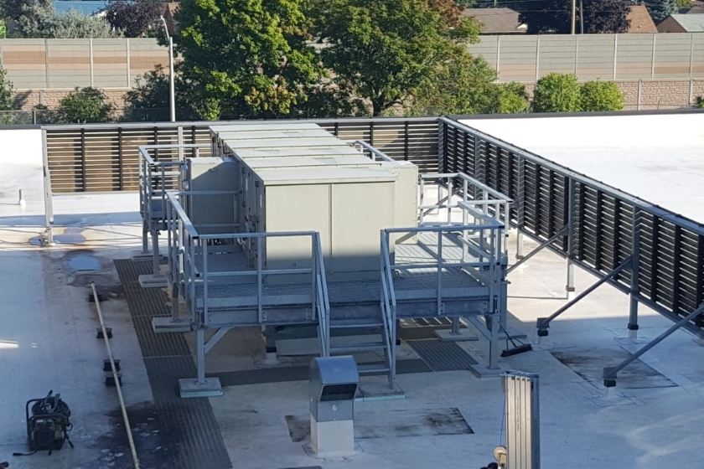
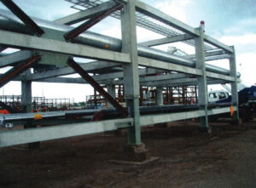
Classification
Vibrationdata
Supported Nonbuilding Structures
Supported by buildings
Example: rooftop equipment frames
Nonbuilding Structures Similar to Buildings
Act like buildings dynamically
Example: pipe racks, structural frames
Other Nonbuilding Structures
Require special procedures
Tanks, stacks, silos
Rooftop Equipment
Design path depends on classification:
Use Chapter 12 (ELF / MRSA) if Structure behaves like a building
Use Chapter 15 provisions if: Unique dynamic behavior exists
Pipe Rack

Slide 5
Chapter 15 Design Path Flowchart
Vibrationdata
Does it behave like a building?
Use Chapter 12 (ELF / MRSA)
Is it supported by a building?
Use Chapter 13 + 15 interface
Otherwise:
Use Chapter 15 provisions
Then:
Identify applicable standard (AWWA, API, etc.)
Determine R, Cd, Ω₀ source

Slide 6
Dynamic Behavior Comparison
Vibrationdata
Feature | Buildings | Nonbuilding Structures
Damping | Moderate | Often low
Modes | 1st mode dominant | Multi-mode important
Mass distribution | Uniform | Concentrated / irregular
Special effects | Rare | Sloshing, appendages

Slide 7
Design Approach
Vibrationdata
Determine:
Seismic Design Category (SDC)
Risk Category
Select:
Analysis method
Structural system
Apply:
Appropriate R, Cd, Ω₀ factors
Review Relevant Slides from Previous Units

Slide 8
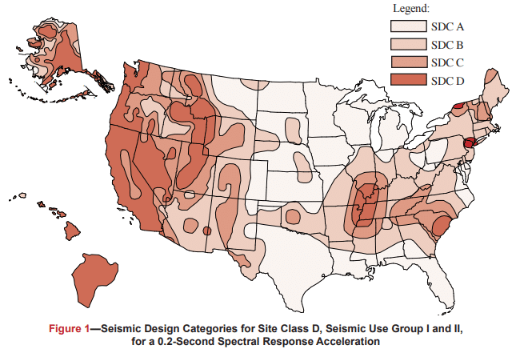
Seismic Hazard Map
Vibrationdata
SDC | Detailing Level
A–B | Minimal
C | Moderate
D–F | Special (strict)

Slide 9
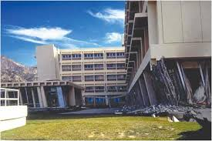
Risk Categories
Vibrationdata
Risk Category | Meaning | Typical Examples | Importance Factor I_{e} | Typical Interstory Lateral Drift Limit
I | Low risk to life if failure occurs | Barns, sheds, low-occupancy storage | 1.00 | 0.020 h
II | Ordinary risk structures (most buildings) | Homes, offices, retail | 1.00 | 0.020 h
III | Substantial hazard to life & community | Schools, assembly buildings, prisons | 1.25 | 0.015 h
IV | Essential facilities — must remain operational | Hospitals, fire/police stations | 1.50 | 0.010 h
Olive View Hospital, Los Angeles, San Fernando earthquake 1971
h is the story height measured between floor levels

Slide 10

Three Seismic Modification Coefficients
Vibrationdata
Factor | Used For | Physical Meaning | Notes
Response (R) | Reduces base shear | Expected ductility | Global energy dissipation assumption
Overstrength (Ω₀) | Amplifies forces locally | Hidden overstrength | Protects brittle/local elements
Deflection (Cd) | Amplifies drift | Inelastic deformation | Reconstructs actual deformation
Base shear
$V_{design}={V_{elastic}}/R$
Lateral Force Amplification for specific elements that remain elastic
$F_{amplified}=$ ${\text{Ω}}_{0}{ F}_{Design}$

Slide 11
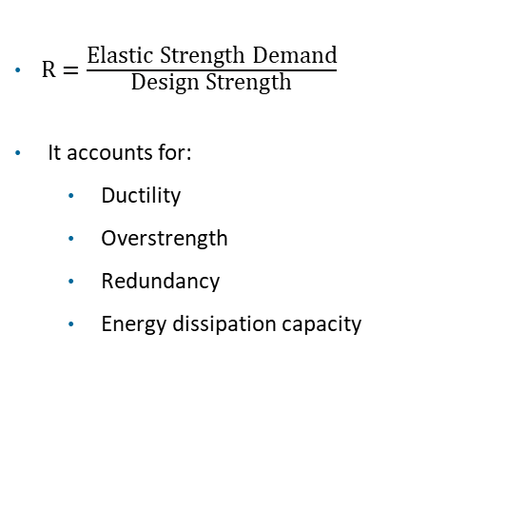
Response Modification Factor R “Credit for Ductility”
Vibrationdata
$R=\frac{\text{Elastic} \text{Strength} \text{Demand}}{\text{Design} \text{Strength}}$
It accounts for:
Ductility
Overstrength
Redundancy
Energy dissipation capacity
Larger R → smaller base shear
Smaller R → larger base shear
Higher ductility systems permit higher R
Large R assumes the structure can:
Yield
Form plastic hinges
Dissipate energy
Redistribute forces
Large R trades strength for ductility and allows for inelastic deformation

Slide 12
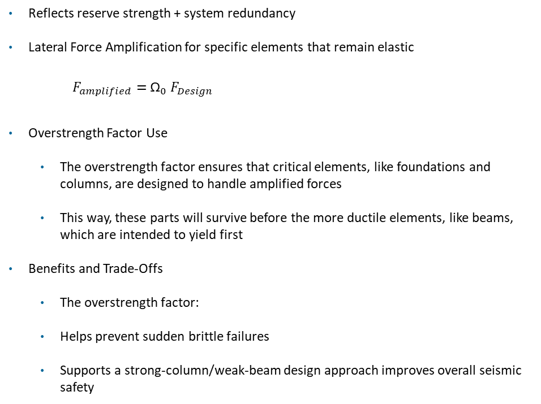
Vibrationdata
Overstrength Factor Ω₀
Reflects reserve strength + system redundancy
Lateral Force Amplification for specific elements that remain elastic
$F_{amplified}=$ ${\text{Ω}}_{0}{ F}_{Design}$
Overstrength Factor Use
The overstrength factor ensures that critical elements, like foundations and columns, are designed to handle amplified forces
This way, these parts will survive before the more ductile elements, like beams, which are intended to yield first
Benefits and Trade-Offs
The overstrength factor:
Helps prevent sudden brittle failures
Supports a strong-column/weak-beam design approach improves overall seismic safety

Slide 13
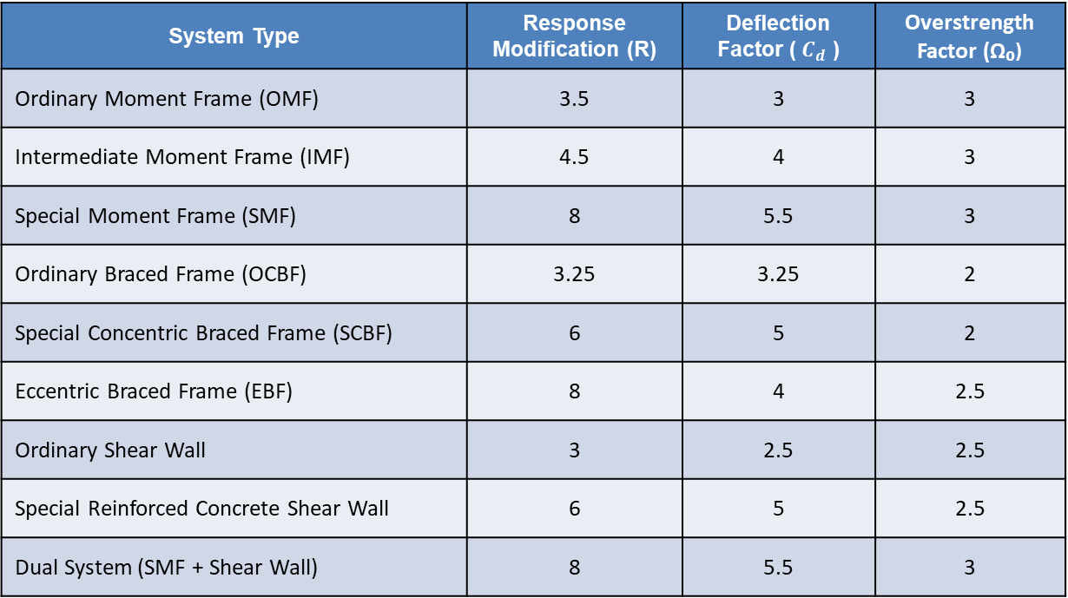
Typical Values
Vibrationdata
System Type | Response Modification (R) | Deflection Factor (${ C}_{d}$ ) | Overstrength Factor (Ω₀)
Ordinary Moment Frame (OMF) | 3.5 | 3 | 3
Intermediate Moment Frame (IMF) | 4.5 | 4 | 3
Special Moment Frame (SMF) | 8 | 5.5 | 3
Ordinary Braced Frame (OCBF) | 3.25 | 3.25 | 2
Special Concentric Braced Frame (SCBF) | 6 | 5 | 2
Eccentric Braced Frame (EBF) | 8 | 4 | 2.5
Ordinary Shear Wall | 3 | 2.5 | 2.5
Special Reinforced Concrete Shear Wall | 6 | 5 | 2.5
Dual System (SMF + Shear Wall) | 8 | 5.5 | 3

Slide 14
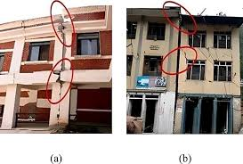
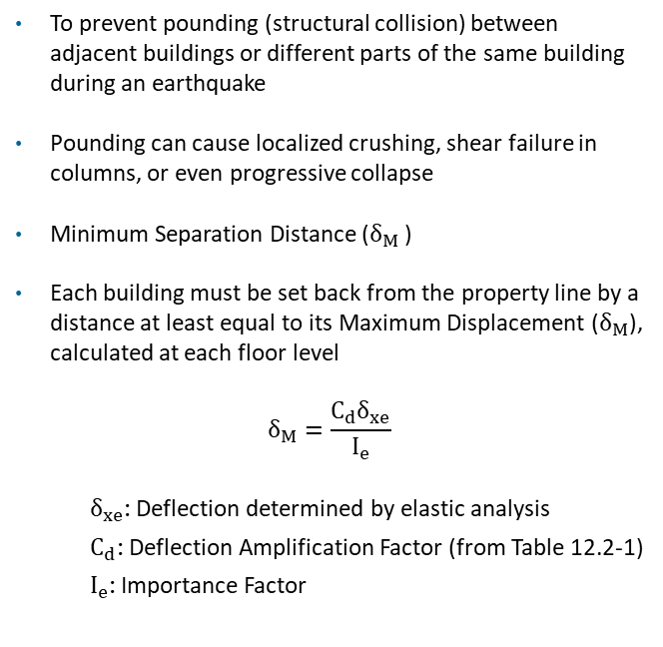
Seismic Separation Gap
Vibrationdata
To prevent pounding (structural collision) between adjacent buildings or different parts of the same building during an earthquake
Pounding can cause localized crushing, shear failure in columns, or even progressive collapse
Minimum Separation Distance ($δ_{M}$ )
Each building must be set back from the property line by a distance at least equal to its Maximum Displacement ($δ_{M}$), calculated at each floor level
$$δ_{M}=\frac{C_{d}δ_{xe}}{I_{e}}$$
$δ_{xe}$: Deflection determined by elastic analysis
$C_{d}$: Deflection Amplification Factor (from Table 12.2-1)
$I_{e}$: Importance Factor
Assessing seismic gap in adjacent RC buildings post Gorkha earthquake in Nepal, Aviral Upadhayay, et al.

Slide 15
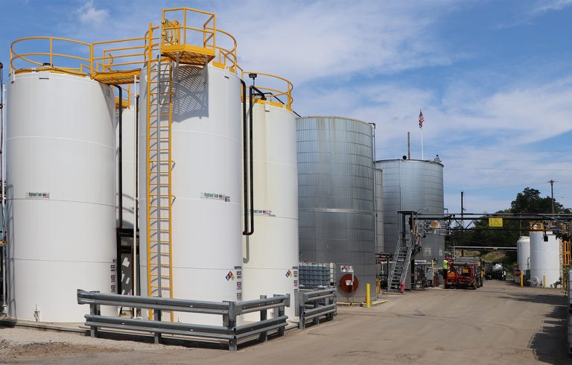
Standards
Vibrationdata
ASCE 7-22 provides seismic demand
The following standards give resistance design details:
ACI 350 / 371 (tanks)
AWWA D100 (steel tanks)
API 650 Appendix E (storage tanks)
ASME / industry standards

Slide 16
Seismic Forces
Vibrationdata
Base shear similar to buildings:
Depends on:
SDS, SD1
Period
Importance factor
But:
Adjusted for structure type
May include impulsive + convective components (tanks)
Parameters | Meaning | Units | Notes
S_{DS} | Design spectral acceleration, short periods | G | = 2/3 × S_{MS}
S_{D1} | Design spectral acceleration, 1 sec | G | = 2/3 × S_{M1}
Tₛ | Transition period | sec | = S_{D1} / S_{DS}
T₀ | 0.2 × Tₛ | sec | Defines lower bound period
TL | Long-period transition | sec | Used in design spectrum shape
S_{MS} & S_{M1} are design spectral values

Slide 17
Dynamic Behavior Differences
Vibrationdata
Nonbuilding structures often exhibit:
Flexible appendages
Fluid-structure interaction
Sloshing effects
Higher modes significant
Standard Equivalent Force (ELF) may be inadequate

Slide 18
Example
Vibrationdata
The subscript "p" on the following factors simply denotes they are component-specific values
Condition | aₚ | Rₚ | Ω₀ₚ
Mounted directly (rigid) — equipment period Tₐ ≤ 0.06s | 1.0 | 2.5 | 2.0
Vibration isolated — flexible mounting | 2.5 | 2.5 | 2.0
Flexibly mounted / on a supporting frame (as shown in your image) | 2.5 | 2.5 | 2.0

Slide 19
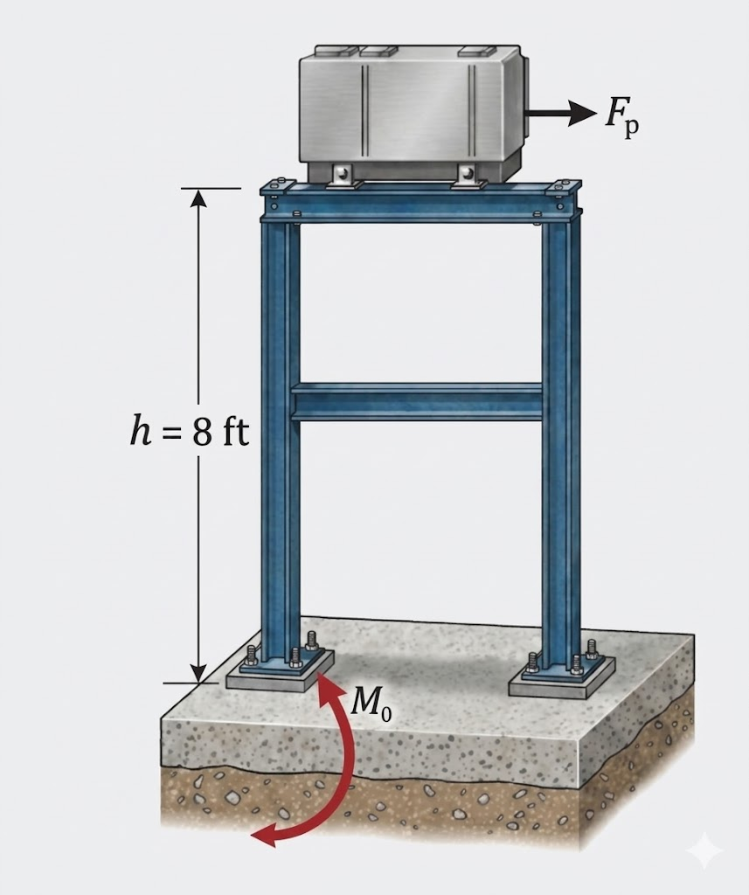
Equipment on Supporting Beam Frame
Parameter | Value | Source
SDS | 1.24g | USGS ASCE 7-22, Los Angeles, Site Class D
Ip | 1.5 | Essential/ hazardous facility
Rp | 2.5 | ASCE 7-22
SDC | D | Given
h (floor-to-top height of structure) | 8 ft | Given
Height of CG above base | 36 inch | Given
Wp | 5000 lbm (5 kips) | Given

Slide 20
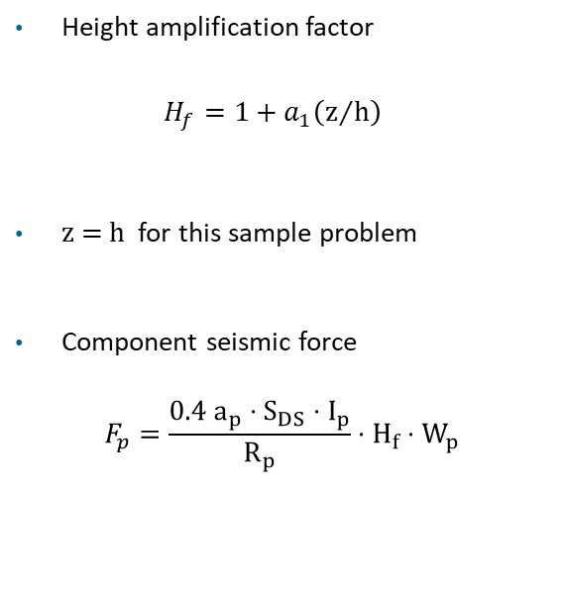
Example
Height amplification factor
$H_{f}=1+a_{1}\left(z/h\right)$
z = h for this sample problem
Component seismic force
$$F_{p}=\frac{{0.4 a}_{p}⋅S_{DS}⋅I_{p}}{R_{p}}⋅H_{f}⋅W_{p}$$
Per ASCE 7-22 §13.3.1, the factor a₁ depends on the number of stories of the supporting structure:
a₁ = 2.5 for a one-story structure
a₁ = 2.0 for a two-or-more story structure

Slide 21
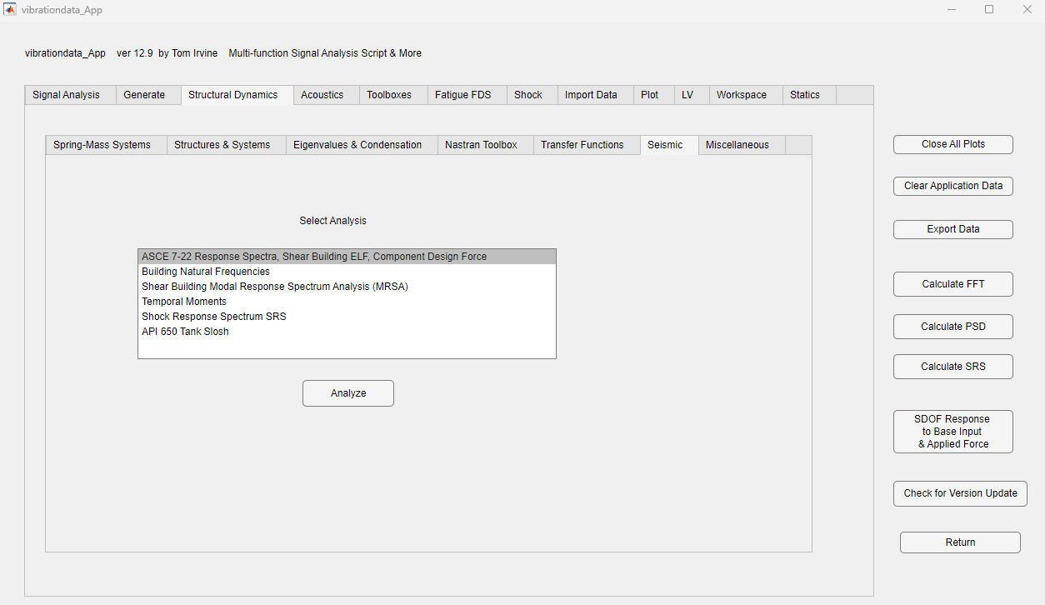
Example
Vibrationdata

Slide 22
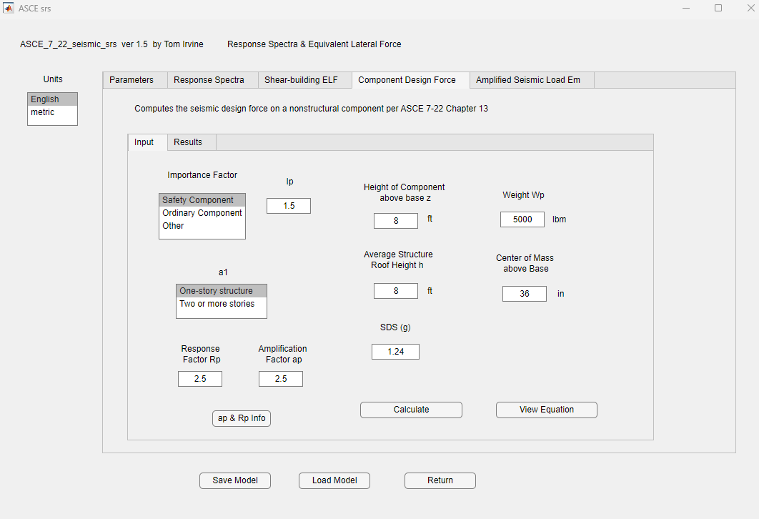
Example
Vibrationdata

Slide 23
