Slide 1
Vibrationdata
ASCE 7-22, Ch 13, Requirements for Nonstructural Components
Revision A
By Tom Irvine

Slide 2
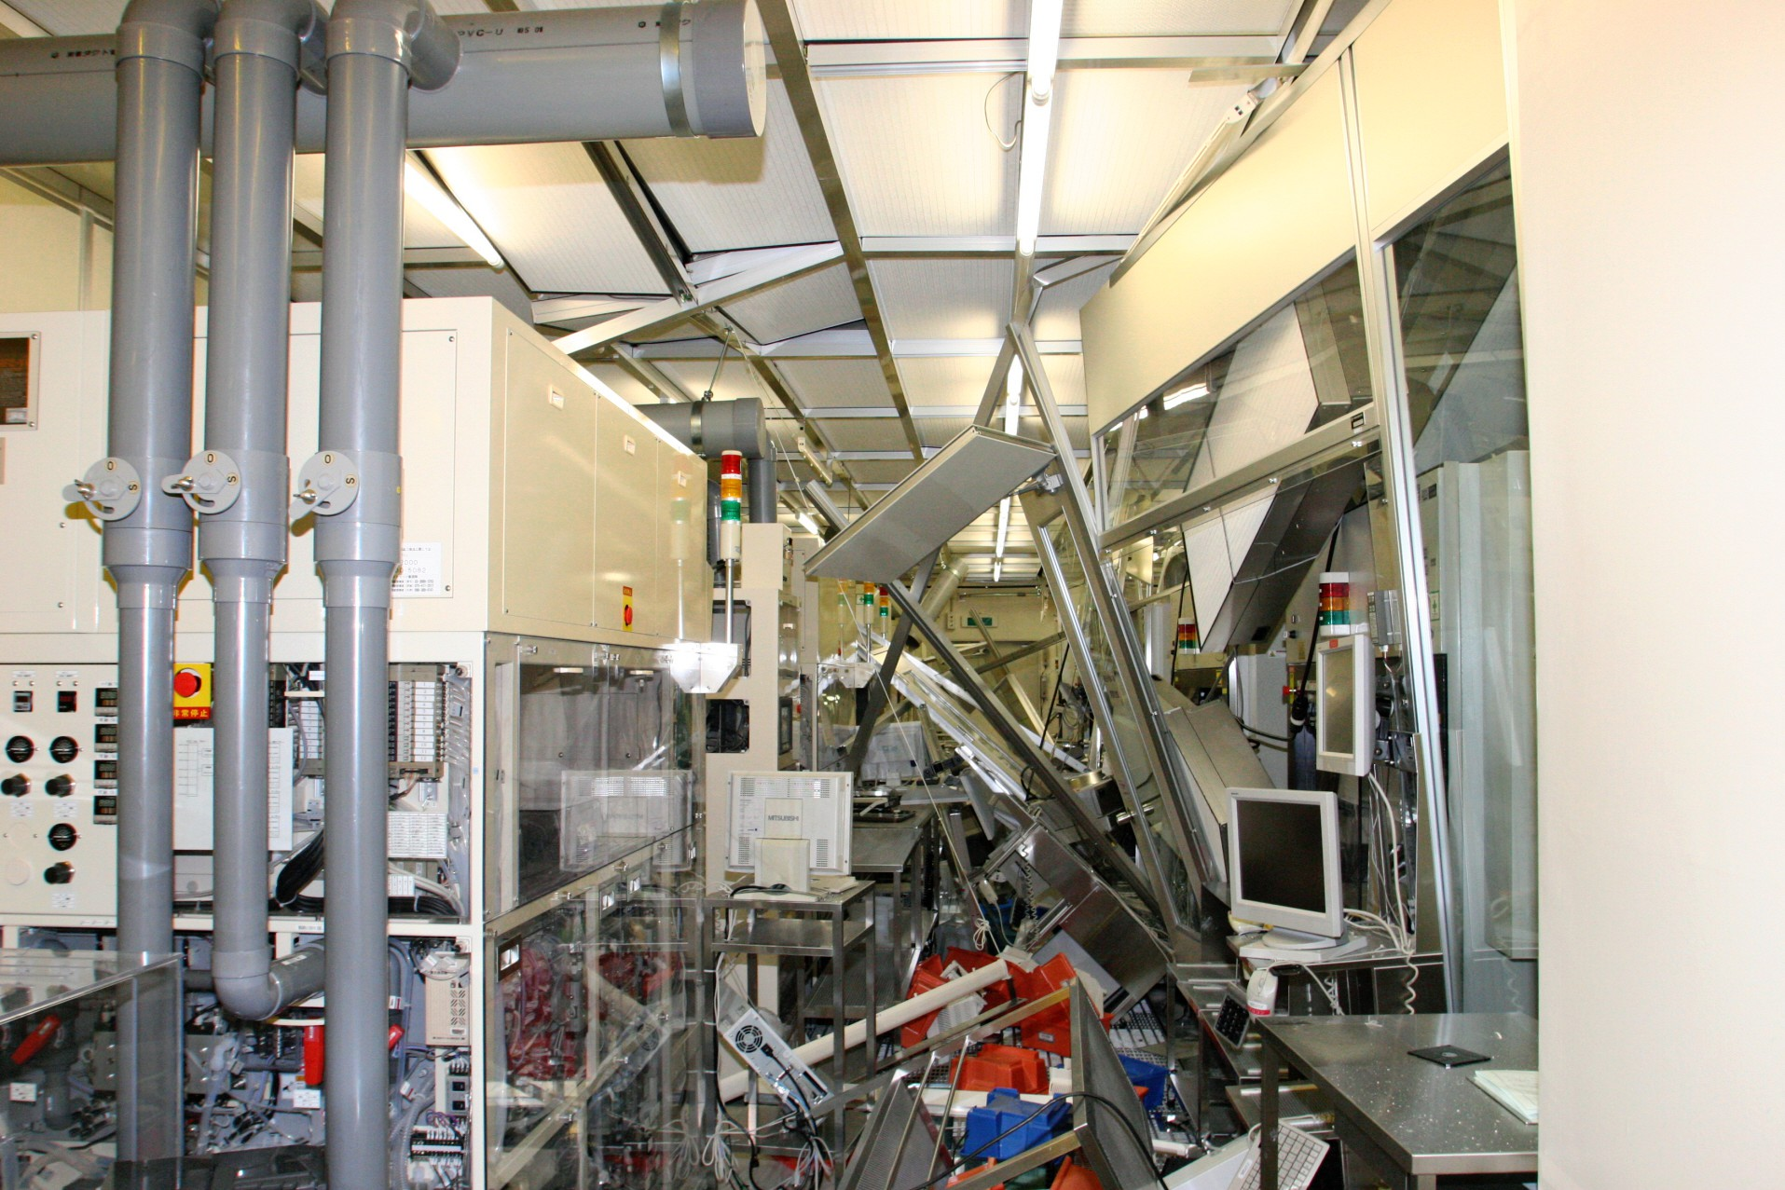
Vibrationdata
Introduction
Structural collapse is rare in modern codes
Most earthquake losses come from nonstructural damage
Damage causes:
  injuries
  building shutdowns
  fire protection failure
  economic loss
2011 Tōhoku Japan Earthquake
Semiconductor plant
https://asia.nikkei.com/business/business-trends/japanese-manufacturers-capitalize-on-the-lessons-from-3-112

Slide 3
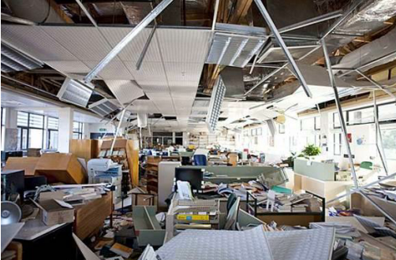
Vibrationdata
Nonstructural Component Types
Nonstructural components include:
  Mechanical equipment
  Electrical equipment
  Architectural components
  Piping and ducts
  Ceilings and partitions
  Storage racks
https://www.bhbengineers.com/articles/seismic-bracing-of-non-structural-components

Slide 4
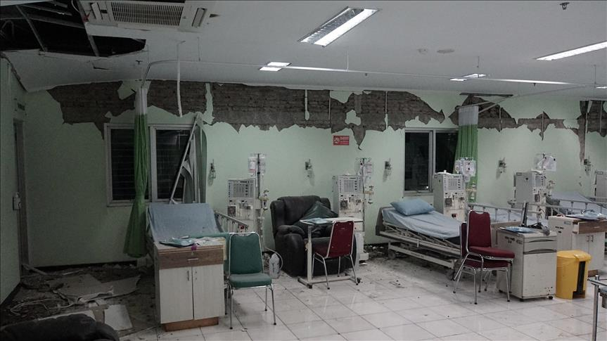
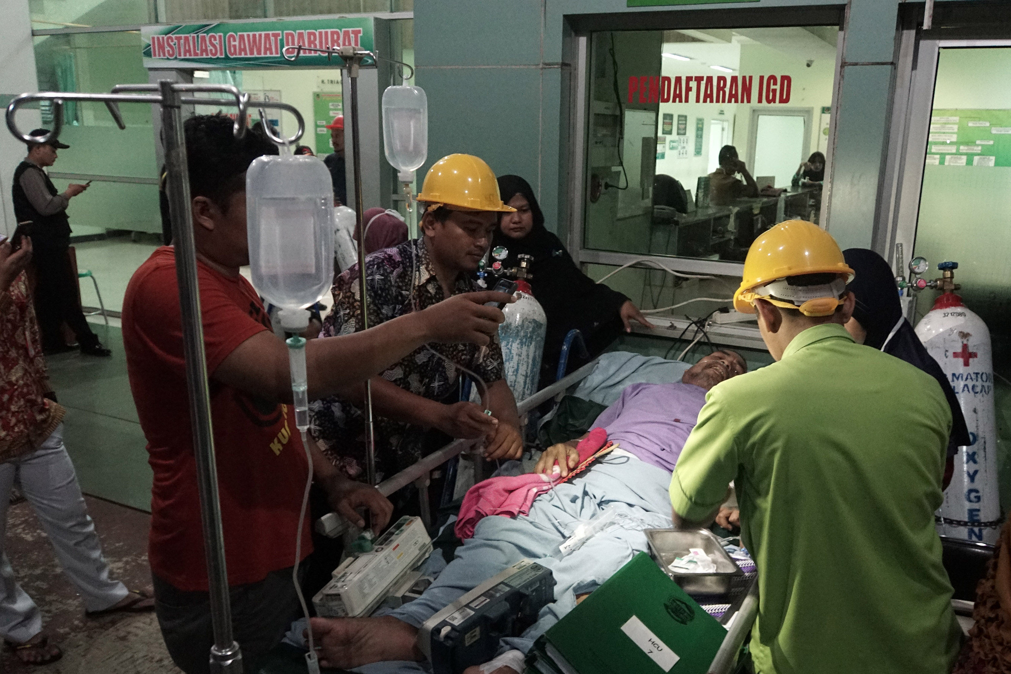
Vibrationdata
Nonstructural Damage
Earthquake performance is not only about preventing collapse
Nonstructural damage can cause:
  Hospital shutdowns
  Loss of emergency services
  Fire protection system failure
  Data center outages
  Economic losses
Central Java, Indonesia, December 16, 2017, Magnitude 6.9
https://www.aa.com.tr/en/asia-pacific/two-dead-buildings-damaged-by-indonesia-earthquake/1006495

Slide 5
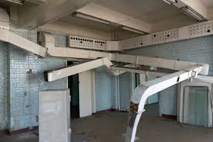
Nonstructural Components
Vibrationdata
Architectural Components
  Ceilings
  Partitions
  Facades
  Cladding
  Lighting
Mechanical Components
  HVAC equipment
  Pumps
  Boilers
  Chillers
Electrical Components
  Switchgear
  Transformers
  Control panels
Distribution Systems
  Piping
  Ductwork
  Cable trays
https://blog.qrfs.com/329-seismic-bracing-for-ductwork-hvac-electrical-systems/

Slide 6
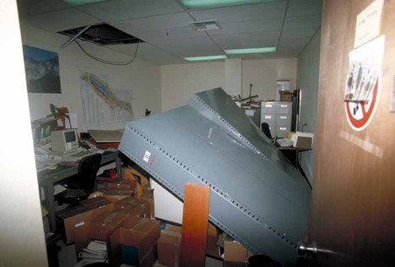
Nonstructural Components Failure Modes
Component | Typical Failure
Suspended ceilings | Grid collapse
HVAC units | Sliding or overturning
Piping | Joint rupture
Fire sprinklers | Pipe separation
Equipment racks | Toppling
https://www.jdsupra.com/legalnews/major-earthquakes-what-to-expect-during-8852622/

Slide 7
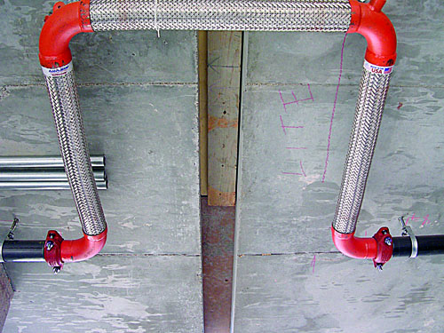
Seismic Joint for Fire Sprinkler Pipes
The expansion sections have a braided metal outer layer
The inner layer is typically corrugated stainless steel
NFPA 13, Standard for the Installation of Sprinkler Systems
https://www.nfpa.org/news-blogs-and-articles/blogs/2021/03/19/introduction-to-seismic-protection-for-sprinkler-systems

Slide 8
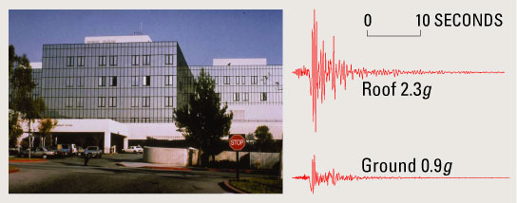
Vibrationdata
Floor Acceleration Amplification
Components see floor acceleration, not ground acceleration
Location | Approximate Acceleration
Base | 1.0 × ground
Mid height | 1.5 ×
Roof | 2–3 ×
Olive View Hospital, Northridge Earthquake 1994

Slide 9
Vibrationdata
Seismic Design Force for Components

Slide 10
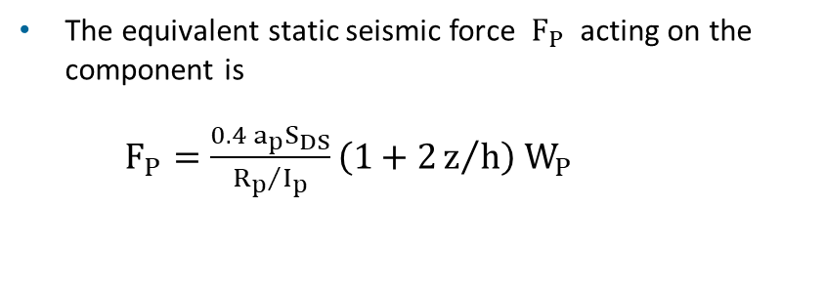
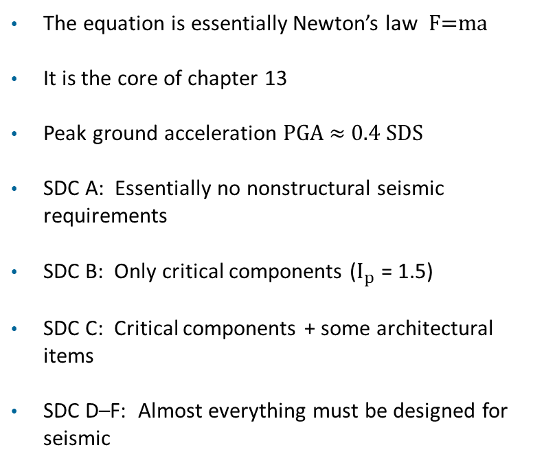
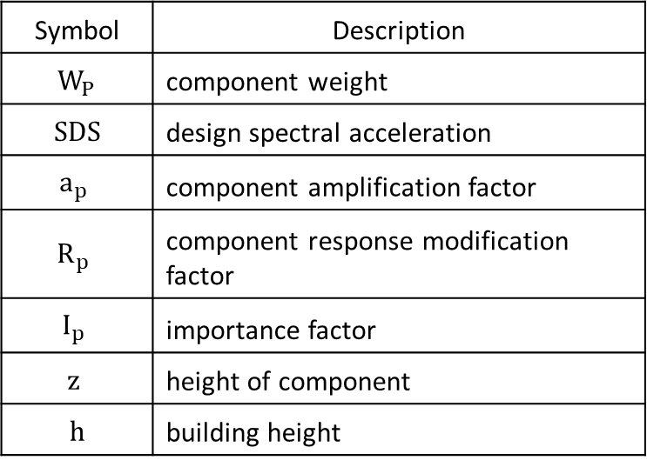
Vibrationdata
Seismic Design Force for Components
The equivalent static seismic force $F_{P}$ acting on the component is
$F_{P}=\frac{{0.4 a}_{p}S_{DS}}{{R_{p}}/{I_{p}}}\left(1+2z/h\right){ W}_{P}$​
The equation is essentially Newton’s law F=ma
It is the core of chapter 13
Peak ground acceleration PGA ≈ 0.4 SDS​
SDC A: Essentially no nonstructural seismic requirements
SDC B: Only critical components ($I_{p}$ = 1.5)
SDC C: Critical components + some architectural items
SDC D–F: Almost everything must be designed for seismic
Symbol | Description
$${ W}_{P}$$ | component weight
SDS | design spectral acceleration
$$a_{p}$$ | component amplification factor
$$R_{p}$$ | component response modification factor
$$I_{p}$$ | importance factor
$$z$$ | height of component
h | building height

Slide 11
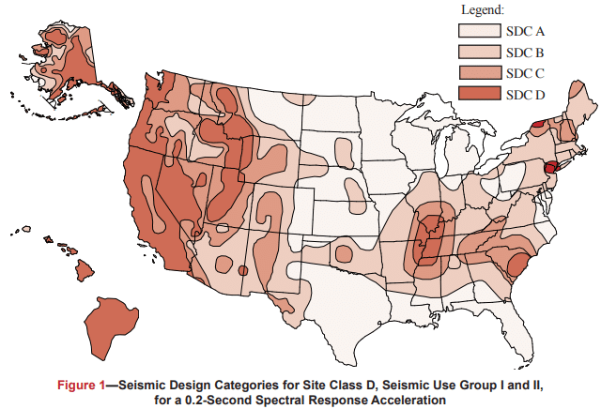
Vibrationdata
Seismic Hazard Map
Each figure is based on Site Class D (the default class when the soil profile is not known) and is applicable to structures assigned to Occupancy Categories I, II, and III (buildings other than high hazard exposure structures)
Note that if the soil profile is known and is lower than D, a correspondingly lower SDC may be realized
https://www.cmha.org/resource/tek-14-18b/

Slide 12
Vibrationdata
Seismic Design Categories (SDC)
Seismic Design Category (SDC) | Applicability of ASCE 7-22 Chapter 13 (Nonstructural Components) | Key Requirements / Exemptions
A | Chapter 13 does not apply | Essentially exempt. Only a simple lateral force requirement (§1.4) applies.
B | Limited applicability | Only components with Ip = 1.5 (life-safety or post-earthquake critical components) must be seismically designed. Ordinary components (Ip = 1.0) are exempt.
C | Moderate applicability | All mechanical and electrical components with Ip = 1.5 must comply. Certain architectural components (parapets, exterior wall elements, etc.) also apply. Most ordinary equipment (Ip = 1.0) still exempt.
D, E, F | Full applicability | Virtually all nonstructural components must meet Chapter 13 requirements. Exemptions limited to very small/light items (§13.1.4).

Slide 13
Vibrationdata
Factors
The Ip = 1.5 trigger is independent of SDC — components required for life safety or post-earthquake functionality must be designed to Ch. 13 regardless of SDC (with the exception of SDC A)
§13.1.4 exemptions (applicable in SDC D–F) include:
  very light components
  Example components < 400 lbm (180 kg) often exempt, depending on attachment
  components with flexible connections
  small architectural items
Higher SDCs also impose stricter anchorage and bracing detailing requirements for nonstructural components
SDC is determined per §11.6 and must be established before any Ch. 13 design work begins — it governs both which components require design and which exemptions are available

Slide 14
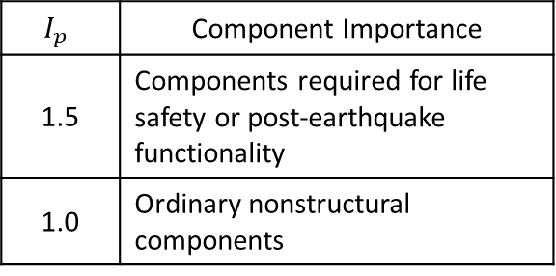
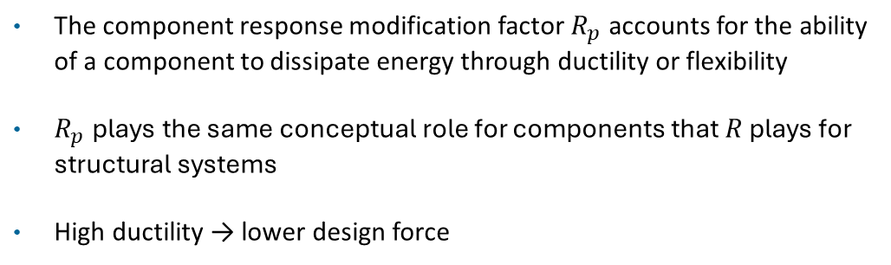
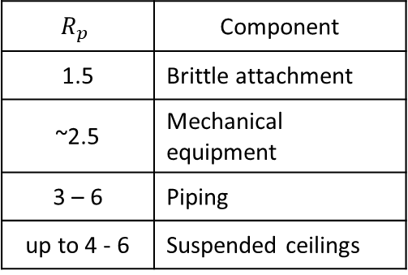
Vibrationdata
Importance & Response Factors
$$I_{p}$$ | Component Importance
1.5 | Components required for life safety or post-earthquake functionality
1.0 | Ordinary nonstructural components
$$R_{p}$$ | Component
1.5 | Brittle attachment
~2.5 | Mechanical equipment
3 – 6 | Piping
up to 4 - 6 | Suspended ceilings
The component response modification factor $R_{p}$ accounts for the ability of a component to dissipate energy through ductility or flexibility
$R_{p}$ ​plays the same conceptual role for components that $R$ plays for structural systems
High ductility → lower design force

Slide 15
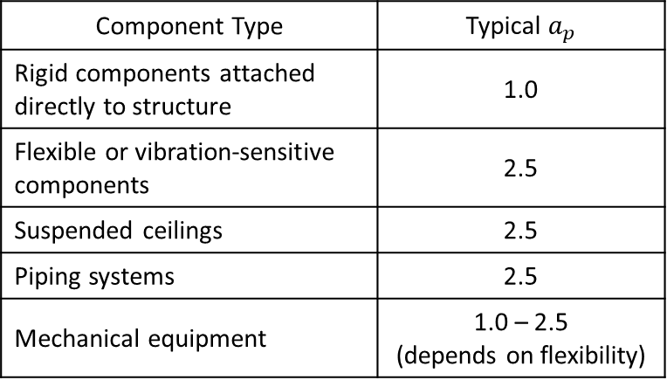
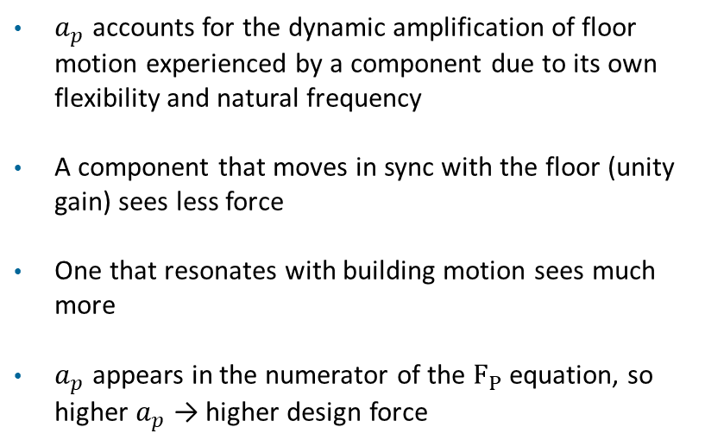
Vibrationdata
Amplification Factor
$a_{p}$ accounts for the dynamic amplification of floor motion experienced by a component due to its own flexibility and natural frequency
A component that moves in sync with the floor (unity gain) sees less force
One that resonates with building motion sees much more
$a_{p}$ appears in the numerator of the $F_{P}$ equation, so higher $a_{p}$ → higher design force
Component Type | Typical $a_{p}$
Rigid components attached directly to structure | 1.0
Flexible or vibration-sensitive components | 2.5
Suspended ceilings | 2.5
Piping systems | 2.5
Mechanical equipment | 1.0 – 2.5 (depends on flexibility)

Slide 16

Vibrationdata
Rigid $a_{p}$ = 1.0
A component is considered rigid when its fundamental period Tp < 0.06 seconds (natural frequency > ~17 Hz)
At this stiffness, the component moves essentially as a single unit with the floor — no dynamic amplification occurs
The floor acceleration is transmitted directly to the component without magnification
Mechanical / Electrical Equipment
  Small rigid pumps
  Air compressors
  Rigid heat exchangers
  Electric motors
  Diesel generators (rigidly mounted)
  Plumbing Equipment
  Water heaters
  Pressure vessels
  Small storage tanks rigidly mounted
  Boilers
Electrical Equipment
  Rigid electrical cabinets
  Motor control centers
  Transformers (floor-mounted, rigid)
Architectural / Miscellaneous
  Rigid steel stairways
  Elevator machinery
  Rigidly mounted industrial machines

Slide 17
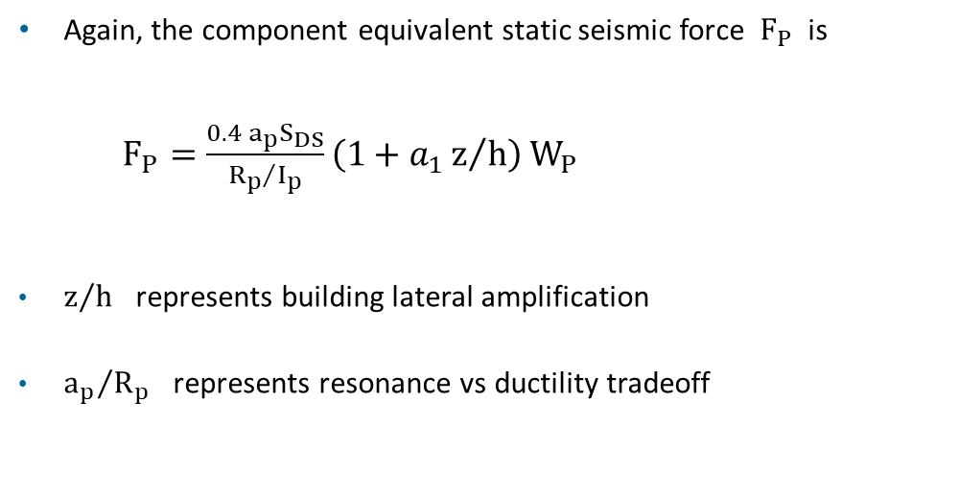
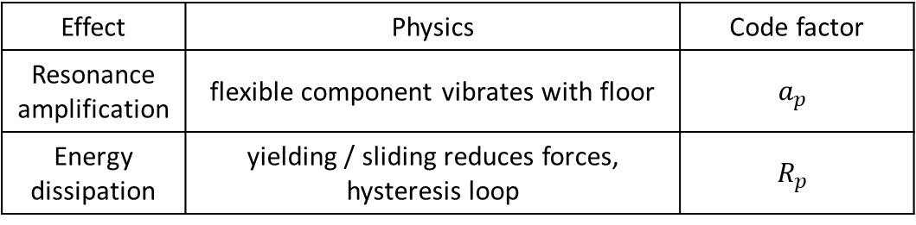
Vibrationdata
Seismic Design Force for Components (cont)
Again, the component equivalent static seismic force $F_{P}$ is
$F_{P}=\frac{{0.4 a}_{p}S_{DS}}{{R_{p}}/{I_{p}}}\left(1+a_{1}z/h\right){ W}_{P}$​
$z/h$ represents building lateral amplification
${a_{p}}/{R_{p}}$ represents resonance vs ductility tradeoff
  a₁ = 2.5 for a one-story structure
  a₁ = 2.0 for a two-or-more story structure
Effect | Physics | Code factor
Resonance amplification | flexible component vibrates with floor | $$a_{p}$$
Energy dissipation | yielding / sliding reduces forces, hysteresis loop | $$R_{p}$$

Slide 18
Energy Interpretation
Elastic system:
  Earthquake energy → stored as elastic strain → large forces
Ductile system:
  Earthquake energy → plastic deformation + friction → smaller forces
Seismic design codes intentionally allow controlled damage because ductility dissipates earthquake energy

Slide 19
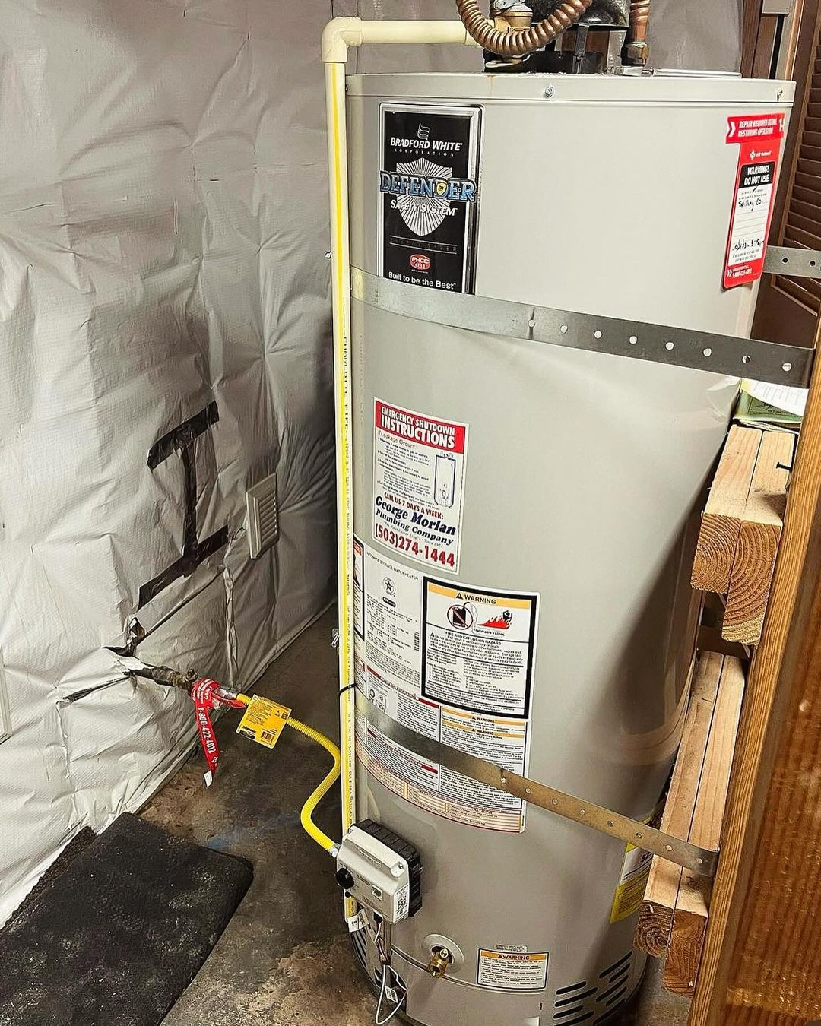
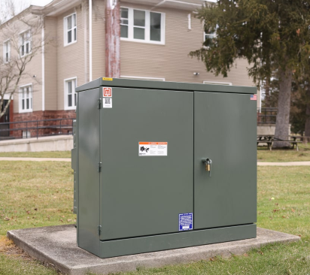
Rigid Examples
Water heat with seismic restraint straps
https://buyersask.com/strapping-of-water-heaters-for-earthquakes-3892
https://www.maddox.com/resources/articles/cast-resin

Slide 20

Vibrationdata
Flexible & Sensitive Components $a_{p}$ = 2.5
Components that deform significantly under vibration
Components with low stiffness or long natural periods
Equipment whose function is affected by vibration
Systems that can amplify motion relative to the supporting structure
Mechanical Systems
  HVAC equipment mounted on spring isolators
  Air handling units (AHUs) with flexible supports
  Cooling towers on vibration isolators
  Large suspended ductwork
  Flexible piping systems with long unsupported spans
Electrical and Instrumentation Equipment
  Sensitive laboratory instruments
  Control panels with delicate electronics
  Computer servers or racks
  Medical imaging equipment (MRI, CT scanners)
Architectural Components
  Large suspended ceilings
  Pendant lighting systems
  Flexible partition walls
  Long-span cable-supported elements
Industrial Equipment
  Precision manufacturing machines
  Optical instruments
  Semiconductor fabrication tools
  Metrology equipment

Slide 21

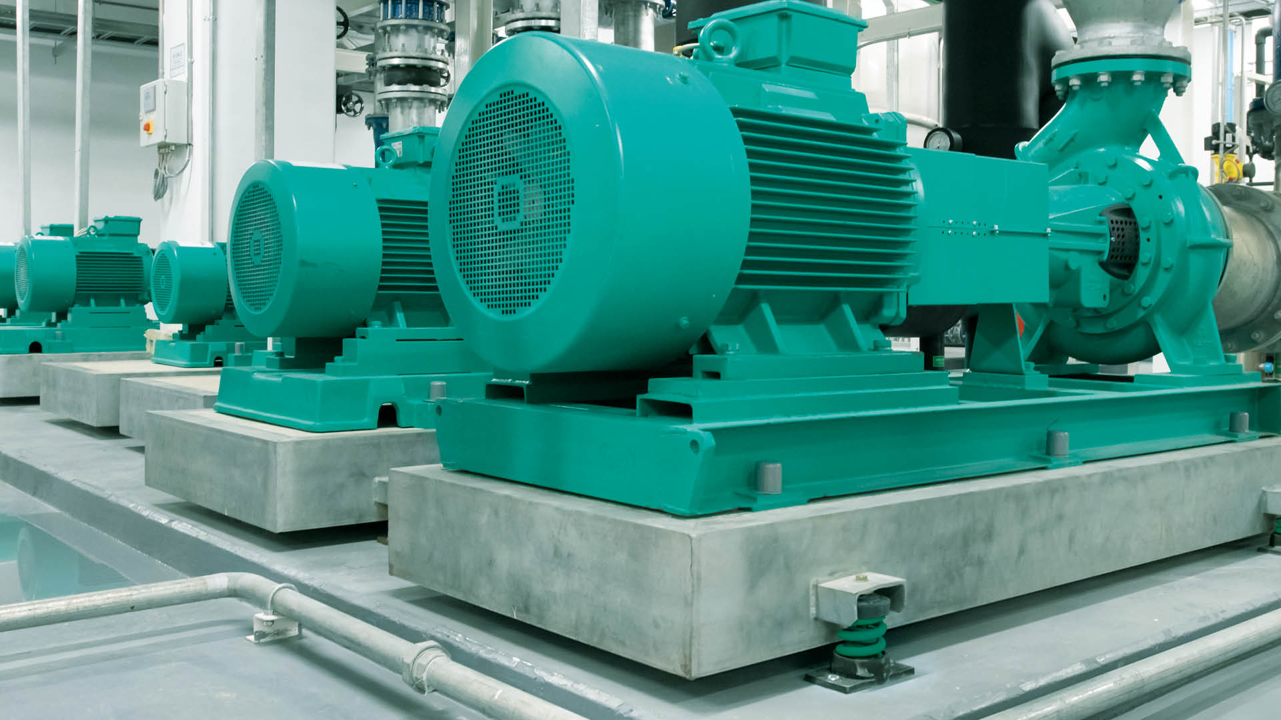
Flexible & Sensitive Examples
The equipment is mounted via isolators to reduce the dynamic forces transmitted to the floor
https://www.walraven.com/en/about-walraven/news/basics-of-vibration-isolation/
https://www.myssmi.com/blog/mri-101-preparing-for-your-first-scan-with-ease

Slide 22

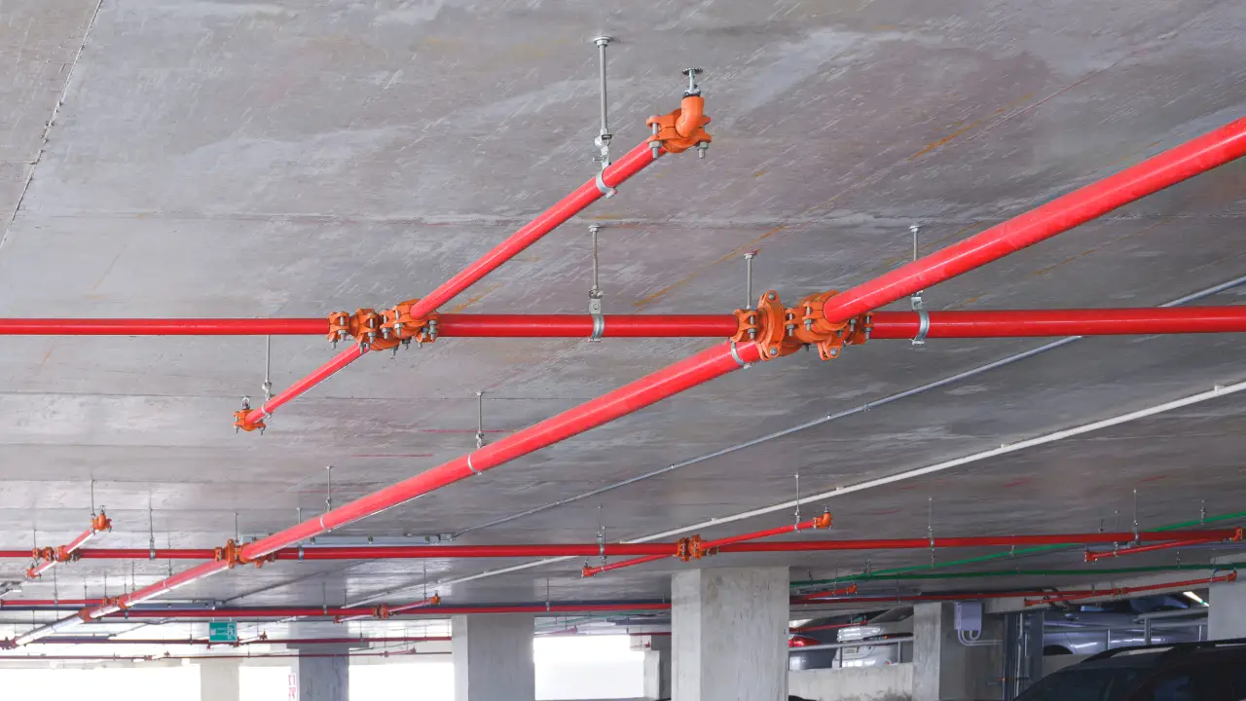
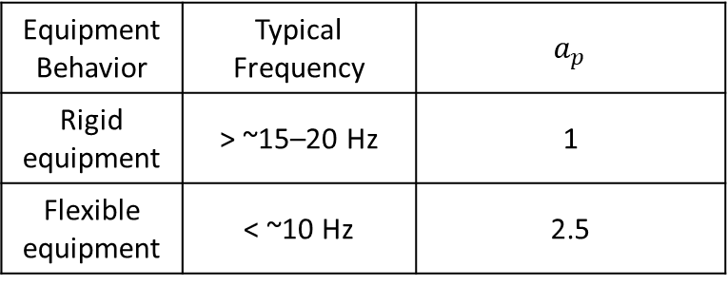
Vibrationdata
Amplification Factor & Natural Frequency
Equipment Behavior | Typical Frequency | $a_{p}$
Rigid equipment | > ~15–20 Hz | 1
Flexible equipment | < ~10 Hz | 2.5
Component | Equipment Behavior | Typical Frequency
Small rigid equipment | Rigid | 20–40 Hz
Suspended ceiling | Flexible | 1–5 Hz
Long piping | Flexible | 2–8 Hz

Slide 23
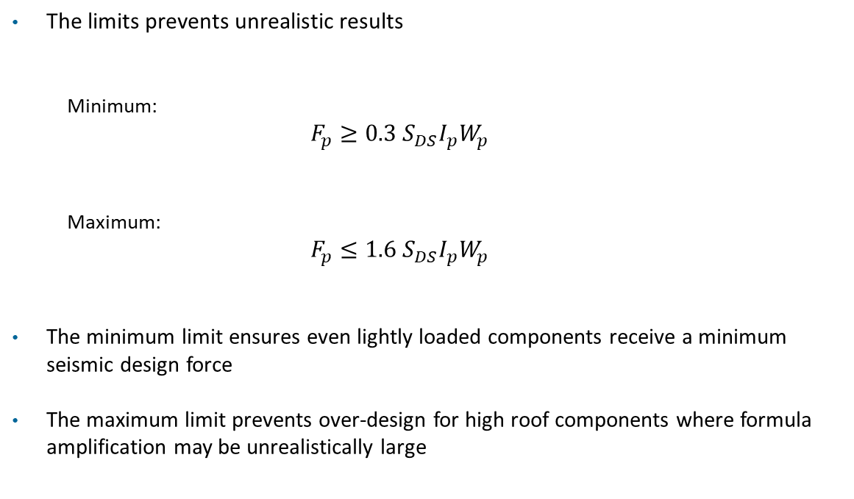
Vibrationdata
Force Limits
The limits prevents unrealistic results
  Minimum:
  $$F_{p}≥0.3 S_{DS}I_{p}W_{p}$$
  Maximum:
  $$F_{p}≤1.6{ S}_{DS}I_{p}W_{p}$$
The minimum limit ensures even lightly loaded components receive a minimum seismic design force
The maximum limit prevents over-design for high roof components where formula amplification may be unrealistically large

Slide 24
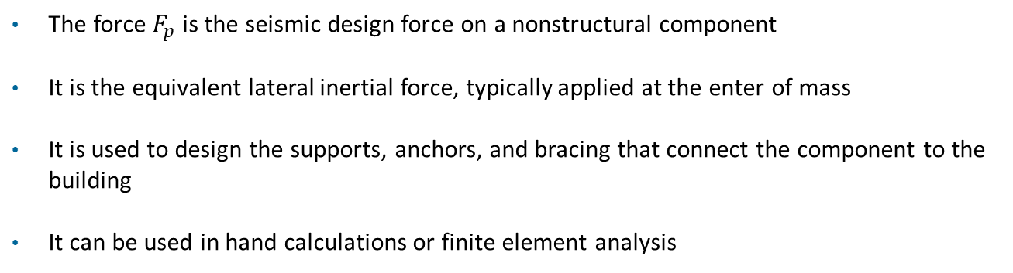

Why is the Design Force $F_{P}$Useful?
The force $F_{p}$ is the seismic design force on a nonstructural component
It is the equivalent lateral inertial force, typically applied at the enter of mass
It is used to design the supports, anchors, and bracing that connect the component to the building
It can be used in hand calculations or finite element analysis

Slide 25
Design Force Limit Examples
Typical checks:
  bolt tension
  bolt shear
  brace axial force
  sliding
  overturning
Used for:
  equipment anchorage
  piping bracing
  ceiling systems
  support frames
  complex piping systems
  large mechanical units

Slide 26
Output Metrics & Design Checks
Metric | Used for
Bolt shear force | anchor bolt design
Bolt tension | uplift / overturning
Brace axial force | sway brace sizing
Frame stresses | support structure design
Displacement | clearance / impact checks
Anchorage checks
  anchor tension
  anchor shear
  combined tension + shear
Usually per:
  ACI 318 anchor design
  steel bolt design provisions

Slide 27

Stability Checks
Stability checks
Sliding
$$F_{p}≤μW$$
Overturning
$$M_{resisting}>M_{seismic}$$
Brace capacity
Check:
$$P_{brace}≤P_{allowable}$$
for rods, angles, or struts.

Slide 28
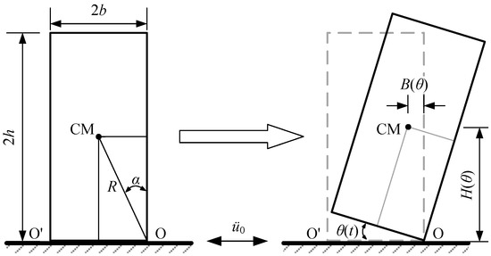
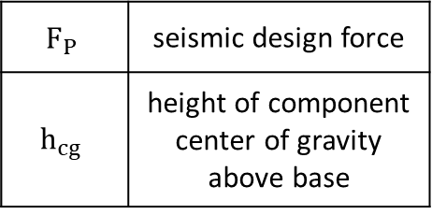
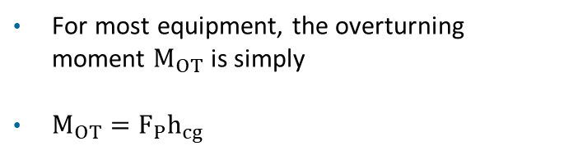
Overturning Moment
For most equipment, the overturning moment $M_{OT}$ is simply
$M_{OT}=F_{P}h_{cg}$
$$F_{P}$$ | seismic design force
$$h_{cg}$$ | height of component center of gravity above base
Freestanding rigid block, rocking-overturning fragility
https://www.mdpi.com/2071-1050/15/6/4945

Slide 29

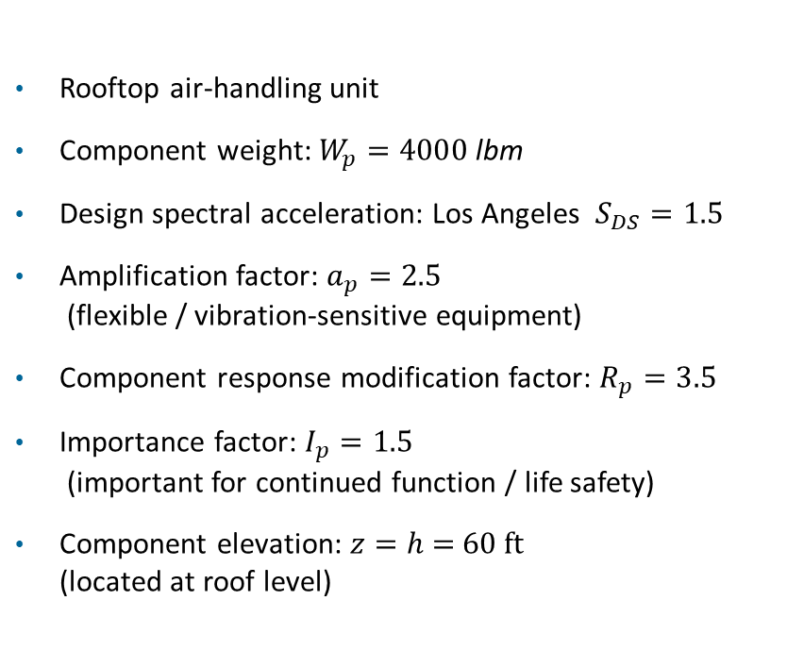
Example
Rooftop air-handling unit
Component weight: $W_{p}=4000 \text{l}\text{bm}$
Design spectral acceleration: Los Angeles $S_{DS}=1.5$
Amplification factor: $a_{p}=2.5$
(flexible / vibration-sensitive equipment)
Component response modification factor: $R_{p}=3.5$
Importance factor: $I_{p}=1.5$
(important for continued function / life safety)
Component elevation: $z=h$ = 60 ft
(located at roof level)
The equivalent static seismic force $F_{P}$ acting on the component is
$F_{P}=\frac{{0.4 a}_{p}S_{DS}}{{R_{p}}/{I_{p}}}\left(1+a_{1}z/h\right){ W}_{P}$​

Slide 30
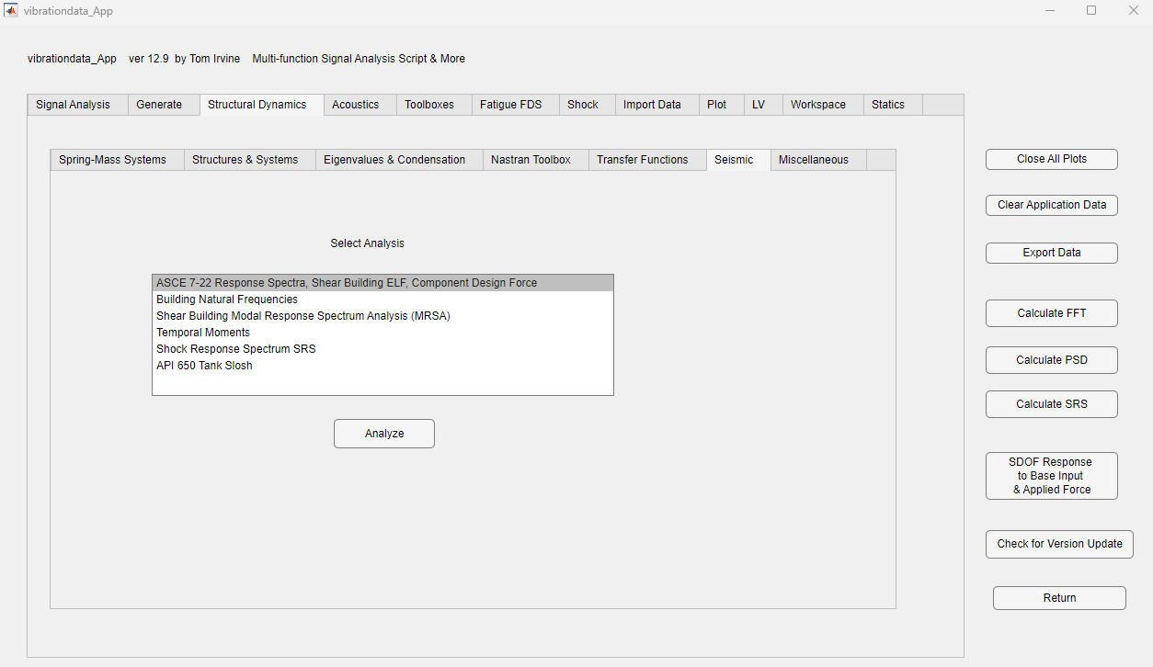
Example
Vibrationdata

Slide 31
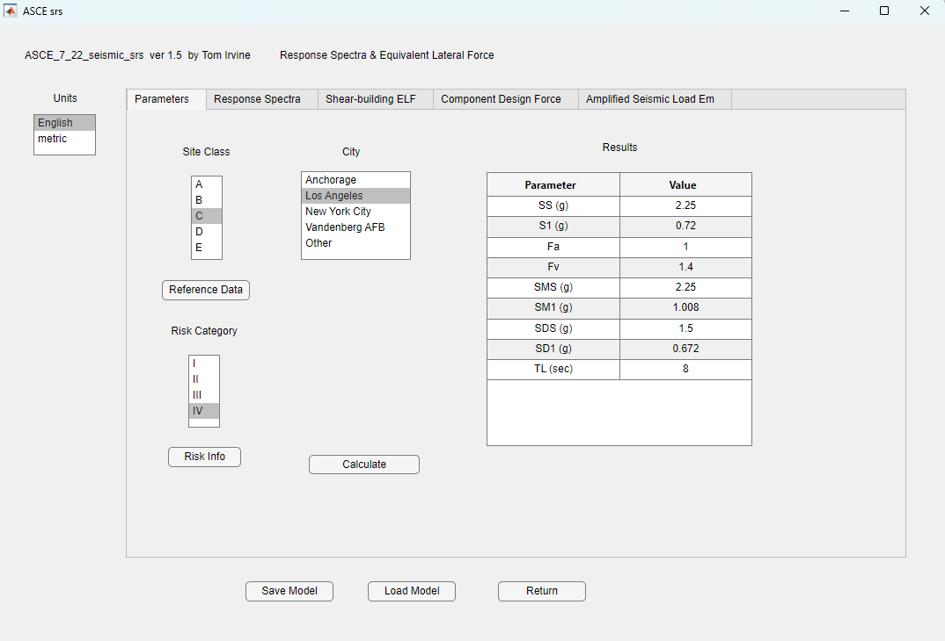

Slide 32
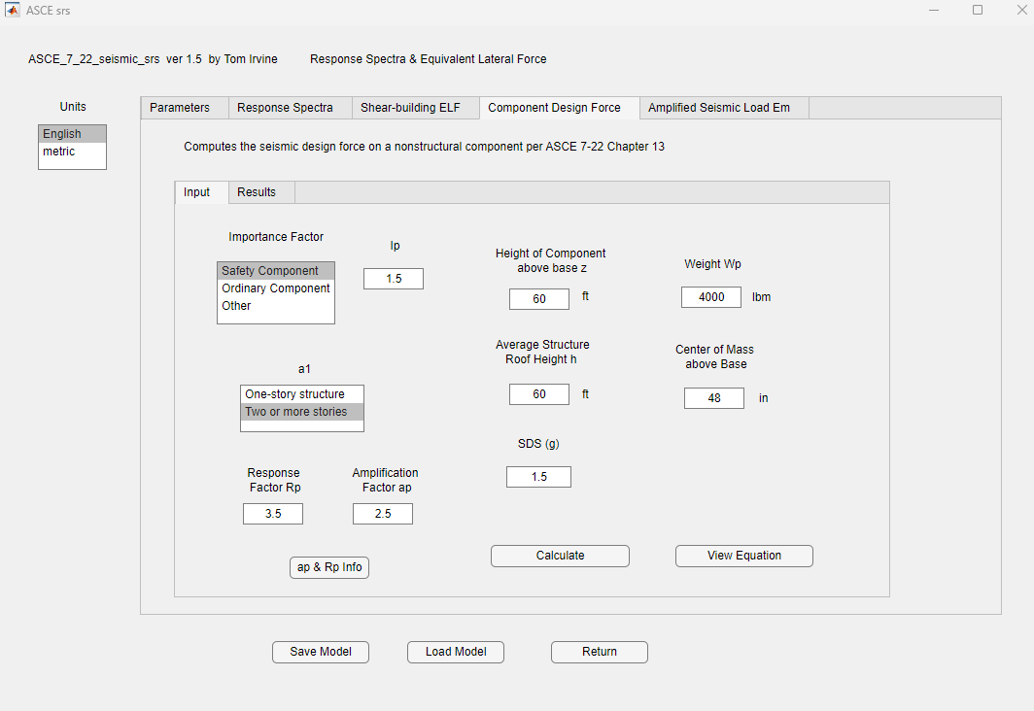

Slide 33
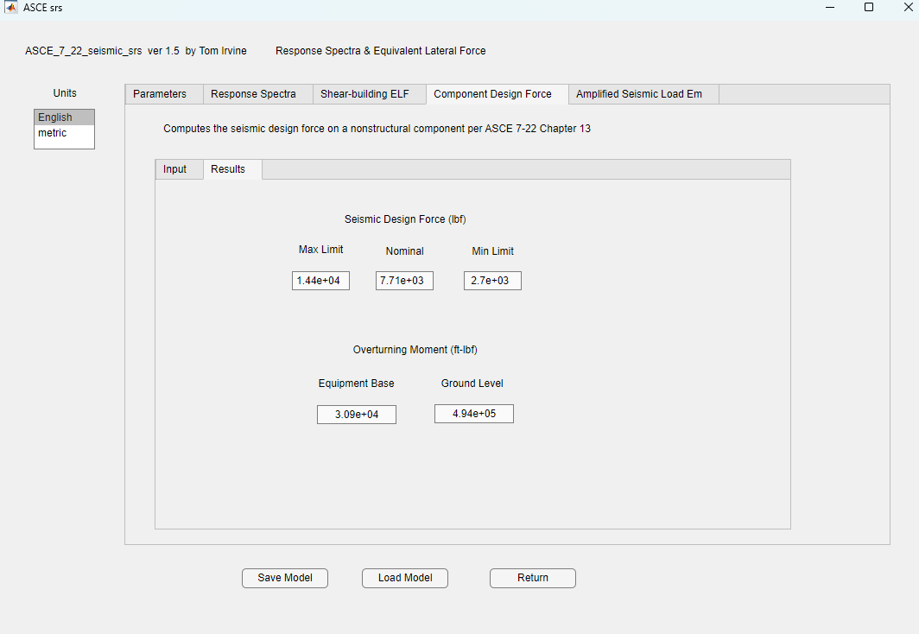

Slide 34
Results
This means the air handling unit AHU and its anchorage/bracing should be designed for a horizontal equivalent static seismic force of about 5.1 kips applied at the component center of mass
That force can then be used for:
  Anchor bolt shear and tension
  Brace design
  Support frame stress
  Sliding check
  Overturning check

