Slide 1
Vibrationdata
Multi-degree-of-freedom System
Shock Response Spectrum
Revision D

Slide 2
Introduction
Vibrationdata
The Shock Response Spectrum (SRS) can be extended to multi-degree-of-freedom systems
There are two options each requires a starting normal modes analysis
  Modal transient analysis using synthesized waveform
  Approximation techniques using participation factors and normal modes (modal combination methods)
The second method is called Modal Response Spectrum Analysis (MRSA) in earthquake engineering
It is a dynamic analysis method used in seismic design, including procedures referenced in ASCE 7-22 Chapter 12
Both method assume linearity

Slide 3
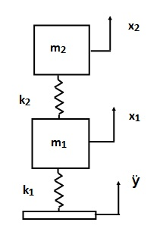
Two-dof System Subjected to Base Excitation
Vibrationdata
Damping will be applied as modal damping

Slide 4


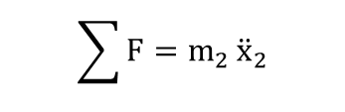
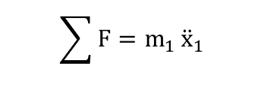
Free-Body Diagrams
k₂ ( x₂ - x₁ )
x₂
m₂
x₁
m₁
k₂ (x₂-x₁)
k₁ ( x₁ - y )
$$\sum{F=m_{1}}{\ddot{x}}_{1}$$
$$\sum{F=m_{2}}{\ddot{x}}_{2}$$
$$m_{1}{\ddot{x}}_{1}{+\left(k_{1}+k_{2}\right)x}_{1}−k_{2}x_{2}=k_{1}y$$
$$m_{2}{\ddot{x}}_{2}{+k_{2}x}_{2}−k_{2}x_{1}=0$$

Slide 5
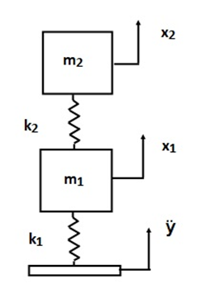

Global Equations of Motion
Vibrationdata
Assemble the equations in matrix form
The equations are coupled via the stiffness matrix
$$\left[\begin{matrix}m_{1} & 0 \\ 0 & m_{2}\end{matrix}\right]\left[\begin{matrix}{\ddot{x}}_{1} \\ {\ddot{x}}_{2}\end{matrix}\right]+\left[\begin{matrix}k_{1}+k_{2} & −k_{2} \\ −k_{2} & k_{2}\end{matrix}\right]\left[\begin{matrix}x_{1} \\ x_{2}\end{matrix}\right]=\left[\begin{aligned}k_{1}y \\ \begin{matrix} \\ 0\end{matrix}\end{aligned}\right]$$

Slide 6


Relative Displacement Substitution
Vibrationdata
Define relative displacement terms as follows
$$x_{1}=z_{1}+y$$
This works for some simple systems. Enforced acceleration method is required for other systems.
$$x_{2}=z_{2}+y$$
The resulting equation of motion is
$$\left[\begin{matrix}m_{1} & 0 \\ 0 & m_{2}\end{matrix}\right]\left[\begin{matrix}{\ddot{z}}_{1} \\ {\ddot{z}}_{2}\end{matrix}\right]+\left[\begin{matrix}k_{1}+k_{2} & −k_{2} \\ −k_{2} & k_{2}\end{matrix}\right]\left[\begin{matrix}z_{1} \\ z_{2}\end{matrix}\right]=\left[\begin{aligned}{−m}_{1}\ddot{y} \\ {−m}_{2}\ddot{y}\begin{matrix} \\ \end{matrix}\end{aligned}\right]$$

Slide 7


General Form
Vibrationdata
$M \overline{\ddot{z}}+K \overline{z}=\overline{F}$
where
$$M=\left[\begin{matrix}m_{1} & 0 \\ 0 & m_{2}\end{matrix}\right], K=\left[\begin{matrix}k_{1}+k_{2} & −k_{2} \\ −k_{2} & k_{2}\end{matrix}\right], \overline{F}=\left[\begin{aligned}{−m}_{1}\ddot{y} \\ {−m}_{2}\ddot{y}\begin{matrix} \\ \end{matrix}\end{aligned}\right]$$

Slide 8
Decoupling
Vibrationdata
Decouple equation of motion using eigenvalues and eigenvectors
The natural frequencies are calculated from the eigenvalues
The eigenvectors are the “orthogonal normal modes”
Details given in accompanying reference papers

Slide 9

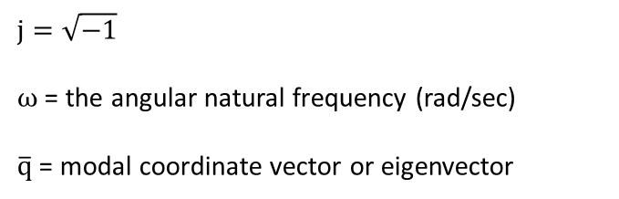
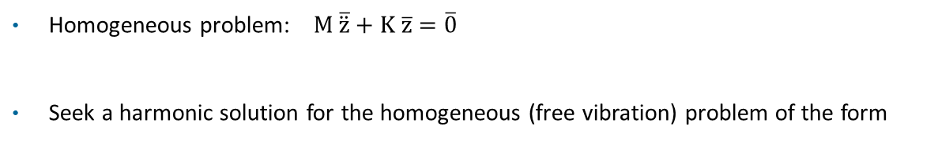
Proposed Solution
Vibrationdata
Homogeneous problem: $M \overline{\ddot{z}}+K \overline{z}=\overline{0}$
Seek a harmonic solution for the homogeneous (free vibration) problem of the form
$$\bar{z}=\bar{q}\exp\left(jωt\right)$$
where
$$j=\sqrt{−1}$$
ω = the angular natural frequency (rad/sec)
$\overline{q}$= modal coordinate vector or eigenvector

Slide 10


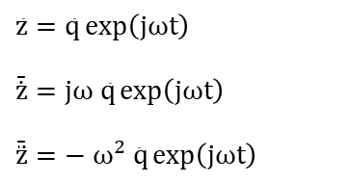

Solution Development
Vibrationdata
The solution and its derivatives are
$$\bar{z}=\bar{q}\exp\left(jωt\right)$$
$$\bar{\dot{z}}=jω \bar{q}\exp\left(jωt\right)$$
$$\bar{\ddot{z}}=− ω^{2}\bar{ q}\exp\left(jωt\right)$$
Substitute into the homogeneous equation of motion
$M \overline{\ddot{z}}+K \overline{z}=\overline{0}$
$$−ω^{2}M \bar{q}\exp\left(jωt\right)+K\bar{q}\exp\left(jωt\right)=\bar{0}$$
$$\left\{−ω^{2}M+K\right\}\bar{q}\exp\left(jωt\right)=\bar{0}$$

Slide 11

Generalized Eigenvalue Problem
Vibrationdata
Eigenvalues $ω^{2}$ are calculated via
$$\det{ }\left\{ K−ω^{2}M \right\} =0$$
where
K is the global stiffness matrix
M is the global mass matrix
ω is the angular natural frequency (rad/sec)
There is a natural frequency for each degree-of-freedom

Slide 12

Solve for Eigenvalues
Vibrationdata
Find the eigenvalues by setting the determinant equal to zero
$$det\left\{K−ω^{2}M\right\}=0$$
$\det\left\{\left[\begin{matrix}k_{1}+k_{2} & −k_{2} \\ −k_{2} & k_{2}\end{matrix}\right]−ω^{2}\left[\begin{matrix}m_{1} & 0 \\ 0 & m_{2}\end{matrix}\right]\right\}=0$
$$\det\left\{\left[\begin{matrix}\left(k_{1}+k_{2}\right)−ω^{2}m_{1} & −k_{2} \\ −k_{2} & k_{2}−ω^{2}m_{2}\end{matrix}\right]\right\}=0$$
$$\left[\left(k_{1}+k_{2}\right)−ω^{2}m_{1}\right]\left[k_{2}−ω^{2}m_{2}\right]−{k_{2}}^{2}=0$$
The roots ω₁² and ω₂² are the squares of the angular natural frequencies (rad/sec)
Polynomial solutions are available for up to 4-dof systems
Numerical methods are used for higher dof systems

Slide 13


Generalized Eigenvalue Problem (cont)
Vibrationdata
Calculate eigenvectors $\bar{q}$
$$\left\{ K−ω^{2}M \right\}\bar{q}=\bar{0}$$
The eigenvectors describe the relative displacements of the degrees-of-freedom for each mode
The overall motion of the system is a superposition of the individual modes for the case of free vibration (aka modal superposition)
There is a corresponding mode shape for each natural frequency

Slide 14


Eigenvector Relationship
Vibrationdata
Form matrix from eigenvectors
Column 1 is mode 1
Column 2 is mode 2
Row 1 is dof 1
Row 2 is dof 2
Each eigenvector has an arbitrary scale factor
But mass-normalize the eigenvectors such that
${\hat{Q}}^{T}M\hat{Q}=I$ (identity matrix)
Then
${\hat{Q}}^{T}K\hat{Q}=Ω2$ (diagonal matrix of eigenvalues)

Slide 15

Decouple Equation of Motion
Vibrationdata
Coupled equation of motion
$M \overline{\ddot{z}}+K \overline{z}=\overline{F}$
Define a modal displacement coordinate $\bar{η}$
$\bar{z}=\hat{Q} \bar{η}$
Substitute into the equation of motion
$M \hat{Q }\overline{\ddot{η}} + K \hat{Q }\overline{η}= \overline{F}$
Premultiply by ${\hat{Q}}^{T}$
${\hat{Q} }^{T}M \hat{Q }\overline{\ddot{η}} + {\hat{Q} }^{T}K \hat{Q }\overline{η}= {\hat{Q} }^{T}\overline{F}$
Orthogonality relationships yields
$I \overline{\ddot{η}}+ Ω2 \overline{η}= {\hat{Q} }^{T}\overline{F}$

Slide 16
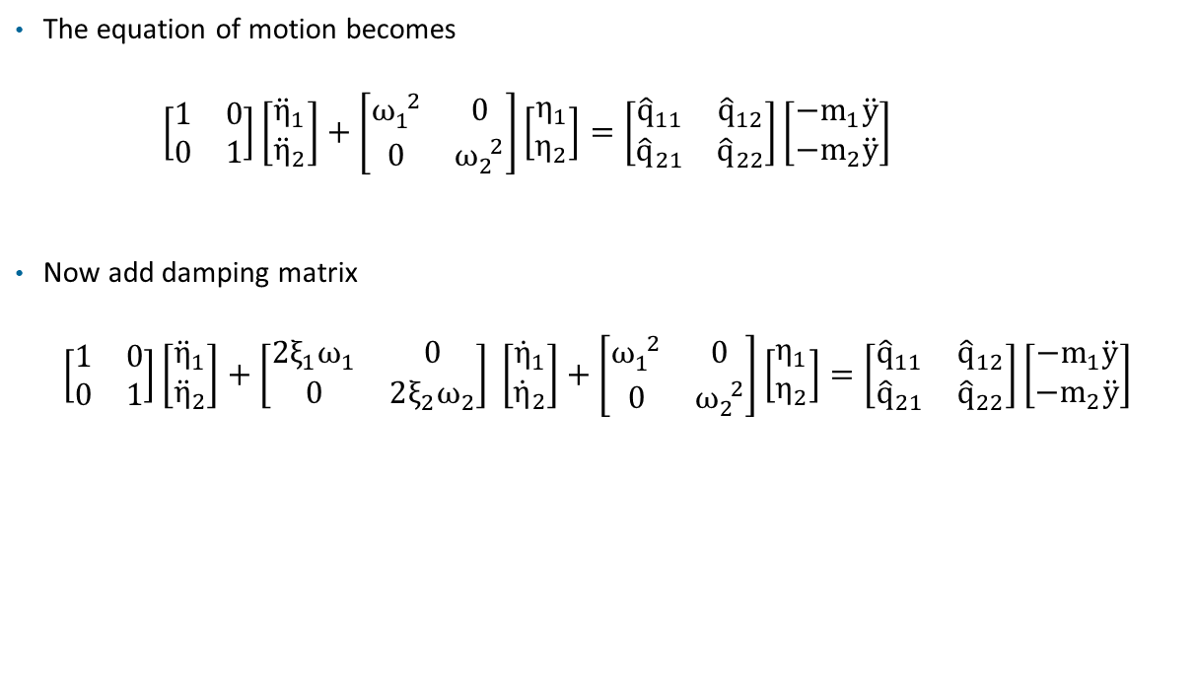

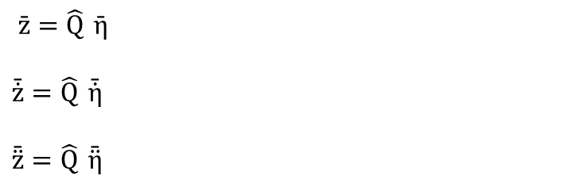
Modal Equations of Motion
Vibrationdata
The equation of motion becomes
$\left[\begin{matrix}1 & 0 \\ 0 & 1\end{matrix}\right]\left[\begin{matrix}{\ddot{η}}_{1} \\ {\ddot{η}}_{2}\end{matrix}\right]+\left[\begin{matrix}ω_{1}^{ 2} & 0 \\ 0 & ω_{2}^{ 2}\end{matrix}\right]\left[\begin{matrix}η_{1} \\ η_{2}\end{matrix}\right]=\left[\begin{matrix}{\hat{q}}_{11} & {\hat{q}}_{12} \\ {\hat{q}}_{21} & {\hat{q}}_{22}\end{matrix}\right]\left[\begin{matrix}{−m}_{1}\ddot{y} \\ −m_{2}\ddot{y}\end{matrix}\right]$
Now add damping matrix
$$\left[\begin{matrix}1 & 0 \\ 0 & 1\end{matrix}\right]\left[\begin{matrix}{\ddot{η}}_{1} \\ {\ddot{η}}_{2}\end{matrix}\right]+\left[\begin{matrix}2ξ_{1}ω_{1} & 0 \\ 0 & 2ξ_{2}ω_{2}\end{matrix}\right] \left[\begin{matrix}{\dot{η}}_{1} \\ {\dot{η}}_{2}\end{matrix}\right]+\left[\begin{matrix}ω_{1}^{ 2} & 0 \\ 0 & ω_{2}^{ 2}\end{matrix}\right]\left[\begin{matrix}η_{1} \\ η_{2}\end{matrix}\right]=\left[\begin{matrix}{\hat{q}}_{11} & {\hat{q}}_{12} \\ {\hat{q}}_{21} & {\hat{q}}_{22}\end{matrix}\right]\left[\begin{matrix}{−m}_{1}\ddot{y} \\ −m_{2}\ddot{y}\end{matrix}\right]$$
$ξ_{i}$ is the modal damping for mode i
$$x_{1}=z_{1}+y$$
$$x_{2}=z_{2}+y$$
$\bar{z}=\hat{Q} \bar{η}$
$$\bar{\dot{z}}=\hat{Q} \bar{\dot{η}}$$
$$\bar{\ddot{z}}=\hat{Q} \bar{\ddot{η}}$$

Slide 17
Candidate Methods, Time Domain
Vibrationdata
Runge-Kutta - becomes numerically unstable for “stiff” systems
Newmark-Beta - reasonably good – favorite of Structural Dynamics textbooks
Digital recursive filtering relationship - best choice but requires constant time step

Slide 18
Participation Factors
Vibrationdata
Participation factors and effective modal mass values can be calculated from the eigenvectors and mass matrix
These factors represent how “excitable” each mode is for base excitation
Please read:
https://blog.vibrationdata.com/2026/02/07/effective-modal-mass-and-modal-participation-factors/

Slide 19
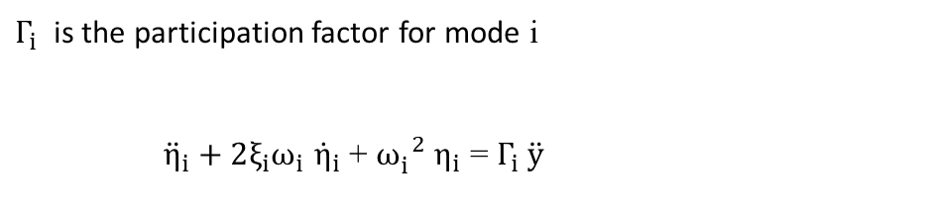
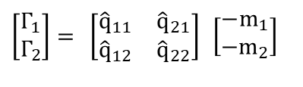
Participation Factors for Example
Vibrationdata
$$\left[\begin{matrix}1 & 0 \\ 0 & 1\end{matrix}\right]\left[\begin{matrix}{\ddot{η}}_{1} \\ {\ddot{η}}_{2}\end{matrix}\right]+\left[\begin{matrix}2ξ_{1}ω_{1} & 0 \\ 0 & 2ξ_{2}ω_{2}\end{matrix}\right] \left[\begin{matrix}{\dot{η}}_{1} \\ {\dot{η}}_{2}\end{matrix}\right]+\left[\begin{matrix}ω_{1}^{ 2} & 0 \\ 0 & ω_{2}^{ 2}\end{matrix}\right]\left[\begin{matrix}η_{1} \\ η_{2}\end{matrix}\right]=\left[\begin{matrix}{\hat{q}}_{11} & {\hat{q}}_{12} \\ {\hat{q}}_{21} & {\hat{q}}_{22}\end{matrix}\right]\left[\begin{matrix}{−m}_{1}\ddot{y} \\ −m_{2}\ddot{y}\end{matrix}\right]$$
$Γ_{i}$ is the participation factor for mode i
${\ddot{η}}_{i}$ $+ 2ξ_{i}ω_{i}$ ${\dot{η}}_{i}$ + $ω_{i}^{ 2}$ $η_{i}$ = $Γ_{i} \ddot{y}$
For the two-dof example in this unit
$$\left[\begin{matrix}Γ_{1} \\ Γ_{2}\end{matrix}\right]= \left[\begin{matrix}{\hat{q}}_{11} & {\hat{q}}_{21} \\ {\hat{q}}_{12} & {\hat{q}}_{22}\end{matrix}\right] \left[\begin{matrix}−m_{1} \\ −m_{2}\end{matrix}\right]$$

Slide 20
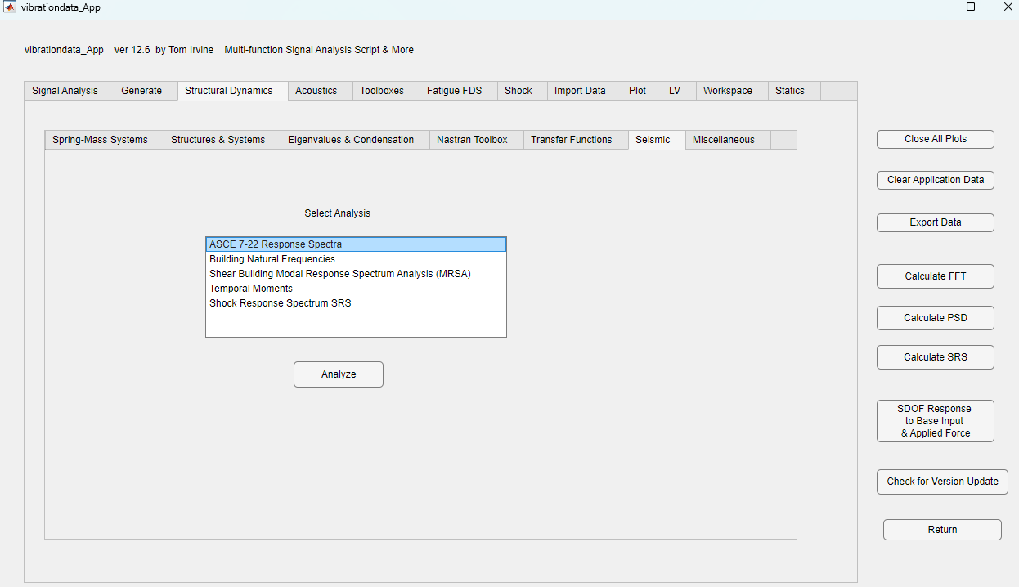

Slide 21
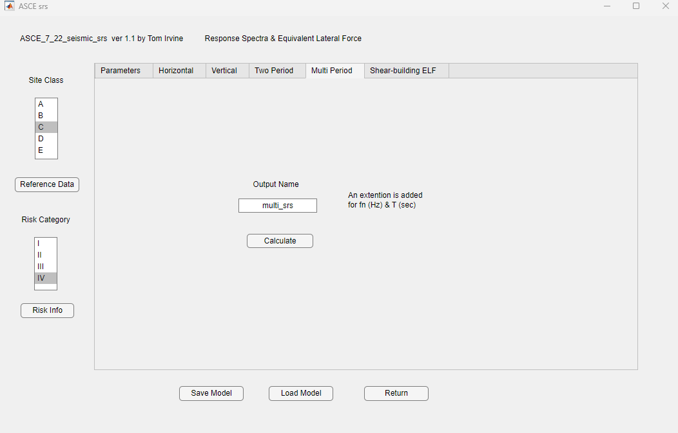

Slide 23
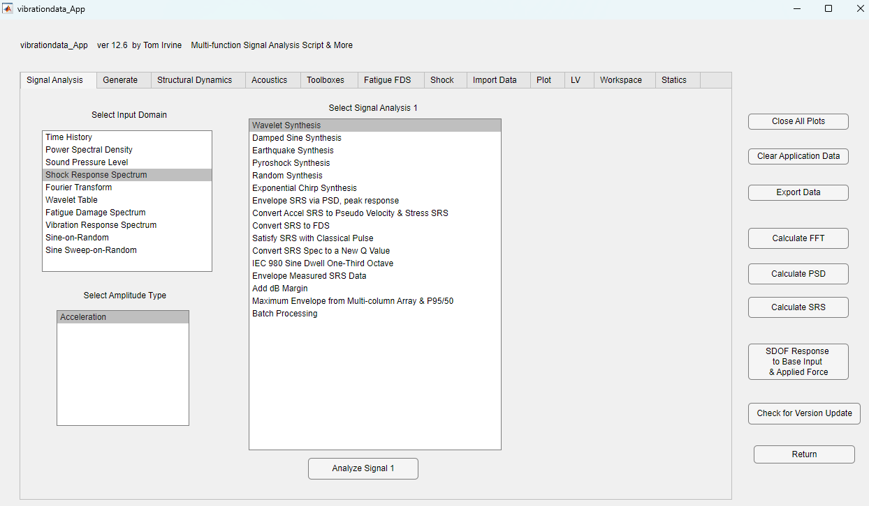

Slide 24
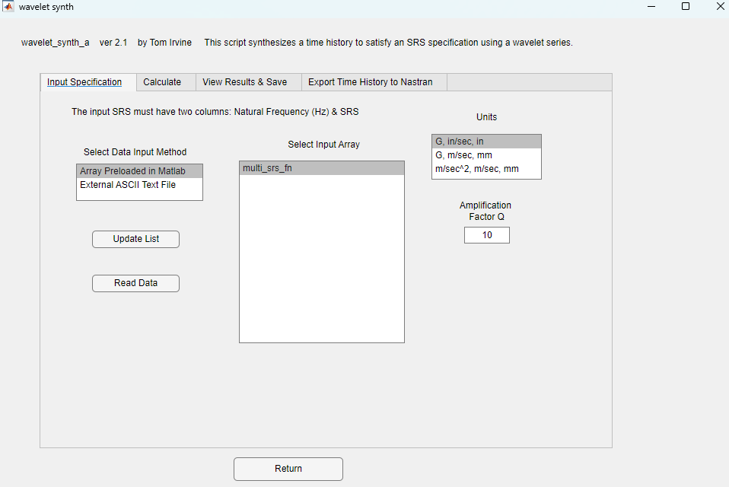
Q=10 is the same
as 5% damping

Slide 25
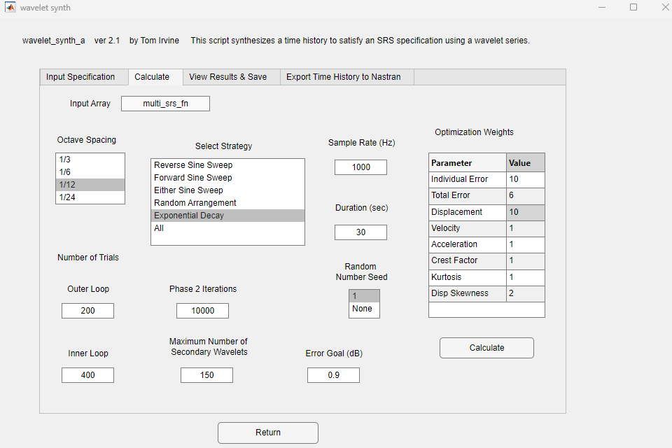

Slide 26
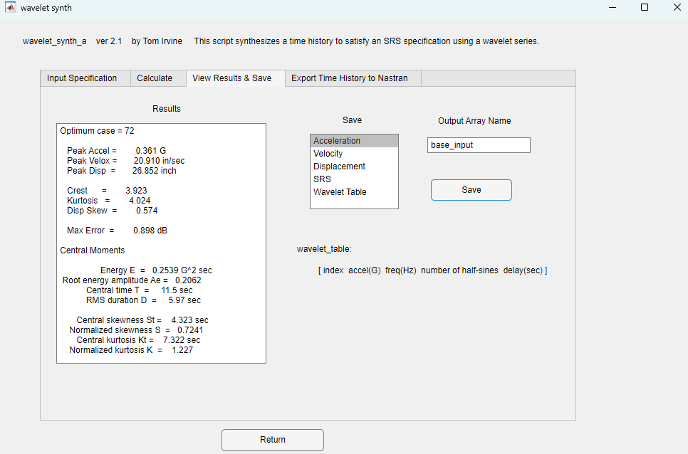

Slide 29
MDOF Estimation for SRS, Modal Combination Methods
Method | Description | Application
ABSSUM | absolute sum method | Highly conservative upper-bound combination
SRSS | square-root-of-the-sum-of-the-squares | Standard for systems with well-separated modal frequencies (Δf/f > 0.2). Appropriate for simple, lightly coupled MDOF structures.
CQC | Complete Quadratic Combination | Preferred for closely spaced modal frequencies or moderate damping (ξ ≈ 0.02–0.10). Recommended by ASCE 7 and IEEE 344 for seismic or dynamic response analyses.
NRL | Naval Research Laboratory method | Used in shock qualification standards (e.g., MIL-STD-810H, MIL-STD-1540). Suitable when empirical data or coupling information is available for transient or SRS testing.

Slide 30


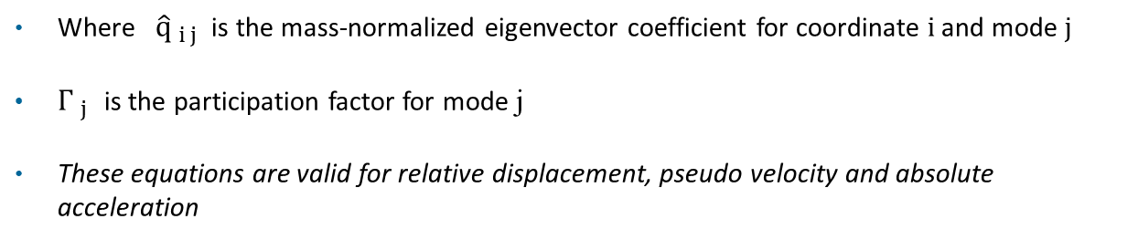

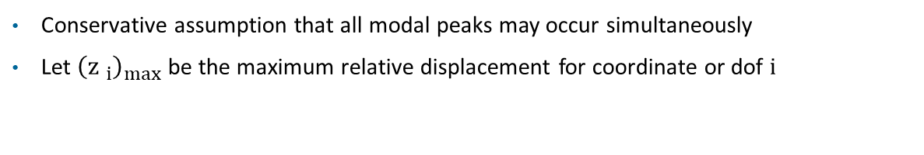
ABSSUM Method
Vibrationdata
Conservative assumption that all modal peaks may occur simultaneously
Let ${\left({z }_{i}\right)}_{max}$ be the maximum relative displacement for coordinate or dof i
$${\left({z }_{i}\right)}_{max} ≤\sum_{j = 1}^{N}{\left|{\hat{q}}_{ i j}\right| \left|{\left({η }_{j}\right)}_{max}\right|}$$
${\left({η }_{j}\right)}_{max}$ = ${ Γ}_{ j}$ ${\left({D }_{j}\right)}_{max}$
Pick D values directly from Relative Displacement SRS curve for mode j’s natural frequency
$${\left({z }_{i}\right)}_{max} ≤\sum_{j = 1}^{N}{\left|{\hat{q}}_{ i j}\right| \left|Γ_{ j}\right| \left|{\left({D }_{j}\right)}_{max}\right|}$$
Where ${\hat{q}}_{ i j}$ is the mass-normalized eigenvector coefficient for coordinate i and mode j
$Γ_{ j}$ is the participation factor for mode j
These equations are valid for relative displacement, pseudo velocity and absolute acceleration

Slide 31
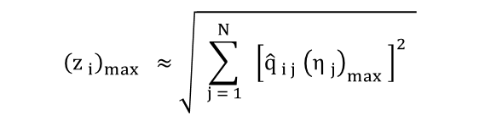
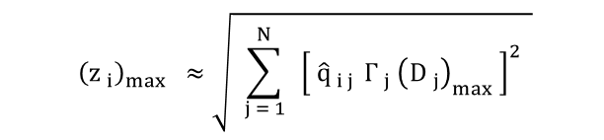
SRSS Method
Vibrationdata
$${\left({z }_{i}\right)}_{max} ≈\sqrt{ \sum_{j = 1}^{N}{ { \left[{\hat{q}}_{ i j} {\left({η }_{j}\right)}_{max} \right]}^{2} }}$$
Pick D values directly off of Relative Displacement SRS curve
$${\left({z }_{i}\right)}_{max} ≈\sqrt{ \sum_{j = 1}^{N}{ { \left[ {\hat{q}}_{ i j }Γ_{ j}{ \left({D }_{j}\right)}_{max} \right]}^{2} }}$$
These equations are valid for relative displacement, pseudo velocity and absolute acceleration

Slide 32
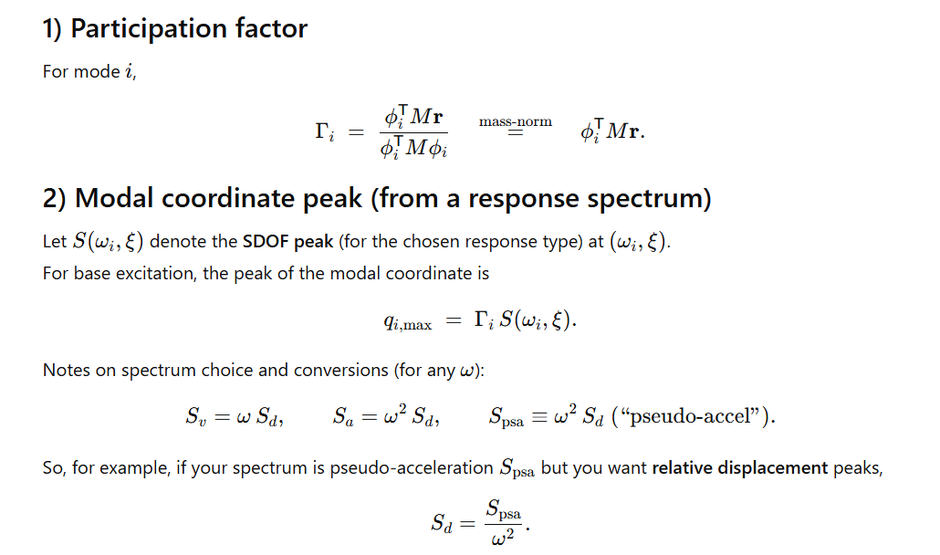
CQC Method
Vibrationdata

Slide 33
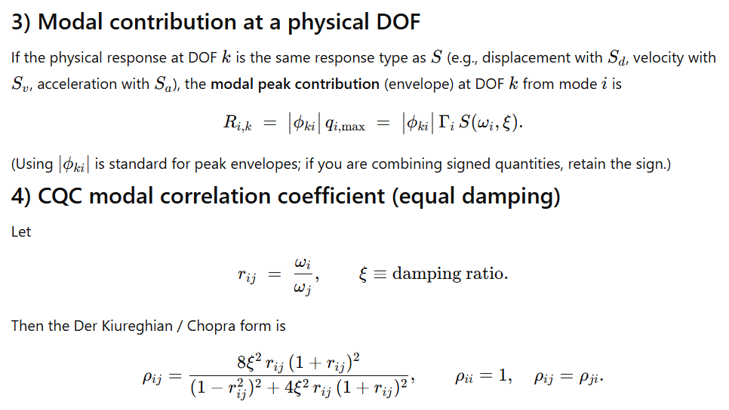
CQC Method (cont)
Vibrationdata

Slide 34
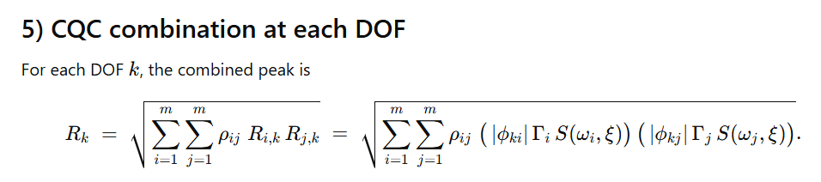
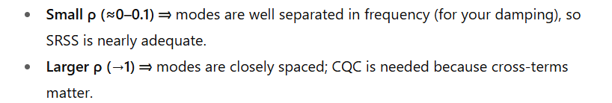
CQC Method (cont)
Vibrationdata
The CQC (Complete Quadratic Combination) method can yield results slightly greater than the ABSSUM (absolute sum) method for very closely spaced modes, although this is rare and limited to extreme correlation cases

Slide 35
Example: 4-dof Shear Building Model
Vibrationdata
x₄
m₄
Story | Mass (lbm) | Stiffness (lbf/in) | Height (ft)
1 | 1.6e6 | 3.5e6 | 15
2 | 1.6e6 | 3.2e6 | 30
3 | 1.6e6 | 2.8e6 | 45
4 | 1.4e6 | 2.4e6 | 60
k₄
m₃
x₃
k₃
x₂
m_{a,2}
m₂
k₂
x₁
m_{a,1}
m₁
5% damping for all modes
Perform normal modes analysis
k₁
ӱ

Slide 36
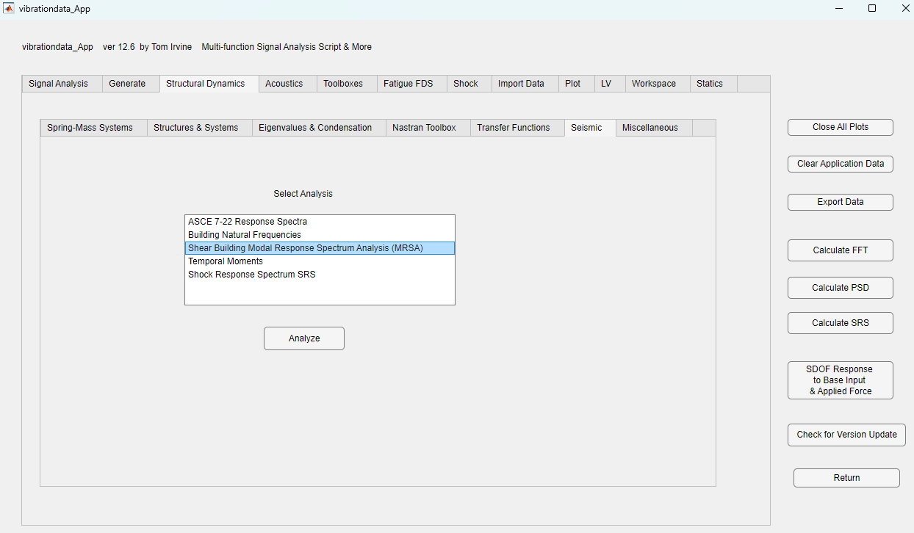

Slide 37
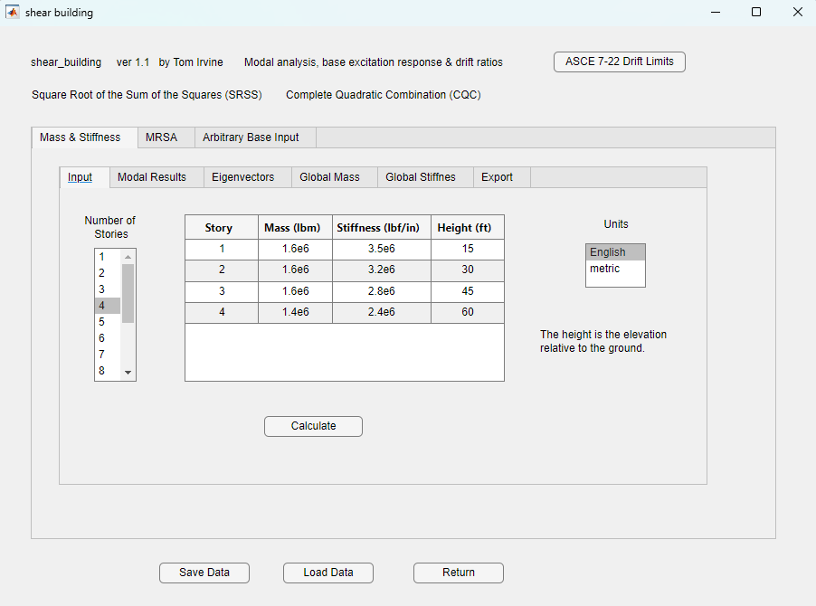

Slide 38
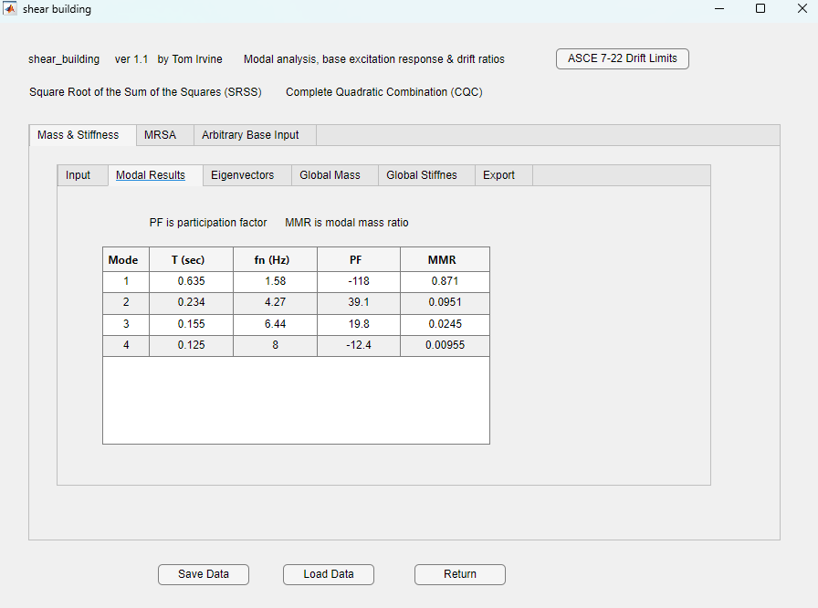

Slide 39
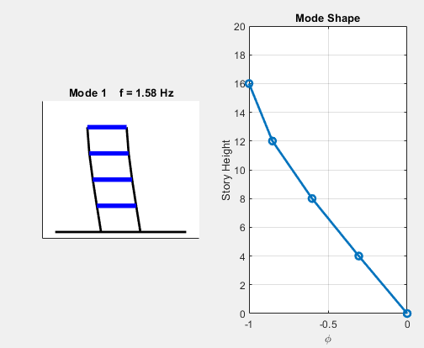

Slide 40
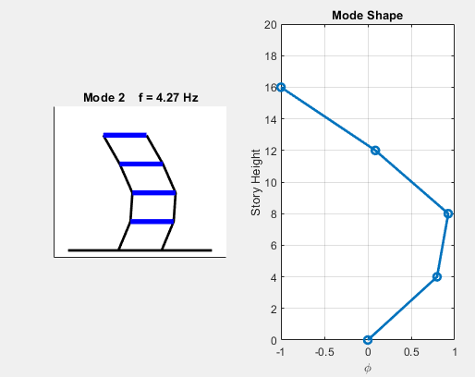

Slide 41
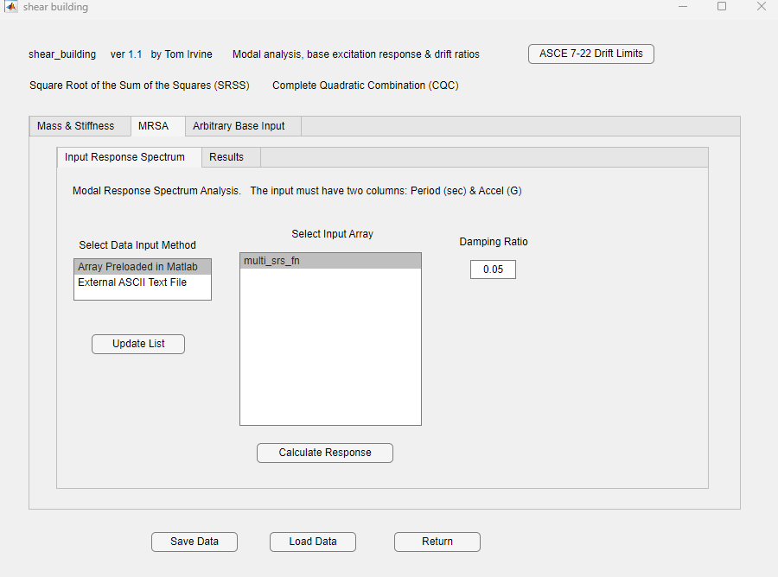

Slide 42
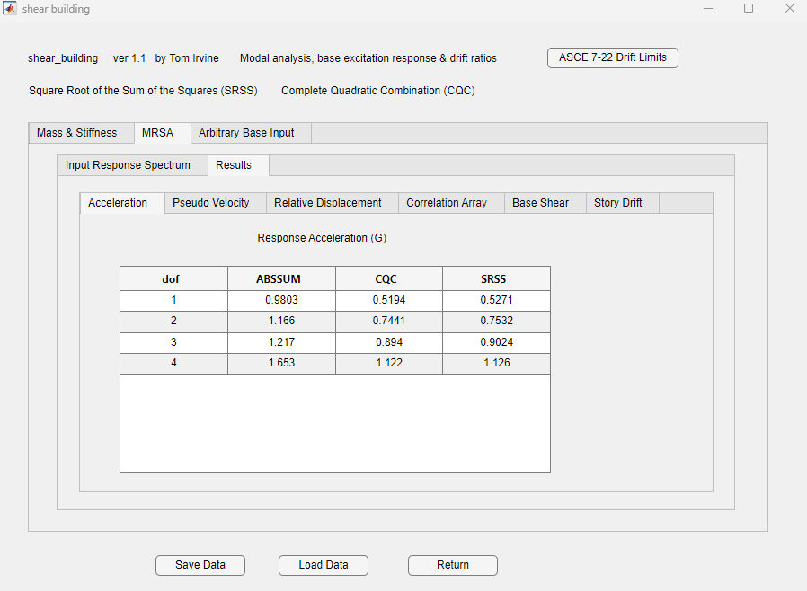

Slide 43
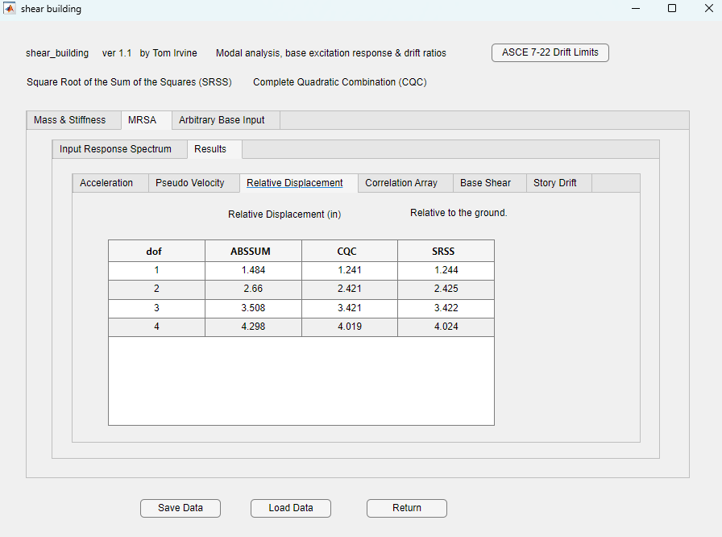

Slide 44
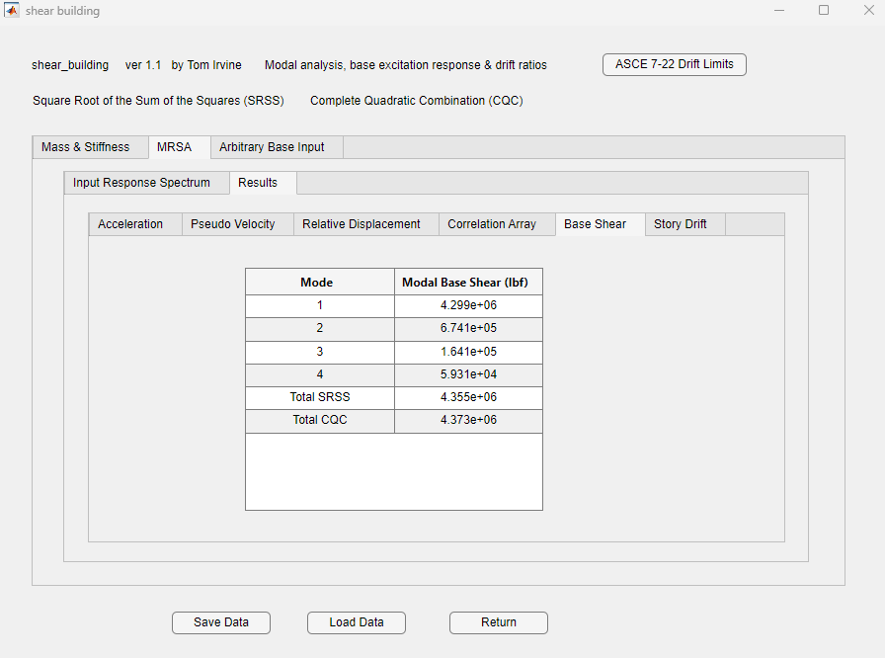

Slide 45
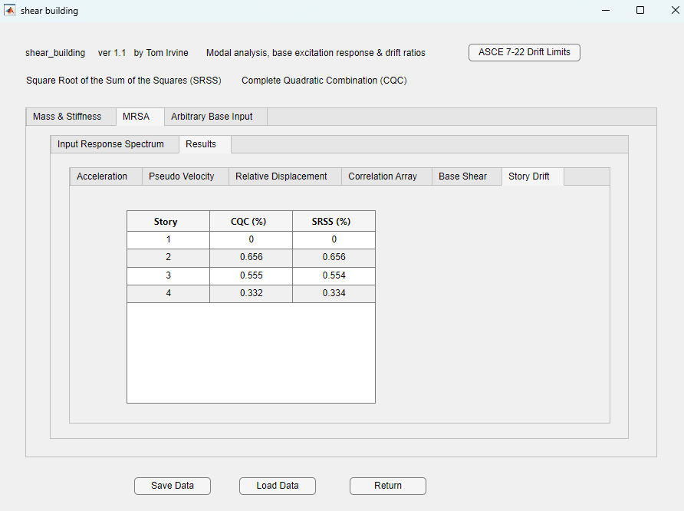

Slide 46
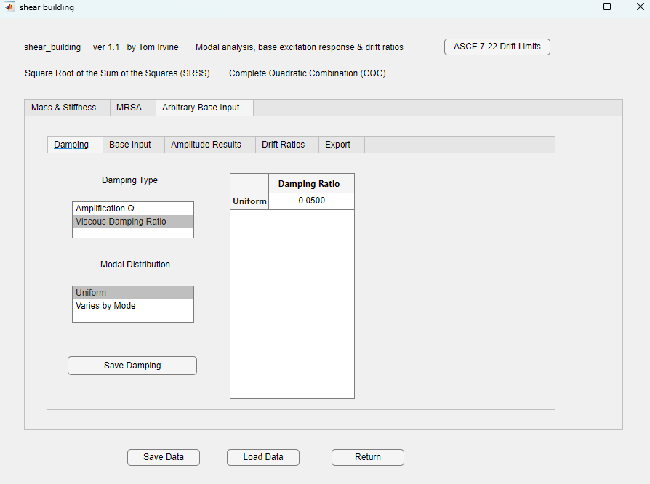


Slide 47
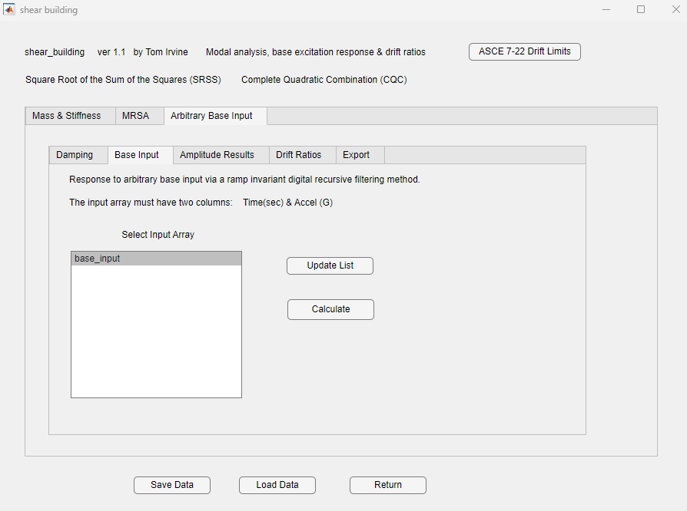

Slide 48
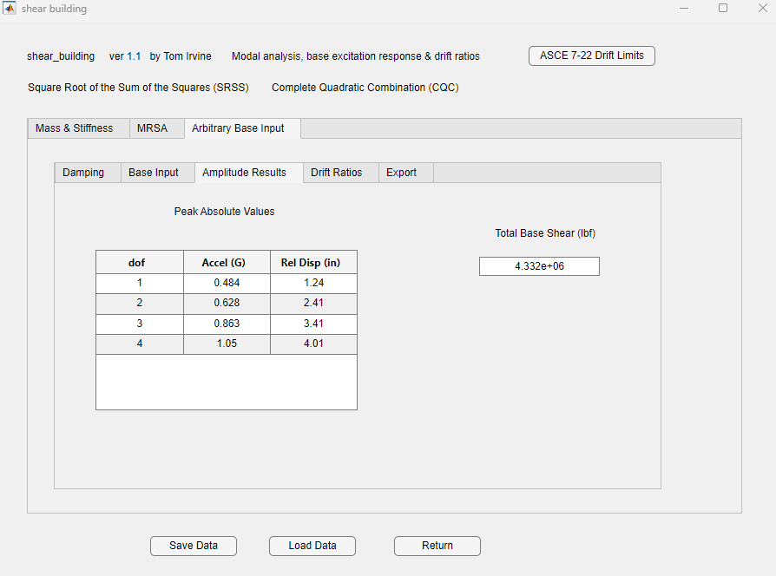

Slide 49
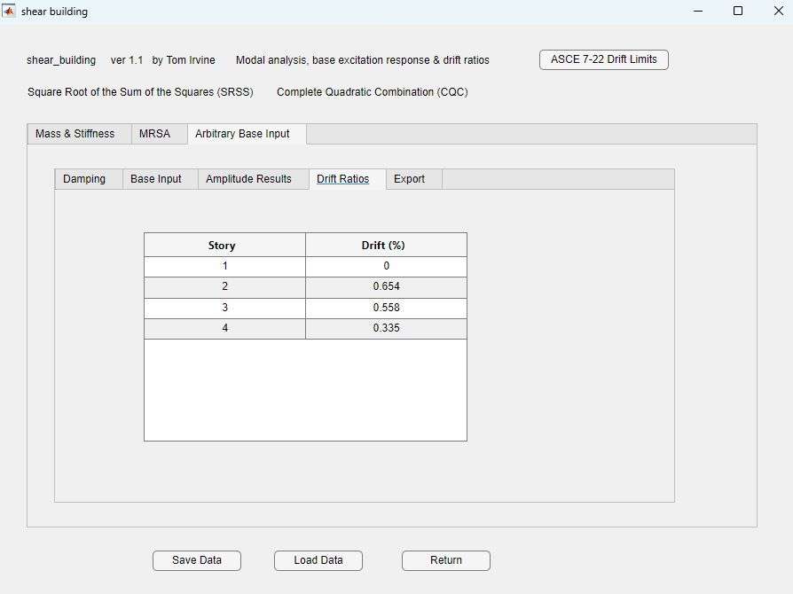

Slide 53
Story Drift Comparison
Story | MRSA CQC Drift (%) | Modal Transient Drift (%)
1 | 0 | 0
2 | 0.656 | 0.654
3 | 0.555 | 0.558
4 | 0.332 | 0.335
Excellent agreement
Parseval’s theorem explains why: modal energy computed in frequency-domain methods can match the full time-domain transient response

Slide 54
SRS Specification Q Concerns
The shock response of a physical coordinate in a multiple-degree-of-freedom system can be approximated as the summation response of a series of single-degree-of-freedom systems
(modal superposition)
This method works best if the specification SRS has the same Q as the component’s modes
The goal is to use modal combination methods to avoid computation time for a full modal transient analysis
For example, the specification is typically Q=10 but the structure may have modes with Q=20
The higher Q yields a higher SRS, but there is no exact direct scaling method
Use conservative approach loosely based on Miles’ equation

Slide 55

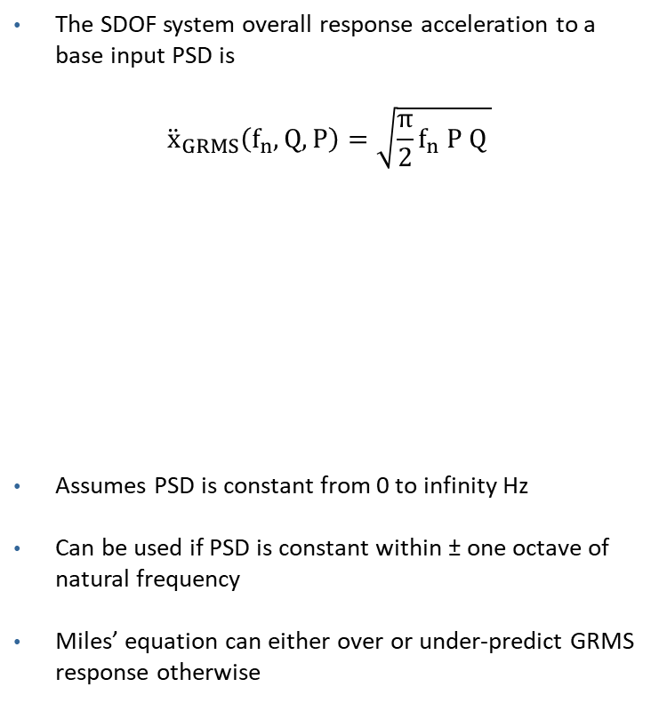
Miles Equation for Base Input PSD Applied to Response Spectrum (RS)
The SDOF system overall response acceleration to a base input PSD is
$${\ddot{x}}_{GRMS}\left(f_{n},Q, P\right)=\sqrt{{\frac{π}{2}f}_{n} P Q }$$
Assumes PSD is constant from 0 to infinity Hz
Can be used if PSD is constant within ± one octave of natural frequency
Miles’ equation can either over or under-predict GRMS response otherwise
Make the conservative assumption that
$$\frac{{RS}_{2}}{{RS}_{1}}=\sqrt{ \frac{Q_{2}}{Q_{1}} }$$
$${RS}_{2}={RS}_{1}\sqrt{ \frac{Q_{2}}{Q_{1}} }$$
where ${ Q}_{2}$ > $Q_{1}$
Note that
$$Q=1/{\left(2 ξ\right)}$$
where
f_{n} = natural frequency
P = PSD level at f_{n}
Q = amplification factor

