Slide 1
Olive View Hospital
By Tom Irvine

Slide 2
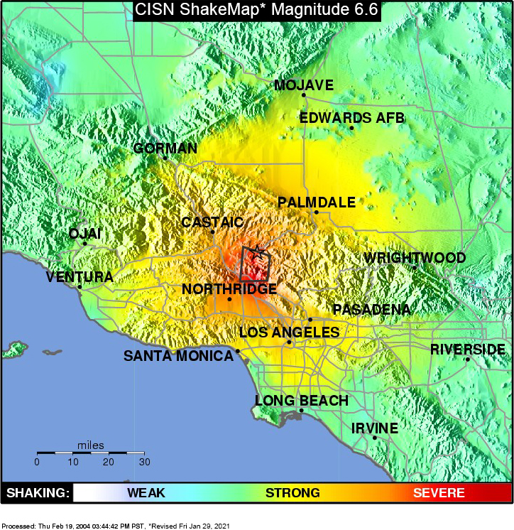
The San Fernando Earthquake occurred on February 9, 1971
It had a magnitude of 6.5, and shaking lasted about 60 seconds
The resulting death toll was 65

Slide 3
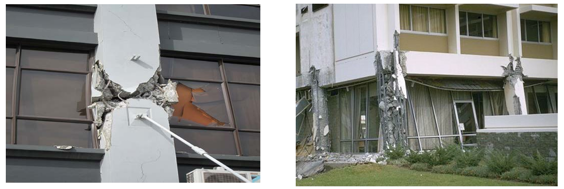
Olive View Hospital, 1971
The Olive View Hospital is located in Sylmar, California.
The original hospital was built in 1964, in compliance with the earthquake codes of that time
It partially collapsed, however, during the 1971 San Fernando Earthquake and was later demolished

Slide 4
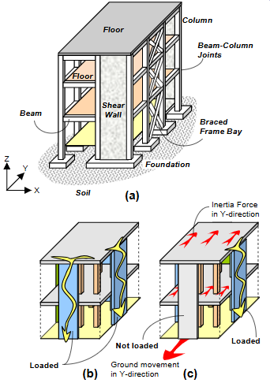
As the ground shakes, a building’s mass elements undergo acceleration, thus developing inertial loads
The dynamic loads from these reactive elements must be carried across floors
diaphragms to vertical elements in the lateral load system, and then to the foundation, and finally, to the ground
The building must have a continuous load path from the roof to the foundation to safely carry these loads
Load paths for different load actions
(a) key structural elements constituting load Paths
(b) vertical load paths
(c) lateral load paths
https://studylib.net/doc/18891850/earthquake-tip

Slide 5
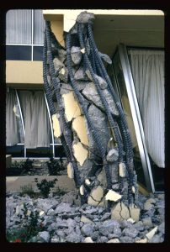
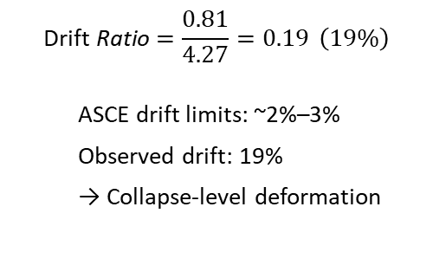
$$\text{Drift} \text{Ratio}=\frac{0.81}{4.27}=0.19 \left(19\%\right)$$
ASCE drift limits: ~2%–3%
Observed drift: 19%
→ Collapse-level deformation
The Olive View Hospital building had vertical shear walls in its upper stories to carry the inertial loads
The first floor, however, did not have shear walls. Instead, the load was carried by the first story columns down to the foundation
This discontinuous design thus has a “soft first story”
As a result, the first story columns failed
One of the first story columns underwent 0.81 meters of lateral displacement in a clear height of 4.27 meters, resulting in an inter-story drift index of 0.19

Slide 6
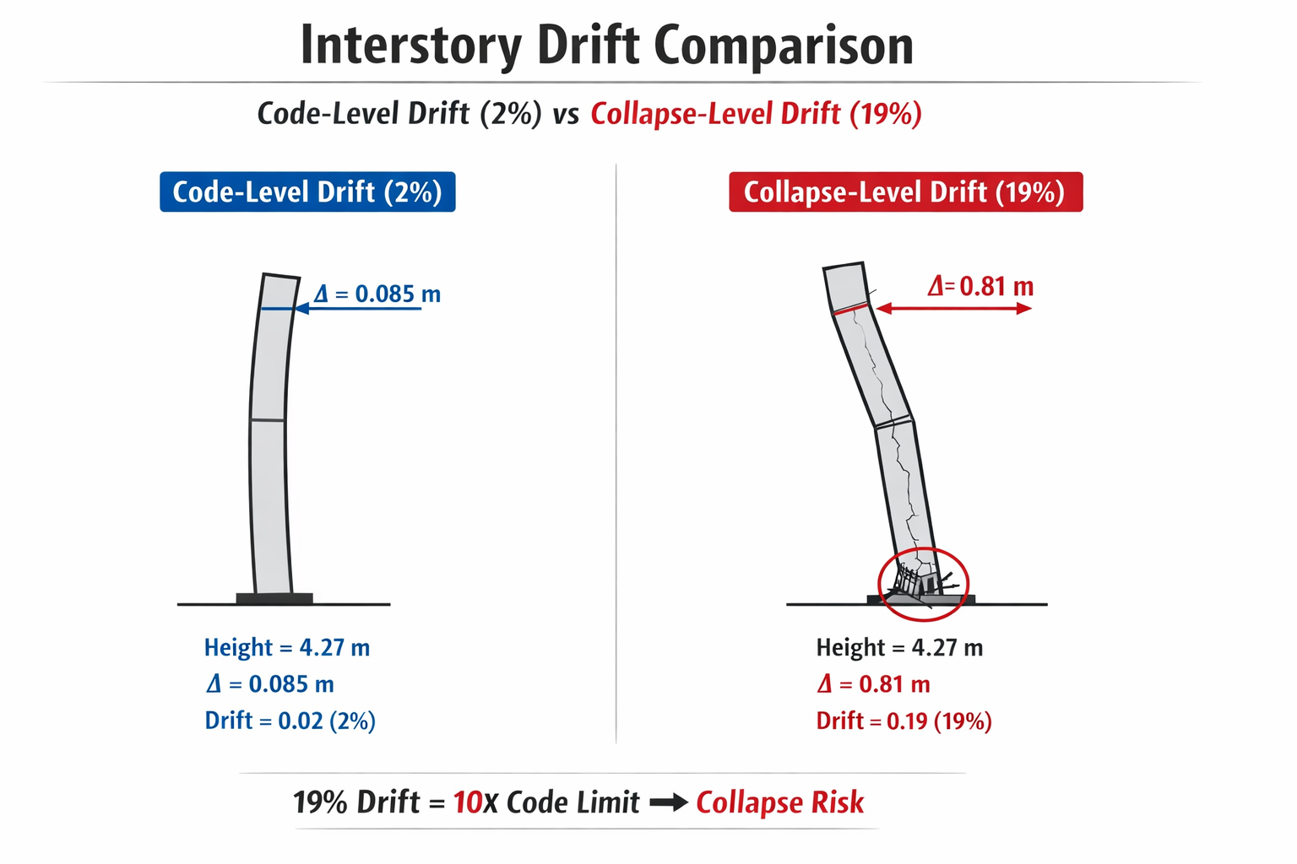

Slide 7
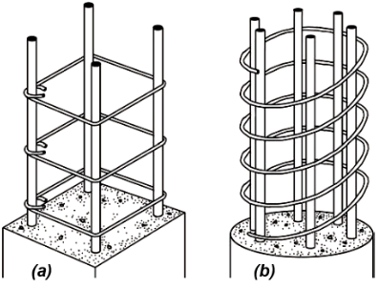
Column Reinforcement
Ties
Spiral
Poor workmanship also contributed to the building’s failure
The first story columns were spirally reinforced, but the spiral ended prematurely at the top of each column
Thus, the spiral did not connect to spandrel girder
As a result, a “plastic joint” was created that was unable to provide the needed lateral confinement

Slide 8
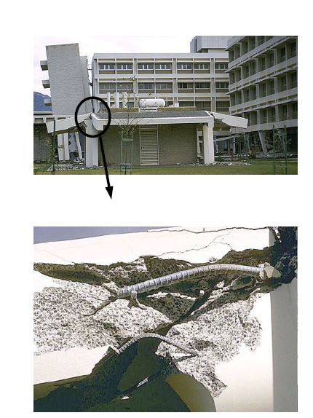
Reinforcement Bar Failure
The bending stress causes both axial tension and compression
The top bar in the lower image was subject to high tension
The lower bar buckled in compression

Slide 9
Olive View Summary
Feature | Failure Mechanism | Modern Solution
First Story | Soft-story stiffness mismatch | Continuous shear walls or braced frames
Reinforcement | Premature spiral termination | Continuous confinement into joints
Load Path | Discontinuous path to foundation | Redundant, continuous load paths

Slide 10
Seismic Code Evolution: California Hospital Standards
1933
1964
1971
1973
1987
Field Act (1933)
After Long Beach earthquake, required seismic design for CA public schools. First major seismic law in the US — but hospitals not yet covered.
Olive View Built (1964)
Built under existing codes with no hospital-specific seismic rules. Soft-story design and poor column confinement left it critically vulnerable.
San Fernando Earthquake
Mag. 6.5 — 65 deaths. Olive View partially collapsed. Hospitals, critical to disaster response, failed precisely when needed most.
Alquist Act / OSHPD (1973)
SB 519 created OSHPD oversight. Hospitals must remain operational post-earthquake. Banned soft-story designs and required continuous load paths.
New Olive View Opens
Rebuilt under OSHPD: continuous shear walls, proper confinement, spread footings. Survived 1994 Northridge earthquake intact.
OSHPD stands for the Office of Statewide Health Planning and Development
3a

Slide 11
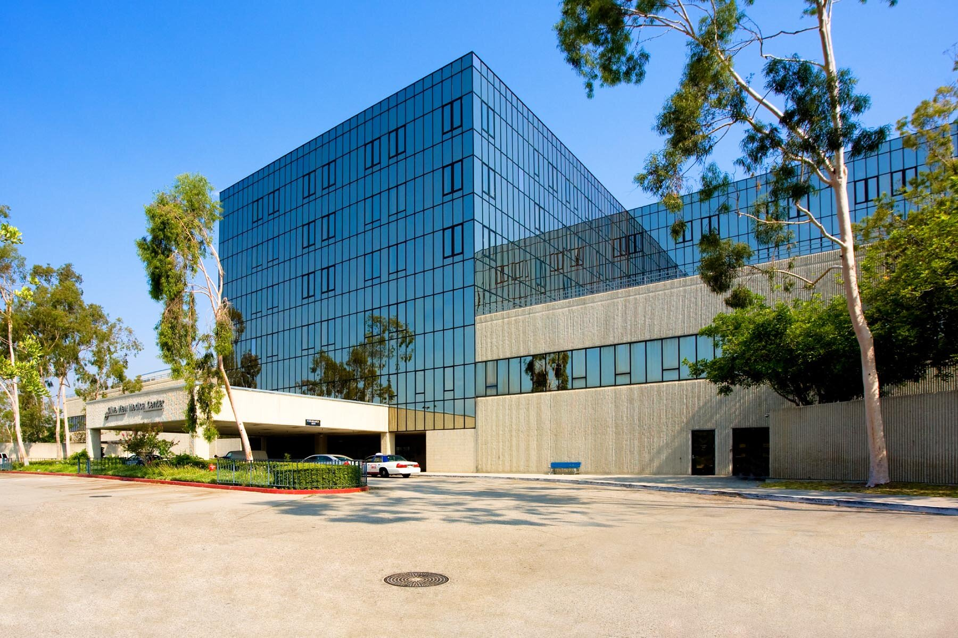
New Olive View Hospital
The new Olive View building was designed to withstand increased levels of ground motion, based on the lessons of its predecessor
It is very strong and stiff
The foundation consists of spread footings and concrete slab-on-grade for the first floor
The first and second stories are built of concrete
shear walls 25 centimeters thick
Steel shear walls are used for remaining upper stories

Slide 12
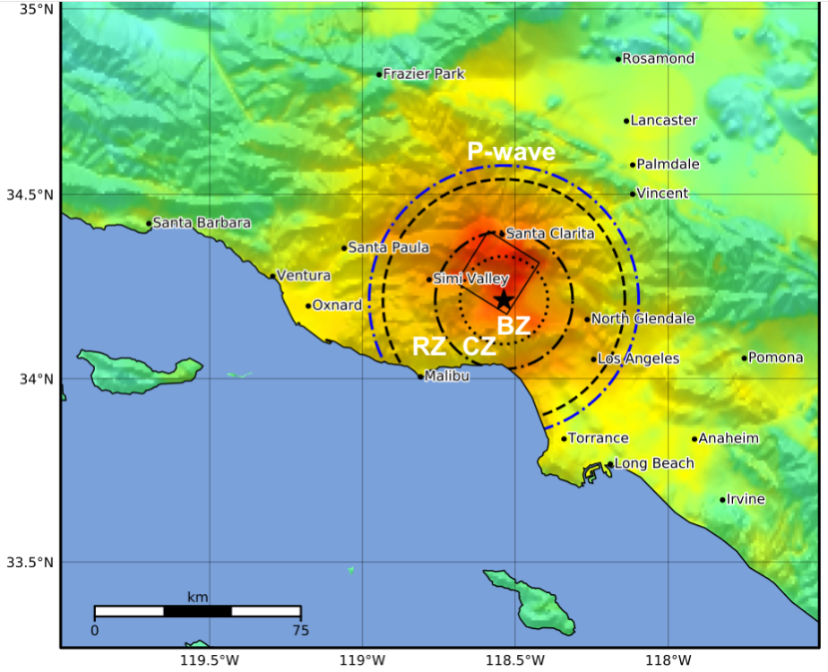
Northridge Earthquake 1994
The Northridge earthquake occurred at 4:30 AM local time on January 17, 1994
Northridge is located about 30 km northwest of Los Angeles
This earthquake had a 6.8 magnitude
The hypocentral depth was 19 km
The duration was about 10 seconds to 20 seconds
The earthquake occurred along a "blind" thrust fault, close to the San Andreas Fault
Note that a blind fault is a buried fault that does not extend to the surface

Slide 13
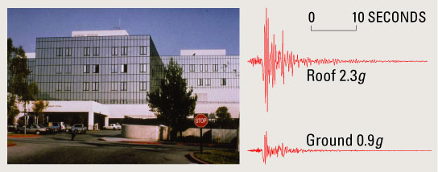
Northridge Earthquake 1994, Olive View Hospital
Accelerometers were mounted in the new Olive View Hospital and on the adjacent ground
The peak ground level was 0.91 G, and the amplified peak roof level was 2.31 G
The building structure’s fundamental frequency is estimated at 2.5 Hz in the north-south axis, rocking mode
The dominant earthquake excitation at the hospital’s foundation was in the 2 to 3 Hz domain and is largely a result of the local soil conditions
Thus, the building natural frequency and the site excitation frequency were nearly the same, causing the building to undergo a resonant response
U.S. Geological Survey Fact Sheet 068-03

Slide 14
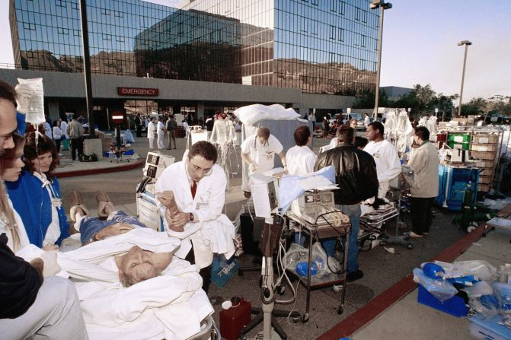
Northridge Earthquake 1994, Olive View Hospital
The building natural frequency and the site excitation frequency were nearly the same, causing the building to undergo a resonant response
Despite the resonance, the hospital structure successfully withstood the Northridge earthquake
A water pipe broke, however, forcing evacuation
The hospital’s structural damping limited the resonant response.
One of the damping mechanisms may have been radiation damping whereby the building dissipates energy into the surrounding soil
The measured damping for the Northridge event was 10% to 15% (north-south) and 5% to 10% (east-west)

Slide 15

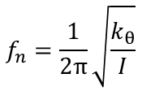
Rocking Mode
The natural frequency $f_{n}$is
$$f_{n}=\frac{1}{2π}\sqrt{\frac{k_{θ}}{I}}$$
$k_{θ} =$ rotational stiffness of foundation + soil
$I =$mass moment of inertia about base
Rocking is a soil–structure interaction (SSI) mode
Foundation flexibility lowers system stiffness
Radiation damping occurs as rocking energy propagates into soil
Controlled rocking can:
Increase effective damping
Reduce internal force demand
Limit structural damage

Slide 16
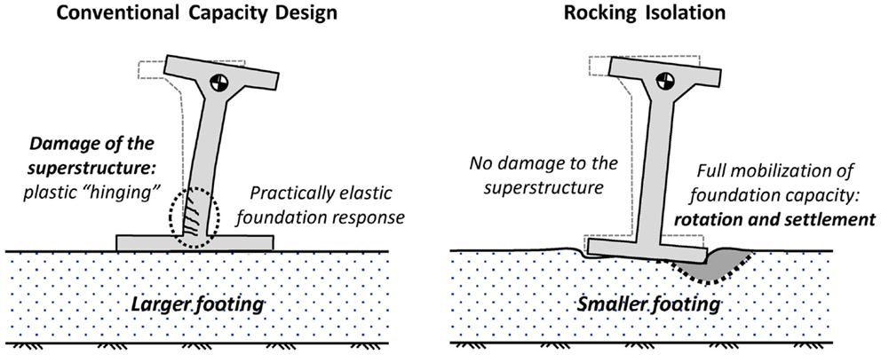
Recent studies have highlighted the potential benefits of inelastic foundation response during seismic shaking
According to an emerging seismic design scheme, termed rocking isolation, the foundation is intentionally under-designed to promote rocking and limit the inertia transmitted to the structure
Such reversal of capacity design may improve the seismic performance, drastically increasing the safety margins
However, the benefit comes at the expense of permanent settlement and rotation, which may threaten post-earthquake functionality
https://www.frontiersin.org/journals/built-environment/articles/10.3389/fbuil.2015.00009/full

Slide 17
Olive View Hospital, Response Comparison
Feature | 1971 Hospital | New Hospital
Soft Story | Yes | No
Confinement | Poor | Modern
Resonance | Yes | Yes
Collapse | Yes | No
Damping | Unknown | 10–15%

Slide 18
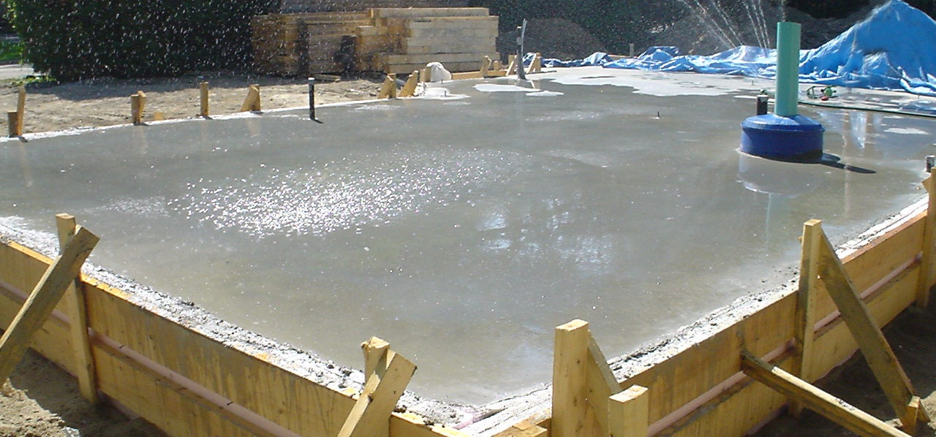
Appendix: Slab-on-Grade Foundation
A home with a slab-on-grade foundation has no crawl space
The "slab on grade" is concrete poured over a layer of an approved vapor barrier material that is usually placed on a base of gravel to allow better drainage
It is placed directly on the ground (grade) level
When the concrete is poured at once, it is called a "monolithic" slab
In this way, there are no breaks in the concrete between pours
Wire mesh is used to reinforce the concrete
The concrete's edge is poured to a greater thickness, and reinforcing rods are installed for a stronger perimeter

