Slide 1
Vibrationdata
ASCE 7-22, Ch 12, Seismic Design Requirements for Buildings
By Tom Irvine

Slide 2
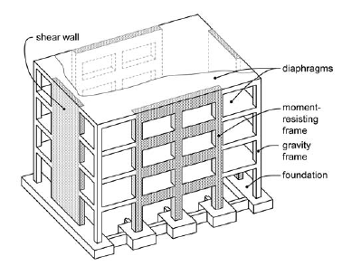
Vibrationdata
Introduction
Chapter 11 tells us how strong the earthquake is
Chapter 12 tells us what we’re allowed to build in response and controls which structural systems are legally permitted based on:
Seismic Design Category (SDC)
Building height
Structural regularity
System selection is therefore a code-driven design decision, not purely an engineering preference
NEHRP Seismic Design Technical Brief No. 3, Seismic Design of Cast-in-Place Concrete Diaphragms, Chords, and Collectors

Slide 3
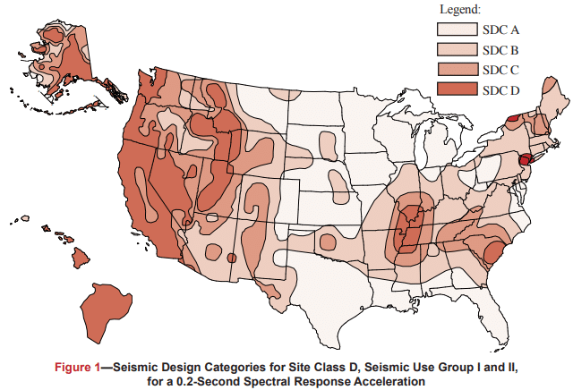
Vibrationdata
Seismic Hazard Map
Each figure is based on Site Class D (the default class when the soil profile is not known) and is applicable to structures assigned to Occupancy Categories I, II, and III (buildings other than high hazard exposure structures)
Note that if the soil profile is known and is lower than D, a correspondingly lower SDC may be realized
https://www.cmha.org/resource/tek-14-18b/

Slide 4
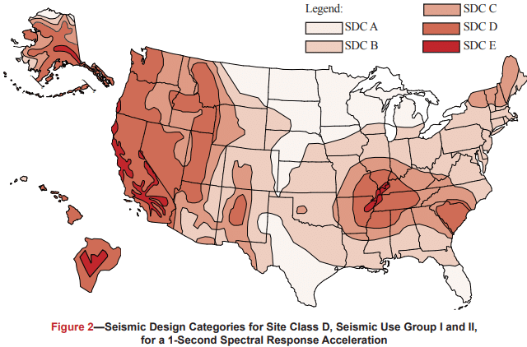
Vibrationdata
Seismic Hazard Map

Slide 5
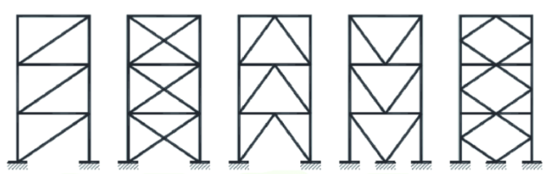
Vibrationdata
Scope
Diagonal X-Bracing Inverted V-Bracing K-Bracing
Bracing V-Bracing
Chapter 12 = “How to design the building once hazard is known”
Applies to:
Building Seismic Force-Resisting Systems (SFRS)
Diaphragms
Frames, shear walls, braced frames
Building height & configuration limits
Analysis procedures
Drift and stability checks
https://www.linkedin.com/pulse/bracing-up-concentric-vs-eccentric-decoding-steel-skeleton-a-j-vkbfc/

Slide 6
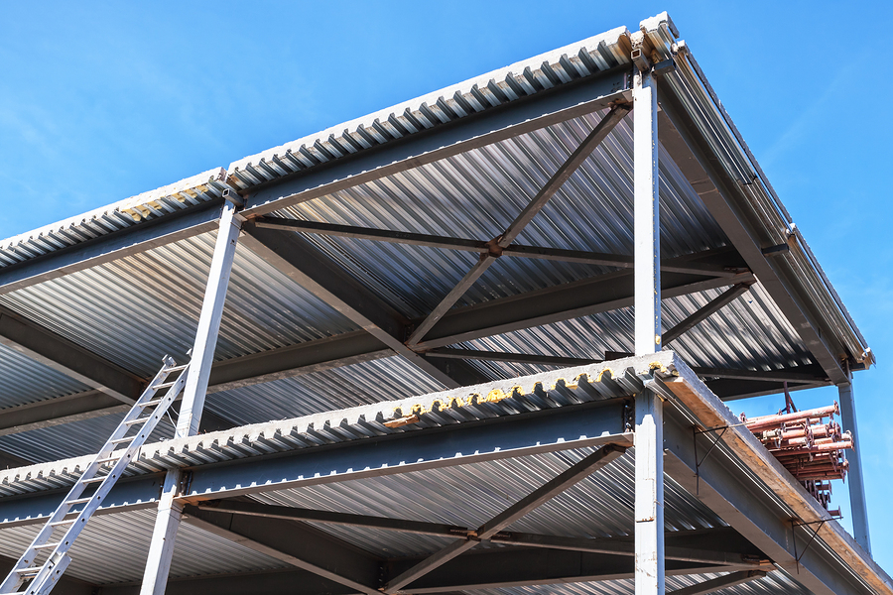
Vibrationdata
Workflow
Get SDS, SD1 (Ch 11)
Determine Seismic Design Criteria (SDC)
Select structural system
Apply Ch 12 analysis & detailing rules
Corrugated Steel Floor and Roof Diaphragms with Steel cross-bracing and diagonal members for lateral stability
https://www.constructionspecifier.com/smdi-and-aisc-partner-to-establish-sdii/

Slide 7
Vibrationdata
From Hazard to Structural System
Step | Meaning
Hazard | SS, S1, Site Class, Risk Category
SDC | A through F
System Selection | SMRF, SCBF, Shear Wall, Dual System
Analysis Method | ELF or MRSA
Drift Check | Δ ≤ Cd·Δe / Ie
Stability | P-Δ limits
Detailing | AISC 341 / ACI 318 seismic provisions
Seismic Design Category (SDC)
Equivalent Lateral Force (ELF)
Modal Response Spectrum Analysis (MRSA)
Cd = Design Deflection Amplification Factor
Ie = Importance Factor
Δe = Story Elastic Displacement
P = vertical gravity load (axial load in columns)
Δ = lateral displacement

Slide 8
Decision Flowchart, Phase 1 – Seismic Hazard Determination
STEP 1 · Determine Risk Category (RC)
Classify by occupancy/function → RC I, II, III, or IV.
RC IV = Essential Facilities (hospitals, EOCs, fire stations)
§1.5 · Table 1.5-1
STEP 2 · Obtain Ground Motion Parameters
Use USGS/ASCE Hazard Tool: obtain SS & S1.
Apply site coefficients: Fa, Fv per Site Class A–F.
SDS = ⅔ · Fa · SS SD1 = ⅔ · Fv · S1
§11.4.1–11.4.5 · Table 11.4-1 & 11.4-2
STEP 3 · Assign Seismic Design Category (SDC)
Use Tables 11.6-1 & 11.6-2 with SDS, SD1 and Risk Category.
Categories: A (least) → B → C → D → E → F (most severe)
§11.6 · Tables 11.6-1 & 11.6-2
SDC = A only?
§11.6 · §11.7
Yes
No
Apply §11.7 Only
Min. lateral force = 1% W per floor. No further seismic analysis required.
§11.7.1–11.7.3
SDC B–F → Continue
Proceed to Step 4:
Select SFRS & analysis procedure
§12.2 et seq.

Slide 9
Phase 2 – SFRS Selection & Structural Irregularies
STEP 4 · Select Seismic Force-Resisting System (SFRS)
Choose system from Table 12.2-1. Obtain R, Ω₀, Cd.
Verify system is permitted for assigned SDC and height limit.
Systems: Bearing Wall, Building Frame, Moment Frame, Dual,
Cantilever Column, Shear Wall–Frame Interactive
§12.2.1 · Table 12.2-1
Yes
Irregularity Types (Tables 12.3-1 & 12.3-2) Horizontal & Vertical
Structural Irregularity present?
§12.3 · Tables 12.3-1 & 12.3-2
Regular Structure
No special irregularity requirements apply.
Proceed to analysis procedure selection.
§12.3.1 — Regular structures
→ Proceed to Phase 3
Analysis Procedure Selection (§12.6)
See next slide.

Slide 10
Phase 3 – Analysis Selection & Forces
Vibrationdata
STEP 5 · Select Analysis Procedure (Table 12.6-1)
Determine permitted method based on SDC, height h, period T, and irregularity type.
§12.6 · Table 12.6-1
LRHA
LRHA / NRHA
Linear or Nonlinear, Response History Analysis.
Permitted for all structures.
Required: isolated/damped.
Peer review required.
Base shear comes directly from the response history results, not from Cs·W
§12.9.2 · §16
Which Analysis Procedure?
§12.6 · Table 12.6-1
ELF
MRSA
ELF Procedure
Equivalent Lateral Force
V = Cs · W
Cs = SDS/(R/Ie)
Simplest method.
OK: SDC B–D, regular,
hn ≤ height limits
§12.8
Modal RSA (§12.9.1)
Multi-mode response spectrum.
Combine via SRSS or CQC.
Require ≥90% mass participation.
Required for irregular/tall.
Must scale if VMRSA < 0.85·VELF
Base shear is computed differently (summed modal forces via SRSS/CQC)
§12.9.1 · §12.9.1.4
LRHA — Reduced Roof Live Load, Horizontal Area-based
NRHA — Nominal (unreduced) Roof Live Load, Horizontal Area-based

Slide 11
Phase 3 – Analysis Selection & Forces (cont)
Vibrationdata
ELF
STEP 6 · Compute Seismic Base Shear ELF
Cs = SDS / (R/Ie) [§12.8.1.1]
Cs,max = SD1 / (T · R/Ie) or SD1 · TL / (T² · R/Ie)
Cs,min = max(0.044·SDS·Ie, 0.01) [or 0.5·S1/(R/Ie) if S1 ≥ 0.6g]
V = Cs · W
Scale MRSA result if Vmrsa < 0.85·VELF (§12.9.1.4)
STEP 7 · Distribute Forces Vertically & Apply Torsion
Fx = Cvx · V where Cvx = wxhxᵏ / Σwihiᵏ
k = 1 (T ≤ 0.5s) | k = 2 (T ≥ 2.5s) | interpolate between
Accidental torsion: Mta = Vx · 0.05 · B (§12.8.4.2)
Amplify torsion if Type 1a/1b horizontal irregularity (§12.8.4.3)

Slide 12
Phases 4-5, Drift, P-delta, Diaphragms & Foundations
Vibrationdata
ELF, MRSA, LRHA
STEP 8 · Compute Design Story Drift & Stability
δx = Cd · δxe / Ie (amplified elastic displacement)
Δ = δx − δx−1 (story drift)
P-Delta stability coefficient: θ = PxΔ / (Vx · hsx · Cd)
§12.8.6 · §12.8.7 · §12.12.1
Δ ≤ Δa and θ ≤ 0.10?
§12.12.1 · §12.8.7
No -> redesign
Yes
STEP 9 · Diaphragm Forces, Collectors & Connections
Fpx = (ΣFi / Σwi) · wpx ≥ 0.2·SDS·Ie·wpx
Collector (drag strut) elements: design for Ω₀ seismic forces.
Verify diaphragm shear transfer to vertical SFRS elements.
§12.10 · §12.10.2 Collector overstrength
STEP 10 · Foundation Design & Soil–Structure Interaction
Transfer amplified seismic demands to foundation per §12.13.
SSI reduction optional per §12.13.3 (can reduce base shear).
Pile/pier detailing varies by SDC per §12.13.5.
§12.13 · Foundation detailing by SDC
STEP 11 · Nonstructural Component Anchorage (§13)
Fp = 0.4·SDS·Ip·Wp · (1 + 2z/h) · (1 + 2/Rp)
Check mechanical, electrical, plumbing, cladding, equipment.
Triggered for SDC C–F. Use Tables 13.5-1 & 13.6-1.

Slide 13
Phases 4-5, Drift, P-delta, Diaphragms & Foundations (cont)
Vibrationdata
ELF, MRSA, LRHA
FINAL COMPLIANCE CHECKLIST (All Steps Complete?)
☑ RC & SDC assigned ☑ SFRS selected from Table 12.2-1 ☑ Irregularities assessed ☑ Analysis procedure confirmed ☑ V & Fx computed
☑ Drift Δ ≤ Δa ☑ P-delta θ ≤ 0.10 ☑ Diaphragm Fpx checked ☑ Collectors: Ω₀ forces ☑ Foundation demands transferred ☑ Nonstructural anchors (§13)
P-Delta Limits (§12.8.7): θ ≤ 0.10: No P-delta amplification needed 0.10 < θ ≤ θmax: Amplify by 1/(1−θ) θ > θmax: Redesign required
SEISMIC SEPARATION GAP (§12.12.3)
Adjacent dissimilar structures:
δMT = √(δM1² + δM2²)
Same structure with joint:
δMT = δM1 + δM2 (absolute sum)

Slide 14
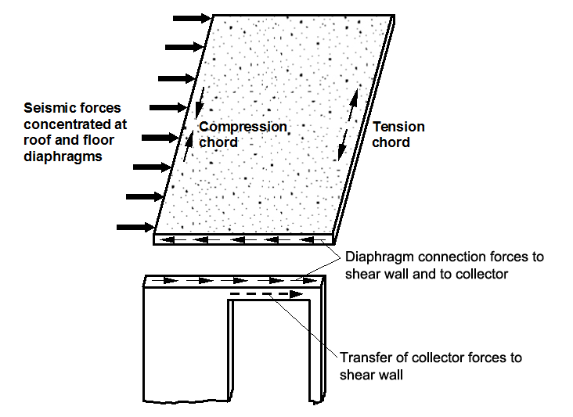
Vibrationdata
Structural System Selection
R (Response Modification Factor)
Reduces design forces → assumes ductility and energy dissipation
Ω₀ (Overstrength Factor)
Used for collectors, chords, connections, discontinuities
Cd (Deflection Amplification Factor)
Used to compute amplified drift for code drift checks
Height Limits Increase with Ductility
Special systems (SMRF, SCBF, Special Shear Walls, Dual Systems) are permitted in higher SDC and greater heights
https://www.skghoshassociates.com/blog/about-that-25-increase-in-diaphragm-connection-forces/

Slide 15
Vibrationdata
Three Seismic Modification Coefficients
Factor | Used For | Physical Meaning
R | Reduces base shear | Expected ductility
Ω₀ | Amplifies forces locally | Hidden overstrength
Cd | Amplifies drift | Inelastic deformation

Slide 16
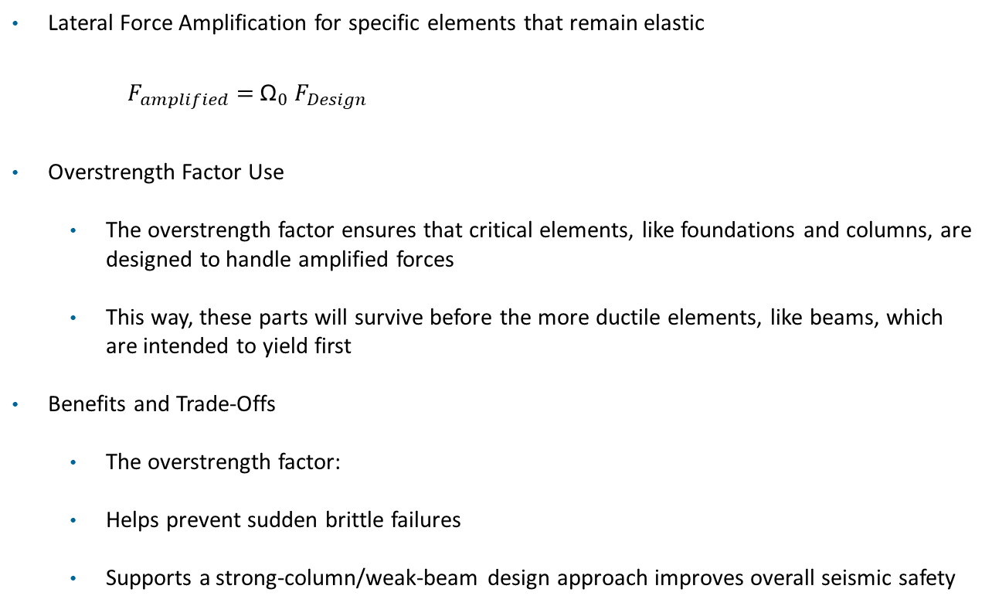
Vibrationdata
Overstrength Factor Ω₀
Lateral Force Amplification for specific elements that remain elastic
$F_{amplified}=$ ${\text{Ω}}_{0}{ F}_{Design}$
Overstrength Factor Use
The overstrength factor ensures that critical elements, like foundations and columns, are designed to handle amplified forces
This way, these parts will survive before the more ductile elements, like beams, which are intended to yield first
Benefits and Trade-Offs
The overstrength factor:
Helps prevent sudden brittle failures
Supports a strong-column/weak-beam design approach improves overall seismic safety

Slide 17
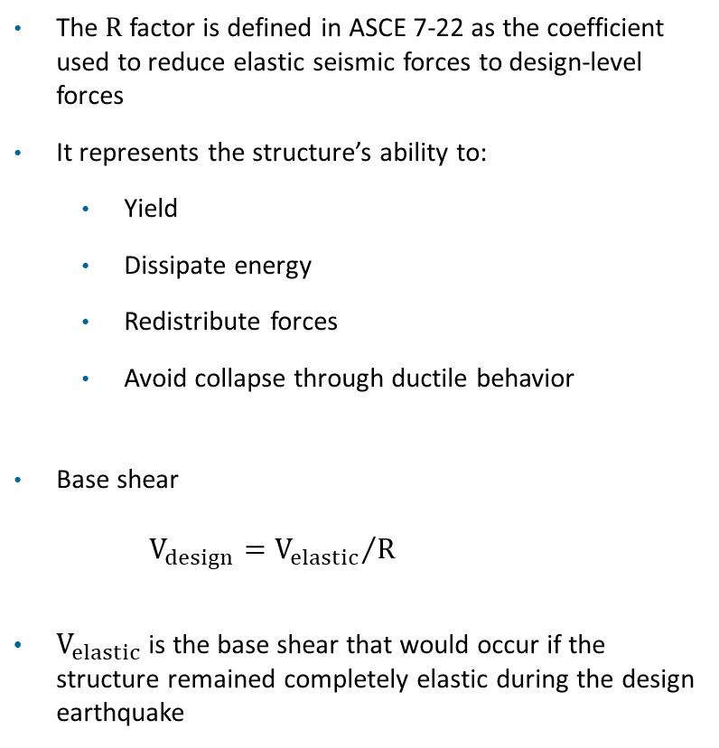

Response Modification Coefficient R “Credit for Ductility”
Vibrationdata
The R factor is defined in ASCE 7-22 as the coefficient used to reduce elastic seismic forces to design-level forces
It represents the structure’s ability to:
Yield
Dissipate energy
Redistribute forces
Avoid collapse through ductile behavior
Base shear
$V_{design}={V_{elastic}}/R$
$V_{elastic}$is the base shear that would occur if the structure remained completely elastic during the design earthquake
Base shear review
V = $C_{S}$ ​W
Base shear
If T < T_{s} ,
$$C_{S}=\frac{\text{S}\text{DS} I_{e}}{\text{R}}$$
If T > T_{s} ,
$$C_{S}=\frac{\text{S}\text{D}\text{1 }I_{e}}{\text{T} \text{R}}=\frac{\text{S}\text{a} {\left(T\right) I}_{e}}{\text{R}}$$
T_{s} is the transition period between the constant-acceleration and constant-velocity regions of the design response spectrum

Slide 18
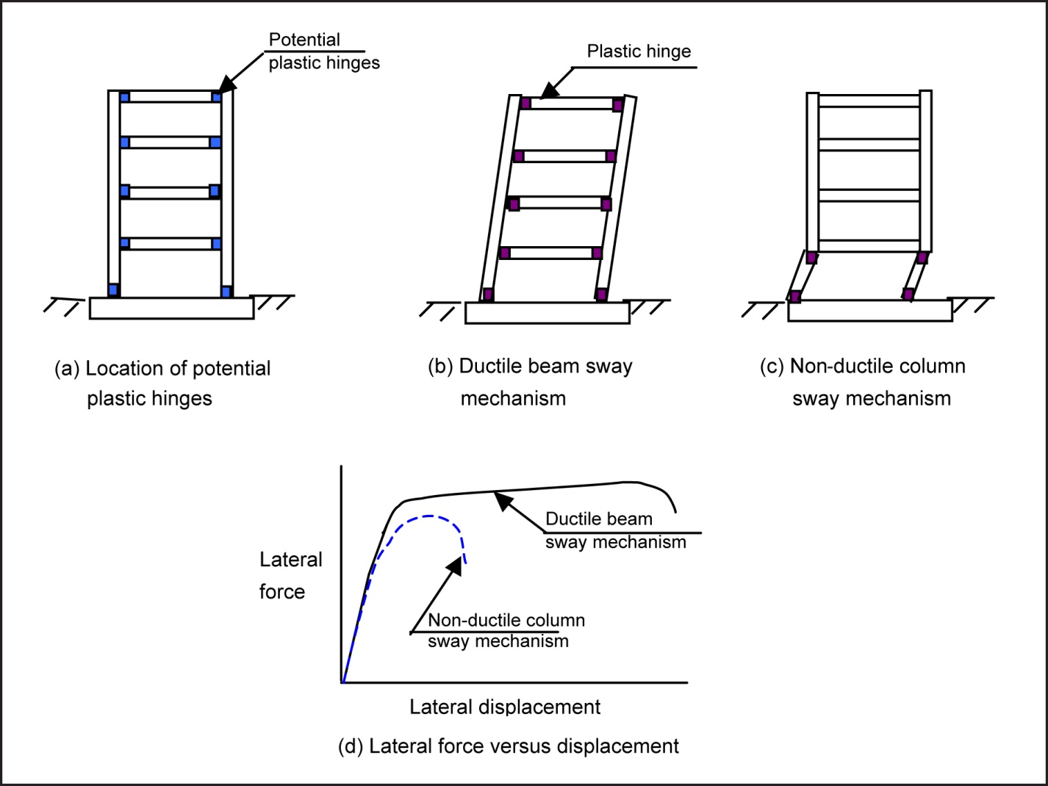
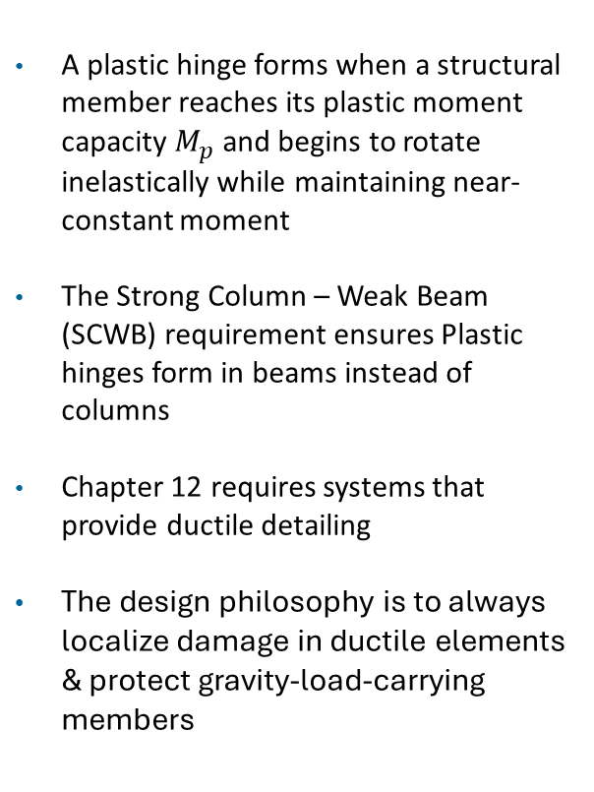
Plastic Hinges in Beam Structures
A plastic hinge forms when a structural member reaches its plastic moment capacity $M_{p}$ and begins to rotate inelastically while maintaining near-constant moment
The Strong Column – Weak Beam (SCWB) requirement ensures Plastic hinges form in beams instead of columns
Chapter 12 requires systems that provide ductile detailing
The design philosophy is to always localize damage in ductile elements & protect gravity-load-carrying members
Image courtesy of Canterbury Earthquake Royal Commission

Slide 19
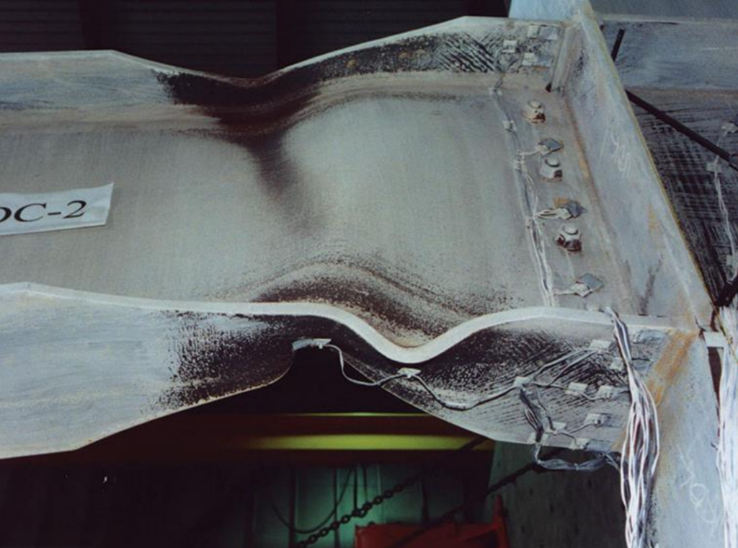
Vibrationdata
Formation of Plastic Hinge Zone
A wide-flange steel beam framing into a column with web yielding
A plastic hinge is not a literal hinge
It is a localized region where the section has yielded across most of its depth and rotates at approximately constant bending moment
The goal is controlled energy dissipation through stable beam plastic hinging
https://seblog.strongtie.com/2024/11/framing-the-future-the-evolution-of-moment-frames/formation-of-plastic-hinge-zone/

Slide 20
Vibrationdata
Structural Ductility
Ductility Level | Structural System | Primary Behavior | Typical R | Typical Ω₀ | Typical Cd | Design Philosophy
Low | Ordinary Shear Wall | Strength-controlled | 3 | 2.5–3 | 2.5 | Limited inelastic rotation
 | OCBF | Brace buckling governed | 3.25 | 2 | 3 | Limited ductility
 | OMF | Limited moment ductility | 3–3.5 | 3 | 3 | Basic detailing
Moderate | IMRF | Controlled yielding | 4–5 | 3 | 4 | Improved detailing
 | Special RC Shear Wall | Confined boundary yielding | 5–6 | 2.5–3 | 5 | Capacity design elements
OCBF = Ordinary Concentrically Braced Frame
OMF = Ordinary Moment Frame
IMRF = Intermediate Moment Resisting Frame

Slide 21
Vibrationdata
Structural Ductility
Ductility Level | Structural System | Primary Behavior | Typical R | Typical Ω₀ | Typical Cd | Design Philosophy
High | SCBF | Stable brace yielding | 6 | 2 | 5 | Designed ductile fuse
 | SMRF | Plastic hinge mechanism | 8 | 3 | 5.5 | Strong-column weak-beam
 | EBF | Link beam yielding | 8 | 2 | 5 | Replaceable ductile links
 | Dual Systems | Frame + wall interaction | 7–8 | 2.5–3 | 5–6 | Redundant energy dissipation
SCBF = Special Concentrically Braced Frame
SMRF = Special Moment Resisting Frame
EBF = Eccentrically Braced Frame

Slide 22
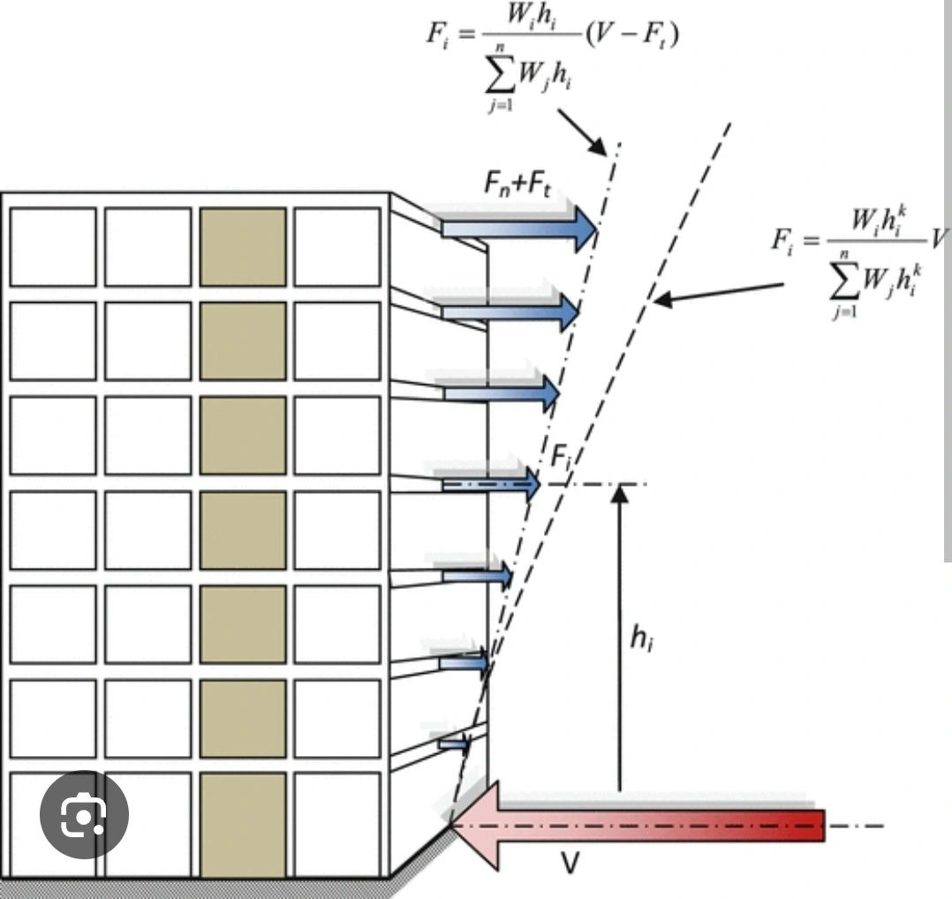
Vibrationdata
Permitted Analysis Procedures
Method | Use
Equivalent Lateral Force (ELF) | Most common
Modal Response Spectrum Analysis (MRSA) | Required for taller/irregular buildings
Nonlinear Response History | Chapter 16
Simplified Method | Limited low-rise
https://www.linkedin.com/posts/shawkatalikhan_the-equivalent-lateral-force-elf-procedure-activity-7363651518165663746-DMu-/

Slide 23
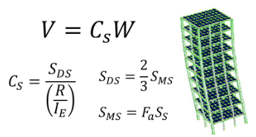
Vibrationdata
Equivalent Lateral Force
Steps:
Compute period T
Compute Cs
Compute base shear V = Cs W
Distribute vertically
Check drift
Valid for:
Regular structures
Limited height
Certain SDC limits
Covered in previous slide set
https://www.youtube.com/watch?v=GjNI3VGmEfc

Slide 24
Response Modification & Height Limits by SDC
Vibrationdata
System | R | Ω₀ | Cd | Height Limits by SDC
Steel Special Moment Frame (SMRF) | 8 | 3 | 5.5 | No explicit limit in B/C; permitted to greater heights in D/E/F (commonly up to 160 ft+ depending on SDC & occupancy)
Steel Intermediate Moment Frame (IMRF) | 4.5 | 3 | 4 | Limited in SDC D; typically not permitted in E/F for tall buildings
Steel Ordinary Moment Frame (OMF) | 3.5 | 3 | 3 | Height limited in SDC C; prohibited in D/E/F
Steel Special Concentrically Braced Frame (SCBF) | 6 | 2 | 5 | Permitted in D/E/F; moderate height limits depending on occupancy

Slide 25
Response Modification & Height Limits by SDC
Vibrationdata
System | R | Ω₀ | Cd | Height Limits by SDC
Steel Ordinary Concentrically Braced Frame (OCBF) | 3.25 | 2 | 3.25 | Limited to low-rise in C; prohibited in D/E/F
Steel Eccentrically Braced Frame (EBF) | 8 | 2 | 4 | Permitted in D/E/F; good for mid- to high-rise
Special Reinforced Concrete Shear Wall | 6 | 2.5 | 5 | Permitted in D/E/F; height limits based on occupancy
Ordinary Reinforced Concrete Shear Wall | 5 | 2.5 | 4 | Limited in C; prohibited in D/E/F
Dual System (SMRF + Shear Wall or SCBF) | 8 | 2.5–3 | 5–5.5 | Often used for taller buildings in D/E/F

Slide 26
Vibrationdata
Building Height Limits by SDC
SDC B / C (Low–Moderate Seismic Risk)
Ordinary systems generally permitted
Height limits are moderate
Dynamic analysis often not required
Drift usually governs before system prohibition
SDC D (High Seismic Risk)
Ordinary braced frames → height severely limited
Ordinary moment frames → limited or prohibited
Special systems required for taller buildings
Special Moment Resisting Frame (SMRF)
Special Concentrically Braced Frame (SCBF)
Special shear walls
Dual systems
Increased detailing per AISC 341 / ACI 318

Slide 27
Vibrationdata
Permitted Analysis Procedures
SDC E / F (Very High / Near-Fault)
Ordinary systems prohibited
Ordinary Moment Frame (OMF)
Ordinary Concentrically Braced Frame (OCBF)
Ordinary shear walls
Only Special or Dual systems permitted
Stricter height caps apply
Dynamic analysis commonly required
Design Decision Logic
As SDC increases:
Permitted ductility must increase
Allowable height for low-ductility systems decreases
Ordinary systems are eliminated
Special detailing becomes mandatory

Slide 28
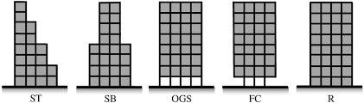
Vibrationdata
Structural Irregularities
ASCE 7-22 Tables 12.3-1 (Plan) & 12.3-2 (Vertical)
Structural irregularities trigger:
Mandatory dynamic analysis
Torsional amplification
Height restrictions
Stricter detailing requirements
ST – Stepped / Setback Tower, vertically irregular
SB – Setback Building, vertically irregular
OGS – Open Ground Story, soft story / weak story irregularity
FC – Floating Column, vertical stiffness discontinuity, often with torsional issues
R – Regular

Slide 29
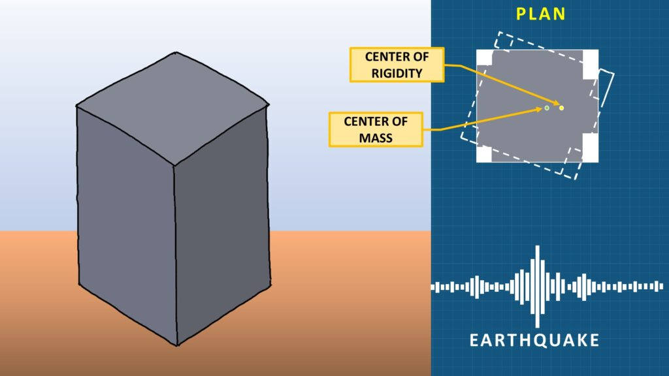
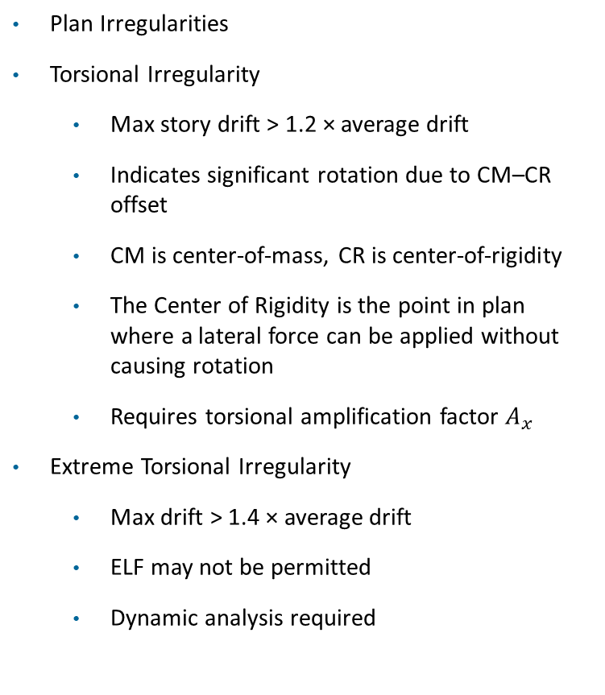
Vibrationdata
Structural Irregularities
Plan Irregularities
Torsional Irregularity
Max story drift > 1.2 × average drift
Indicates significant rotation due to CM–CR offset
CM is center-of-mass, CR is center-of-rigidity
The Center of Rigidity is the point in plan where a lateral force can be applied without causing rotation
Requires torsional amplification factor $A_{x}$
Extreme Torsional Irregularity
Max drift > 1.4 × average drift
ELF may not be permitted
Dynamic analysis required
https://structures-explained.com/torsion-in-structures/

Slide 30
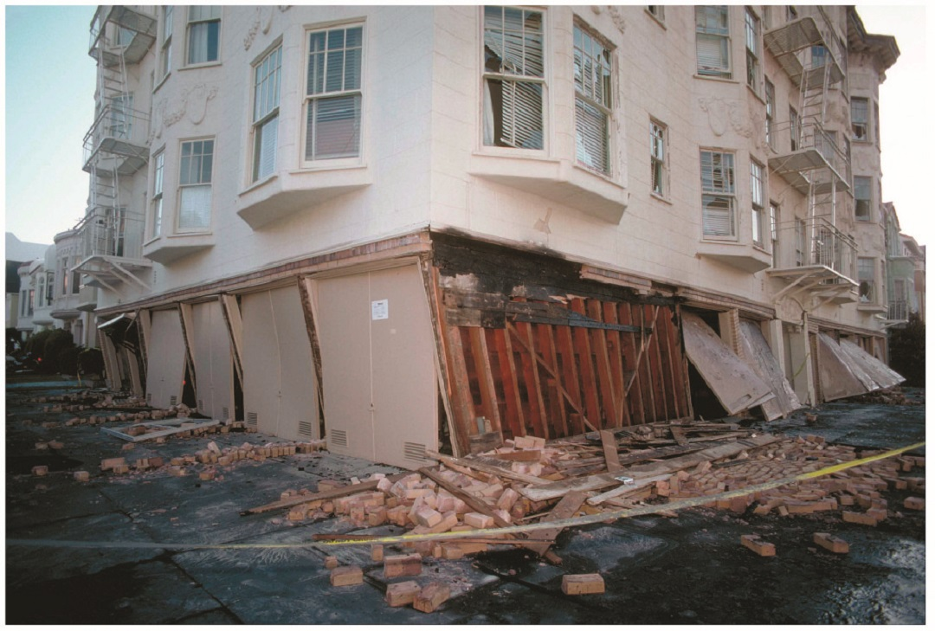
Vibrationdata
Structural Irregularities
Vertical Irregularities
Soft Story
Story stiffness < 70% of story above OR < 80% of average of three above
High drift concentration risk
Common in podium / open first-floor buildings
Weak Story
Story strength < 80% of story above
Collapse mechanism risk
Soft-Story Building Failure, Loma Prieta Earthquake
https://seblog.strongtie.com/

Slide 31
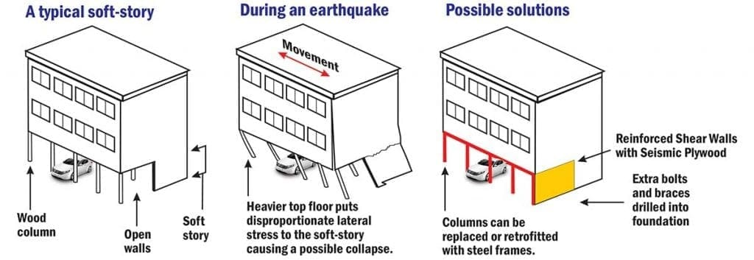
Soft Story & Retrofit
Vibrationdata
https://weinsteinconstruction.com/soft-story-retrofitting/

Slide 32
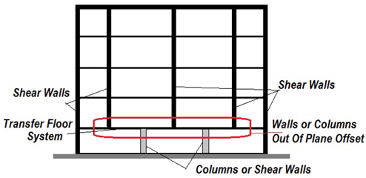
Vibrationdata
Structural Irregularities
In-Plane Discontinuity
Sudden change in lateral-force-resisting elements
Discontinuous shear walls / braced frames
Out-of-Plane Offset
Vertical lateral elements not aligned between stories
Load path interruption
Diaphragm Discontinuity
Large openings
Abrupt stiffness changes
Split diaphragms
Vulnerability of Buildings With Irregularity Due to Out-of-Plane Offsets in Mexico, A. Gómez-Bernal, et al.

Slide 33
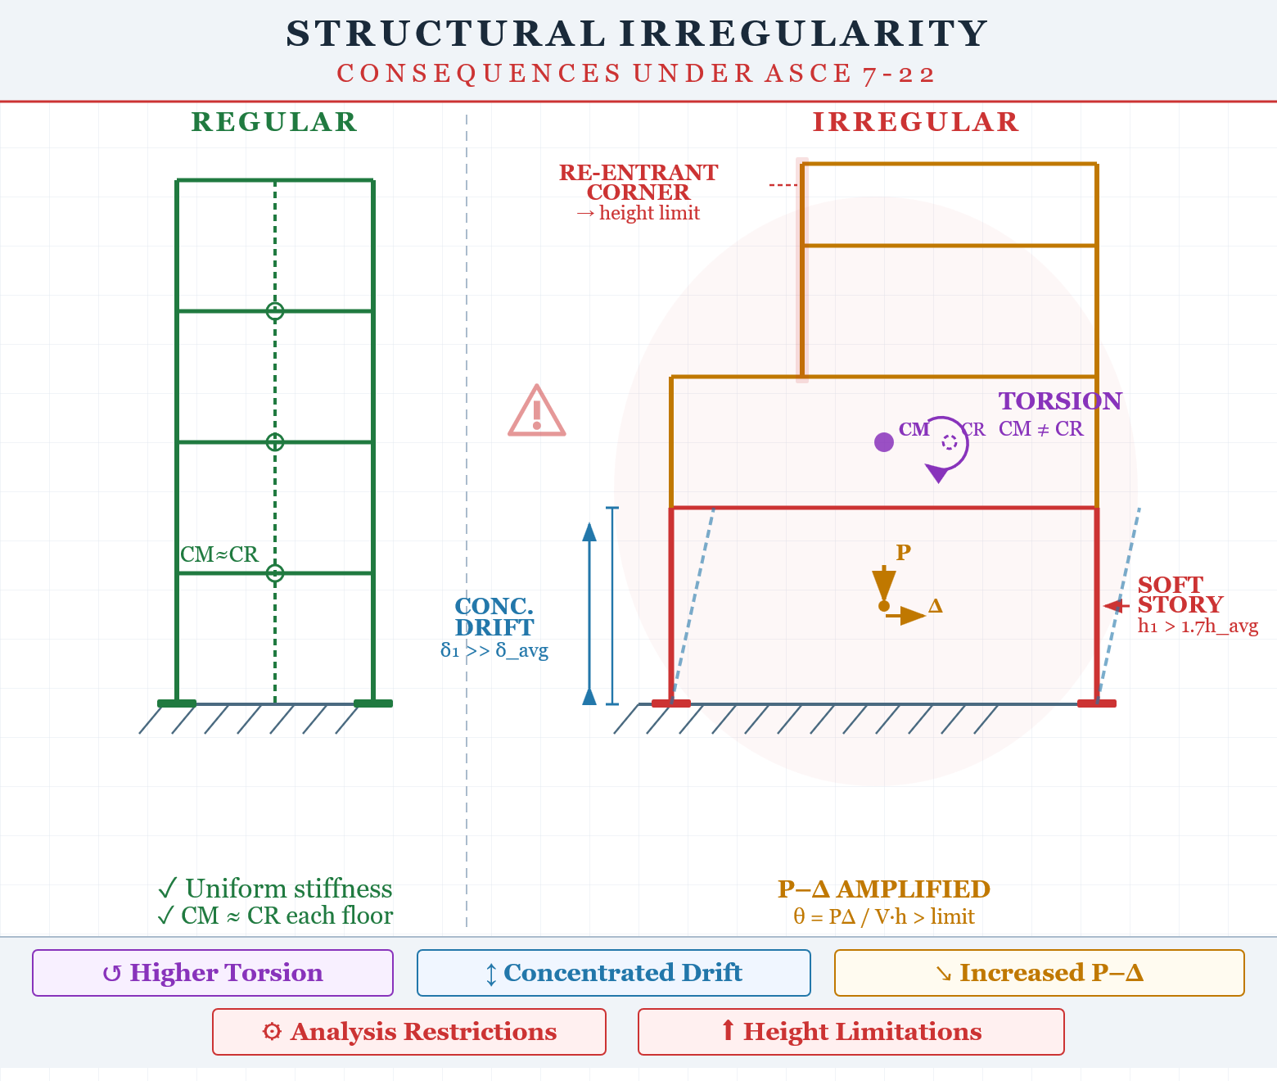
Irregularities
Irregularity →
Higher torsion
Concentrated drift
Increased P–Δ
Analysis restrictions
Height limitations

Slide 34
Vibrationdata
Irregular Consequences
Irregularity | Effect | Code Consequence
Torsional | Edge drift amplification | Ax required
Soft Story | Drift concentration | Dynamic analysis
Weak Story | Collapse risk | Prohibited in high SDC
Diaphragm Discontinuity | Force redistribution | Collector design
Ax​ is the torsional amplification factor applied at a given story level x
It increases the design torsional moment when a building has torsional irregularity

Slide 35
Vibrationdata
Irregular Code Consequence Summary
Irregularity | Analysis | Height | Amplification
Torsional | MRSA required | Limited | Ax
Extreme Torsion | ELF prohibited | Severe | Ax > 1
Soft Story | Dynamic | Restricted | Drift amplified
Weak Story | Prohibited in D/E/F | N/A | Collapse risk
Diaphragm Discontinuity | Collector Ω₀ | Limited | Redistribution
Modal Response Spectrum Analysis (MRSA)

Slide 36
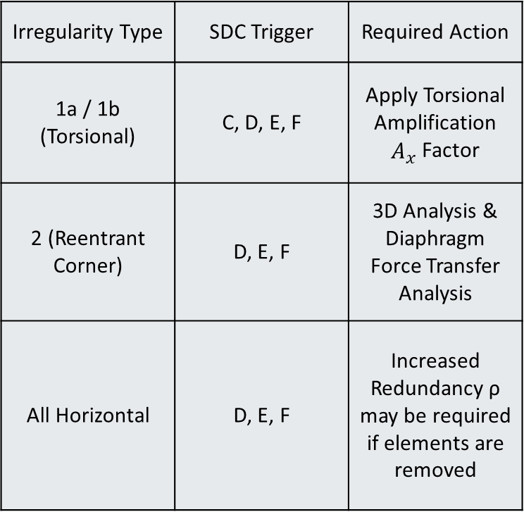
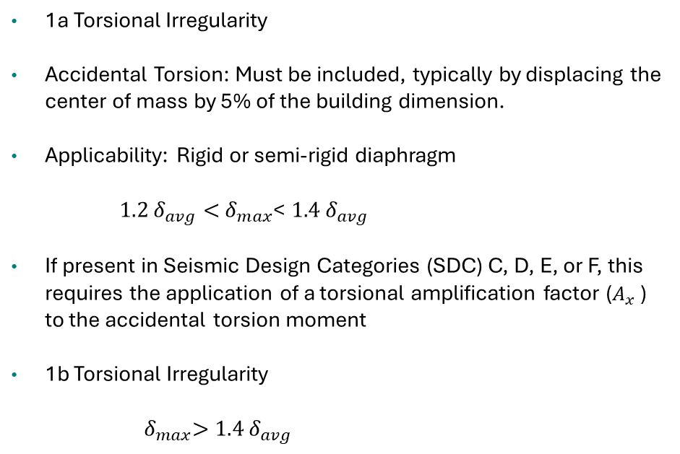
Vibrationdata
Irregularity Types
1a Torsional Irregularity
Accidental Torsion: Must be included, typically by displacing the center of mass by 5% of the building dimension.
Applicability: Rigid or semi-rigid diaphragm
$1.2 δ_{avg}<{ δ}_{max}$< $1.4 δ_{avg}$
If present in Seismic Design Categories (SDC) C, D, E, or F, this requires the application of a torsional amplification factor ($A_{x}$ ) to the accidental torsion moment
1b Torsional Irregularity
${ δ}_{max}>$ $1.4 δ_{avg}$
Irregularity Type | SDC Trigger | Required Action
1a / 1b (Torsional) | C, D, E, F | Apply Torsional Amplification $A_{x}$ Factor
2 (Reentrant Corner) | D, E, F | 3D Analysis & Diaphragm Force Transfer Analysis
All Horizontal | D, E, F | Increased Redundancy ρ may be required if elements are removed

Slide 37
Irregularity Types (cont)
Vibrationdata
Type 2: Reentrant Corners
Definition: Occurs in L, T, U, or H-shaped buildings where the "projections" (the wings) are longer than 15% of the total plan dimension in that direction
The Risk: The "inside corner" of the building becomes a stress concentration point where the two wings pull in different directions
Type 3: Diaphragm Discontinuity
Definition: Occurs when the floor system (the diaphragm) has large cutouts or open areas (like a massive atrium) that exceed 50% of the total gross area, or when the stiffness of the floor changes by more than 50% from one story to the next
The Risk: The floor isn't "stiff" enough to transfer the seismic forces to the walls or frames
Type 4: Out-of-Plane Offsets
Definition: Occurs when there is a "jog" in the lateral force path. For example, a shear wall on the 3rd floor does not sit directly above the shear wall on the 2nd floor.
The Risk: This creates massive "overturning" forces on the floor system that has to bridge the gap between the two walls.

Slide 38
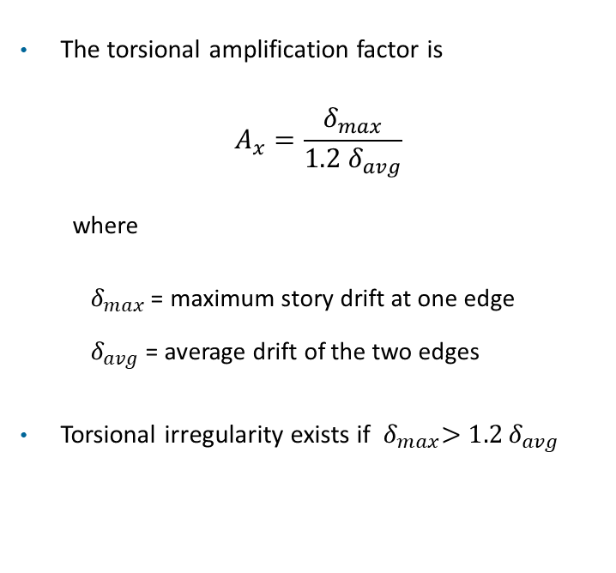
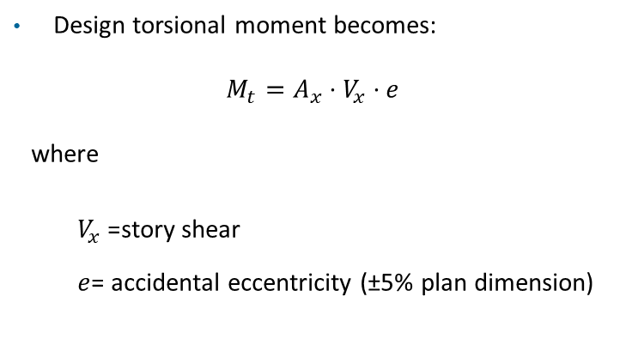
Vibrationdata
Torsional Amplification Factor
The torsional amplification factor is
$$A_{x}=\frac{δ_{max}}{1.2{ δ}_{avg}}$$
where
$δ_{max}$= maximum story drift at one edge
$δ_{avg}$= average drift of the two edges
Torsional irregularity exists if ${ δ}_{max}>1.2 δ_{avg}$
Design torsional moment becomes:
$$M_{t}=A_{x}⋅V_{x}⋅e$$
where
$V_{x}$= story shear
$e$= accidental eccentricity (±5% plan dimension)

Slide 39
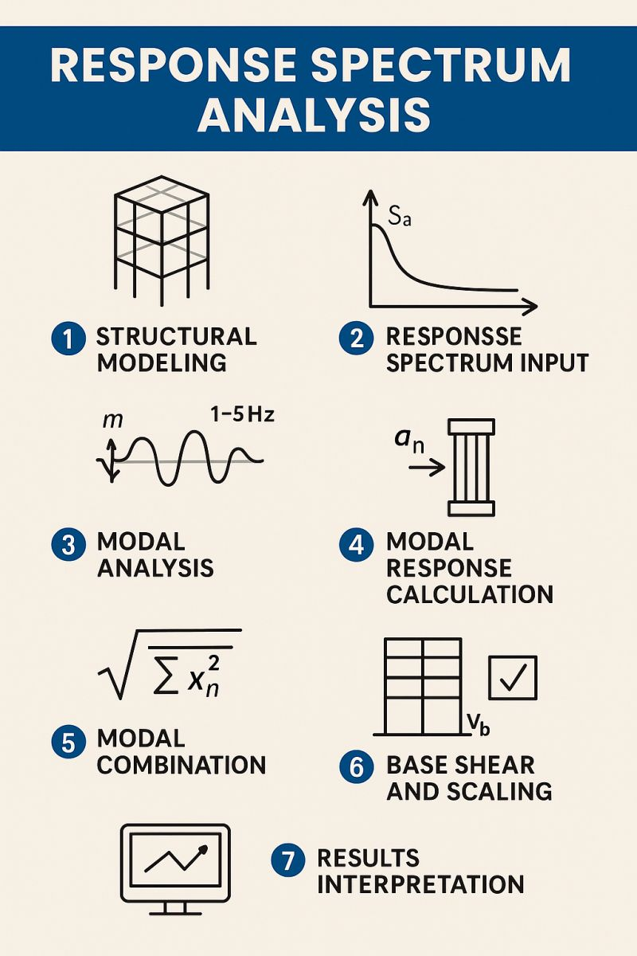
Vibrationdata
https://www.linkedin.com/posts/mohdabdulmannankhan_response-spectrum-analysis-rsa-is-a-seismic-activity-7328031801552134145-Jghn/

Slide 40
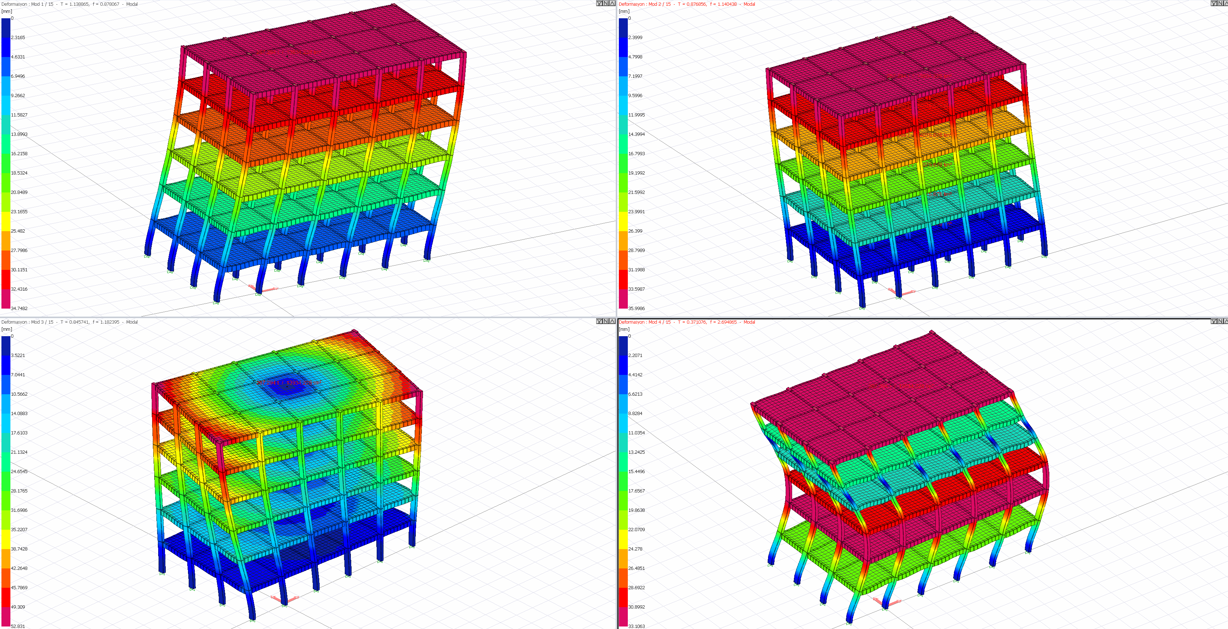
Vibrationdata
Modal Analysis
ASCE 7-22 §12.9
Required when:
Structure is irregular
T > limits
SDC D, E, F and exceeds height limits
Torsional irregularity or extreme torsion
Modal analysis better captures:
Higher mode effects
Irregular mass/stiffness
Tall buildings
https://help.idecad.com/ideCAD/mode-shapes-and-modal-vibration-periods

Slide 41
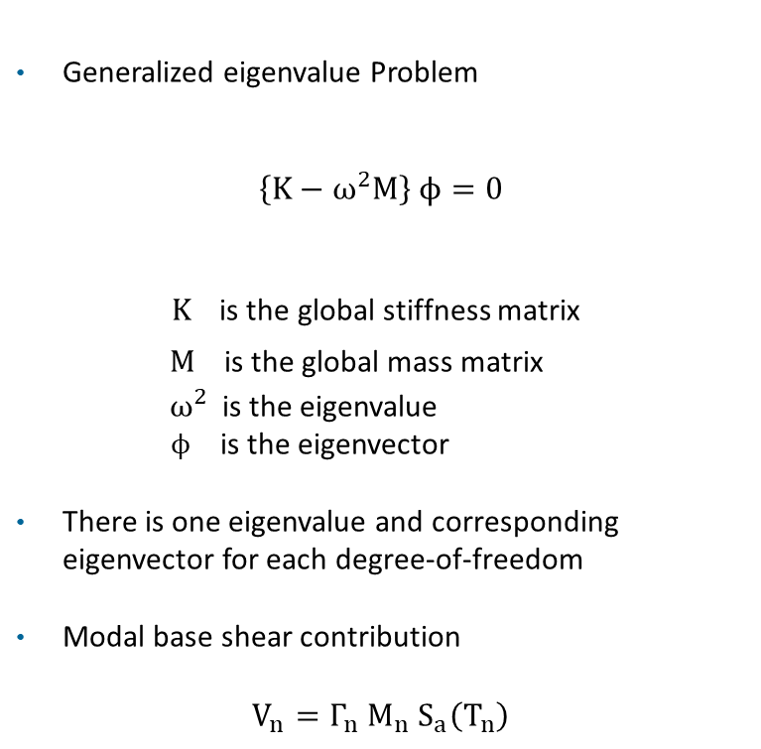
Vibrationdata
Modal Response Spectrum Analysis (MRSA)
Solves eigenvalue problem
→ natural frequencies & mode shapes
Computes modal participation factors
Extracts spectral accelerations from design spectrum
Combines modal responses (SRSS or CQC)
Square-root-of-the-sum-of-the-squares (SRSS)
Complete Quadratic Combination (CQC)
Captures higher-mode effects and torsion
Generalized eigenvalue Problem
$$\left\{K−ω^{2}M\right\} ϕ=0$$
$K$is the global stiffness matrix
$M$ is the global mass matrix
${ ω}^{2}$is the eigenvalue
$ϕ$ is the eigenvector
There is one eigenvalue and corresponding eigenvector for each degree-of-freedom
Modal base shear contribution
$$V_{n}={\text{Γ}}_{n}{ M}_{n}{ S}_{a}\left(T_{n}\right)$$

Slide 42
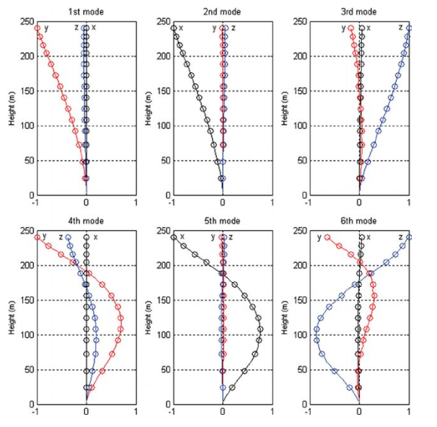
Vibrationdata
MRSA
Include sufficient modes to capture ≥ 90% mass participation
Include accidental torsion
Apply torsional amplification factor Ax when required
Use 5% damping unless otherwise justified
Image courtesy of K.T. Tse

Slide 43
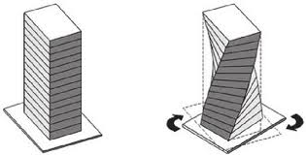
Vibrationdata
ELF & MRSA Comparison
ELF | MRSA
Assumes dominant first mode | Includes multiple modes
Cannot capture torsion properly | Includes rotational DOF
Limited for tall buildings | Accurate for higher-mode response
Static force pattern | Dynamic modal superposition

Slide 44
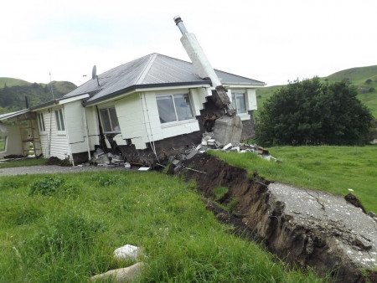
Vibrationdata
Near Fault Effects, SDC F
Located near major active faults
Large spectral accelerations (high SDS and/or SD1)
Often governed by long-period ground motion effects
Strong potential for pulse-like ground motions
Velocity Pulses (Near-Fault Directivity)
Caused by rupture propagation toward the site
Produces large, concentrated velocity pulse
Energy delivered in one or two strong cycles
Can dramatically increase displacement demand
Bluff Station, Kēkerengū Valley, Kaikoura, New Zealand earthquake 2016
https://www.tasman.govt.nz/my-region/environment/environmental-management/natural-hazards/geological-hazards/earthquake-faults

Slide 45
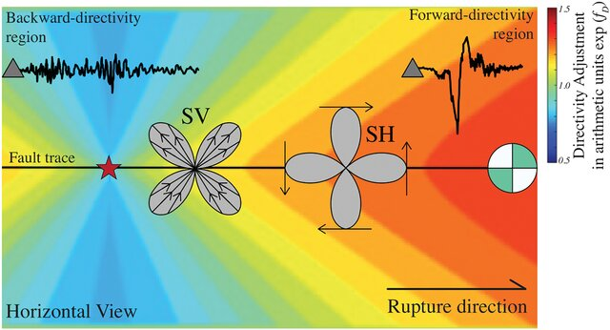
Vibrationdata
Near Fault Effects, SDC F
Circle with green & white quadrants is a “beachball”
Fault type (strike-slip, normal, reverse, oblique
In this earthquake radiation pattern (horizontal view), SV and SH refer to the two types of S-waves (shear waves), distinguished by their particle motion direction
SV Wave — Shear Vertical
SH Wave — Shear Horizontal

Slide 46
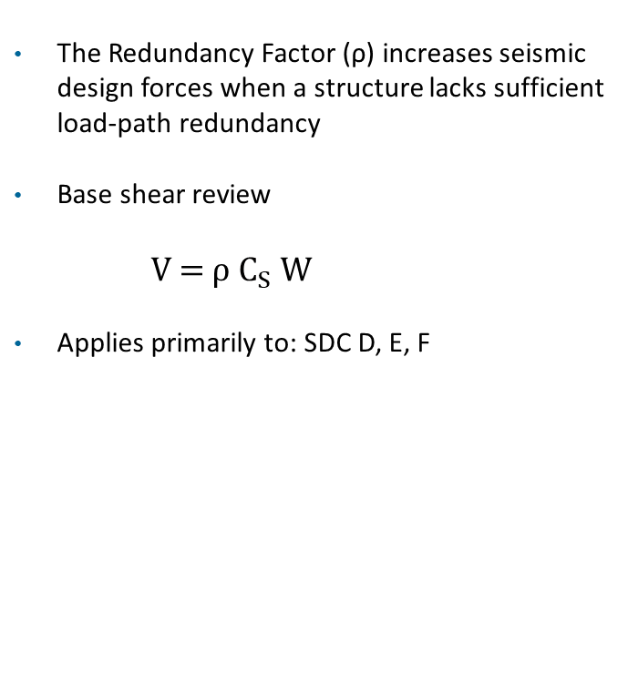
Vibrationdata
Redundancy Factor ρ
The Redundancy Factor (ρ) increases seismic design forces when a structure lacks sufficient load-path redundancy
Base shear review
V = ρ $C_{S}$ ​W
Applies primarily to: SDC D, E, F
A building is redundant if:
Multiple lateral-force-resisting elements share load
Loss of one element does not cause disproportionate failure
More than two lines of resistance per direction (typical threshold
Condition | ρ Value
Adequate redundancy | 1
Limited redundancy | 1.3

Slide 47
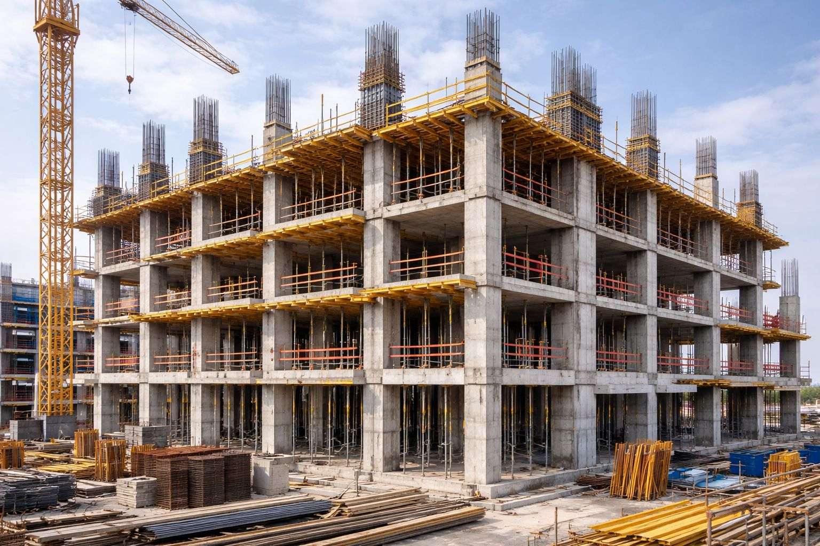
Vibrationdata
Structural Redundancy
High redundancy reinforced concrete moment frame building under construction.
Multiple moment frames in both directions provide distributed lateral load paths.
Loss or yielding of a single column or beam can be redistributed to adjacent bays.
Continuous beam-column framing supports ductile plastic hinge formation across many members.
Floor slabs act as diaphragms to transfer seismic forces to multiple frame lines.
https://www.facebook.com/groups/705929013755256/posts/1632814721066676/

Slide 48
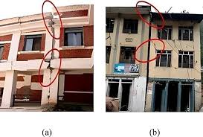
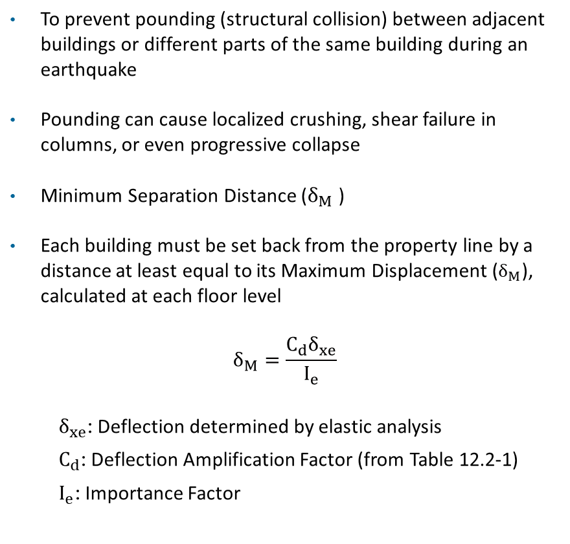
Vibrationdata
Seismic Separation Gap
To prevent pounding (structural collision) between adjacent buildings or different parts of the same building during an earthquake
Pounding can cause localized crushing, shear failure in columns, or even progressive collapse
Minimum Separation Distance ($δ_{M}$ )
Each building must be set back from the property line by a distance at least equal to its Maximum Displacement ($δ_{M}$), calculated at each floor level
$$δ_{M}=\frac{C_{d}δ_{xe}}{I_{e}}$$
$δ_{xe}$: Deflection determined by elastic analysis
$C_{d}$: Deflection Amplification Factor (from Table 12.2-1)
$I_{e}$: Importance Factor
Assessing seismic gap in adjacent RC buildings post Gorkha earthquake in Nepal, Aviral Upadhayay, et al.

Slide 49
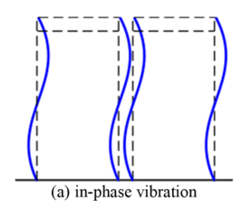
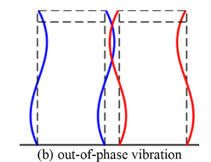
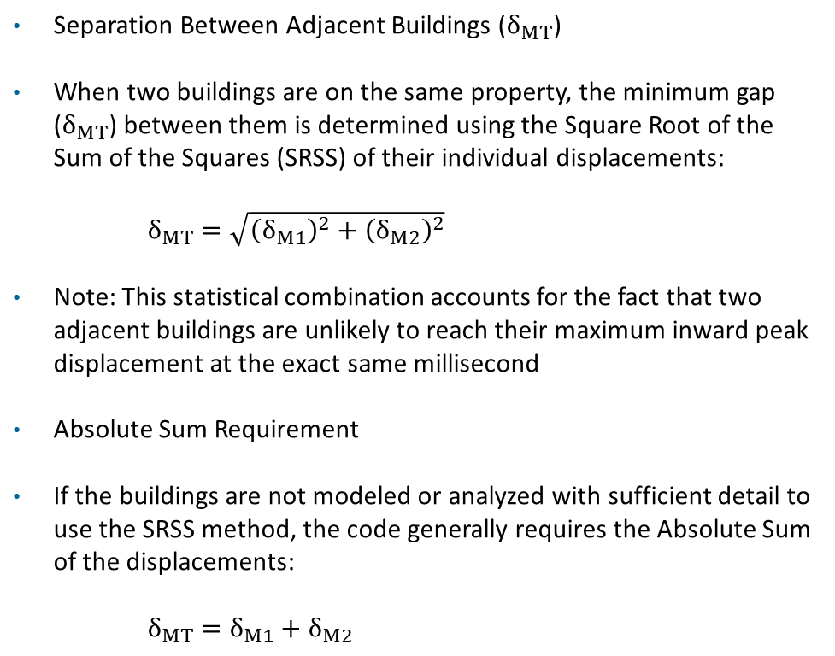
Vibrationdata
Seismic Separation Gap (cont)
Separation Between Adjacent Buildings ($δ_{MT}$)
When two buildings are on the same property, the minimum gap ($δ_{MT}$) between them is determined using the Square Root of the Sum of the Squares (SRSS) of their individual displacements:
$δ_{MT}=\sqrt{{\left(δ_{M1}\right)}^{2}+{\left(δ_{M2}\right)}^{2}}$
Note: This statistical combination accounts for the fact that two adjacent buildings are unlikely to reach their maximum inward peak displacement at the exact same millisecond
Absolute Sum Requirement
If the buildings are not modeled or analyzed with sufficient detail to use the SRSS method, the code generally requires the Absolute Sum of the displacements:
$δ_{MT}=δ_{M1}+δ_{M2}$

