Slide 1
Vibrationdata
ASCE 7-22, Chapter 11,
Seismic Design Criteria
Revision A
By Tom Irvine

Slide 2
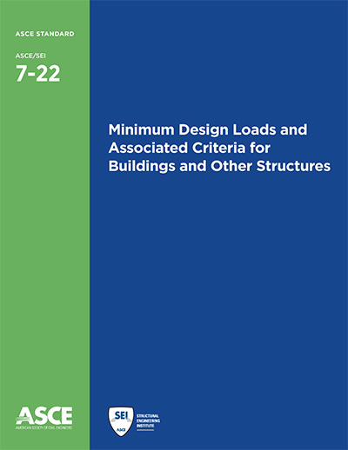
Vibrationdata
Introduction
Purpose: To present criteria for the design and construction of buildings and other structures subject to earthquake ground motions
Core Philosophy: Earthquake loads are based on the post-elastic energy dissipation of the structure
Key Requirement: Design and detailing requirements must be met even if other load combinations (like wind) result in higher demands

Slide 3

Vibrationdata
Scope & Applicability
General Scope: Applies to every structure and portion thereof, including nonstructural components.
Categorization by Chapter:
  Seismic Design Criteria: Chapter 11
  Buildings: Chapter 12
  Nonstructural Components: Chapter 13
  Material-Specific Seismic Design Requirements: Chapter 13
  Nonbuilding Structures: Chapter 15
  Nonlinear Response History Procedure: Chapter 16
  Seismically Isolated Structures: Chapter 17
  Structures with Damping Systems: Chapter 18
Alcoa Building with diagonal exterior bracing, San Francisco

Slide 4
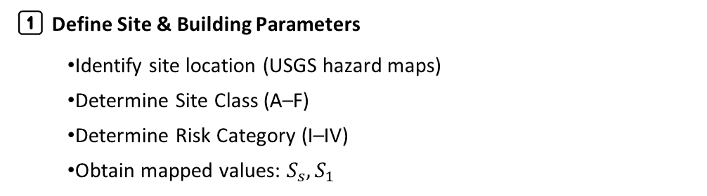
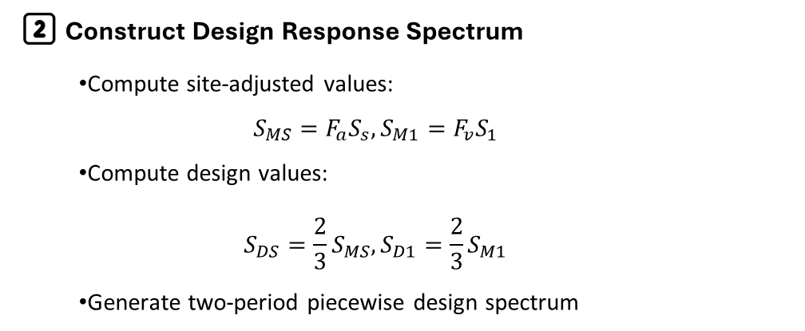
Vibrationdata
Workflow
1️⃣ Define Site & Building Parameters
  Identify site location (USGS hazard maps)
  Determine Site Class (A–F)
  Determine Risk Category (I–IV)
  Obtain mapped values: $S_{s},S_{1}$
2️⃣ Construct Design Response Spectrum
  Compute site-adjusted values:
  $$S_{MS}=F_{a}S_{s}, S_{M1}=F_{v}S_{1}$$
  Compute design values:
  $$S_{DS}=\frac{2}{3}S_{MS}, S_{D1}=\frac{2}{3}S_{M1}$$
  Generate two-period piecewise design spectrum

Slide 5

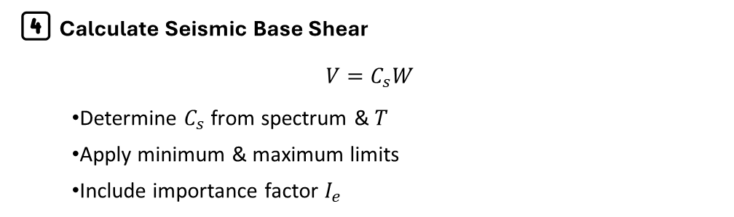
Vibrationdata
Workflow (cont)
3️⃣ Determine Fundamental Period $T$
  Approximate period $T_{a}($code formula)
  Analytical period (Rayleigh / Eigenvalue)
  Apply upper-bound limits per §12.8.2.1
4️⃣ Calculate Seismic Base Shear
$$V=C_{s}W$$
  Determine $C_{s}$ from spectrum & $T$
  Apply minimum & maximum limits
  Include importance factor $I_{e}$

Slide 6
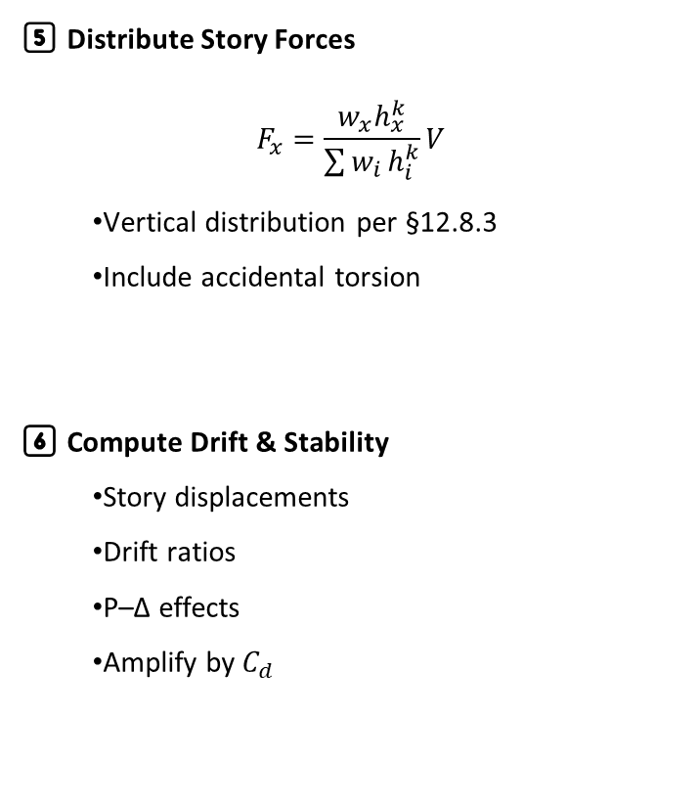
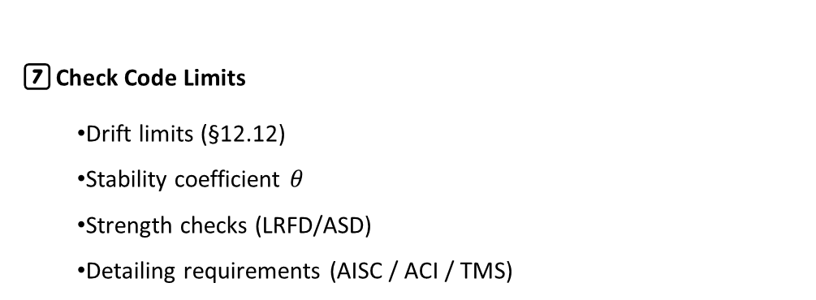
Vibrationdata
Workflow (cont)
7️⃣ Check Code Limits
  Drift limits (§12.12)
  Stability coefficient $θ$
  Strength checks (LRFD/ASD)
  Detailing requirements (AISC / ACI / TMS)
5️⃣ Distribute Story Forces
$$F_{x}=\frac{w_{x}h_{x}^{k}}{\sum{w_{i}}h_{i}^{k}}V$$
  Vertical distribution per §12.8.3
  Include accidental torsion
6️⃣ Compute Drift & Stability
  Story displacements
  Drift ratios
  P–Δ effects
  Amplify by $C_{d}$

Slide 7
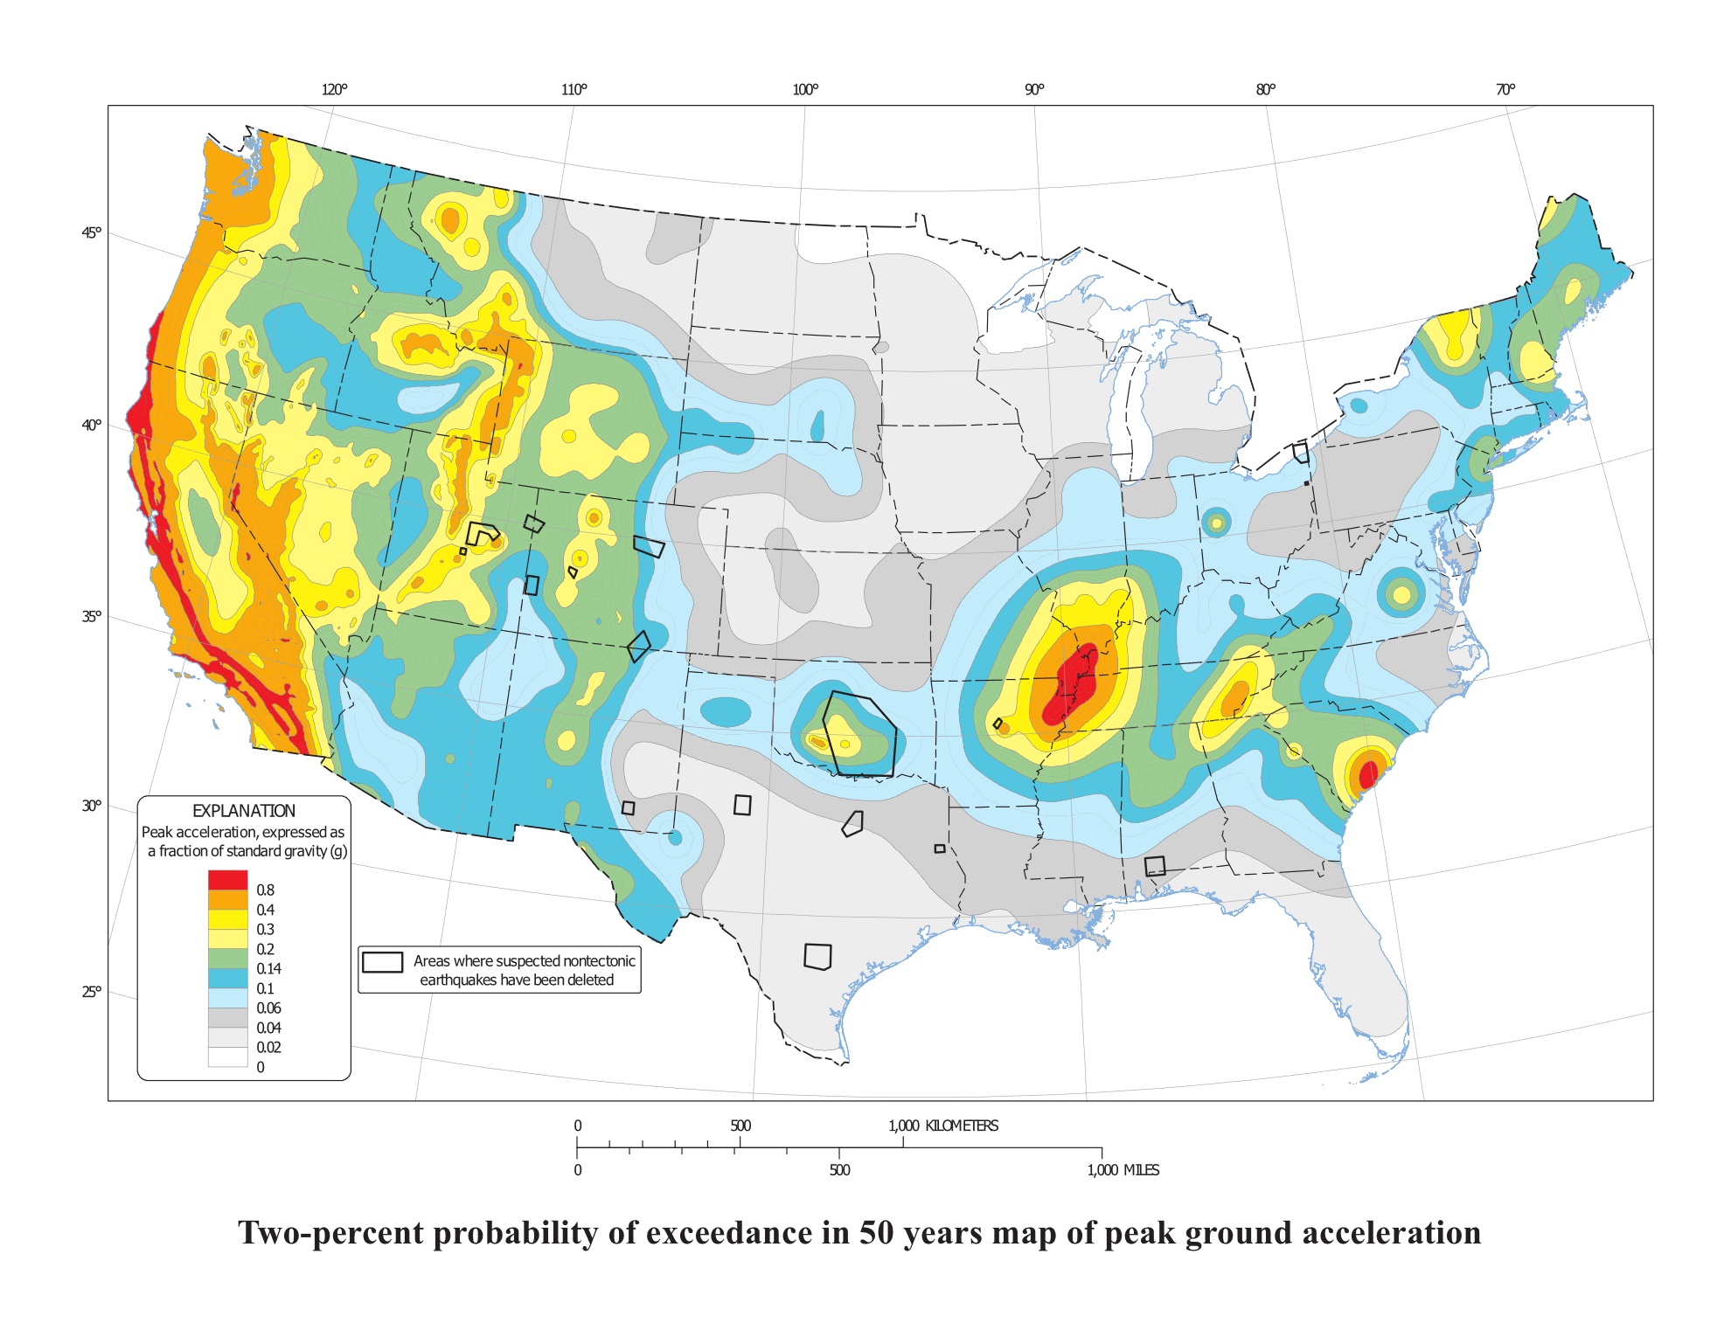

Slide 8
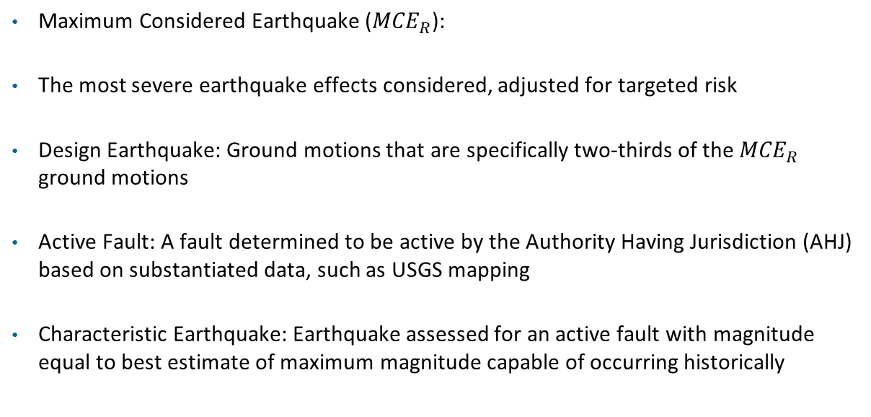
Vibrationdata
Seismic Ground Motion Concepts
Maximum Considered Earthquake (${MCE}_{R}$):
The most severe earthquake effects considered, adjusted for targeted risk
Design Earthquake: Ground motions that are specifically two-thirds of the ${MCE}_{R}$ ground motions
Active Fault: A fault determined to be active by the Authority Having Jurisdiction (AHJ) based on substantiated data, such as USGS mapping
Characteristic Earthquake: Earthquake assessed for an active fault with magnitude equal to best estimate of maximum magnitude capable of occurring historically

Slide 9

Vibrationdata
Maximum Considered Earthquake (${MCE}_{R}$)
MCER in ASCE 7-22 corresponds approximately to ground motions with a 2% probability of exceedance in 50 years (about a 2475-year return period), but the mapped values are risk-targeted rather than purely probabilistic
The risk-targeting adjusts the hazard so that buildings designed per ASCE 7 have roughly a 1% probability of collapse in 50 years, producing more uniform national collapse risk compared to the older purely 2%/50-year definition
The design response spectrum used in practice is 2/3 of the MCER spectrum, meaning code-level forces are intentionally reduced below the maximum considered shaking while relying on ductility, overstrength, and detailing to prevent collapse
Thus, the 2% relates to earthquake shaking probability, while the 1% relates to structural collapse probability, and they describe different aspects of seismic risk within the same design framework

Slide 10
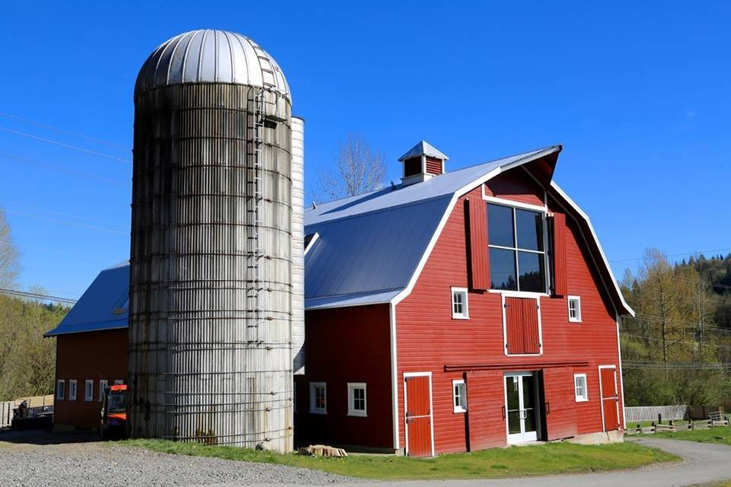
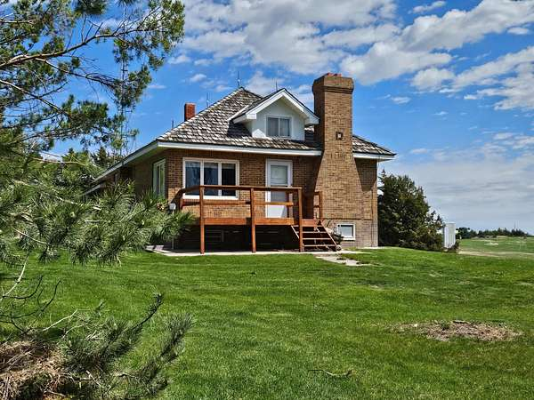
Vibrationdata
Seismic Exemptions
Not all structures must comply with ASCE 7-22 seismic requirements; several categories are explicitly exempted
Detached Dwellings: One- and two-family dwellings in SDC A or B are fully exempt; those in SDC C with Ss < 0.35g are exempt from most Chapter 12 detailing requirements
Agriculture: Storage structures intended only for incidental human occupancy
Public Access: Piers and wharves not accessible to the general public
Structures with Dedicated Codes: Vehicular bridges, electrical transmission towers, hydraulic structures, buried utility pipelines, and nuclear reactors are governed by their own regulatory frameworks and are exempt from ASCE 7 seismic provisions
SDC A Structures: Buildings assigned to Seismic Design Category A need only meet the minimum structural integrity requirements of §11.7 and are not required to perform a full seismic analysis
Important Note: Exemption from ASCE 7 seismic provisions does not override other governing codes (e.g., state building codes or federal regulations) that may still impose seismic requirements on those structures

Slide 11
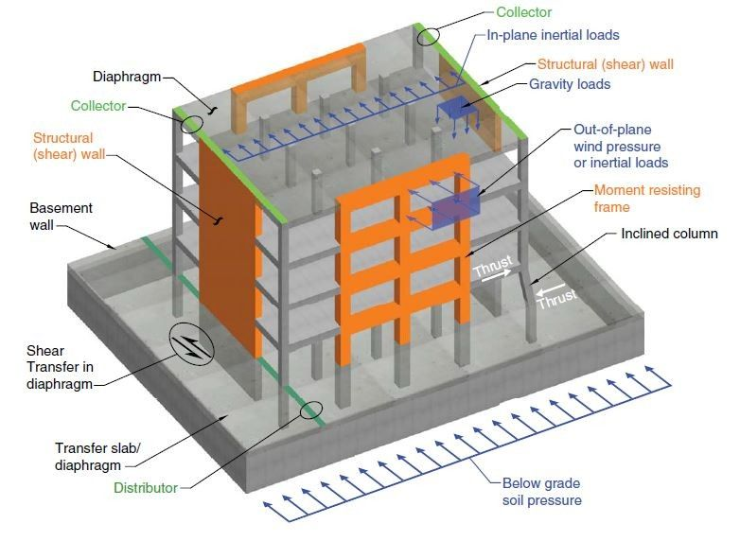
Building Diagram
Vibrationdata
https://www.linkedin.com/posts/engr-nurislam-gazi_why-diaphragms-are-used-in-buildings-what-activity-7319215231379849216-3nD6/

Slide 12
Vibrationdata
Key Structural Definitions
Understanding these terms is critical for the design process:
Base: The level where horizontal seismic ground motions are imparted to the structure
Base Shear (V ): The total design lateral force or shear at the base of the structure
Diaphragm: Roof, floor, or other membranes that transfer lateral forces to the vertical resisting elements
Seismic Force-Resisting System (SFRS): The specific part of the structural system designed to resist prescribed seismic forces
Boundary Elements: Portions along wall and diaphragm edges for transferring/resisting forces. Includes chords, collectors, diaphragm and shear wall perimeter
Building: Any structure whose intended use includes shelter for human occupants
Component: Part of architectural, electrical, or mechanical system within or without a building or nonbuilding structure (can be rigid, flexible, or nonstructural)

Slide 13
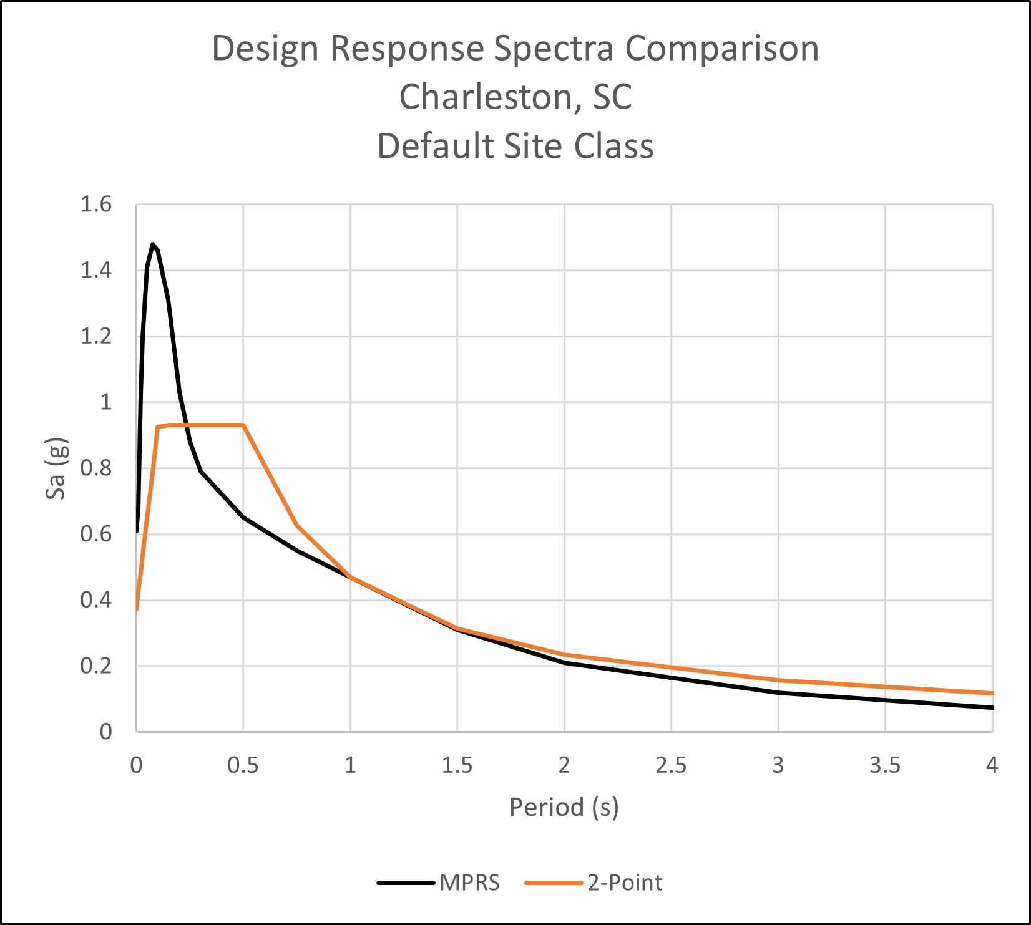
Vibrationdata
Response Spectra
The parameters in the following slides are used to derive the response spectrum curves
Multi-Period Response Spectrum (MPRS)
ASCE response spectrum curves typically do not show damping but imply 5% damping
The x-axis label is “Period (sec)” which is the inverse of “Natural Frequency (Hz)”

Slide 14
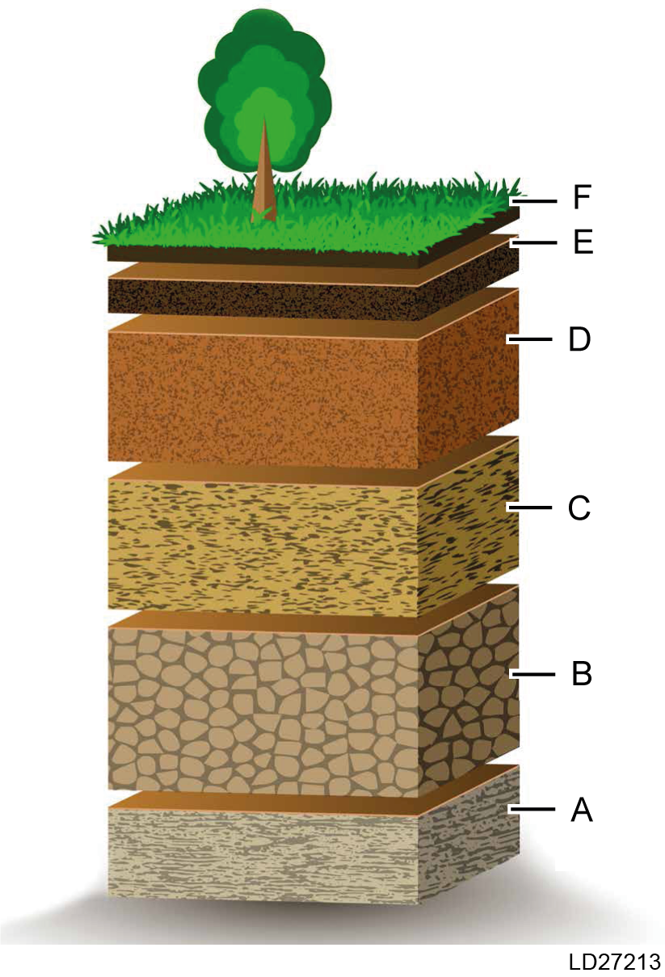
Vibrationdata
Site Classes
Site Class | Description | Typical Ground | Vs Trend | Velocity (m/sec)
A | Hard Rock | Very stiff, little amplification | Very high | Vs > 1500
B | Medium Hard Rock | Competent rock | High | 760 < Vs < 1500
C | Very Dense Soil / Soft Rock | Dense soils, hard clays | Moderate | 360 < Vs < 760
D | Stiff Soil | Medium dense soils | Lower | 180 < Vs < 360
E | Soft Soil | Very loose sands, soft clays | Low | Vs < 180
F | Soils requiring response analysis | Liquefiable or complex soils | Highly variable | Site Specific Evaluation
Vs or Vs30 is shorthand for average shear-wave velocity to 30 m depth, a key metric used in site classification
Image courtesy of Johnson Controls

Slide 15
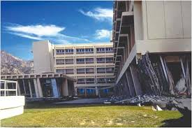
Vibrationdata
Risk Categories
Risk Category | Meaning | Typical Examples | Importance Factor I_{e} | Typical Interstory Lateral Drift Limit
I | Low risk to life if failure occurs | Barns, sheds, low-occupancy storage | 1.00 | 0.020 h
II | Ordinary risk structures (most buildings) | Homes, offices, retail | 1.00 | 0.020 h
III | Substantial hazard to life & community | Schools, assembly buildings, prisons | 1.25 | 0.015 h
IV | Essential facilities — must remain operational | Hospitals, fire/police stations | 1.50 | 0.010 h
Olive View Hospital, Los Angeles, San Fernando earthquake 1971
h is the story height measured between floor levels

Slide 16
Vibrationdata
Key Parameters
Parameters | Meaning | Units | Notes
Sₛ | Mapped MCER short-period (for Site Class B/C) | G | From USGS seismic hazard maps (MCER)
S₁ | Mapped MCER at 1 sec (for Site Class B/C) | G | From USGS seismic hazard maps (MCER)
Fₐ | Short-period site coefficient | — | Adjusts Sₛ for local site effects (soil)
Fᵥ | Long-period site coefficient | — | Adjusts S₁ for local site effects (soil)
S_{MS} | Site-adjusted MCER spectral response acceleration, short periods | G | = Fₐ × Sₛ (in editions where this applies)
S_{M1} | Site-adjusted MCER spectral response acceleration at 1 sec | G | = Fᵥ × S₁ (in editions where this applies
“B/C” represents the boundary between Site Class B (rock) and Site Class C (very dense soil / soft rock)

Slide 17
Vibrationdata
Key Parameters
Parameters | Meaning | Units | Notes
S_{DS} | Design spectral acceleration, short periods | G | = 2/3 × S_{MS}
S_{D1} | Design spectral acceleration, 1 sec | G | = 2/3 × S_{M1}
Tₛ | Transition period | sec | = S_{D1} / S_{DS}
T₀ | 0.2 × Tₛ | sec | Defines lower bound period
TL | Long-period transition | sec | Used in design spectrum shape
TL​ is the corner period in the response spectrum that marks the transition between the “constant velocity” segment and the “constant displacement” segment of the design spectrum
T_{s} is the transition period between the constant-acceleration and constant-velocity regions of the design response spectrum

Slide 18
Vibrationdata
Response Spectra Comparison
5% damping is assumed but not stated
Spectrum Type | What It Represents | Key Parameters Used | Typical Use | Level of Detail
Horizontal | Design horizontal response spectrum (most common) | SDS, SD1, TL | Building seismic design, base shear, modal analysis | Standard design spectrum
Vertical | Vertical seismic response spectrum | Derived from horizontal spectrum (code-defined ratios) | Equipment anchorage, vertical members, nuclear/industrial | Simplified vertical amplification
Two-Period | Simplified spectrum defined by only SDS & SD1 | SDS, SD1 | Equivalent Lateral Force (ELF) procedure | Simplified envelope spectrum
Multi-Period | Full site-specific multi-point design spectrum | Multi-period ordinates from USGS | Modal response spectrum analysis | Highest resolution / most accurate

Slide 19
Vibrationdata
Response Spectra Notes
Two-Period Design Response Spectrum is the classic ASCE spectrum used for:
  Equivalent Lateral Force (ELF) procedure
  Most building design
  Base shear calculations
  Vertical distribution of forces
  It is defined by two parameters only:
  SDS → short-period design spectral acceleration
  SD1 → 1-second design spectral acceleration
ASCE 7-22 allows use of the multi-period spectrum directly from USGS
The actual spectral values at many periods are returned by USGS instead of reconstructing a simplified shape from SDS & SD1

Slide 20
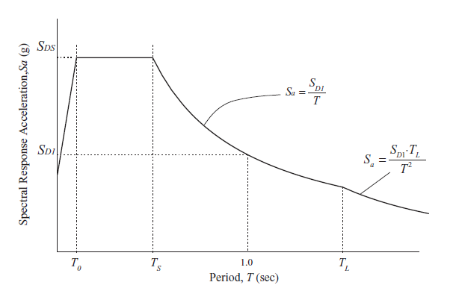
Vibrationdata
Two-Period Design Response Spectrum

Slide 21
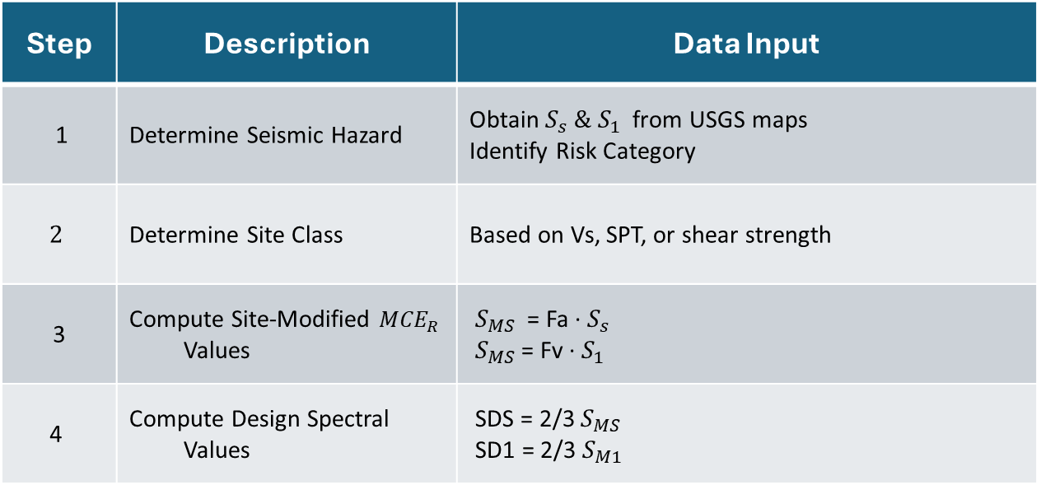
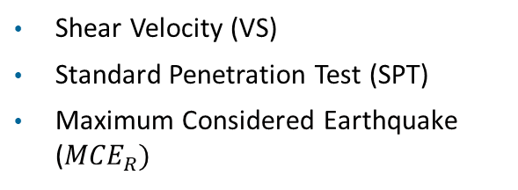
Vibrationdata
Design Workflow
Step | Description | Data Input
1 | Determine Seismic Hazard | Obtain $S_{s} \& S_{1}$ from USGS maps Identify Risk Category
$$2$$ | Determine Site Class | Based on Vs, SPT, or shear strength
3 | Compute Site-Modified ${MCE}_{R}$ Values | $S_{MS}$ = Fa · $S_{s}$ $S_{MS}$= Fv · $S_{1}$
4 | Compute Design Spectral Values | SDS = 2/3 $S_{MS}$ SD1 = 2/3 $S_{M1}$
Shear Velocity (VS)
Standard Penetration Test (SPT)
Maximum Considered Earthquake (${MCE}_{R})$
https://www.usgs.gov/programs/earthquake-hazards/design-ground-motions

Slide 22
Vibrationdata
Design Workflow (Cont)
Step | Description | Data Input
5 | Compute Design Spectral Values | SMS, SM1
6 | Define the Design Response Spectrum shape | SDS, SD1, TL
7 | Build the full piecewise spectrum Sa(T) | T, SDS, SD1, TL, T0, Ts
8 | Check special site requirements (if applicable) | Site Class E/F, near-fault issues, soft soils
Shear Velocity (VS)
Standard Penetration Test (SPT)
Maximum Considered Earthquake (${MCE}_{R})$

Slide 23
Vibrationdata
Example
Derive response spectra
Generic hospital
Site Class D, Stiff Soil
Risk Category IV, Essential Facilities

Slide 24
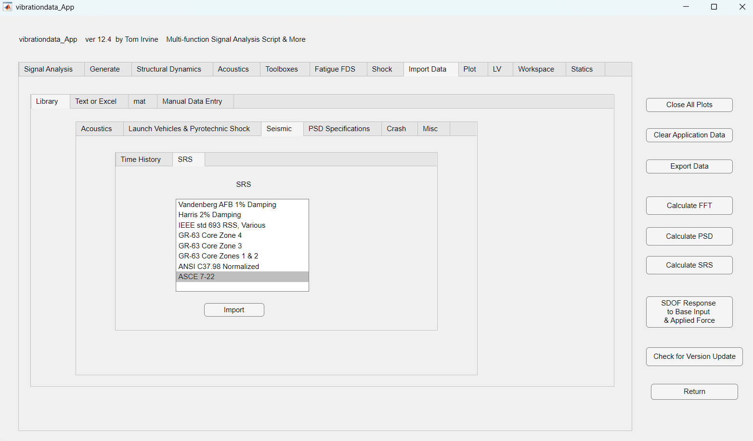

Slide 25
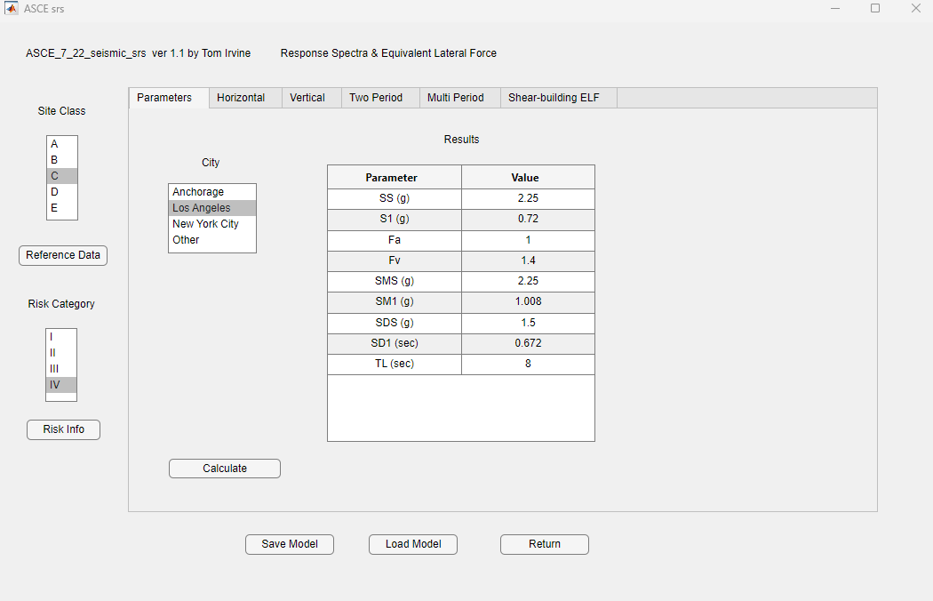

Slide 26
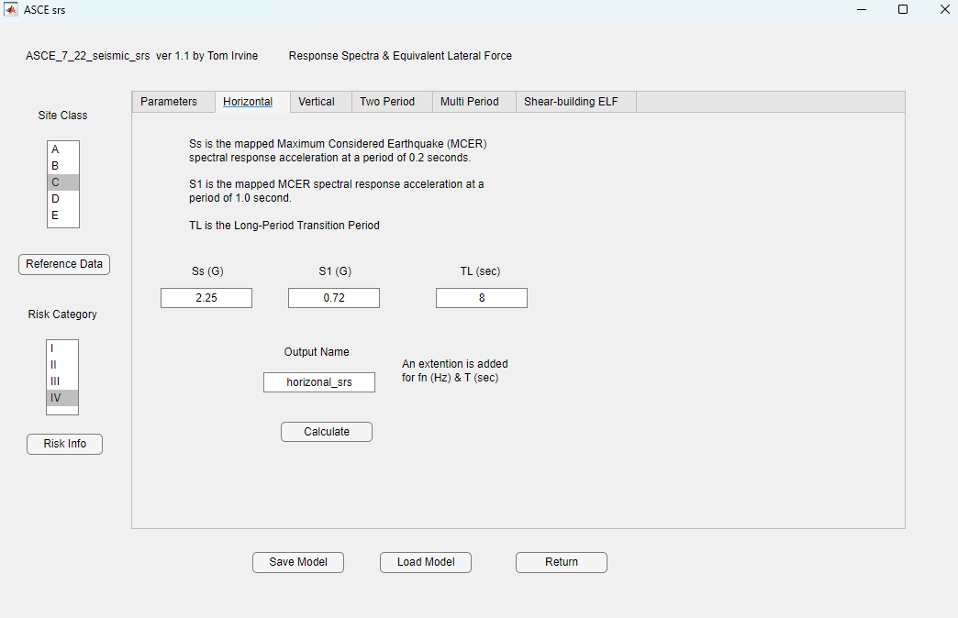

Slide 28
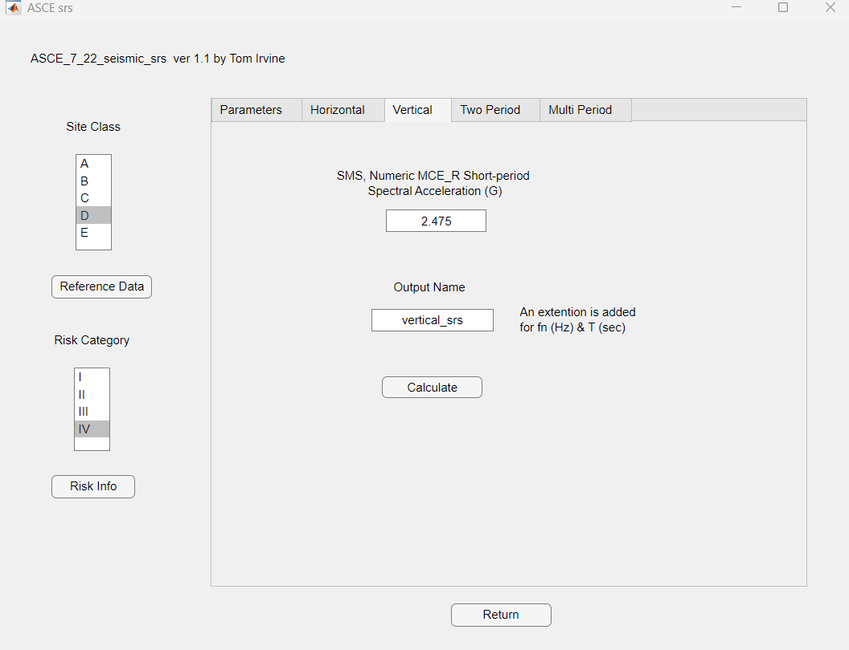

Slide 30
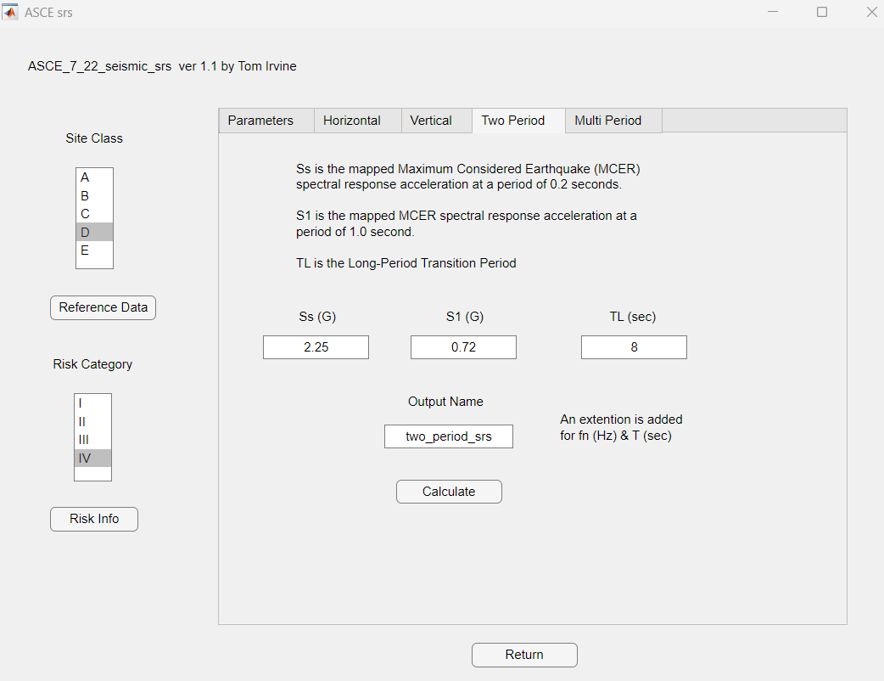

Slide 32
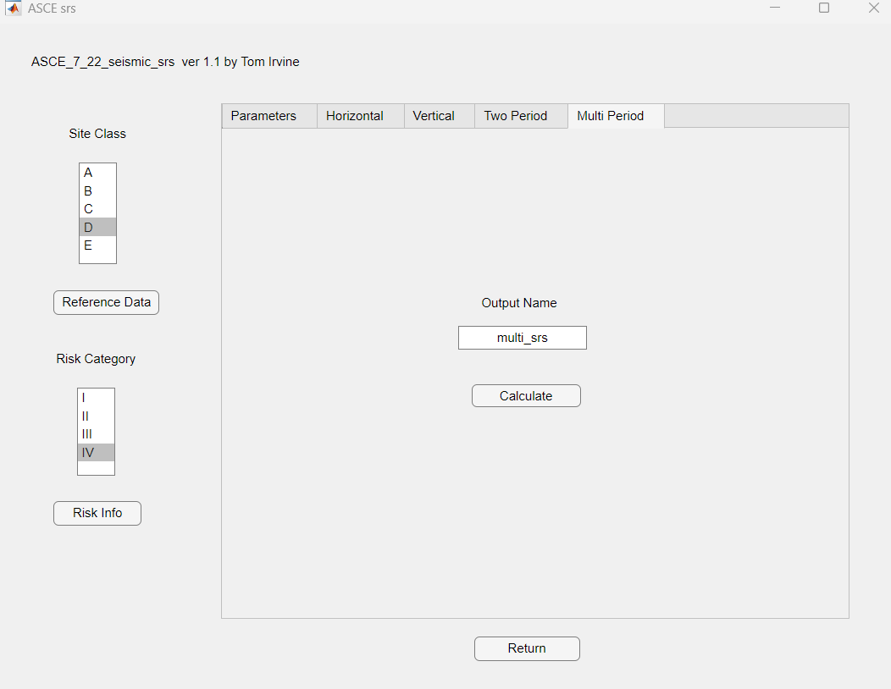

Slide 33
The Multi-period Response Spectrum (MPRS) is a smooth curve defined by discrete spectral values at specific periods from USGS probabilistic hazard data

Slide 34
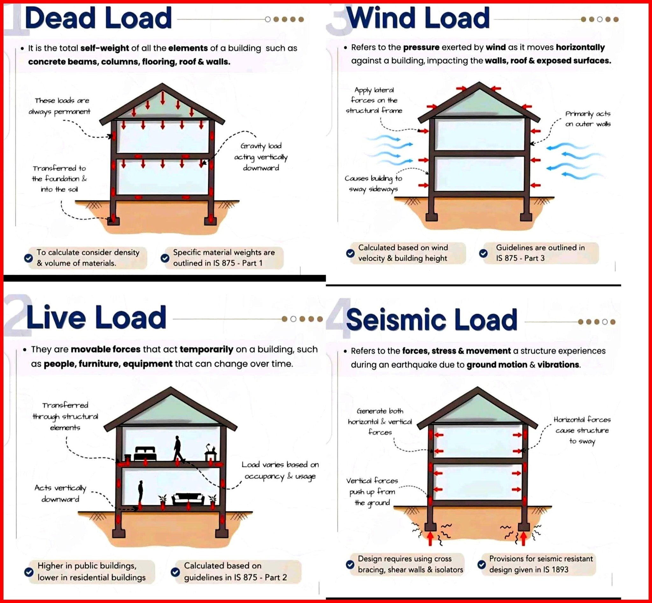

Slide 35
Vibrationdata
Effective Seismic Weight W
W is the total of loads that contribute to a building’s inertial forces during an earthquake
W includes:
  All dead loads (roof, floor slabs, structural framing, walls)
  25% of the maximum design live load where required (e.g., people, furniture, desks, merchandise, storage boxes)
  Additional contributors as permitted by ASCE 7-22 (mechanical/electrical/plumbing equipment, water tanks, partition loads, limited snow)
  The W sum used with the seismic coefficients to get base shear and distribute seismic forces
  Live loads are set at 25% because buildings are rarely fully loaded at maximum live load
  Link for previous slide image: https://www.facebook.com/photo/?fbid=122203811642099845&set=a.122181435974099845

Slide 36

Vibrationdata
Response Modification Factor R “Credit for Ductility”
$R=\frac{\text{Elastic} \text{Strength} \text{Demand}}{\text{Design} \text{Strength}}$
It accounts for:
  Ductility
  Overstrength
  Redundancy
  Energy dissipation capacity
Larger R → smaller base shear
Smaller R → larger base shear
Higher ductility systems permit higher R
Large R assumes the structure can:
  Yield
  Form plastic hinges
  Dissipate energy
  Redistribute forces
Large R trades strength for ductility and allows for inelastic deformation

Slide 37
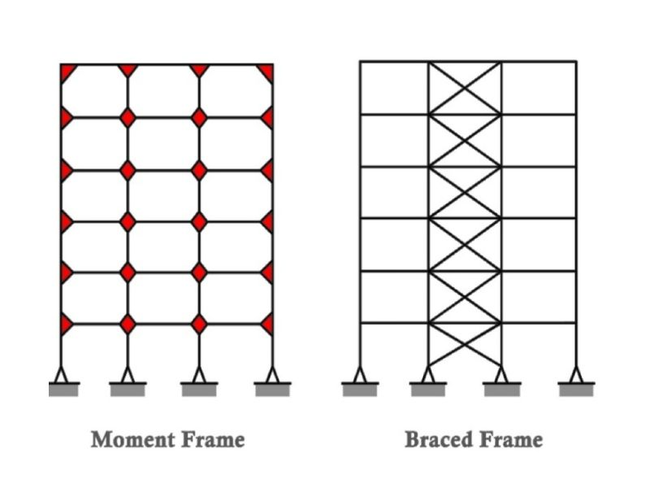
Vibrationdata
Response Modification Factor R
Material | General Ductility | Typical R Range
Steel | Very High | 6–8
Reinforced Concrete | High | 6–8
Masonry | Moderate to Low | 1.5–5
Wood | Moderate to High | 4–7
R depends on frame design for steel
https://everseismic.com/moment-frames-vs-braced-frames/

Slide 38


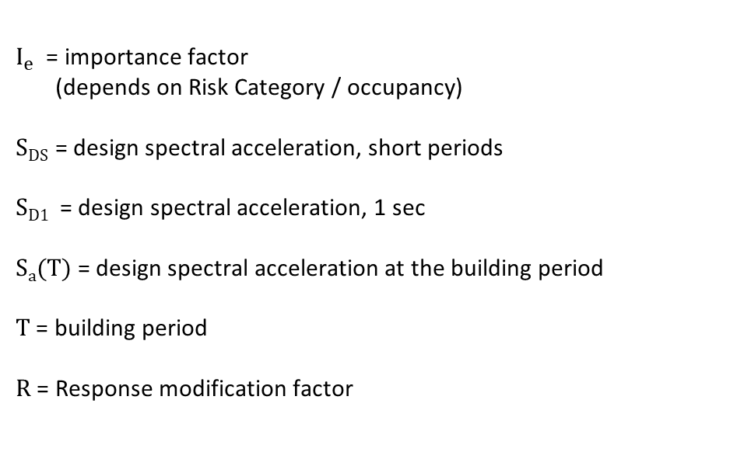
Vibrationdata
Seismic Coefficient C_{S}
If T < T_{s} ,
$$C_{S}=\frac{\text{S}\text{D}\text{S} I_{e}}{\text{R}}$$
    If T > T_{s} ,
    $$C_{S}=\frac{\text{S}\text{D}\text{1 }I_{e}}{\text{T} \text{R}}=\frac{\text{S}\text{a} {\left(T\right) I}_{e}}{\text{R}}$$
$T_{S}=\frac{\text{S}\text{D}\text{1} }{\text{S}\text{DS}}$ transition period
    $I_{e}$​ = importance factor
    (depends on Risk Category / occupancy)
    S_{DS} = design spectral acceleration, short periods
    S_{D1} = design spectral acceleration, 1 sec
    S_{a}(T) = design spectral acceleration at the building period
    T = building period
    R = Response modification factor

Slide 39
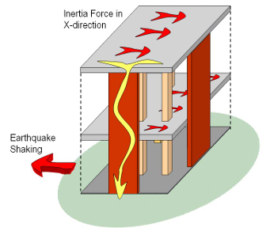
SFRS Load Path
A Seismic Force Resisting System (SFRS) is the part of a building's structure designed to withstand lateral earthquake forces and provide ductility
It typically consists of vertical elements: shear walls, braced frames, or moment frames
During an earthquake:
  Ground motion → inertia forces generated in floors
  Floors (diaphragms) collect and distribute forces
  Forces go into the SFRS
  SFRS transfers forces down to the foundation
  So, the SFRS is the vertical lateral-force path
Two-Story Building with Multiple Load Paths
Gregory A. J. Szakats, Improving The Earthquake Resistance Of Small Buildings, Houses And Community Infrastructure

Slide 40
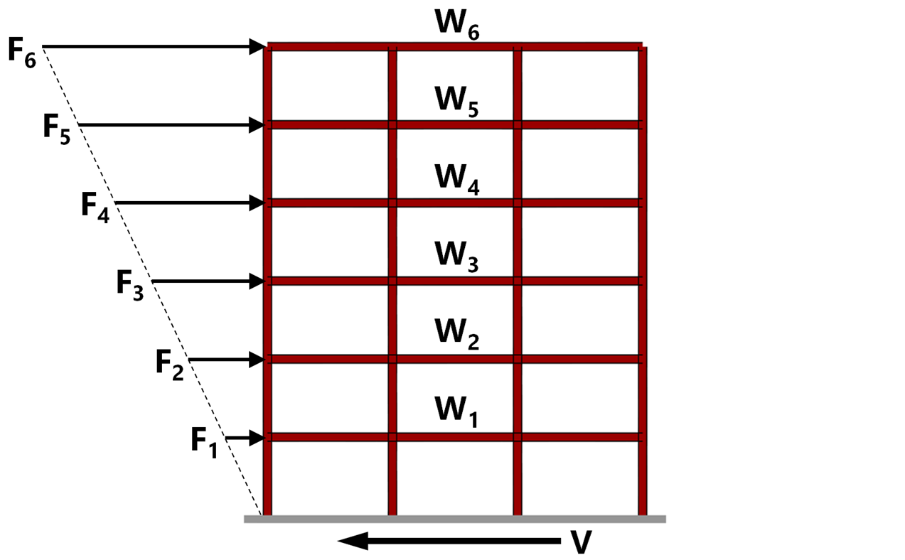
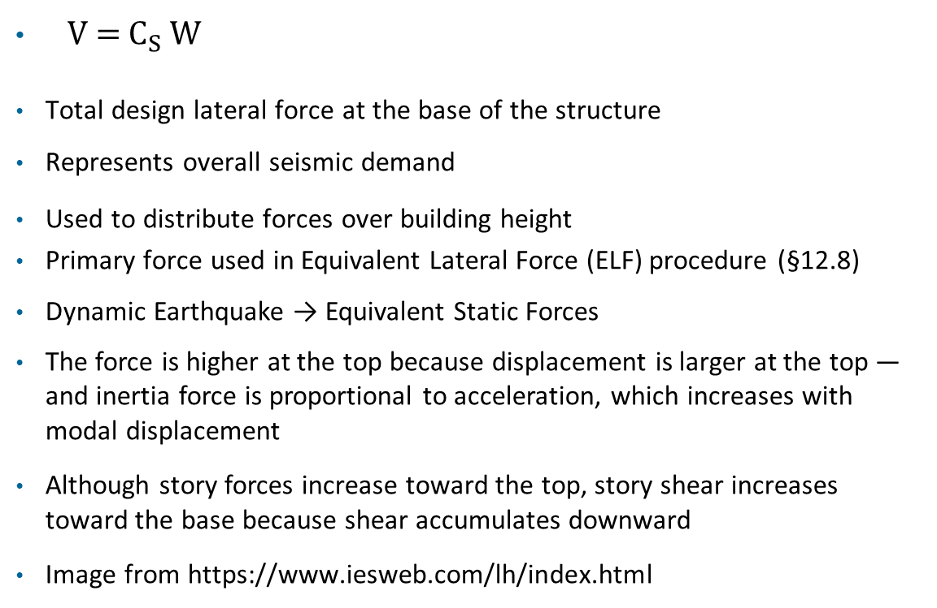
Base Shear V
V = $C_{S}$ ​W
Total design lateral force at the base of the structure
Represents overall seismic demand
Used to distribute forces over building height
Primary force used in Equivalent Lateral Force (ELF) procedure (§12.8)
Dynamic Earthquake → Equivalent Static Forces
The force is higher at the top because displacement is larger at the top — and inertia force is proportional to acceleration, which increases with modal displacement
Although story forces increase toward the top, story shear increases toward the base because shear accumulates downward
Image from https://www.iesweb.com/lh/index.html

Slide 41
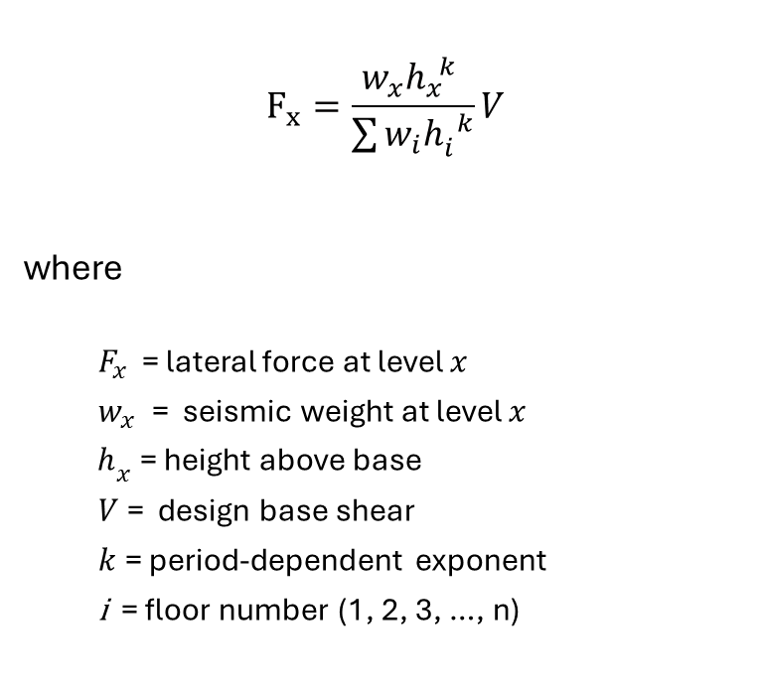
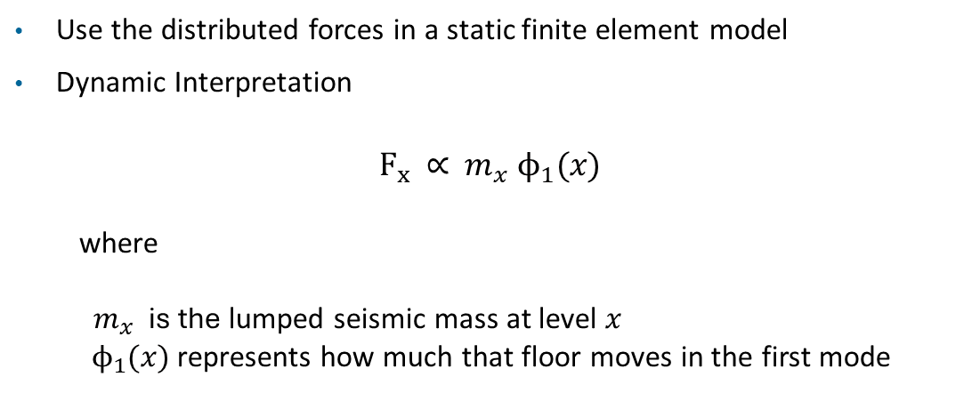
Story Force Distribution (ASCE 7-22 §12.8.3)
$$F_{x}=\frac{w_{x}h_{x}^{ k} }{\sum{w_{i}h_{i}^{ k}}}V$$
where
  $F_{x} \text{=}$lateral force at level $x$
  $w_{x}$= seismic weight at level $x$
  $h_{x}$ = height above base
  $V$= design base shear
  $k$= period-dependent exponent
  i = floor number (1, 2, 3, …, n)
Structural Period | Typical k Value | Force Shape | Mode Shape
Short-period (stiff) | k =1 | Nearly triangular | Nearly linear
Long-period (flexible) | k =2 | Top-heavy (parabolic) | Curved / parabolic mode shape
Use the distributed forces in a static finite element model
Dynamic Interpretation
$$F_{x}\text{ ∝ }m_{x} ϕ_{1}(x)$$
where
$m_{x}$​ is the lumped seismic mass at level $x$
${ ϕ}_{1}(x)$ represents how much that floor moves in the first mode

Slide 42
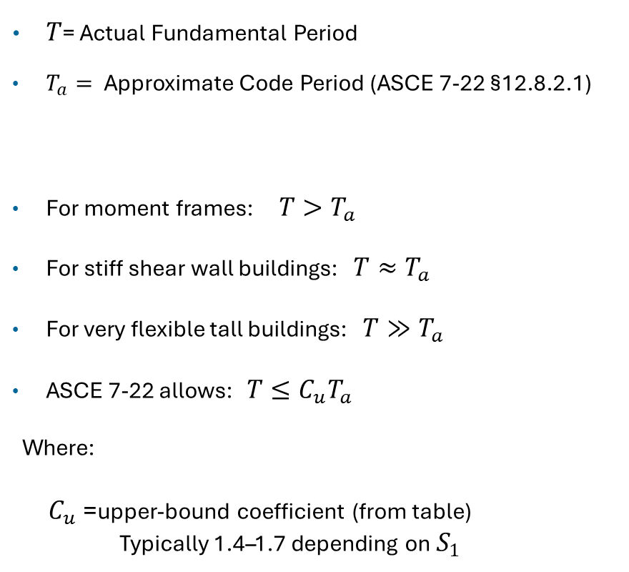
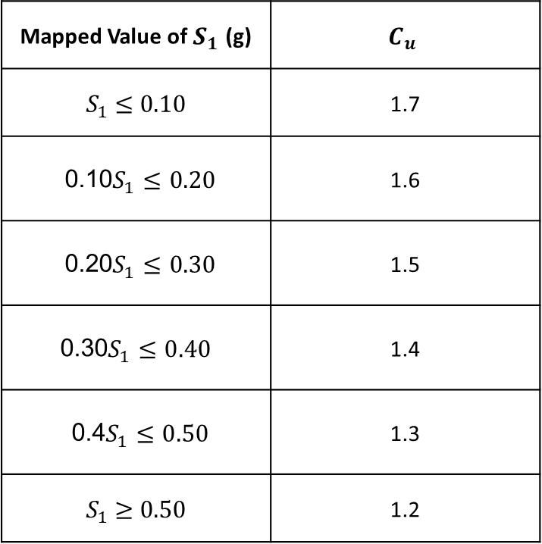
Vibrationdata
Building Period T (cont)
$T$= Actual Fundamental Period
$T_{a}=$ Approximate Code Period (ASCE 7-22 §12.8.2.1)
For moment frames: $T>T_{a}$
For stiff shear wall buildings: $T≈T_{a}$
For very flexible tall buildings: $T≫T_{a}$
ASCE 7-22 allows: $T≤C_{u}T_{a}$
Where:
$C_{u}$= upper-bound coefficient (from table)
Typically 1.4–1.7 depending on $S_{1}$
Mapped Value of ​$S_{1}$ (g) | $$C_{u}$$
$S_{1}$ ​≤ 0.10 | 1.7
0.10 $S_{1}≤0.20$ | 1.6
0.20 $S_{1}≤0.30$ | 1.5
0.30$S_{1}≤0.40$ | 1.4
0.4 $S_{1}≤0.50$ | 1.3
$S_{1}$​ ≥ 0.50 | 1.2

Slide 43
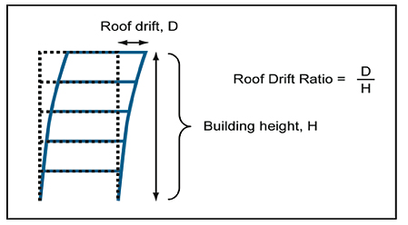
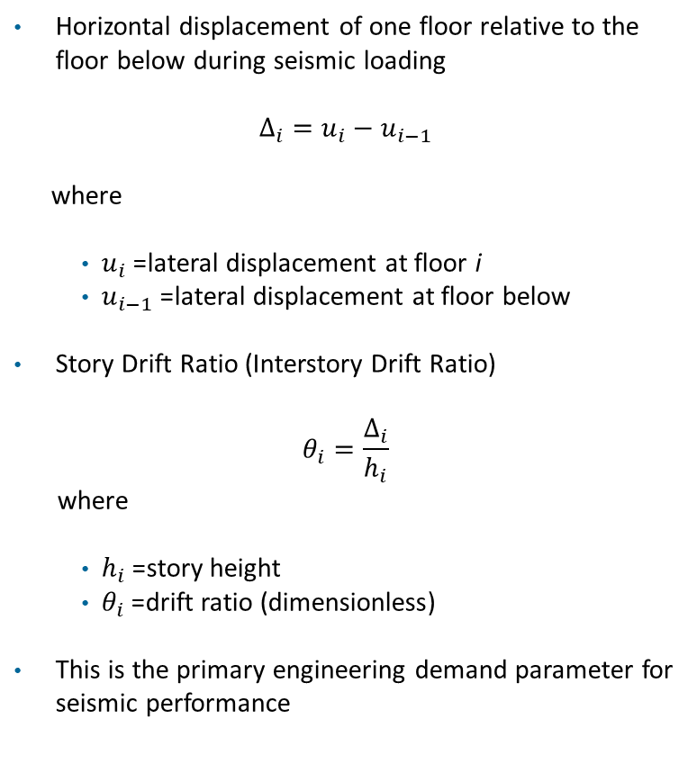
Building Story Drift (Δ)
Horizontal displacement of one floor relative to the floor below during seismic loading
$$Δ_{i}=u_{i}−u_{i−1}$$
where
  ${ u}_{i}$= lateral displacement at floor i
  ${ u}_{i−1}$= lateral displacement at floor below
Story Drift Ratio (Interstory Drift Ratio)
$$θ_{i}=\frac{Δ_{i}}{h_{i}}$$
where
  $h_{i}$= story height
  $θ_{i}$= drift ratio (dimensionless)
This is the primary engineering demand parameter for seismic performance
https://plus.maths.org/content/modelling-catastrophes

Slide 44
Building Story Drift (cont)
Controls structural damage (plastic hinge formation)
Controls nonstructural damage (partitions, glazing, cladding)
Governs P–Δ instability effects
Used directly in ASCE 7-22 drift limits
Risk Category | Representative Structures | Approx. Max Drift Ratio Design Allowable Limit
I | Agricultural buildings, storage sheds, temporary facilities | ~0.025 (2.5%)
II | Most residential, office buildings, retail, schools | ~0.020 (2.0%)
III | Large assembly buildings, high-occupancy schools, public utilities | ~0.015 (1.5%)
IV | Hospitals, emergency facilities, fire stations | ~0.010 (1.0%)

Slide 45
Building Earthquake Design Factors
The two key factors are base shear & story drift, as covered in future slides
Base Shear | Drift
Force-based | Deformation-based
Depends on R | Depends on stiffness
Reduced by large R | Increased by flexibility
Strength design | Performance design
Governs member sizing | Governs damage & stability
R (Response Modification Factor)

Slide 46
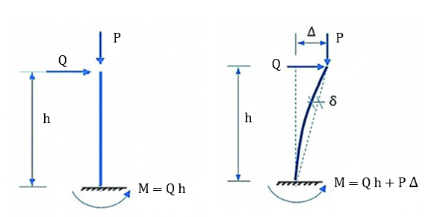
P-Δ Stability Check, Global Inter-story Drift
Vibrationdata
P-Δ (P-Delta) stability checks determine if second-order effects—where vertical loads acting on a laterally deflected structure create additional moments—are significant enough to require non-linear analysis

Slide 47
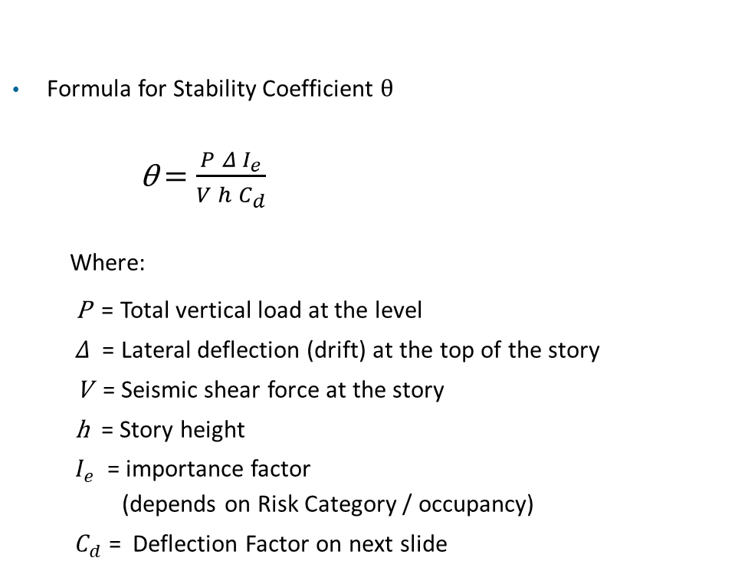
P-Δ Stability Check, Global Inter-story Drift
Vibrationdata
Formula for Stability Coefficient θ
θ $=\frac{P Δ I_{e}}{V h{ C}_{d}}$
  Where:
  P = Total vertical load at the level
  $Δ$= Lateral deflection (drift) at the top of the story
  V = Seismic shear force at the story
  h = Story height
  ${ I}_{e}$​ = importance factor
  (depends on Risk Category / occupancy)
  ${ C}_{d}$ = Deflection Factor on next slide

Slide 48
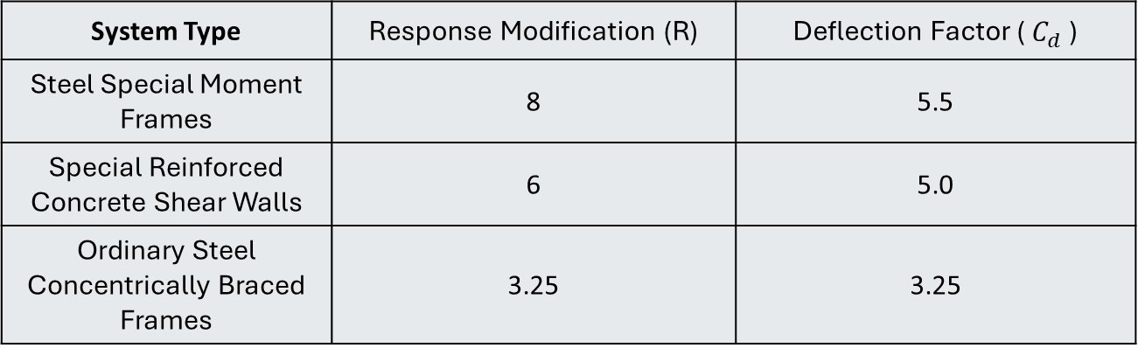
Response & Deflection Factors
Vibrationdata
System Type | Response Modification (R) | Deflection Factor (${ C}_{d}$ )
Steel Special Moment Frames | 8 | 5.5
Special Reinforced Concrete Shear Walls | 6 | 5.0
Ordinary Steel Concentrically Braced Frames | 3.25 | 3.25

Slide 49
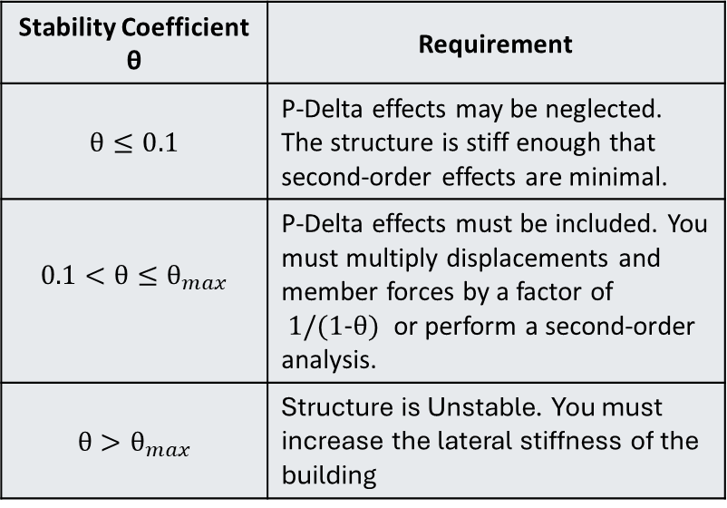
P-Δ Stability Check, Global Inter-story Drift
Vibrationdata
Stability Coefficient θ | Requirement
$$θ≤0.1$$ | P-Delta effects may be neglected. The structure is stiff enough that second-order effects are minimal.
$$0.1<θ≤θ_{max}$$ | P-Delta effects must be included. You must multiply displacements and member forces by a factor of 1/(1-$θ$) or perform a second-order analysis.
$$θ>θ_{max}$$ | Structure is Unstable. You must increase the lateral stiffness of the building

Slide 50
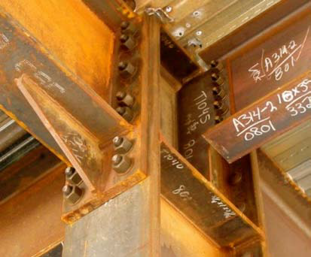
Example
Four Story Hospital, Anchorage Alaska
Steel Special Moment Resisting Frame (SMRF) - highest ductility, energy dissipation & detailing
Site Class C – Very dense soil & soft rock
Essential facilities including hospitals
  Risk Category IV
  Importance Factor Ie = 1.5
Generate two period response spectrum
Calculate base shear & drift
Compare results to maximum limits
Full moment connection: Bolted flange plates and web bolts transfer beam bending and shear into the column — not a simple shear joint
Ductile seismic behavior: SMRFs (R ≈ 8) are detailed so beams yield first (strong column–weak beam) and sustain large cyclic rotations
Seismic detailing: Heavy bolts and thick plates resist high flange forces and panel zone shear per AISC 341/358 post-Northridge requirements
NEHRP Seismic Design Technical Brief No. 2, Seismic Design of Steel Special Moment Frames: A Guide for Practicing Engineers

Slide 51
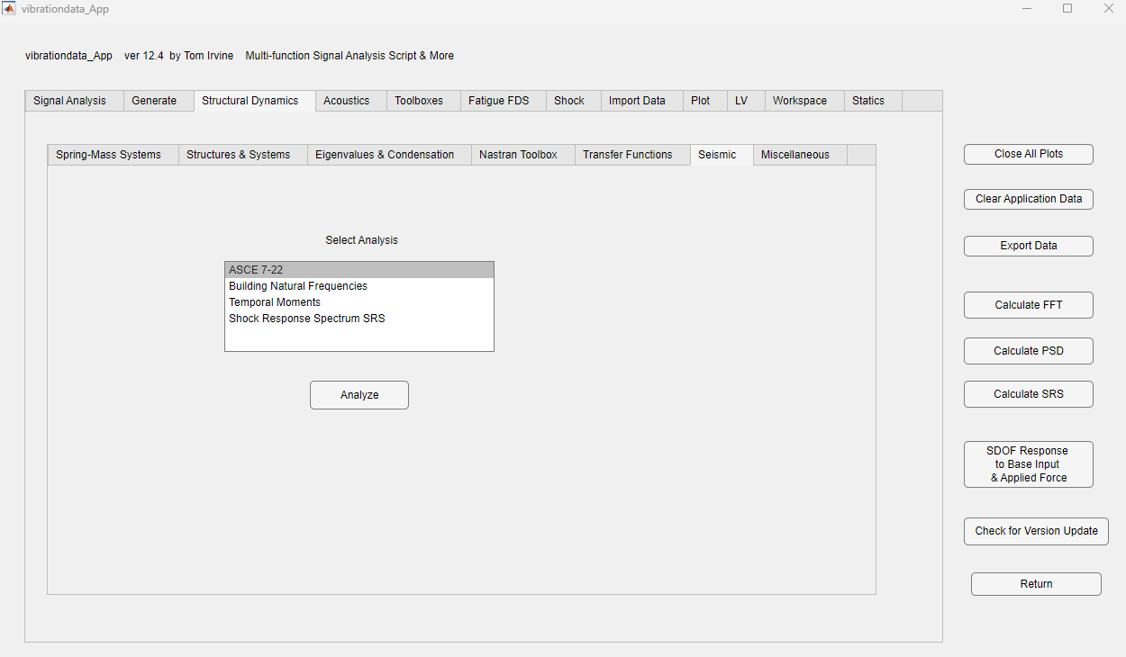

Slide 52
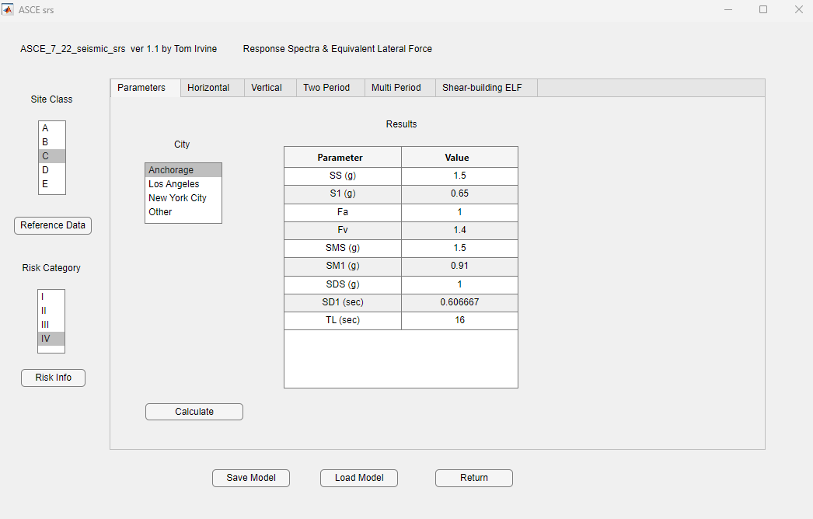

Slide 53
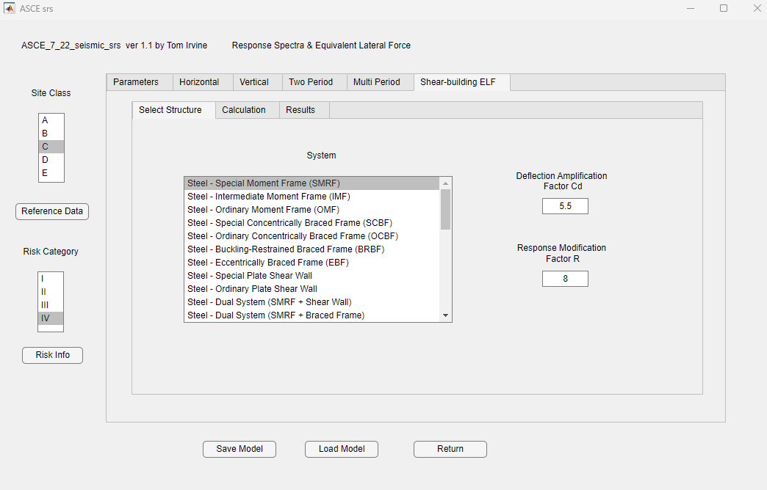

Slide 54
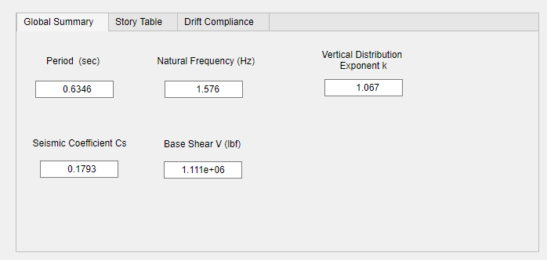
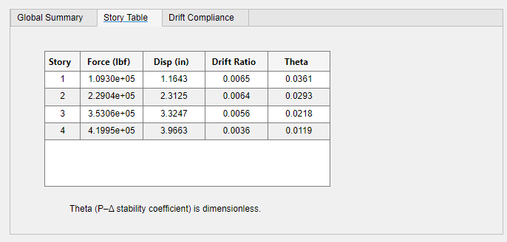
Example Results

Slide 55
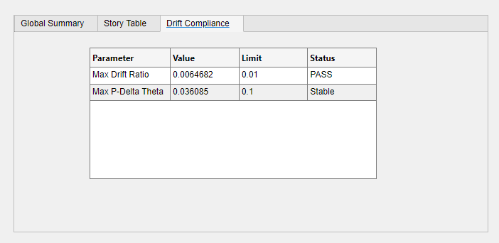
Example Results

Slide 56
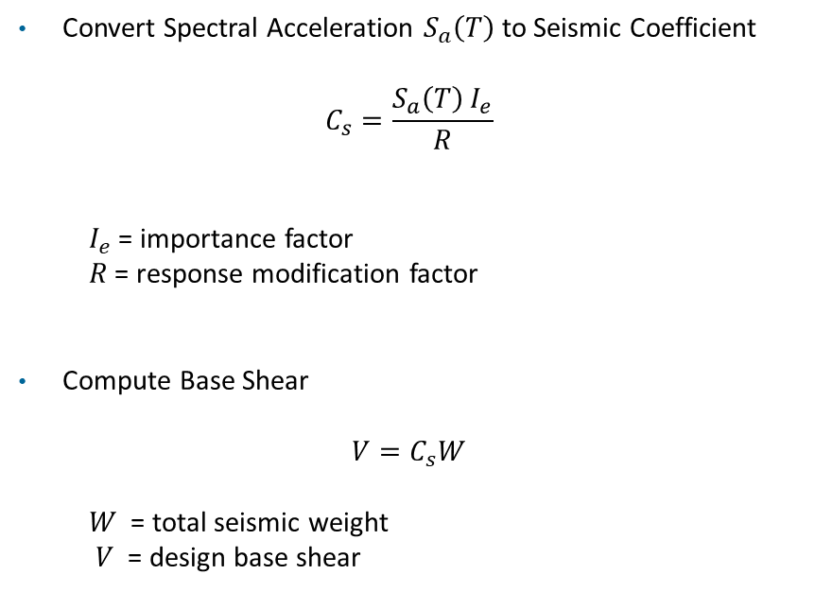
Example Results
Convert Spectral Acceleration $S_{a}\left(T\right)$to Seismic Coefficient
$$C_{s}=\frac{S_{a}\left(T\right) I_{e}}{R}$$
  $I_{e}$= importance factor
$R$ = response modification factor
Compute Base Shear
$$V=C_{s}W$$
$W$= total seismic weight
$V$ = design base shear

Slide 57
Example Results, Chapter 12 Related
Building recap: 4-story hospital, Anchorage AK, Site Class C, RC IV, SDC D
Goal: choose a Seismic Force-Resisting System (SFRS) from Table 12.2-1 and verify it is permitted
Candidate System | R | Ω₀ | Cd | Permitted in SDC D? | Height Limit (ft) | Selected?
Steel OMF | 3.5 | 3 | 3 | NO — Prohibited | N/A
Steel IMRF | 4.5 | 3 | 4 | Limited | 35
Steel SMRF | 8 | 3 | 5.5 | YES | No limit | ✔
Dual: SMRF + SCBF | 7 | 2.5 | 5.5 | YES | No limit
Special Moment Resisting Frame (SMRF)
Special Concentrically Braced Frame (SCBF)
Eccentrically Braced Frame (EBF)
Ordinary Moment Frame (OMF)
R = Response Modification Factor
Ω₀ = Overstrength Factor
Cd = Deflection Amplification Factor

Slide 58
Detailed Seismic Design Category (SDS)
Purpose: SDC is a classification assigned to a structure based on its Risk Category and the severity of the design ground motion at the site
It determines permissible analysis procedures, building height limits, and structural detailing requirements
Step 1: Determine Risk Category
  I: Low risk to human life (e.g., agricultural facilities)
  II: Standard occupancy (e.g., residential, commercial)
  III: High-occupancy or substantial economic impact (e.g., schools, water treatment)
  IV: Essential facilities (e.g., hospitals, fire stations, police stations)

Slide 59
Vibrationdata
Detailed Seismic Design Category (cont)
Acceleration Parameter | Range | Risk Category I–III | Risk Category IV
SDS | SDS < 0.167g | A | A
 | 0.167g ≤ SDS < 0.33g | B | C
 | 0.33g ≤ SDS < 0.50g | C | D
 | SDS ≥ 0.50g | D | D
SD1 | SD1 < 0.067g | A | A
 | 0.067g ≤ SD1 < 0.133g | B | C
 | 0.133g ≤ SD1 < 0.20g | C | D
 | 0.20g ≤ SD1 < 0.75g | D | D
 | SD1 ≥ 0.75g | E | E
 | Near major active fault | F | F
SDC | Meaning
A | Very low seismic risk
B | Low
C | Moderate
D | High
E | Very High
F | Near major active faults (special requirements

Slide 60
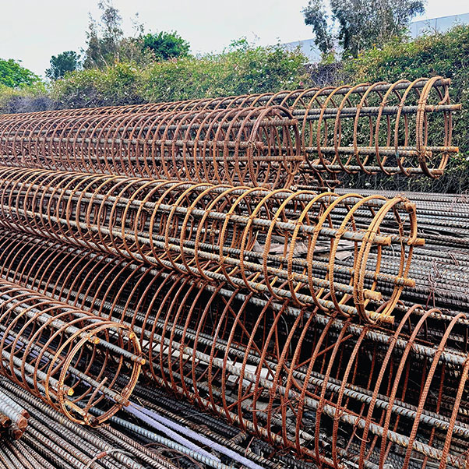
Vibrationdata
Detailed Seismic Design Category (cont)
The SDC dictates the entire design path:
Analysis Procedures: SDC A allows for simplified lateral force bracing
SDC D-F often requires more complex dynamic analysis.
SDC B & C: Moderate risk. Standard "Ordinary" structural systems are usually okay
SDC D: High risk. Most of the Western US and high-importance buildings fall here. "Special" detailing (like extra steel hoops in columns) becomes mandatory
Height Limits: Certain structural systems are prohibited above specific heights in high SDCs
Nonstructural Components: Determines if mechanical/electrical components require seismic bracing
Steel Rebar Hoops
https://rebardirect.com/

Slide 61
Vibrationdata
Detailed Seismic Design Category (cont)
The SDC further dictates
Permitted Analysis: Can you use the simple "Equivalent Lateral Force" method, or must you do a complex computer simulation?
Height Limits: SDC D/E/F often places strict caps on how tall a building can be for certain materials (e.g., you cannot build a very tall "Ordinary" braced frame in SDC D)
Nonstructural Requirements: In SDC C and higher, you must start bracing your pipes, ducts, and lights so they donot fall on people.

Slide 62
Vibrationdata
Quality Assurance & Inspection
Alternate Methods: Alternate materials or methods require evidence that they are at least equal in strength and seismic resistance to the standard
Quality Assurance Plan: Must be submitted if the AHJ has not adopted specific requirements; it identifies the program elements to be implemented
Special Inspection: Observation of work to determine compliance with approved documents
Continuous: Inspector is present full-time during work
Periodic: Part-time or intermittent observation
Inspector, Special: Person approved by the Authority Having Jurisdiction to perform special inspection, who must be identified as a special inspector
Testing Agency: Company or corporation providing testing and/or inspection services

