Slide 1
Seismic Shock Response Spectra
Complex Oscillating Shock Pulse
Revision A

Slide 2
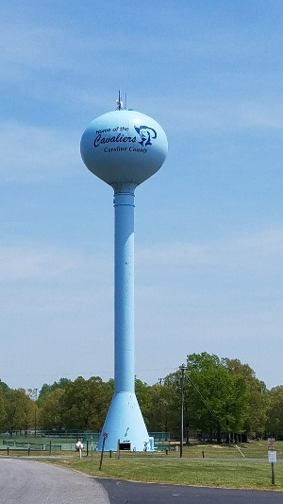
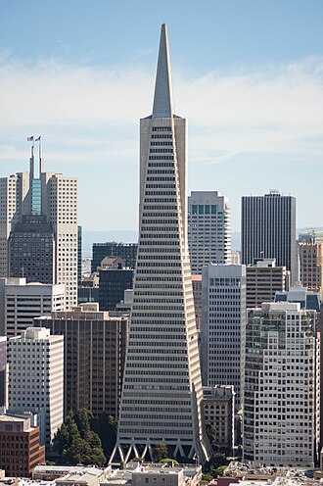
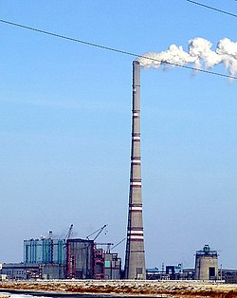
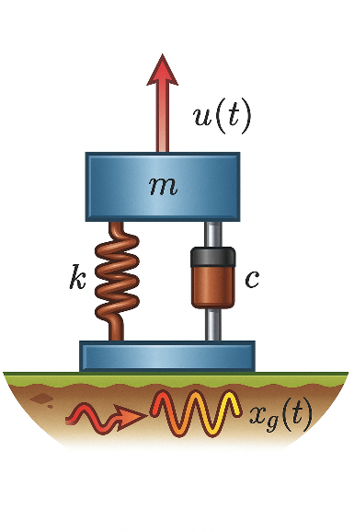
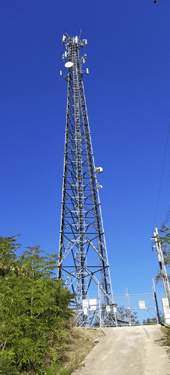
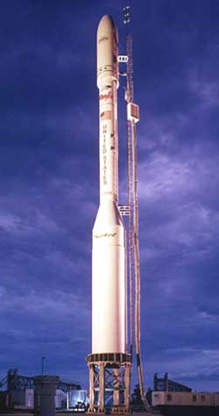
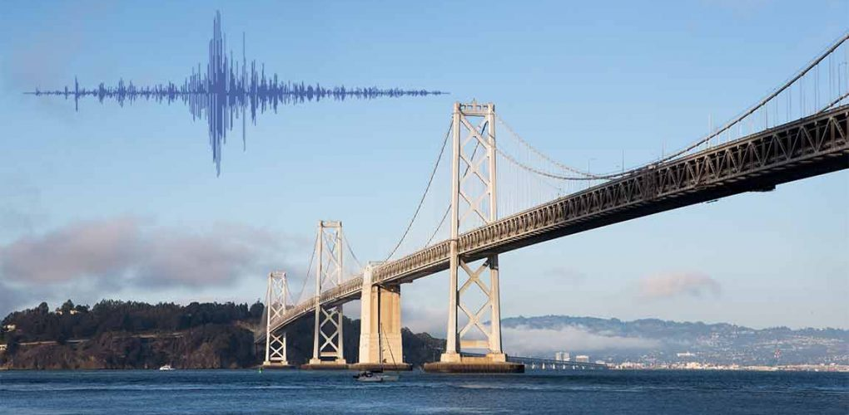

Slide 3
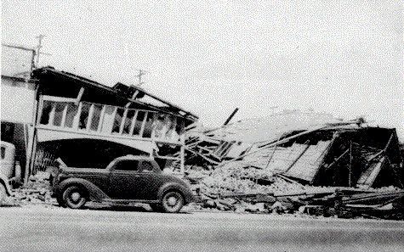
El Centro, Imperial Valley, Earthquake
Nine people were killed by the May 1940 Imperial Valley earthquake. At Imperial, 80 percent of the buildings were damaged to some degree. In the business district of Brawley, all structures were damaged, and about 50 percent had to be condemned. The shock caused 40 miles of surface faulting on the Imperial Fault, part of the San Andreas system in southern California. Total damage has been estimated at about $6 million. The magnitude was 7.1.

Slide 4
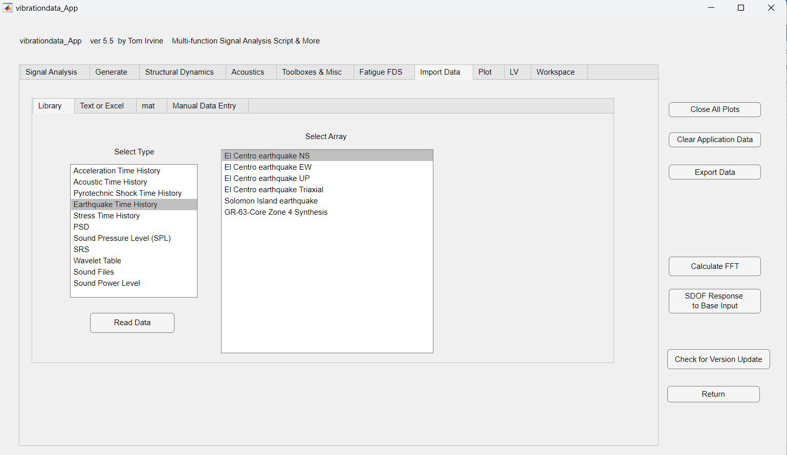

Slide 5
El Centro, Imperial Valley, Earthquake

Slide 6
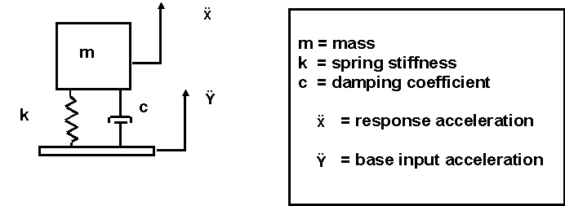
SDOF System Subjected to Base Excitation

Slide 7
Algorithm
Problems with arbitrary base excitation are solved using a convolution integral
The convolution integral is represented by the Smallwood ramp invariant digital recursive filtering relationship for numerical efficiency

Slide 8
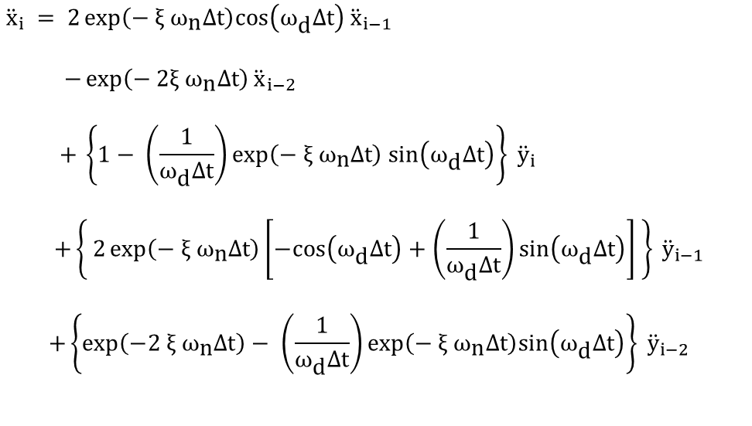
Smallwood Digital Recursive Filtering Relationship
$${\ddot{x}}_{i} = 2\exp\left(− \text{ξ} {\text{ω}}_{\text{n}}Δt\right)cos\left({\text{ω}}_{\text{d}}Δt\right){\ddot{x}}_{i−1 }$$
$$−\exp\left(−\text{ 2}\text{ξ} {\text{ω}}_{\text{n}}Δt\right){\ddot{x}}_{i−2}$$
$$+ \left\{1− \left(\frac{1}{{\text{ω}}_{\text{d}}Δt}\right)exp\left(− \text{ξ} {\text{ω}}_{\text{n}}Δt\right) sin\left({\text{ω}}_{\text{d}}Δt\right)\right\} {\ddot{y}}_{i}$$
$$+\left\{ 2\exp\left(− \text{ξ} {\text{ω}}_{\text{n}}Δt\right)\left[−cos\left({\text{ω}}_{\text{d}}Δt\right)+\left(\frac{1}{{\text{ω}}_{\text{d}}Δt}\right)sin\left({\text{ω}}_{\text{d}}Δt\right)\right] \right\} {\ddot{y}}_{i−1}$$
$$+\left\{\exp\left(−2 \text{ξ} {\text{ω}}_{\text{n}}Δt\right)− \left(\frac{1}{{\text{ω}}_{\text{d}}Δt}\right)\exp\left(− \text{ξ} {\text{ω}}_{\text{n}}Δt\right)sin\left({\text{ω}}_{\text{d}}Δt\right)\right\} {\ddot{y}}_{i−2 }$$
where Δt is the time step

Slide 9
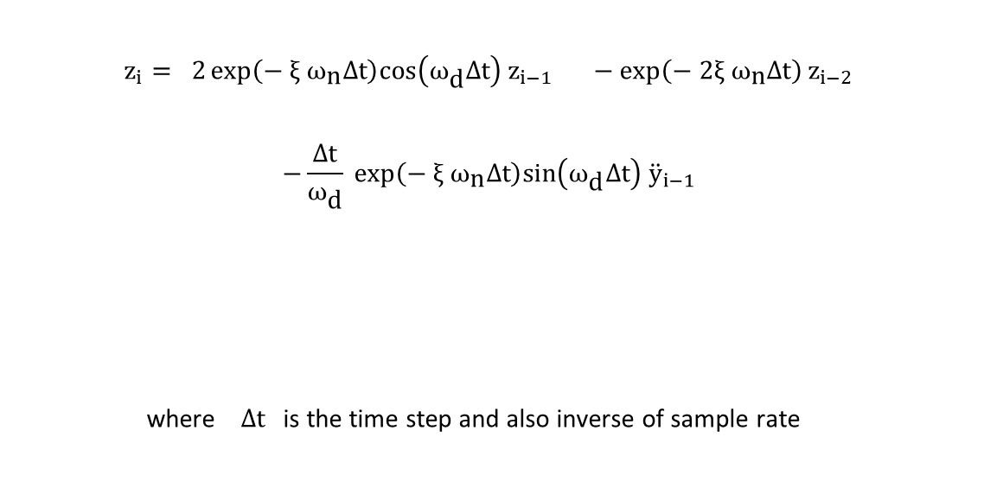
Relative Displacement
Vibrationdata
$$z_{i}= 2\exp\left(− \text{ξ} {\text{ω}}_{\text{n}}Δt\right)cos\left({\text{ω}}_{\text{d}}Δt\right)z_{i−1 }−\exp\left(−\text{ 2}\text{ξ} {\text{ω}}_{\text{n}}Δt\right)z_{i−2}$$ $$−\frac{Δt}{{\text{ω}}_{\text{d}}} \exp\left(− \text{ξ} {\text{ω}}_{\text{n}}Δt\right)sin\left({\text{ω}}_{\text{d}}Δt\right){ \ddot{y}}_{i−1}$$ where Δt is the time step and also inverse of sample rate
9
Notes:
9

Slide 10
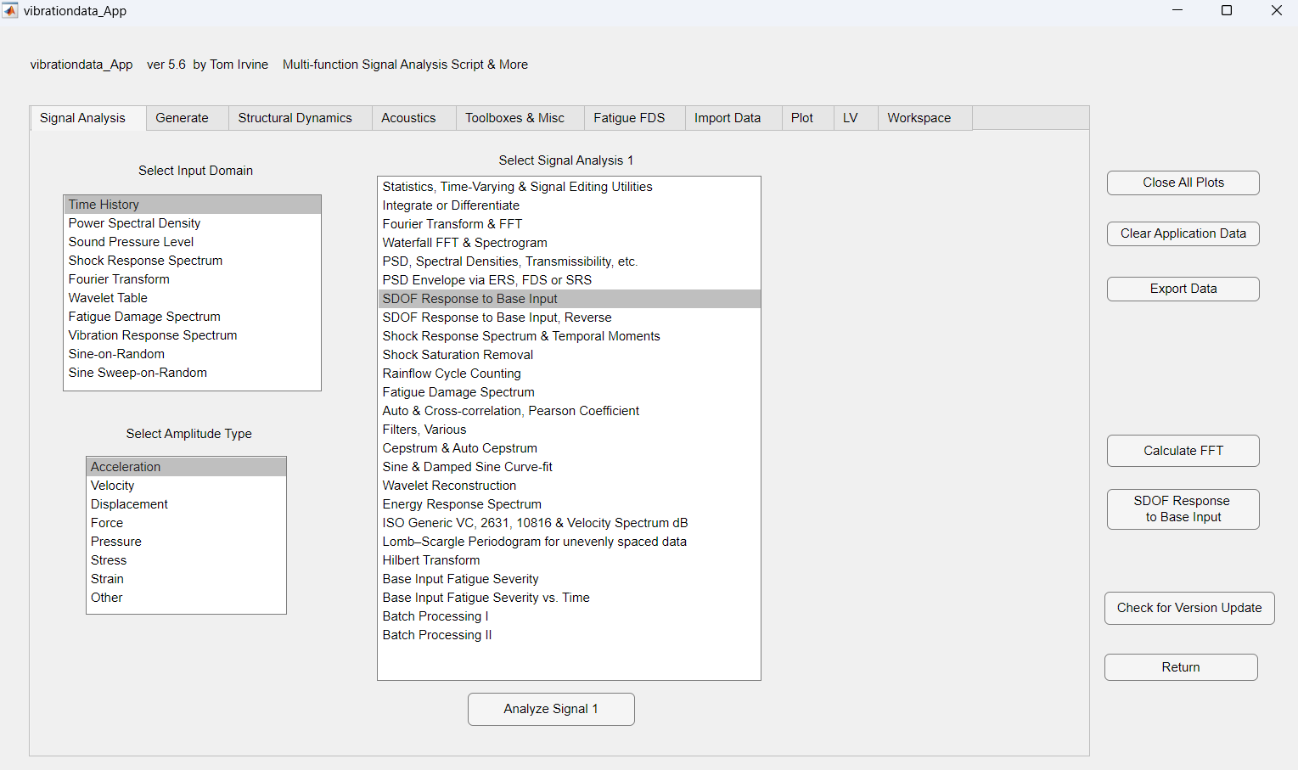

Slide 11
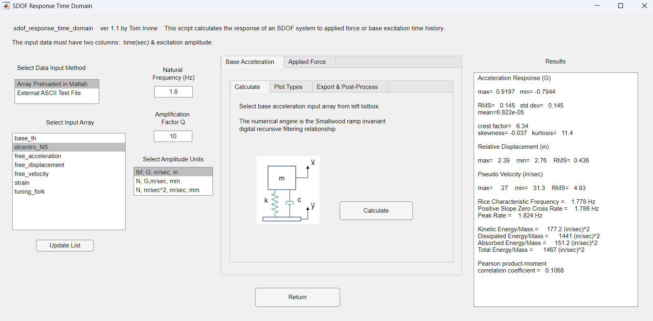

Slide 12
El Centro Earthquake Exercise I
Peak Response Accel = 0.92 G

Slide 13
El Centro Earthquake Exercise I
Peak Rel Disp = 2.8 in

Slide 14
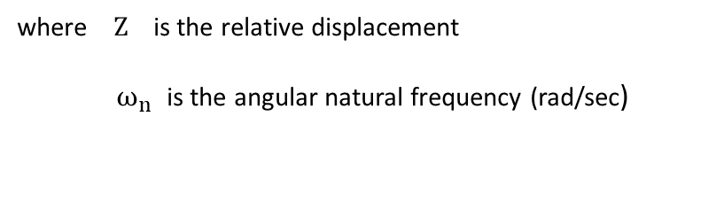

Pseudo Velocity
The pseudo velocity PV is
$$PV=ω_{n} Z$$
where Z is the relative displacement
$ω_{n}$ is the angular natural frequency (rad/sec)
Dr. Howard Gaberson and others have written papers showing that dynamic stress is proportional to pseudo velocity

Slide 15
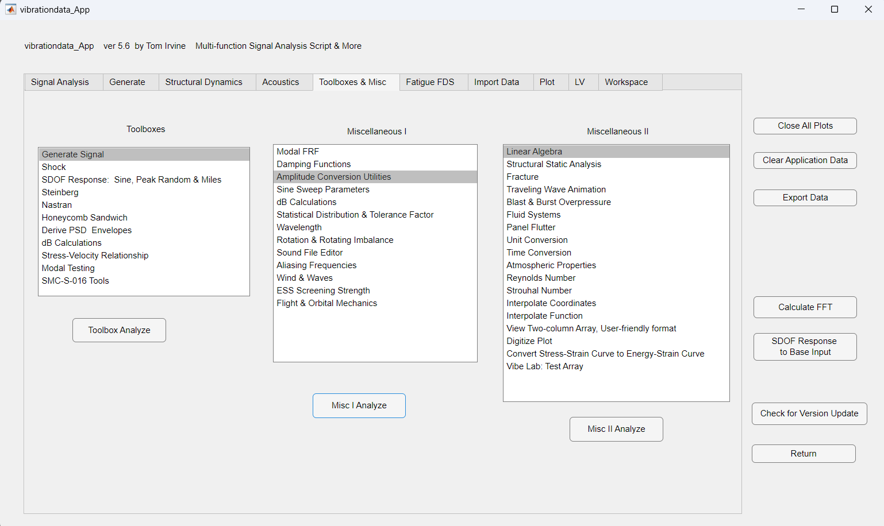

Slide 16
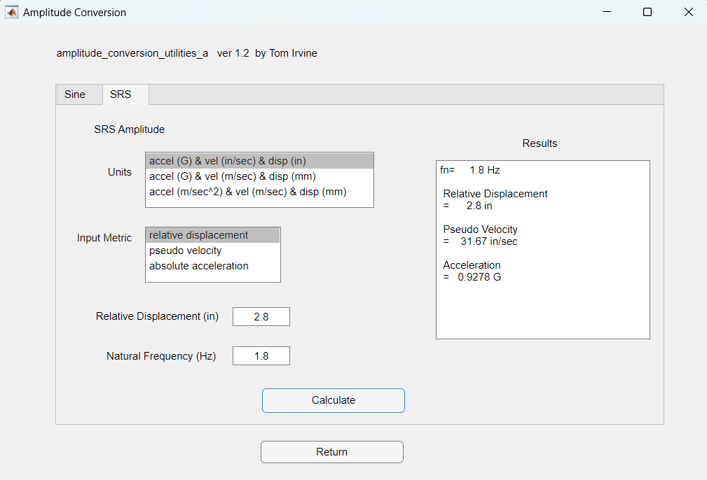

Slide 17
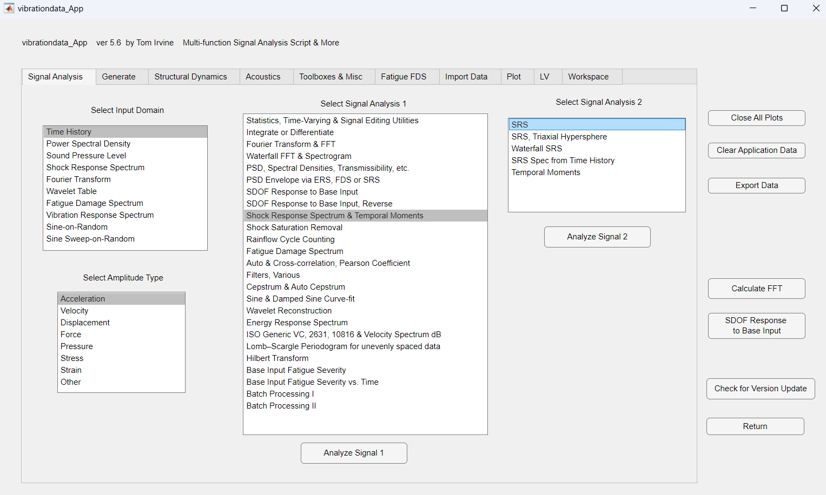

Slide 18
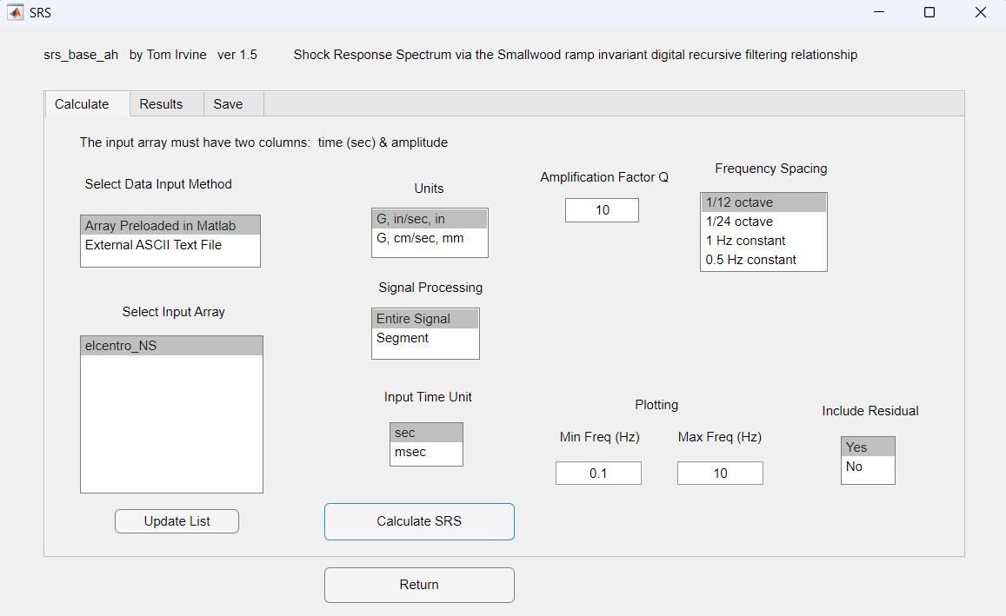

Slide 19
El Centro Earthquake SRS

Slide 20
El Centro Earthquake SRS

Slide 21
El Centro Earthquake SRS

Slide 22
El Centro NS
fn = 1.8 Hz
Accel = 0.92 G
Vel = 31 in/sec
Rel Disp = 2.8 in

Slide 23
El Centro Earthquake SRS, Q=50, 1% damping
Assume light damping for conservatism
Highest SRS peak is 1.5 G
Add some uncertainty margin ~ 3 dB
Derive equivalent static load of 2 G
Equivalent static load derived so that civil engineers do not have to calculate natural frequency

Slide 24
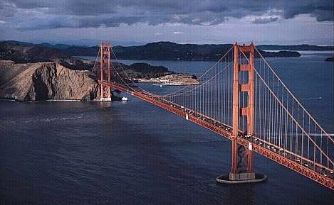
Golden Gate Bridge
Note that current Caltrans standards require bridges to withstand an equivalent static earthquake force (EQ) of 2.0 G
May be based on El Centro SRS peak Accel + dB margin

Slide 25
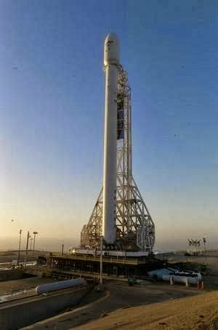
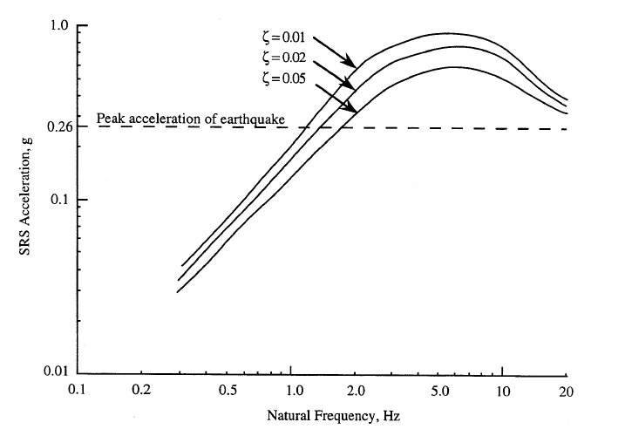
Vandenberg, California SRS
NASA-HDBK-7005, Shock Response Spectrum for Typical Central California Earthquake

