Slide 1
Equipment Isolation & Bracing
By Tom Irvine

Slide 2
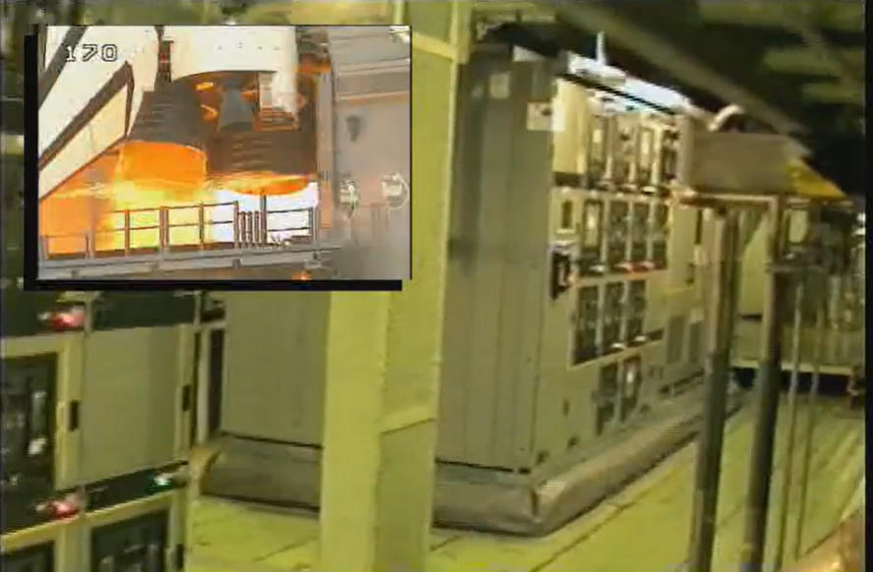
NASA Video
Vibrationdata
The excitation is man-made rather than natural but still representative of base excitation
https://www.youtube.com/watch?v=wN5fjtHnhWA
Notes:
2

Slide 3
More Videos
Vibrationdata
https://www.youtube.com/watch?v=wuQXWnSnKwQ
https://www.youtube.com/watch?v=ViJSyHgANYk
https://www.youtube.com/watch?v=q7feC-tX1hI
Notes:
3

Slide 4
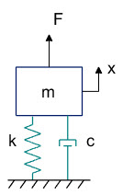
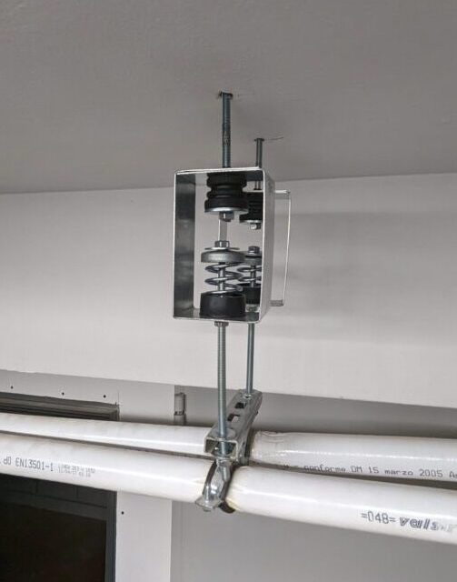
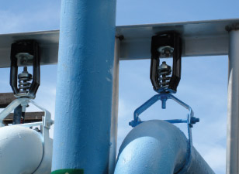
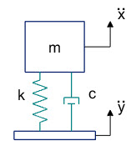
Isolation Hangers
Designed to reduce the transmission of vibration and noise from suspended mechanical equipment such as fans, pumps, air handling units, piping and ductwork
Also used to protect suspended equipment from earthquake excitation

Slide 5
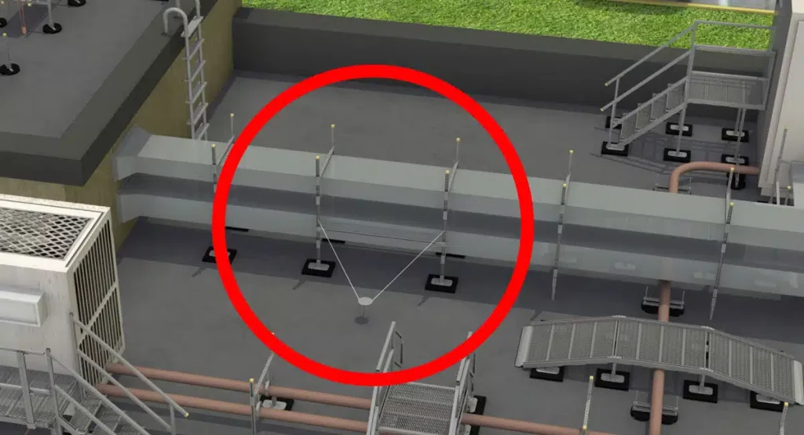
Rooftop Duct Anchoring
https://rooftopsupportsystems.com/navigating-seismic-bracing-requirements-a-comprehensive-guide/
Notes:
5

Slide 6
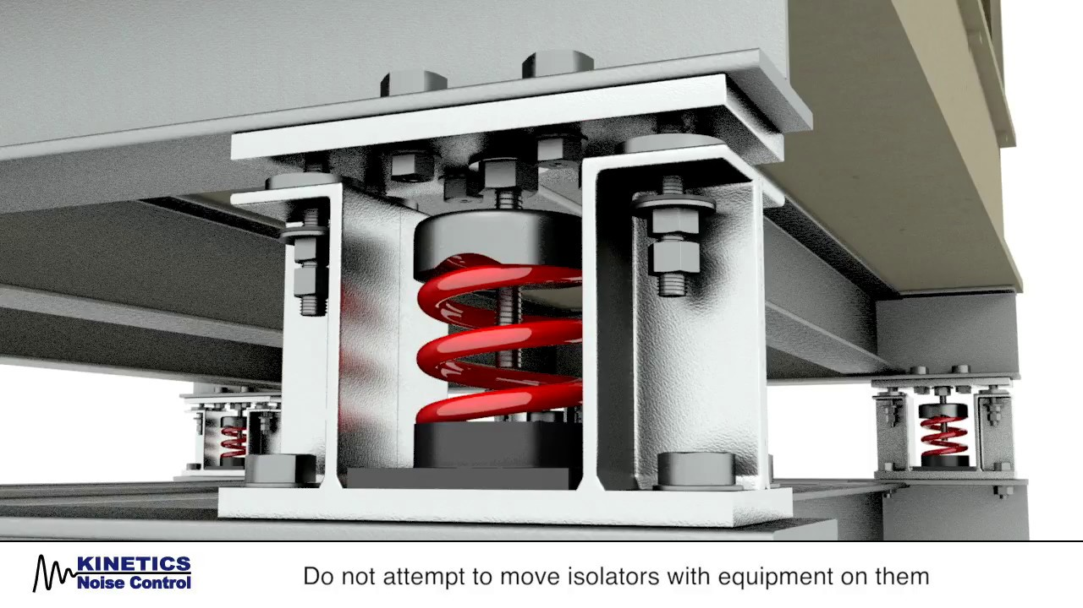
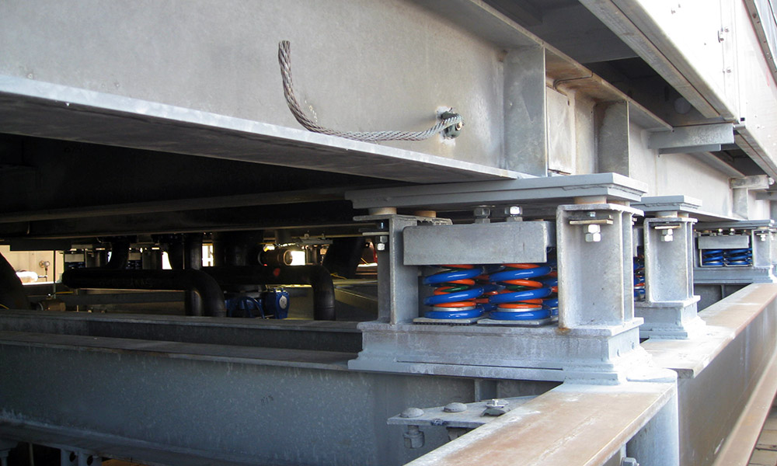
Equipment Racks
Vibrationdata
Rack tipping / overturning
If a rack is not anchored or braced properly, ground shaking can cause it to tip or buckle
Once it starts moving, everything inside shifts and falls
For example, the support structure may deform, causing rails to bend or collapse
A rack can be mounted via isolators and still be anchored using seismic-restrained isolators with snubbers or limit stops
Notes:
6

Slide 7

Equipment Racks (cont)
Vibrationdata
Internal Movement
Even if the rack remains upright, the shaking moves everything inside: circuit boards, cables, servers, power supplies
Connectors can loosen
Power/cable disruption is a concern
Cable / wiring strain, connector failure
When the rack moves, cables and power/ground connections are stressed
This can pull on connectors, loosen them, or create intermittent faults
https://www.amcoenclosures.com/
Notes:
7

Slide 8
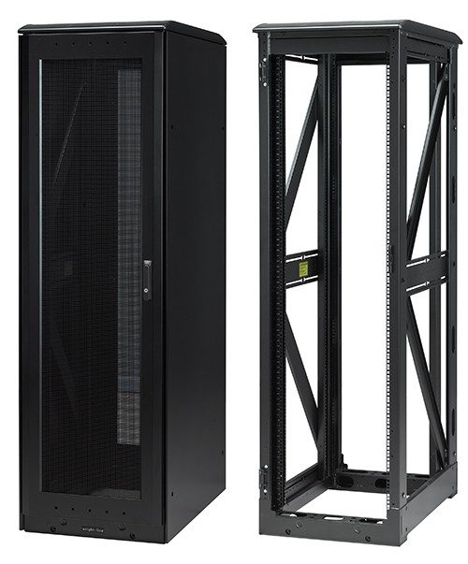
Equipment Racks (cont)
Vibrationdata
Rack structural failure
If the rack itself is not designed for seismic loads, the frame, mounting rails, or anchor points may deform or fail
This can cascade to internal failure of mounted equipment
Bending, twisting, stretch and compression of structural members may occur
Diagonal stiffeners can be installed to reduce dynamic loads
https://www.eaton.com/us/en-us/products/server-racks-enclosures-airflow-management/seismic-cabinets-for-harsh-environments.html
Notes:
8

Slide 9
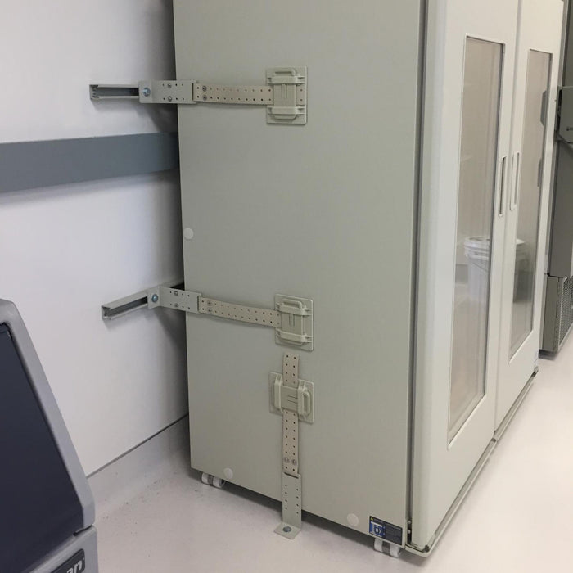
Equipment Racks (cont)
Vibrationdata
Floor or building movement / base isolation issues
Even if the rack is well mounted, building motion, floor vibrations, or resonance can amplify motion
Also, non-structural components (like racks) are required by building codes to be anchored or braced in many cases.
Anchoring / bracing
The rack should be firmly anchored to the floor (and/or wall) with appropriate seismic-rated anchor bolts or braces.
If the center of gravity is high (heavy equipment up top) or the rack is very tall, the risk increases.
One article notes: “Any component weighing more than 400 pounds. … Or center of gravity more than 4 feet above the floor” triggers the need for anchoring. lewisbass.com
https://safe-t-proof.com/
Notes:
9

Slide 10
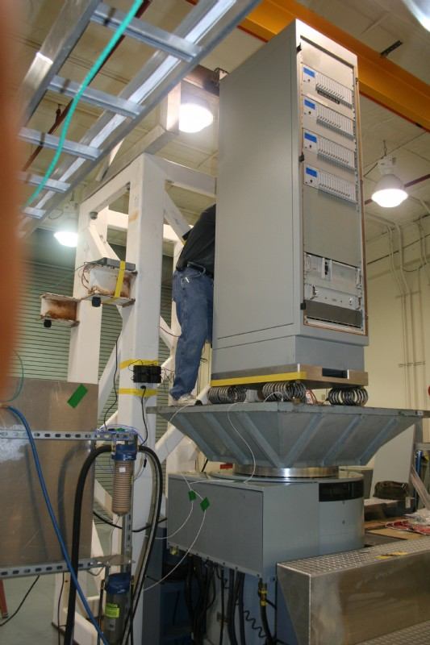
Equipment Racks (cont)
Vibrationdata
Use floor anchors designed for seismic loads (shear and tensile rated)
Rack design and seismic rating
Choose a rack designed for seismic zones (many manufacturers offer “seismic server racks” or “NEBS/Zone-rated racks”)
One article says “Seismic server racks protect servers by transforming potential disaster scenarios into manageable events.”
These racks include features such as reinforced frames, cross-bracing, base plates, and damping/shock absorption systems
Look for compliance with standards like Telcordia GR-63 or building code (e.g., International Building Code (IBC) seismic requirements)
Equipment rack with wire rope isolators, shaker test, Unholtz-Dickie
Notes:
10

Slide 11
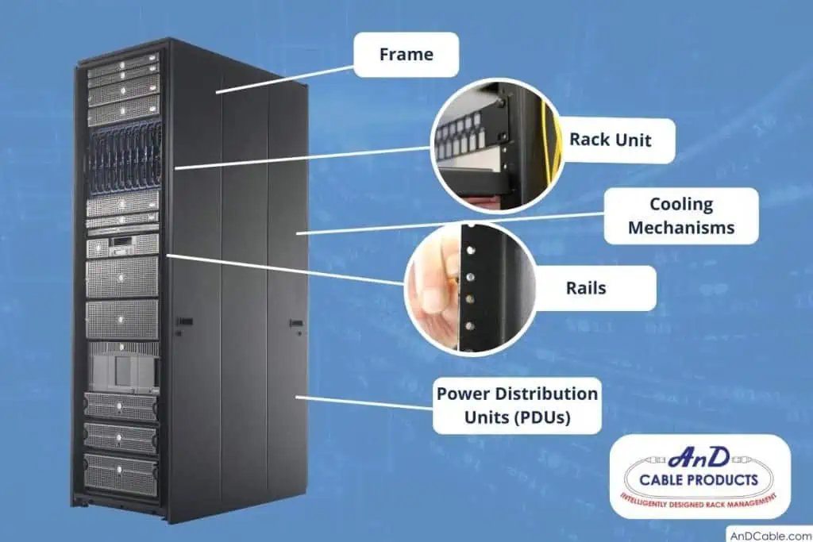
Equipment Racks (cont)
Vibrationdata
Internal load planning and mounting
Place heavier equipment (batteries, UPS, storage) low in the rack so that the center of gravity is low
One article: “… the distribution of equipment inside the cabinet in such a way that the center of gravity is closest to the bottom …”
Use locking rails, mounts and fasteners designed to hold equipment even under seismic motion
Ensure cables are managed/restrained so they do not pull out under motion
Cable & power/wiring management
Secure power distribution units (PDUs) and wiring so they do not shift, loosen or get pulled during motion
Grounding and bonding: though more related to electrical safety than earthquakes, ensuring the rack frame is properly grounded ensures better safety and less risk of damage via stray currents
Notes:
11

Slide 12
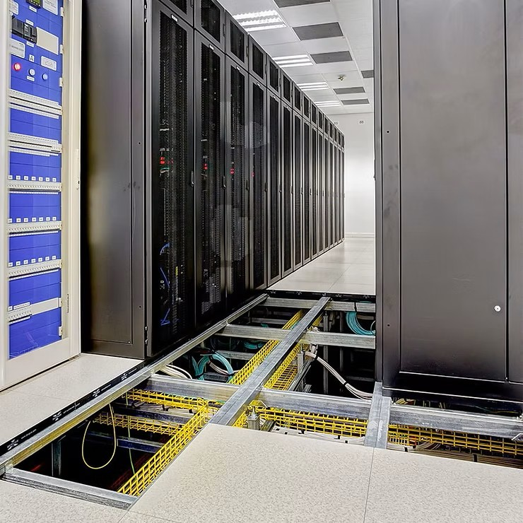
Equipment Racks (cont)
Vibrationdata
Regular inspection & maintenance
Periodically check anchor bolts, brackets, vibration isolators (if any), cable restraints
Check clearances: racks should not impede egress or maintenance even after motion
Test or review the load: if new equipment added changed the weight drastically, the seismic rating/anchoring might need review
Environment & room preparedness
Consider the room/floor itself: raised floors, floating slabs, etc. can amplify motion
Ensure that other non-structural items (lighting, ceiling tiles, emergency systems) are braced too — a rack might survive but surrounding damage could knock it offline
https://www.powerinfrastructure.co.za/
Notes:
12

Slide 13
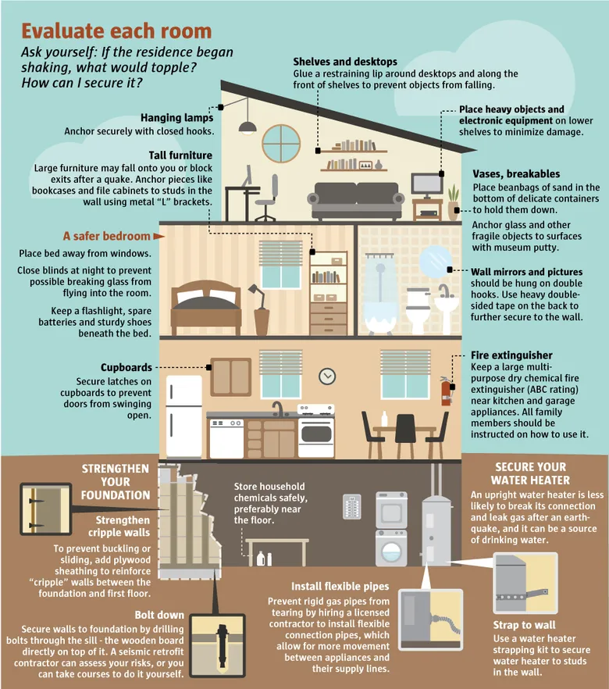
https://www.seattletimes.com/seattle-news/get-ready-to-rumble-a-guide-to-earthquake-preparedness/

Slide 14
Base or Seismic Excitation
Vibrationdata
14
Notes:
14

Slide 15
Base or Seismic Excitation
Vibrationdata
15
Notes:
15

