Slide 1
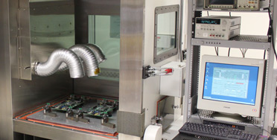
Unit 101
Vibrationdata
HALT/HASS for Product Reliability
Revision C

Slide 2
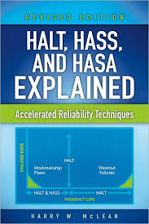
Vibrationdata
References
Harry W. McLean
Also articles by Kirk Gray, Stephen Smithson, et al.

Slide 3
Vibrationdata
Introduction
Highly Accelerated Life Testing (HALT) is a process for ruggedization of preproduction products
HALT is also referred to as AST (Accelerated Stress Testing)
Highly Accelerated Stress Screening (HASS) is the production screen for products once they have been characterized in HALT, typically performed on 100% of units per lot
Highly Accelerated Stress Audit (HASA) is a HASS on a sample of units from a production lot after “statistical process control” has been achieved

Slide 4
Vibrationdata
Comparison
Type | Stress beyond Spec | Prior Product Ruggedization Required | When used? | Design Defect Discovery? | Process Defect Discovery?
ESS | Maybe | No | Mfg. | Some | Yes
HASS | Yes | Yes | Mfg. | Some | Yes
HALT | Yes, Very | Is Part of Ruggedization | Design | Yes | Yes
HALT/HASS is the a direct offspring of the classical Environmental Stress Screening (ESS) process

Slide 5
Vibrationdata
HALT/HASS Environments
Each test/screen uses very high rate of change temperature chambers which are combined with multi-axis pneumatic vibration systems
Environments are used to “precipitate latent defects”
Any additional flaw-inducing stress can be used as a part of the HALT/HASS program, such as
power cycling humidity
pressure
altitude
corrosion
Environments may be performed separate or in combination
Goal to achieve < 1% annual field failure rate

Slide 6
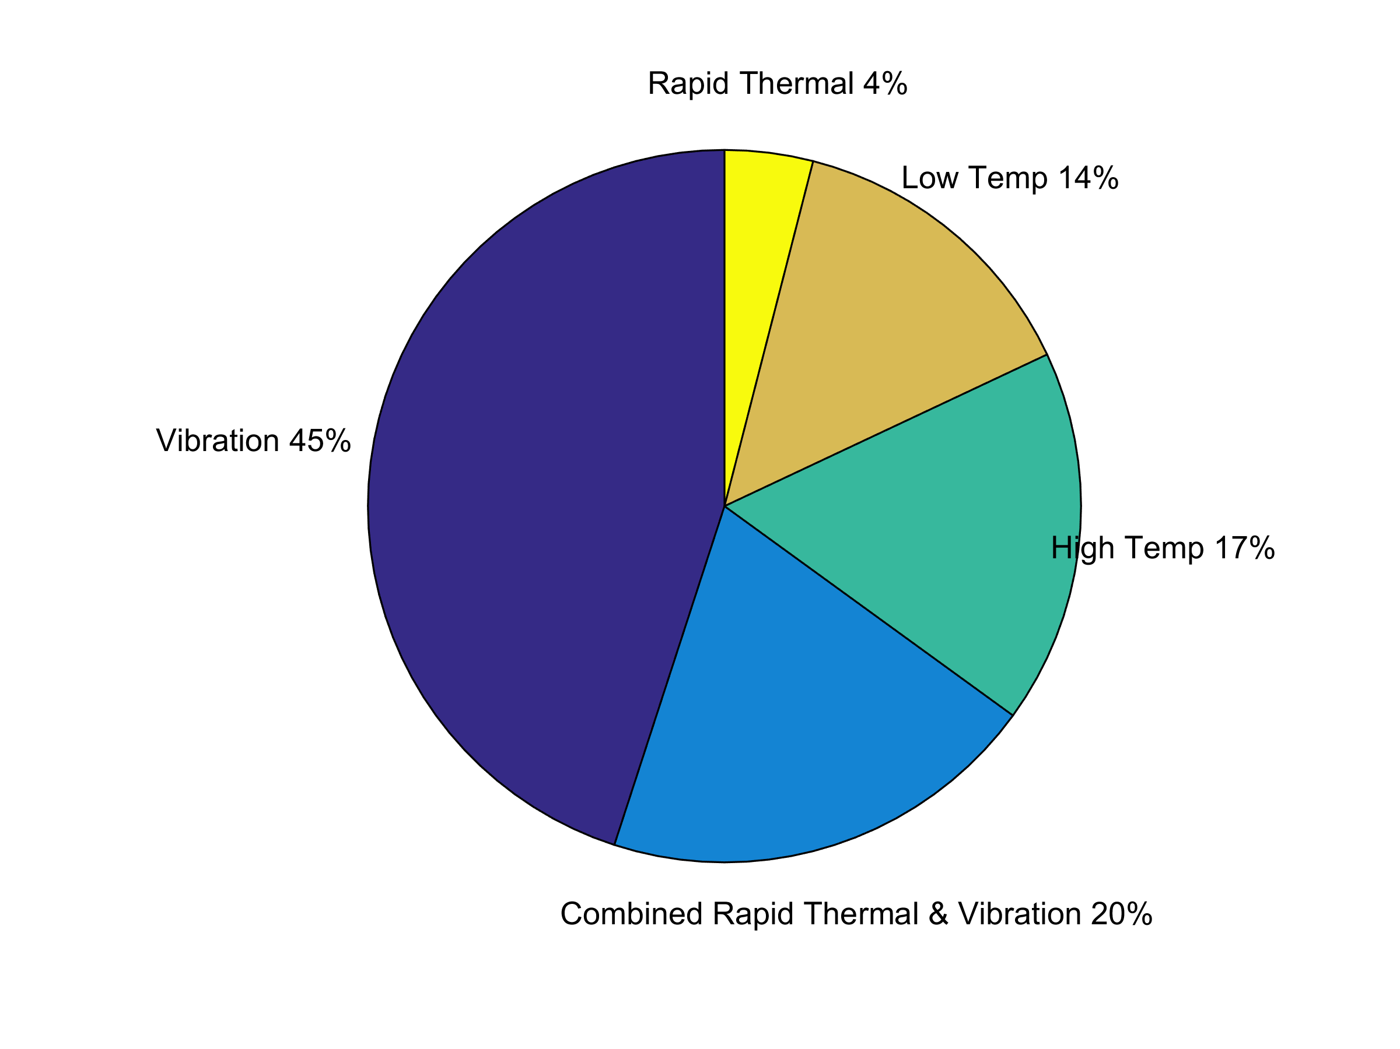
Vibrationdata
HALT Defects by Environments

Slide 7
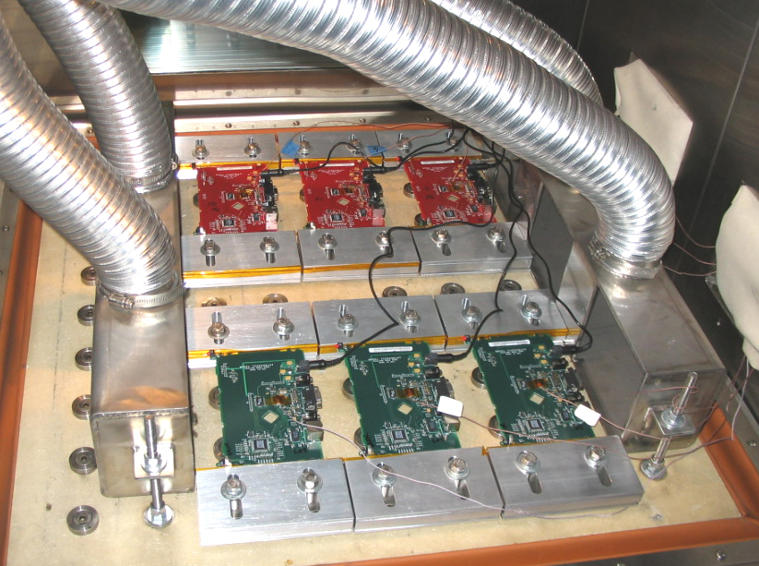
Circuit Boards undergoing HALT or HASS
Vibrationdata
A thermocouple is attached to each board
Temperature can be controlled using either board-mounted thermocouple or an air thermocouple

Slide 8
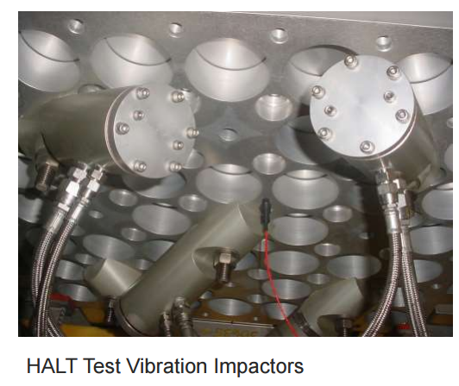
Vibrationdata
Underside of HALT/HASS Table
Control is typically performed via an accelerometer mounted on underside of table
But some consultants advocate controlling with accelerometers mounted on the product
Only overall GRMS is controlled
Spectrum is uncontrolled
Control Accelerometer

Slide 9
Vibrationdata
Test Chambers
Liquid nitrogen (LN2) for rapid cooling
Multiphase electrical heaters
(Temperature changes rates in an automobile or jet engine can easily exceed 60°C/minute)
Multiple high-velocity fans
Pneumatic actuated vibrators (pistons or hammers)
Six-degree-of-freedom excitation (three translational and three rotational)
Nonstationary, noncoherent random vibration – actually repetitive shock
Temperature and vibration stresses are applied independently at first and later simultaneously
Products should be powered and monitored during the test/screen

Slide 10
Vibrationdata
Fixtures
Halt Fixture
Does not need to have the same boundary conditions as the actual production unit installation
Purpose is to stimulate failure modes.
Suggested material: Ultem, thermoplastic polyetherimide resin
Hass Fixture
Provide same boundary conditions as product’s actual field service installation
Delrin, highly-crystalline polymer resin
Common Concerns
Be aware of fixture and circuit board natural frequencies
Add dampening material to the fixture if necessary to attenuate fixture resonant response
Allow gap underneath boards for air flow

Slide 11


Vibrationdata
David Packard (1912-1996)
Build it, test it and fix the things that go wrong.

Slide 12
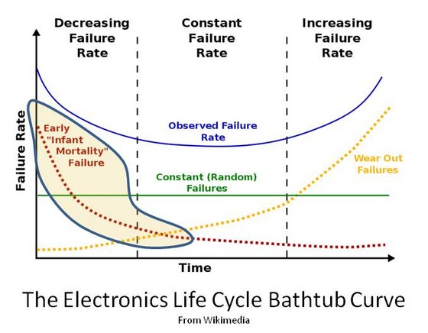
Vibrationdata
Bathtub Curve
The Electronics Life Bathtub Curve
From Wikimedia

Slide 13
Vibrationdata
HALT Purposes
Improve & verify design
Make product robust and mature at market introduction
Test to stresses at least twice as severe as those expected in the field environment
Perform so that a product and its production process are mature at product introduction
Benefits: customer satisfaction, reduced warranty and service costs, avoid product recall
Best performed at earliest product development stage
Not intended as pass or fail, rather as a learning process
Test at Lowest assembly possible such as circuit board
Test units are not shipped to customer

Slide 14
Vibrationdata
Product Vibration Response
Perform preliminary test on a nonfunctional circuit board with an attached response accelerometer to measure the board’s natural frequencies and transmissibility
Also mount one or more accelerometers on fixture
Control accelerometer is mounted on the underside of the table
Product and fixture resonant frequencies are a concern

Slide 15
Vibrationdata
HALT Phases
Pre-HALT - test engineers & designers have planning meetings
2. HALT – perform tests with at least four samples & document uncovered defects
Post-HALT – meetings, root cause & corrective action for each issue & ruggedize design to increase both operational and destruction limits
4. Repeat HALT to verify corrections
Use HALT to identify operating & destruct limits

Slide 16
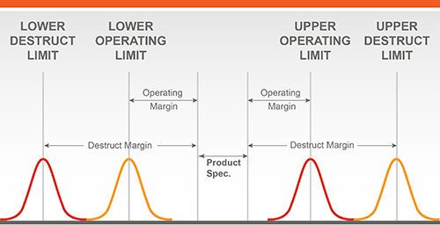
Vibrationdata
Operating & Destruct Limits
Operating Limits: degradation
excessive noise
gain change intermittent dropouts needs reboot other anomaly
Destruct Limits: hard failure
Use HALT to identify limits
Each curve represents a normal distribution
Assume +16°C ( + 4σ x 4°C ) for thermal
Assume +8 GRMS ( + 4σ x 2 GRMS ) for vibration

Slide 17
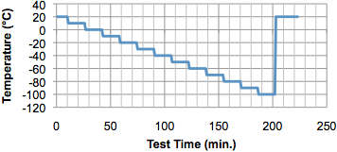
Vibrationdata
HALT Cold Step Stress
Image courtesy of DynaQual Test Labs
Start at room temperature
Cool down in 10°C steps to lower operating or destruct limit
Dwell times are typically 15-20 minutes to stabilize product
Have airflow around the product
Note temperature at which first anomaly occurs, operating limit
Continue until hard failure occurs to establish destruct limit
Return to ambient and take corrective action if failure occurs

Slide 18
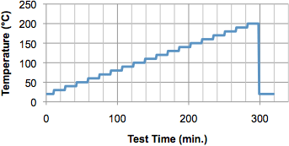
Vibrationdata
HALT Hot Step Stress
Similar process as Cold Step Stress
Start at room temperature
Heat up in 10°C steps to upper operating or destruct limit
Dwell times are typically 15-20 minutes to stabilize product

Slide 19
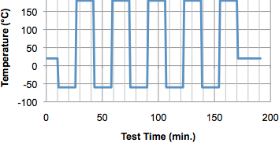
Vibrationdata
Rapid Thermal Transition Stress
Start at room temperature
Set limits to 5°C less than the thermal operational limits found during step stress testing
Perform five cycles with the thermal change rate as rapid as possible, maybe 60°C/min or greater
10 minute or longer dwell

Slide 20
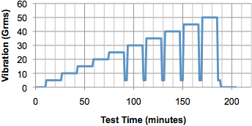
Vibrationdata
Vibration Step Stress
Entire test performed at room temperature
Wideband random vibration applied in 5 Grms increments
Steps applied to identifying operating and destruct limits
Dwells of 10 minutes
After 20 GRMS is reached than reduce to 2 to 3 GRMS for “tickle” vibration test to detect failure modes that would remain undetected at higher levels
Verify that there are no loose fasteners or connections

Slide 21
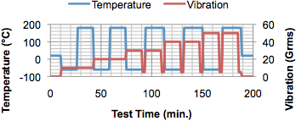
Vibrationdata
Combined Thermal & Vibration
Rapid thermal cycling combined vibration step stressing
Uses same limits as Rapid Thermal Cycling
Vibration follows limits discovered in Vibration Step Stress
Dwell times are typically 15-20 minutes to stabilize product
Tickle vibration also used here
The highest vibration levels should be 3 to 5 GRMS less than the vibration UOL

Slide 22
Vibrationdata
HASS Purposes
Perform on HASS being performed on 100% of the units shipped
Monitor production process because processes may shift
Precipitation Screen – convert a relevant defect from latent (dormant) to patent (active)
Pass/Fail Test
HASS tests are at reduced HALT levels
Proof of Screen (POS) needed to develop & verify HASS program
Rule-of-thumb
Temperature extremes reduced by 15% to 20% of operating limits (OL)
Vibration GRMS by 50% of destruct limit (DL)

Slide 23
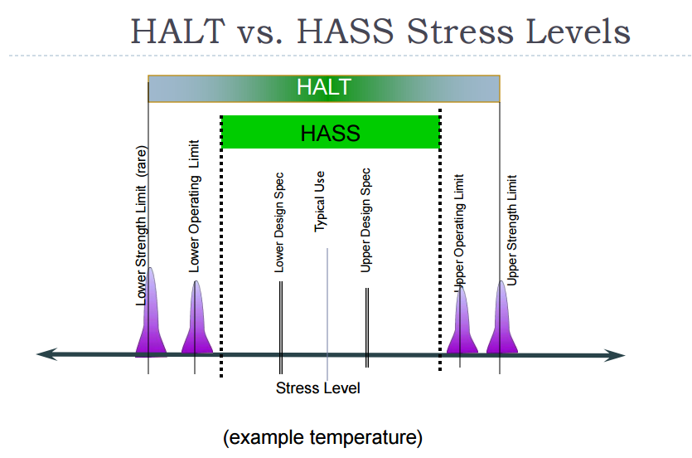
Vibrationdata
HALT vs. HASS Stress Levels

Slide 24
Vibrationdata
HASS Thermal Cycle
Temperature
UDL
Rate Thermal
UOL
Slow Rate Thermal
20°C
Time
LOL
LDL
Precip
Detection
Precipitation Screen with 50% DL Vibration
Detection Screen with 80% OL Temperatures and Low-level Tickle Vibration

Slide 25
Vibrationdata
HASS Thermal Cycle, Alternate Method
Temperature
UOL -20%
20°C
Time
LOL +20%
Number of cycles may vary
Perform with vibration with varying intensity

Slide 26
Vibrationdata
Proof of Screen (POS)
Fixture characterization
Establish HASS Profile – trial-and-error
Verify that HASS Profile can expose defects
Use products with “seeded defects” if possible
Or use field failed products that are functional but classified as no defect found (NDF) or no trouble found (NTF)
Record the number of stress cycles required to uncover the defects from each
Determine root cause and take corrective action
Life determination – at least six new, unstressed units subjected to repeated HASS for a minimum of 10 times (30 to 50 times recommended) – verify product has life after HASS
Determine whether position correlates with HASS failure (i.e. vibration and thermal stress levels should consistent for each position)

Slide 27
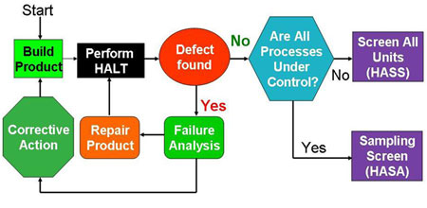
Vibrationdata
HASA
Image courtesy of Integrated Service Technology
HASA – highly accelerated stress audit
HASA is used after HASS have verified that manufacturing process is under control
Consult with statisticians to determine sample size per lot, required pass rate for among samples, etc.

Slide 28
Vibrationdata
Some Common Sense
Visual inspection
A unit may pass its electrical functional test but still be considered a failure if any of the following occurs
cracked circuit board loose connectors or screws bent clamps worn parts smoke or fire

Slide 29
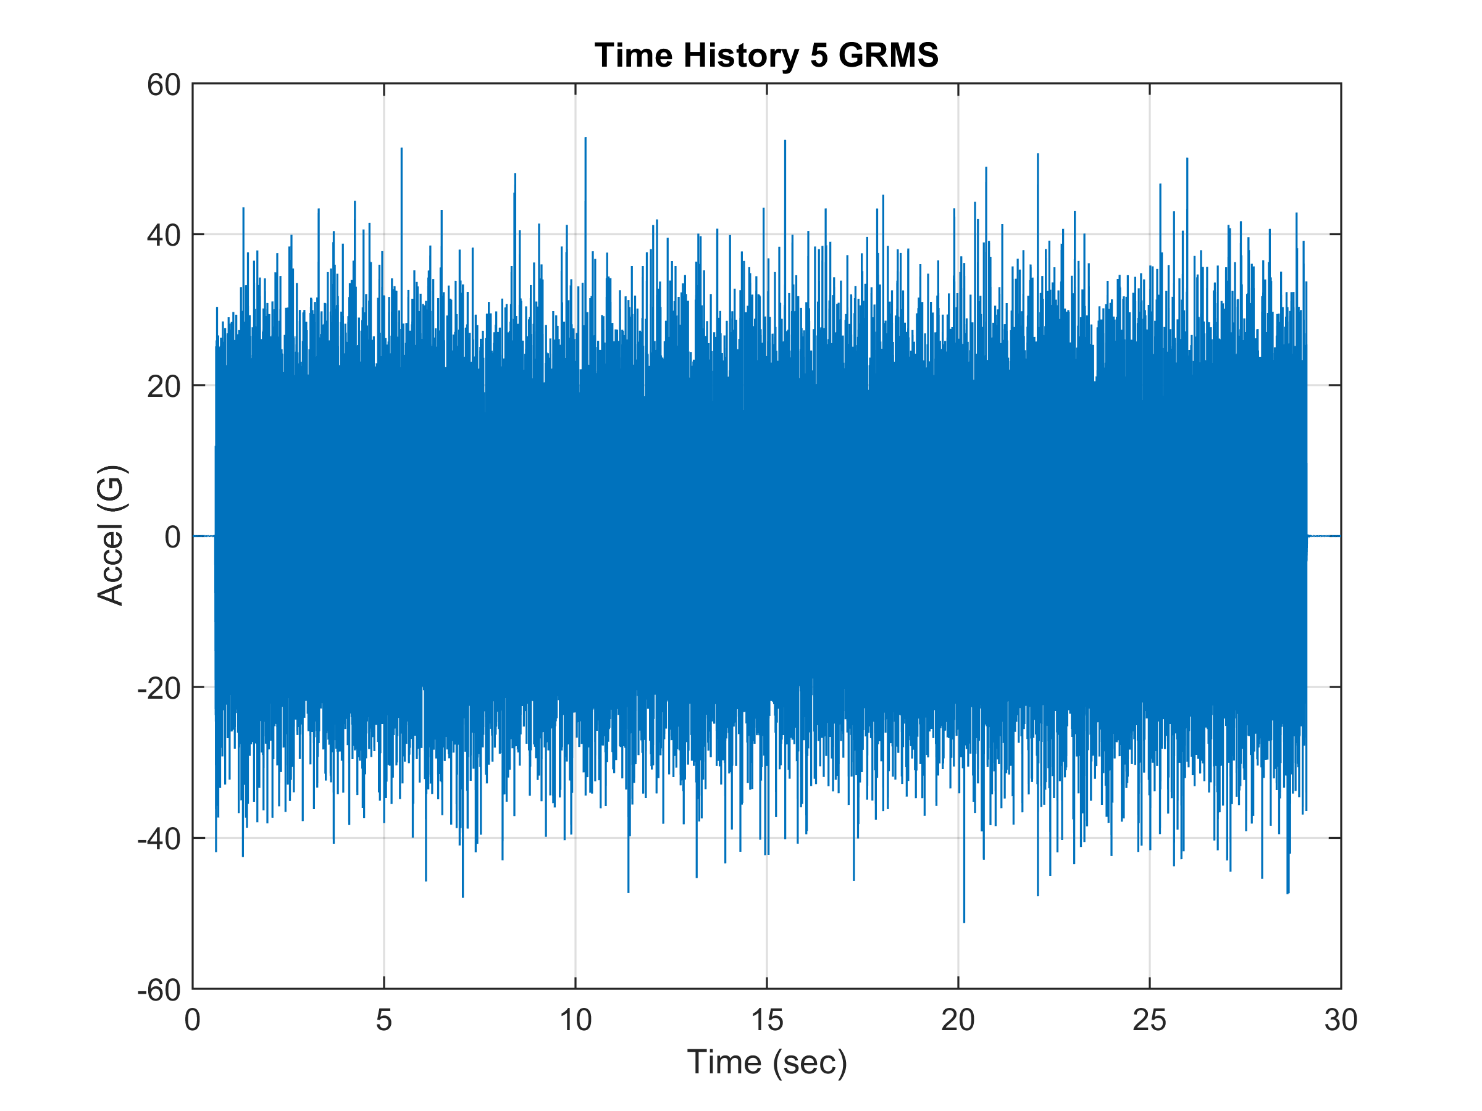
Simulated HALT/HASS Acceleration Time History
Vibrationdata
RMS = 5
kurtosis = 11.24
Maximum = 52.88
Minimum = -51.28
Crest Factor = 10.58
Crest Factor =
(Max Absolute/RMS)

Slide 30
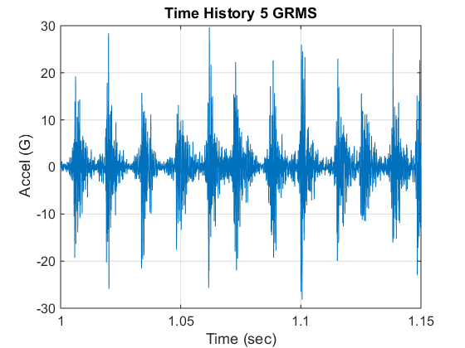
Vibrationdata
Acceleration Segment
Repetitive Shock Pattern

Slide 31
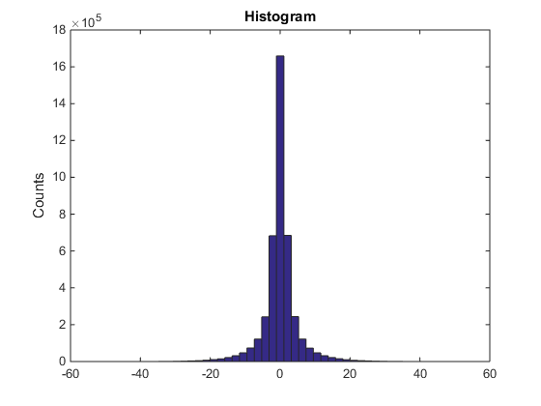
Vibrationdata
Acceleration Histogram
Non-Gaussian due to high kurtosis =11.24
Gaussian distribution has kurtosis = 3
Acceleration (G)

Slide 32
Vibrationdata
Statistics
Skewness =
Kurtosis =
Mean =
Variance =
Standard Deviation is the square root of the variance
where Y_{i} is each instantaneous amplitude, n is the total number of points,
μ is the mean, σ is the standard deviation

Slide 33
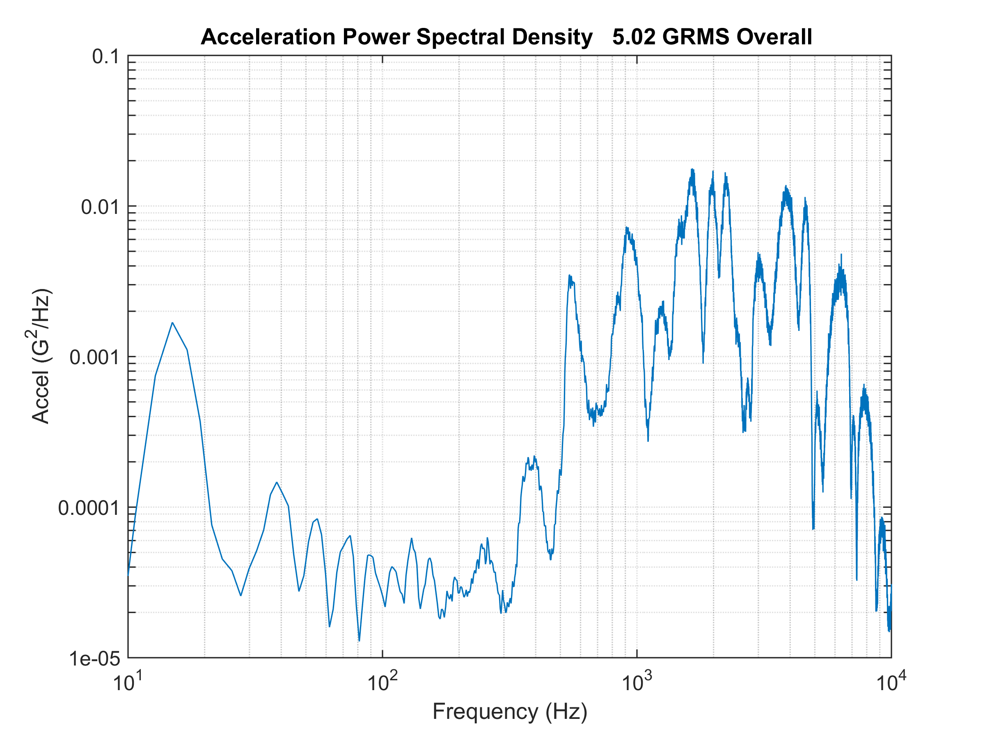
Vibrationdata
Sample Acceleration PSD

Slide 34
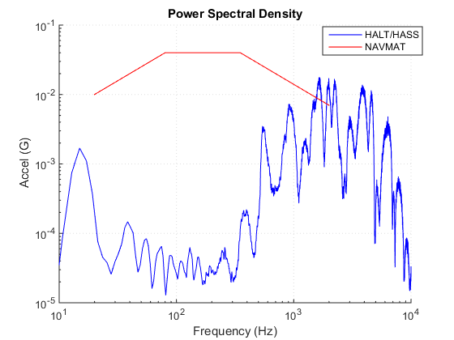
Vibrationdata
PSD Comparison
The HALT/HASS PSD is only a representative simulation
HALT/HASS PSD can be scaled up or down
NAVMAT PSD is fixed

Slide 35
Vibrationdata
Conclusions
McLean gives case histories in his book where HALT/HASS has been very successful for assuring product reliability
Critics raise concerns:
Do your own due diligence!
Only the GRMS is controlled
PSD is not controlled
Vibration levels will vary per axis
Excitation may not replicate field vibration
Circuit board response levels may vary significantly per location in the chamber
Fixture resonances affect circuit board response
Variation from one chamber to the next even for same vendor and model

