Slide 1
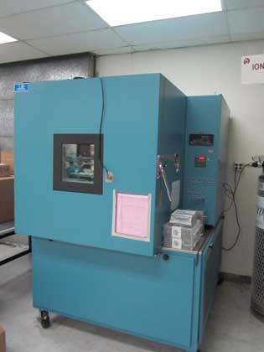
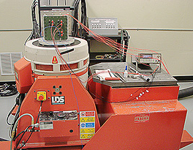
Unit 102
Vibrationdata
Environmental Stress Screening (ESS) for Product Reliability

Slide 2
Vibrationdata
Introduction & References
Many types of ESS, standards, guidelines, etc.
HALT/HASS is an outgrowth of ESS and is covered in a separate slide presentation
This presentation will focus mostly on classical ESS per U.S. military references
ESS may be a contract requirement for U.S. military program
NAVMAT P-9492, Navy Manufacturing Screening Program, 1979
Tri-Service Technical Brief 002-93-08, Environmental Stress Screening Guidelines, 1993
See also publications by the Institute of Environmental Sciences and Technology www.iest.org

Slide 3
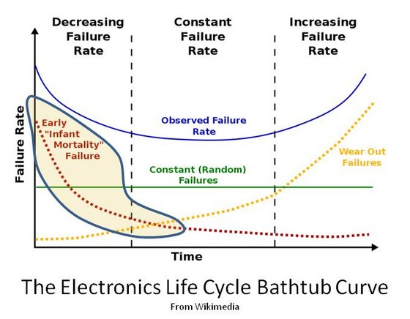
Vibrationdata
Bathtub Curve
The Electronics Life Bathtub Curve
From Wikimedia

Slide 4
Vibrationdata
Scope, Classical ESS
ESS is a manufacturing screen intended to precipitate latent defects due to defective parts or workmanship
ESS can be expanded and tailored for a given product or program
ESS is not necessarily a qualification process to verify design
But qualification, or proof-of-screen, is highly advisable for:
design verification demonstrate that the product still has remaining life after ESS

Slide 5
Vibrationdata
Test Types
Random vibration and temperature cycling have proven to be the most successful forms of ESS in terms of effective flaw precipitation
Random vibration and thermal cycling are performed separately for basic ESS
Other tests can be performed such as burn-in, humidity, pressure, sine sweep vibration, combined random vibration & thermal, etc.

Slide 6
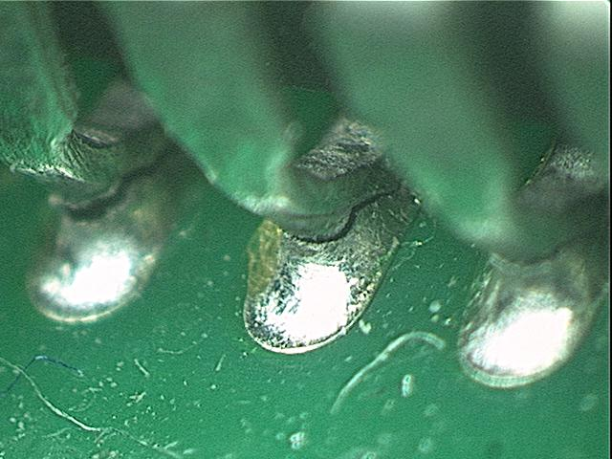
Vibrationdata
Test Types
Electronic ccomponents must be designed and tested to withstand thermal & vibration environments
Cracked solder Joints for Piece Part with “J leads”

Slide 7
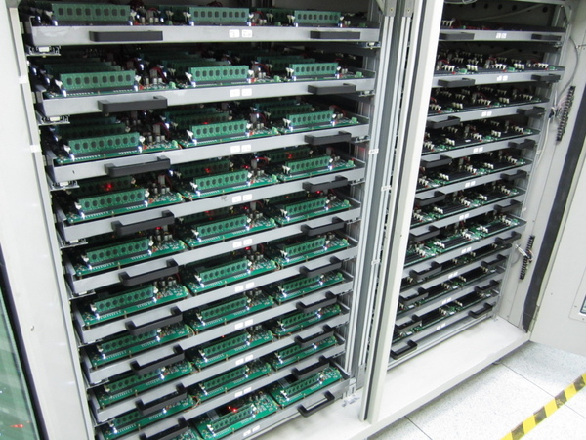
Vibrationdata
Burn-in
Also called Pre-Conditioning Testing
Intended to uncover defective parts and workmanship
Typical test 168 hours at +125°C
Power cycling (on/off) may be included
BS 9450, Specification for Integrated Electronic Circuits and Micro-Assemblies of Assessed Quality: Generic Data and Methods of Test, Para 1.2.10.3
See also Mil-Std-750D, Mil-Std-883E, and Mil-Std-202G
DiMM burn-in testing machine

Slide 8
Vibrationdata
ESS Random Vibration

Slide 9
Vibrationdata
NAVMAT P-9492 Power Spectral Density
Parts & workmanship screen
Does not necessarily cover field environment
Applied as base input via shaker table

Slide 10
Vibrationdata
Baseline Vibration Profile
 | Level of Assembly
Characteristic | PWA | UNIT | SYSTEM
Overall Response Level | 6 GRMS | 6 GRMS | 6 GRMS
Frequency | 20 – 2000 Hz | 20 – 2000 Hz | 20 – 2000 Hz
Axes | 3 | 3 | 3
Duration Axes Sequentially Axes Simultaneously | 10 min/axis 10 min | 10 min/axis 10 min | 10 min/axis 10 min
Product Condition | Unpowered (unless end item) | Powered, Monitored | Powered, Monitored
The baseline PSD is the NAVMAT P-9492, with modifications as described in next slides.

Slide 11
Vibrationdata
Vibration Screen Development
Options
Vibration Survey
Step-Stress Tests
Fault Replication Tests
Heritage Screen
The vibration survey is the preferred method.

Slide 12
Vibrationdata
Method A Vibration Survey
Requires prior knowledge of test item stress limits
Measure natural frequencies and damping ratios of test item
Mount response accelerometers on item
Apply low-level random vibration input, 2 to 3 GRMS using scaled-down NAVMAT PSD
Or use sine sweep input
Apply in each of three axes
Compare vibration response survey spectra against allowable stress limit criteria for the item
Make design modifications to remove vibration screen concerns
Or tailor input spectrum (NAVMAT PSD) via notching to reduce response maxima within allowable stress limits

Slide 13
Vibrationdata
Method B Step-Stress Tests
Determine stress limit of the test item by experiment
Start with NAVMAT PSD scaled down to 2 or 3 GRMS for 5 minutes
Power & monitor test item before, during and after vibration
Determine whether any failures are due to design flaws or latent defects
Increase vibration in 2 GRMS steps until tolerance limit is reached where unit malfunctions or flaws are introduced into “good” hardware
Do failure analysis, design modifications and restesting as needed to establish “design capability” from tolerance limit
Use at least one-half of the design capability GRMS as the initial screening level

Slide 14
Vibrationdata
Method B Step-Stress Tests (cont)
Design Capability
Screen Level
Design Requirement
Field (Operating Level)
Frequency
Screen level should also be > design requirement or operating level

Slide 15
Vibrationdata
Method C Fault Replication Tests
Similar to Method B but with “seeded latent defects”
Loose hardware
Flawed components (transistors, relays, etc)
Cold solder joints
Nicked component mounting legs or wires
Incorrect or removed bonding
Intermittent switch
Insufficient solder
Connected or plug partially unseated
Fractured hardware

Slide 16
Vibrationdata
Method D Heritage Screen
Use screen from recent successful experience on equipment of comparable design and manufacture
Iterative process whereby screen strength can be adjusted
Or use NAVMAT PSD, which is a heritage screen derived from general vibration screening experience

Slide 17
Vibrationdata
ESS Thermal Cycling

Slide 18
Vibrationdata
Baseline Temperature Cycling Profile
 | Level of Assembly
Characteristic | PWA | Unit | System
Temperature range of hardware | -50°C/+75°C | -40°C/+70°C | -40°C/+60°C
Temperature rate of change of hardware | 15°C/min to 20°C/min | 10°C/min to 20°C/min | 10°C/min to 15°C/min
Soak time of hardware at temperature extremes (minimum) | 5 minutes | 5 minutes | 5 minutes
Number of Cycles | 20 to 40 | 12 to 20 | 12 to 20
Equipment Conditions | Unpowered | Powered, monitored | Powered, monitored

Slide 19
Vibrationdata
Thermal Cycling Screen Development
Options
Thermal Survey
Heritage Screen
The thermal survey is the preferred method.

Slide 20
Vibrationdata
Method A Thermal Survey
A thermal screen is characterized by
Cycle characteristics
Equipment condition
Number of cycles
Level of assembly at which screen is performed
low temperature
high temperature
rate of temperature change
dwell times at temperature extremes
powered or unpowered
monitored or unmonitored

Slide 21
Vibrationdata
Method A Thermal Survey (cont)
Perform analysis using computer models
Perform thermal tests where the test unit is monitored via thermocouples
Also monitor chamber air temperature
Dwell times should be long enough so that test unit temperatures reaches chamber air temperature plus some soak time
Soak time allows solder to creep ~ 5 minutes
Use chamber air flow for temperature stabilization
Recommended: power & monitor test unit

Slide 22
Vibrationdata
Method A Thermal Survey (cont)
Recommended: power & monitor test unit
Thermal cycling produces thermal stress from alternate expansion & contraction
Begin with baseline parameter in previous table
Vary temperature extremes & number of cycles to determine most effective screen for precipitating latent defects
Investigate any failures and make design or screen modifications as needed

Slide 23
Vibrationdata
B. Heritage Screen
Use screen from recent successful experience on equipment of comparable design and manufacture
Iterative process whereby screen strength can be adjusted
Or use the baseline thermal cycle profile, which is a heritage screen derived from general screening experience

Slide 24
Vibrationdata
ESS Order
Random vibration can precipitate flaws that are then detected during thermal cycling, and vice-versa
One strategy is to perform the following sequence
5 minutes vibration
Full thermal cycling
5 minutes vibration

Slide 25
Vibrationdata
Proof of Screen
Both random vibration and thermal cycling remove life from product
Need to verify life remaining after ESS
Proof of screen involves the application of the screening regimen and test repeatedly without failure
Subject one or more test items to 10 – 20 cycles of ESS (random vibration + thermal cycling)
Power and monitor test item before, during and after each environment
Investigate any failures and modify screen or design accordingly

