Slide 1
Unit 7
Fast Fourier Transform (FFT)
Revision E

Slide 2
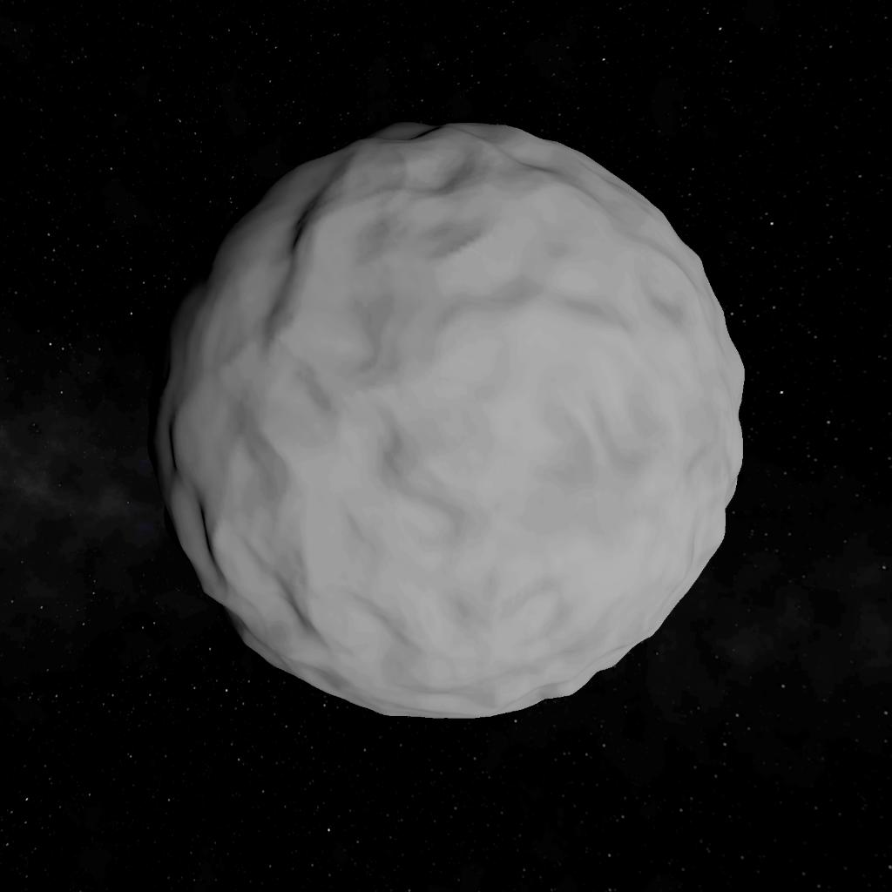
FFT Algorithm History
Carl Friedrich Gauss's unpublished work in 1805 when he needed it to interpolate the orbits of the asteroids Pallas and Juno from sample observations and invented the FFT to do so
Mathematicians James Cooley and John Tukey “reinvented the wheel” in 1965
Pallas is the second asteroid to have been discovered, after Ceres. It is the third-largest asteroid in the Solar System and is orbiting in the asteroid belt.

Slide 3
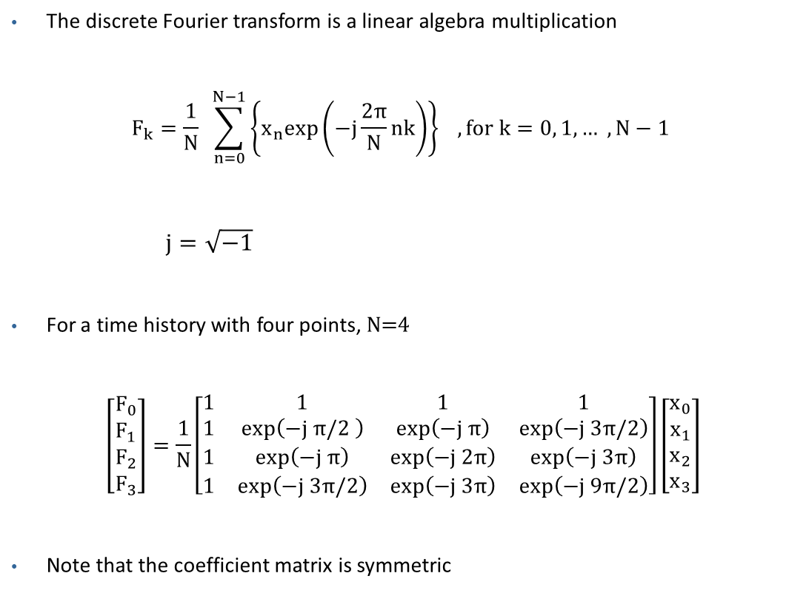
Introduction
The discrete Fourier transform is a linear algebra multiplication
$$F_{k}=\frac{1}{N} \sum_{n=0}^{N−1}{\left\{x_{n}exp\left(−j\frac{2π}{N}nk\right)\right\}} , for k=0, 1,… , N−1$$
$j=\sqrt{−1}$
For a time history with four points, N=4
$$\left[\begin{matrix}F_{0} \\ F_{1} \\ F_{2} \\ F_{3}\end{matrix}\right]=\frac{1}{N}\left[\begin{matrix}1 & 1 & 1 & 1 \\ 1 & exp\left(−j π/2 \right) & exp\left(−j π\right) & exp\left(−j 3π/2\right) \\ 1 & exp\left(−j π\right) & exp\left(−j 2π\right) & exp\left(−j 3π\right) \\ 1 & exp\left(−j 3π/2\right) & exp\left(−j 3π\right) & exp\left(−j 9π/2\right)\end{matrix}\right]\left[\begin{matrix}x_{0} \\ x_{1} \\ x_{2} \\ x_{3}\end{matrix}\right]$$
Note that the coefficient matrix is symmetric

Slide 4
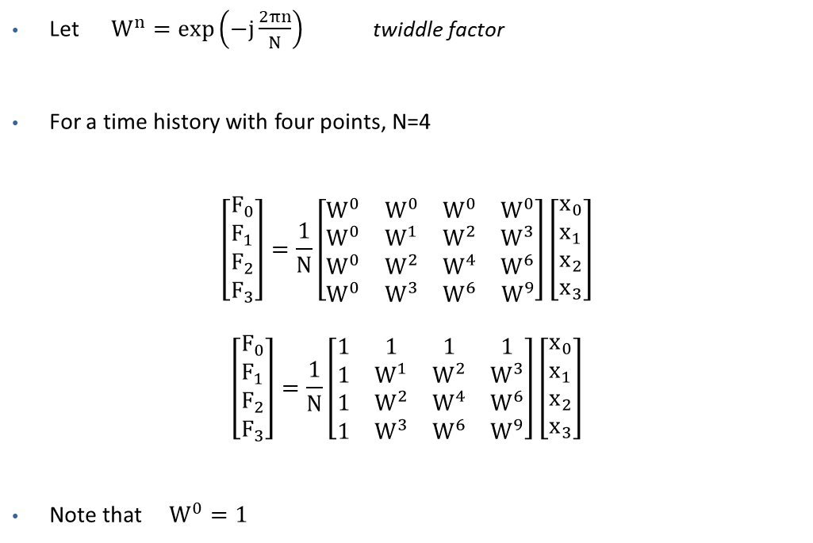
Introduction (cont)
Let $W^{n}=exp\left(−j\frac{2πn}{N}\right)$ twiddle factor
For a time history with four points, N=4
$$\left[\begin{matrix}F_{0} \\ F_{1} \\ F_{2} \\ F_{3}\end{matrix}\right]=\frac{1}{N}\left[\begin{matrix}W^{0} & W^{0} & W^{0} & W^{0} \\ W^{0} & W^{1} & W^{2} & W^{3} \\ W^{0} & W^{2} & W^{4} & W^{6} \\ W^{0} & W^{3} & W^{6} & W^{9}\end{matrix}\right]\left[\begin{matrix}x_{0} \\ x_{1} \\ x_{2} \\ x_{3}\end{matrix}\right]$$
$$\left[\begin{matrix}F_{0} \\ F_{1} \\ F_{2} \\ F_{3}\end{matrix}\right]=\frac{1}{N}\left[\begin{matrix}1 & 1 & 1 & 1 \\ 1 & W^{1} & W^{2} & W^{3} \\ 1 & W^{2} & W^{4} & W^{6} \\ 1 & W^{3} & W^{6} & W^{9}\end{matrix}\right]\left[\begin{matrix}x_{0} \\ x_{1} \\ x_{2} \\ x_{3}\end{matrix}\right]$$
Note that $W^{0}=1$

Slide 5





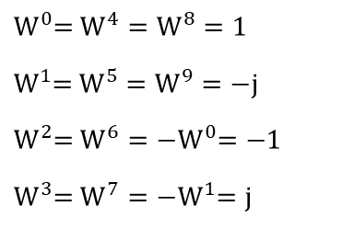
Unit Circle, for N=4
Imaginary Axis
$W^{n}=exp\left(−j\frac{2πn}{N}\right)$
$W^{0}$= $W^{4}=W^{8}=1$
$W^{1}$= $W^{5}=W^{9}=−j$
$W^{2}$= $W^{6}={−W}^{0}=−1$
$W^{3}$= $W^{7}={−W}^{1}=j$
0
1
Real Axis

Slide 6
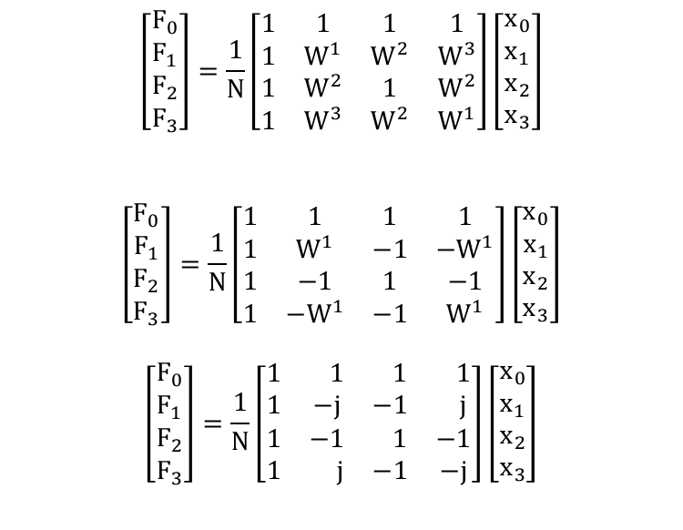
Simplification
Simplifying & accounting for repetition
$$\left[\begin{matrix}F_{0} \\ F_{1} \\ F_{2} \\ F_{3}\end{matrix}\right]=\frac{1}{N}\left[\begin{matrix}1 & 1 & 1 & 1 \\ 1 & W^{1} & W^{2} & W^{3} \\ 1 & W^{2} & 1 & W^{2} \\ 1 & W^{3} & W^{2} & W^{1}\end{matrix}\right]\left[\begin{matrix}x_{0} \\ x_{1} \\ x_{2} \\ x_{3}\end{matrix}\right]$$
$$\left[\begin{matrix}F_{0} \\ F_{1} \\ F_{2} \\ F_{3}\end{matrix}\right]=\frac{1}{N}\left[\begin{matrix}1 & 1 & 1 & 1 \\ 1 & W^{1} & −1 & {−W}^{1} \\ 1 & −1 & 1 & −1 \\ 1 & {−W}^{1} & −1 & W^{1}\end{matrix}\right]\left[\begin{matrix}x_{0} \\ x_{1} \\ x_{2} \\ x_{3}\end{matrix}\right]$$
$$\left[\begin{matrix}F_{0} \\ F_{1} \\ F_{2} \\ F_{3}\end{matrix}\right]=\frac{1}{N}\left[\begin{matrix}1 & 1 & 1 & 1 \\ 1 & −j & −1 & j \\ 1 & −1 & 1 & −1 \\ 1 & j & −1 & −j\end{matrix}\right]\left[\begin{matrix}x_{0} \\ x_{1} \\ x_{2} \\ x_{3}\end{matrix}\right]$$

Slide 7
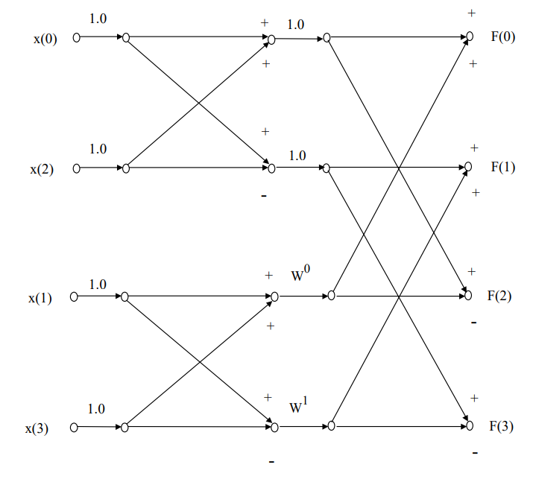
Butterfly Diagram
Imagine rearranging your data, then "folding and combining" it in a structured way across several stages — the butterfly is the core folding mechanism that efficiently mixes and reduces the data

Slide 8
Discrete Fourier Transform & FFT
The discrete Fourier transform requires a tremendous amount of calculations
A time history with M coordinates would require M² complex multiplication steps
The discrete Fourier transform can be carried out by a Fast Fourier transform method, however
The Cooley-Tukey Radix 2 FFT method is based on a time series with a number of points equal to 2^{N}, where N is an integer
The FFT requires M log ₂ M complex multiplication steps, where M = 2^{N}

Slide 9
Calculation Step Example
Now consider a time history with 1,000,000 points
A regular Discrete Fourier transform would require 10¹² complex multiplication steps
(1 Trillion)
On the other hand, an FFT would only require approximately 2(10⁷) steps
Thus, the Cooley-Tukey Radix 2 FFT achieves the calculation in 1/50,000th of the time

Slide 10
Suitable Time Histories for Cooley-Tukey FFT
An FFT can be calculated for a time history with any of the following number of coordinates
2 |  | 256 |  | 32,768
4 |  | 512 |  | 65,536
8 |  | 1024 |  | 131,072
16 |  | 2048 |  | 262,144
32 |  | 4196 |  | 524,288
64 |  | 8192 |  | 1,048,576
128 |  | 16,384 |  | 2,097,152

Slide 11
Limitations of the Cooley-Tukey FFT
The above example is not quite correct
Again, the FFT is based on a time series with 2^{N} coordinates
Note that
2 ¹⁹ = 524,288
and
2 ²⁰ = 1,048,576
Unfortunately, a time history with 1,000,000 points falls between these two cases

Slide 12
Cooley-Tukey Options
There are two options for dealing with a time history that is not an integer power of 2
One option is to truncate the time history
This should be acceptable if the data is stationary
In the above example, the time history would thus be truncated to 524,288 points
The second option is to pad the time history with trailing zeroes to bring its length to an integer power of 2
A problem with this option is that it artificially reduces the amplitude of the Fourier transform spectral lines
Truncation, rather than zero-padding, is the preferred method in this course

Slide 13

Other FFT Algorithms
"Fastest Fourier Transform in the West"
Since Cooley-Tukey, numerous algorithms have been developed that can handle arrays with arbitrary length
Truncation or zero-padding is no longer needed
Matlab uses free library from: www.fftw.org
FFTW is a C subroutine library from MIT for computing the discrete Fourier transform (DFT) in one or more dimensions, of arbitrary input size

Slide 14
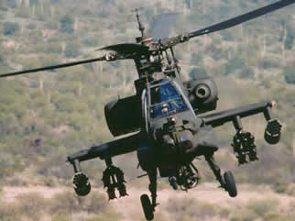
Exercise 1
Apache helicopter fly-over
Take the FFT of audio data file with maximum plotting frequency = 400 Hz
Sample rate is 2.205e+04 Hz
Use the mean removal and rectangular window options
What is the blade passing frequency of the main rotor?

Slide 15
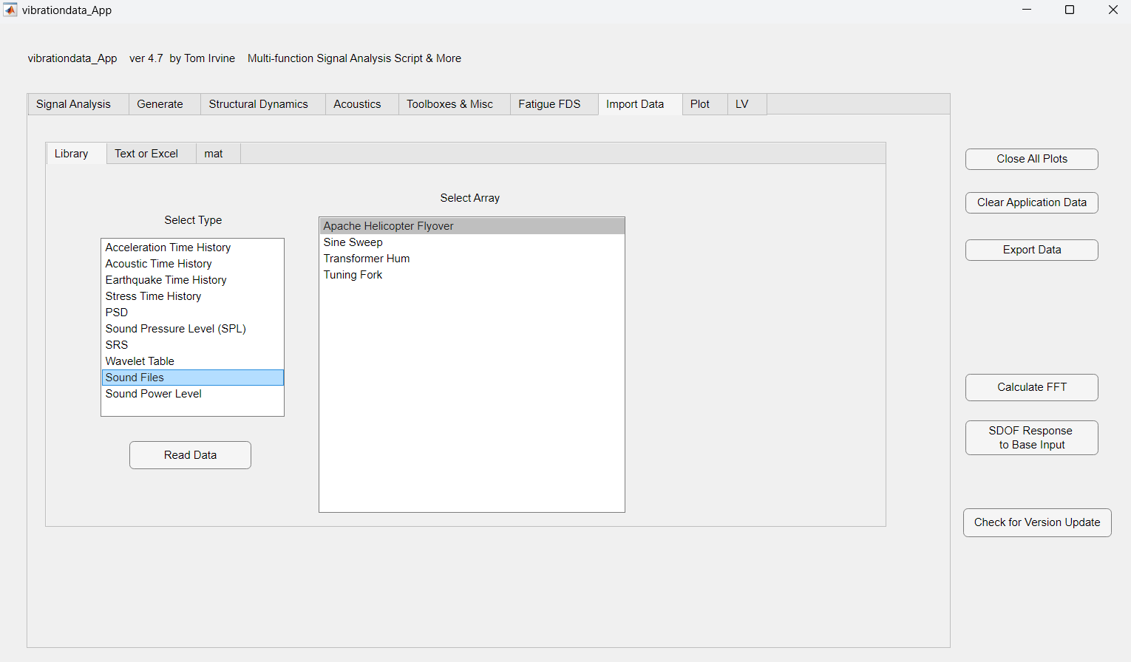
Listen to Apache Sound File

Slide 16
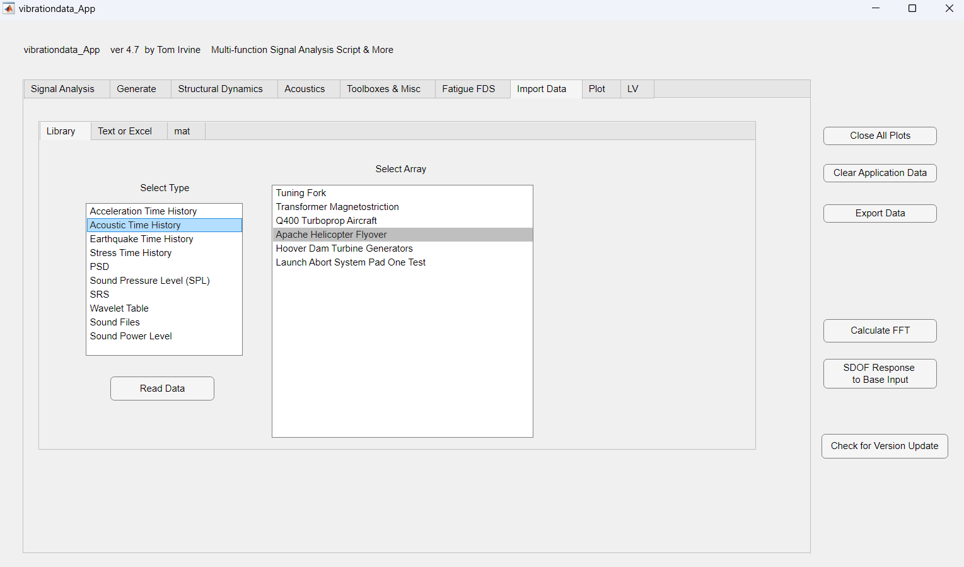
Import Apache Time History Array

Slide 17
Time History

Slide 18
Close-up View
Mostly a series of sine tones
Main & Tail rotor blade passing frequencies & integer harmonics

Slide 19
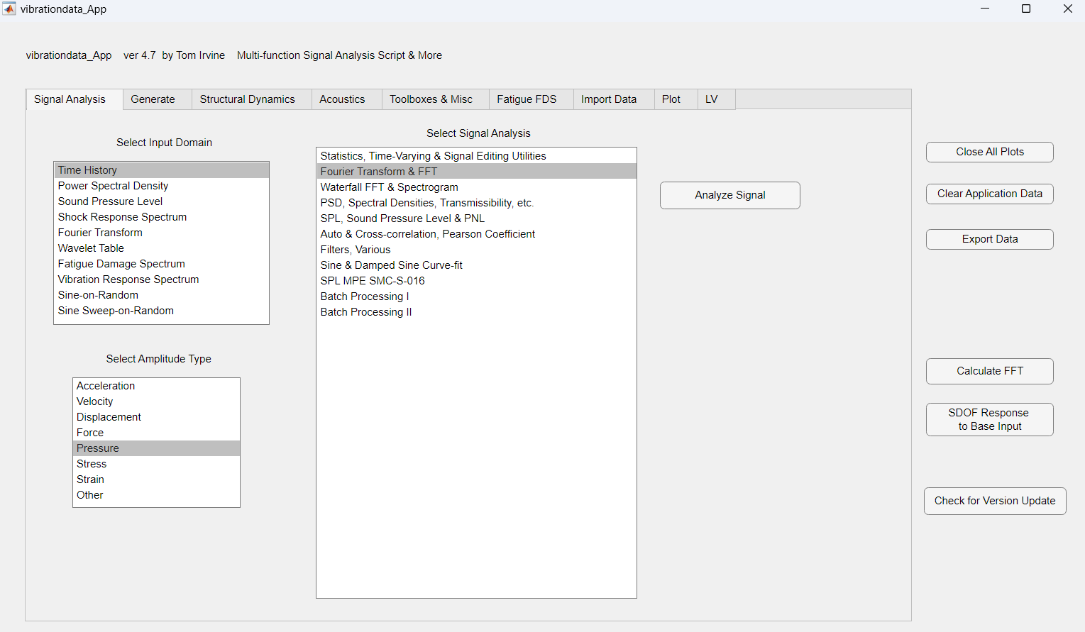
Main GUI

Slide 20
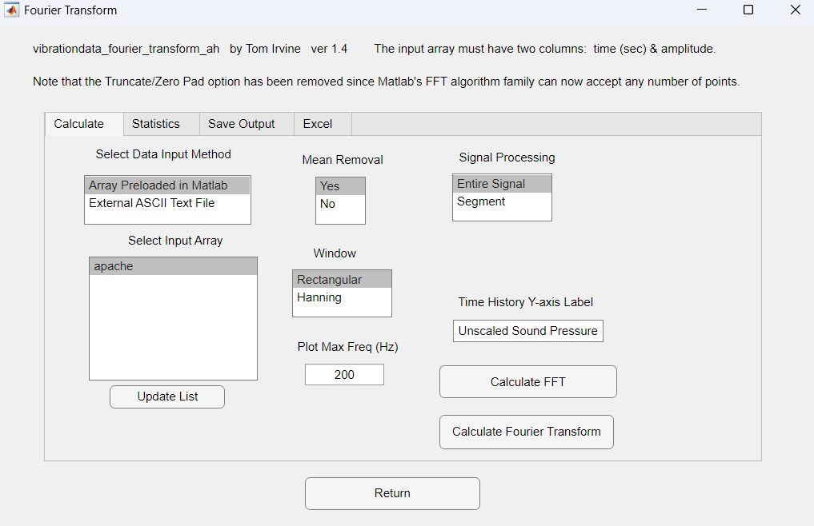
Apache FFT

Slide 21
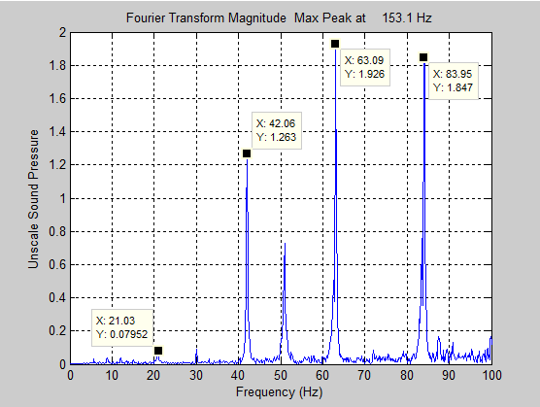
Apache Helicopter Flyover
The measured blade passing frequency is 21 Hz with integer multiples thereof.
The main rotor has four blades
The apparent main hub frequency is thus 5.25 Hz

Slide 22
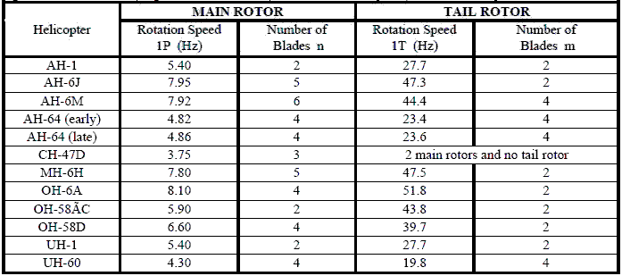
Exercise 2 (cont)
MIL-STD-810G - Apache is AH-64

Slide 23
Exercise 1 (cont)
The measured blade passing frequency is 21 Hz
The apparent main hub frequency is thus 5.25 Hz
The actual main hub frequency is ≅ 4.84 Hz per MIL-STD-810G
What is the estimate speed accounting for Doppler shift?
c = speed of sound
velocity of the receiver relative to the source

Slide 24
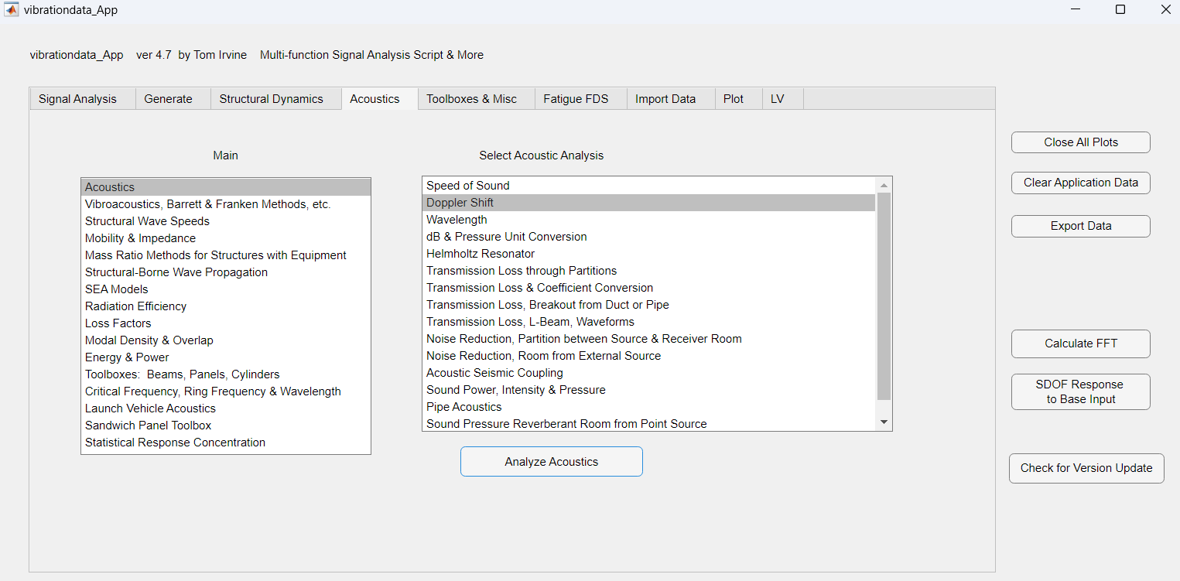
Exercise 1 (cont)

Slide 25
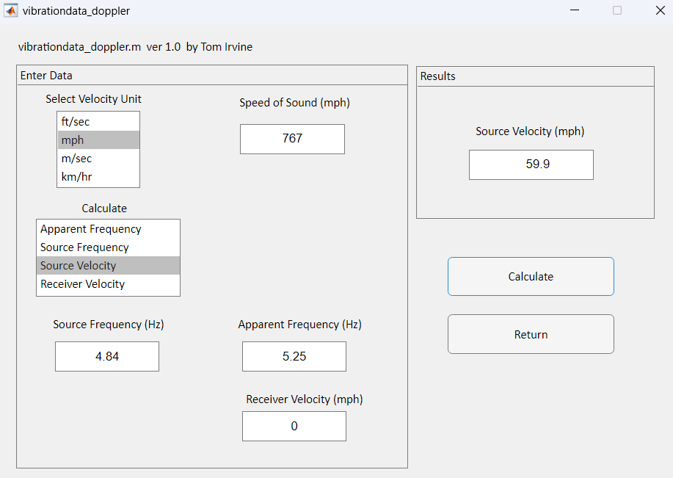
Exercise 1 (cont)
Assume flyover directly over microphone
Speed estimate of 59.9 mph is plausible

Slide 26
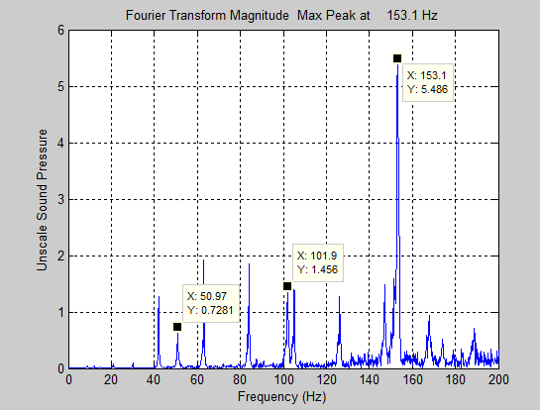
Apache Helicopter Flyover
The measured tail rotor blade passing frequency is 51 Hz with integer multiples thereof
The tail rotor has four blades, but they behave as two

Slide 27
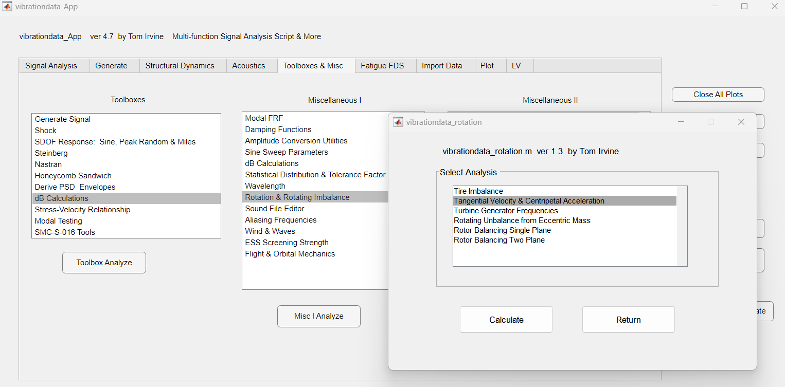
Exercise 1 (cont)

Slide 28
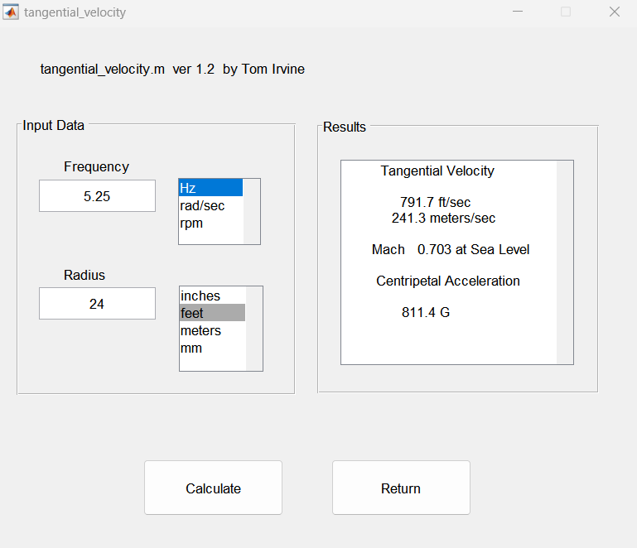
Exercise 1 (cont)
Blade tip tangential velocity must be subsonic for control and to mitigate vibration

Slide 29
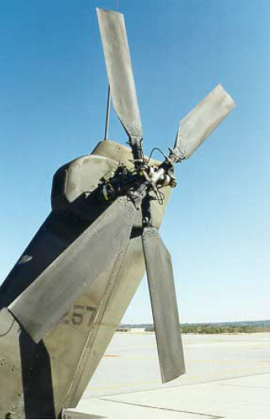
Apache Tail Rotor
The Apache tail rotor has four blades
The blades, however, are not oriented 90° (perpendicular) from each other as in most helicopters
Specifically, one set in front of the other at a 55° angle
The supplementary angle is 125°
This unusual arrangement is required because the two sets of blades use a "Delta-Hinge“ which allows the blades to simultaneously flap and feather
Hypothesis: The four blades appear to behave as two for the tail rotor blade passing frequency

Slide 30
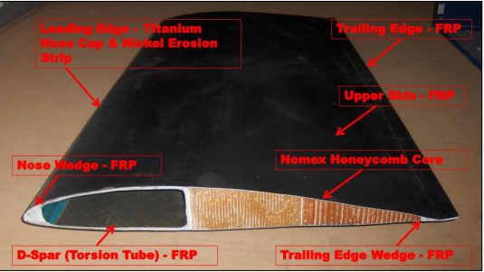
Apache Blade Maximum Tip Tangential Velocity
Generic blade
The main rotor blade length is 24 ft (from center of rotation to blade tip)
The motor rotor hub frequency is 4.86 Hz (30.84 rad/sec)
The tangential blade tip velocity at hover is (30.84 rad/sec) (24 ft) = 740 ft/sec
The maximum speed of the helicopter is 182 mph (267 ft/sec) (Wikipedia)
The total blade tip maximum velocity for an advancing blade is 740 + 267 = 1007 ft/sec (Mach 0.90)
Transonic velocity is roughly Mach 0.8 to 1.2
Local air flow over the tops of the blades may exceed Mach 1 causing severe stress

Slide 31
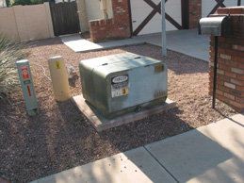
Exercise 2 Transformer Hum
Calculate an FFT of: transformer.txt
Maximum plotting frequency = 1000 Hz
This is unscaled acoustic pressure versus time from the transformer box buzzing.
Is there a spectral component at 60 Hz with integer harmonics thereof?

Slide 32
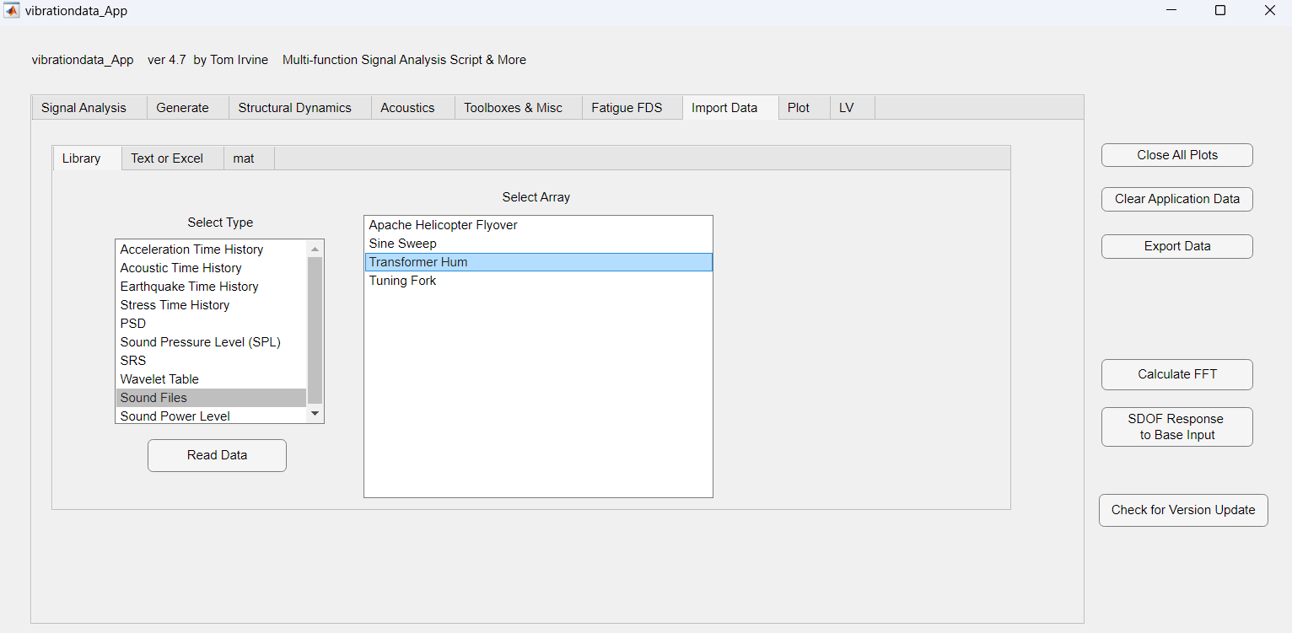
Listen to Transformer Hum

Slide 33
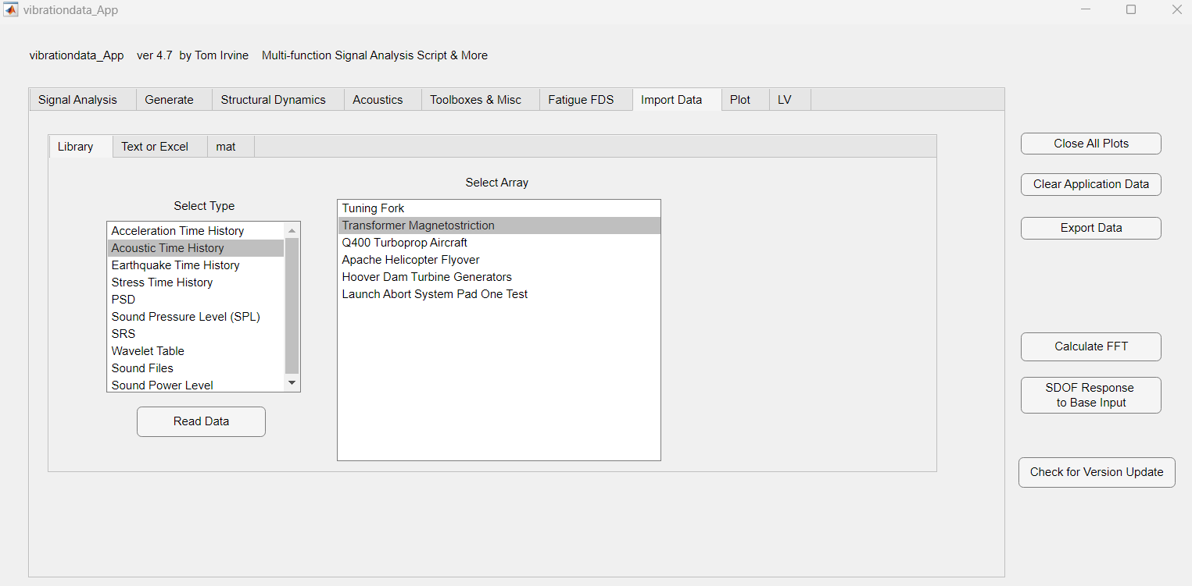
Transformer Hum Time History

Slide 34
Transformer Hum Close-up View

Slide 35
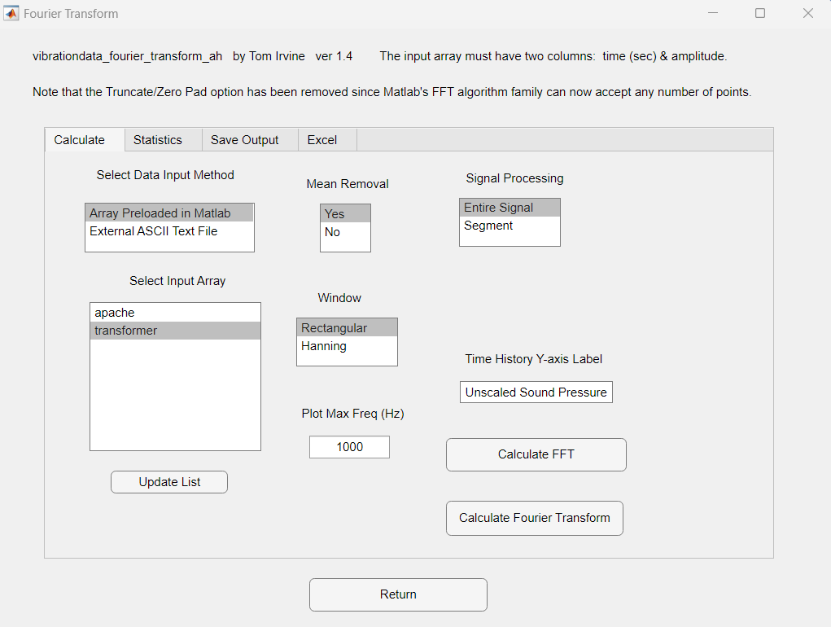
Transformer Hum FFT

Slide 36
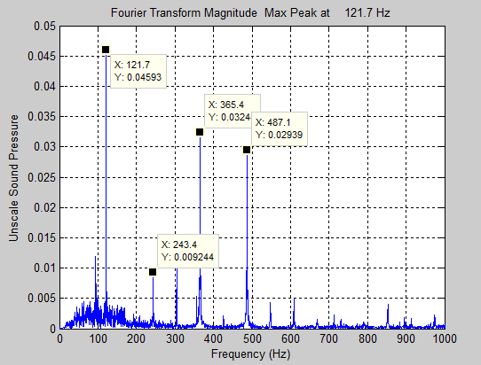
Transformer Data
Spectral peaks at 120 Hz and integer multiples thereof (approx)

Slide 37
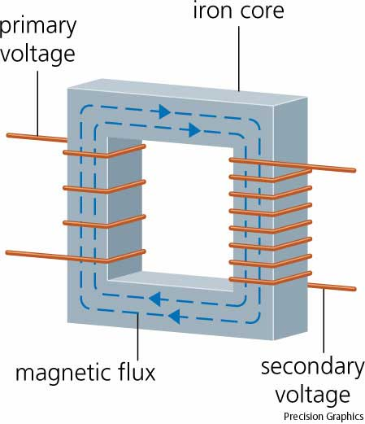
Transformer Core

Slide 38
Magnetostriction
N
S
There are two mechanical cycles per every electromagnetic cycle
Better explanation is that the mechanical cycle is a rectified sine function

Slide 39
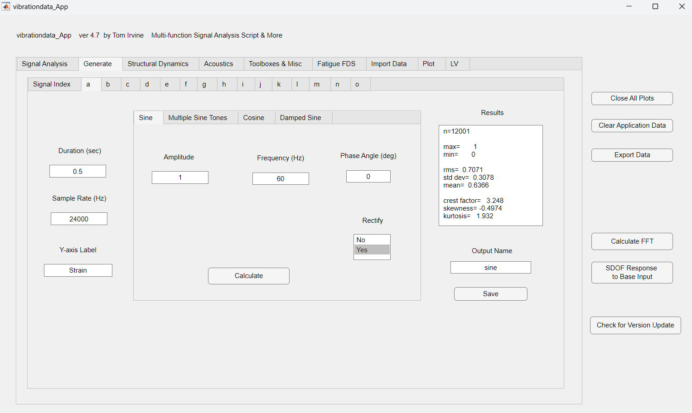
Generate 60 Hz Rectified Sine Function

Slide 40
Rectified Sine 60 Hz Function

Slide 41
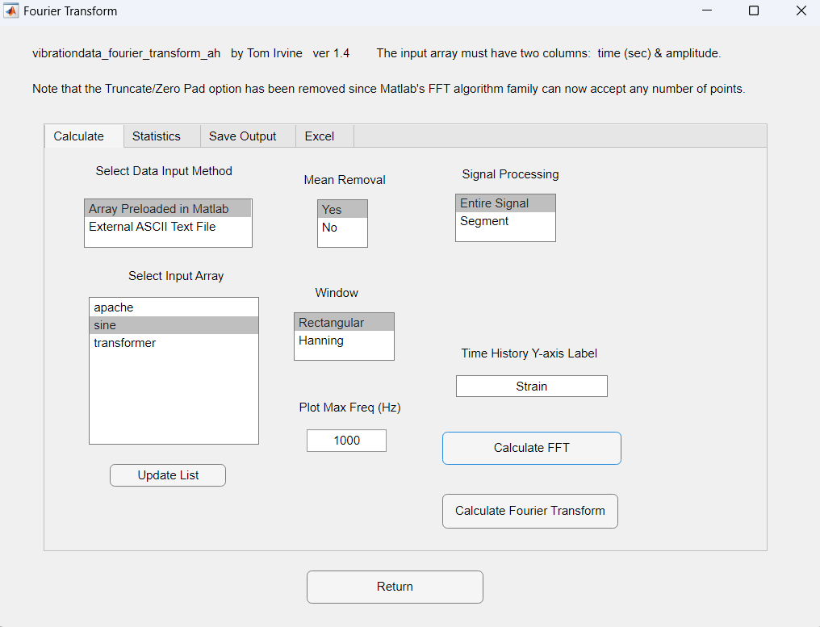
Rectified Sine Function FFT

Slide 42
Rectified Sine 60 Hz Function FFT
Spectral peaks at 120 Hz and integer multiples

Slide 43
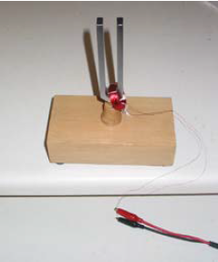
Tuning Fork
Drive a tuning fork into steady-state resonance using magnetostriction.
Tuning fork mechanical natural frequency = 442.4 Hz (approximately A note)
Electrical current frequency = 221.2 Hz

Slide 44
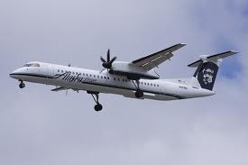
Exercise 3
Bombardier Q400 Turboprop Acoustics
Calculate an FFT of sound array
Maximum plotting frequency = 1000 Hz
This is unscaled acoustic pressure versus time
This model aircraft has two Pratt & Whitney Canada PW150A turboprop engines
The engine/propeller rotation rate during takeoff and climb is 1020 RPM, but is throttled back at cruise altitude to 850 RPM, or 14.17 Hz
There are six blades on each engine, so the blade passing frequency is 85 Hz

Slide 45
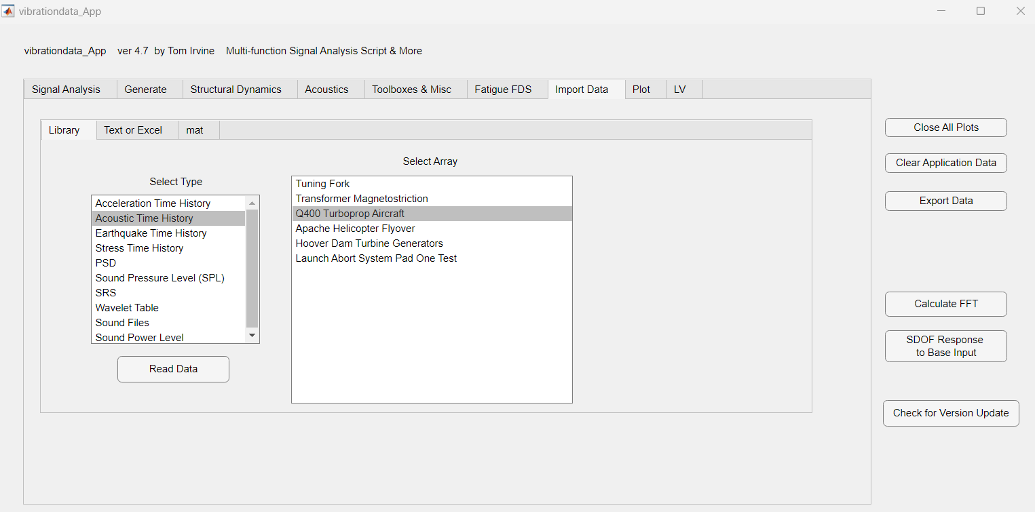
Q400 Turboprop Sound File

Slide 46
Q400 Sound Time History

Slide 47
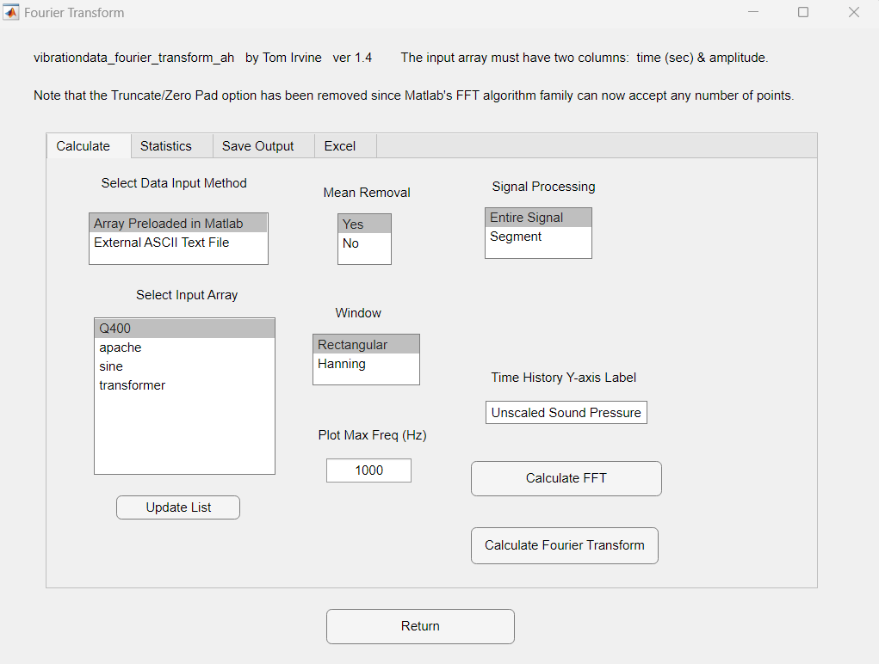
Q400 FFT

Slide 48
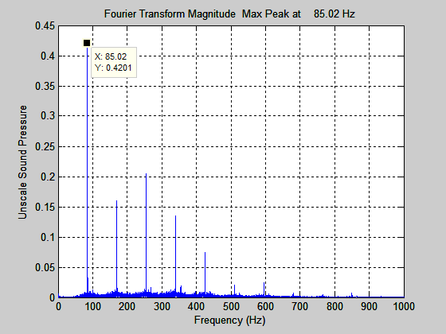
Bombardier Q400 Turboprop Acoustics

Slide 49
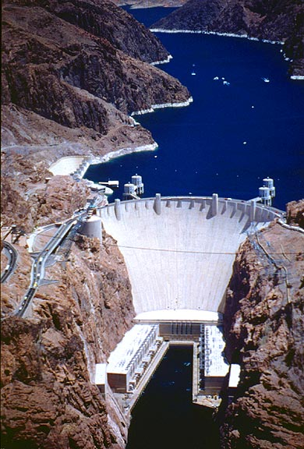
Hoover Dam
You know that you are an engineer when your favorite part of your Las Vegas trip was the Hoover Dam tour!

Slide 50
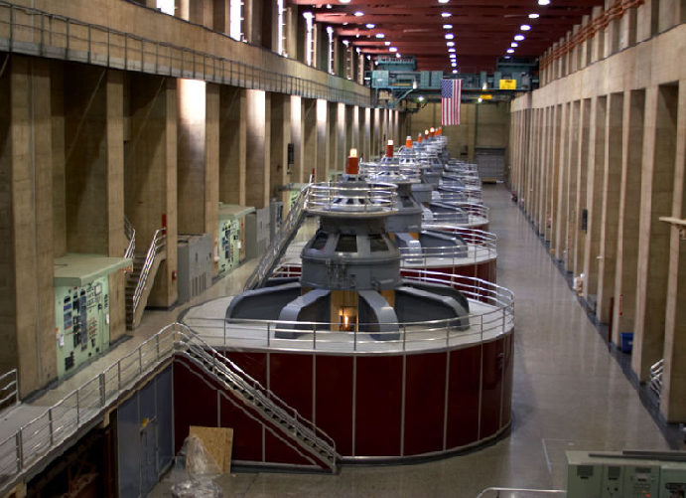
Hoover Dam Turbine Generators

Slide 51
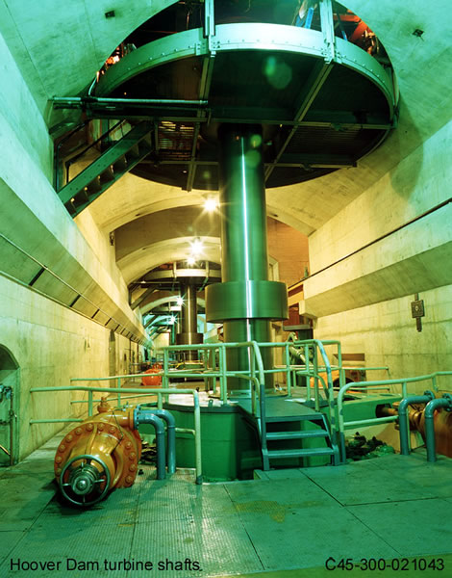
Turbine Shafts Underneath the Generators
The shaft is 65 feet (19.8 meters) tall
The shaft diameter is 38 inch
(96.5 cm)

Slide 52
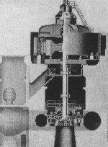
Generator Subsystem
Water impacts the turbine at a speed of 60 miles per hour (97 km/hr), causing the turbine to rotate at 180 rpm
Among the 17 turbines, there are five configurations in terms of the number of blades or vanes
Exciter
Rotor
Stator
Shaft
QTY | No. of Vanes
9 | 15
5 | 16
2 | 17
1 | 19
Turbine

Slide 55
Hoover Dam, Turbine Generator Frequency Results, Rotor Speed = 3 Hz
Freq (Hz) | Source
24 | -
28 | -
30 | -
45 | Rotor Speed x 15 Vanes
48 | Rotor Speed x 16 Vanes
60 | (1/2) x Rotor Speed x 40 Poles
90 | 2 x Rotor Speed x 15 Vanes
96 | 2 x Rotor Speed x 16 Vanes
120 | Rotor Speed x 40 Poles
240 | 2 x Rotor Speed x 40 Poles
360 | 3 x Rotor Speed x 40 Poles

